Slide 1
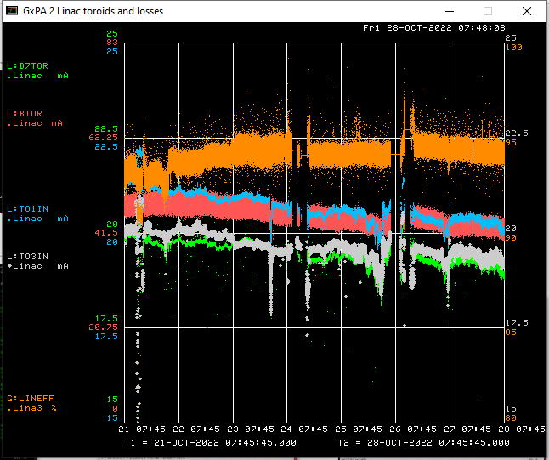
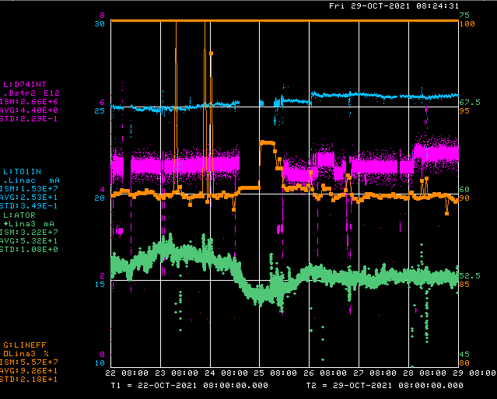
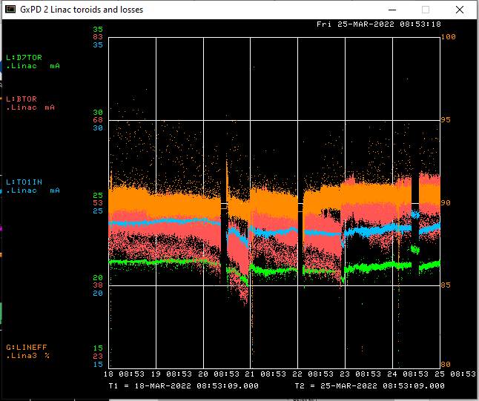
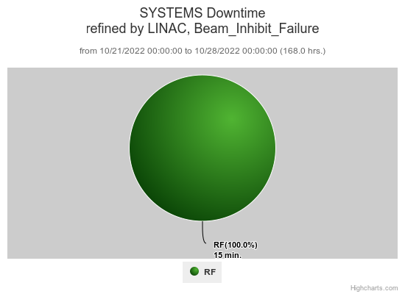
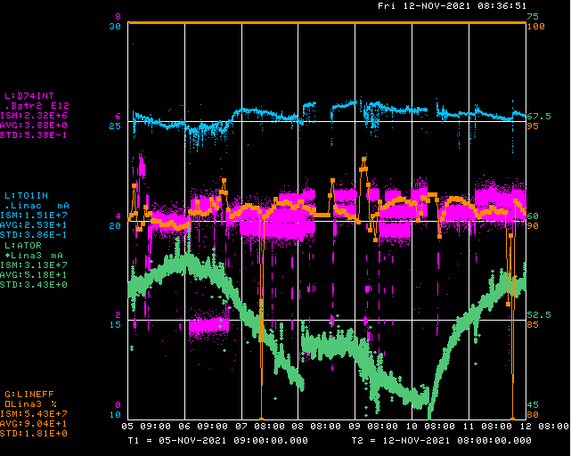
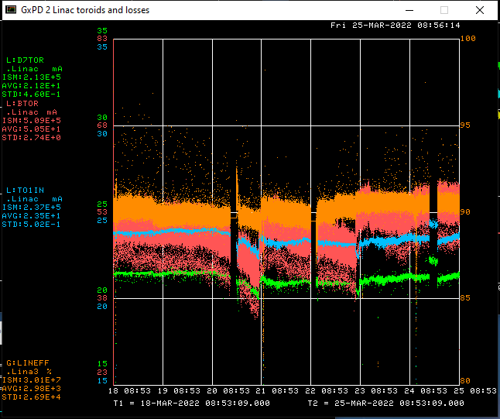
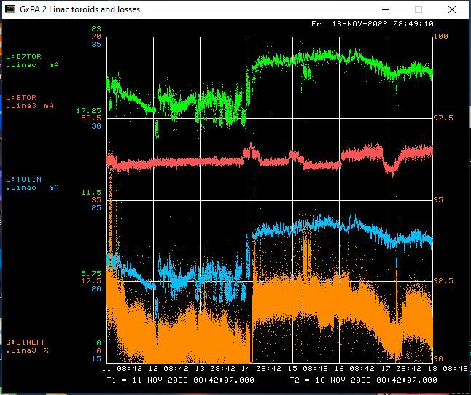
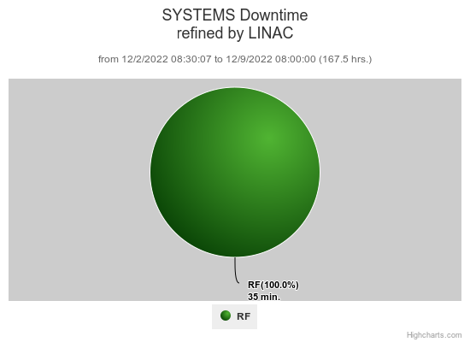
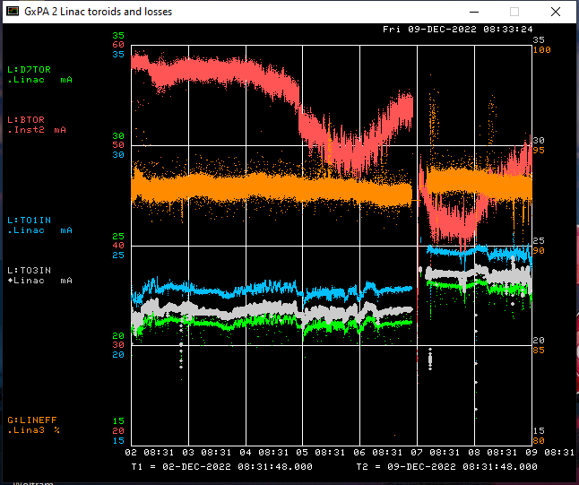
Preacc/Linac Weekly Performance
Wednesday Swapped to Source B

Slide 2
Current Conditions/Plans
Source B – 48 mA
Linac input – 24 mA
Linac output – 22.5 mA
Downtime requests: Opportunistic request:
- an Hour to replace a Thermocouple feedthrough for the Debuncher LCW Skid PLC
- 15 Minute slices for Pre-acc to diagnose/resolve the failing DTI switch

