Slide 1
November Reports – use with caution
Budget is correct by B&R and Project number, but not by task or person
GSO reserve has been distributed and is included – this may skew %
Overhead pools will be tracked by cost basis – reports still show obs

Slide 2
CSS charging changes
PPD still funds
Office moves (40PD.01.01.21)
Janitorial requests (40PD.01.01.22) – new centralized task for FY23
ISD (FES) funds
Painting
Carpet replacement
Conference room modification
Maintenance
Betterments (process still needs to be worked out)
ITD (CD) funds
Zoom room equipment
Zoom room licenses
To be determined
Name plates
New furniture

Slide 3
Training time
Communicate to your teams that 40PD.00.01 General Training is no longer used.
General training → primary effort
Management-specific training → Mgmt & Supervision task
Job-specific training → direct charge or primary effort
On the job training → direct charge or primary effort
The General Training task will be closed in Kronos.
Historical Edits will be done to move FY23 General Training time to the primary effort task.
Budget allocations are being corrected from General Training task to the homecode for December reports

Slide 4
Reminder – Charging Practices Notable Changes
EDI & EPE
Separate task codes for each
No longer charged to Lab Committees & Groups
No longer using Outreach or D&I codes
Training
General training – primary effort
Discontinued usage of General Training task
Management-specific training – Mgmt & Supervision task
Job-specific training – direct charge or primary effort
On the job training – direct charge or primary effort
Management & Supervision
Department Management & Supervision – primary effort or Mgmt & Supervision task
Management & Supervision of Experimental Ops, Collaborators, G&V – direct charge
Business Development
New task!
Engineering support, equipment support and tool support
Sometimes direct charge, sometimes primary effort, sometimes burden pool

Slide 5
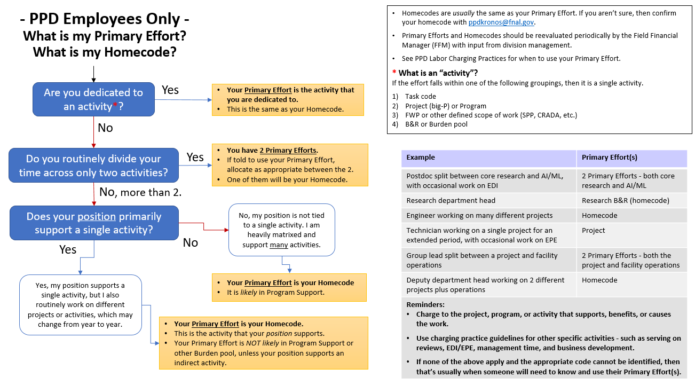
Reminder – Primary Effort code

