Slide 1
72 Hour Summary
Kevin McDonough
12/12/2022

Slide 2
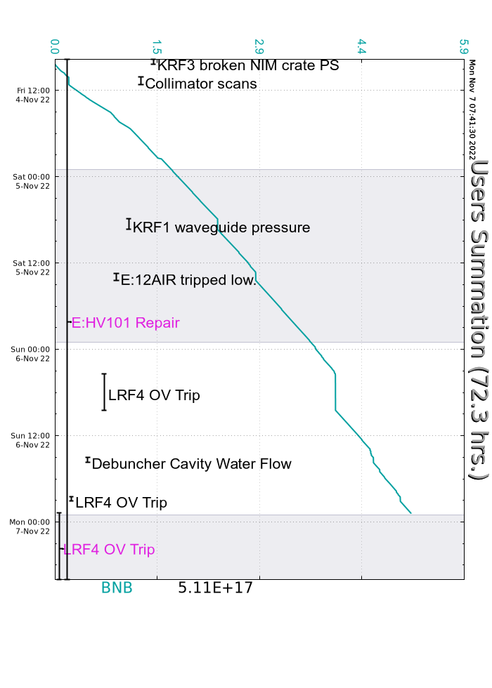
Summary
Friday
Diagnostic probes installed in Source B HV extractor cabinet
Diagnostic probes installed in Source B HV extractor cabinet
Bimodal losses in Linac developed and propagated down the line Traced back to 250v discrepancy on the extractor voltage
MSD and ISD work on MS2 LCW system
Saturday
g-2 did a trolley run.
Training and walk throughs.
SUNDAY
Monitored systems
.Tuning and training
Booster RF Station 15 tripped off and took West Anode Power Supply down. Required local attention.
Dan Bollinger took down Linac source A today,
MONDAY
SrcB extractor voltage was wandering over shift
Debuncher chilled out temp readback dropped and became noisywiggled sensor connector, and readbacks recovered partially
CURRENT CONDITIONS:
Beam to BNB and g-2

