Slide 1
LAr TPC R&D in the U.S.
Bruce Baller - Fermilab
October 6, 2012
NNN12

Slide 2
Outline
R&D approach
Materials testing
Computational Fluid Dynamics modeling
Electronics test stand – cryogenic electronics
ArgoNeuT
Light collection
Liquid Argon Purity Demonstrator (LAPD)
LAr Time Projection Chamber (TPC) in a test beam
LAr R&D Coalition
Summary
Slide “contributions” from many people
S. Mufson, S. Pordes, B. Rebel, E. Voirin

Slide 3
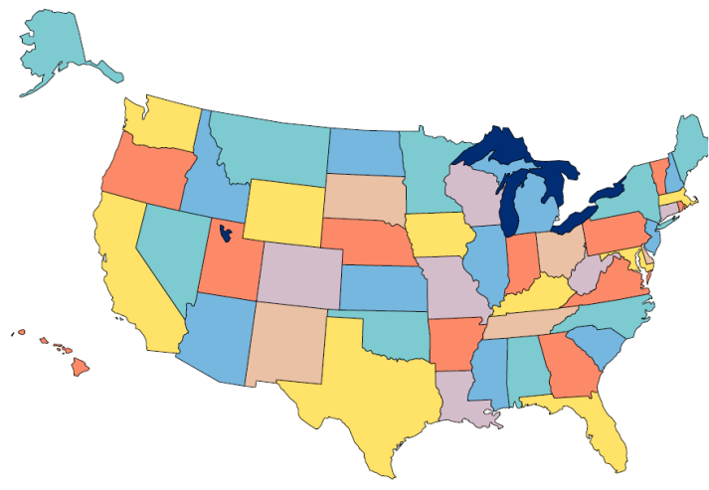
R&D Approach
LAr Roadmap
Learn as much from previous work
  Single phase TPC based on pioneering work on ICARUS
Develop U.S. experience and facilities
  Cryostats design, filters, HV feedthroughs, cryogenic electronics
Explore technical areas in detail
  Materials testing, CFD simulations, light detection
Develop operational detector experience
  ArgoNeuT, MicroBooNE
Demonstrate good LAr purity in a non-evacuated commercial cryostat
  Liquid Argon Purity Demonstrator (LAPD), LBNE 35 ton membrane cryostat
Understand the response of particles in a test beam
  Liquid Argon in A Test beam (LArIAT)
Develop simulation and reconstruction tools
  LArSoft

Slide 4
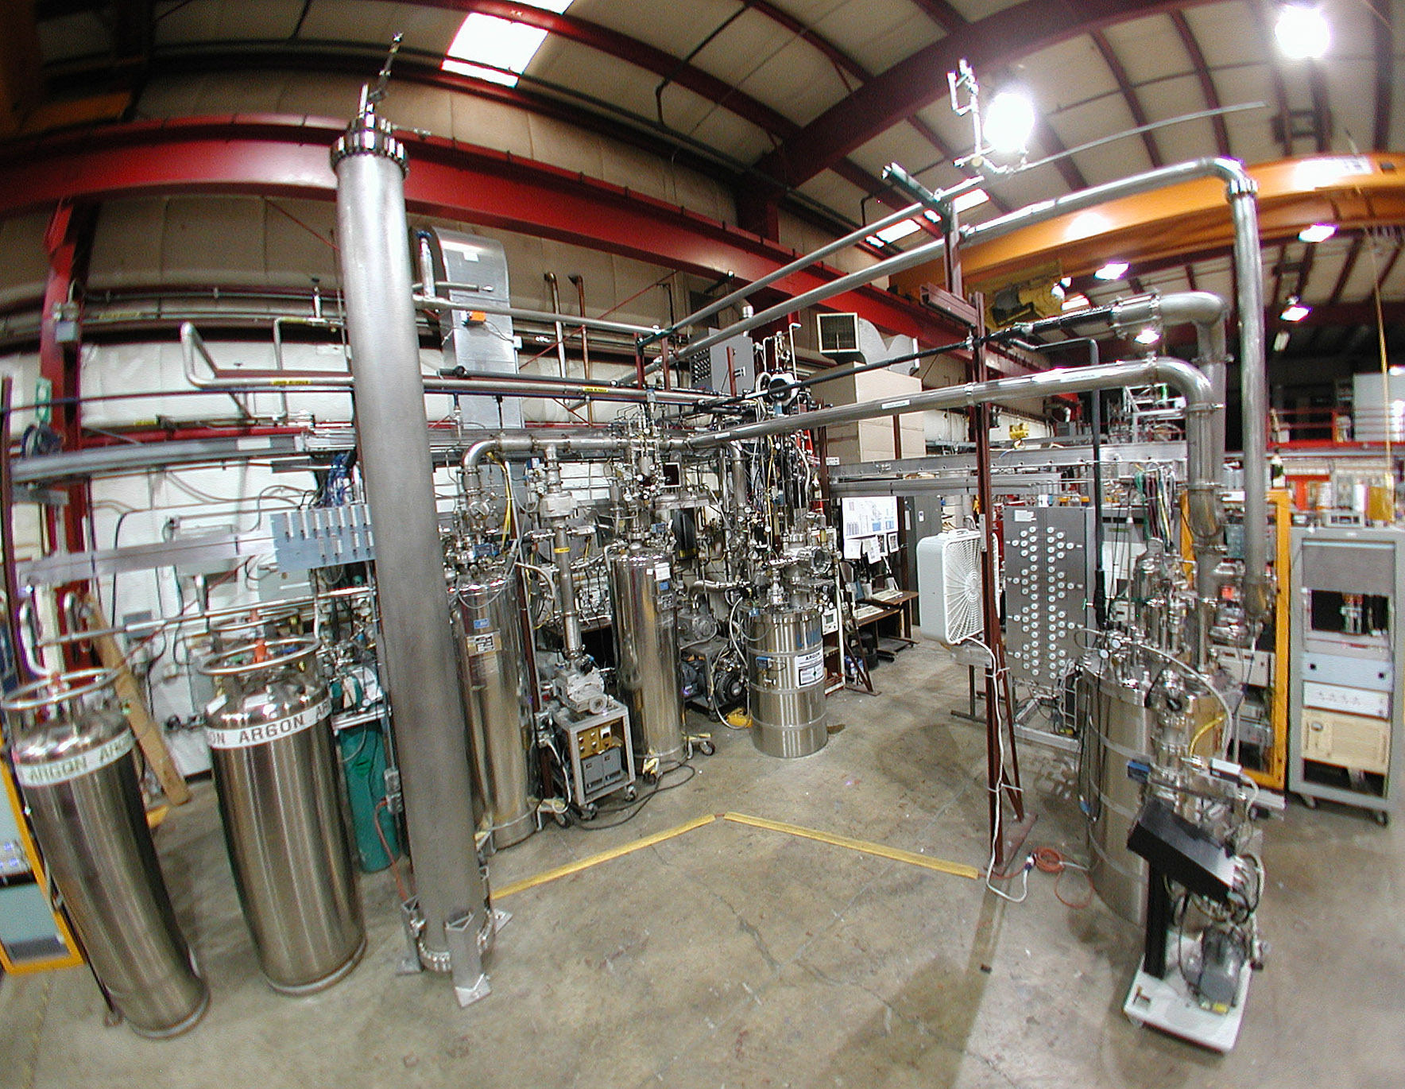
LAr Test Systems at Fermilab
Materials Test System
Argon Source
Electronics Test System

Slide 5
Material Test System Results
`A system to test the effects of materials on the electron drift lifetime in liquid argon and observations on the effect of water’ R. Andrews et al., Nucl.Instrum.Meth.A608:251-258,2009.
Main Findings
All tested materials have good lifetime (~6 ms) when in the liquid argon
Primary contaminant is water vapor outgassing from “warm” components
Teflon is preferred over polyolefin in “warm” areas of the cryostat (ullage)
Application to LArTPCs
Reduce/eliminate the cable plant in the ullage → in-liquid electronics + MUX
Sample data on different materials (bad, good,OK in liquid)

Slide 6
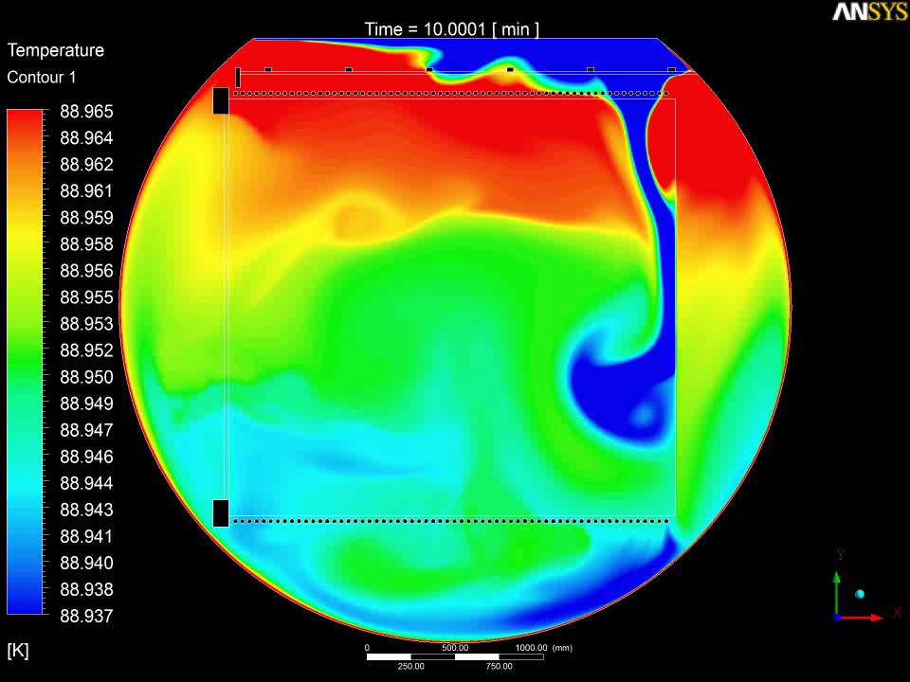
Argon Liquid Flow Modeling
Field cage
10 min real time movie MicroBooNE detector
Anode plane
Cathode plane
0.03K ΔT
Time evolution of impurities and positive ions
Field cage
Erik Voirin (FNAL)

Slide 7
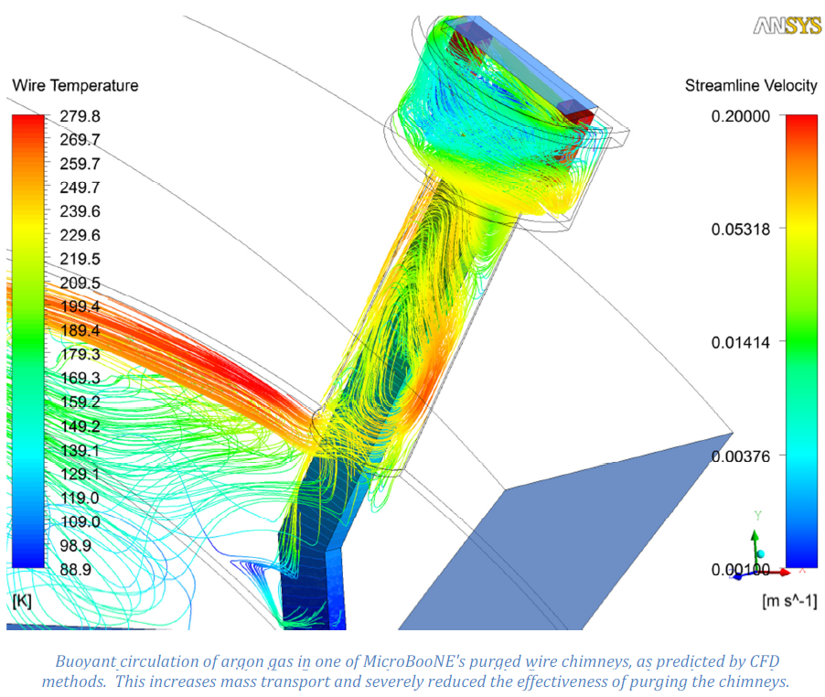
Argon Gas Flow Modeling
Gas purge
Warm cables in chimneys are main source of impurities by 3 – 5 orders of magnitude
Buoyancy driven fluid motion and turbulent mixing makes gas purging ineffective
Several solutions…
Insulation
Chimney
Ullage
Cables
Erik Voirin (FNAL)

Slide 8
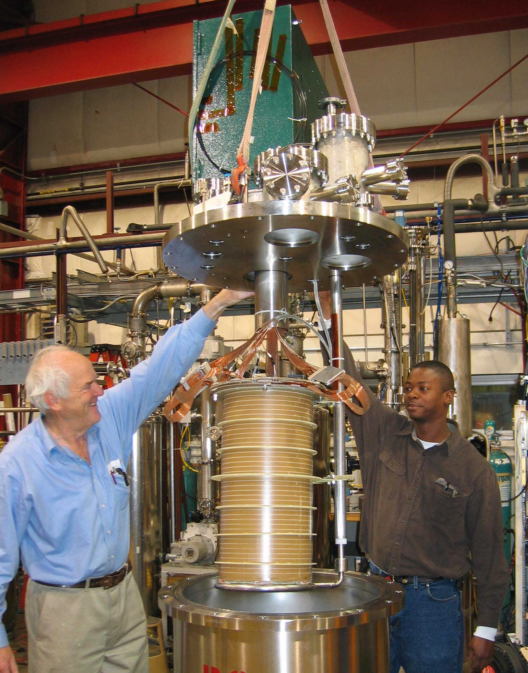
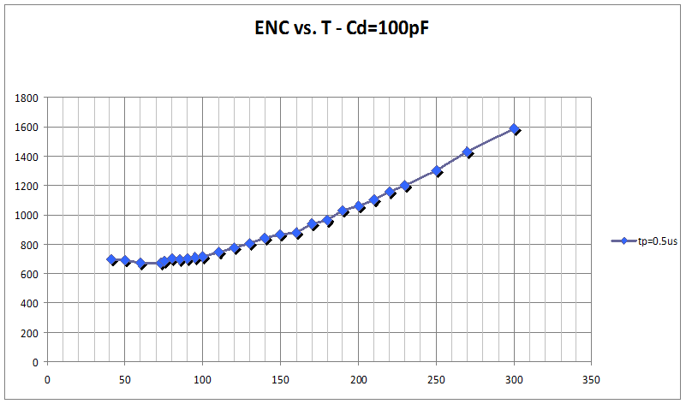
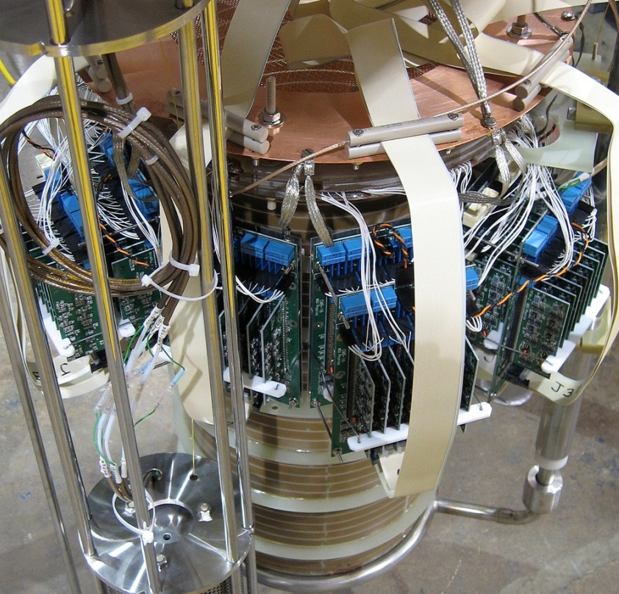
Electronics Test System
Warm electronics readout (Michigan State University)
CMOS Ideal for operation in LAr
Low power, low noise
Cryogenic CMOS electronics (MSU)
ENC drops by ~2X
Equivalent Noise Charge (electrons)
FNAL
Argon,TPC
HV Feedthrough
Brookhaven National Lab
Temperature (K)

Slide 9
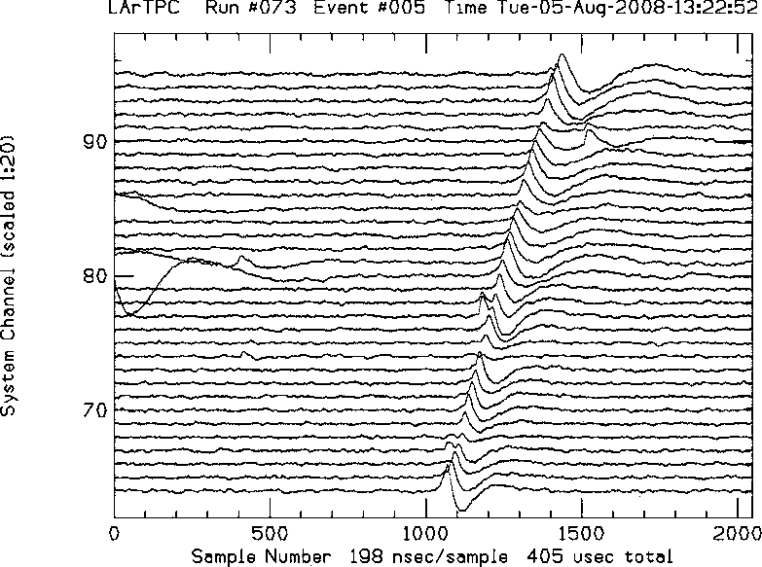
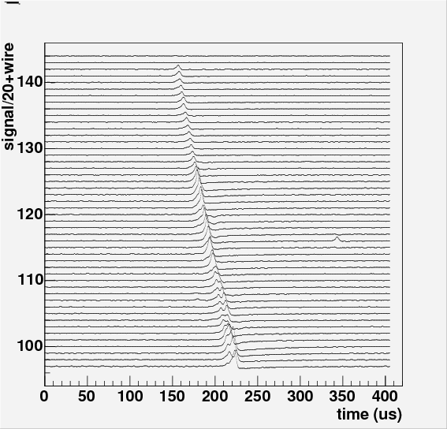
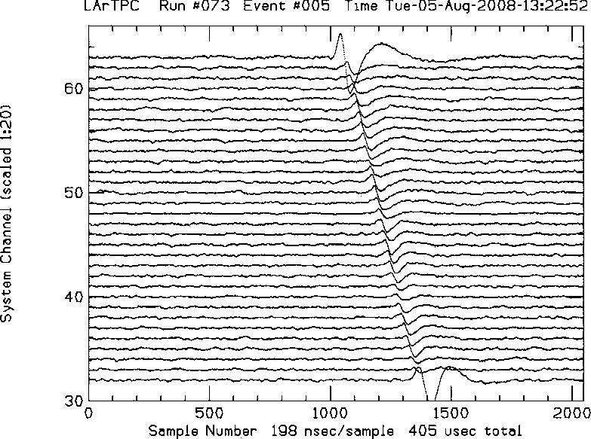
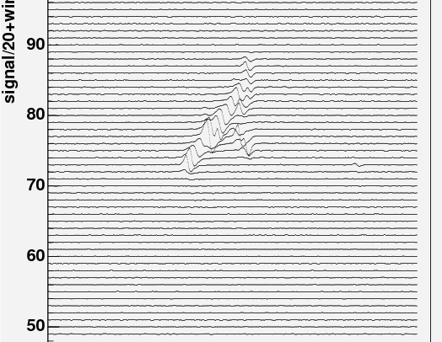
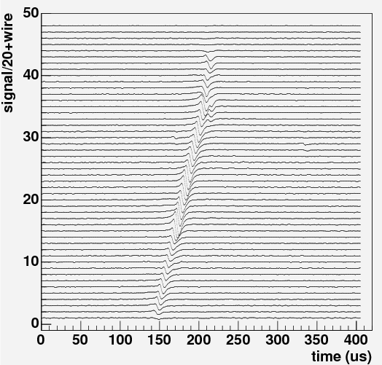
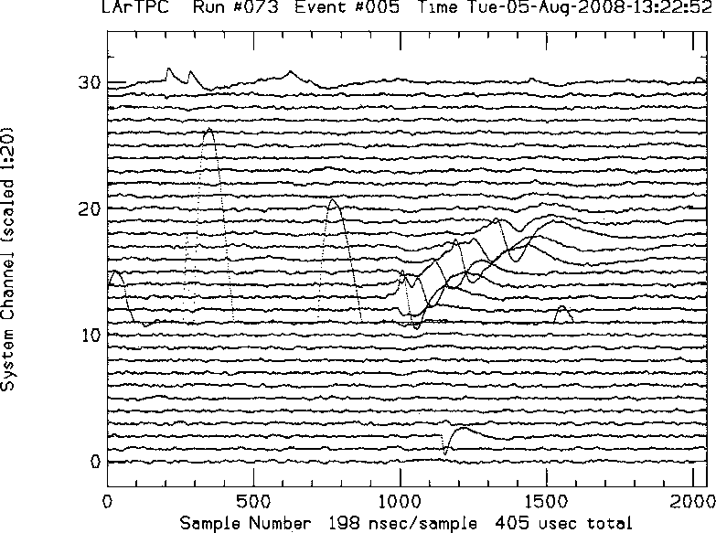
Warm electronics S/N = 15
Cryogenic electronics S/N > 30
Collection
Collection
wire
wire
Induction
Induction
Raw Data
Raw Data
Induction
wire
Induction

Slide 10
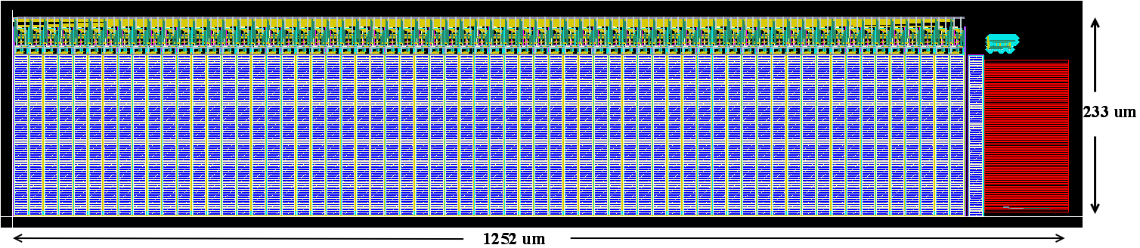
BNL CMOS ASIC Development
Front End Amplifier
Clock-less Low Power Current Mode ADC
One ADC stage
Fabricated in ASIC for SNS, see De Geronimo, et al., IEEE Trans NSS, 54 (2007) 541.
Measured linearity
  DNL < 1.5 LSB for majority of codes
  INL ~1% of Range
Equivalent input noise measurement
  1.27 LSB
  Effective resolution: 11.6 bits
The ADC has been tested with an FPGA, both immersed in LN₂
MicroBooNE 128 channel mother board
ENC (electrons)
300K
77K
Channel

Slide 11
ArgoNeuT
Bern (CH), FNAL, INFN/Gran Sasso, L’Aquila, KSU, MSU, Syracuse, Texas, Yale
1m x 50 cm x 50 cm;
2 views +/- 30⁰ to vertical;
480 channels total;
External (warm) electronics
Ran in NuMI beam
neutrino (1 month)
anti-neutrino (4 months) in 2009
C. Anderson et al., The ArgoNeuT detector in the NuMI low-energy beam line at Fermilab, [arXiv:1205.6747] → JINST

Slide 12
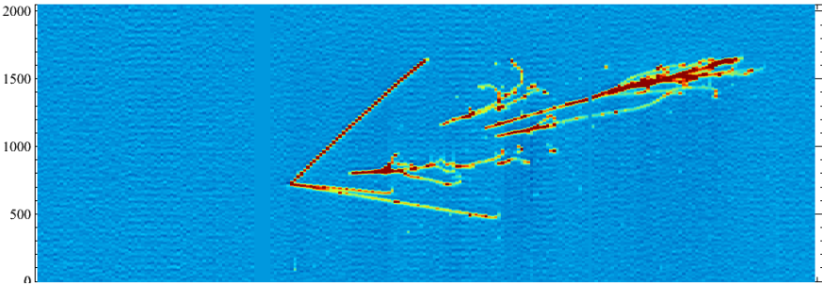
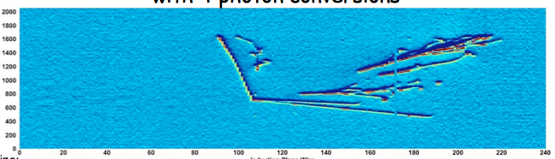
ArgoNeuT Data in NuMI Beam
Event with 4 photon conversions (2 π⁰)
400
360
320
280
240
200
160
120
80
40
time (μs)
Collection Plane
2
1
4
3
65 cm
100 cm
400
360
320
280
240
200
160
120
80
40
time (μs)
Induction Plane
1
2
4
3
65 cm
Channel No.
~10,000 ν interactions

Slide 13
ArgoNeut Physics
C. Anderson et al., Analysis of a Large Sample of Neutrino-Induced Muons with the ArgoNeuT Detector, [arXiv:1205.6702], accepted by JINST
C. Anderson et al., “First Measurements of Inclusive Muon Neutrino Charged Current Differential Cross Sections on Argon”, Phys.Rev.Lett. 108 (2012) 161802, [arXiv:1111.0103]
Anti ν_{μ} CC-inclusive differential cross-sections: in progress
ν_{μ} CC-QE total and differential cross-sections: in progress
Final State Interactions in ν_{μ} and anti- ν_{μ} CC-QE events: in progress
Neutral strange particle production: in progress

Slide 14
Light Collection
Provides sub-mm position accuracy in drift direction
Cosmic ray rejection for a surface detector
Supernova and proton decay trigger for underground detector
Reject cosmic ray spallation background
Neutrino time-of-flight
LBNE system based on concept developed at MIT
Bugel et al. Nucl.Inst.Meth. A 640, 69 (2011)
Energy deposition in LAr
TPB/Bis-MSB doped coating
128 nm γ
wire planes
425 nm γ
Acrylic light guide
SiPM
wire planes

Slide 15
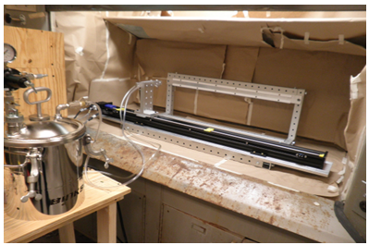
Light guide spray booth and LAr testing at Indiana
3/4 of light τ = 1.6 μs
15
R&D areas
Improve light yield
Attenuation length
Wavelength shifters
Large SiPMs
Production scale
IU
MIT
1/4 of light τ = 6 ns

Slide 16
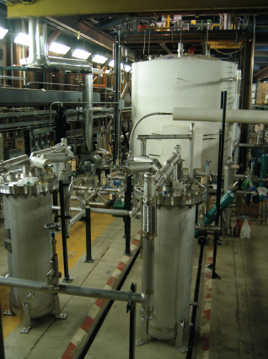
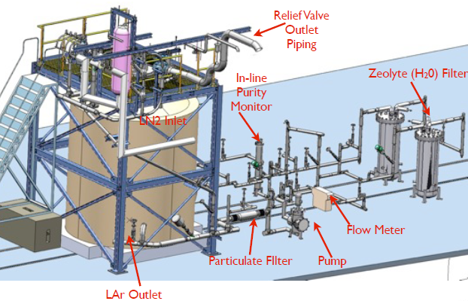
Liquid Argon Purity Demonstrator (LAPD)
Demonstrate that required drift electron lifetime can be achieved in a commercial vessel without evacuation – 1) gas purge, 2) gas recirculation + filtration, 3) liquid recirculation + filter

Slide 17
LAPD Results
Concentrations of O₂, N₂ & H₂0 during
purge,
gas recirculation through filters, and
liquid recirculation.
Note: constant level of H₂0 (in vapor)* and the removal of N₂ (which affects light production at 1 ppm level)
*H₂0 in liquid below measurable levels
Tank 1/3 full
c)

Slide 18
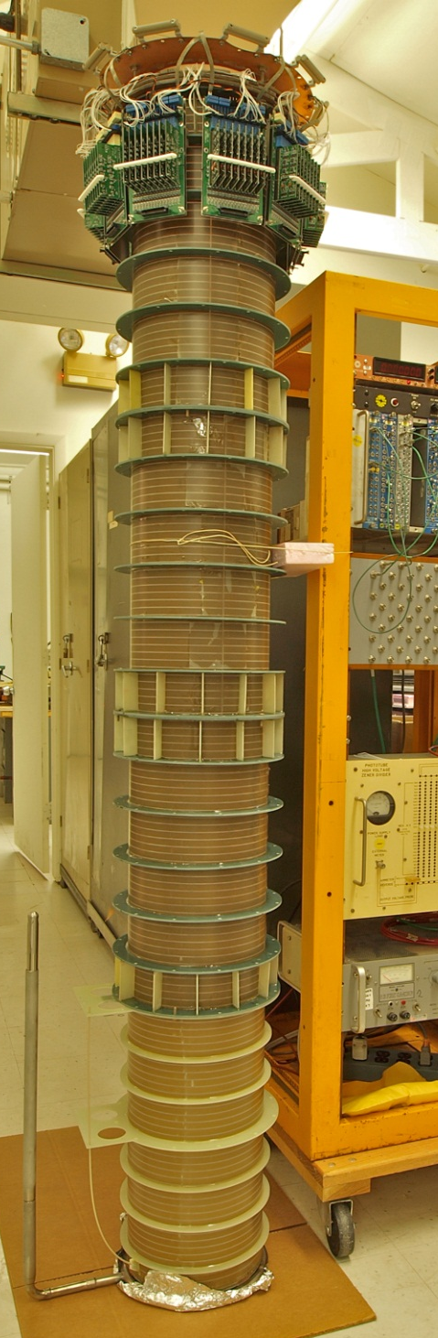
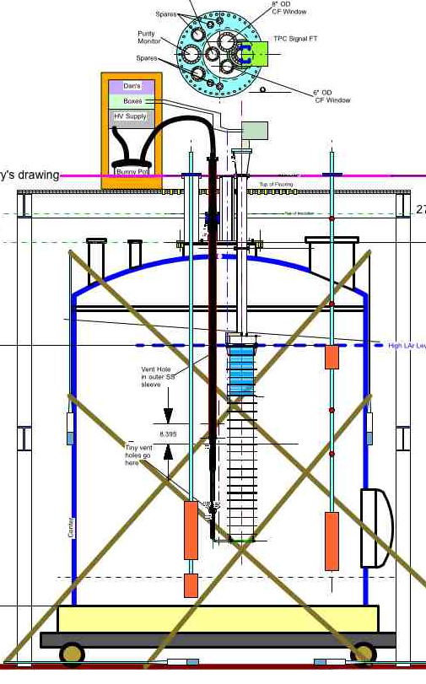
LAPD Phase 2 - Long Drift TPC
Cylindrical TPC with 2m drift
Cold CMOS electronics
Challenge purification with a TPC in the volume – 2 m drift, 100 kV
Fully characterize filter sizing and material performance
Study the effect of varying the recirculation rate on the drift lifetime
Perform studies of how quickly lifetimes can be recovered from (intentional) poisoning of the Argon

Slide 19
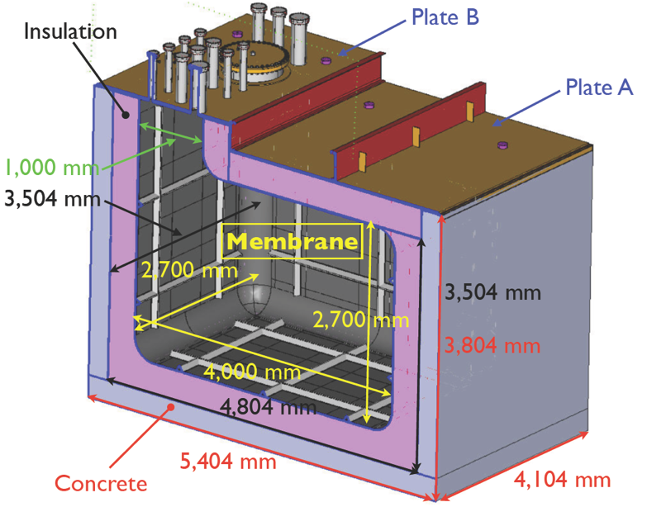
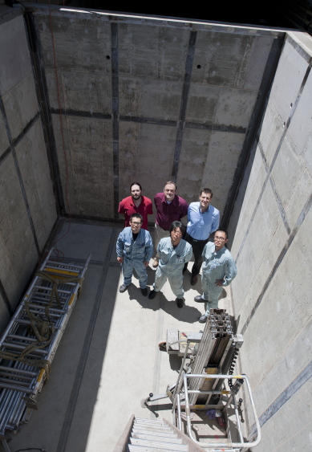
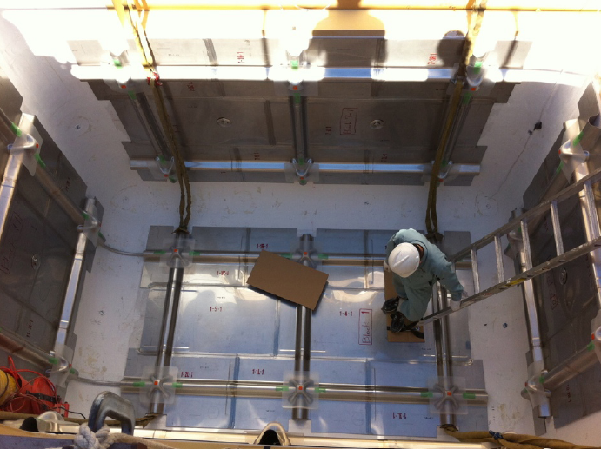
LBNE 35 Ton Membrane Cryostat Prototype
Demonstrate that required drift electron lifetime can be achieved in a commercial membrane cryostat using techniques developed in LAPD
Concrete structure complete in May
Primary SS membrane installation in September

Slide 20














LArIAT
LArIAT → LAr in a Test Beam (MCenter at Fermilab)
Phase 1: Modified ArgoNeuT detector
  Study charge response from single particles dE/dx → dQ/dx
  Study low energy EM showers, e to πº/γ separation
Phase 2: a mid-scale TPC (~2m x ~2m x ~5m)
  Study EM/hadronic shower containment
  Medium scale test bed for LAr TPC development, e.g. light collection, detector design, electronics testing

Slide 21
LAr R&D Coalition – “An alliance for combined action”
Purity and Detector Materials, Filters, Controls
Purity and Detector Materials, Non-evacuable Cryostat, Insulation, Filters
Physics Capability
Front-end Electronics
R&D
Projects
Light Detection
Low Radioactivity Argon
LAPD
Micro
BooNE
LArTPC in Test Beam
Dark Matter R&D
Distill-
ation
Column
Dark
Side
MTS
LBNE
Cold
Elec.
SCENE
Light
Detection
ETS
TPC Read-
out
Argo
NeuT

Slide 22
Summary
Liquid argon is ideal for low rate TPCs
  mm-scale resolution in large volumes in a benign environment – hermetic cryostat, uniform low temperature → chemical reactions, mechanical creep → long term operation
Results from materials testing, LAPD and CFD modeling point the way to achieving excellent liquid argon purity → long drift TPC’s
  These ideas will be tested in the next 1 – 2 years in LAPD Phase 2, LBNE 35 ton prototype and MicroBooNE
CMOS is a natural solution for in-liquid electronics
  Low power, minimum noise, in-vessel zero suppression & multiplexing
Low-profile light collection conceptual design exists for LBNE
  R&D focused on improving light yield → lower cost
Fermilab is launching a new LAr test beam initiative
  Characterize response of various particles in argon
  Test bed for evaluating new detector concepts

