Slide 1

Long Liquid Argon Drift Studies (in CH)
Thomas Strauss
Albert Einstein Center for Fundamental Physics
Laboratory for High Energy Physics
University of Bern
AEC, Bern: A. Blatter, L. Bütikofer, A. Ereditato, R. Haenni,
C.C. Hsu, S. Janos, I. Kreslo, M. Lüthi, P. Lutz, C. Rudolf von Rohr,
T. Strauss, M.S. Weber, M. Zeller
ETH Zurich: A. Badertscher, A. Curioni, U. Degunda, L. Epprecht,
A. Gendotti, S. Horikawa, L. Knecht, D. Lussi, S. Murphy
G. Natterer, K. Nguyen, L. Periale, F. Resnati, A. Rubbia,
F. Sergiampietri, T. Viant, L. Zheng

Slide 2
Outline
Physics Motivation: see also LBNE/LBNO proposals
LAr TPC technique
Novel readout technologies
Towards very long drift, Argontube, a 5m drift LAr TPC
Conclusions

Slide 3
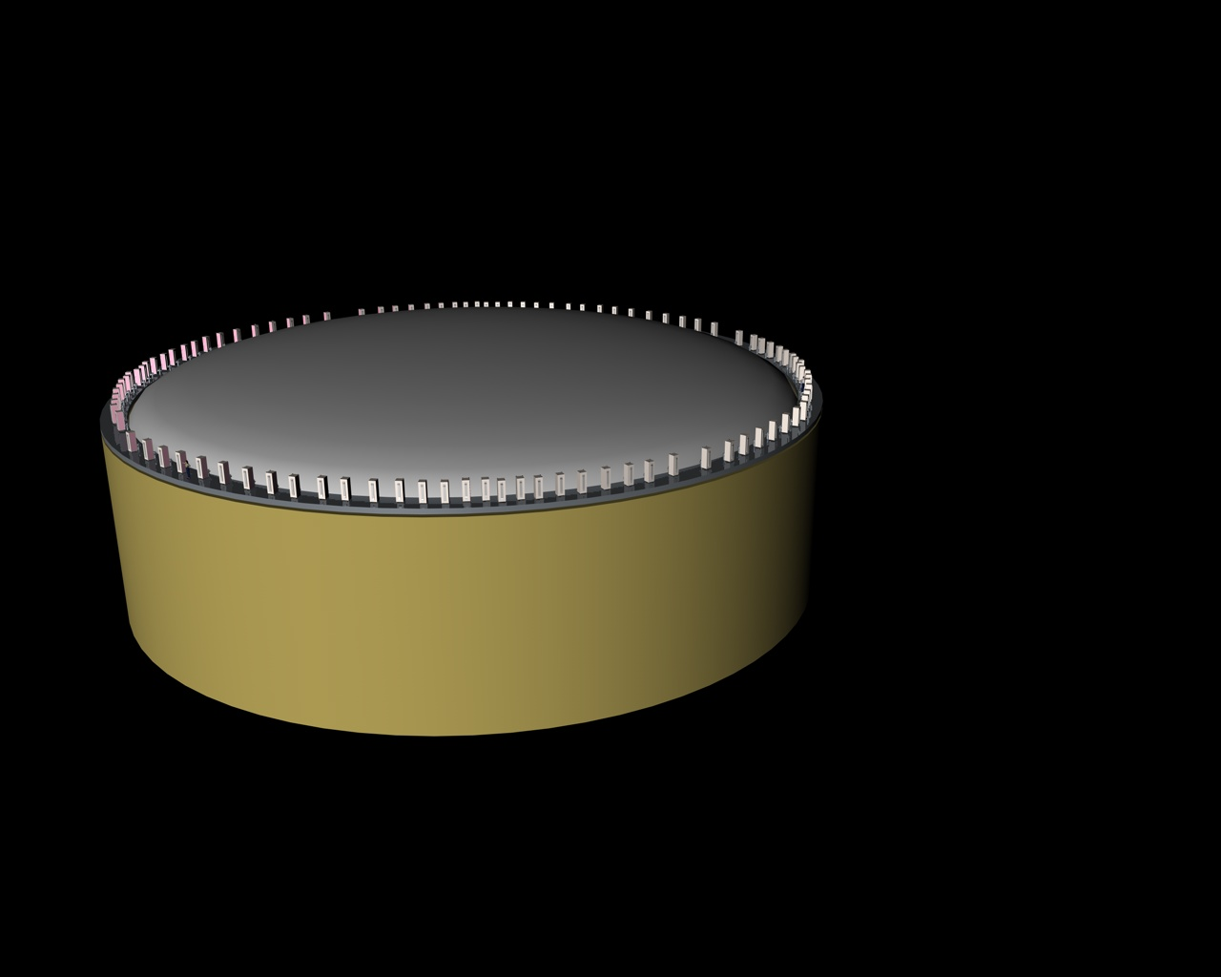
The way to long drift
The proposed LBNO-Glacier study intends to be an O(100kton) LAr TPC with a drift of 20m. Apart of the needed purity, the main challenges are:
Novel required readout technologies:
  Double Phase readout via Large Electron Multiplier (LEM)
Very long drift distances:
  Argontube programme
φ≈70 m
h =20 m
Max drift length
Passive perlite insulation
hep-ph/0402110 and J.Phys.Conf.Ser. 171 (2009) 012020

Slide 4
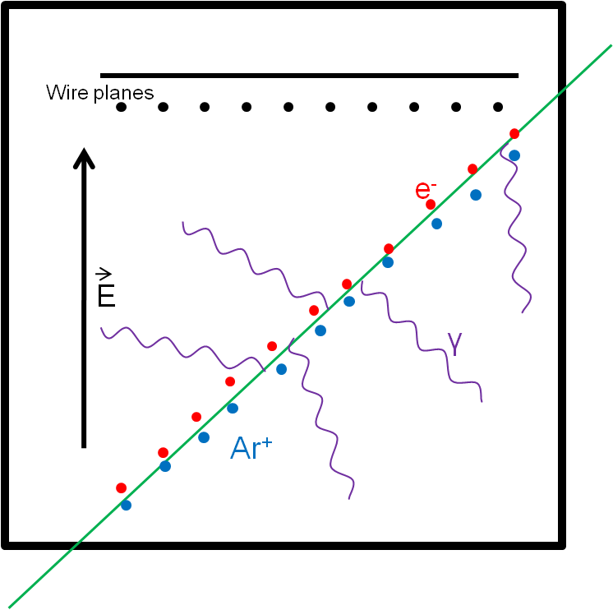
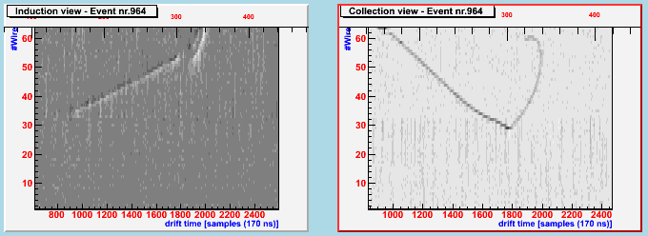
LAr TPC technique
Three dimensional tracking device
Readout of the charge deposited
Charge readout correlates to deposited energy
Momentum estimation via multiple coulomb scattering
The detector is fully homogenous
UV scintillation light
Charge yield (m.i.p.) | 6000 e⁻/mm (1fC/mm)
Photon yield (m.i.p.) | 5000 photons/mm (128 nm)
Electron drift velocity | 2mm/μs (@ 1kV/cm)

Slide 5
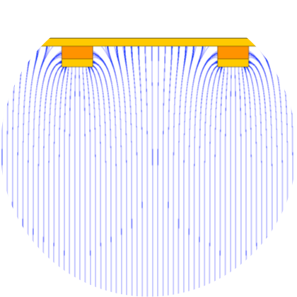
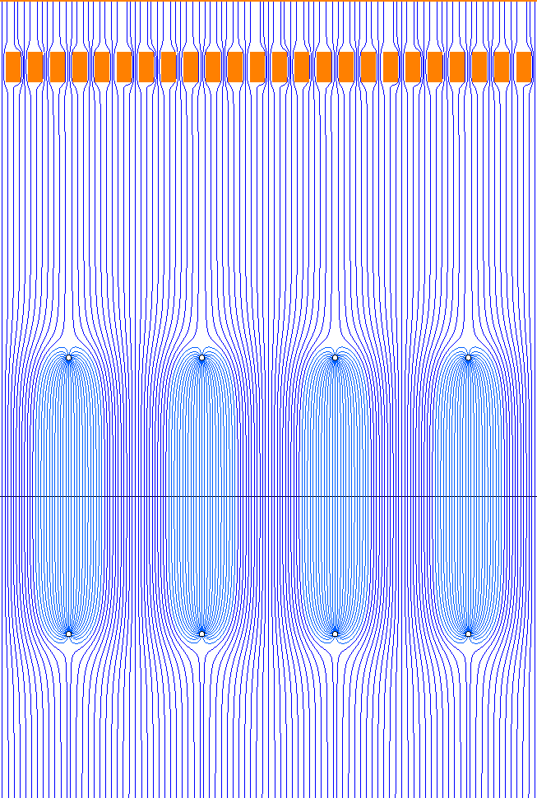
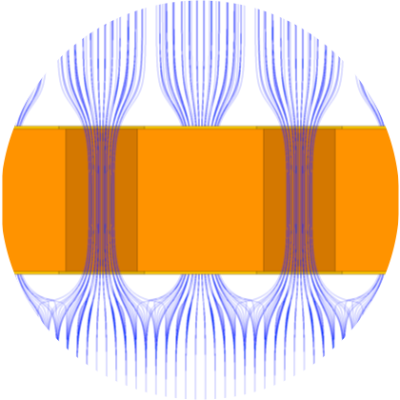
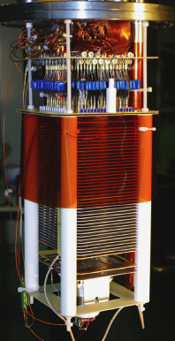
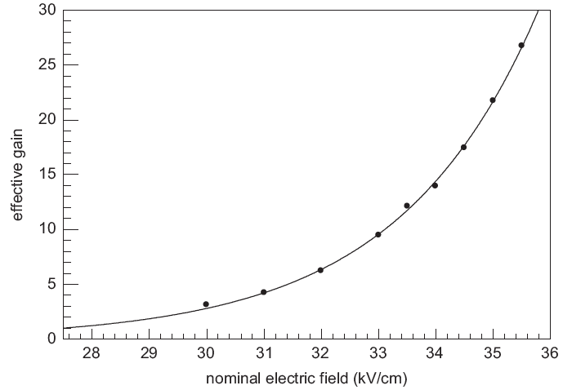
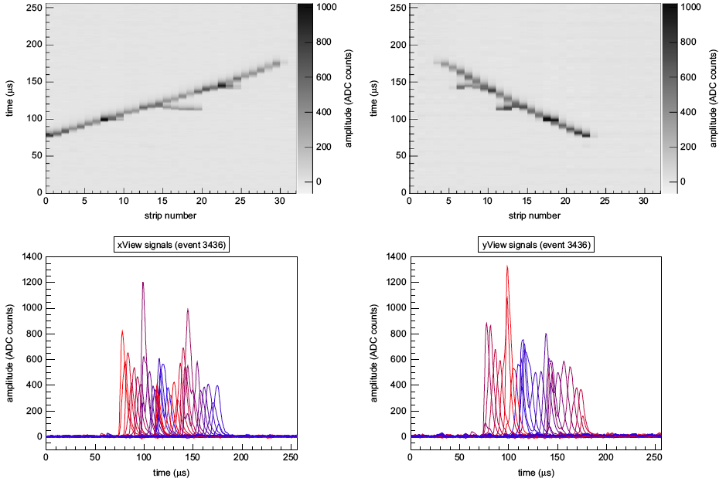
The double phase concept
anode
3.0 kV/cm
upper electrodes
1.) Ionization electrons drift towards the liquid argon surface
2.) Drift electrons are efficiently emitted into the gas phase
3.) Charge multiplication in the holes of the Large Electron Multiplier (LEM)
4.) Charge collection on a 2D anode readout
(symmetric unipolar signals with two
orthogonal views)
Results from a 10x10 cm² prototype
lower electrodes
35 kV/cm
1.5 kV/cm
LEM
4.5 kV/cm
3.0 kV/cm
extraction
grids
0.5 kV/cm
charge sharing test of the 2D anode
signal shape of x and y view identical
charge sharing verified:
(x-y)/<x+y> better than 5%
design parameters verified
gain curve
gain 27
S/N>200 for m.i.p.
NIM A 641 (2011) 48-57
Notes:
(actually the gain was 60 but we discovered a calibration error after we published and did not send an errata to NIM !!)

Slide 6
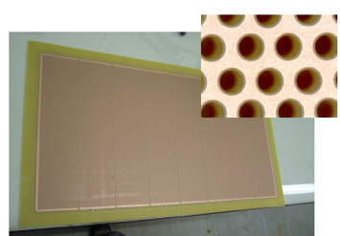
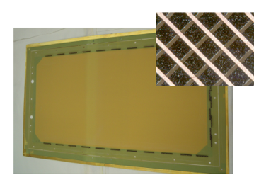
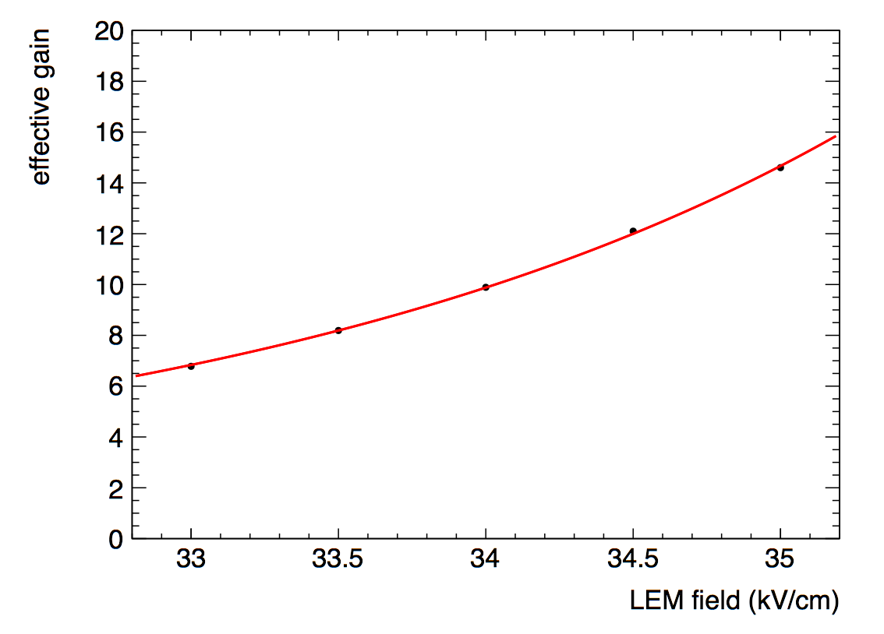
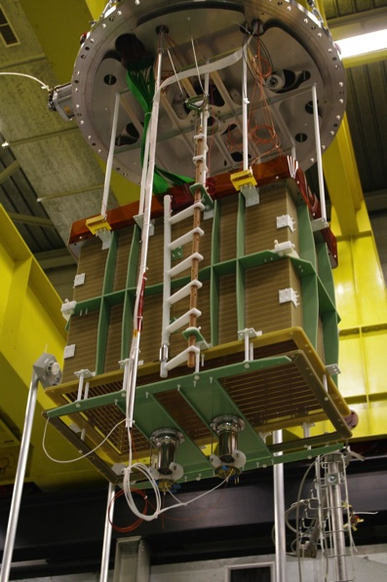
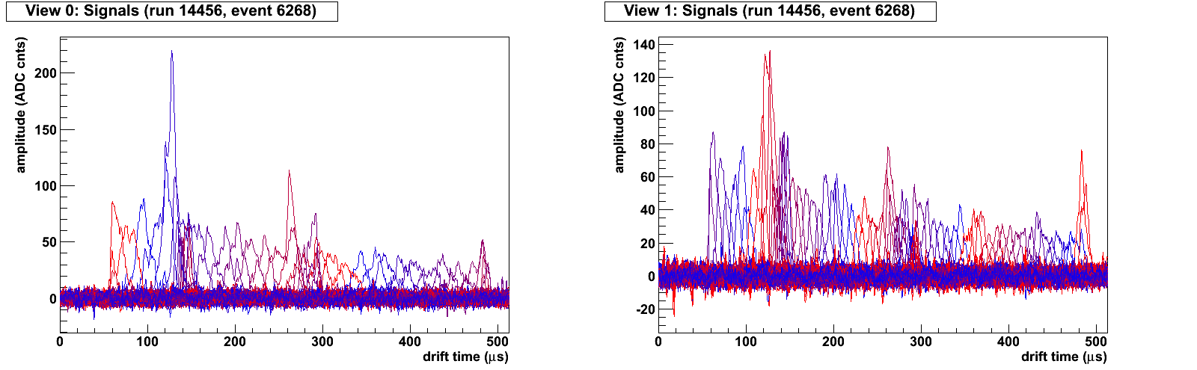
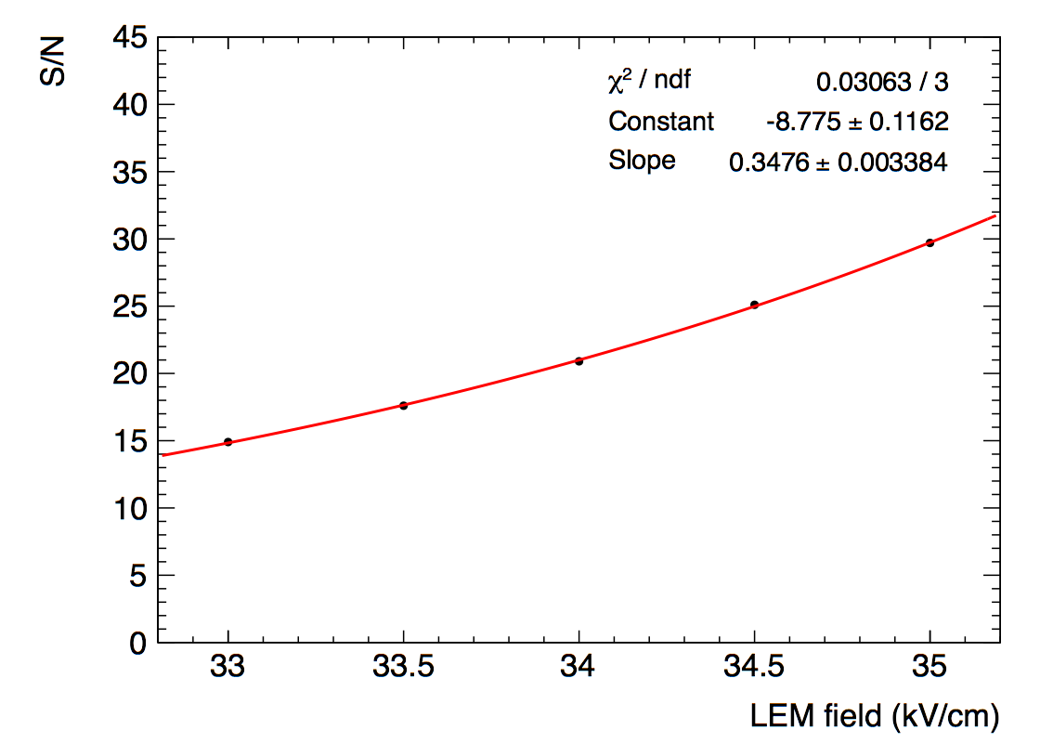
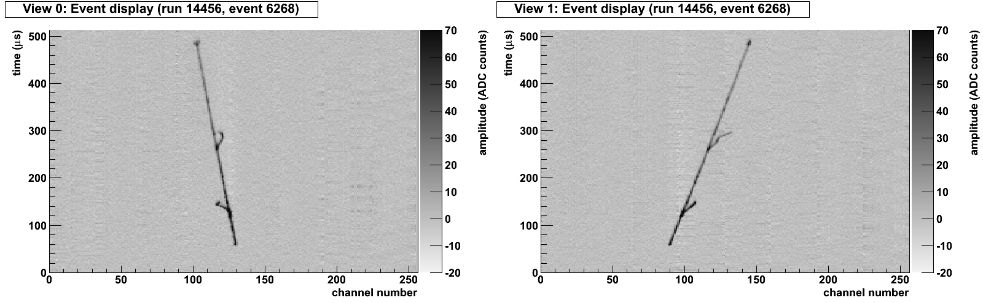
40x80 cm² LEM and 2D anode
Large Electron Multiplier (LEM)
Macroscopic Gas hole multiplier
(=Thick GEM)
manufactured with standard PCB techniques
Large area coverable (1 m² size modules)
O(10⁶) holes
40 cm
40 cm
2D projective anode readout
80 cm
80 cm
Charge is equally collected on two sets of strips (views)
readout independent of multiplication
induced signals have the same shape
effective gain vs. LEM field
60 cm
80 cm
40 cm
<dQ/dx>=146 fC/cm, effective gain≈14.6, (S/N≈30)
Charge sharing asymmetry: (<Q1>-<Q0>)/(<Q1>+<Q0>)=7%
S/N vs. LEM field
Results:
JINST 7 (2012) P08026
Notes:
sorry, the number should be 7% and it is the asymmetry factor of the mean values
(<Q1>-<Q0>)/(<Q1>+<Q0>)=7%
here in more detail:
from the two values <dQ0/dx>= 67.7 fC/cm and <dQ0/dx>= 77.8 fC/cm, we get the
gain: <dQ1/dx>+<dQ0/dx>=146 fC/cm
and the asymmetry factor: (<dQ1/dx>-<dQ0/dx>)/(<dQ1/dx>+<dQ0/dx>) = 7%
sorry for the confusion and the wrong number, I hope this email clarifies this.

Slide 7
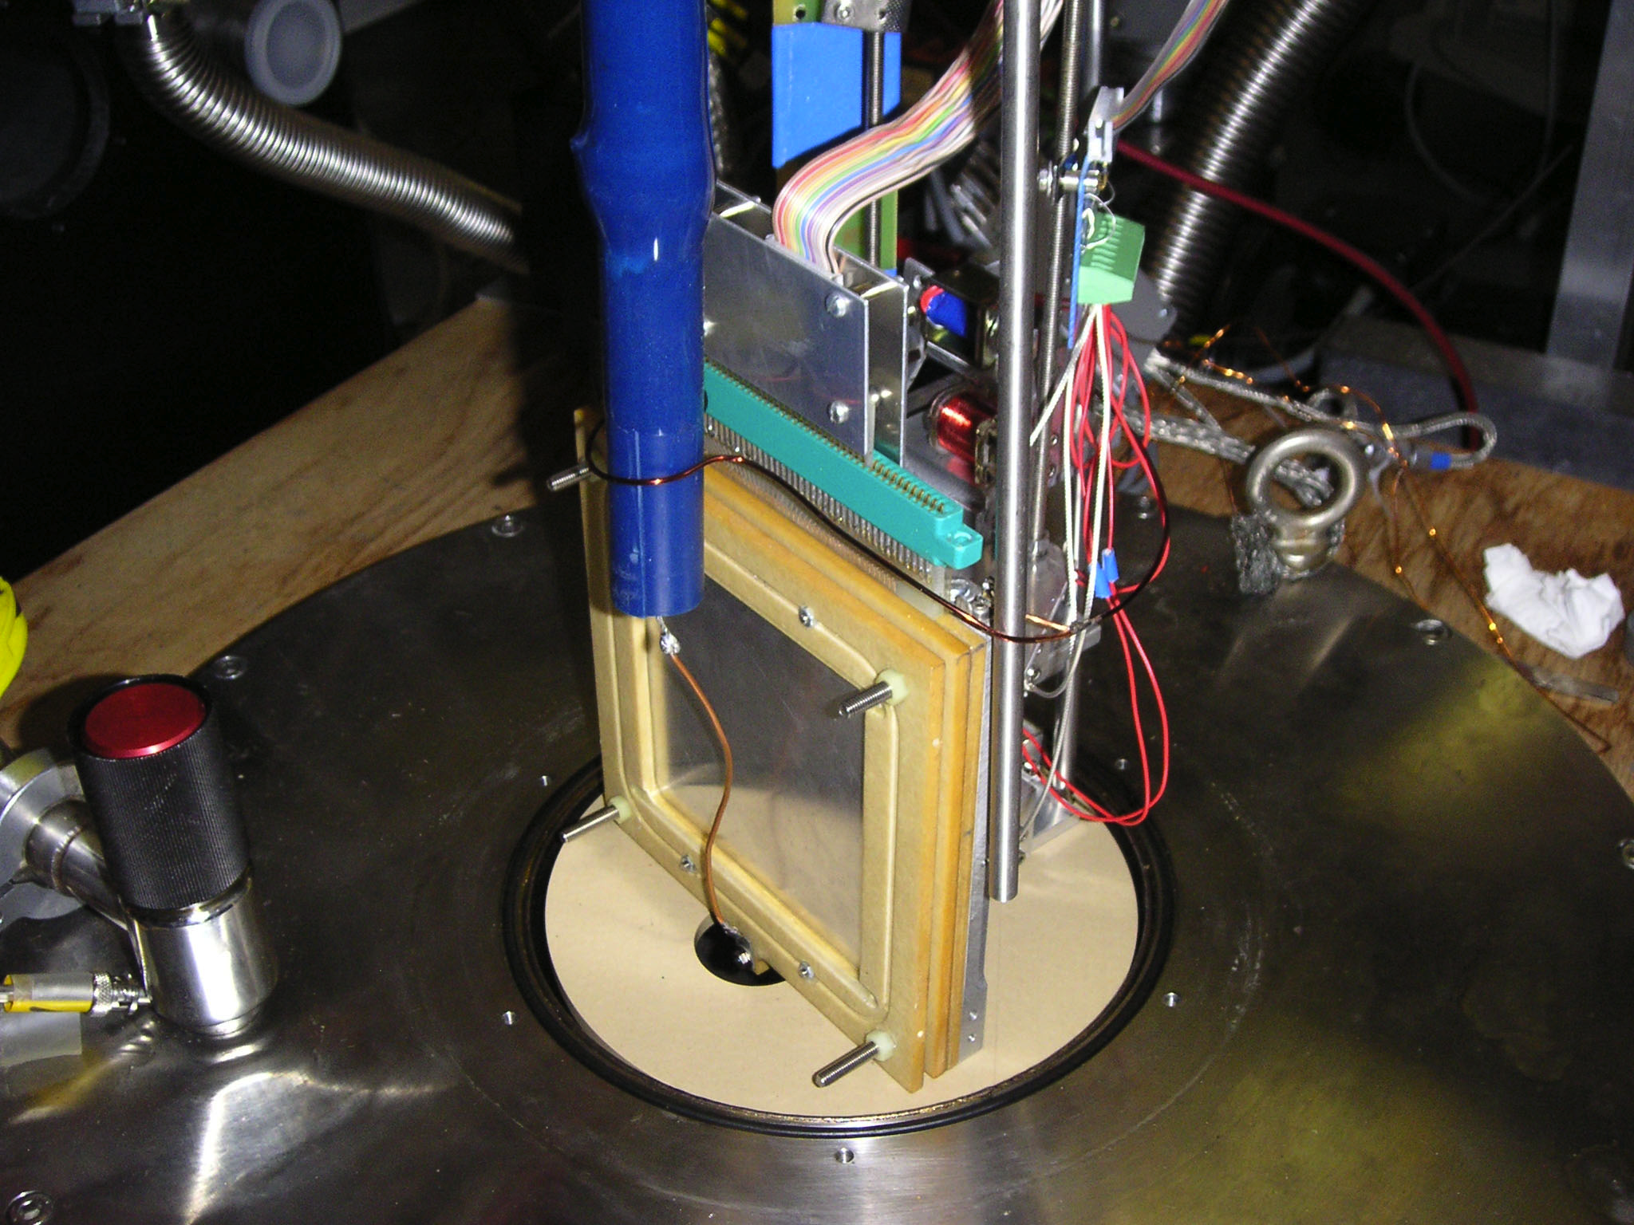
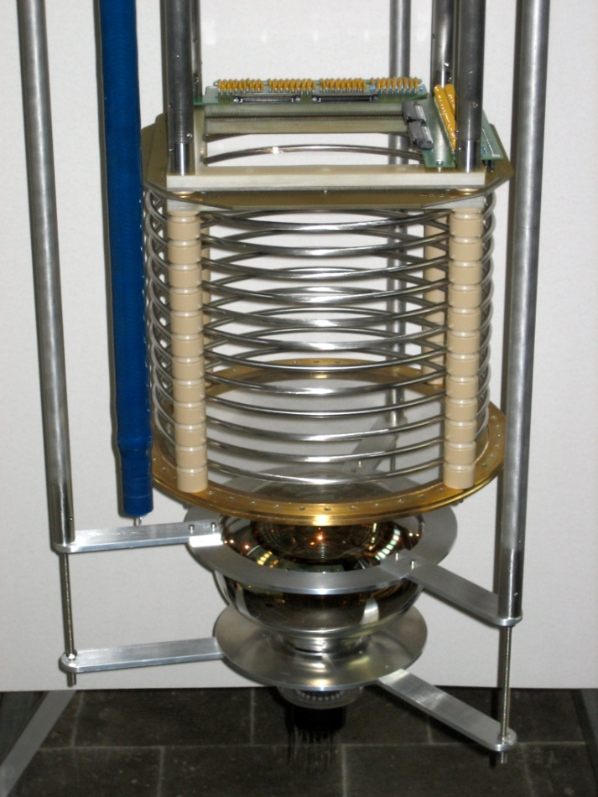
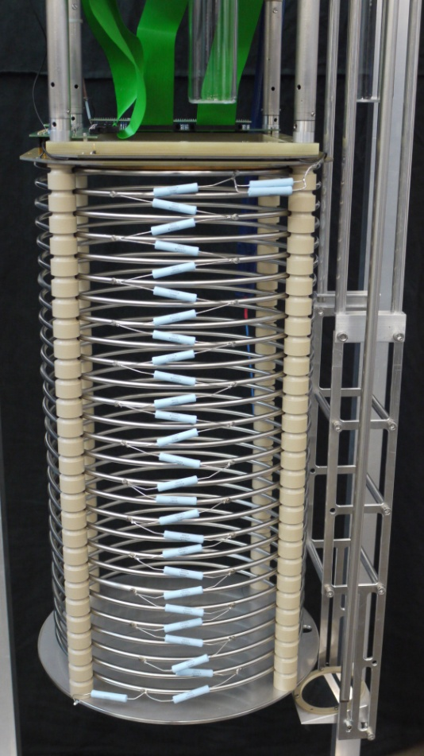
Evolution of LAr TPCs in Bern
Mini Argontube
Medium Argontube
Medium Argontube +
0.5 cm
25cm
57cm

Slide 8
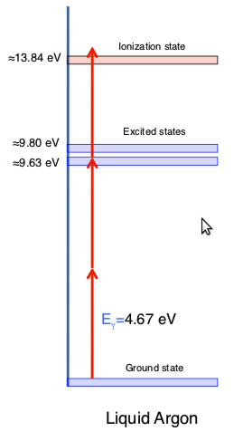
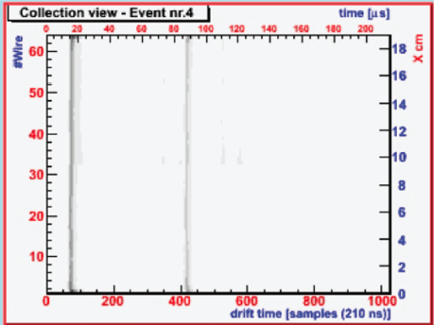
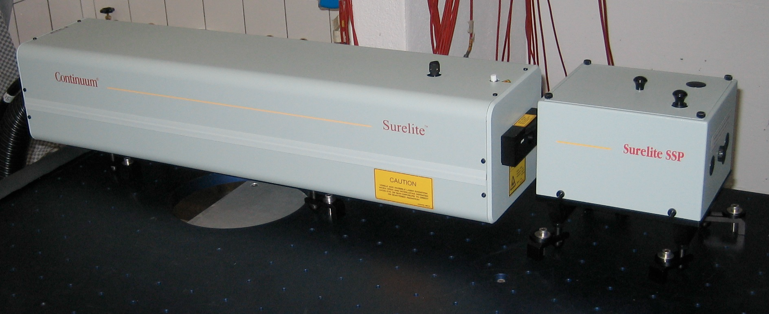
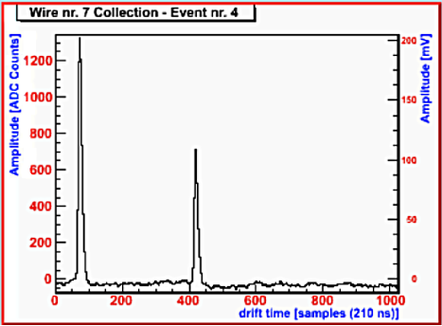
UV laser in LAr
Feasibility study of using a UV laser to ionize LAr in a multiphoton process
NJP 12 (2010) 113024
2009 JINST 4 P07011

Slide 9
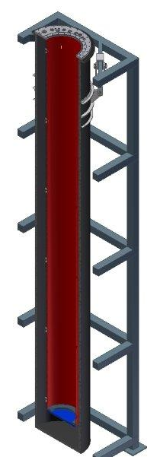
Argontube
  Prove the feasibility of 5 m drift
Main technological issues
  500 kV in liquid Argon
  Signal over noise ratio at least factor 10
  Impurities at the level of < 0.1ppb
Possible studies
  5 m particle tracks
  Measure the purity (Charge loss along the drift)
  Electron diffusion (parallel and perpendicular to E-field)
  Test new readout system and electronics
  Muon decay (Michel spectrum)
Outer volume: 1.2 m³
Inner volume : 1.1 m³
Active volume: 0.2 m³
Mass of active volume: 280 kg
JINST 7 (2012) C02011

Slide 10
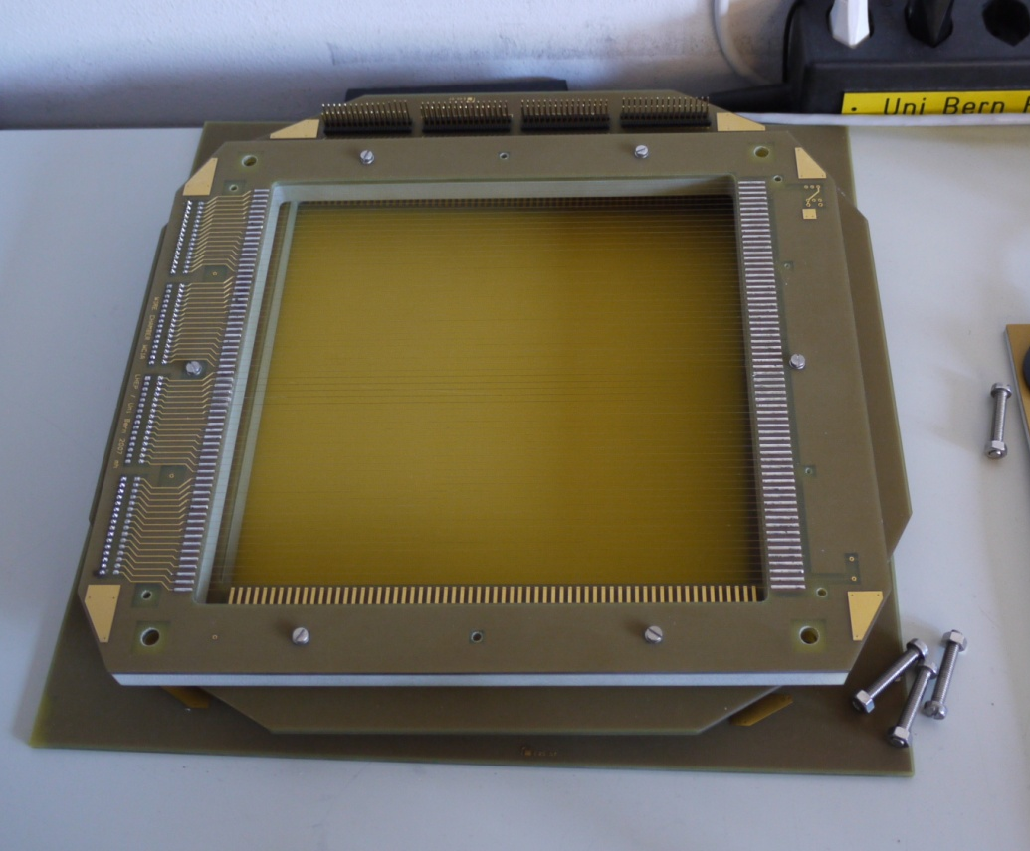
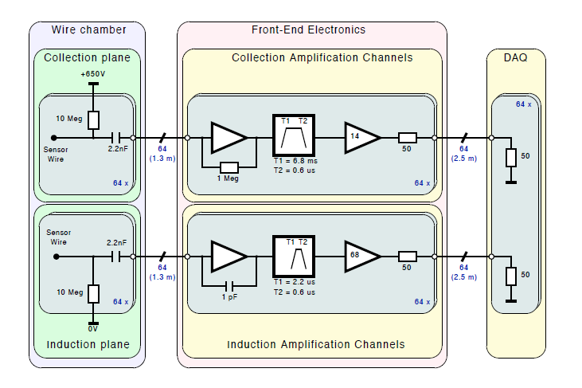
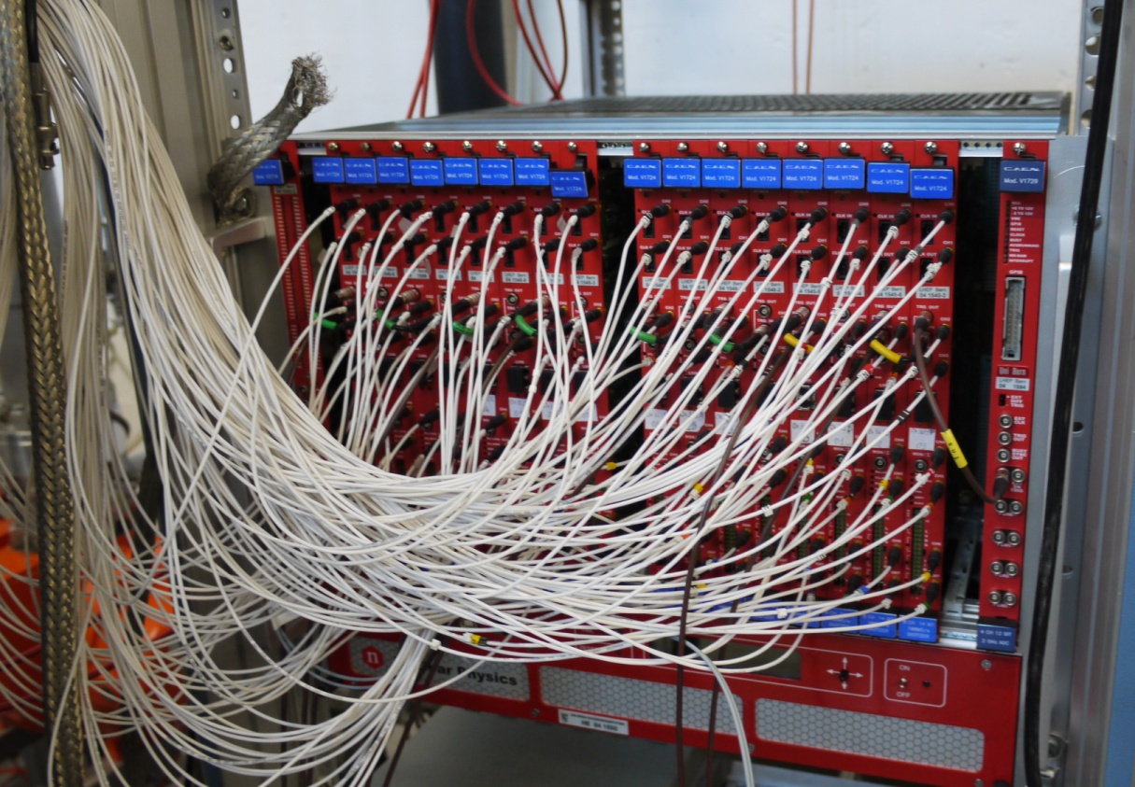
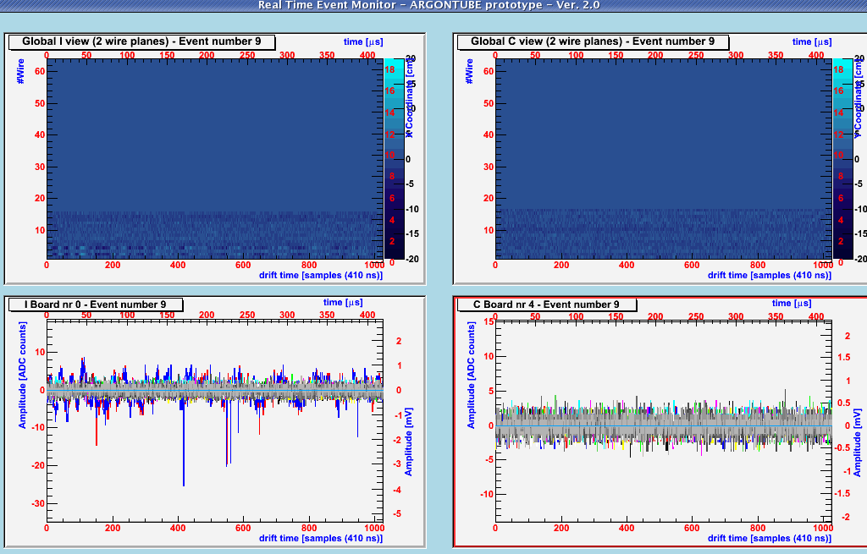
TPC, pre-amplifiers and DAQ
20cm
20cm
ADCs
Max Drift Distance: 5m
e⁻ Velocity: 2mm/μs
Max Drift Time: 2500μs
Sampling: 10 ns
DAQ window: 256kSamples/ch = 512kb/ch
Event Size = 512kb/ch * 128ch = 65MB/e
Sampling: 100 ns
DAQ window: 32kSamples/ch = 64kb/ch
Event Size = 64kb/ch * 128ch = 8MB/ev
CAEN v1724 (ADC) + v2718

Slide 11
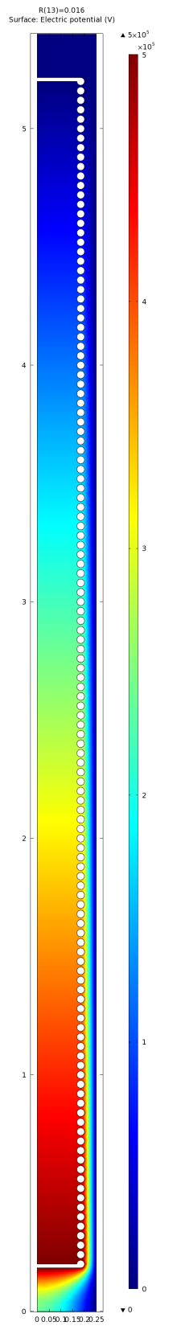
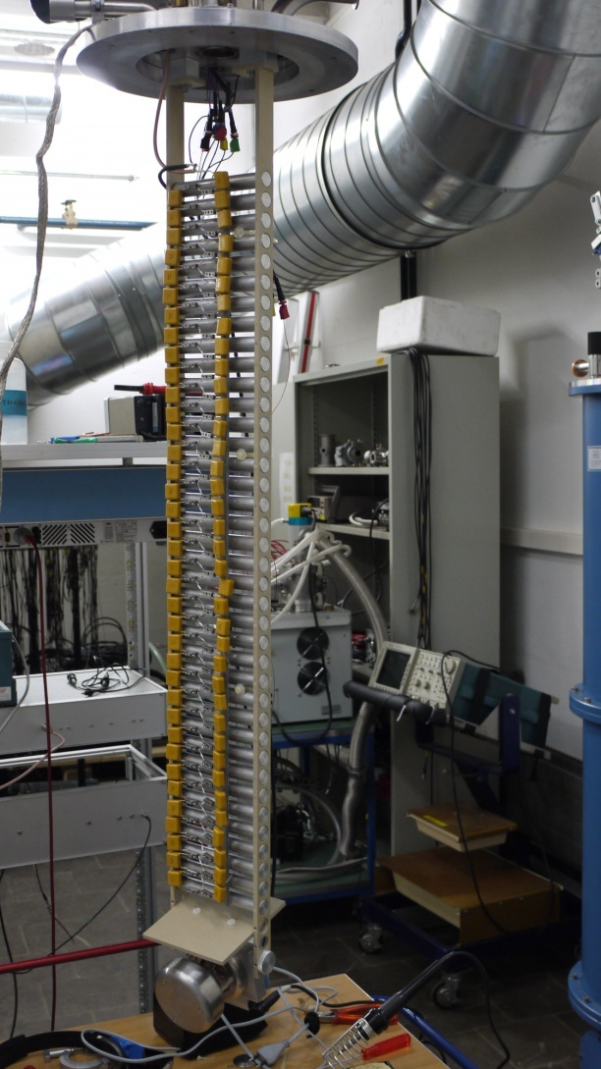
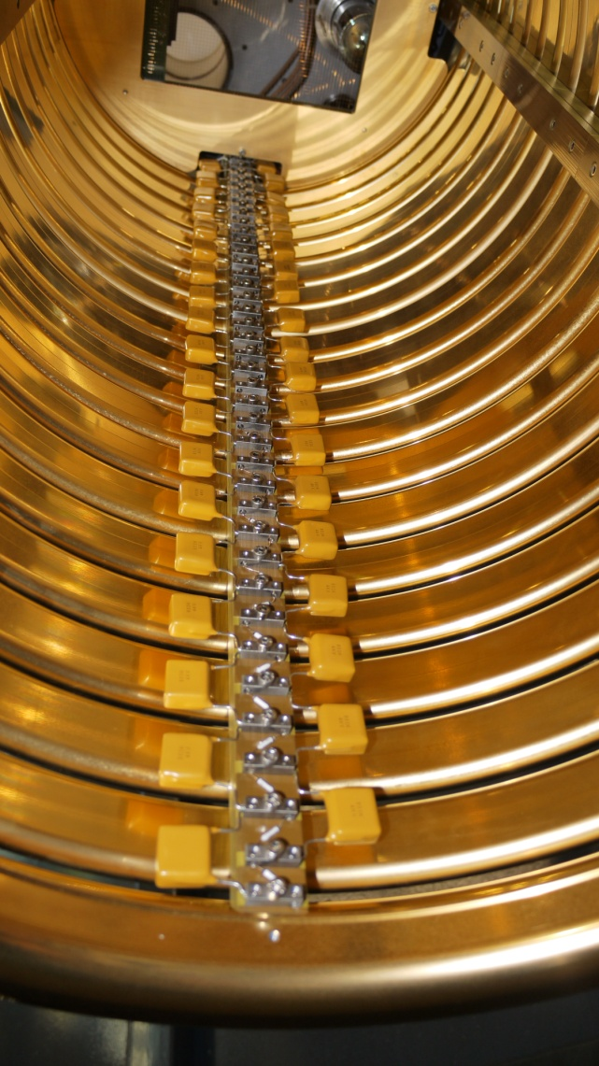
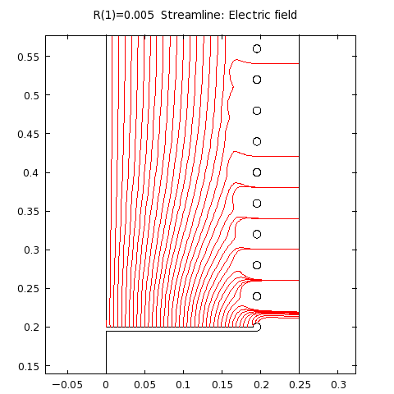
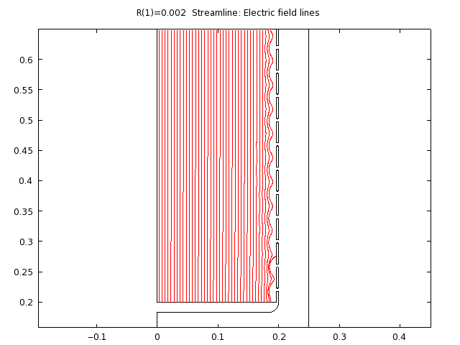
High Voltage
J.Phys.Conf.Ser. 308 (2011) 012027
Cockcroft/Walton – Greinacher circuit for charge multiplication (125 stages,input 4kV AC)
Comsol (Finite element analysis software) to obtain best field rings shapes
Goal: drift field of 1kv/cm
3.5 cm
1.6 cm
breakdown voltage in LAr : 1.1-1.4 MV/cm

Slide 12
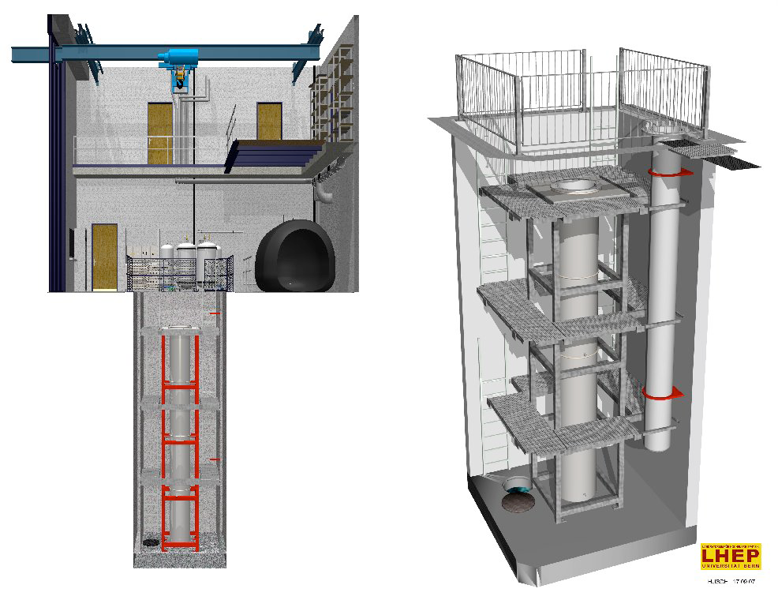
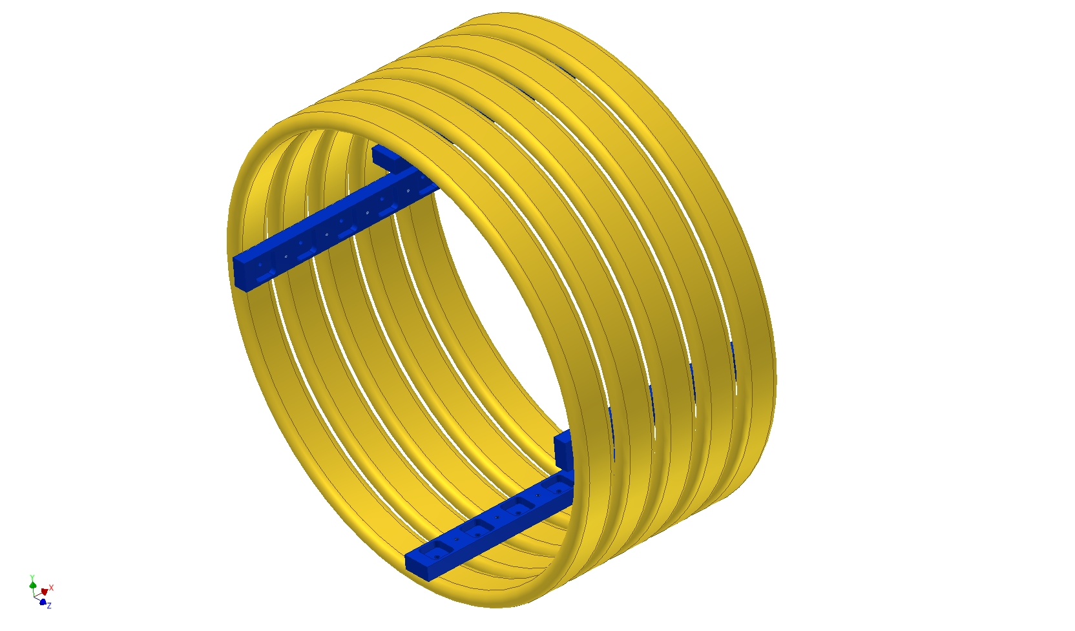
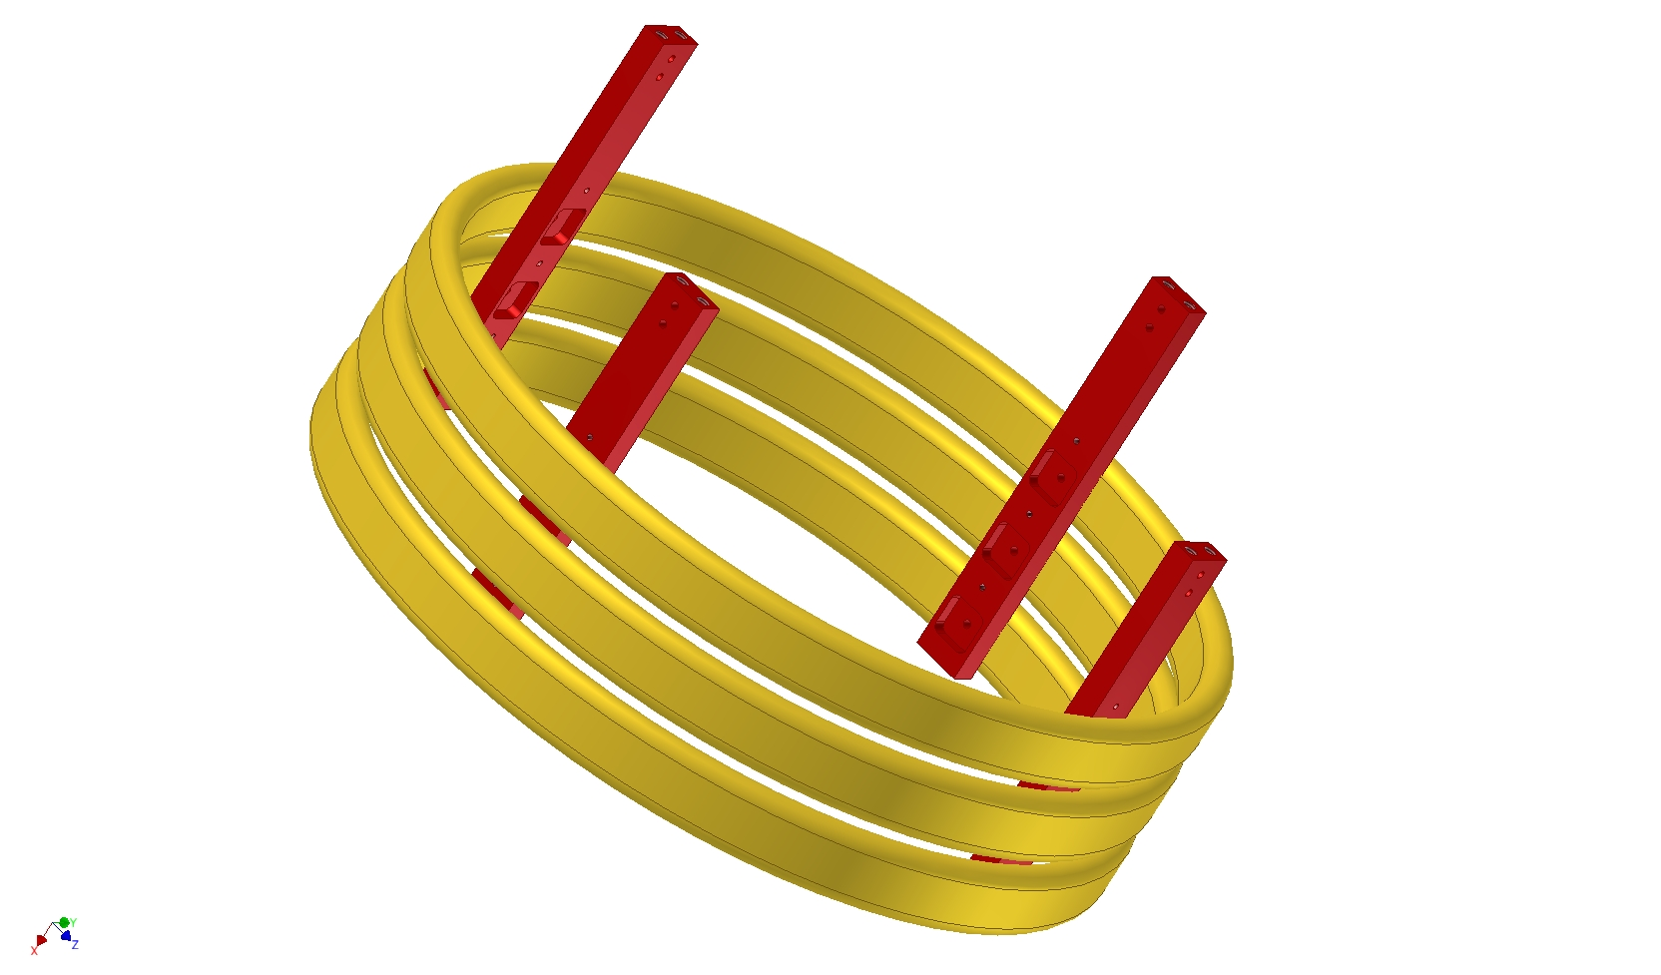
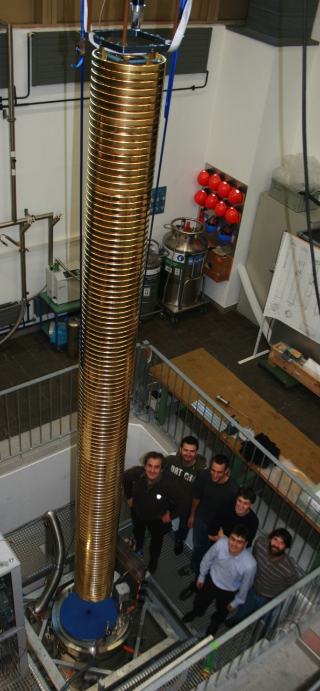
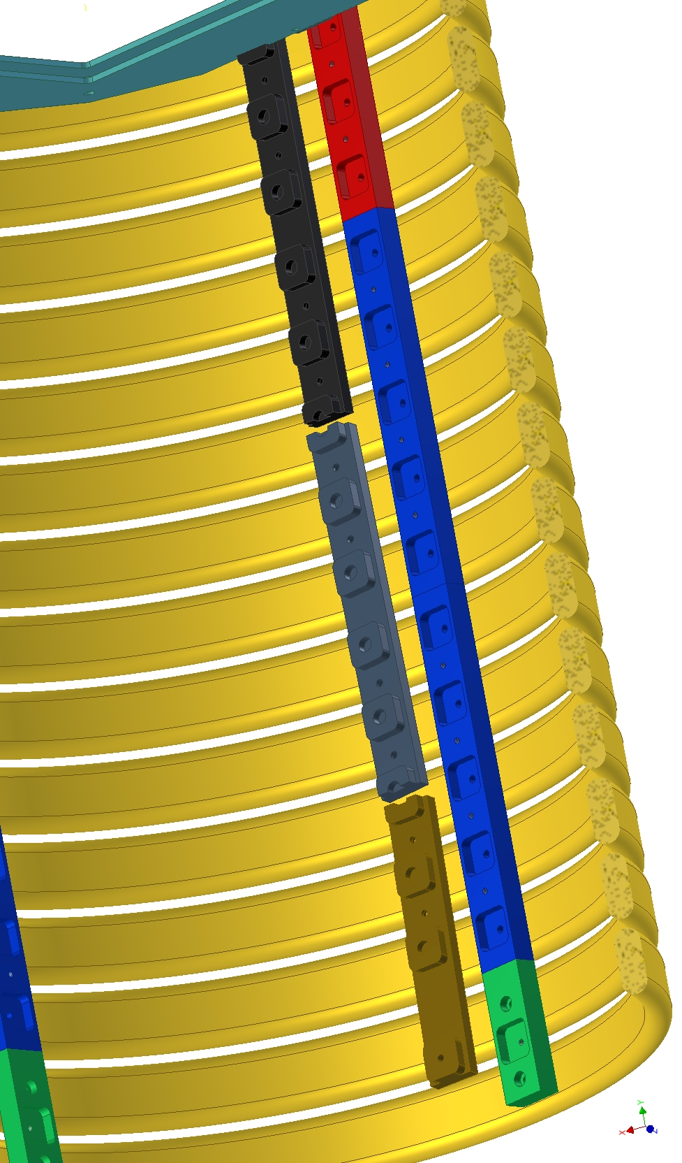
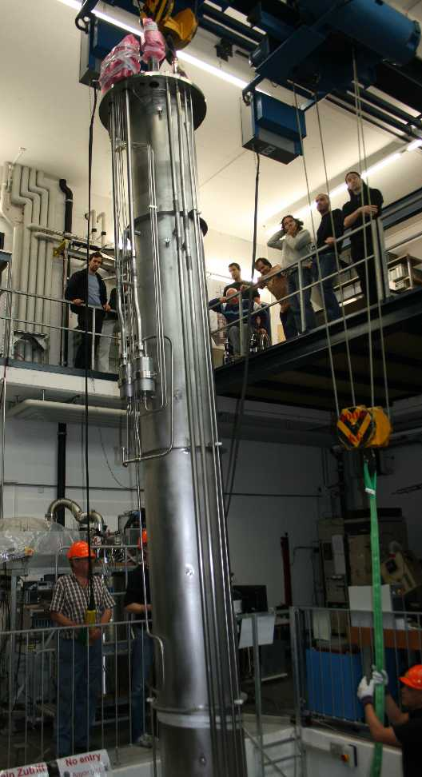
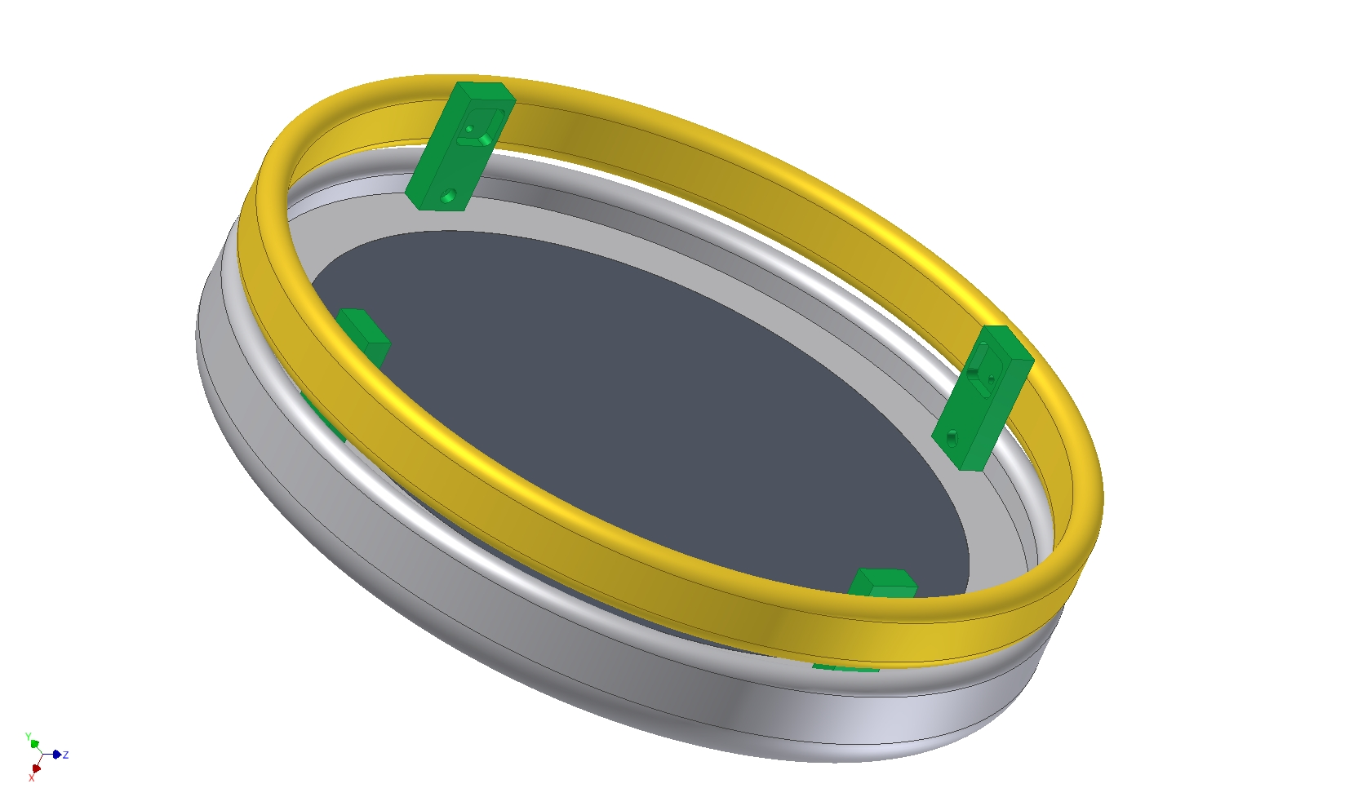
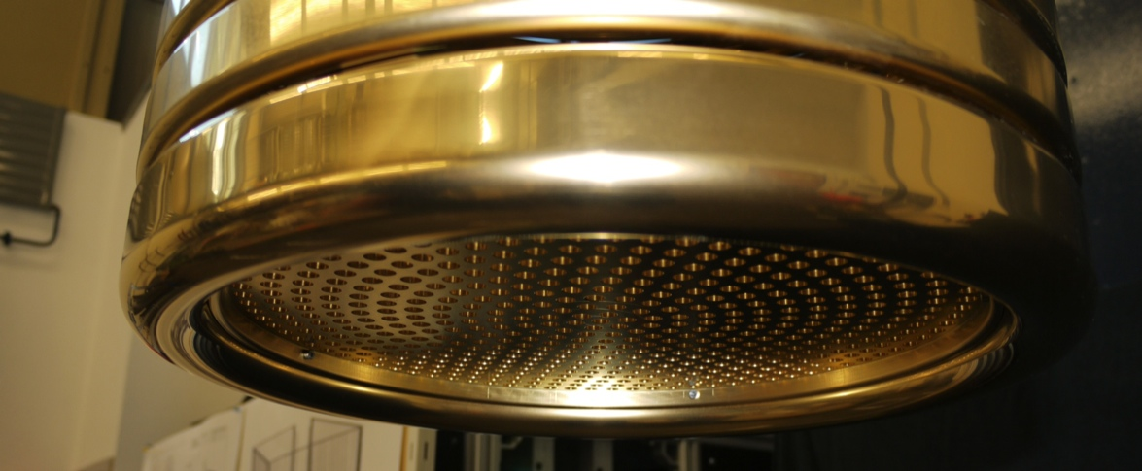
Design and construction

Slide 13
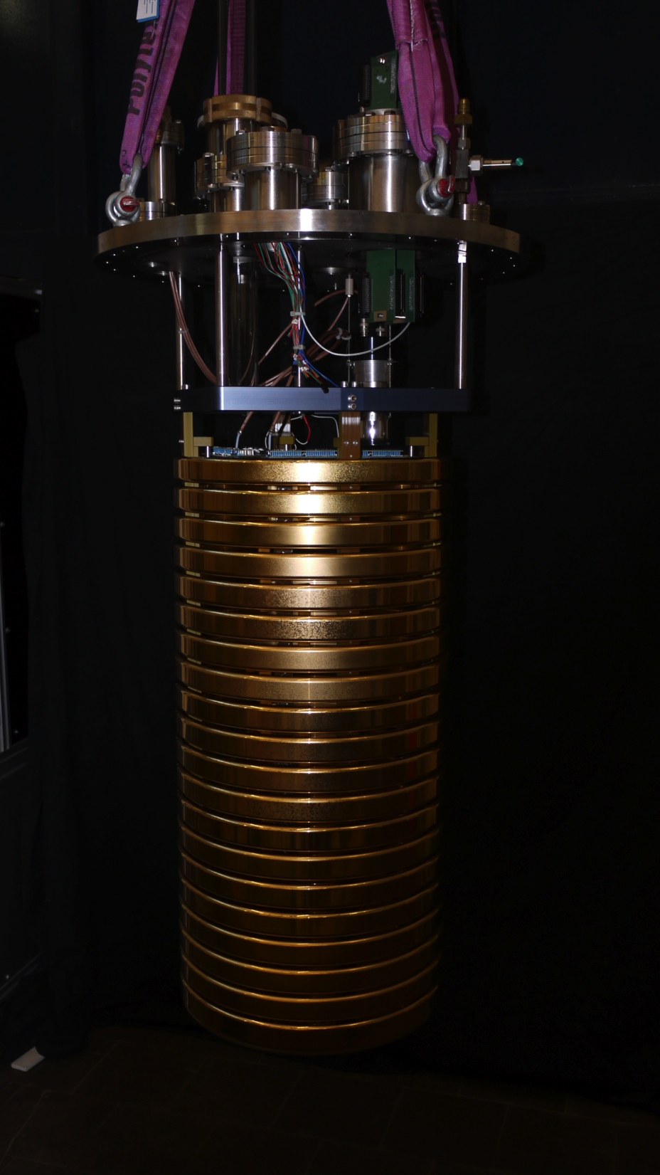
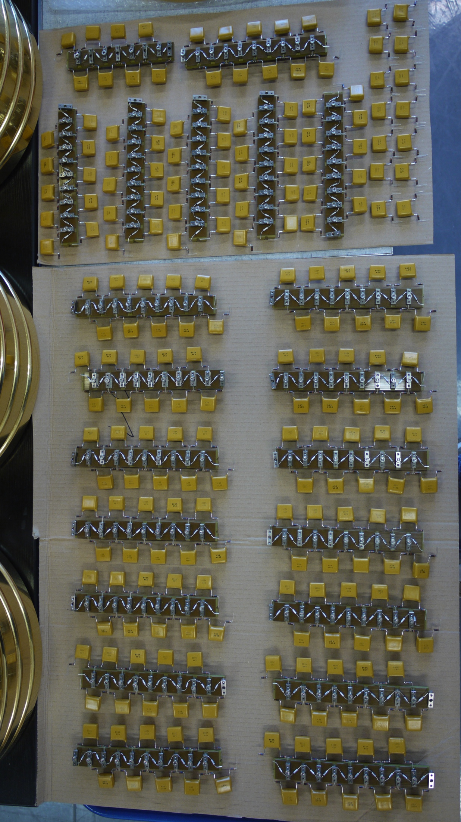
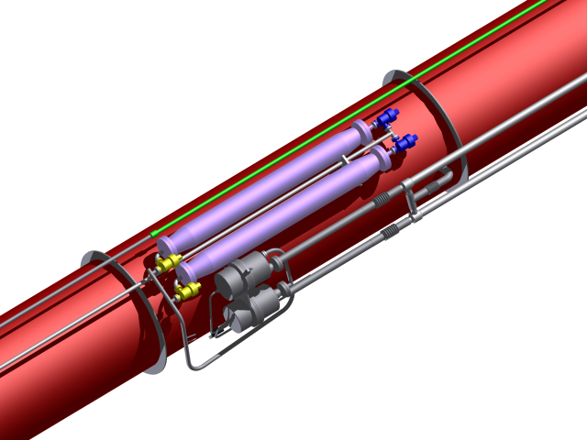
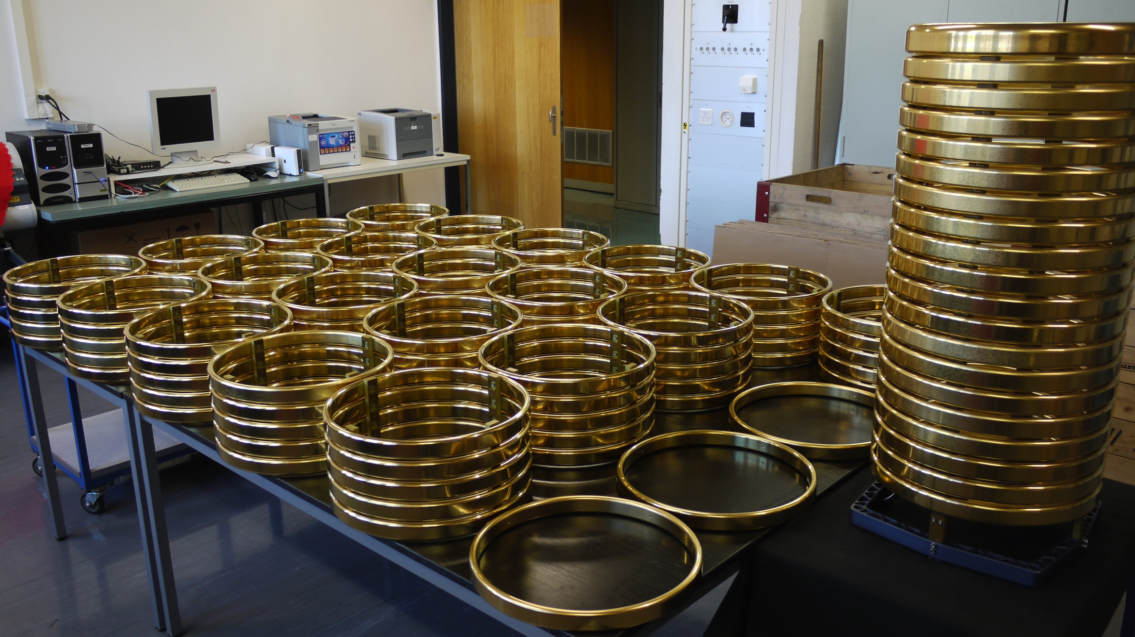
Construction, recirculation
To ensure the required purity, a Argon recirculation system was installed.
First cleaning stage filling
2nd stage with bellow pumps

Slide 14
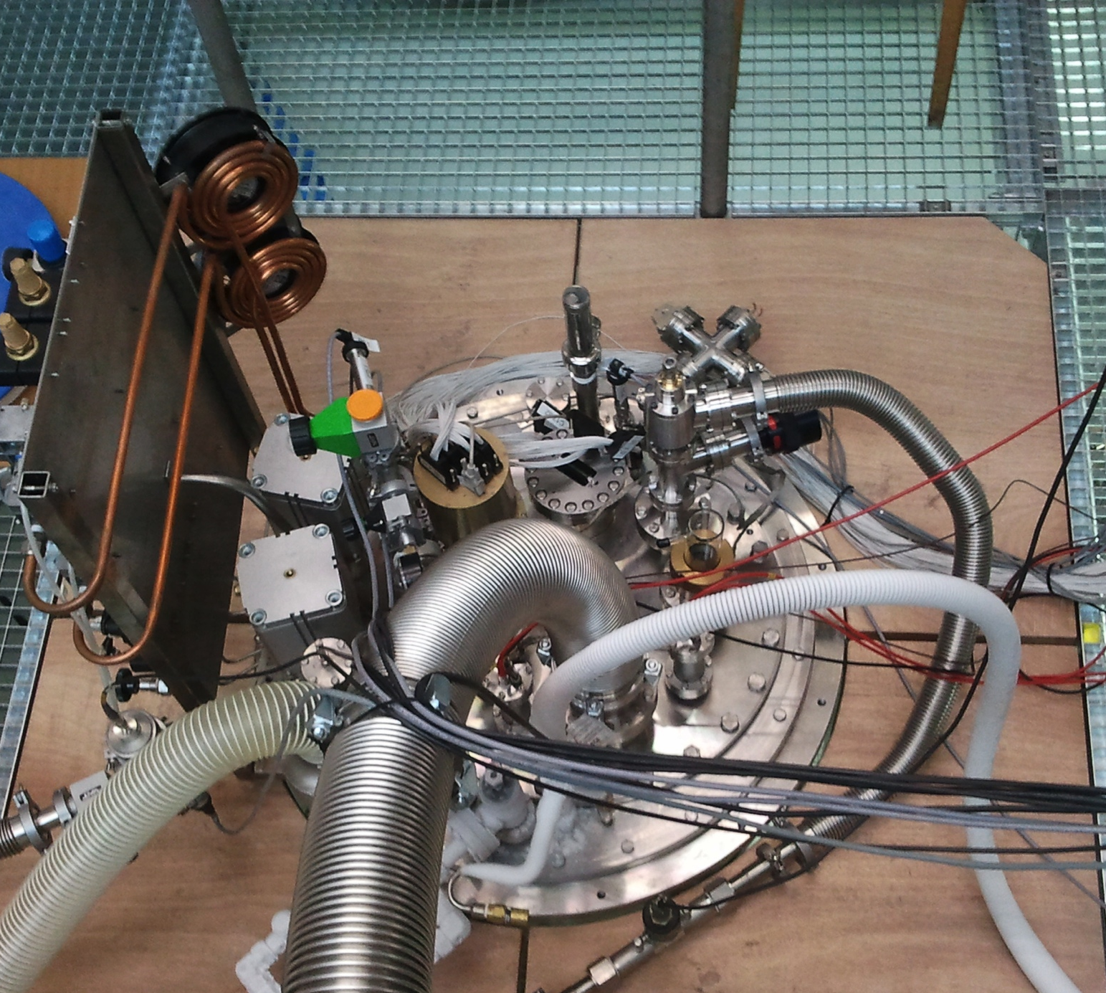
Data run
Vacuum
Pumping with pre-vacuum- and roots-pump
5 days of pumping
Vacuum: 4.8E-5 mbar
Filling
6 h to fill ARGONTUBE
2600 l of Argon used
Filtered Argon was injected (Oxygen trap)
Before taking data one night of liquid recirculation through oxygen trap
Operation
HV was ramped up to 1.3kV AC input voltage (170 kV) -> discharges
Stable conditions at 1 kV AC input voltage (Drift field ~125 kV)
Cosmic muon tracks
Laser induced signals
Drift field not homogenous (from 250V/cm-150V/cm)
2 Weeks of operation (about 10’000 events)

Slide 15
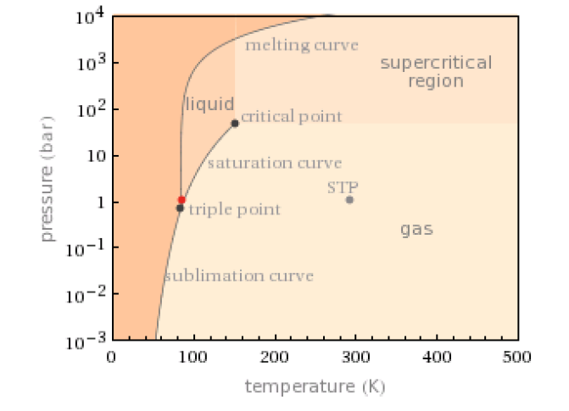
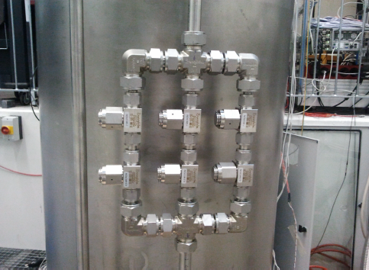
HV breakdowns
  Max stable HV achieved 150-170kV
  Around 170 kV spontaneous discharges of the Greinacher
    Run 1: Few discharges, one broken capacitor
    Run 2: O(100) discharges, one broken capacitor
  candidates for discharges
    Argon bubbles (triple point close)
      Change pressure
      Enrich Argon Gas with He
    Dust from filters
      Copper powder <0.5μm
    Electrostatic forces
      5m leverage in case of small misalignment along drift axis
    Breakdown voltage << 1MV/cm
      Proc Phys Soc 78 448 (1961) measured 1.1 MV/cm for gold/gold

Slide 16
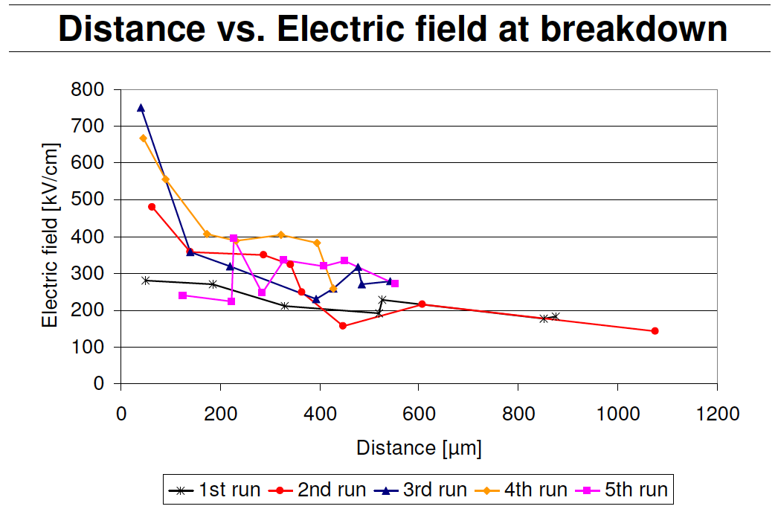
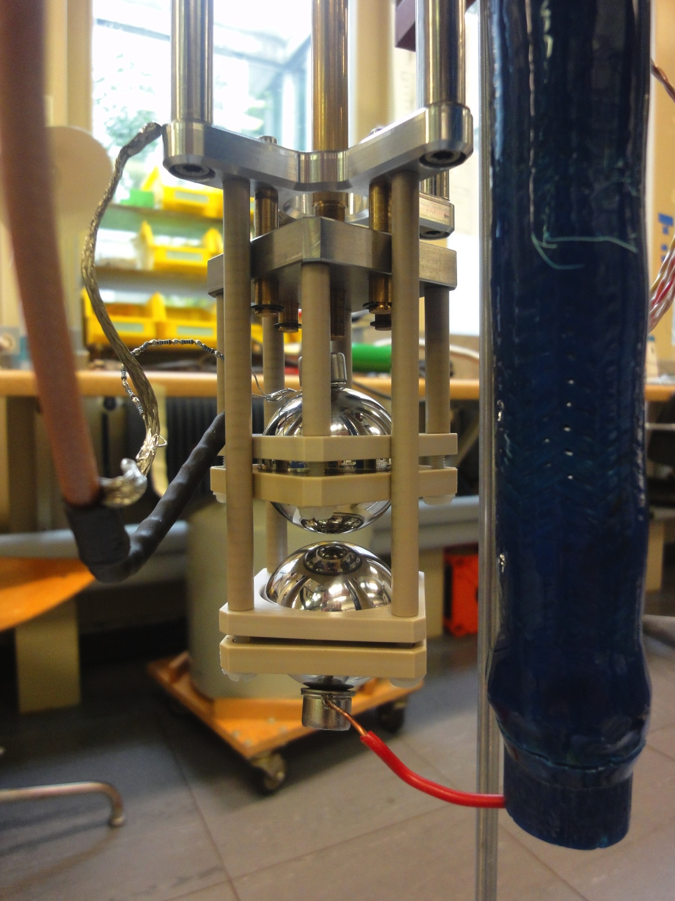


Breakdown Voltage
  Breakdown voltage confirmation
  Micro Argontube with a 30kV HV feedthrough JINST 5:T11002 (2010)
  2 spheres (d=4cm), one moveable with 5μm precision
  Work in progress
Preliminary

Slide 17


UV Laser calibration
5m, ~ 6ms
5m straight cosmic are rare (~1event/min)
Use the UV laser to generate 5m tracks, covering the whole TPC drift length
2 Purity measurements
Non uniform drift field due to HV breakdowns after capacitor broke
From the knowledge of the laser path, we can extract the true drift field, and thus correct the drift time
Application for future large LAr TPC’s
To be demonstrated in MicroBooNE

Slide 18



Cosmic muons
Drift field corrected
Cosmis muon with 5m drift

Slide 19



2m

Slide 20


Purity measurement with UV-laser and muons
Electronegative molecules absorb drifting electrons (Oxygen or Water)
Charge attenuation along the drift is called charge live time
Recirculation system to reduce oxygen impurities
Purity measured with muon tracks
Purity measured with UV laser beam
Preliminary
2500 ms of live time corresponds to 0.12 ppb of oxygen equivalent

Slide 21



Diffusion Measurements
D_{T}=5.18±0.58 cm²/s
or
D_{T}=10.18±0.58 cm²/s
Behavior for t>5500μs to be studied
Preliminary
Notes:
Icarus Collaboration measured: D_{L}= 4.8 cm²/s

Slide 22




Diffusion Measurements and further ideas
Micro Argontube
Test of double collection plane readout with wire planes
Cosmis Muons
Red Muons, green UV Laser

Slide 23
Conclusions
Broad R&D program towards very large LAr TPC’s conducted in Switzerland (Bern and ETHZ)
Novel Readout for very large surfaces succesfully developed and operated at ETH Zurich
  Largest gain operated stably with 10x10cm² is approx 30 with S/N > 200 for m.i.p.
  Largest area LEM 40x80 cm^{2,} preliminary stable operation with gain ≈ 15 (more tests in preparation)
Very long drift successfully demonstrated at AEC Bern
  Recirculation system for Argon purification
  Stable HV ~ 125kV with Greinacher multiplier (Cockcroft Walton)
    candidates for discharges are under investigation
  Muon tracks of almost 5m drift
  Laser tracks with 5m drift
  Purity of about 2.5ms
  Transversal electron diffusion D_{T} 5.2 or 10.2 cm²/s
  New ideas for double charge readout
Good prospects for future experiments: MicroBooNE, LBNE, Laguna-LBNO

Slide 24

Thanks for your attention

Slide 25
4 Minute Video of Argontube construction for QA session

