Slide 1
Neutrinos from Stored Muons νSTORM
ν physics with a μ storage ring

Slide 2
Motivation
The idea of using a muon storage ring to produce neutrino beams for experiments is not new
50 GeV beam – Koshkarev @ CERN in 1974
1 GeV – Neuffer in 1980
nuSTORM can:
Address the large Δm² oscillation regime and make a major contribution to the study of sterile neutrinos
Either allow for precision study (in many channels), if they exist in this regime
Or greatly expand the dis-allowed region
Make precision ν_{e} and ν_{e}-bar cross-section measurements
Provide a technology test demonstration ( μ decay ring) and μ beam diagnostics test bed
Provide a precisely understood ν beam for detector studies

Slide 3
μ-based ν beams
Flavor content fully known
“Near Absolute” Flux Determination is possible in a storage ring
Beam current, beam divergence monitor, μ_{p} spectrometer
Overall, there is tremendous control of systematic uncertainties with a well designed system

Slide 4
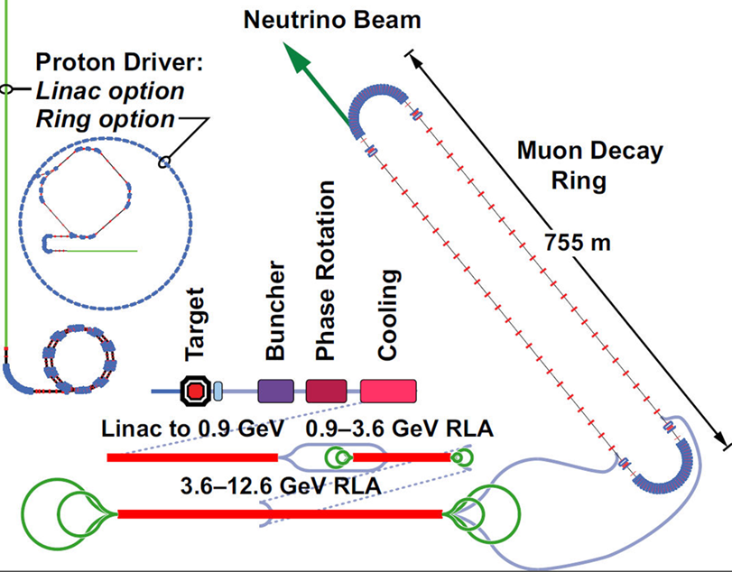
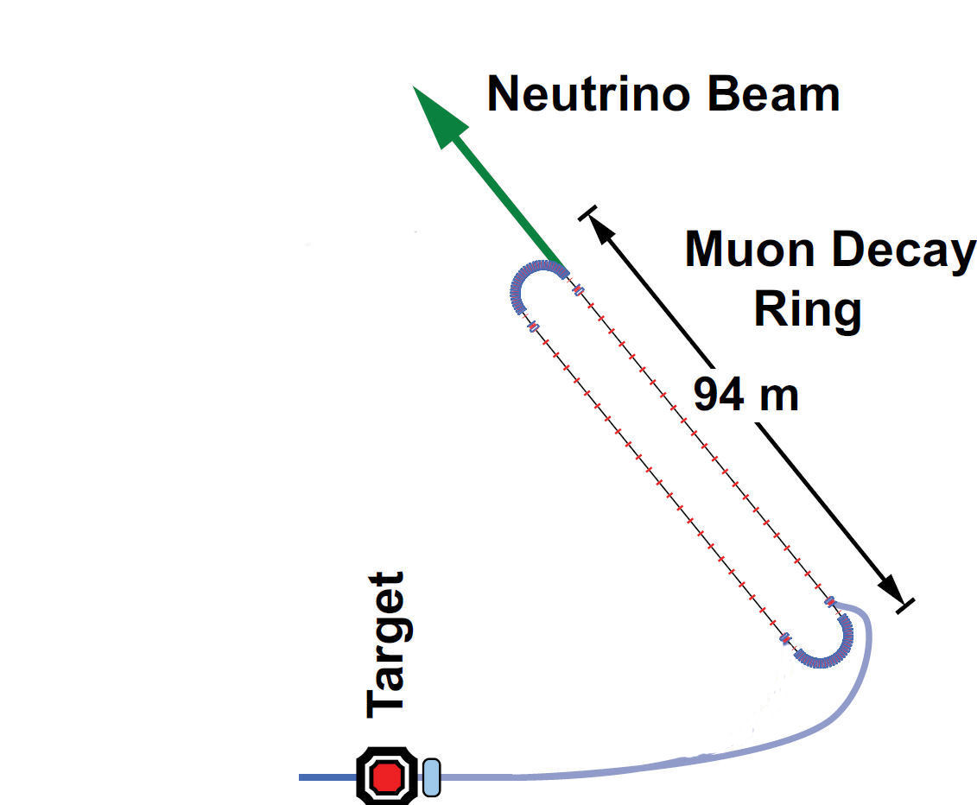
Neutrinos from STORed Muons
IDS-NF
Single baseline, Lower E
495 m
This
is the simplest
implementation
of the NF
150 m
And
DOES NOT
Require the
Development of
ANY
New Technology
10-100kW

Slide 5
Baseline(s)
100 kW Target Station
Assume 60 GeV proton
Fermilab PIP era
Ta target
Optimization on-going
Horn collection after target
Li lens has also been explored
Collection/transport channel
Stochastic injection of π
At present NOT considering simultaneous collection of both signs
Decay ring
Large aperture FODO
Racetrack FFAG
Instrumentation
BCTs, mag-Spec in arc, polarimeter
150 m

Slide 6
FODO Decay ring
Alex Bogacz
JLAB
3.8 GeV/c ± 10% momentum acceptance, circumference = 350 m

Slide 7
The Physics Reach

Slide 8
Assumptions
N_{μ} = (POT) X (π/POT) X ε_{collection} X ε_{inj} X (μ/π) X A_{dynamic} X Ω
10²¹ POT in 5 years of running @ 60 GeV in Fermilab PIP era
0.1 π/POT (FODO)
ε_{collection} = 0.8
ε_{inj} = 0.8
μ/π = 0.08 (γct X μ capture in π → μ decay) [π decay in straight]
A_{dynamic} = 0.75 (FODO)
Ω = Straight/circumference ratio (0.43) (FODO)
This yields ≈ 1.7 X 10¹⁸ useful μ decays
þ
Ao Liu
Fermilab/UI
þ

Slide 9
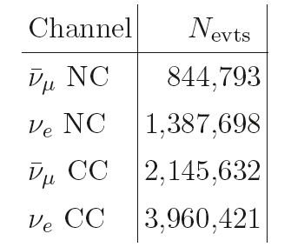
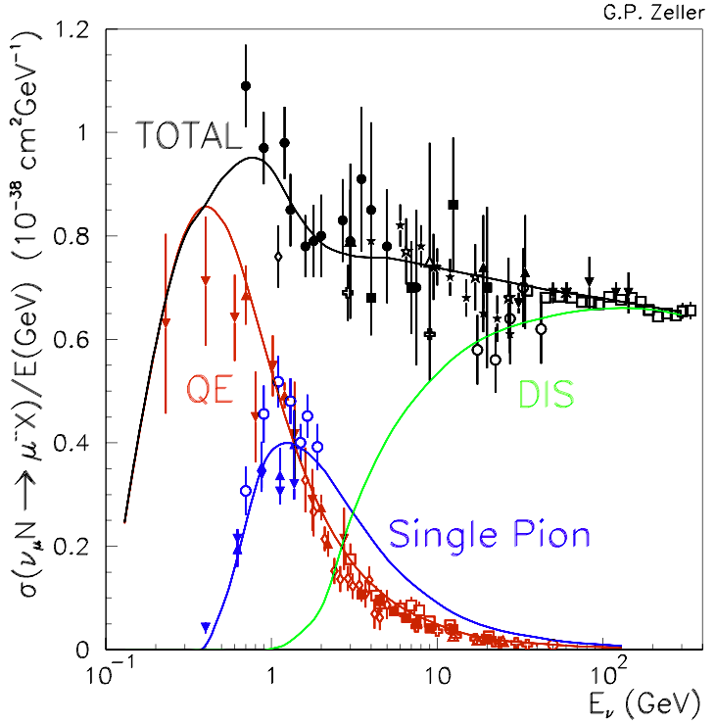
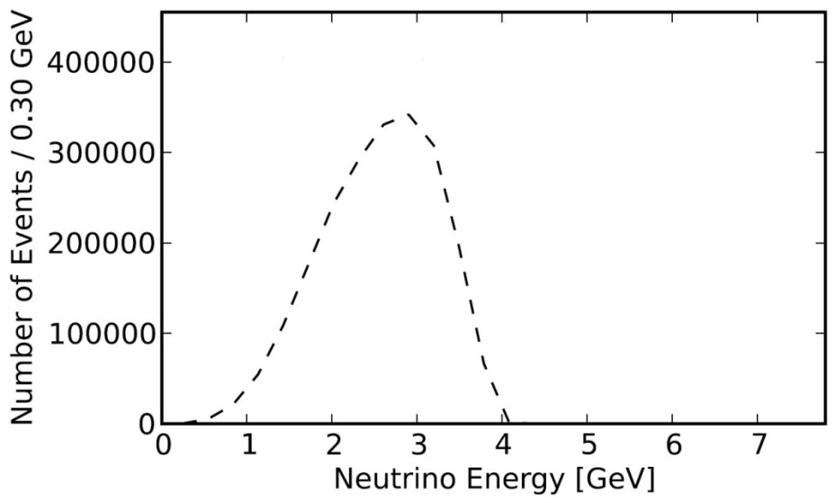
E_{ν} spectra (μ⁺ stored)
Event rates/100T
at ND hall 50m
from straight with
μ⁺ stored
ν_{e}
ν_{μ}-bar

Slide 10
Experimental Layout
Appearance
Channel:
ν_{e} → ν_{μ}
Golden Channel
Must reject the
“wrong” sign μ with
great efficiency
150
~ 1500 m
Why ν_{μ} → ν_{e}
Appearance Ch.
“not” possible

Slide 11
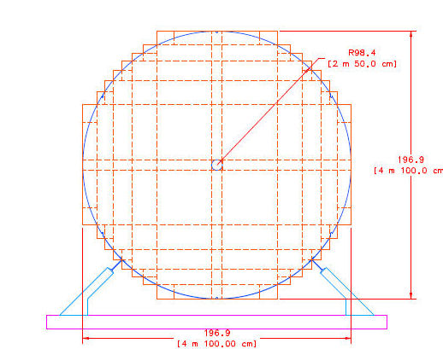
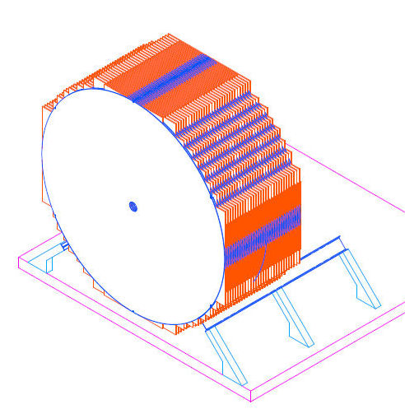
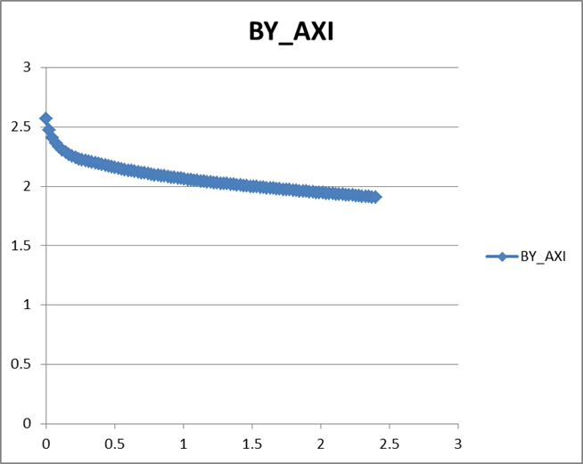
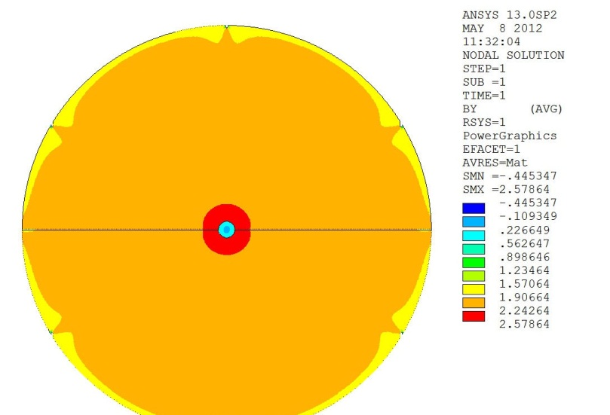
Baseline Detector Super B Iron Neutrino Detector: SuperBIND
Magnetized Iron
1.3 kT
Following MINOS ND ME design
1-2 cm Fe plate
5 m diameter
Utilize superconducting transmission line for excitation
Developed 10 years ago for VLHC
Extruded scintillator +SiPM
20 cm hole
For 6-8 turns
of STL

Slide 12
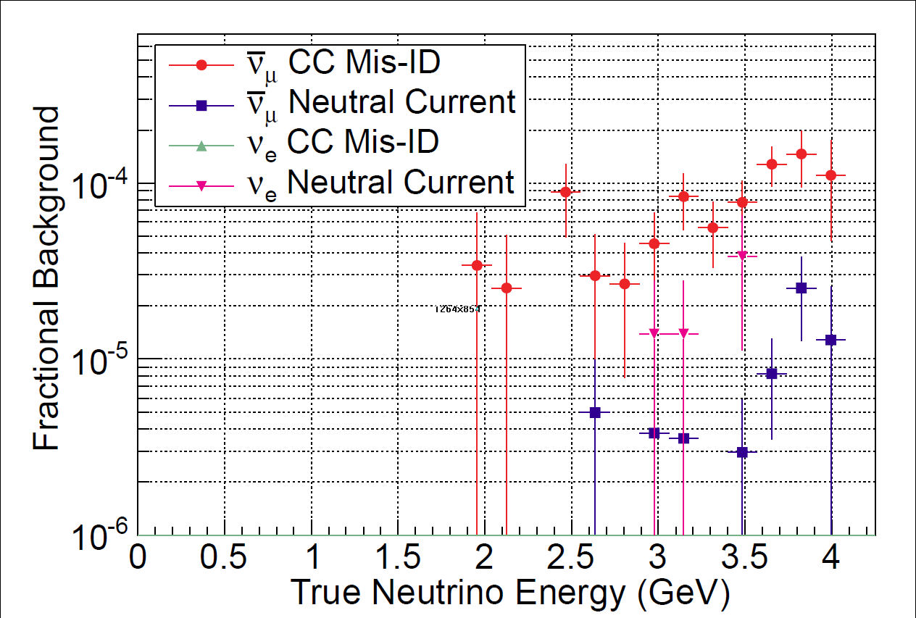
Backgrounds
Ryan Bayes
Glasgow
Left: 1 cm plates Right: 2 cm plates

Slide 13
Raw Event Rates
3+1
Assumption
Appearance channels

Slide 14
ν_{e} → ν_{μ} appearance CPT invariant channel to MiniBooNE
2 cm plate

Slide 15
ν_{e} → ν_{μ} appearance CPT invariant channel to LSND/MiniBooNE
Chris Tunnell
Oxford
3+1
Assumption

Slide 16
Required μ charge mis-ID rate needed for given sensitivity

Slide 17
Comments on ν beam
Although the primary beam is from μ decay, at the beginning of π injection into the first straight, π ® μ ν_{μ} may offer the opportunity to study ν_{μ} ® ν_{e} appearance
Capture transport line reduces ν_{e} background from K decay by factor of roughly 100

Slide 18
Project Considerations

Slide 19
Siting Concept
Steve Dixon (Fermilab FESS) will discuss tomorrow

Slide 20
Preliminary Cost Estimate
Major Components
Beamline, Target Station & Horn
Transport line
Decay ring
Detectors (Far & Near)
Project Office
Total
Basis of Estimation (BOE)
Took existing facilities (MiniBooNE beam line and target station, MINOS detector, vetted magnet costing models, μ2e civil construction costs, EuroNu detector costing, have added all cost loading factors and have escalated to 2012 $ when necessary.
$30M
9
54
18
15
$126M

Slide 21
Moving Forward
Why we are here

Slide 22
® Full Proposal
June 2012 PAC response to nuSTORM presentation
The combination of a clear resolution of the short-baseline neutrino anomalies, the precise measurements of the neutrino cross sections, and the synergy with neutrino-factory technology makes this a potentially attractive project.
From Pier
As you see, the Committee was quite intrigued by the possibility of the nuSTORM approach to resolving the short-baseline neutrino anomalies and its being a stepping stone toward use of neutrino-factory technology.
So,
Although we do not have a mandate ($$$), there is recognition of the power of the concept and encouragement to proceed to a full proposal.
In addition, nuSTORM has been included in the European Strategy for Particle Physics document.

Slide 23
Moving forward:
Facility
Targeting, capture/transport & Injection
Need to complete detailed design and simulation
Decay Ring optimization
Continued study of both RFFAG & FODO decay rings
Decay Ring Instrumentation
Define and simulate performance of BCT, Magnetic-spectrometer, etc.
Produce full G4Beamline simulation of all of the above to define ν flux
And verify the precision to which it can be determined.

Slide 24
Moving forward:
Detector simulation
For oscillation studies, continue MC study of backgrounds & systematics
Start study of disappearance channels
In particular the event classification in the reconstruction needs optimization.
Currently assumes "longest track" is interaction muon.
Plan to assign hits to and fit multiple tracks.
Vertex definition must also be improved.
Multivariate analysis.
For cross-section measurements need detector baseline design
Learn much from detector work for LBNE & IDS-NF
Increased emphasis on ν_{e} interactions, however
Produce Full Proposal for June 2013 PAC Mtg.

Slide 25
nuSTORM: Conclusions
The Physics case:
Initial simulation work indicates that a L/E ≈ 1 oscillation experiment using a muon storage ring can confirm/exclude at 10σ (CPT invariant channel) the LSND/MiniBooNE result
ν_{μ} and (ν_{e} ) disappearance experiments delivering at the <1% level look to be doable
Systematics need careful analysis
Detailed simulation work on these channels has not yet started
Cross section measurements with near detector(s) offer a unique opportunity
The Facility:
Presents very manageable extrapolations from existing technology
But can explore new ideas regarding beam optics and instrumentation
Offers opportunities for extensions
Add RF for bunching/acceleration/phase space manipulation
Provide μ source for 6D cooling experiment with intense pulsed beam
Interested ® subscribe to NUSTORM mailing list on listserv.fnal.gov

