Slide 1
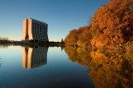
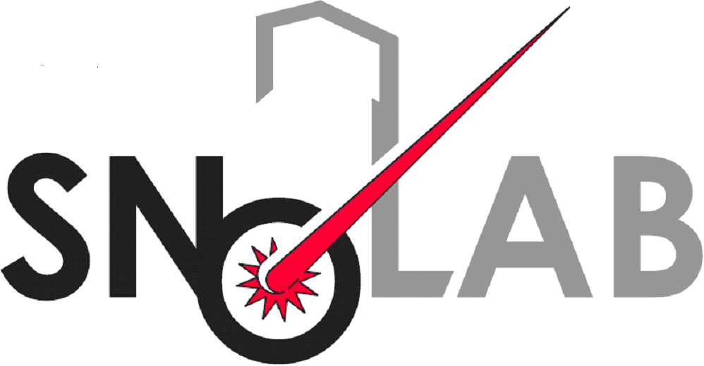

HALO at the
13th Annual NNN International Workshop
October 4, 2012
Clarence J. Virtue

Slide 2
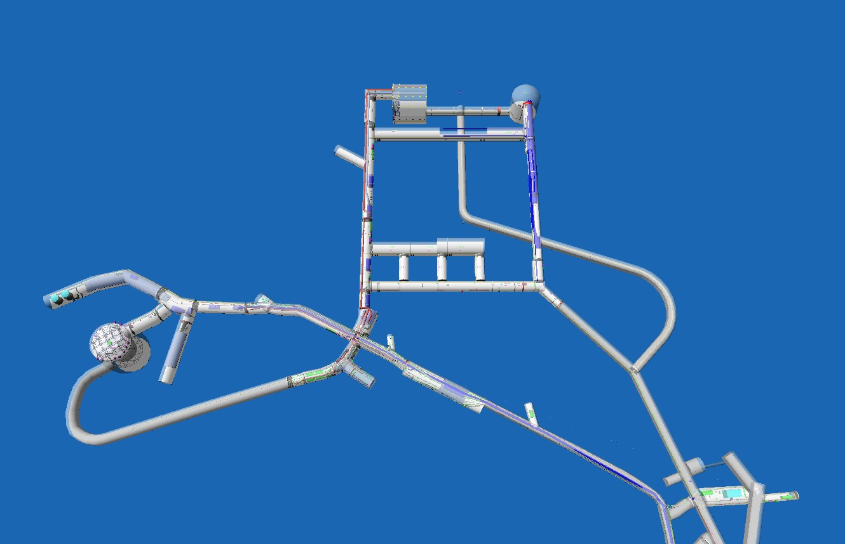
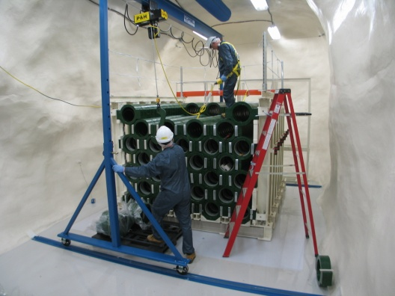
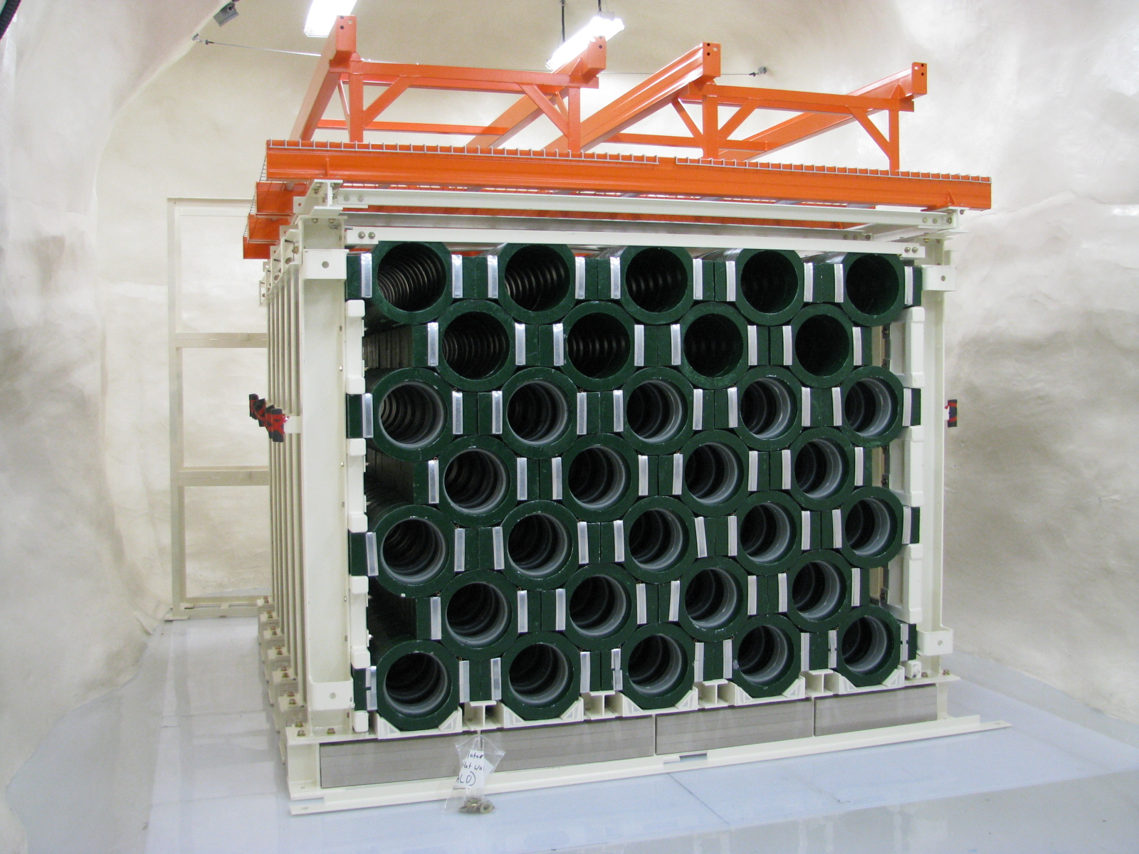
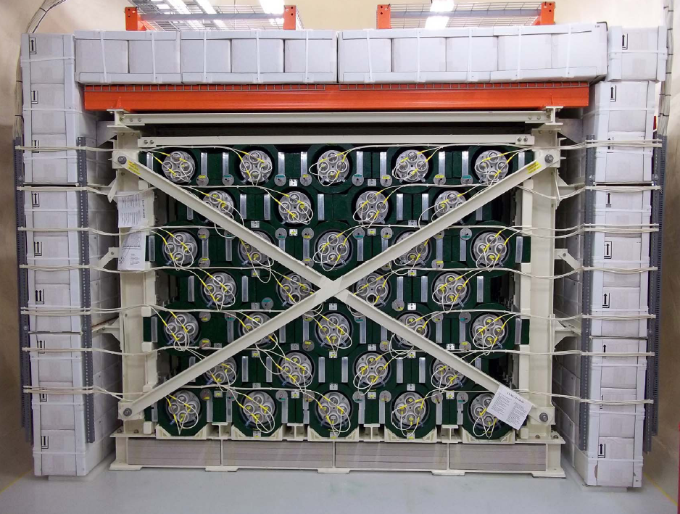
HALO at SNOLAB
SNOLAB 6800’ campus
6000 mwe depth
0.27 µ/m²/day
HALO is a dedicated lead-based supernova detector

Slide 3
HALO at NNN 2012?
HALO is small and existing whereas the theme of NNN 2012 is LARGE and FUTURE
However, HALO has ambitions to be bigger and better…..
Talk Outline
  Preamble, the trouble with supernovae
  Supernovae and the scientific impact
  HALO: sensitivity and rates
  Status
  Future plans

Slide 4
The Trouble with Supernovae
Very frequent in our universe (1 per second)
Current and next generation terrestrial supernova detectors only see supernovae within our galaxy (tiny part of the universe)
So.... The galactic supernova rate is estimated at
3 +/- 1 per century

Slide 5
Worse than that....
For any given supernova detector, but let’s take SNO/SNO+ as a non-representative example, the project cycles are problematic….
    6 years from conception to funding
    8 years to construct (~$70M)
    “Ran” for 8 years (~$4M/year), but
      Was only “on” for 5.5 years of the 8
      Was calibrating for ~25% of those 5.5 years
    Was shutdown in November 2006
    6 years later still isn’t back on....

Slide 6
Which is to say...
While the odds on a galactic SN in your lifetime are pretty good, the chances of seeing it with a detector like SNO are far from guaranteed.
So.... there’s a niche for low cost, low maintenance, long lifetime, dedicated supernova detectors
Also for next generation neutrino detectors costs go up as the energy threshold goes down and there is a risk that supernova sensitivity will be degraded in order to save costs

Slide 7

Supernova neutrinos –
First order expectations
Approximate equipartition of neutrino fluxes
Several characteristic timescales for the phases of the explosion (collapse, burst, accretion, cooling)
Time-evolving ν_{e}, ν_{e}, ν_{”μ”} luminosities reflecting aspects of SN dynamics
  Presence of neutronization pulse
  Hardening of spectra through accretion phase then cooling
Fermi-Dirac thermal energy distributions characterized by a temperature, T_{ν}, and pinching parameter, η_{ν}
Hierarchy and time-evolution of average energies at the neutrinosphere
T(ν_{”μ”} ) > T(ν_{e}) > T(ν_{e} )
ν-ν scattering collective effects and MSW oscillations
See also presentation by Cecilia Lunardini

Slide 8
Put another way...
An observed SN signal potentially has information in its:
The time evolution of the luminosities
The time evolution of the average energies
The values of the pinching parameters
Deviation from the equiparition of fluxes
Modifications of the above due to ν-ν scattering collective effects and MSW oscillations

Slide 9
What is to be learned?
Astrophysics
  Explosion mechanism
  Accretion process
  Black hole formation (cutoff)
  Presence of Spherical accretion shock instabilities (3D effect)
  Proto-neutron star EOS
  Microphysics and neutrino transport (neutrino temperatures and pinch parameters)
  Nucleosynthesis of heavy elements
Particle Physics
  Normal or Inverted neutrino mass hierarchy, θ₁₃
  Presence of axions, exotic physics, or extra large dimensions (cooling rate)
  Etc.

Slide 10
What distinguishes SN neutrinos from others?
Unlike solar, atmospheric, reactor or geo-neutrinos... SN neutrinos are not always there
Unlike accelerator neutrinos we don’t know when they are coming
Unlike appearance or disappearance experiments the “beam” contains all flavours ~ equally
The beam is a primary beam (not tertiary as for atmospheric or accelerator neutrinos) and the energy spectrum has direct physics content
The intensity of the beam has a probable value but could differ by more than 2 orders of magnitude
They have their own characteristic range of energies determined by core collapse physics and SN1987A confirms that we have some understanding of that
Energies are “thermal” described by Fermi-Dirac function modified by a pinching parameter or chemical potential, at least initially, and are imprinted with further physics processes of great interest

Slide 11
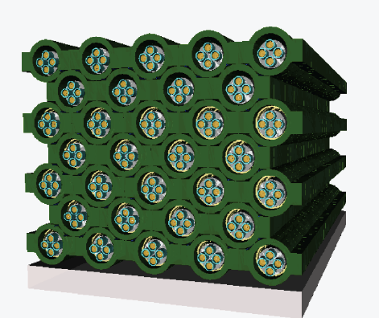
HALO - a Helium and Lead Observatory
A “SN detector of opportunity” / An evolution of
LAND – the Lead Astronomical Neutrino Detector,
C.K. Hargrove et al., Astropart. Phys. 5 183, 1996.
“Helium” – because of the availability of the ³He neutron detectors from the final phase of SNO
+
“Lead” – because of high ν-Pb cross-sections, low n-capture cross-sections, complementary sensitivity to water Cerenkov and liquid scintillator SN detectors
HALO is using lead blocks from a decommissioned cosmic ray monitoring station

Slide 12

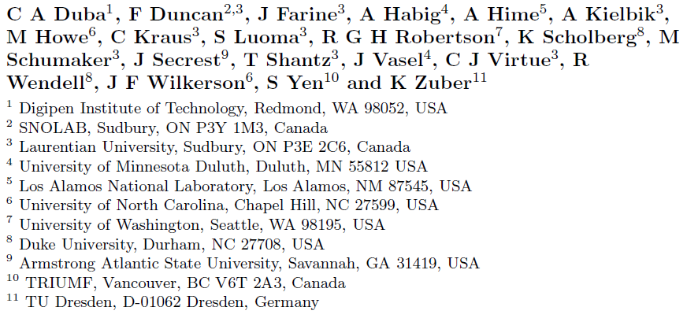



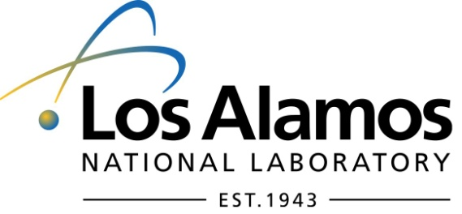



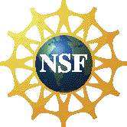

The HALO Collaboration
With assistance this past year from:
  Anne-Mareike Chu – TU Dresden
  Nikki Sanford – Duke University
  Andre-Philippe Olds – Laurentian U.
Funded by:
halo.snolab.ca

Slide 13
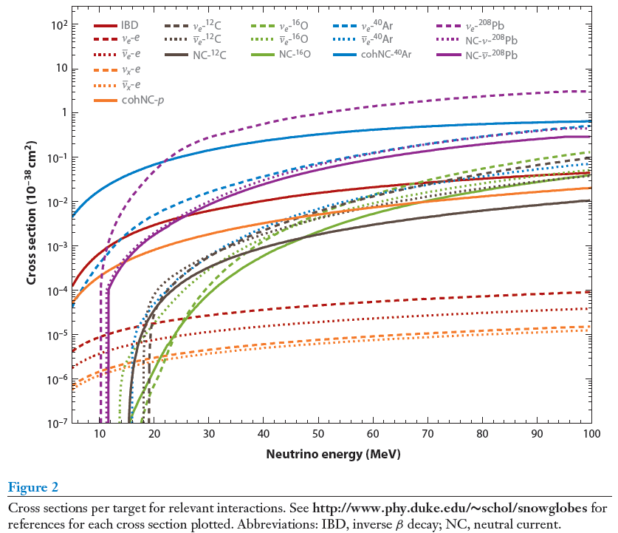
Comparative ν-nuclear cross-sections
Thresholds
NC 1n 7.4 MeV
CC 1n 10.7 MeV
NC 2n 14.4 MeV
CC 2n 18.6 MeV
Kate Scholberg
SNOwGLoBES

Slide 14
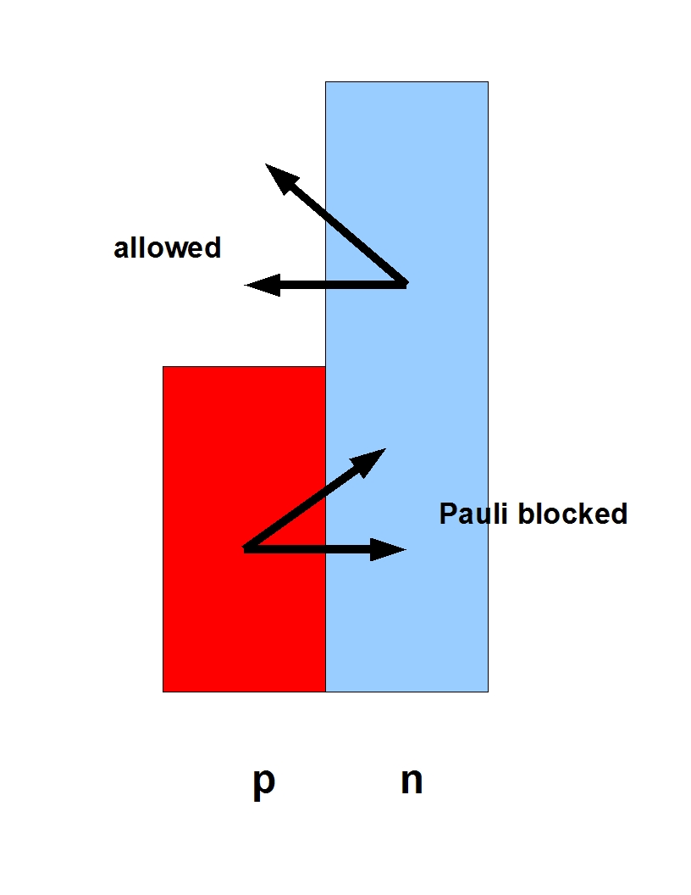

Pb nuclear physics
High Z increases ν_{e} CC cross-sections relative to ν_{e} CC and NC due to Coulomb enhancement.
CC and NC cross-sections are the largest of any reasonable material though thresholds are high
Neutron excess (N > Z) Pauli blocks
further suppressing the ν_{e} CC channel
Results in flavour sensitivity complimentary to water Cerenkov and liquid scintillator detectors
Other Advantages
High Coulomb barrier → no (α, n)
Low neutron absorption cross-section (one of the lowest in the table of the isotopes) → a good medium for moderating neutrons down to epithermal energies

Slide 15
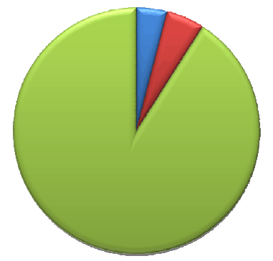
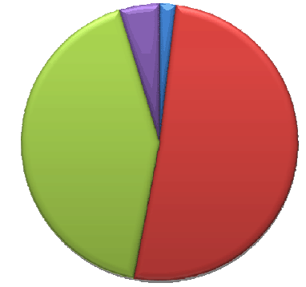
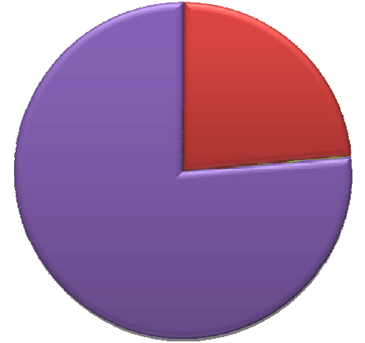
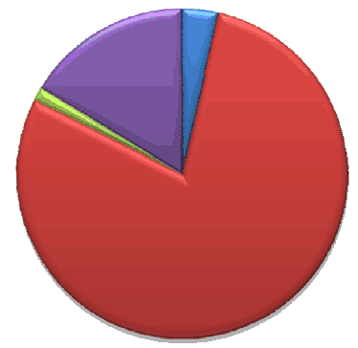
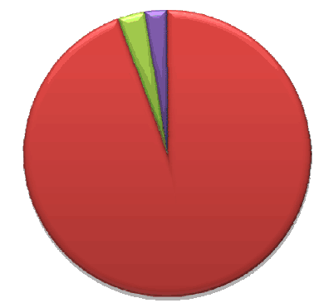
Flavour Sensitivities (subject to neutrino temperatures and thresholds)
ES
Water
Cherenkov
Liquid
Scintillator
ν_{e} CC
NC
ν_{e} CC
NC
ES
ν_{e} CC
ν_{e} CC
Lead
Liquid
Argon
(needs updating
for large θ₁₃)
Iron
NC
NC

Slide 16
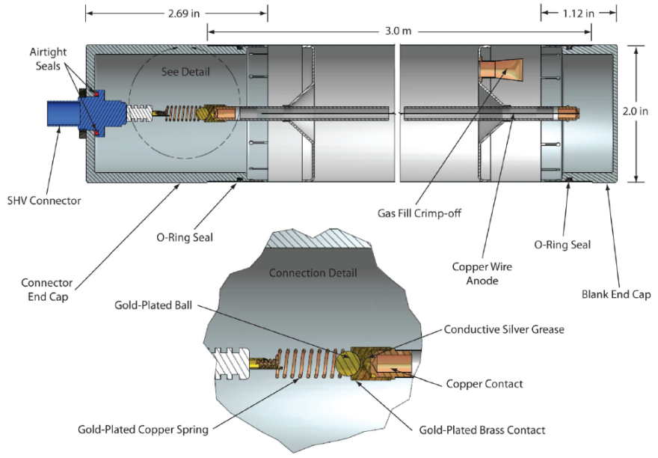
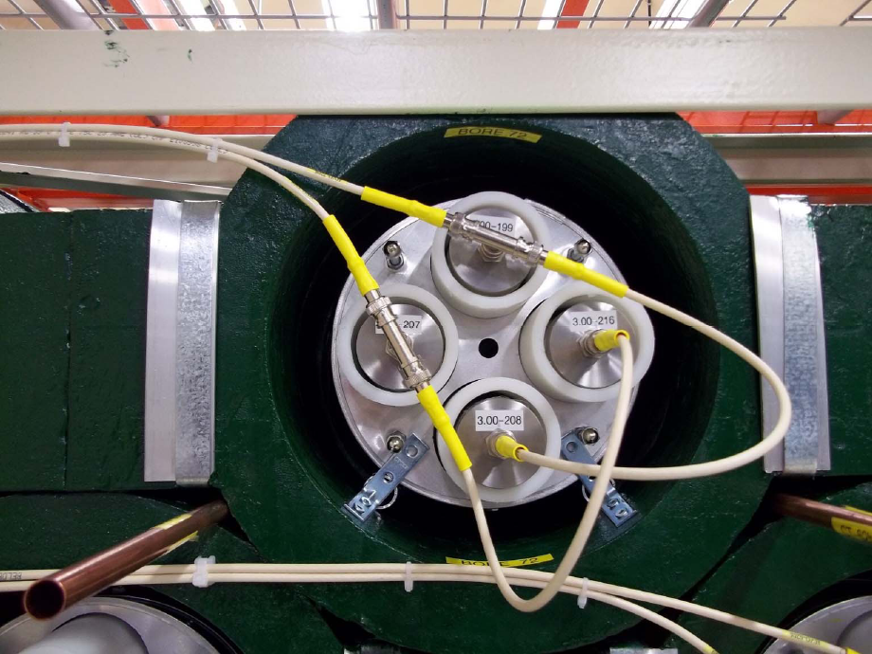
Neutron detection in HALO
Re-using SNO’s “NCD” ³He proportional counters
5 cm diameter x 3m in length, ultra-pure CVD Ni tube (600 micron wall thickness)
2.5 atm (85% ³He, 15% CF₄, by pressure)
Refitted for HALO with new endcaps
Four detectors with HDPE moderator tubes in each of 32 columns of lead rings
Gain matched and paired for 64 channels total of readout

Slide 17
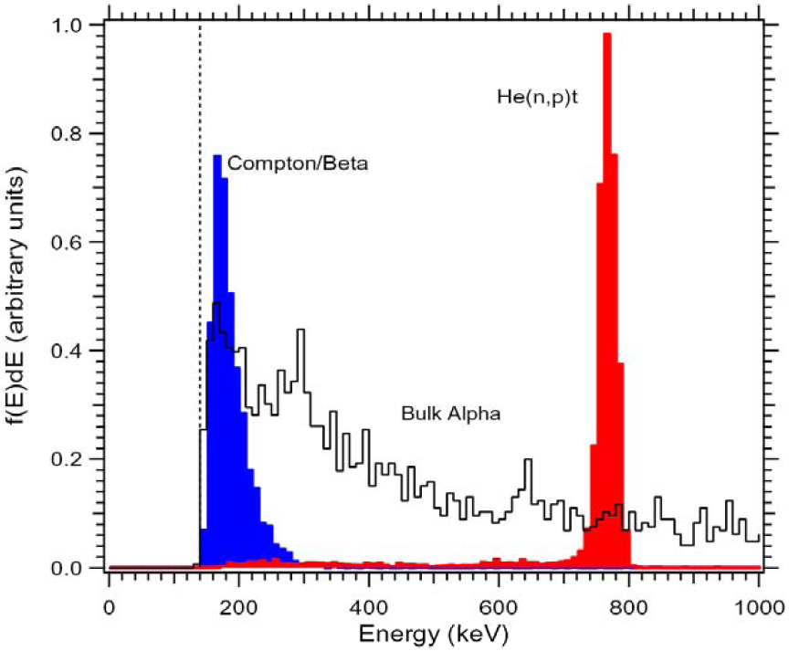
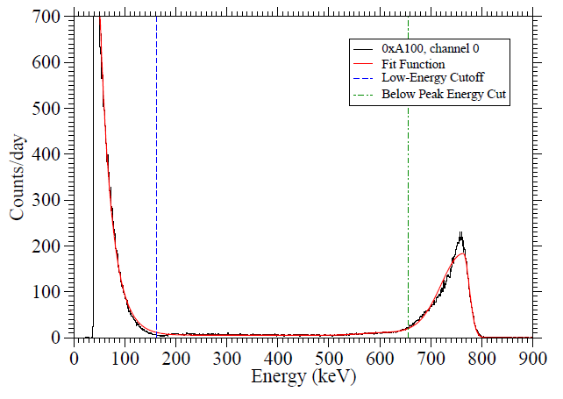
Neutron detection in HALO
Neutron detection via
³He + n → p + t + 764 keV
764 keV FE peak plus LE tail due to wall effects
α’s present at rate of ~20 events per day for the entire array
Compton and beta events at low energies, especially with substantial lead shielding
Background n in room at level of 4000 fast plus 4000 thermal per m² per day.
Cosmic muons < 2 per day
Intrinsic tritium rate (18.6 keV endpoint) above 12 keV threshold ~10 Hz
Current neutron rate in HALO with incomplete shielding ~0.1 Hz

Slide 18
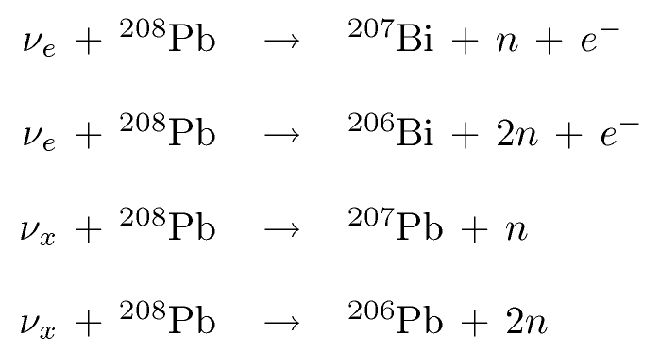
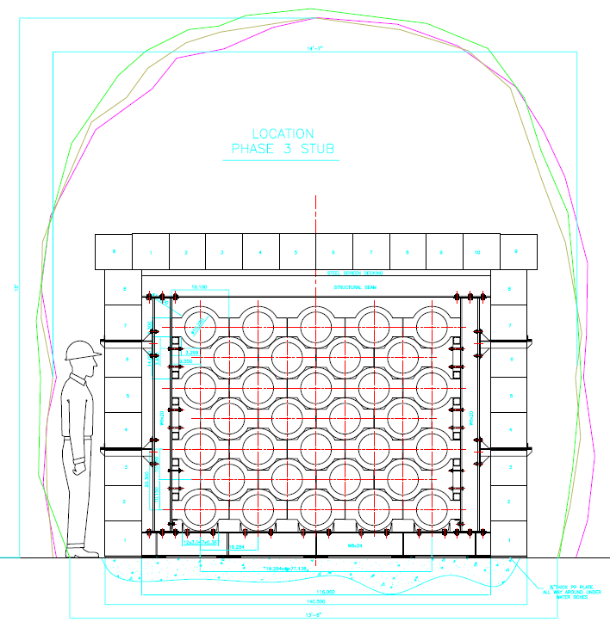
Supernova signal in HALO
CC:
NC:
In 79 tonnes of lead for a SN @ 10kpc†,
    Assuming FD distribution with T=8 MeV for ν_{μ}’s, ν_{τ}’s.
    68 neutrons through ν_{e} charged current channels
      30 single neutrons
      19 double neutrons (38 total)
    20 neutrons through ν_{x} neutral current channels
      8 single neutrons
      6 double neutrons (12 total)
~ 88 neutrons liberated; ie. ~1.1 n/tonne of Pb
†- cross-sections from Engel, McLaughlin, Volpe, Phys. Rev. D 67, 013005 (2003)
For HALO neutron detection efficiencies of 50% have been obtained in MC studies optimizing the detector geometry, the mass and location of neutron moderator, and enveloping the detector in a neutron reflector.

Slide 19
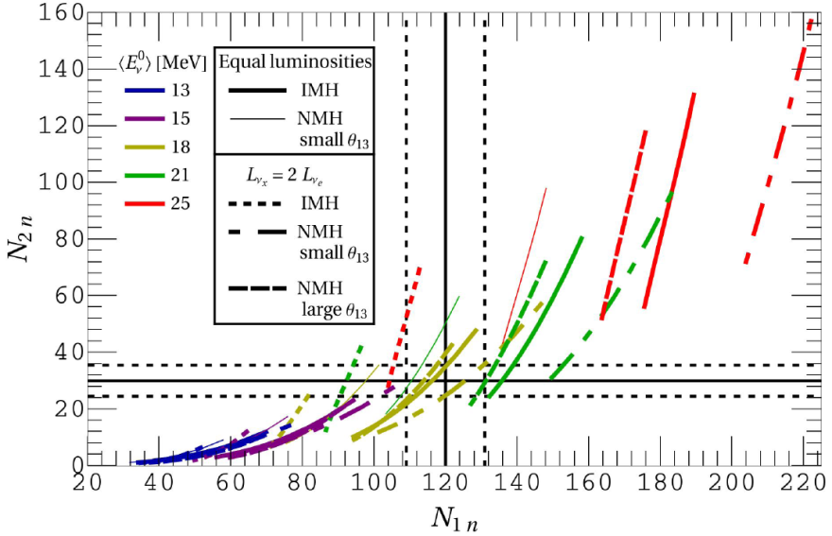
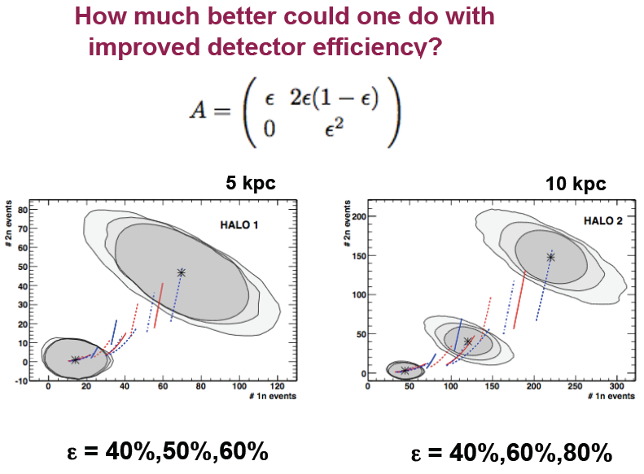
Sensitivity to neutrino energy
Distinct 1n and 2n emission thresholds in lead provide the possibility to measure neutrino temperatures and pinching parameters. N_{1n} and N_{2n} per kT from Vaananen D, Volpe C., J. Cosmol. Astropart. Phys. 1110:019 (2011)
March 2012 APS, K. Scholberg.

Slide 20
Status today
4/5th of shielding in place
Cabling complete
Readout complete
HV on all channels and full detector being read-out since May 8th 2012.
Daily shift-taking since July 27th
Remote control, monitoring and alarm (CMA) capability under active development
Participating in gps time provisioning for SNOLAB
Upgrade of electronics pending
Counter characterization progressing well
Calibration awaits ²⁵²Cf and finalization of characterization

Slide 21

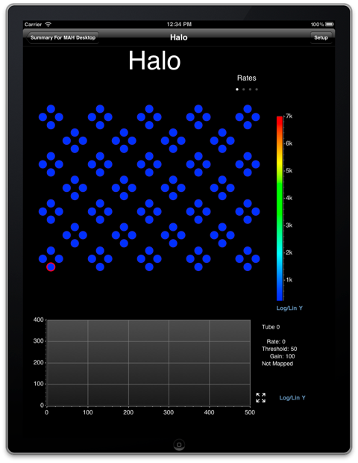
Future Plans
Near-term Plans – completion of HALO
shielding complete shortly
Develop remote CMA
Calibrate n capture efficiency
Participation in SNEWS in 2013
Be astronomically patient
Next steps – ν-Pb cross-section measurement
At SNS at ORNL
Grow collaboration
Future
Development of physics case and detector design for a kT class lead-based detector
Grow collaboration

