Slide 1
Parametric controls and modular quantum computing in superconducting circuits

Slide 2
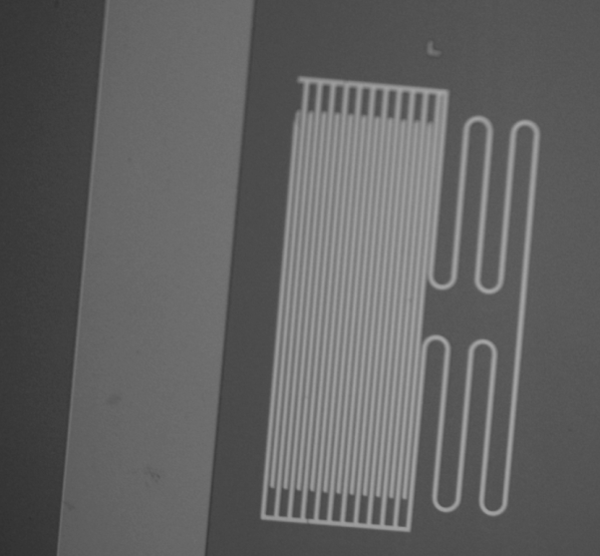
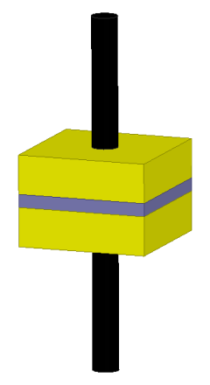
How do we build quantum superconducting circuits?
2D harmonic oscillators
3D harmonic oscillators
Josephson Junction!
S
$$ϕ$$
I
$$L_{J}$$
S
1 mm
$$I$$
$$H_{J}=−E_{J}\cos{(\frac{ϕ }{ϕ_{0}})}$$
Why do we need nonlinearilty
C
L
Natural anharmonicity even order
Huge differences in size (10⁴)
Notes:
We are using the superconducting circuits to make our qubit.
Like traditional circuits superconducting circuits consist of Ls and Cs –finger caps
Youll notice that the hamiltonain of such a system looks remarkably like a typical harmonic oscilaltor with the Kinetic energy and potential energy terms.
This is not a coincidence, as the system behaves almost identically to a HO.
Like traditional, HO,the potential energy is quadratic and features an even energy level spacing.

Slide 3
The transmon qubit
E
$$\left.|f\right\rangle$$
$$L_{J}$$
$$C$$
$$\left.|e\right\rangle$$
$$\left.|g\right\rangle$$
$$ϕ$$
${H/ħ≈ω_{0}a}^{†}a−$ ${\frac{α}{2}a}^{†}a^{†}aa+…$
lowest two levels form a qubit
f_{ge} ~ 3 to 6 GHz, $α$ ~ 160 to 200 MHz
Koch, et al., PRA (2007)

Slide 4
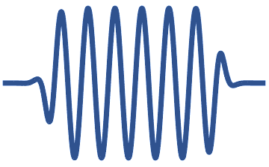
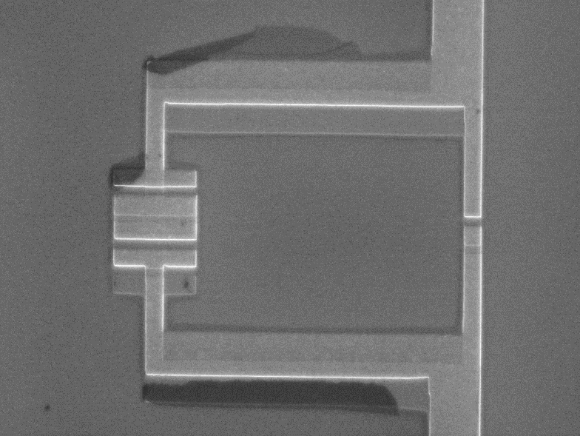
SNAIL mediated Two qubit gates
SNAIL
$${ω_{p}= |ω}_{b}−ω_{a}|$$
$$H_{NL}=ℏg_{3}{\left(a+a^{†}\right)}^{3}$$
$$a$$
$$s$$
$$b$$
$$g≪Δ$$
$$g≪ Δ$$
$${αL}_{J}$$
$$L_{J}$$
$iSWAP$ gate family (conversion)
Drive SNAIL at${|ω}_{b}−ω_{a}|$
$$g_{3}{\left(\frac{g}{Δ}\right)}^{2}\left\langle s\right\rangle \left(ab^{†}+a^{†}b\right)$$
$${αL}_{J}$$
$$L_{J}$$
Pre-factor smaller by ${\left(\frac{g}{Δ}\right)}^{2}$
- Gate rate ~$\left\langle s\right\rangle$
Frattini, et al., APL (2017)
Zhou, et al., arXiv:2109.06848 (2021)

Slide 5
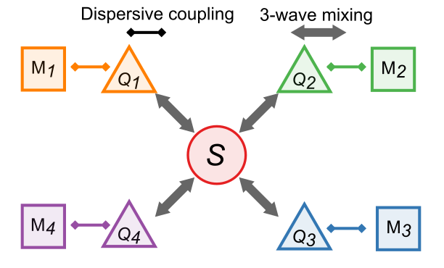
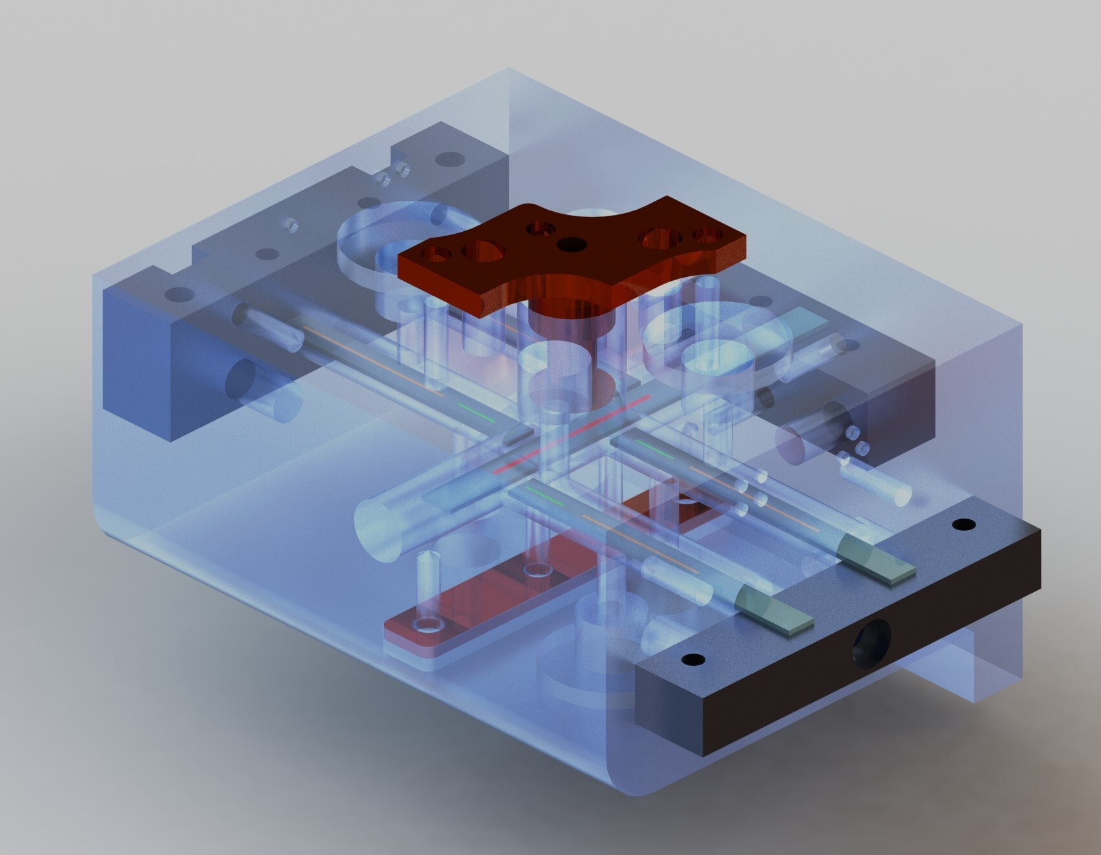
Lets start with a four-transmon machine
All-to-all $iSWAP^{n}$
Rendering of Device
Magnet
SNAIL
Q+C (x4)
1cm
+ Single-qubit gates
+ Qubit-specific readout

Slide 6
Module frequency stack
Magnet
SNAIL
Q+C
1cm
Pump port
Subharmonic single-qubit gate
Parametric two-qubit gate
Modes are protected
Low pass filter (2.8 GHz)
Frequency

Slide 7
Where QICK comes in
6 parametric tones below 2.5 GHz
4 qubit tones either below 2.5 or 3.5-5.5 GHz
4 cavity tones 6 – 7.5 GHz
Hardware $$ with mixers/gens/AWGs
Phase stability critical!!
Implement ZCU 216 + QICK
Subharmonic single-qubit gate
Chao Zhou
Parametric two-qubit gate
Modes are protected
Low pass filter (2.8 GHz)
Frequency

Slide 8
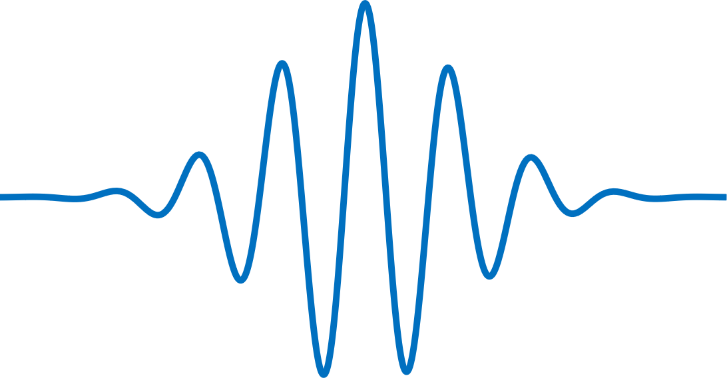
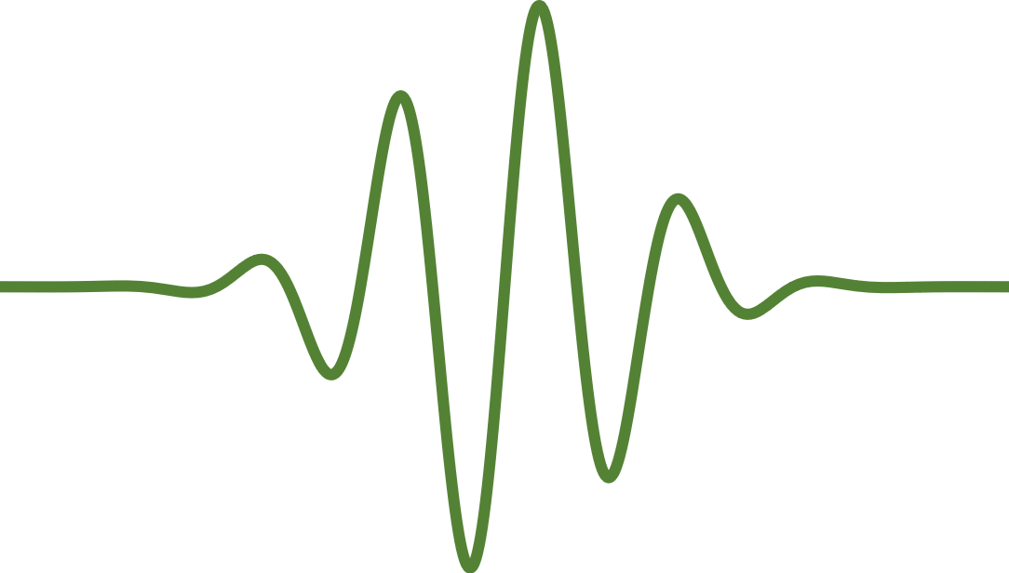
Parametric $iSWAP$ with generators/persistent oscillators
$$φ_{a}^{d}=ω_{a}t_{n}+η_{a}$$
$$\left|ψ_{a}\right\rangle =\frac{1}{\sqrt{2}}\left(\left|0\right\rangle +e^{−iφ_{a}^{d}}\left|1\right\rangle \right)$$
$Q_{a}$ Drive
$$ω_{a}$$
$$φ_{p}=ω_{p}(t_{n}+τ_{1})+η_{p}$$
$$Q_{B}$$
$$S$$
$$τ_{1}$$
SNAIL pump
$$ω_{p}=ω_{b}−ω_{a}+δ$$
$$φ_{b}^{d}=ω_{b}\left(t_{n}+τ_{2}\right)+η_{b}$$
$$τ_{2}$$
$Q_{b}$ Tomography
$$Q_{a}$$
$$ω_{b}$$
$$\left|ψ_{b}\right\rangle =\frac{\left|0\right\rangle +i e^{i\left({−φ}_{a}+φ_{2}−φ_{p}\right)}\left|1\right\rangle }{\sqrt{2}}$$
$$z$$
$n^{th}$repetition starts at $t=t_{n}$
Final $\left\langle Z_{b}\right\rangle =−\cos{({−φ}_{a}+φ_{2}−φ_{p}+φ_{b}^{d})}=−\cos\left(δt_{n}+φ_{2}+η_{d}\right)$
$η_{d}=η_{b}−η_{a}−η_{b}−ω_{p}τ_{1}+ω_{b}τ_{2}$ can be fully controlled with electronics
*$η_{a,p,b}$are phases we can control with AWG
$δt_{n}$changes from run to run!!
Notes:
Here we only focus on the parametrically pumped devices (there are many other schemes e.g. flux tuning, cross resonance). But that’s not very related to what we discuses here.
Before we have the SNAIL, most of this kind of devices are based on pumping the 4th order term. We also have devices like the JPC, which effectively uses 3rd term, but that’s based on some special rediagonalized circuit modes, which is hard to be directly coupled to the E filed from other modes in the space.
However, using 4th order term will introduce many problems for example ZZ interaction due to cross-Kerr term. So some groups prefer to use devices with 3rd order terms for parametric coupling. One of the most popular choice is the SNAIL invented at Prof. Devoret’s lab.
3rd order coupling, or 3-wave-mixing terms can be used for both conversion or amplification. For example, if you have two modes a and b….
In the end, the effective coefficient for the two-body exchange interaction is . This coefficient basically represents how fast we can perform a iSWAP gate between the two coupled modes.
To increase the gate speed.

Slide 9
Detecting this problem: vary input states and repeated $iSWAP$s
$$Q_{B}$$
$$S$$
Example case 1:
$$U_{iSWAP}\left|1\right\rangle ⨂\left|0\right\rangle =\left(\begin{matrix}1 & 0 & 0 & 0 \\ 0 & 0 & ie^{−i φ_{p}} & 0 \\ 0 & ie^{i φ_{p}} & 0 & 0 \\ 0 & 0 & 0 & 1\end{matrix}\right)∗\left(\begin{aligned}0 \\ 0 \\ 1 \\ 0\end{aligned}\right)=e^{i\left(φ_{p}\right)}\text{|}\text{1}\text{⟩}$$
$$Q_{a}$$
Global, non-observable phase
Example case 2:
$$U_{iSWAP} \left(\frac{\left|0\right\rangle +e^{i φ_{a}}\left|1\right\rangle }{\sqrt{2}}\right)⨂\left|0\right\rangle =\left|0\right\rangle ⨂\left(\frac{\left|0\right\rangle +i e^{i\left(φ_{a}+φ_{p}\right)}\left|1\right\rangle }{\sqrt{2}}\right)$$
$Q_{b}$will appear to completely lose coherence if $φ_{p}$ is different from run to run!
Example case 3:
Pump phase $φ_{p}$ is canceled upon return to $Q_{a}$
$$U_{iSWAP} U_{iSWAP} \left(\frac{\left|0\right\rangle +e^{i φ_{a}}\left|1\right\rangle }{\sqrt{2}}\right)⨂\left|0\right\rangle =\left(−\frac{\left|0\right\rangle +e^{i(φ_{a})}\left|1\right\rangle }{\sqrt{2}}\right)⨂\left|0\right\rangle$$
Zhou and Lu, et al. arXiv preprint arXiv:2109.06848 (2021).
Notes:
Here we only focus on the parametrically pumped devices (there are many other schemes e.g. flux tuning, cross resonance). But that’s not very related to what we discuses here.
Before we have the SNAIL, most of this kind of devices are based on pumping the 4th order term. We also have devices like the JPC, which effectively uses 3rd term, but that’s based on some special rediagonalized circuit modes, which is hard to be directly coupled to the E filed from other modes in the space.
However, using 4th order term will introduce many problems for example ZZ interaction due to cross-Kerr term. So some groups prefer to use devices with 3rd order terms for parametric coupling. One of the most popular choice is the SNAIL invented at Prof. Devoret’s lab.
3rd order coupling, or 3-wave-mixing terms can be used for both conversion or amplification. For example, if you have two modes a and b….
In the end, the effective coefficient for the two-body exchange interaction is . This coefficient basically represents how fast we can perform a iSWAP gate between the two coupled modes.
To increase the gate speed.

Slide 10
Control phase coherence with different electronic setups
-- direct digital synthesis (DDS) with high frequency AWGs
$$φ_{a}^{d}=η_{a}$$
$$ω_{a}$$
DDS
$$φ_{p}=ω_{p}{ τ}_{1}+η_{p}$$
$$Q_{B}$$
$$S$$
$$ω_{p}$$
$$τ_{1}$$
DDS
$$φ_{b}^{d}=ω_{b}τ_{2}+η_{b}$$
$$ω_{b}$$
$$τ_{2}$$
$$Q_{a}$$
DDS
$$z$$
$n^{th}$repetition starts at $t=t_{n}$
Final $\left\langle Z_{b}\right\rangle =−\cos{({−φ}_{a}+φ_{2}−φ_{p}+φ_{b}^{d})}=−\cos\left(φ_{2}+η_{d}\right)$
$η_{d}=η_{b}−η_{a}−η_{b}−ω_{p}τ_{1}+ω_{b}τ_{2}$ can be fully controlled with electronics
reset AWG phases
If reset on: both the logic and the physical circuit are greatly simplified!
If reset is disabled: acts like ‘virtual’ generator including flaws
https://github.com/openquantumhardware/qick
Stefanazzi, Leandro, et al. Review of Scientific Instruments 93.4 (2022): 044709.
Just like how you would like to write the math.
The original FW didn’t do the reset.
I showed this to qick people and they build this.
Notes:
Here we only focus on the parametrically pumped devices (there are many other schemes e.g. flux tuning, cross resonance). But that’s not very related to what we discuses here.
Before we have the SNAIL, most of this kind of devices are based on pumping the 4th order term. We also have devices like the JPC, which effectively uses 3rd term, but that’s based on some special rediagonalized circuit modes, which is hard to be directly coupled to the E filed from other modes in the space.
However, using 4th order term will introduce many problems for example ZZ interaction due to cross-Kerr term. So some groups prefer to use devices with 3rd order terms for parametric coupling. One of the most popular choice is the SNAIL invented at Prof. Devoret’s lab.
3rd order coupling, or 3-wave-mixing terms can be used for both conversion or amplification. For example, if you have two modes a and b….
In the end, the effective coefficient for the two-body exchange interaction is . This coefficient basically represents how fast we can perform a iSWAP gate between the two coupled modes.
To increase the gate speed.

Slide 11
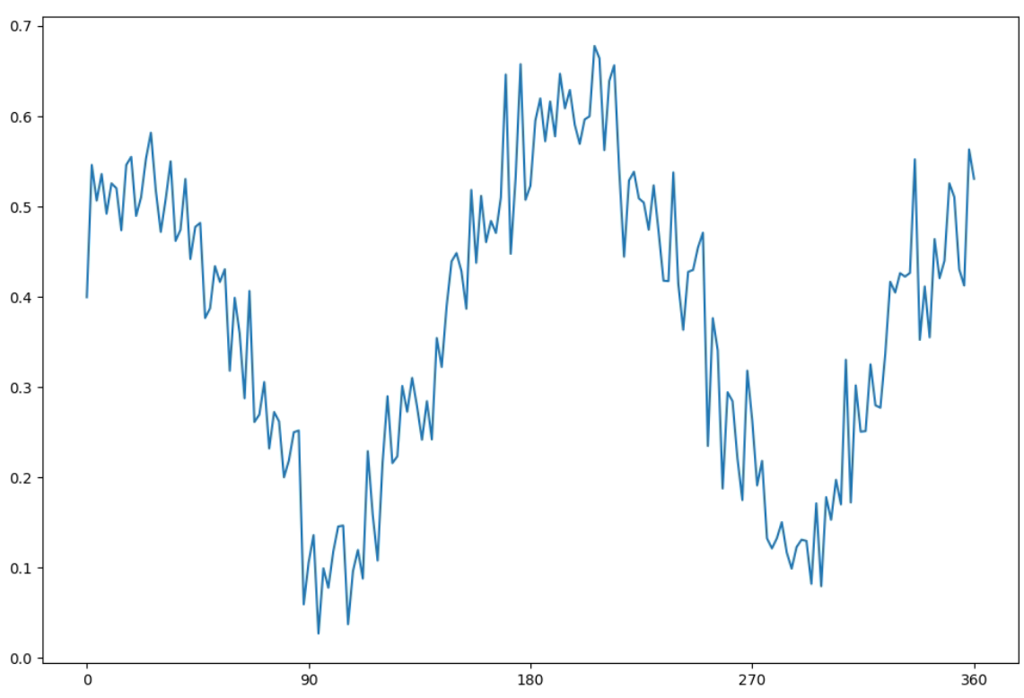
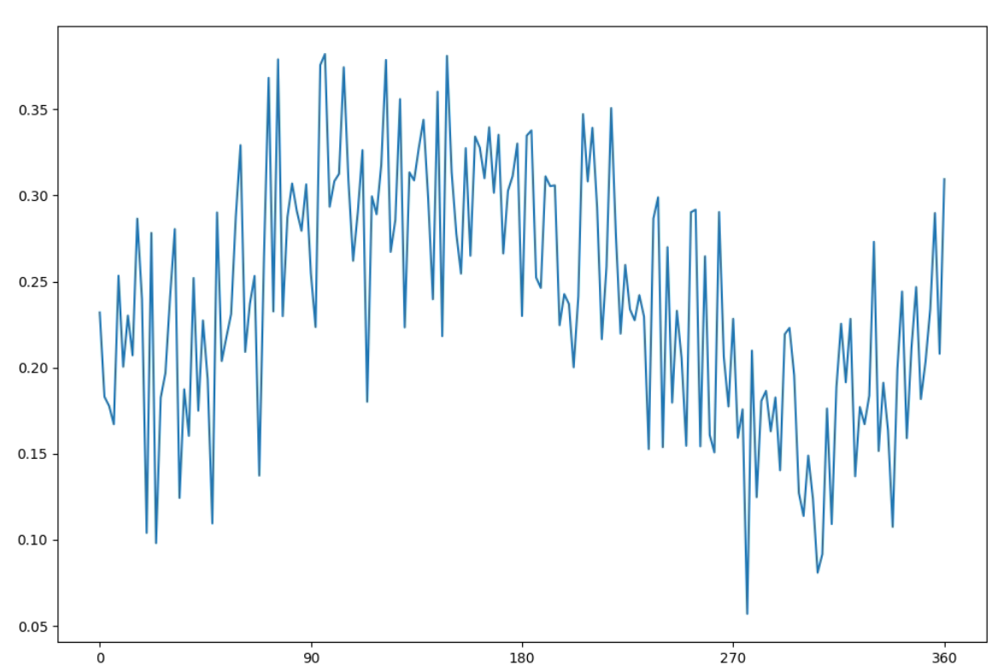
Example data for phase coherent VS non-phase coherent setup
prepare
tomo
Qubit Drive DDS
$$Q$$
$$z$$
Conversion pump DDS
$$S$$
Gain pump DDS
Reset phase at the beginning of each run
No phase reset
0.6
0.3
0.4
$$\sqrt{{\left\langle X\right\rangle }^{2}+{\left\langle Y\right\rangle }^{2}}$$
$$\sqrt{{\left\langle X\right\rangle }^{2}+{\left\langle Y\right\rangle }^{2}}$$
0.2
0.2
0.1
0.0
0
90
180
270
360
0
90
180
270
360
Prepare phase
Prepare phase
Say this is fast drift
Notes:
Here we only focus on the parametrically pumped devices (there are many other schemes e.g. flux tuning, cross resonance). But that’s not very related to what we discuses here.
Before we have the SNAIL, most of this kind of devices are based on pumping the 4th order term. We also have devices like the JPC, which effectively uses 3rd term, but that’s based on some special rediagonalized circuit modes, which is hard to be directly coupled to the E filed from other modes in the space.
However, using 4th order term will introduce many problems for example ZZ interaction due to cross-Kerr term. So some groups prefer to use devices with 3rd order terms for parametric coupling. One of the most popular choice is the SNAIL invented at Prof. Devoret’s lab.
3rd order coupling, or 3-wave-mixing terms can be used for both conversion or amplification. For example, if you have two modes a and b….
In the end, the effective coefficient for the two-body exchange interaction is . This coefficient basically represents how fast we can perform a iSWAP gate between the two coupled modes.
To increase the gate speed.

Slide 12
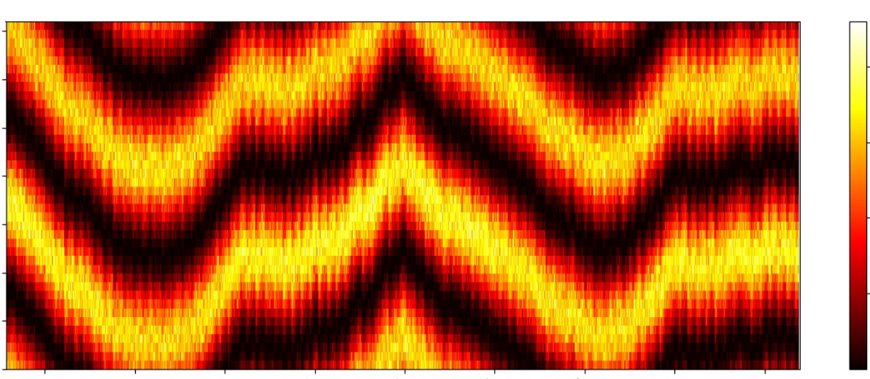
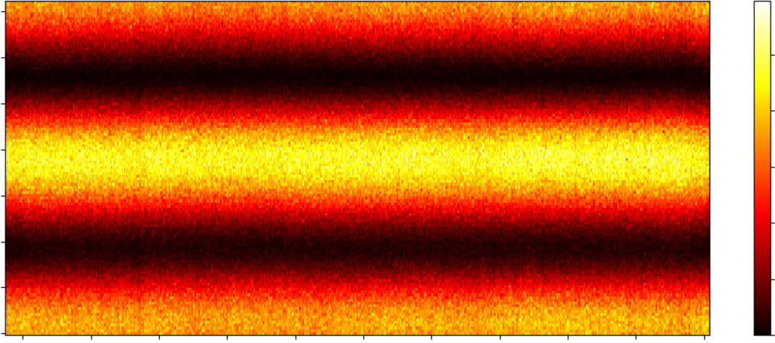
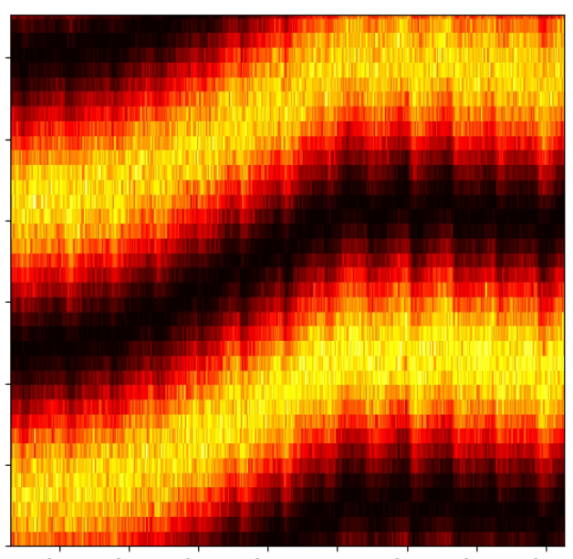
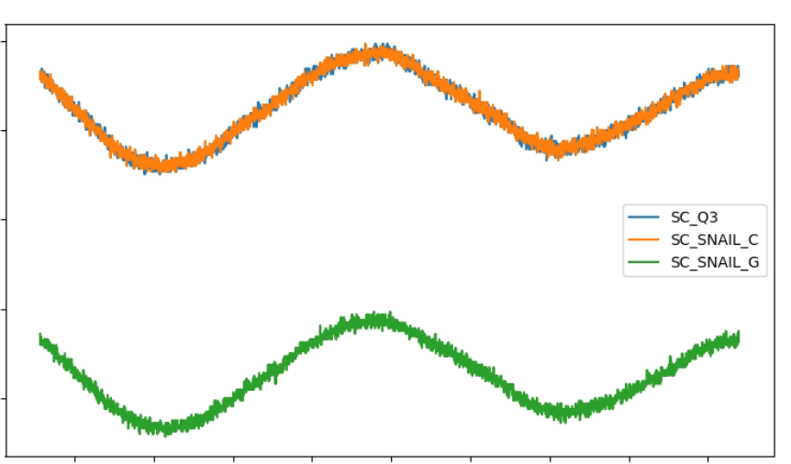
Example data of long-timescale phase drift from different setups
Signal Core SC5511A $⨂$ Keysight M3202A
RFSoC ZCU216 DDS (controlled with QICK*)
360
360
Prepare phase
Prepare phase
$${\left\langle X\right\rangle }^{2}+{\left\langle Y\right\rangle }^{2}$$
$${\left\langle X\right\rangle }^{2}+{\left\langle Y\right\rangle }^{2}$$
0
0
Hours
10
0
360
0
Hours
10
Signal Core temperature change
60
Prepare phase
Reset in DDS eliminates ‘history’ of phase in virtual generators
Important that DDS implementation not inherit flaws from previous hardware
Can now do long experiments, detailed data, no recalibration (as long as the quantum device itself is stable)!
Temperature (°C)
0
6min
55
Hours
10
0
Slow (~ mins) drift due to the PLL imperfection of Signal Cores
Slower drift (~ hours) due to temperature changing.
* https://github.com/openquantumhardware/qick
Stefanazzi, Leandro, et al. Review of Scientific Instruments 93.4 (2022): 044709.
Notes:
Here we only focus on the parametrically pumped devices (there are many other schemes e.g. flux tuning, cross resonance). But that’s not very related to what we discuses here.
Before we have the SNAIL, most of this kind of devices are based on pumping the 4th order term. We also have devices like the JPC, which effectively uses 3rd term, but that’s based on some special rediagonalized circuit modes, which is hard to be directly coupled to the E filed from other modes in the space.
However, using 4th order term will introduce many problems for example ZZ interaction due to cross-Kerr term. So some groups prefer to use devices with 3rd order terms for parametric coupling. One of the most popular choice is the SNAIL invented at Prof. Devoret’s lab.
3rd order coupling, or 3-wave-mixing terms can be used for both conversion or amplification. For example, if you have two modes a and b….
In the end, the effective coefficient for the two-body exchange interaction is . This coefficient basically represents how fast we can perform a iSWAP gate between the two coupled modes.
To increase the gate speed.

Slide 13
Thank you!
Notes:
Today I have shown you how we can build a micromaser using a superconducting microwave components and applying parametric drives. Next we will drive the masing process to create a coherent photon population in our maser cavity.

Slide 14
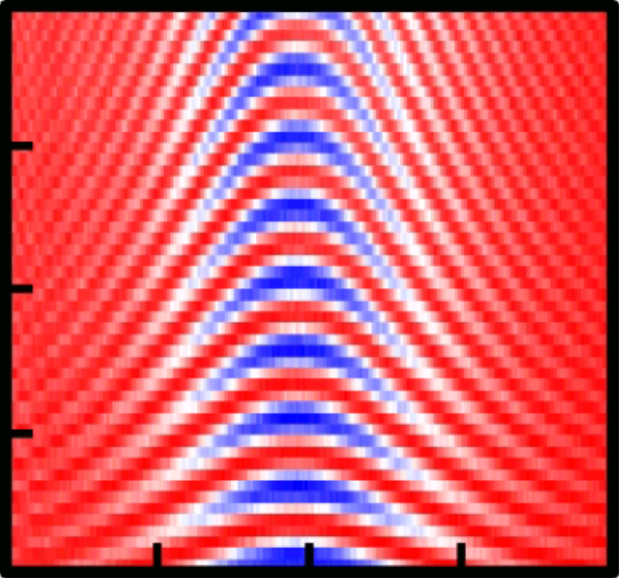
Another option: subharmonic drive
$$τ_{ge}=80 μs$$
$$τ_{eg}=17 μs$$
$${ω_{p}=ω}_{a}/2$$
$$a$$
$$s$$
$$g≪Δ$$
$$τ_{ef}=35 μs$$
$π$ pulse: 12.1 ns
200
$$\frac{H_{int}}{ℏ}≅g_{3}{\left(s+\frac{g}{Δ}a+s^{†}+\frac{g}{Δ}a^{†}\right)}^{3}$$
0
1
150
Pulse length (ns)
Prob. $|\left.g\right\rangle$
Qubit subharmonic gate
100
3rd order variant
$$\sim g_{3}\frac{g}{Δ}{\left\langle s\right\rangle }^{2}\left(a+a^{†}\right)$$
-20.0
0
20.0
Detuning from $ω_{ge}/2$ (MHz)
- Drive SNAIL at $ω_{a}/2$ to give single-qubit Rabi
- Rabi rate ~ ${\left\langle s\right\rangle }^{2}$ (normal is linear in drive)

Slide 15
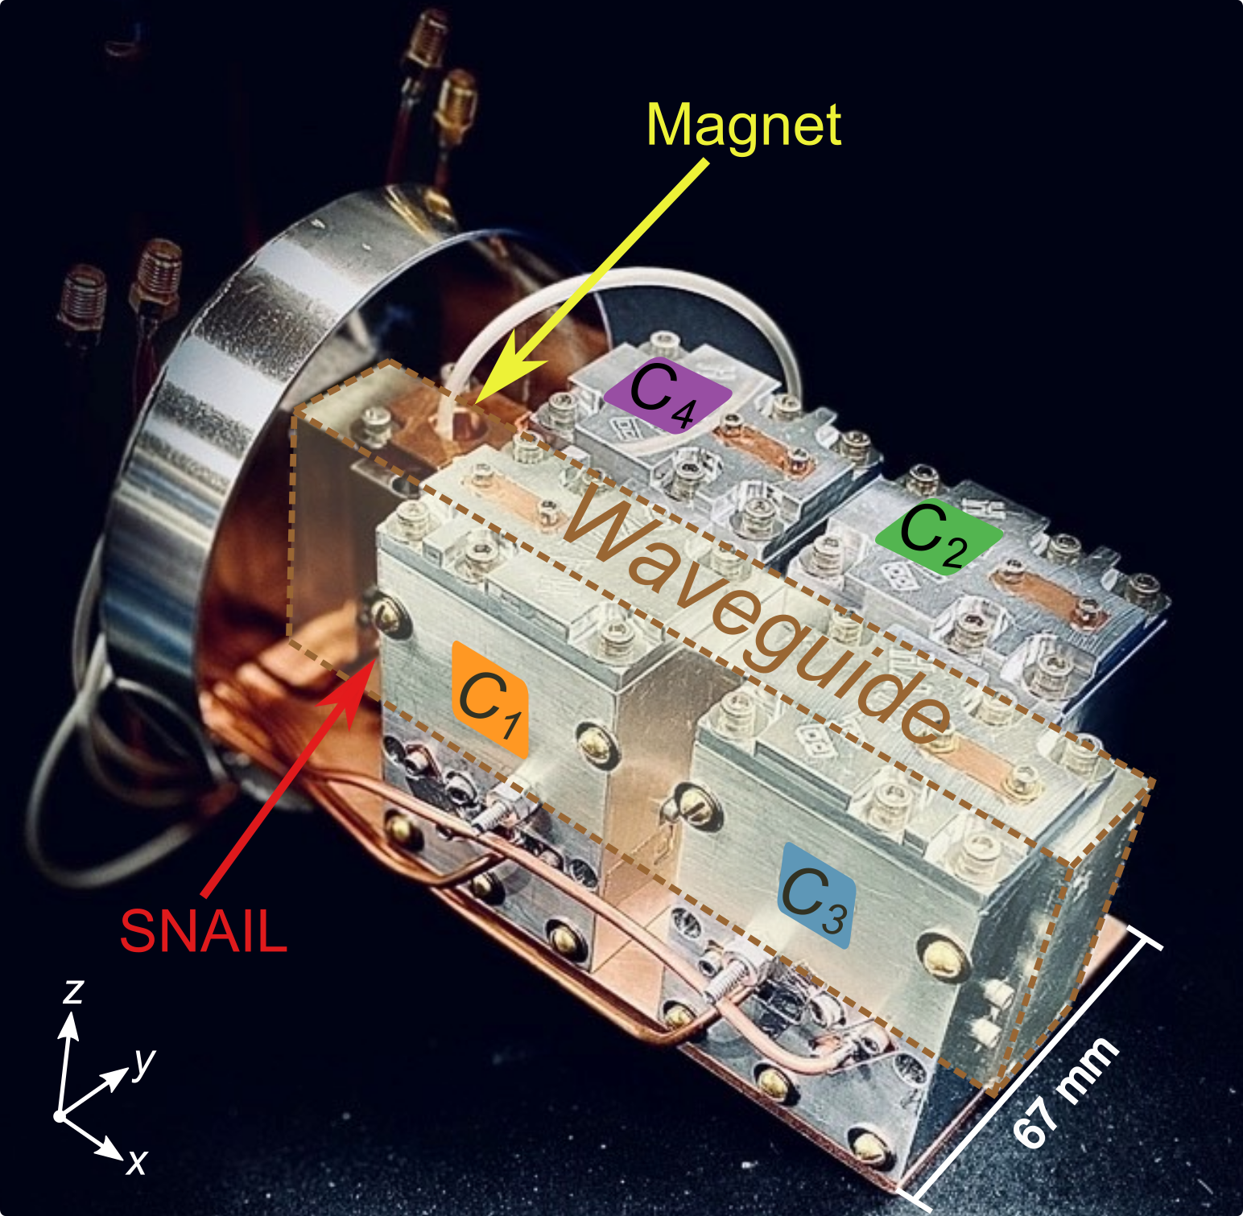
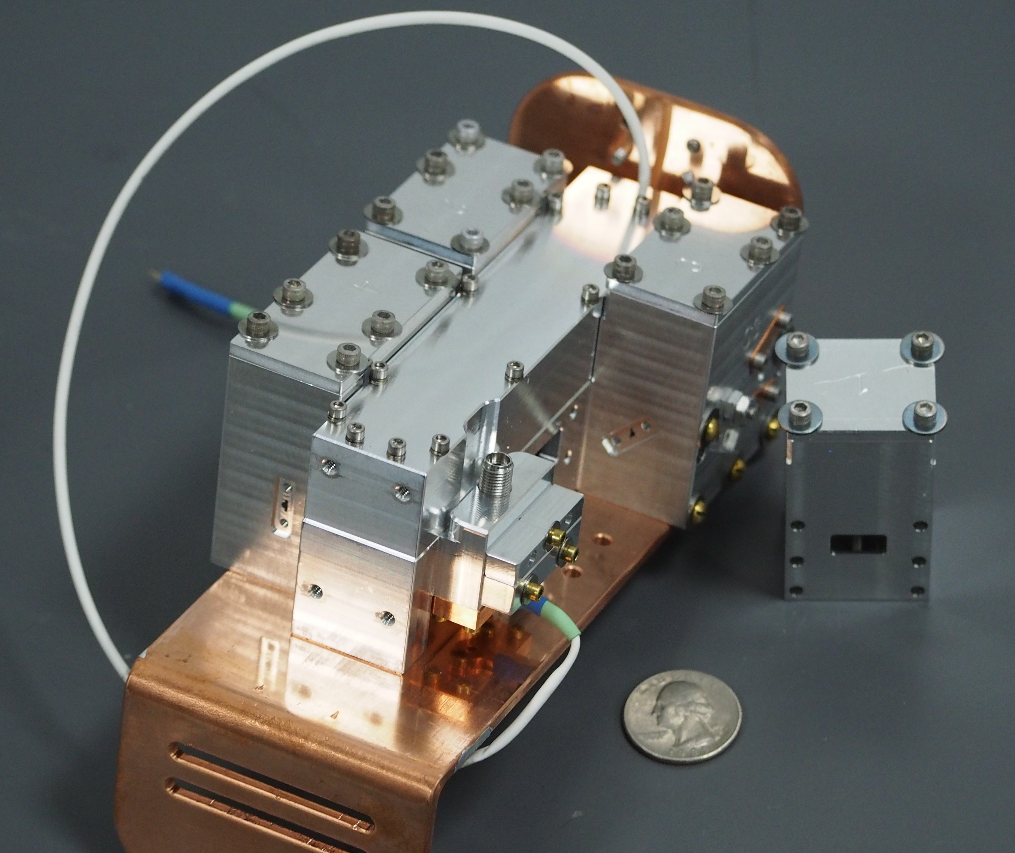
Ongoing work on modular quantum computing
Modular ‘Tree’
Router
Q2
C2
C4
Modules
Q4
The ‘Corral’
Polished, flat seams
Thermalizing attenuators
Eccosorb foam
Thermal anchoring
SNAIL in seamless tube
Mode lifetimes → 100s of $μs$
Qubits: few → ~100 $μs$ T₁
Qubits
SNAILs
McKinney, et al., arXiv:2205.04387 (2022)

