Slide 1
QICK + Schusterlab
Andrew Oriani, Srivatsan Chakram, Kevin He, Tanay Roy, Ankur Agrawal, David I Schuster James Franck Institute, University of Chicago

Slide 2
Outline
Current usage of QICK in schusterlab
Future plans and thoughts on path forward

Slide 3
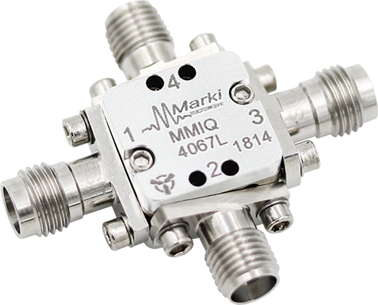
Digital vs Analog signal synthesis
Used to think about local oscillators and mixing of specific frequencies in limited bandwidths combined for control
Now can think in V(t) or for efficiency digital versions of the analog processes that behave ideally.
Even for things we could do before QICK has changed the way we think!

Slide 4
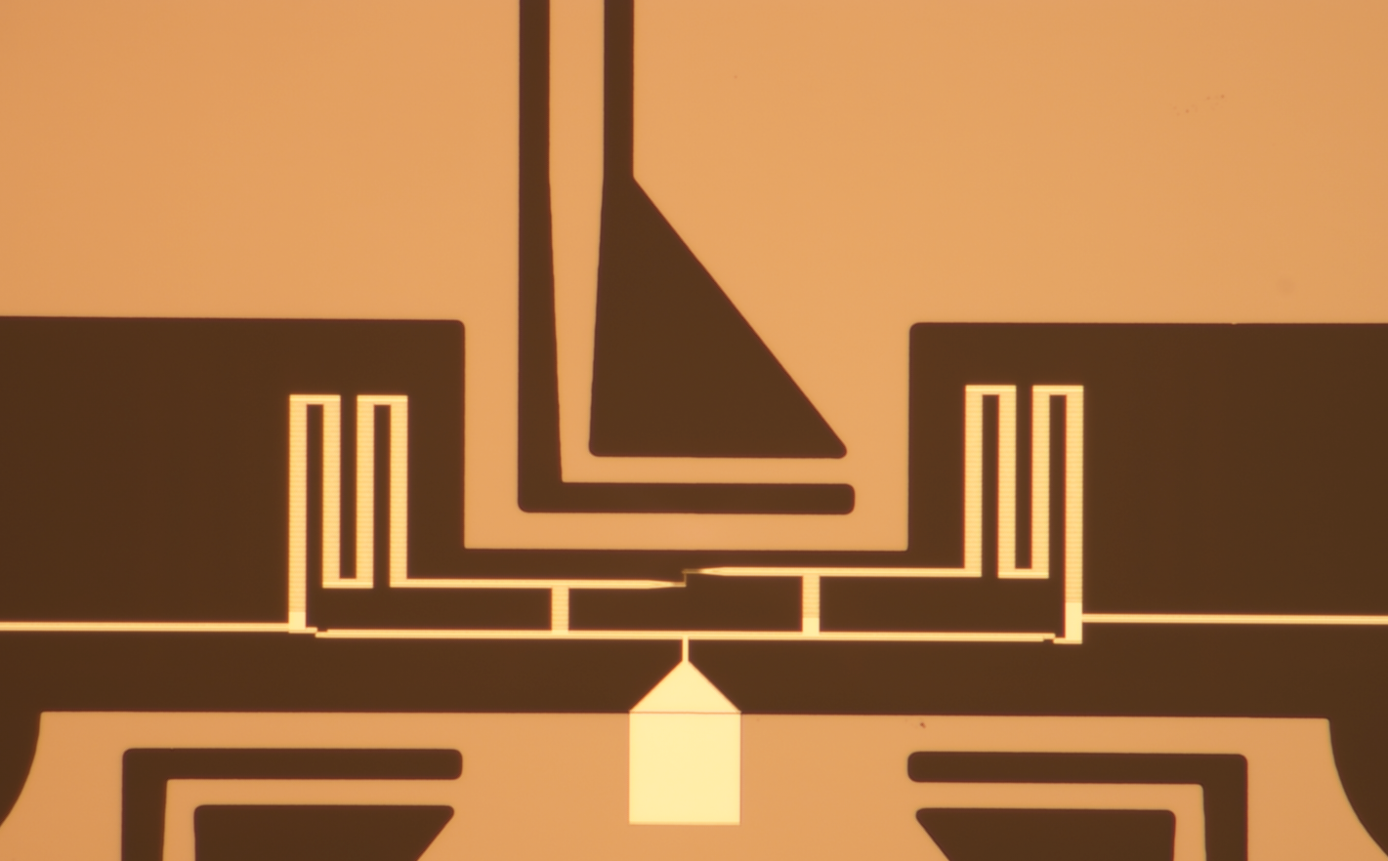
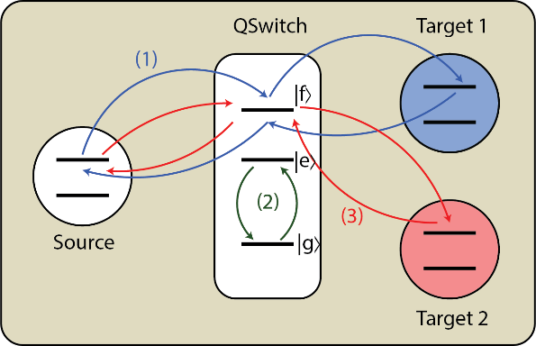
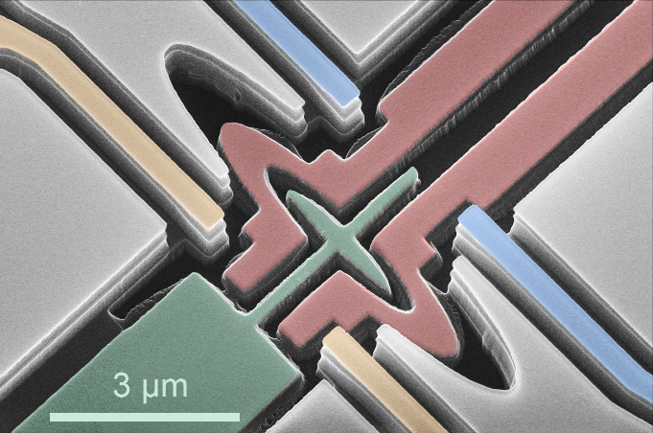
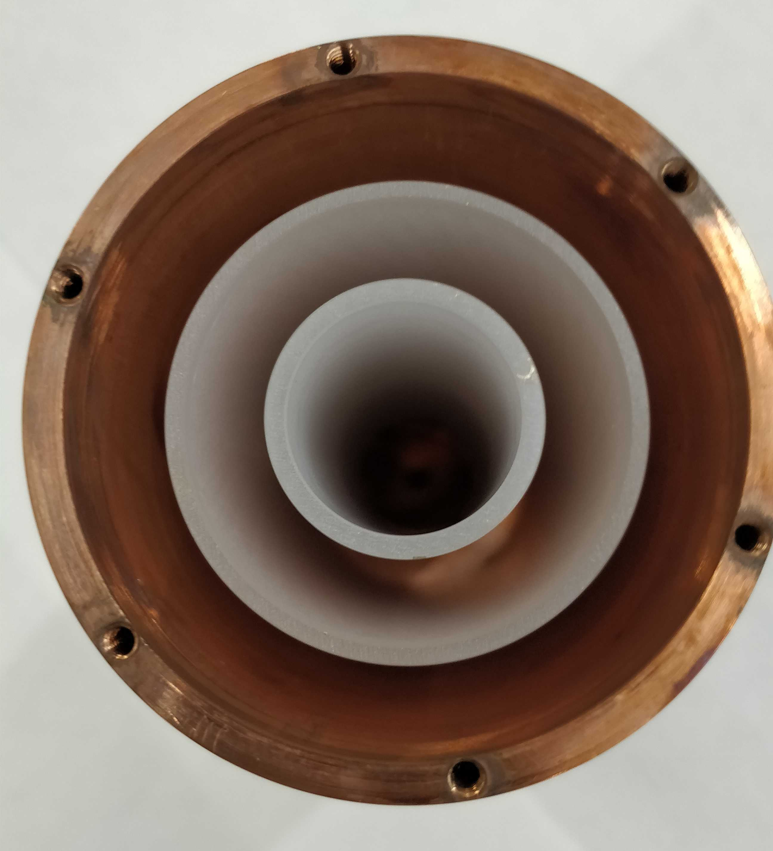
Schusterlab projects using QICK
Fluxonium gates (ZCU111)
Quantum Ram (ZCU216)
Electrons on helium (4x2)
Axion search (ZCU216)
Single qubit characterization (ZCU111)

Slide 5
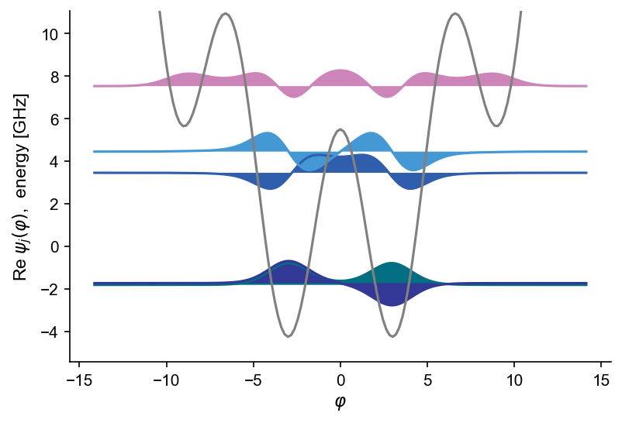
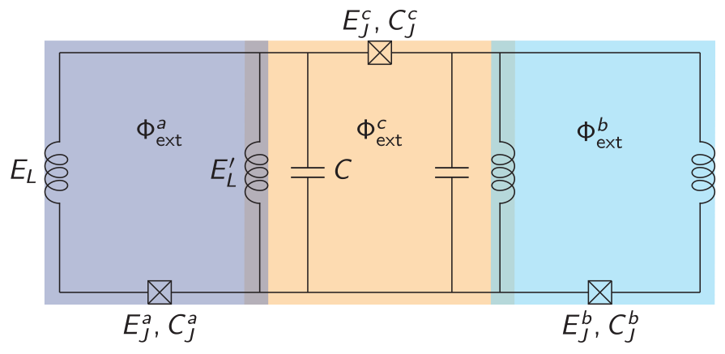
Fluxonium gate experiment
At $Φ_{ext}=0.5Φ_{0}$
E12 – 5.20 GHz
E01 – 50 MHz
Two qubit fluxonium sample with inductive coupler
Three flux drives
Two readouts
All control via QICK

Slide 6
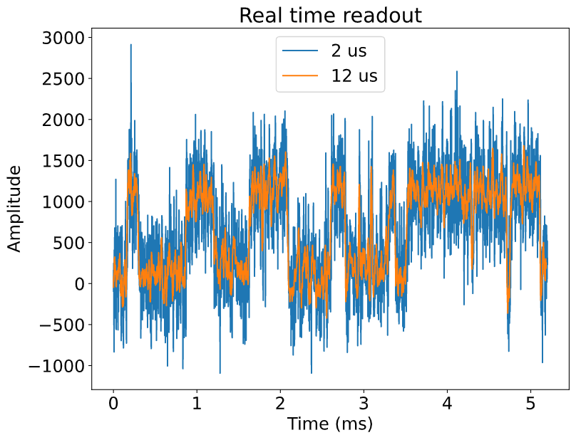
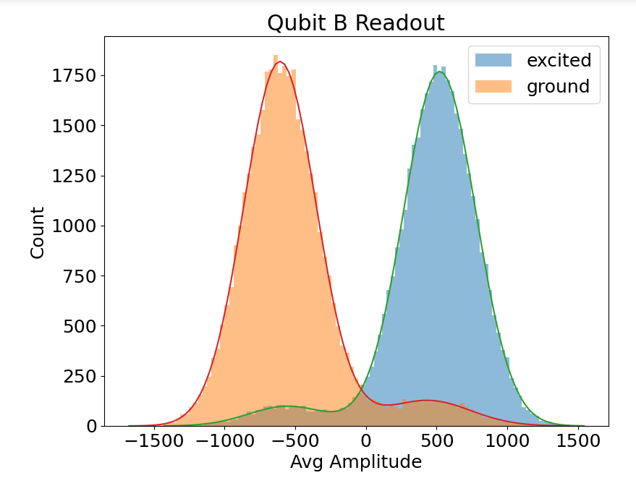
Real time readout
Better readout design results in high fidelity readout
Paramp would speed up (and improve) measurement
Qubit prepared by measurement w/ feedback
Statistical infidelity ~ 2%
Infidelity of prepared states ~8%

Slide 7
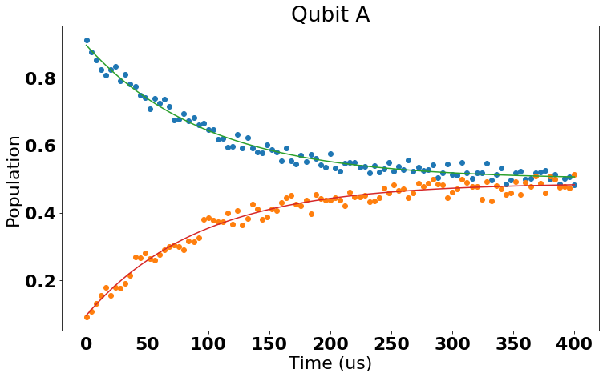
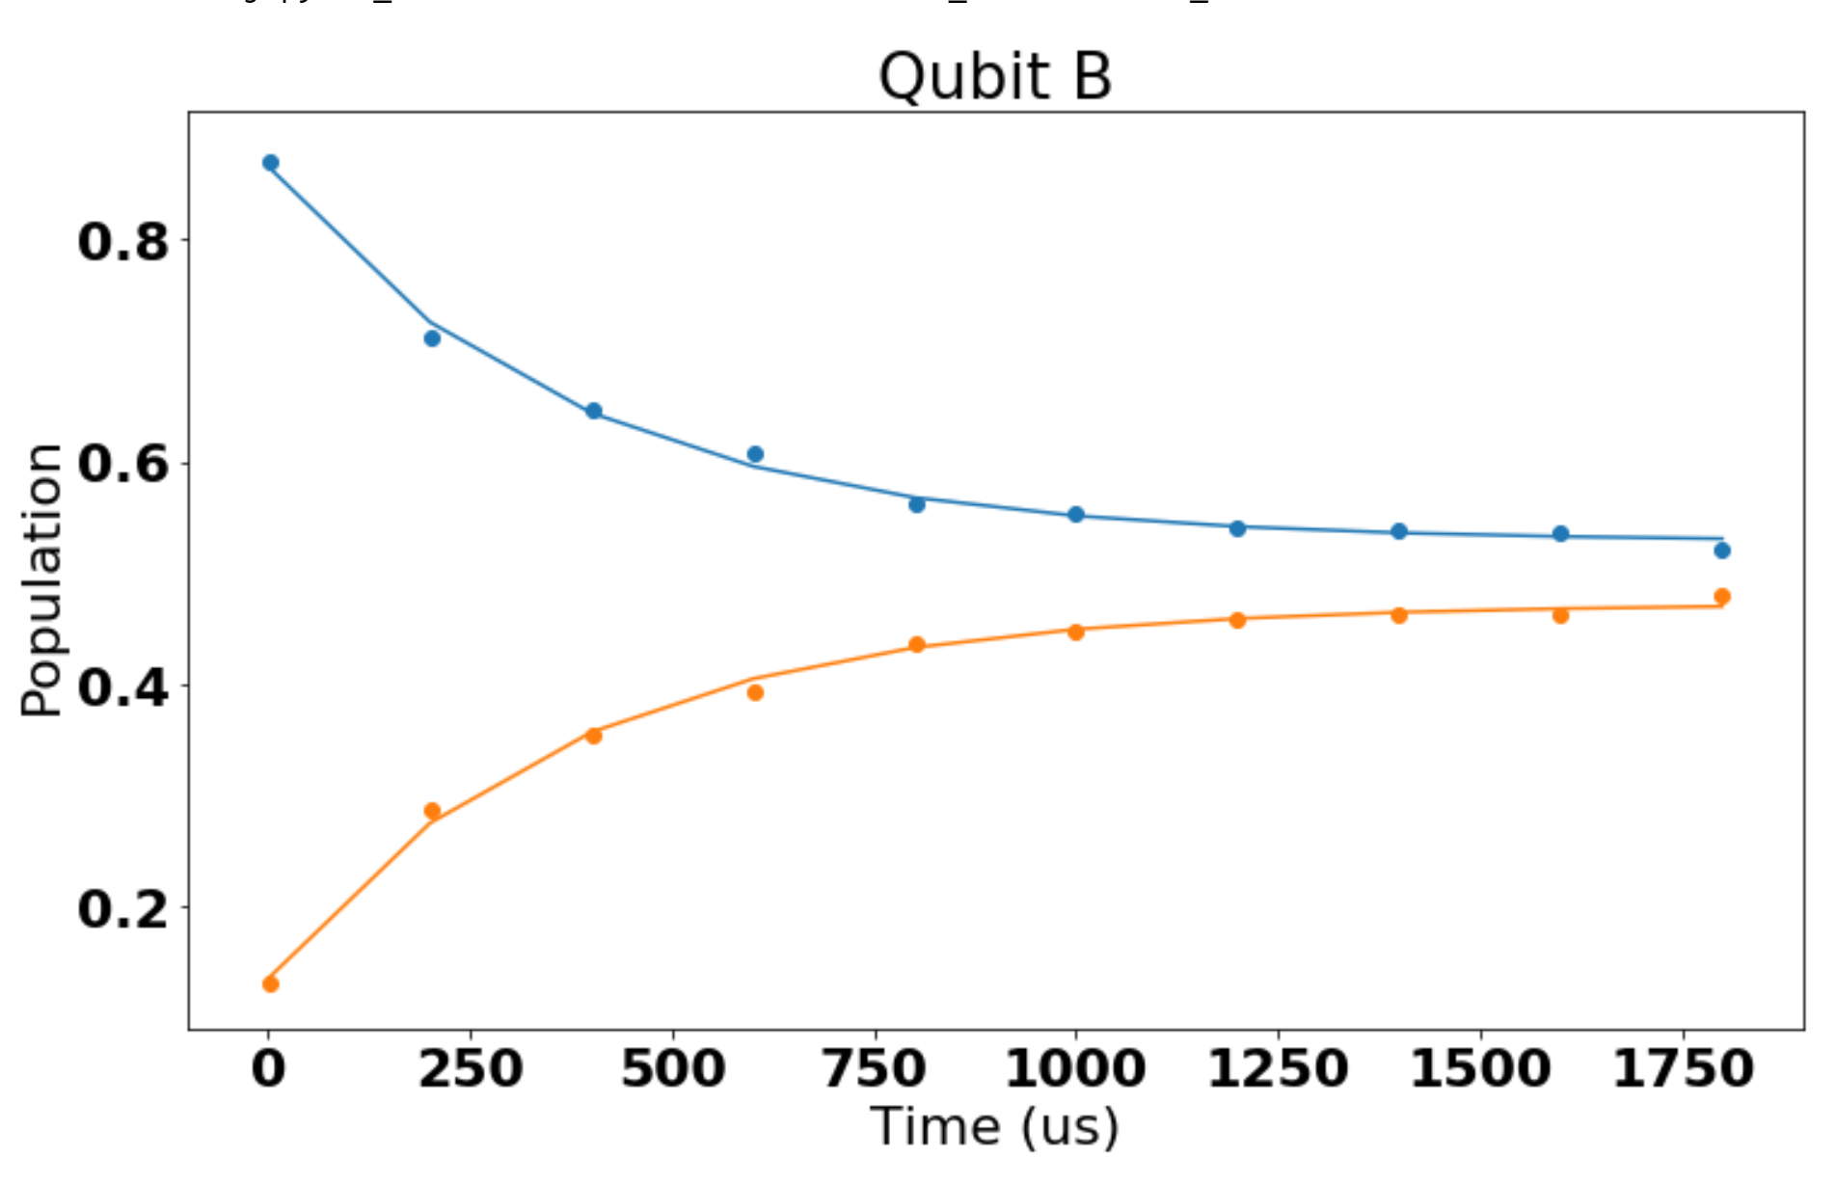
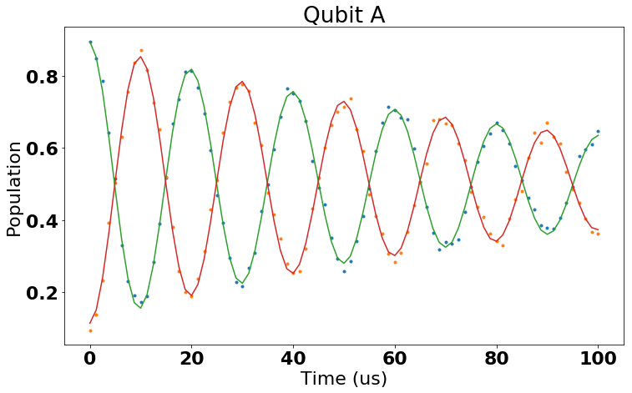
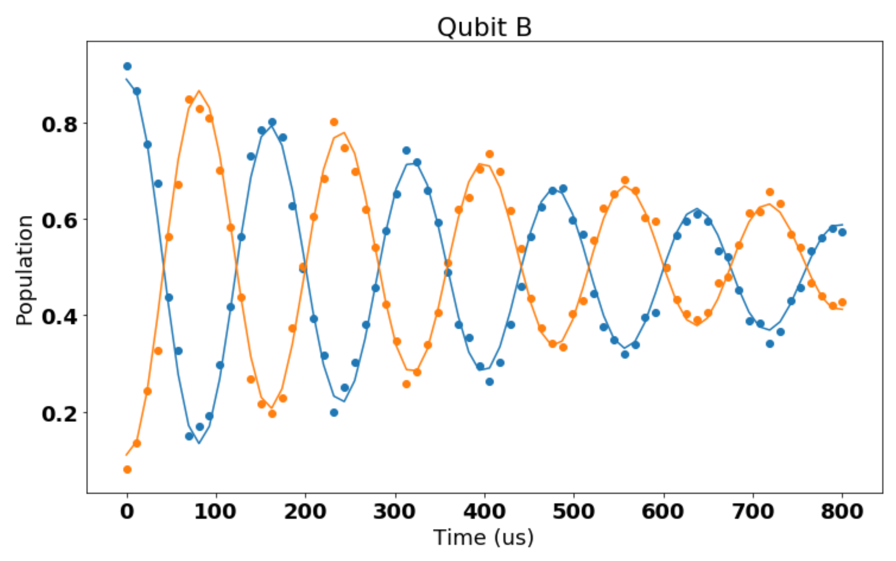
QICK preserves device coherence
Start in $|e⟩$
Qubit relaxes to thermally mixed state
Relaxation time ~100-400us
Qubit effective temperature ~100mK
T2* ~ 90-500us
Suspect poor thermalization of sample/attenuators
T₁=95 us
T₁=373us
Start in $|g⟩$
T₂=90 us
T₂=579 us

Slide 8
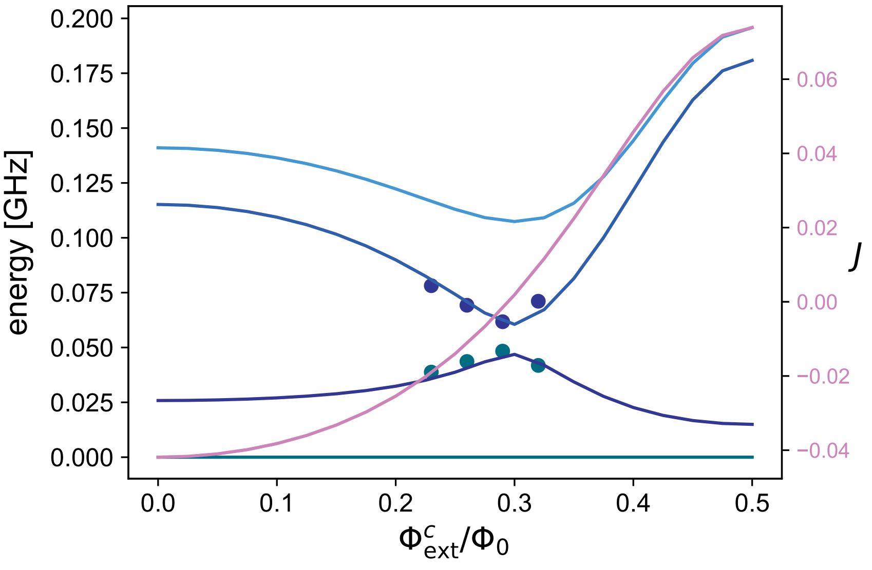
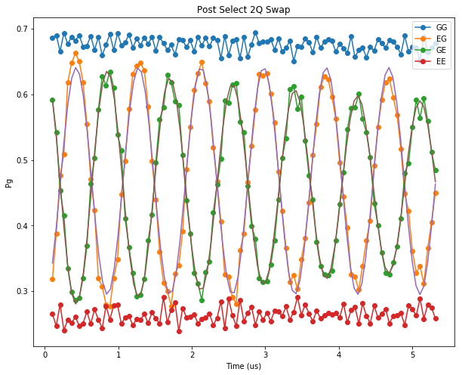
Inducing a parametric interaction – iSwap
ee
ge
eg
gg
Drive at 21.13 MHz (ge-eg)
Observe i-swap interaction
Rate = 1.175 MHz
Sqrt(iswap) in ~212ns
Requires initial phase sync and stability between channels at different frequencies
Q1 - Q2
Q1
Q2

Slide 9
Future lab plans
Academic labs should be able to measure ~50-100 qubits
Requires fabrication foundry
Requires QICK for control (with multiboard scaling)
Requires software and calibration infrastructure
Applications include
Quantum simulation (with topologies different from surface code)
Quantum Ram
Quantum cameras

Slide 10
Qick capabilities to build for future
Firmware
Improved support for optical experiments
FIR filter for fast flux
Multi board experiments
Interpolated / spline based waveforms
Direct to ram saving of adc data
Better trigger engine
Use of realtime processors
Reconfigurable modules
Cross-talk compensation
Hardware / Analog Frontend
Modular quantum control frontend
QICK VNA / Signal Analyzer
Fast real-time scope
Analog noise performance
More ddr/bandwidth
Temperature stabilization
Software
Openqasm 3 / qiskit pulse support
Lower latency program switching
Improved remote serving (AWS/direct)
Experiment libraries

Slide 11
QICK is exemplar of NQI initiatives
Very difficult to develop these systems in universities
Companies keep developments proprietary
Not general enough to be used for experiments
Can’t develop custom modules
DOE engineers (QICK team) had decades of experience solving the exact type of problems that arise in quantum control
Were able to make useful system in <1yr that is now our primary measurement system
QICK developments relevant to non-quantum DOE efforts

Slide 12
Challenges moving forward
Very important to make sure we can support these efforts sustainably
Need to continue to develop QICK firmware
Need to develop hardware and make it available
Need to continue higher level software
As more people use QICK need to support users without overtaxing developers/engineers
How can we continue to adapt QICK to more use cases while keeping things manageable (fragmentation).
Need continued (and expanded) support from DOE
Equally important need to build robust /collaborative community

