Slide 1
AWS SideQICK
Simple Cloud Batching for QICK
Jeff Heckey
Senior Development Engineer
Amazon Braket
Notes:
GOALS: inform audience, gain adoption
Braket is Amazon’s cloud quantum computing service.
Access to 5 QPUs from different QC providers, including Rigetti.
Braket is focused on Circuits and Algorithms, with stable worldwide APIs
QICK and SideQICK are focused on device experiments, pulse sequencing, calibration, and benchmarking; rapid experimentation and ease of access

Slide 2
SideQICK at a glance
create workload
poll for work
User
SideQICK
QICK
download results
upload results
Notes:
Workloads are completely encapsulated – researchers still own both side of building and executing workloads; failures in the daemon or QICK board can be recovered without losing workloads or data except for the current workload
Device scaling – each device polls for its own tasks
Cloud connected – devices anywhere on the Internet are accessible to any authorized user from anywhere on the Internet; users can only access authorized devices
Improved device security – over SSH; no shared credentials/logins between devices; credentials are frequently rotated
Transparent operation – device queues are visible to all users, results can be shared
Low cost – serverless, so pay as you go; <$200/mo for 1M workloads

Slide 3
Deploy to Cloud
Download code from GitHub
(link pending AWS AppSec review)
Run install script
Notes:
CI/CD missing
Some Amplify/deployment issues to fix OOB deployment

Slide 4
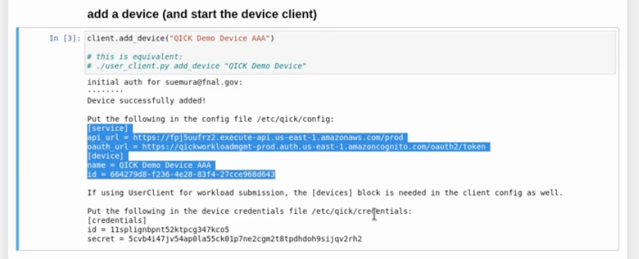
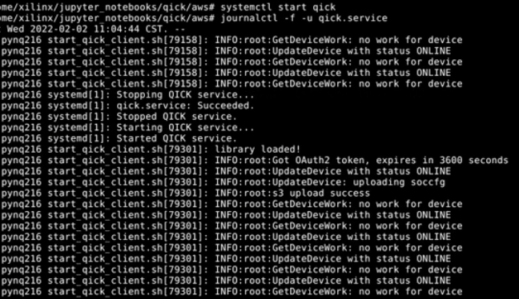
Add a new QICK device

Slide 5
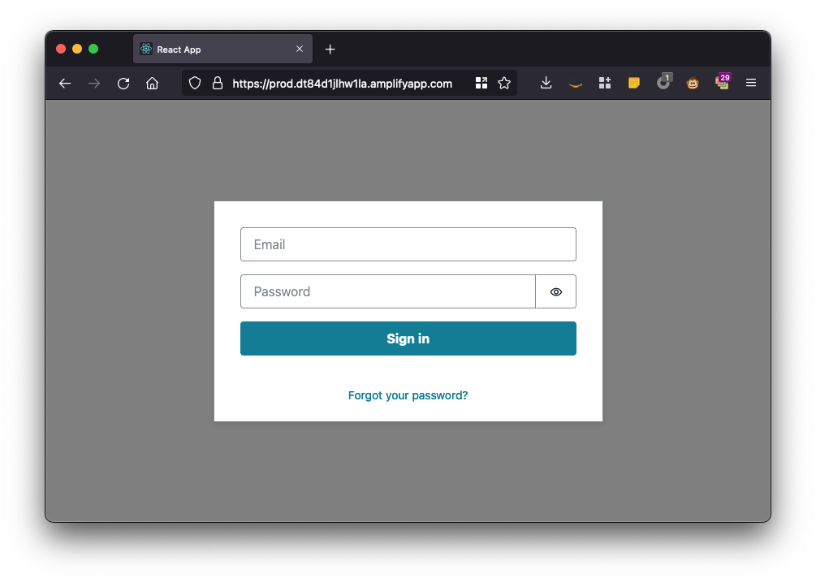
Add a user

Slide 6
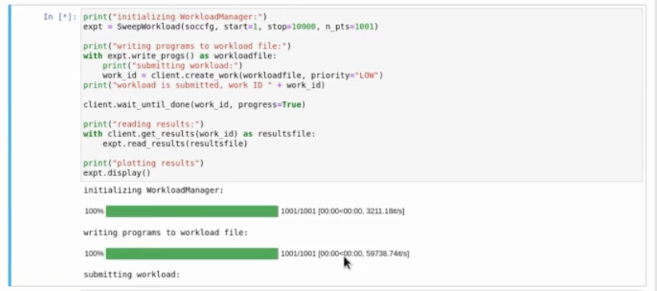
Running a Workload

Slide 7
Dustin Liukkonen – AWS
Sho Uemura – FermiLab
Gustavo Cancelo – FermiLab
Sebastian Hassinger – AWS

Slide 8
Supplementary slides

Slide 9
Design Philosophy
Workloads are completely encapsulated – researchers still own both side of building and executing workloads; failures in the daemon or QICK board can be recovered without losing workloads or data except for the current workload
Device scaling – each device polls for its own tasks
Cloud connected – devices anywhere on the Internet are accessible to any authorized user from anywhere on the Internet; users can only access authorized devices
Improved device security – over SSH; no shared credentials/logins between devices; credentials are frequently rotated
Transparent operation – device queues are visible to all users, results can be shared
Low cost – serverless, so pay as you go; <$200/mo for 1M workloads

Slide 10
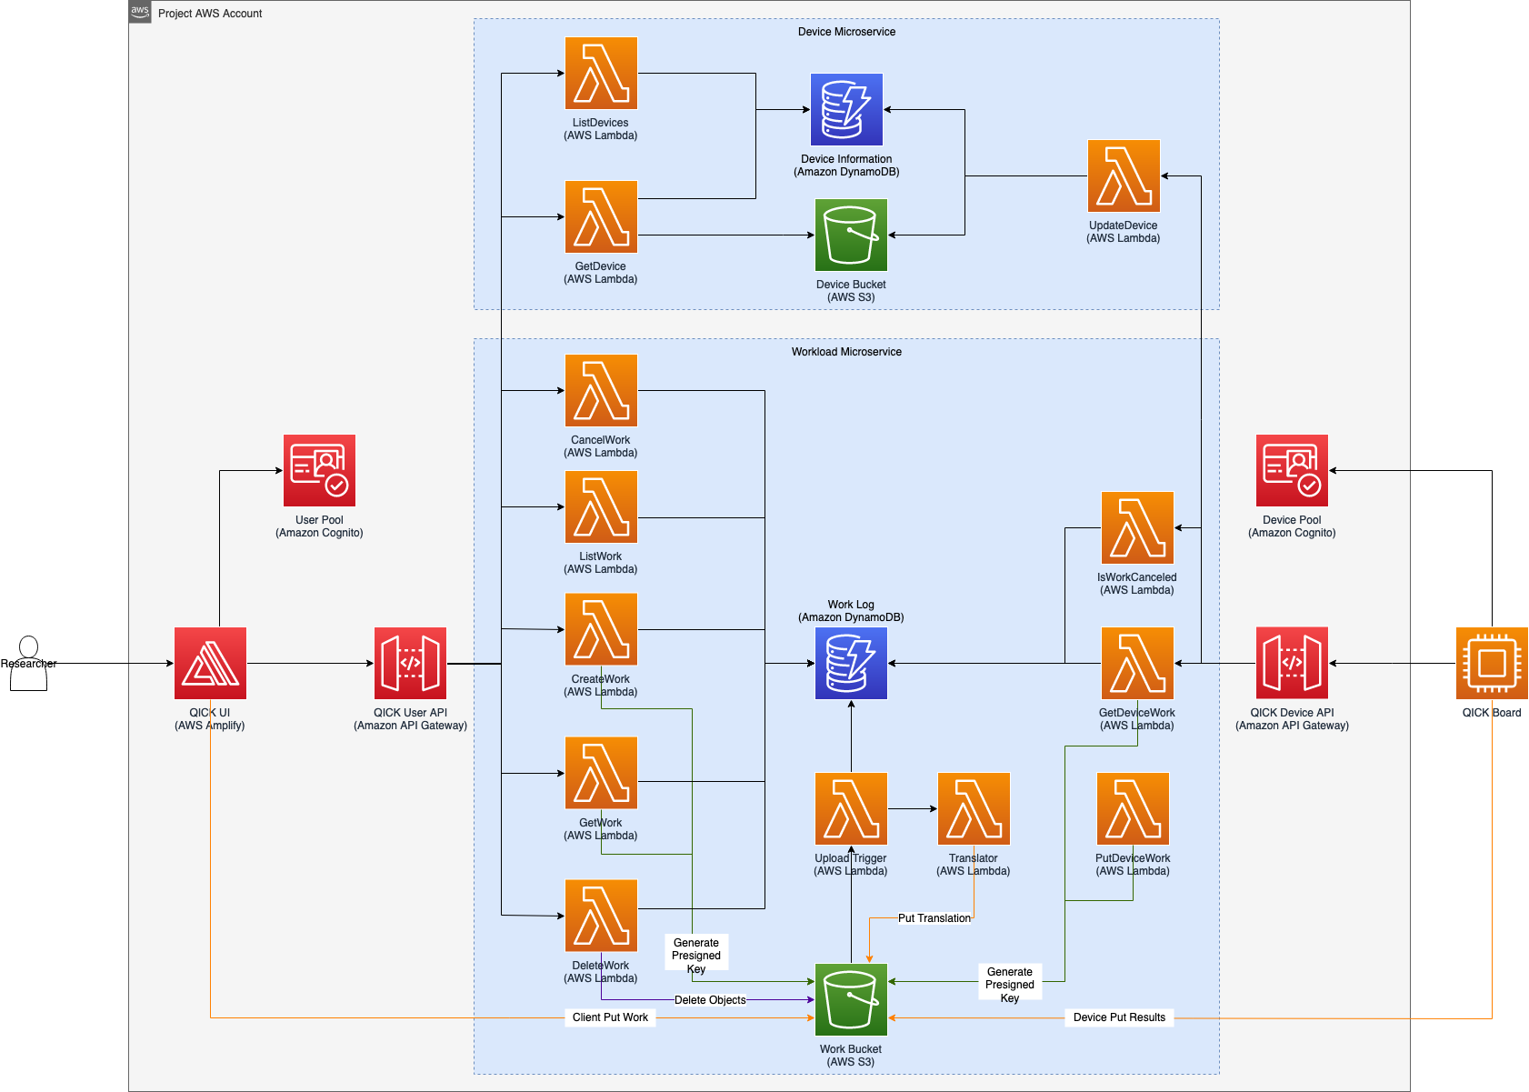
SideQICK design

Slide 11
Pricing
Estimated cost is ~$200/mo based on usage, primary costs below
Service | Tier | Pricing
Lambda 512MB | 512 MB (default) | $0.0000000083/ms
S3* | First 50 TB / Month | $0.023 per GB ($1150 cap)
 | Next 450 TB / Month | $0.022 per GB ($11500 cap)
 | Over 500 TB / Month | $0.021 per GB
https://aws.amazon.com/lambda/pricing/
https://aws.amazon.com/s3/pricing/
https://aws.amazon.com/cognito/pricing/
https://aws.amazon.com/amplify/pricing/
* Each experiment will copy the workload payload and results to and from S3 twice, and repeatedly downloading results will increase the cost

Slide 12
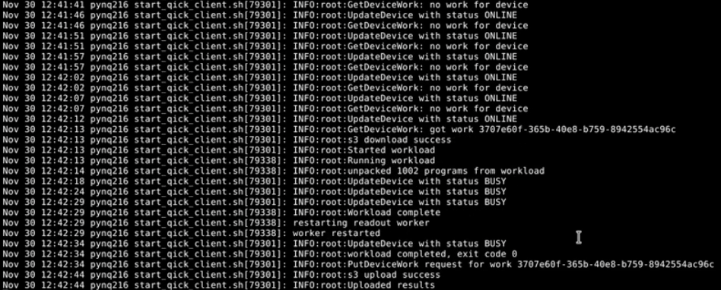
Running the workload

Slide 13
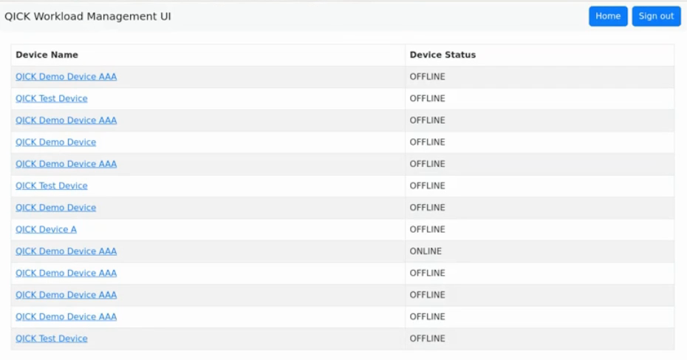
Device Status

Slide 14
Running a workload (GUI)

Slide 15
Running a workload (GUI)

Slide 16
Running a workload (GUI)

Slide 17
Running a workload (GUI)

Slide 18
Run a workload (SDK)

Slide 19
Why not Braket?
 | SideQICK | Braket
Application | Calibration Benchmarking Pulses | Pulses* Circuits Algorithms
Customers | Research groups | Quantum Curious and Corporate
Security | User-based | Account-based
Integration | Flexible User controlled | Standardized Optimized for automation
Timing | ASAP | Longer term Can work with SideQICK

Slide 20
SideQICK Benefits
Workloads are completely encapsulated
Cloud connected
Device scaling
Transparent operation
Simple permissions
Improved security
Low cost
Notes:
Cost <$200/mo assuming 1M workloads (serverless is billed on demand)

