Slide 1
QICK, RFSoC and RFSoC-PYNQ
Patrick Lysaght
Adaptive Embedded Computing Group (AECG)

Slide 2
Outline
QICK
PYNQ
RFSoC 4x2 Kit
RFSoC Book
Additional Resources

Slide 3
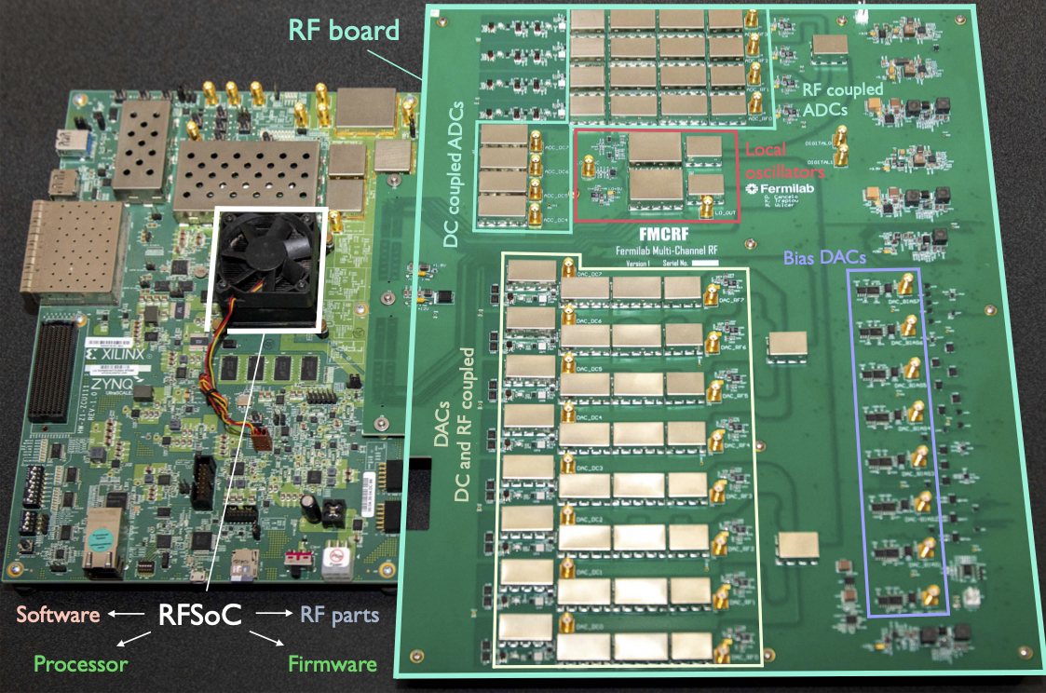
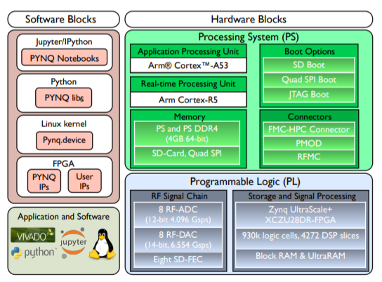
PYNQ accelerates innovation
Quantum computing

Slide 4
Jupyter & Python: Leading Data Science Stack
Data Scientists
Productivity
Frameworks
Jupyter
10 of millions of users
Productivity
Languages
Python
Systems
Languages
C,
C++
OS, hypervisor,
drivers
BSP
Desktop/
Server

Slide 5
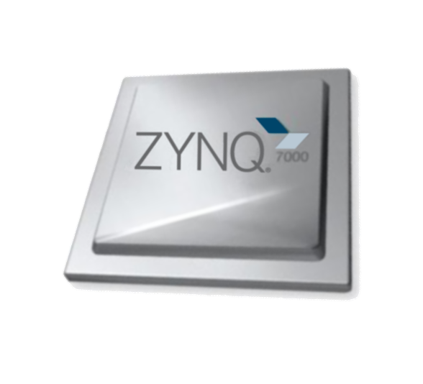
Typical Embedded Stack is Alien to Data Scientists
Data Scientists
Productivity
Frameworks
Jupyter
Productivity
Languages
Python
Embedded/EDA
Systems
Languages
C,
C++
Systems
Languages
C,
C++
OS, hypervisor,
drivers
OS, hypervisor,
drivers
100 of thousands of users
BSP
BSP, RTL/HLS
Desktop/
Server
Embedded
Zynq, RFSoC

Slide 6
Data Science Stack on Adaptive Computing SoCs
Data Scientists
Productivity
Frameworks
Jupyter
Jupyter
Productivity
Languages
Python
Python
Embedded/EDA
Systems
Languages
C,
C++
Systems
Languages
C,
C++
C,
C++
OS, hypervisor,
drivers
OS, hypervisor,
drivers
BSP
BSP, RTL/HLS
Desktop/
Server
Embedded
Zynq, RFSoC
Embedded
Zynq, RFSoC

Slide 7
PYNQ Unifies Data Science & Embedded Stacks
Data Scientists
Productivity
Frameworks
Jupyter
Jupyter
Productivity
Languages
Python
Python
Embedded/EDA
Systems
Languages
C,
C++
Systems
Languages
C,
C++
C,
C++
OS, hypervisor,
drivers
OS, hypervisor,
drivers
BSP
BSP, RTL/HLS
Desktop/
Server
Embedded
Zynq, RFSoC
Embedded
Zynq, RFSoC

Slide 8
Software libraries
pip install a_package
Software

Slide 9
Software libraries become
hybrid libraries
Hybrid libraries
pip install pynq-dpu
Software
Hardware
Notebooks
Support files

Slide 10
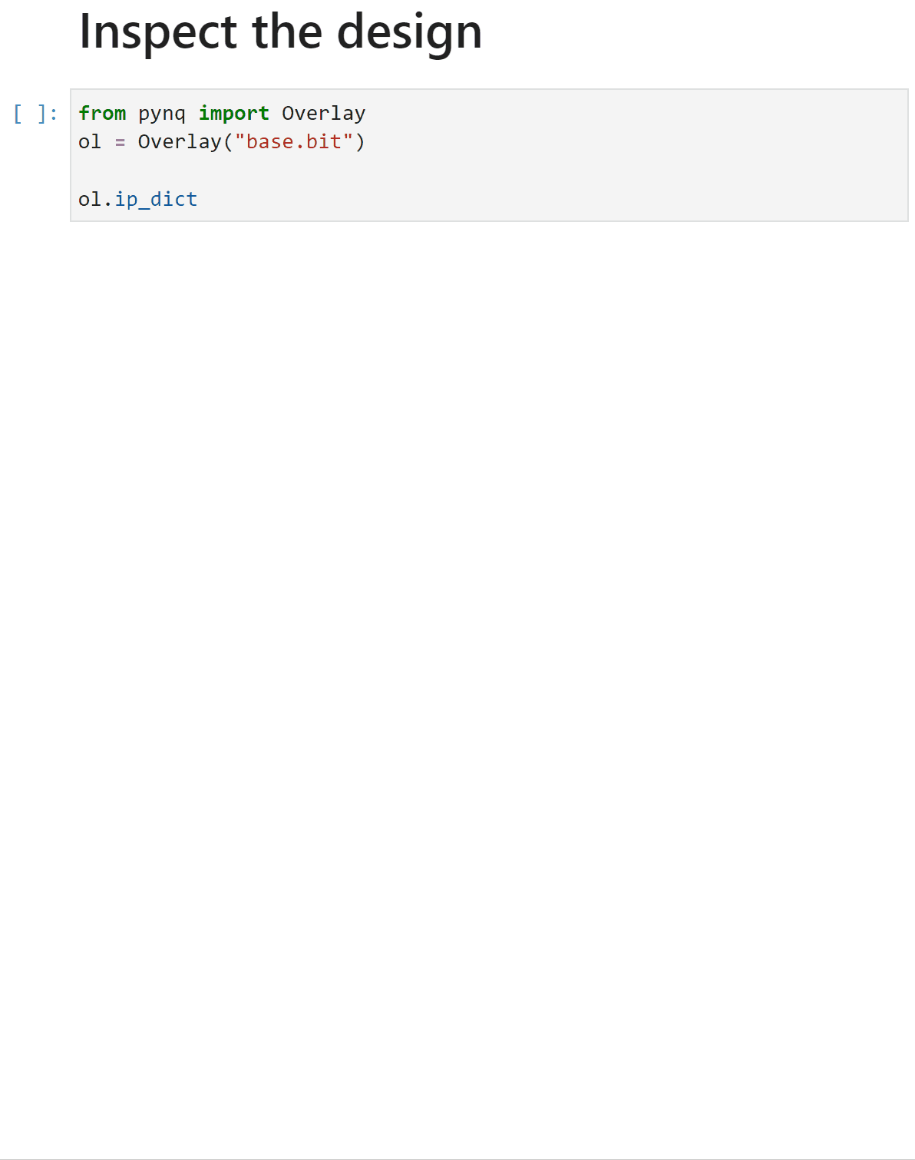
Discovering bitstreams, IP and APIs
RFSoC overlays as Python libraries

Slide 11
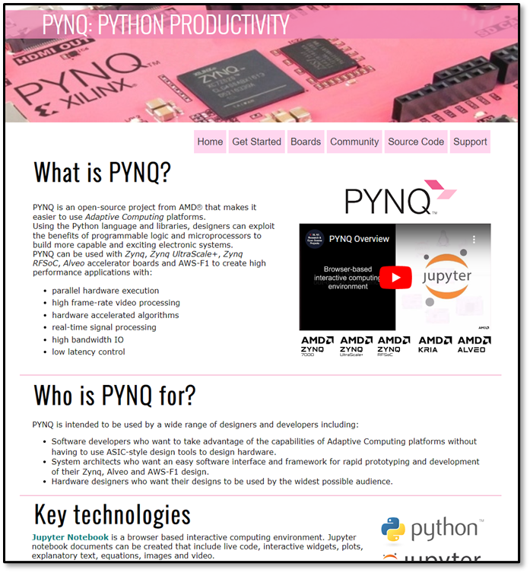
Discovering bitstreams, IP and APIs
PYNQ Overview
pynq.io

Slide 12
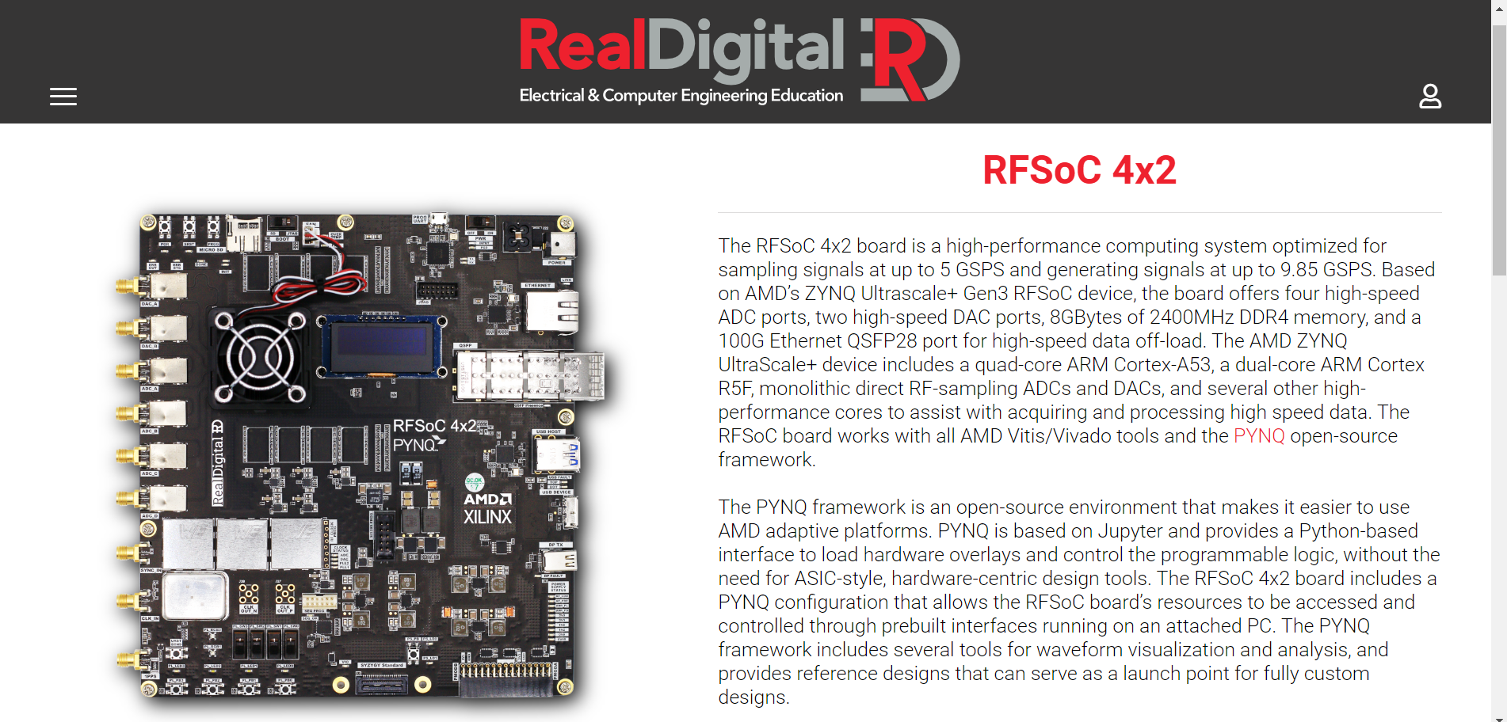
RFSoC 4x2 Kit
Key features
Zynq UltraScale+ RFSoC Gen 3 ZU48DR
4 x 5 GSPS ADC and 2 x 9.85 GSPS DAC 14-bit ports
6 GHz RF input bandwidth
QSFP28 interface for 4x25, 2x50 or 1x100 Gbps Ethernet
4 GB PS and PL DRAM
ZCU208 compatible clocking subsystem
OLED display & battery-backed real-time clock
Extensive tutorials and overlays including spectrum analyzer
$2,149 for academic use

Slide 13
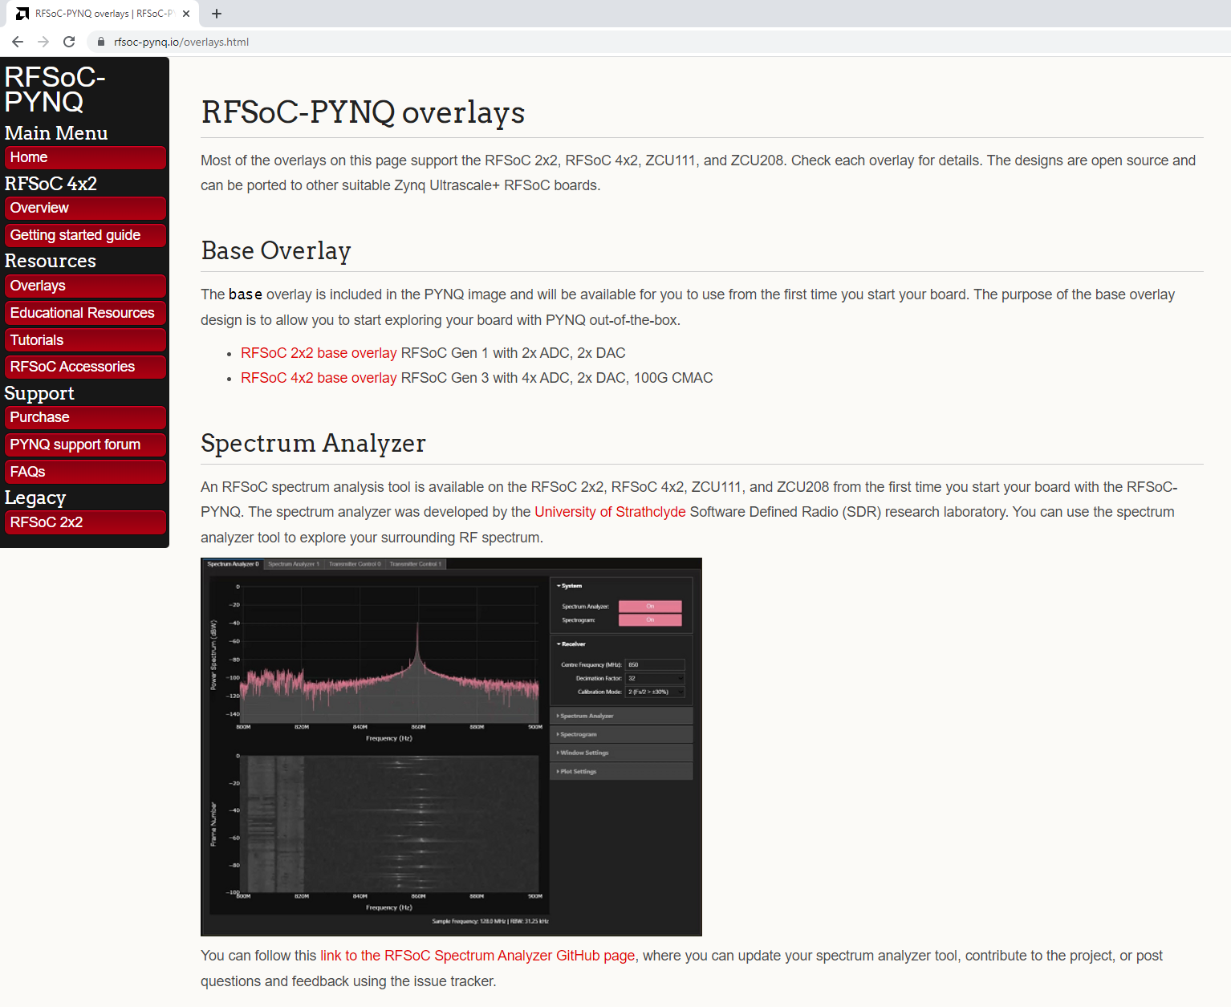
Reusable Open-Source RFSoC-PYNQ Designs and Tutorials
The “hello world” example is a multi-GHz spectrum analyzer
There are multiple overlays, tutorials and notebooks at rfsoc-pynq.io
Everything is open-source, reusable and hosted on GitHub
Delivered in partnership with the University of Strathclyde, Glasgow, UK

Slide 14
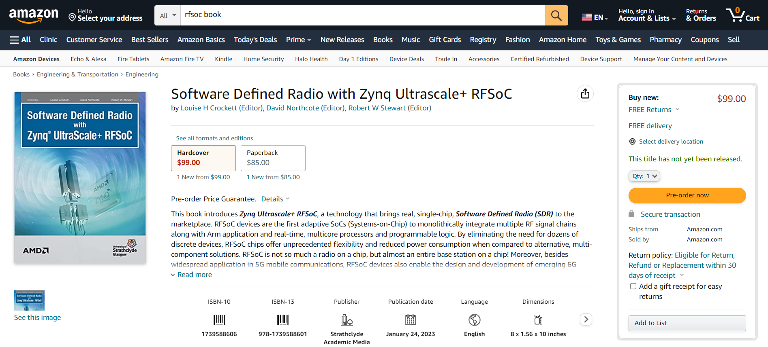
NEW RFSoC Book – Launch Date is 24 Jan 2023

Slide 15
Free PDF Download of RFSoC Book

Slide 16
RFSoC Book has Permissive License and Additional Resources
Open-Source License to Use and Reproduce
“This book is available in print and as an electronic book (PDF format). Text and diagrams from this book may be reproduced in their entirety and used for non-profit academic purposes, provided that a clear reference to the original source is made in all derivative documents …”
Additional Resources
The book comes with 30 tutorial notebooks and designs for hands-on learning and exploration
All tutorials are open-source, reusable and hosted on GitHub
Delivered in partnership with the University of Strathclyde, Glasgow, UK

Slide 17
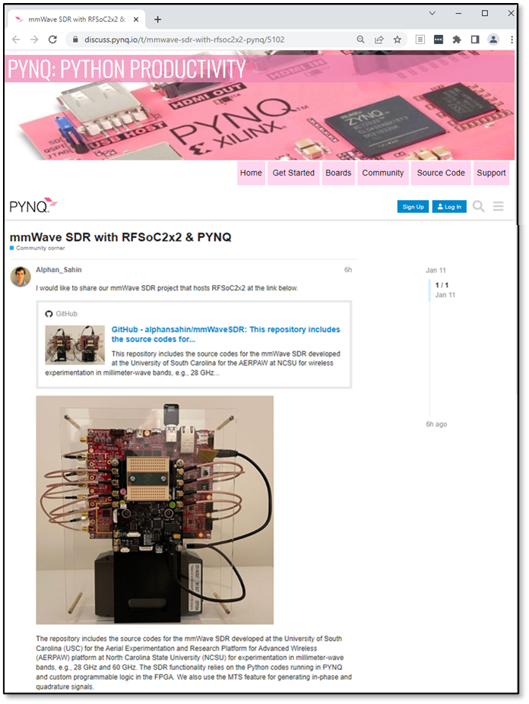
Discovering bitstreams, IP and APIs
PYNQ accelerates innovation
mmWave SDR

Slide 18
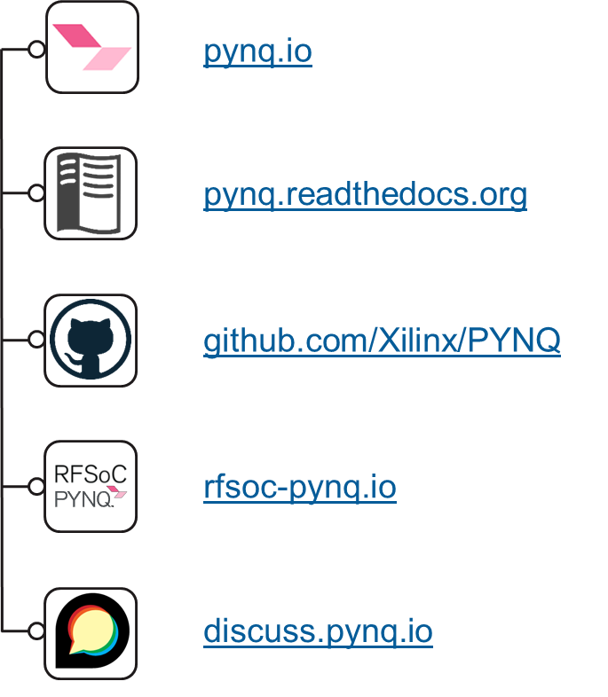
Discovering bitstreams, IP and APIs
To learn more …

