Slide 1
Beam & QC of 2x2 MINERvA
Howard Budd, University of Rochester
Dec 5 2022
ArgonCube Meeting

Slide 2
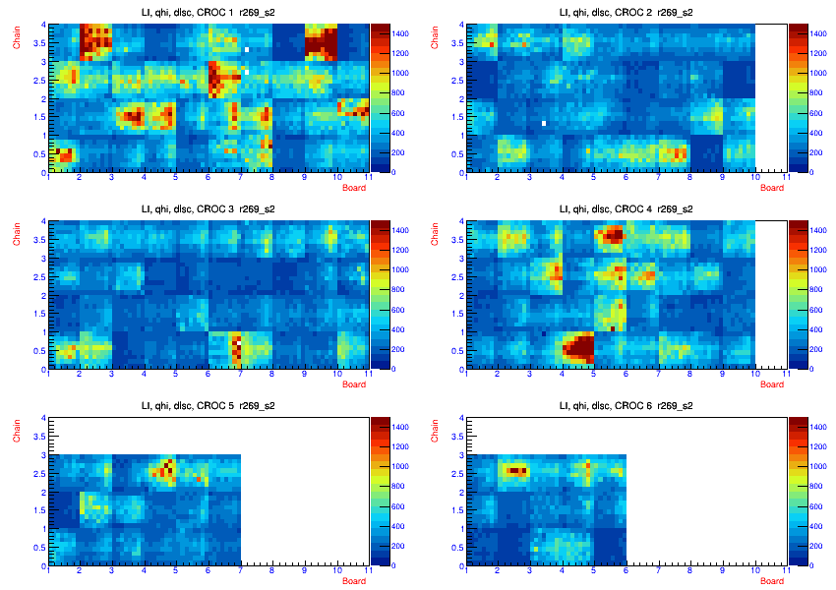
LI for MINERvA
LI qhi ave

Slide 3
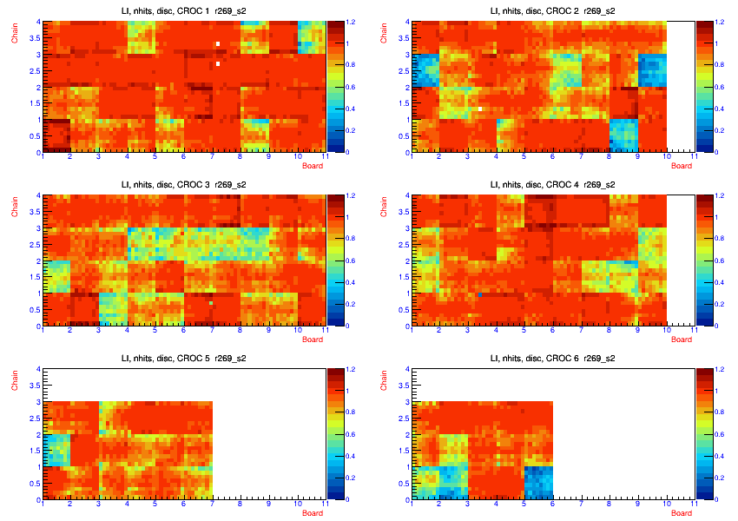
LI ave nhits
Disc Hits
I showed beam plots last month
MS4-11
To see MS1-3 we will need to wait for beam

Slide 4
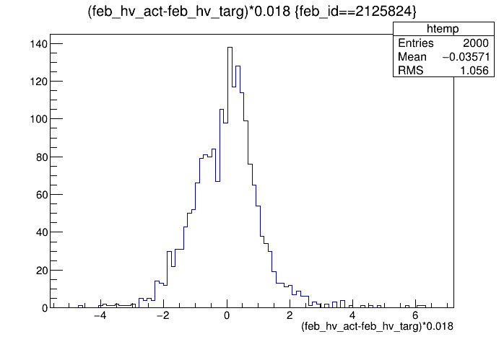
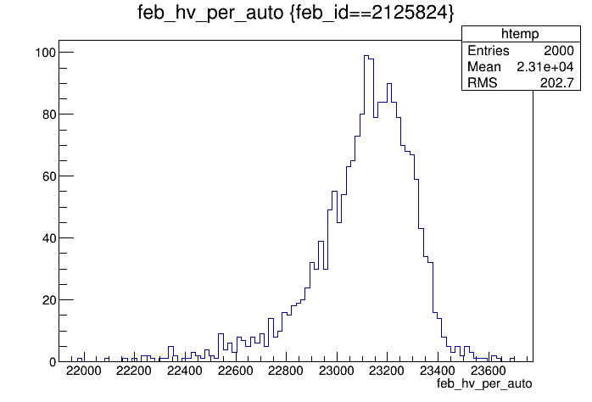
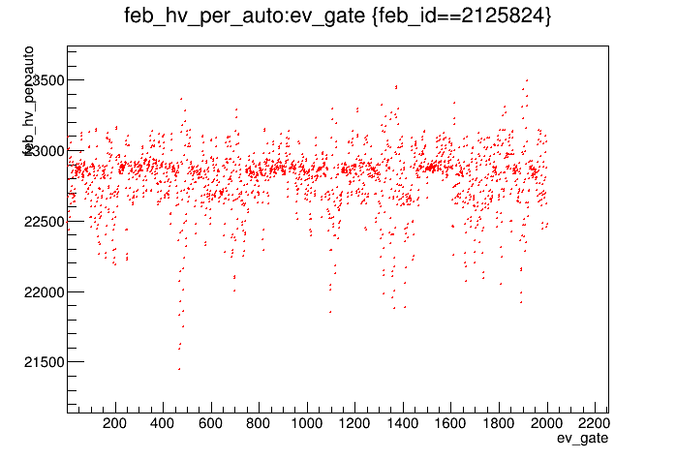
HV of 2-0-7
HV of 2-0-7 seems to be behaving bad.
Absolute value of period seems OK but period & HV have some deviations. I don’t have the hv_act-hv_tar vs gate.

Slide 5
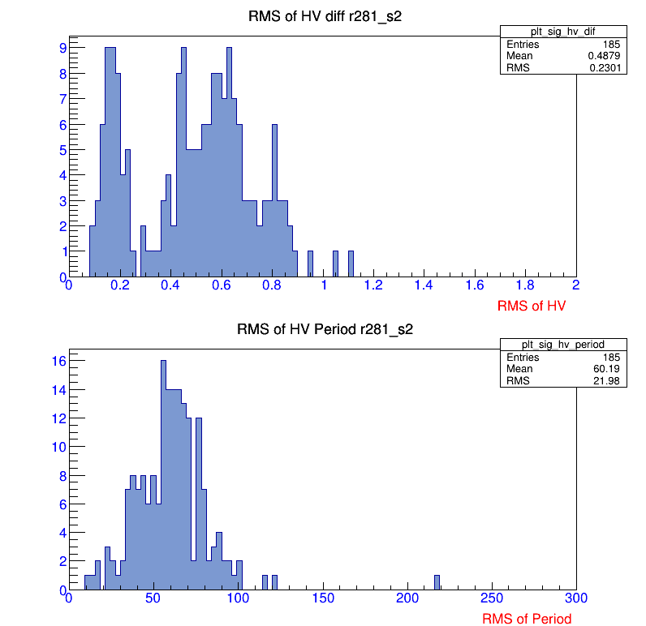
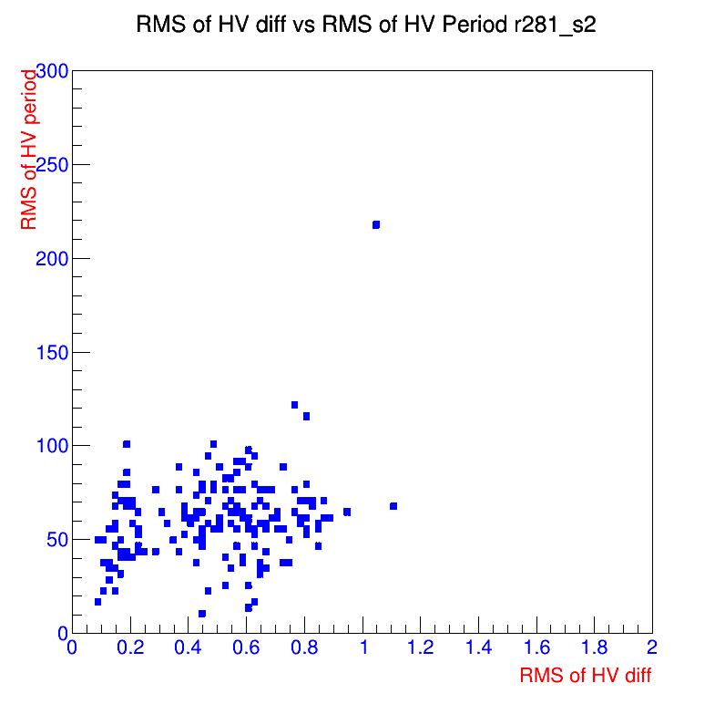
Other tubes with this problem ?
Tube 2-0-7 is an outlier in terms of RMS of voltage and frequency
The tube will probably have to be replace, but easy to replace
It doesn’t look like other tubes have this problem, but I have not finished investigating this problem.

