Slide 1
Beam & QC of 2x2 MINERvA
Howard Budd, University of Rochester
Dec 5 2022
ArgonCube Meeting

Slide 2
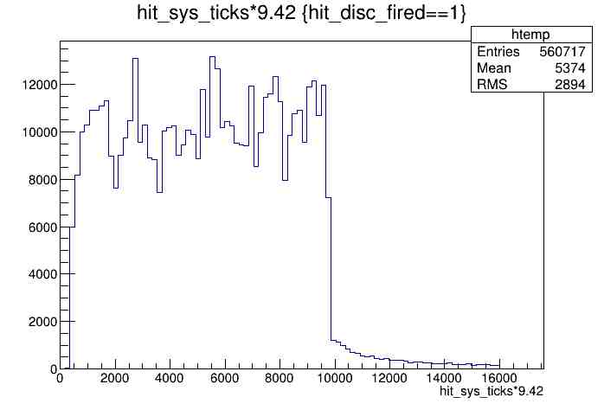
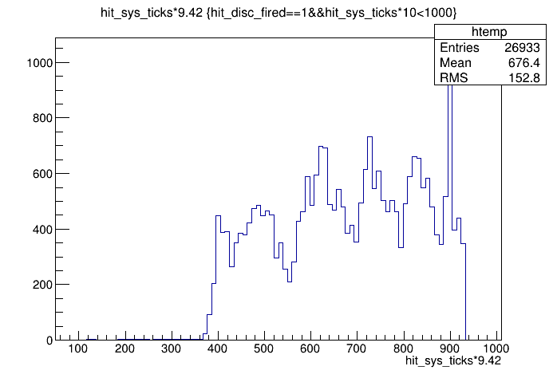
Triggers & Gate
The DAQ crashing problem, CRS0 problem, went away and we don’t know why. My guess is there was a problem on the disk.
MTM triggers on beam signal.
Time of disc hits in ns
16 μs gate which starts ~ 400 ns before beam arrives. Tail is Michel electrons
Plot same as MINERvA
No beam in 40% of the gates
When we unplug the AD signal into the MTM, we still get triggers.
We should get no triggers when don’t get AD triggers, so when we unplug the cable from the AD, we should get no triggers.
Note clear what is happening

Slide 3
DAQ
QC detector of 2x2 MINERvA with NuMI beam.
The FEB PEDs are from MINERvA, Jul 2019, when MINERvA was stopped
This is not nearline, but it is a check of what we are building.
Nearline is on a SLF6 computer in Lab F, not on the network.
We have been checking with LI, but we can do more checks with beam.
To understand the plots
DAQ reads out 5 -10 FEBs in a daisy chain, MINERvA had 59 chains
“The Sequencer”, the FGPA in the CROCE & the name given by Boris Baldin & Cristian Gingu, reads out a chain.
Event Builder & et put the data on disk.
A module set (MS) is a unit of production consisting of 4 steel modules. The scintillator planes are read out by 2 chains, one east and one the west.
2x2 MINERvA consists of 3 HCAL MS (4 scintillator planes), 2 ½ ECAL and 5 ½ tracker MS (8 scintillator planes)
We have assembled and tested 3 HCAL, 2 ½ ECAL and 2 ½ tracker MS
The plots show this, if you know what you are looking at.
qhi is the most sensitive measure of pulse height.
NuMI beam down for a couple of week, so QC MS 2,3 could be a problem.

Slide 4
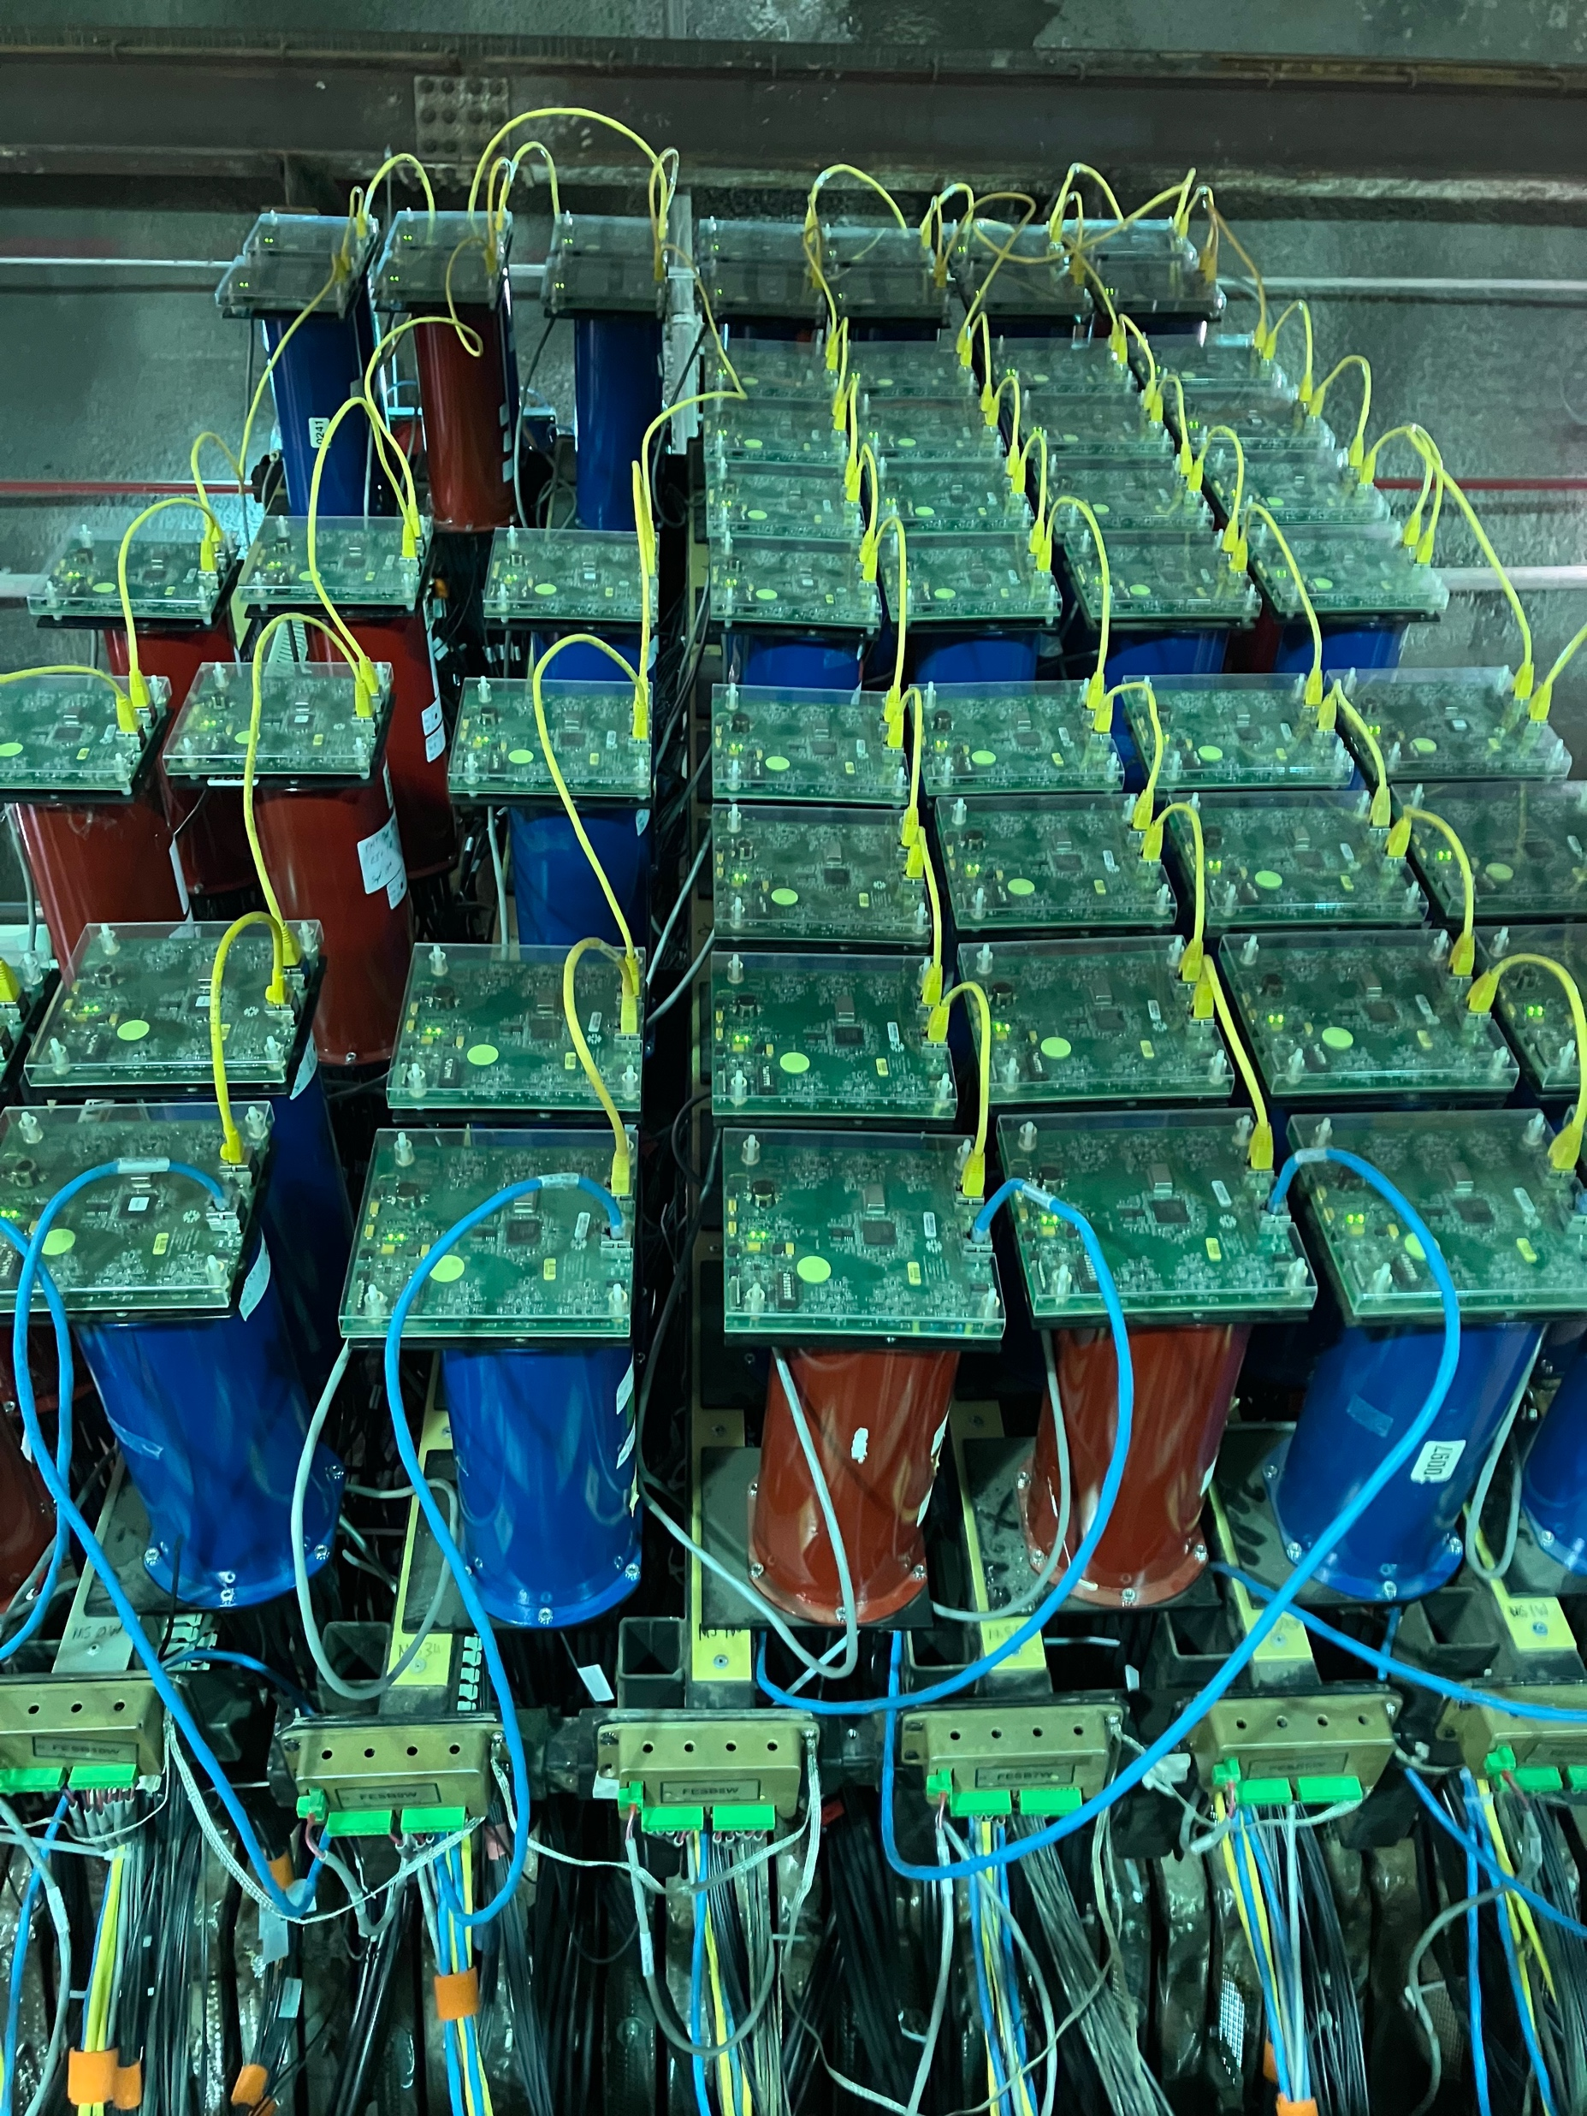
Module Sets
MINERvA From above
West side
Left 3 are HCAL & the 4 on the right side are 2 ½ ECAL and 1 ½ tracker.
FEB
PMT
Daisy Chain
Module Set, going up

Slide 5
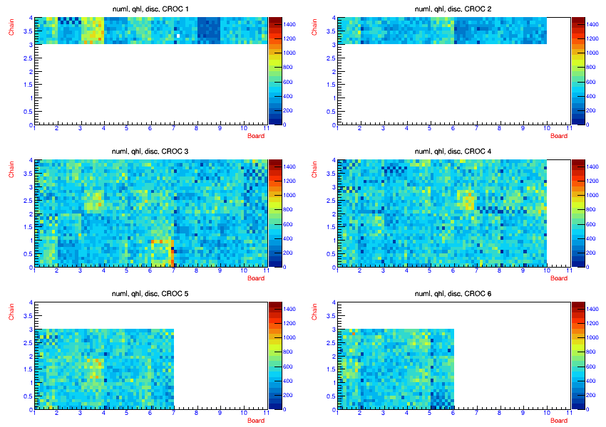
Ave Qhi for Pixel
West
East
qhi for pixels, vs CROC, board & chain
Plotted in MINERvA nearline
No cable, steel prevents cable from being plugged in. Might be able to fix this
Checker board pattern, cable not seeded
O outer calorimer
X x plane
U u plane
V v plane
MS4
MS3
O X X U X X U U U O
O V V V X X V X X
MS2
Tracker
Tracker
To be completed
To be completed
MS1
MS8
MS7
MS6
MS5
O X X U X X U U U O
O V V V X X V X X
HCAL
MS11
HCAL
MS10
MS9
O X UX XU U. O
O V VX XV X

Slide 6
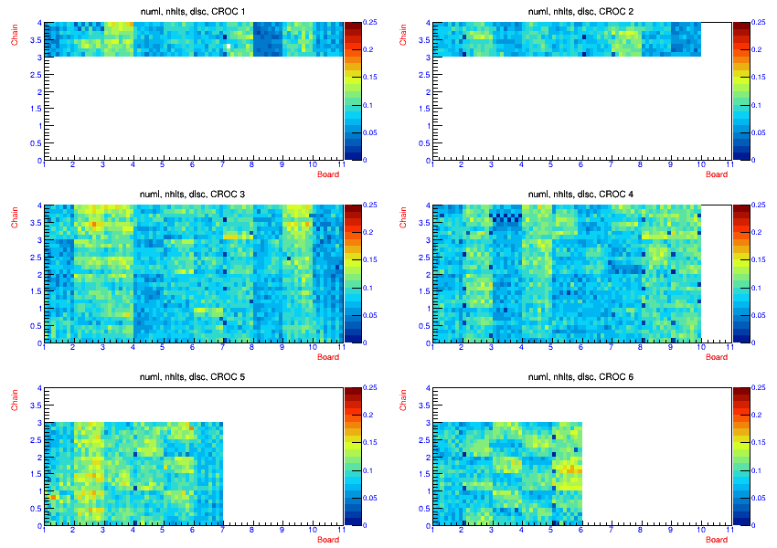
Disc hits/Gates with beam
Qhi is easier to see unseeded cables

Slide 7
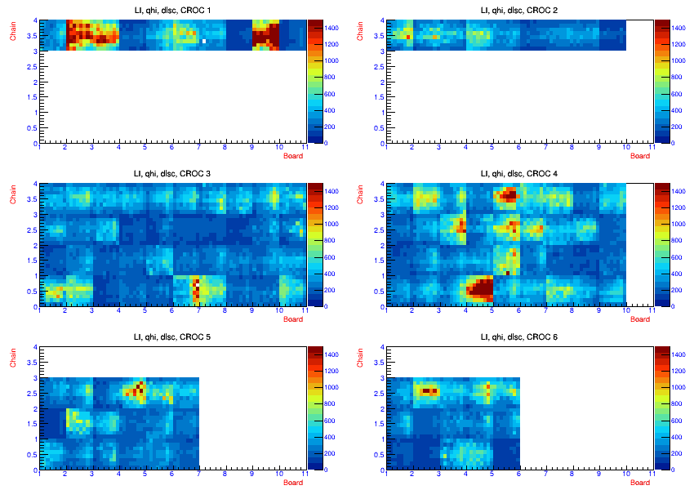
Compare beam with LI
~ 12 tubes, ~10%, only ½ channels see LI. These tube weres replaced immediately. I didn’t see this in MINERvA, We suspect the Cockcroft-Walton which generated the HV, but we are not sure. And we don’t know why this happen. Fortunately, LI could tell us the problem.
Light variation in the LI not seen in the NuMI beam. So, the absolute light level of LI is not a good indicator to set the HV.

Slide 8
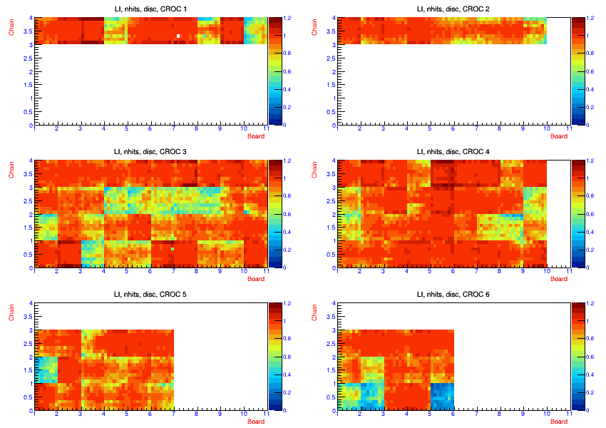
Beam vs LI, disc hits
qhi is more informative.

Slide 9
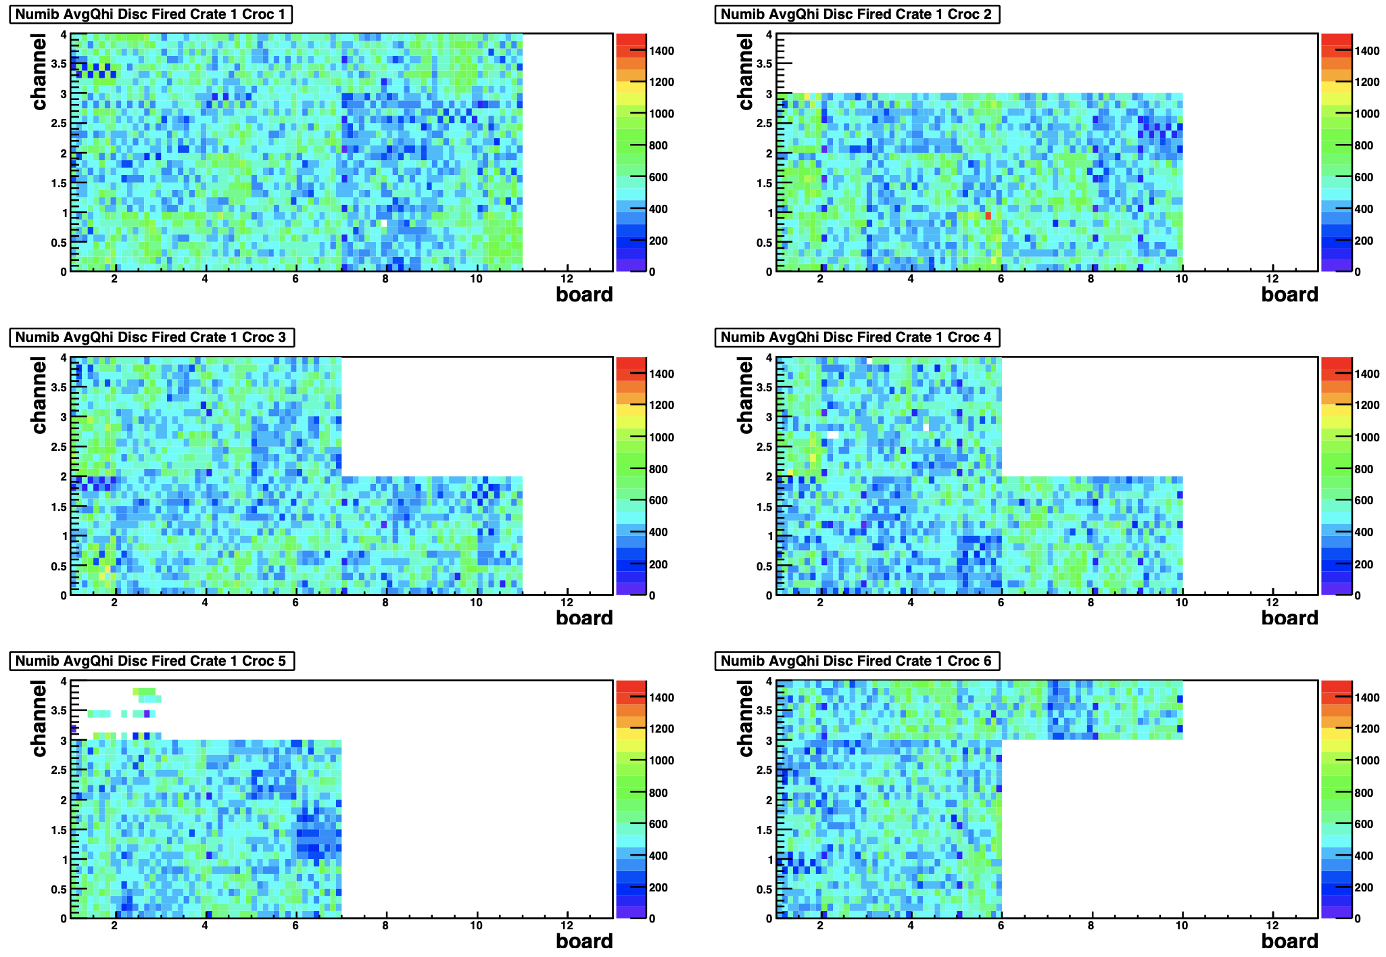
qhi 2x2 MINERvA vs MINERvA
Compare 2x2 MINERvA with MINERvA,we can’t do an absolute comparison
I am not completely clear how well we can compare the colors as they are not generated the same way
One is GIF and the other is postscript converted to pdf by my mac.
We used the same tubes in the same place to that the HV were these same as 2x2 and MINERvA. When they were not the same, we modified the voltage to be the same. 4 tubes in MS 4 have not had their HV corrected, they had the CW problem.
MINERvA MS4 had 11 tubes, 2x2 MINERvA 4 has 19 tubes.
The same comparison for nhits depend on the intensity of the beam so it is not as meaningful.

Slide 10
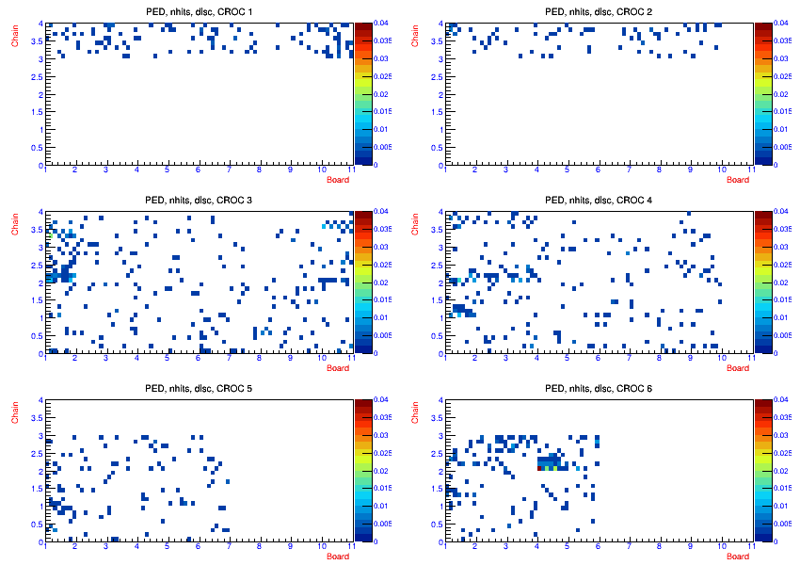
PEDs, nhits
PED during light leak checking.
Z axis changed from 0.25 to 0.04
500 events

Slide 11
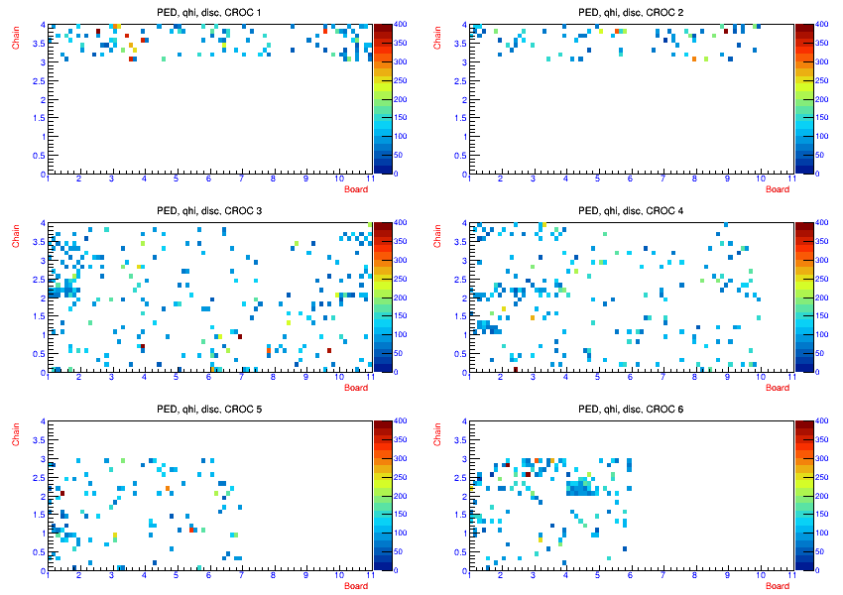
Ped, qhi
Changed z axis to 400 instead of 1500
500 events

