Slide 1
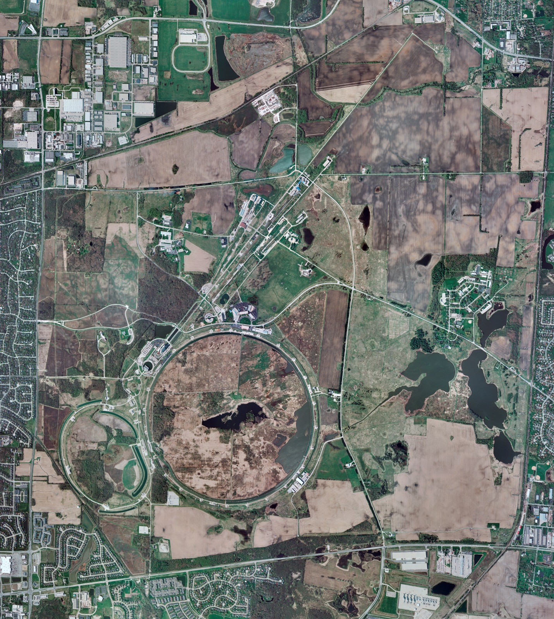
Helium Cryogenics
Status 12/16/2022 J.Makara
CMTF: SCP and comprs shut down
CMTS: HECM23 installation in progress
PIP2IT: SSR1 at RT and HB650 installation prep continuing
MCTF: cryo system warmed up to RT, shut down, and isolated
MDB/HTS: at RT
MDB/STC: at RT
MDB Magnet: at RT
NML/FAST: Cryo system cold and running fine, though difficult time stabilizing CM
CC1: cold at 2 K
CC2: cold at 4-10 K but not full
CM: cold at 2 K but just lost level, pvjt plug ?
IB1: cryo system cold and operating fine with test stands at 4 K or 2 K
Muon Campus: A0 comprs (3) online with MC-1 g-2 cryogenic system cold at 5 K and running fine.
Misc:. LN2, LHe, and Ghe subcontracts under service extensions, of concern.

