Slide 1
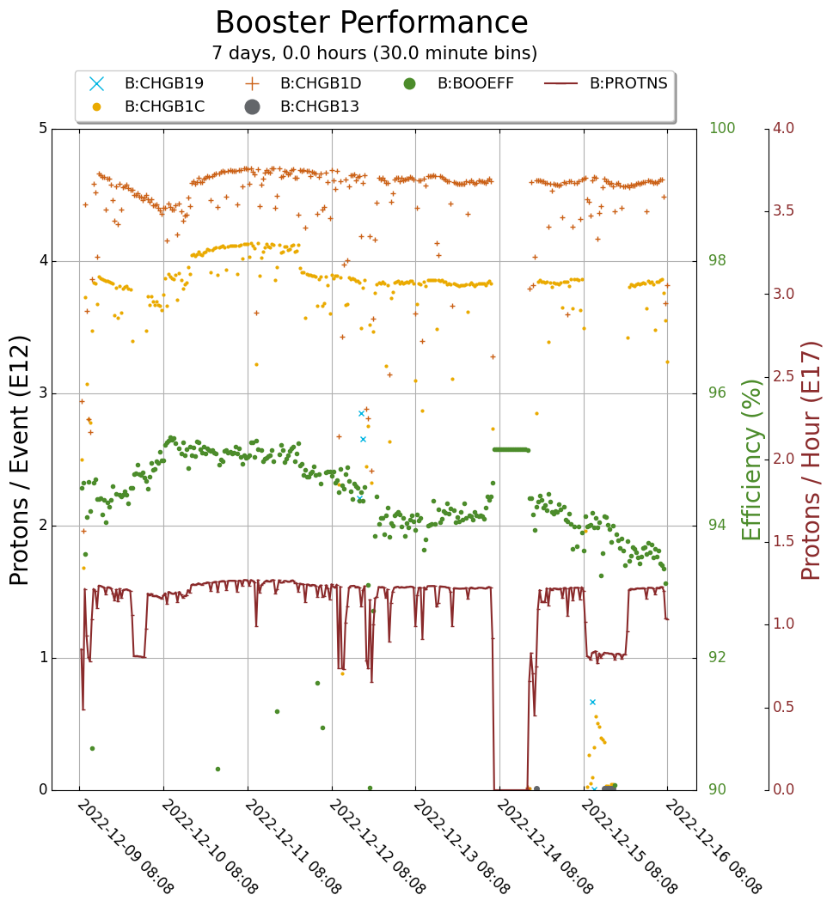
Booster Operations
Downtime 0.5 hour - mostly minor RF trips.
4.6e12 on $1D to BNB
3.9e12 on $1C to Muon
Accessed Wednesday to diagnose and repair BRF15
Off for sparking issue
Found damage inside the cavity
Cavity needs to be replaced
Girder choke inspection for work planning.
Studies completed this week:
Transition crossing
E-cloud
Plan for next week (pending approval):
Move spare cavity from MI60 on Monday
Controlled Access Wednesday for cavity swap
Down most or all of day shift
Would like to do this done before the holiday week so we have full compliment of RF.

Slide 2
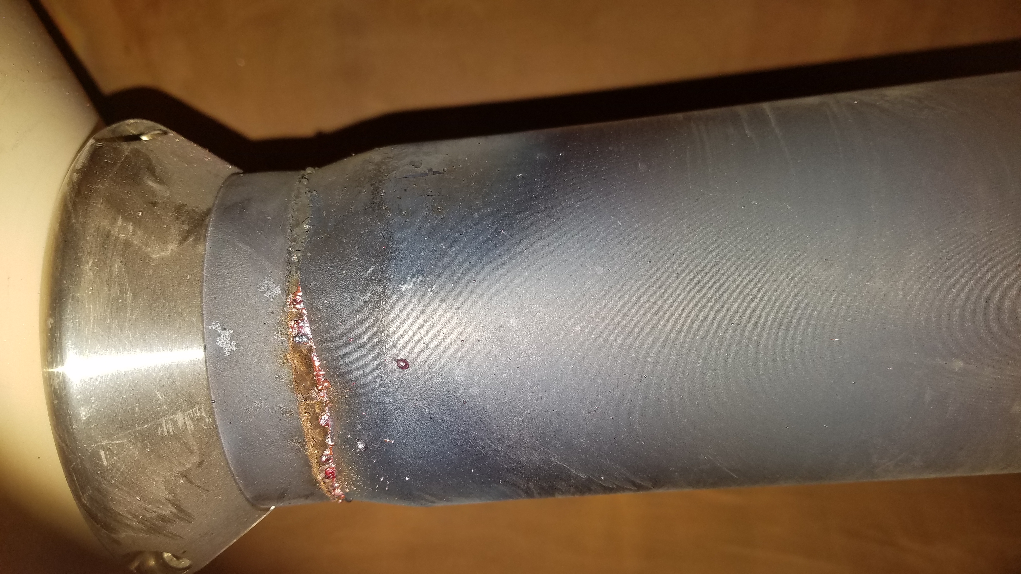
Booster Operations

Slide 3
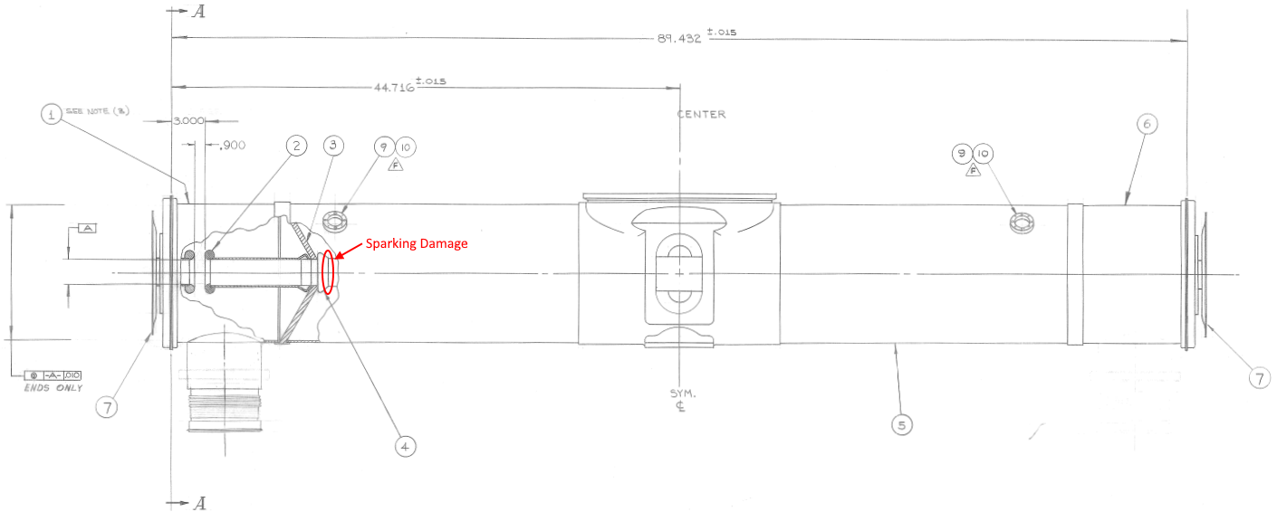
Booster Operations

