Slide 1
Muon Campus Status
D. Vander Meulen
AD Friday 09:00 Meeting
Dec 16, 2022

Slide 2
This Week ...
Running well to G-2 this week.
Construction work on Mu2e Target Hall entrance 8 started Monday morning and is expected to take two weeks to complete.
We had an access Wednesday during the dayshift:
ORC inspection tour of our new Mu2e Electrostatic Septum in D30. This is necessary before we can power it.
Tunnel connections made for ESS ion gauge.
Some minor work done on D10 vacuum.
Water samples taken from Pretarget / Prevault sump
We had studies during the dayshift on Thursday:
Low energy target yield studies while we were still in G-2 running mode (08:00 – 08:30).
Transitioned to 8-GeV mode for the remainder of the dayshift to conduct BPM commissioning and Delivery Ring abort line studies.
Studies ended at 16:00. Transitioned back to G-2 running mode.
CAMAC 119 card for D:H726 replaced.
Intermittent ground fault on D:Q108B (for G-2 running only) repaired during Thursday studies period.

Slide 3
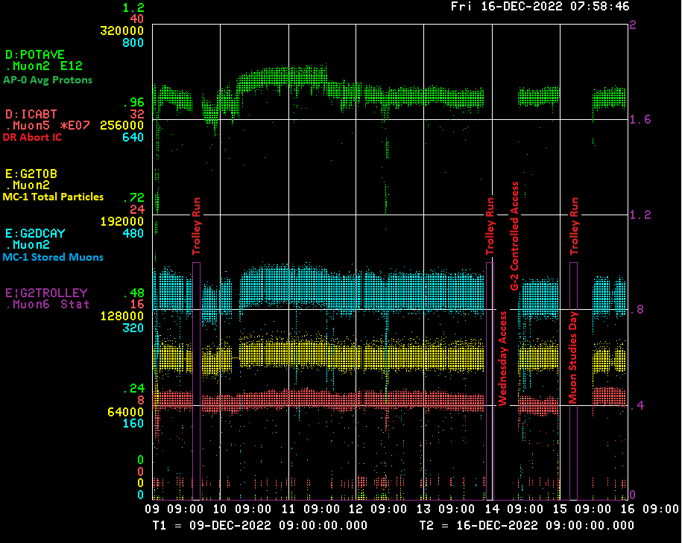

Slide 4
Down Time ...
Muon Campus: (8hrs 42min)
Studies 8hrs 16min
Q108B Ground Flt Repair 0hrs 26min
G-2: (10hrs 6min)
Trolley runs: 3hrs 59min
Scheduled Access: 2hrs 19min
No beam request: 3hrs 45min
DAQ Problem 0hrs 3min

Slide 5
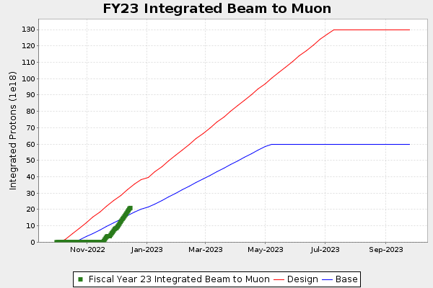
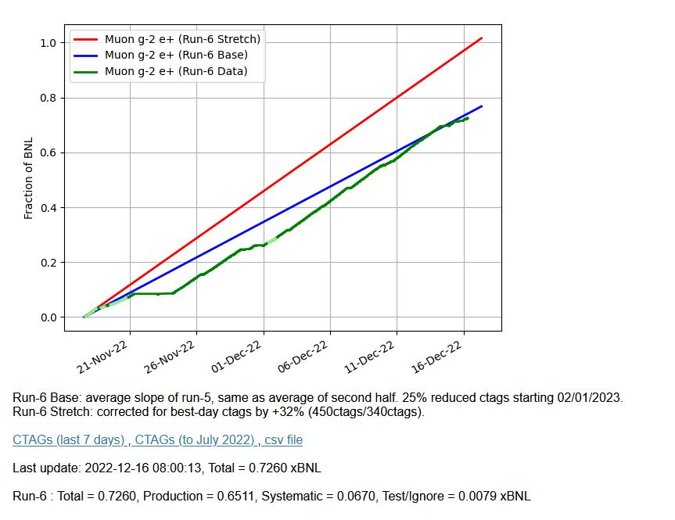
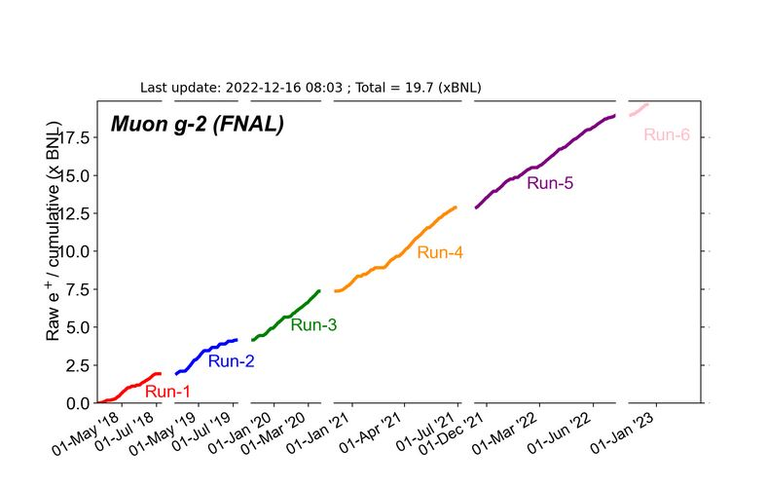
G-2 Performance – Integrated for Run 6
Run 6 # POT
G-2 Experiment POT Run Goal: ~4.2E20 POT
Run 6 period is Nov 2022 – July 2023
Run 6: Goal of ~x6 BNL
Total Run: Goal of x20 BNL
Run 6 Integrated: 0.726 BNL
Total Integrated x 19.7 BNL

Slide 6
Enclosure Access Construction ...
Mu2e Target Hall access enclosure 8 is getting some additional floor space at the top of the stairwell.
Work started Monday December 12th and is expected to take two weeks.
There will be no access through this entrance during the construction. Anyone needing access to the Target Hall will have to enter through the Mu2e building.

Slide 7
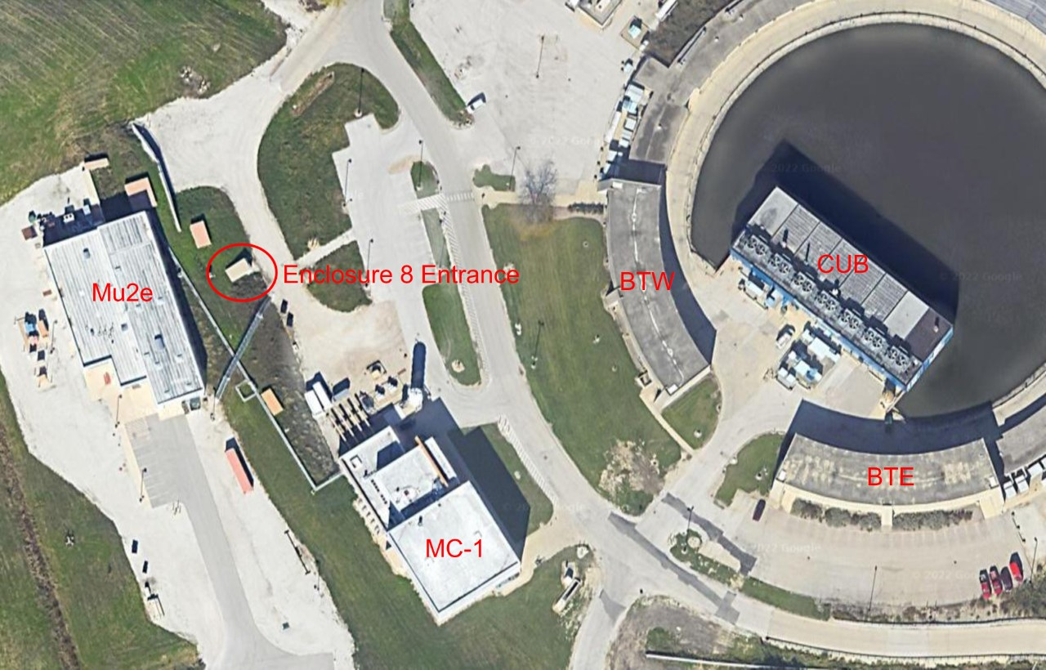

Slide 8
Today / Weekend …
Tune up as needed today.
Run to G-2.

Slide 9
Next Week Studies Plan ...
Monday:
07:00 – 11:00 –> more abort line studies
11:00 – 15:00 more BPM studies
Tuesday:
4 hours of DR BPM Studies, time TBD
Wednesday:
4 hours of DR BPM Studies, time TBD

