Slide 1
MI/RR status
Meiqin Xiao
Friday 9am ops meeting
16 Dec 2022

Slide 2
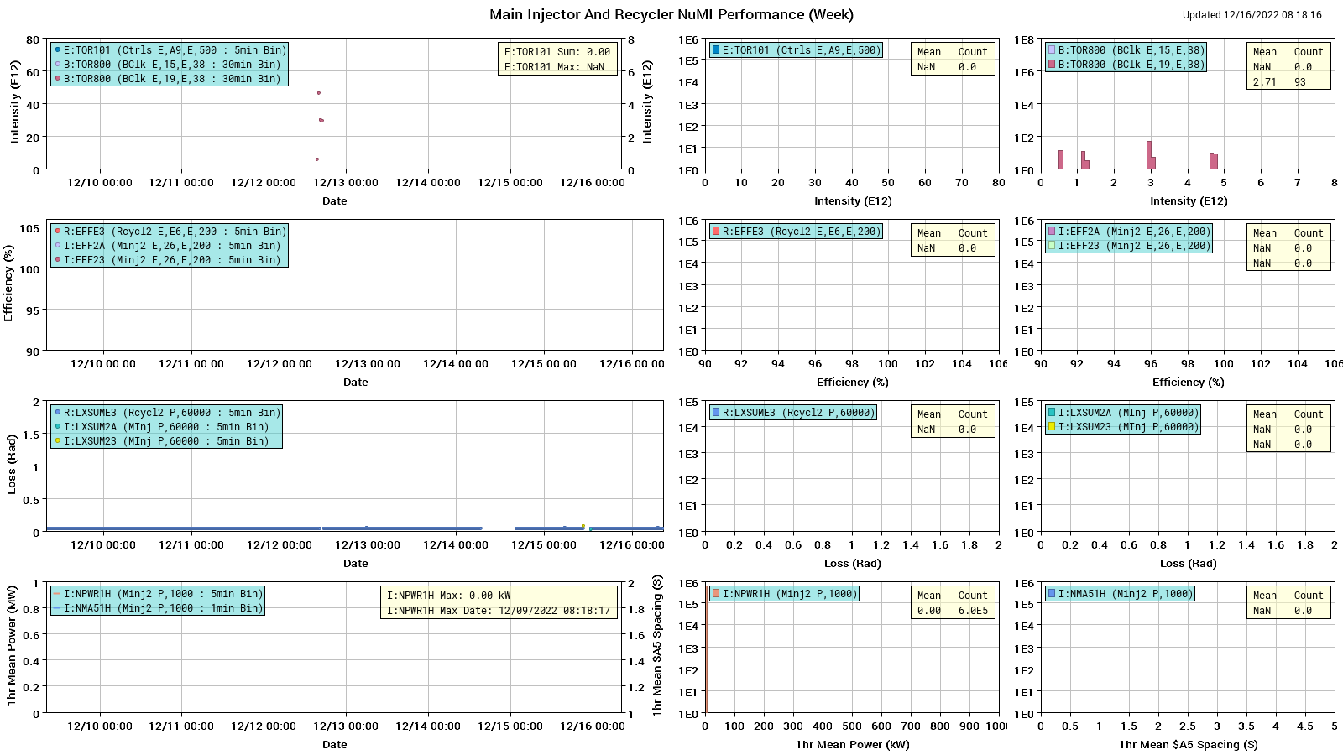
NuMI performance

Slide 3
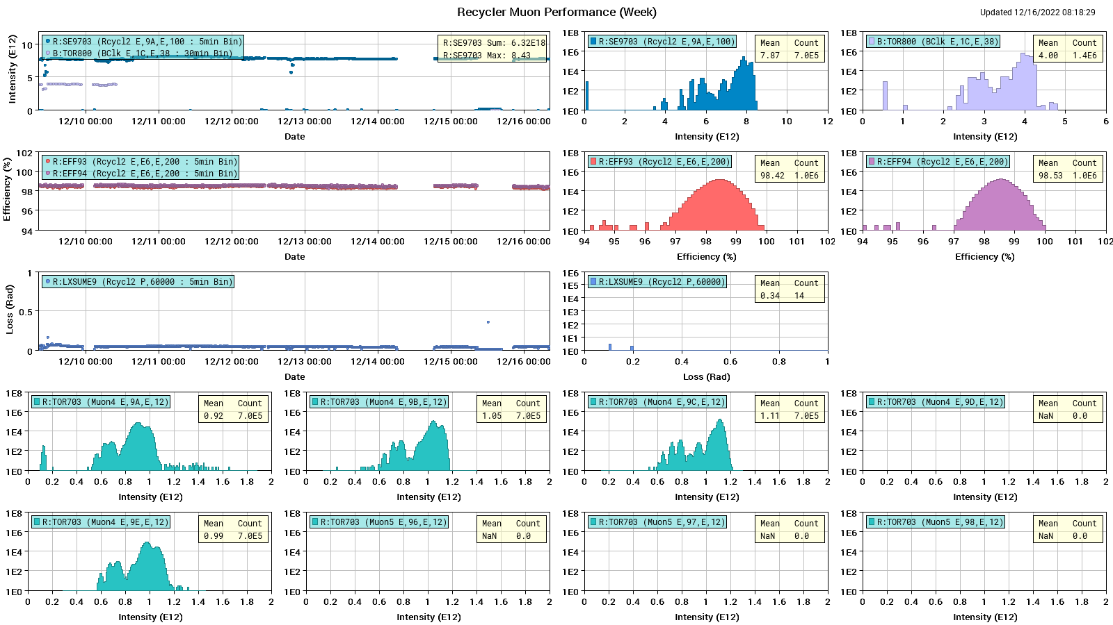
Muon Performance

Slide 4
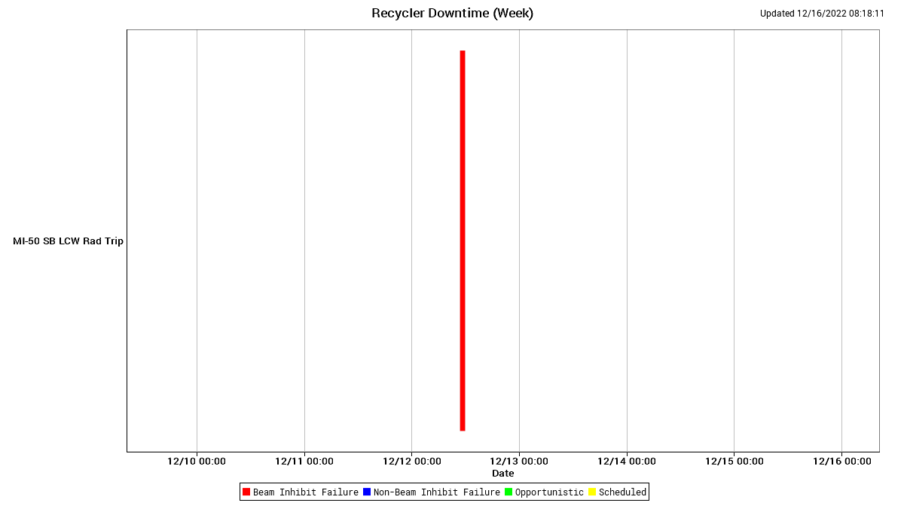
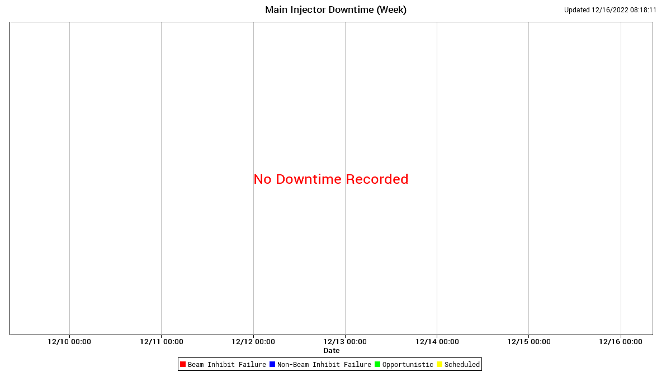
MI/RR downtime

Slide 5
Weekly summary
Beam to G-2 running well
Earlier this week Ops noted problems with the MI10 pond pump VFDs . It got checked on Thursday, and made sure they work properly.
MECAR 1.067S ramp studies. We successfully ran beam on packed $2Es at 1.067s at low single batch intensity. The tune settings calibration was significantly off, but once tunes were set, beam was stable.

Slide 6
Today
External Beams/Switchyard should complete their sign-offs Friday afternoon. MI is right now in a very good condition. There will be no problem if they take the beam of 5.E11. MI personnel will be available over the weekend for slow spill issues.

