Slide 1
Meson Report
Michael K. Olander
AD 9:00 Meeting
28 October 2022

Slide 2
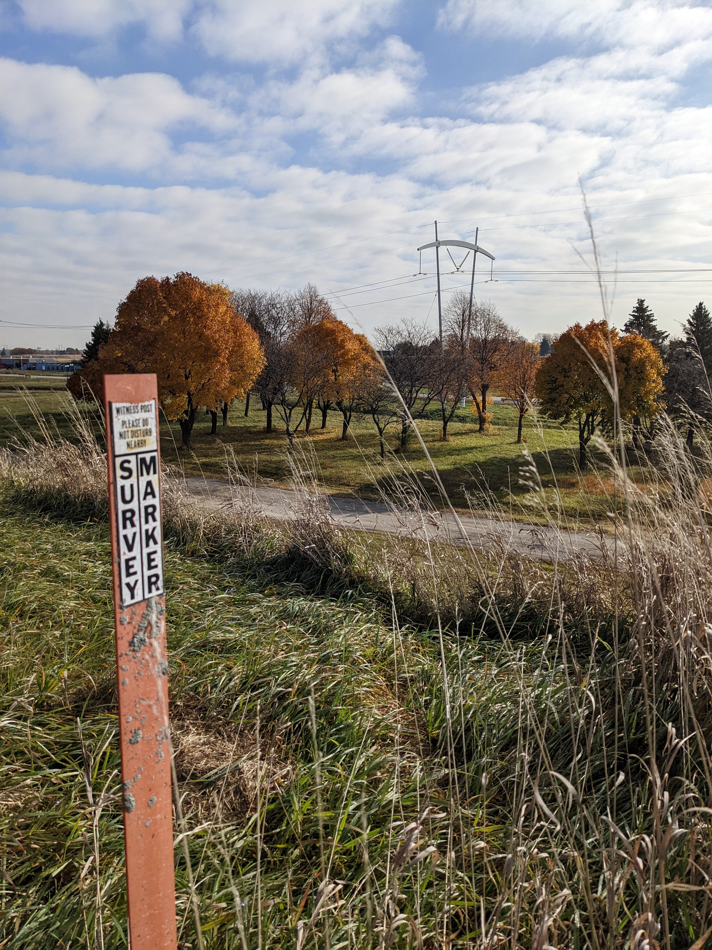
Meson Berm Walkthrough
No sinkholes observed.

Slide 3
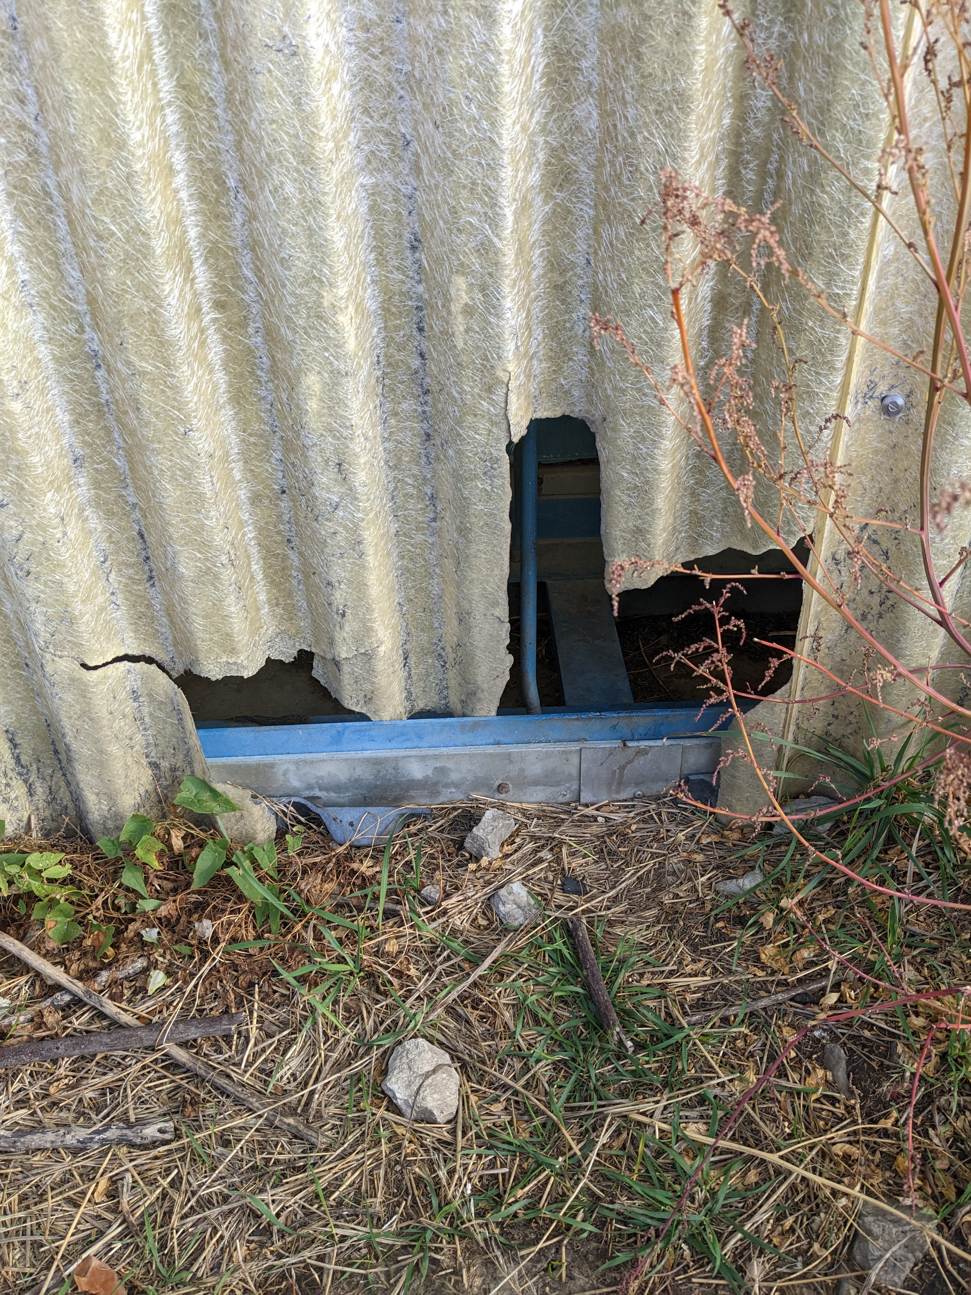
Meson Berm Walkthrough
Meson Detector Building has a hole in the wall above the FTBF offices & workshop.

Slide 4
Shutdown/Restart Work
F1-Manhole Vacuum Repairs
  S220 Repairs
MT5VT2 leak repair
MC6Q1-2 leak repair
Restart & polish MS2 LCW system
Return to service power supplies that were LOTO’d
MC7AN magnetic field measurement for ES&H
  Power supply requires MS2 LCW system operational

