Slide 1
SSR Status Update at Fermilab
SSRs team at Fermilab
December 22, 2022
ALL Partners Coordination Meeting

Slide 2
EPDM for PIP-II/SSRs scope
Engineering Process Documentation Management (EPDM) | Teamcenter No.
Prototype SSR1 | ED0001256
Production SSR1 | ED0011856
Pre-production SSR2 | ED0001257
Production SSR2 | ED0011912
The EPDMs listed contain all the references for the Design, Procurement, Fabrication, Assembly and Testing for all components and subassemblies for the cryomodule.

Slide 3
Flow-down of Requirement and Interface Specifications

Slide 4
Status of Design Reviews

Slide 5
SSRs Niobium and Cavities
SPM: P. Berrutti
Presenter: M. Parise

Slide 6
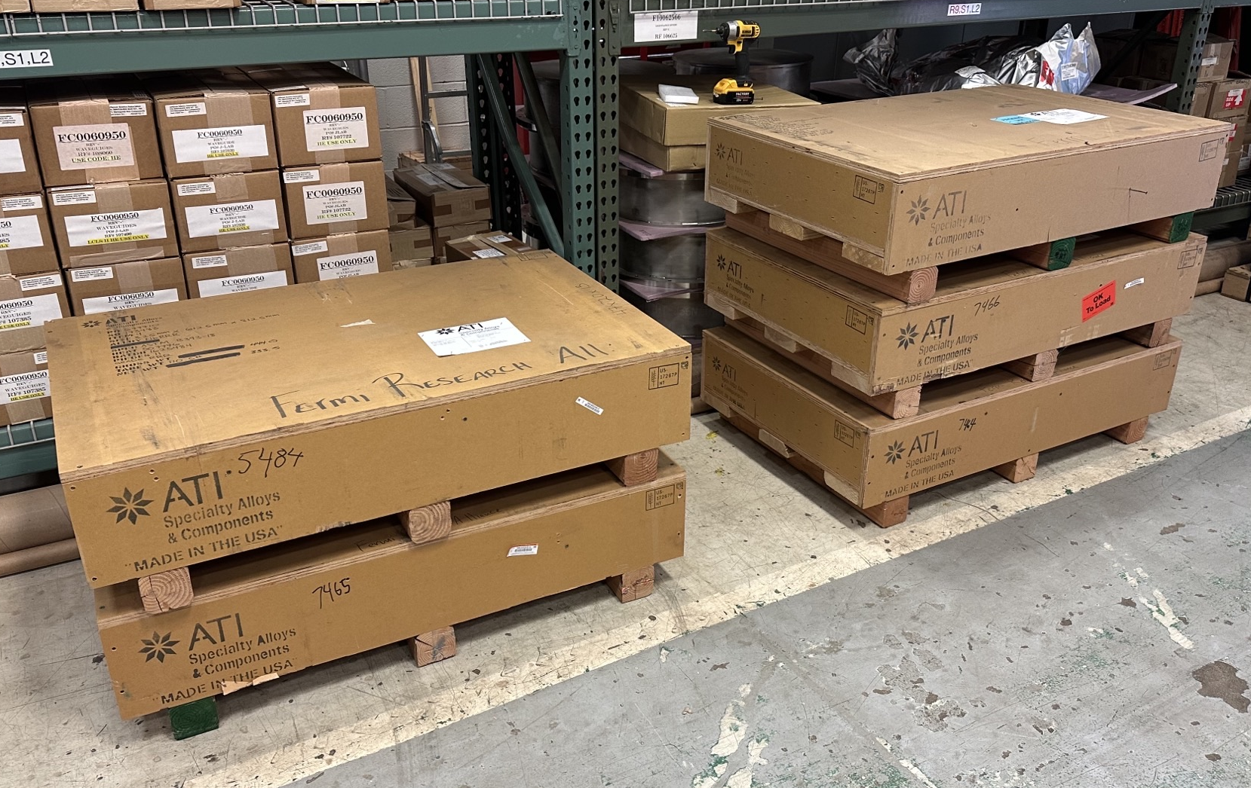
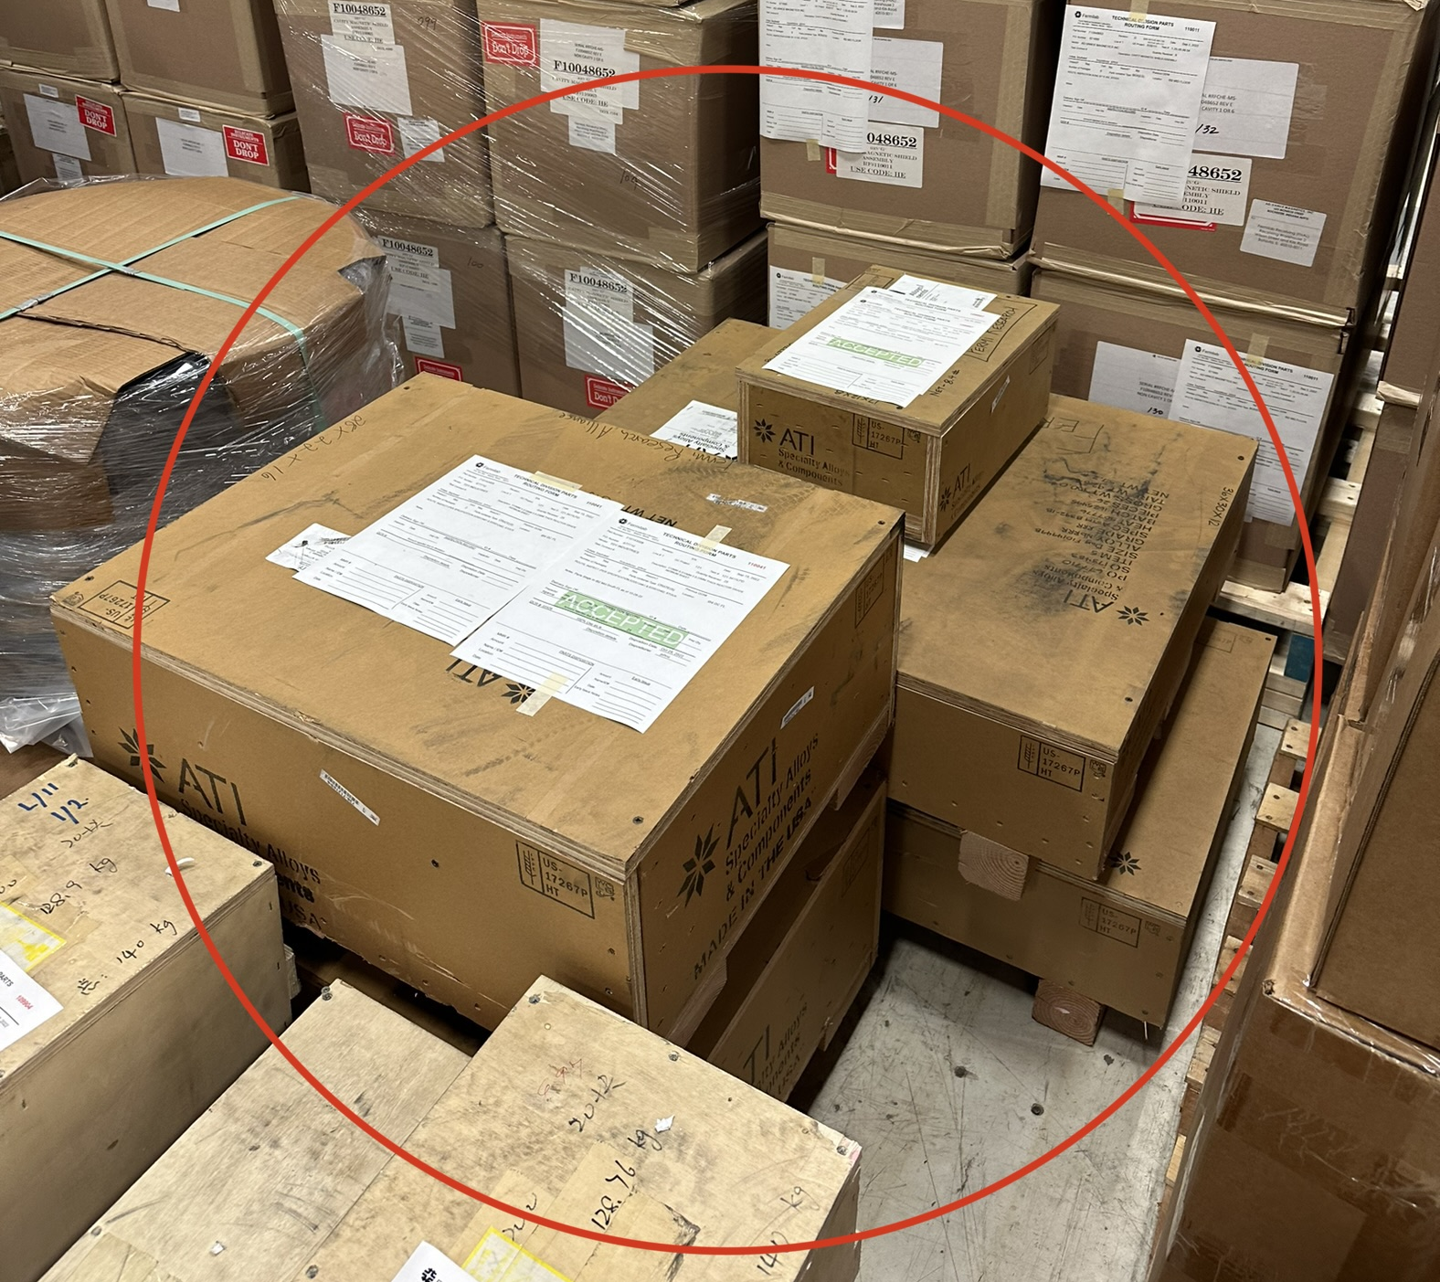
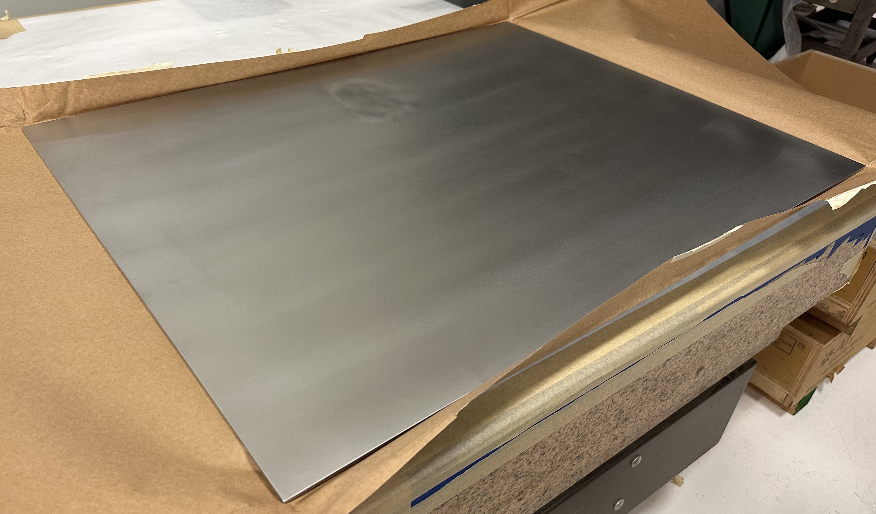
Niobium
SSR1
PO677710 with ATI
All material was received and QCed at Fermi. Strengths are above the required one on average. No major defects were found during visual inspection. Thickness is within the tolerances specified on drawings.
Crates are on their way to Zanon for SSR1 Production Cavities Manufacturing
Awarding second PO for CM2
SSR2
Acquisition Plan approved by FSO
RFP for Production Niobium is being prepared
RRR Grade Sheet Crates
Tubes and Gr1 Crates
RRR Grade Niobium Sheet

Slide 7
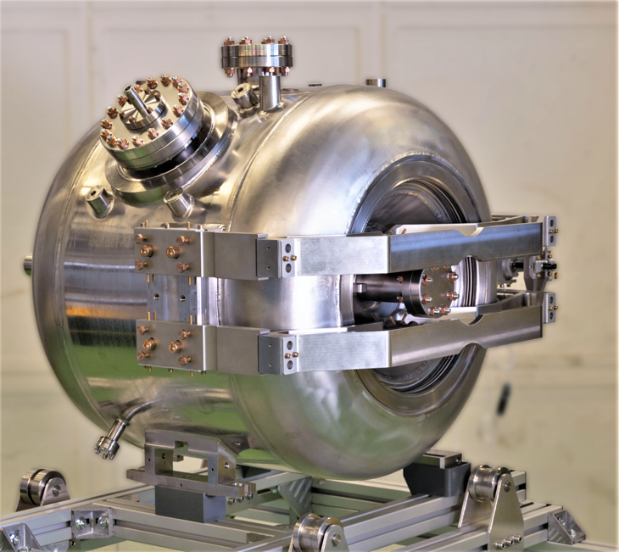
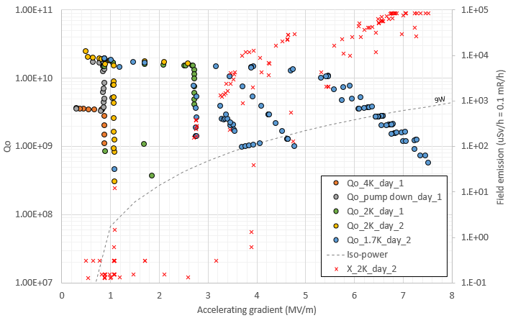
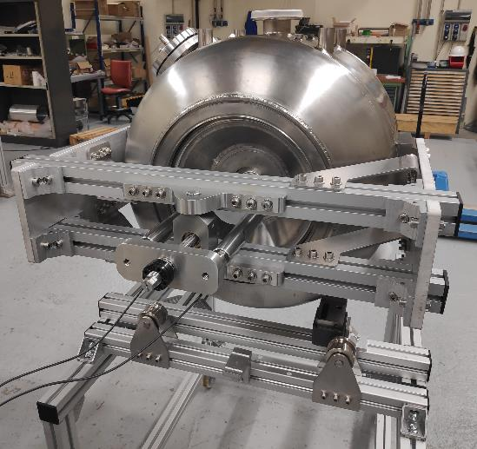
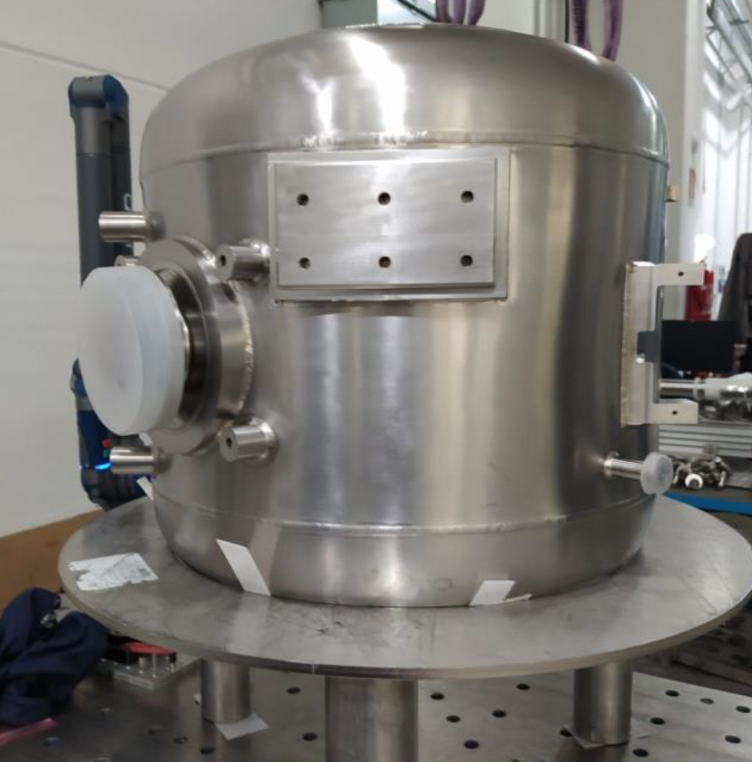
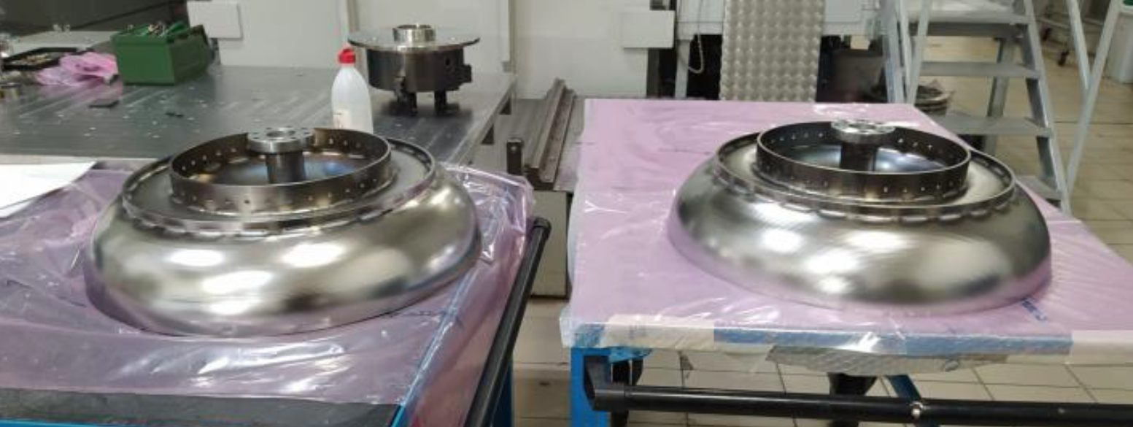
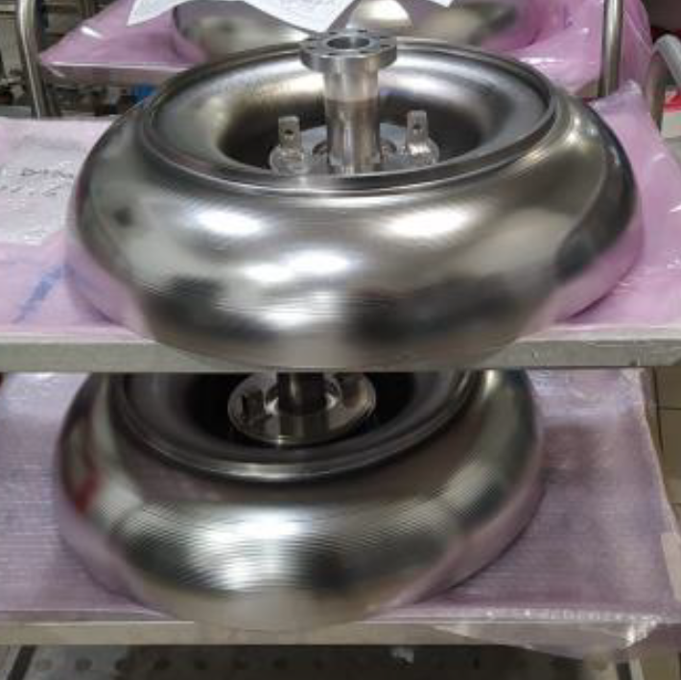
Cavities
S2-ZA-001 E vs Q₀ Plot
SSR1
PO 690591 with Zanon for the fabrication of 9 Production Cavities. Next milestone is the MRR to be scheduled early 2023.
SSR2
Fabrication and processing
3 ppSSR2 cavities (S2-ZA-001/2/3) were manufactured by Zanon. S2-ZA-001 was fully processed. S2-ZA-003 will complete processing early January. S2-ZA-002 is being processed at IJCLab.
Other 3 are expected to be completed (manufactured and processed) in spring 2023 by Zanon.
RI is working on the fabrication of 3 cavities. MRR was performed. First cavity (manufactured and processed) ready in late spring 2023.
Testing
S2-ZA-001 was tested at IJCLab. Structurally sound. Df/dp ~ 3 Hz/mbar. Performance limited by FE. New HPR at IJCLab and testing again in January.
ES&H Compliance
Eng note for S2-ZA-001 is approved and released in TC (EN08416)
Master Eng. Note for ppSSR2 is EN03693
S2-ZA-001 at IJCLab with Tuner
S2-ZA-002 at IJCLab during QC
S2-ZA-003 at Zanon post fabrication
S2-ZA-004/5/6 parts fabricated and welded at Zanon

Slide 8
SSRs Solenoids
SPM: Miao Yu
Presenter: Miao Yu

Slide 9
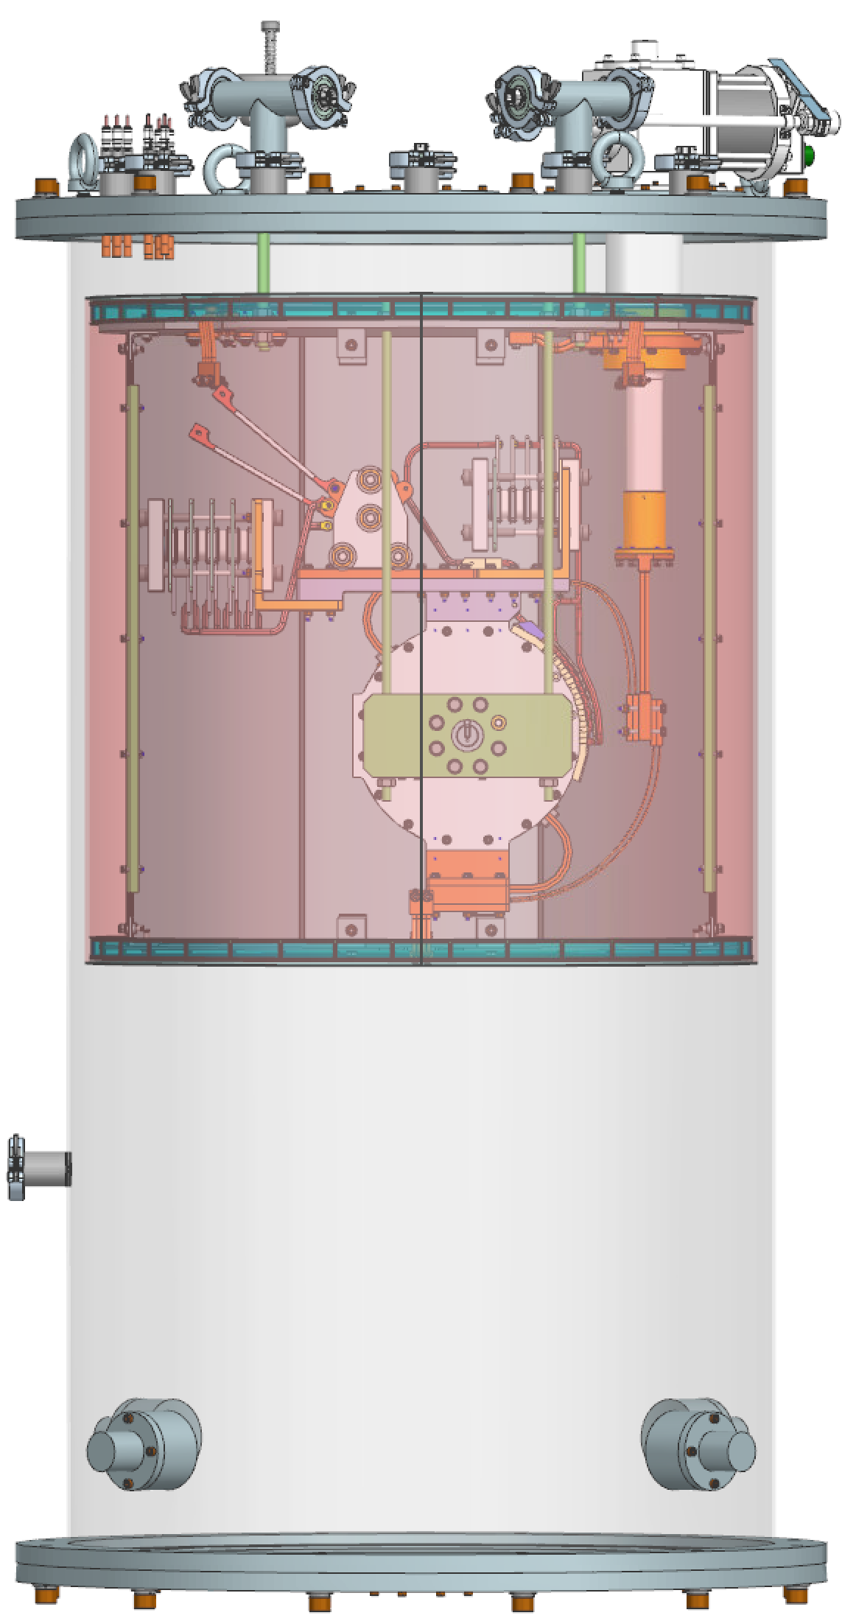
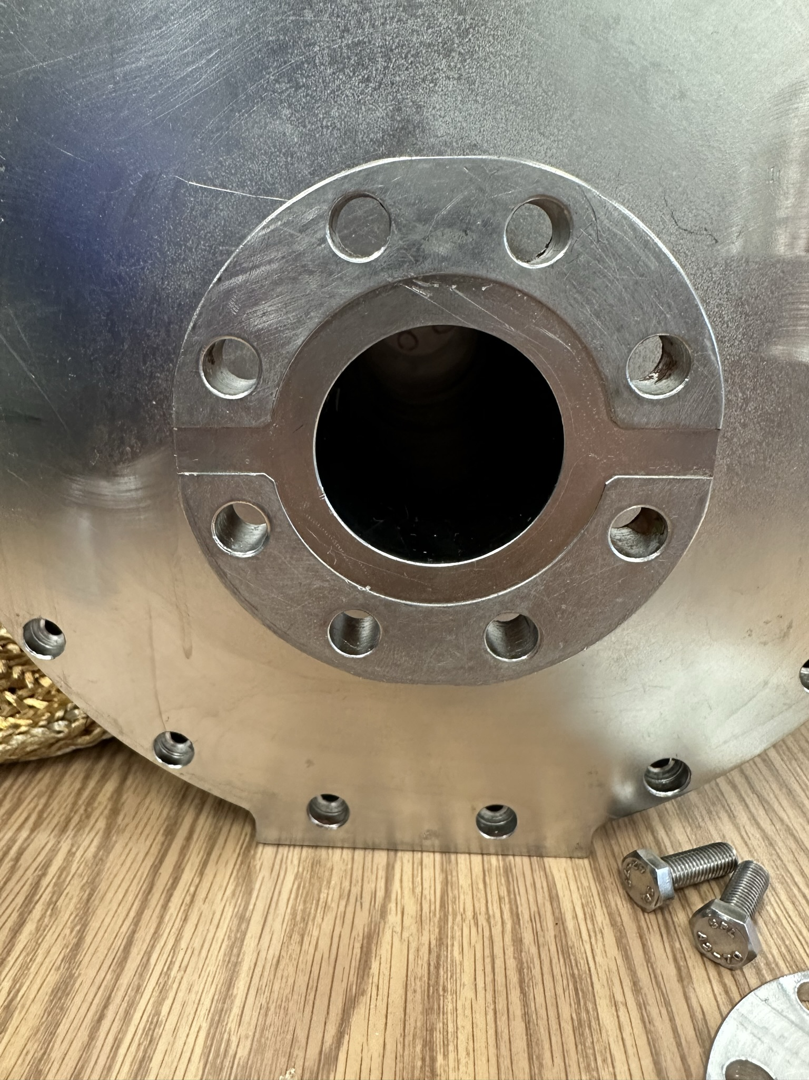
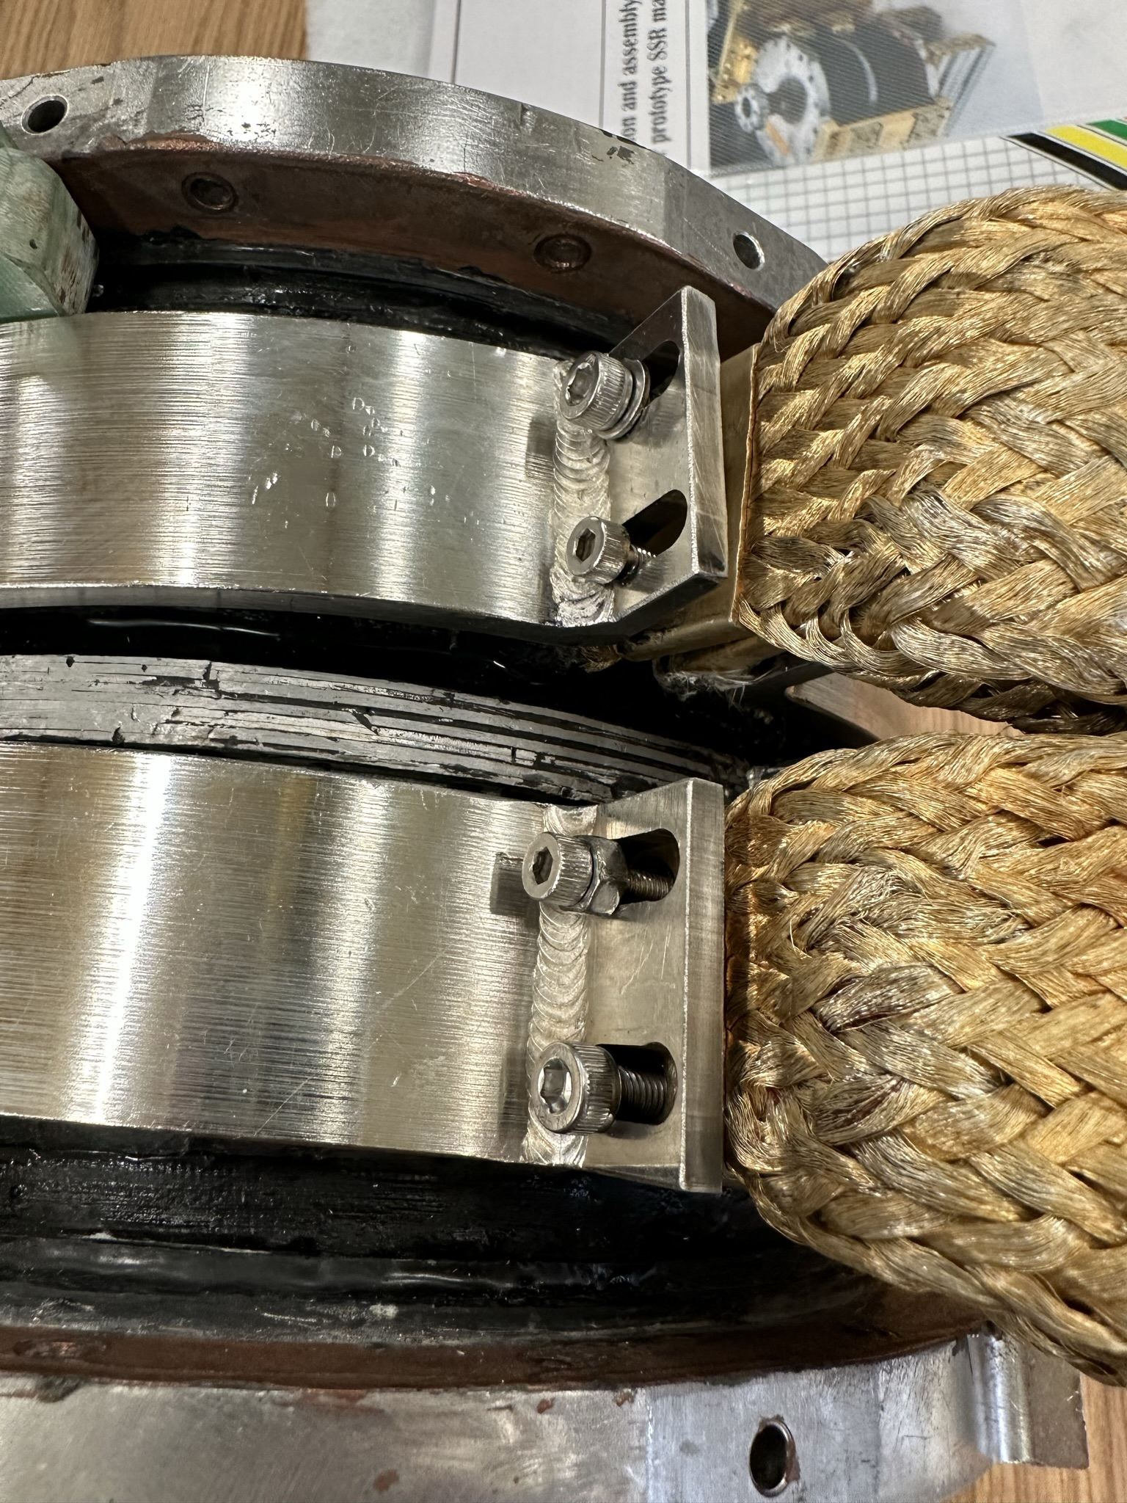
SSR solenoid status update – FNAL activities
Prototype solenoid is under inspection.
The final assembly will be done in Jan. 2023
The cold test to verify the prototype and commissioning the test stand is planned after.

Slide 10
SSR solenoid status update – BARC activities
Three pre-series solenoids (P2-SSR-BARC-A-009, 004 & 007) were delivered to BARC.
The fourth one (P2-SSR-BARC-A-006) is being fabricated at the vendor with estimated completion date by the end of this December.
Waiting for heat sink parts, expected to be delivered in March 2023.
PO for the diode rack assembly will not be placed until June 2023.
Warm measurements are in progress on three pre-series solenoids.
Cold testing is planned to be done by the end of Jan. 2023 for two solenoids and by the end of Feb. 2023 for the other two solenoids.
The schedule and key milestones have been updated by BARC and we are doing analysis to find out any impact.

Slide 11
SSRs Couplers
SPM: N. Solyak
Presenter: N. Solyak

Slide 12
Procurements
From CPI, we have received all couplers which were part of the original procurement
6 Antennas, 4 Vacuum outer conductors, 4 Air side Assemblies
CPI had enough spare parts to make 1x outer conductor and 1x air side, so we agreed to purchase these
Copper plating in progress

Slide 13
Procurements
We are working to fix one antenna which became bent
Bending we believe was during manufacturing (brazing thermal contraction) – design is fixed for future
Bending does not affect Qext so much, but it is incompatible with the test stand
Otherwise, couplers are to our satisfaction
Although it required several returns to the vendor for corrections

Slide 14
SSR2 coupler test stand – First coupler pair

Slide 15
Other side of the SSR2 coupler test stand

Slide 16
Testing protocol
Conditions:
Air flow rate ~3 g/s per coupler
DC bias 3.5kV – each coupler (parallel)
Cooling: radiators on window flange, 2 fans for cooling
Vacuum interlocks 2.e-6 Torr for both vacuum gauges
Window temperature interlock ~140 F (check?)
RF processing for each reflection phase (0, 90, 180, 270 deg)
Pulse mode (1 Hz): 10; 100; 300; 500 ms, power ramp up to 25kW; stay few min per short pulses, ~5min for 500ms at maximum power, if no MP
CW mode: ramp up power to 12kW. Stay >1.5 hours to reach equilibrium temperature
Diagnostics
Vacuum: 2 vacuum gauges on couplers and vacuum in pump line
Temperature: window flanges (2), chamber (1), DC blocks (2);
DC bias: voltage (1) and pick-up probes (2)

Slide 17
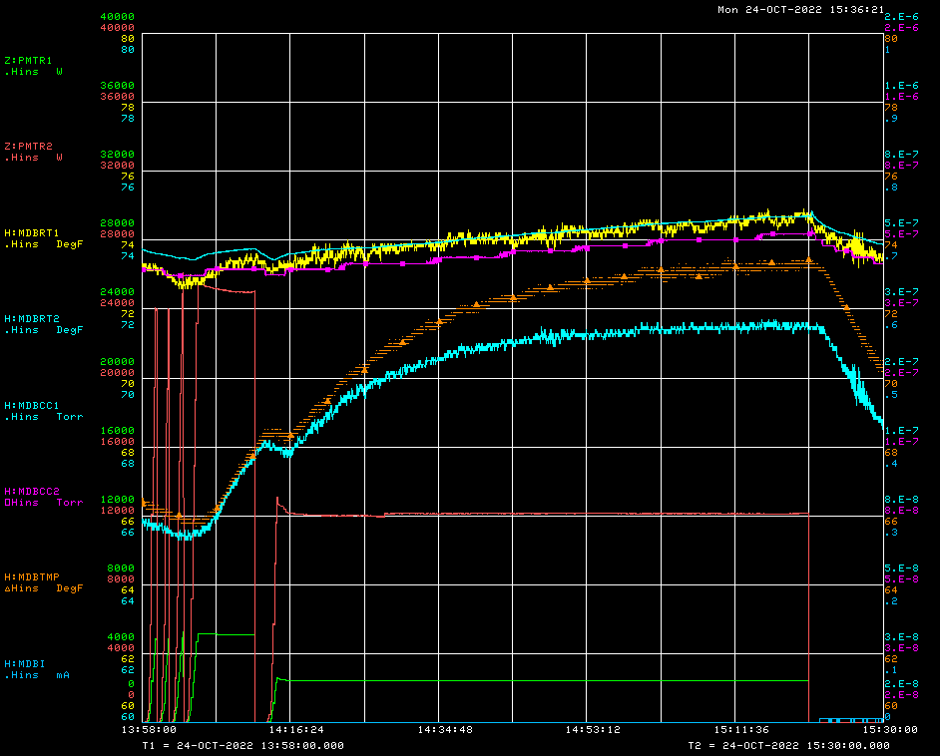
SSR2 couplers
Phase = 90°
Bias ON; 3.5kV
Air flow=3 g/s (ea)
Pulse mode: 10, 100; 300; 500ms, P_{max} =24kW
CW mode (~1.5hrs) P_{max} =12kW
No MP
T _{window#1}
Vacuum#1
Vacuum#2
T _{chamber}
T _{window#2}
RF power

Slide 18
Summary
SSR2 pre-production couplers #1 and #4 were tested at RT stand in standing wave mode for 4 reflection phases: 0, 90, 180, 270 degrees. DC bias 3.5kV was applied for both couplers. Cooling provided by air flow through antennas, outside windows were cooled by 2 fans. Test done for pulse mode (10,100,300,500ms) with RF power up to 25kW and in CW mode for maximum power 12 kW (TRS). We stay at maximum power at least 1.5 hours to reach temperature equilibrium.
Test results:
No MP for all tested regimes. Vacuum increase follows the temperature rise
Maximum window flange temperature is < 80F (30C)

Slide 19
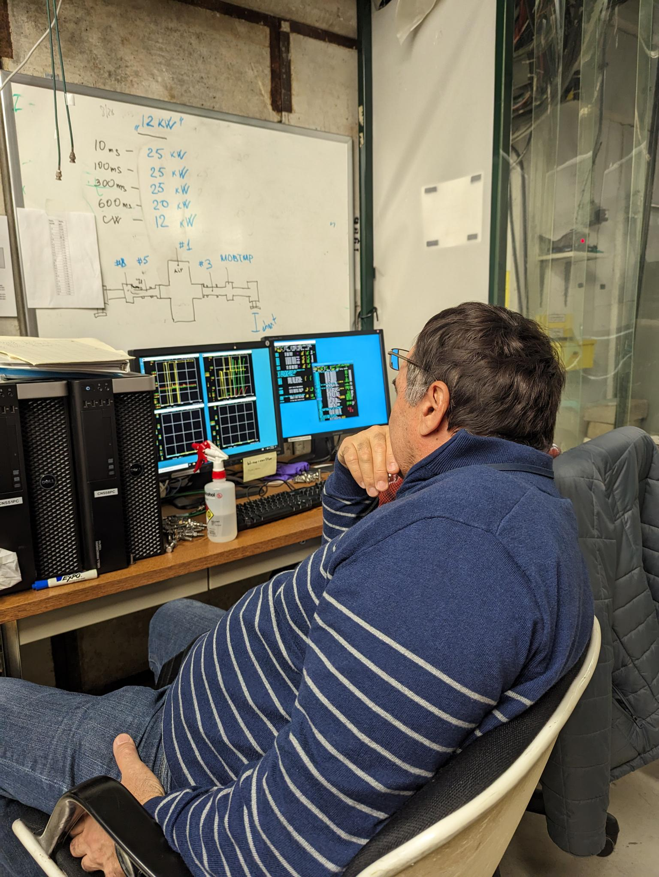
Testing – Second coupler pair
One window has Ti-N coating
Both couplers with ‘long e-probe’
We will test without HV bias to determine Ti-N effect
In progress!

Slide 20
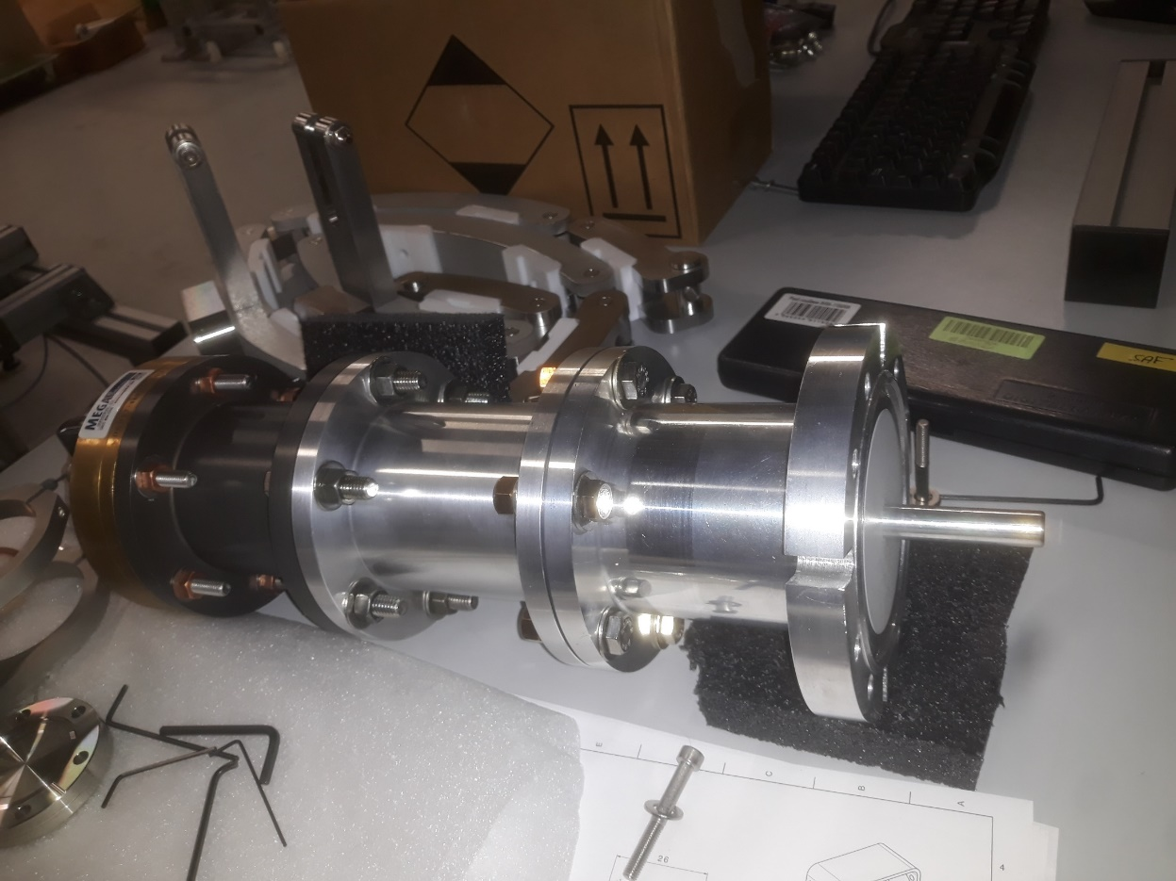
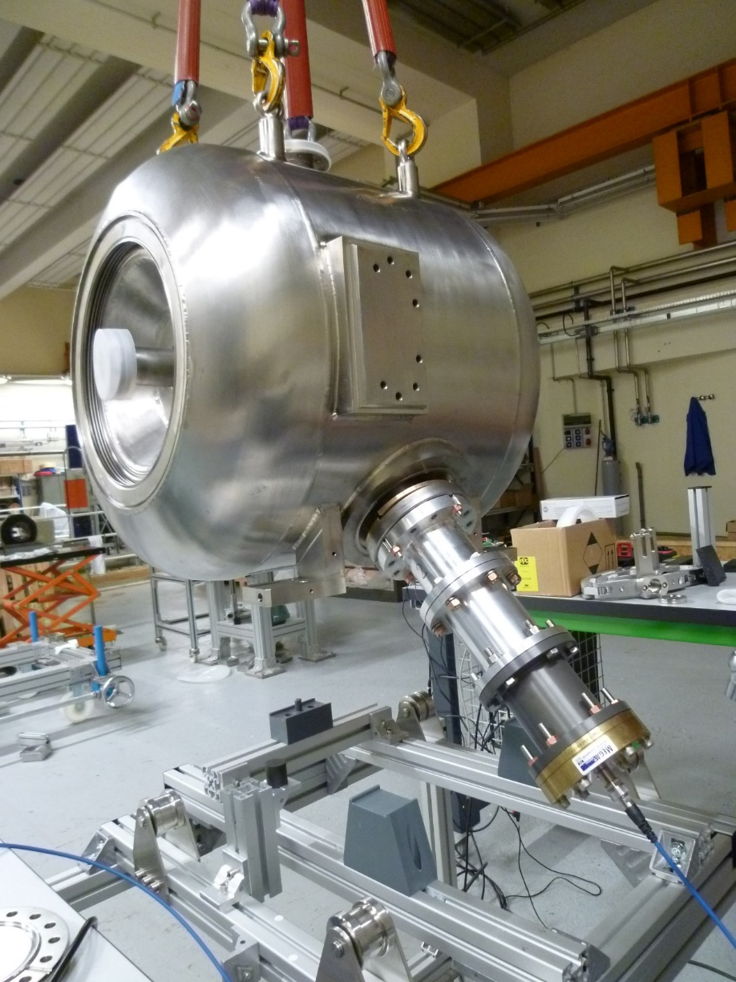
Power coupler mockup
53.35mm
Fixed only by 4 screws
Antenna length (extremity from blank surface) = 53.35mm
Seal thickness = 4.4mm (used seal from JCAV 1)

Slide 21
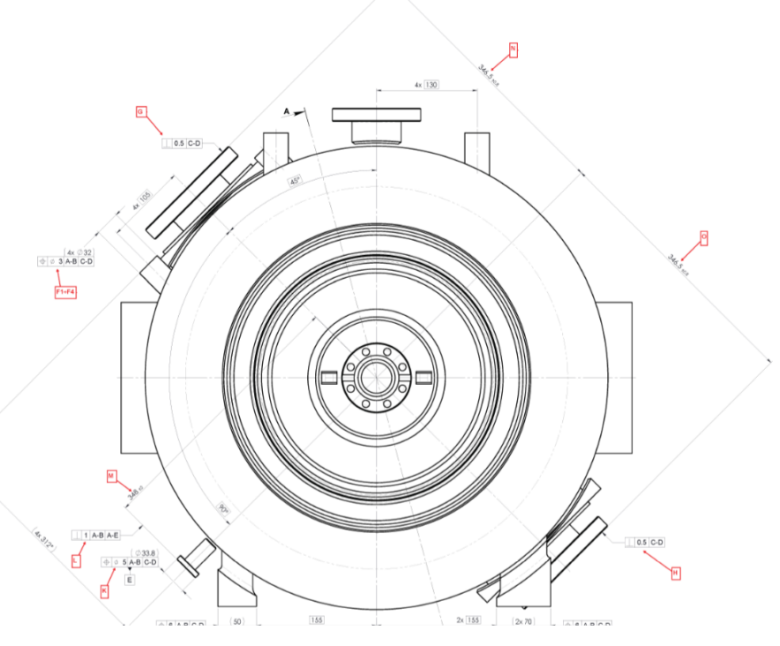
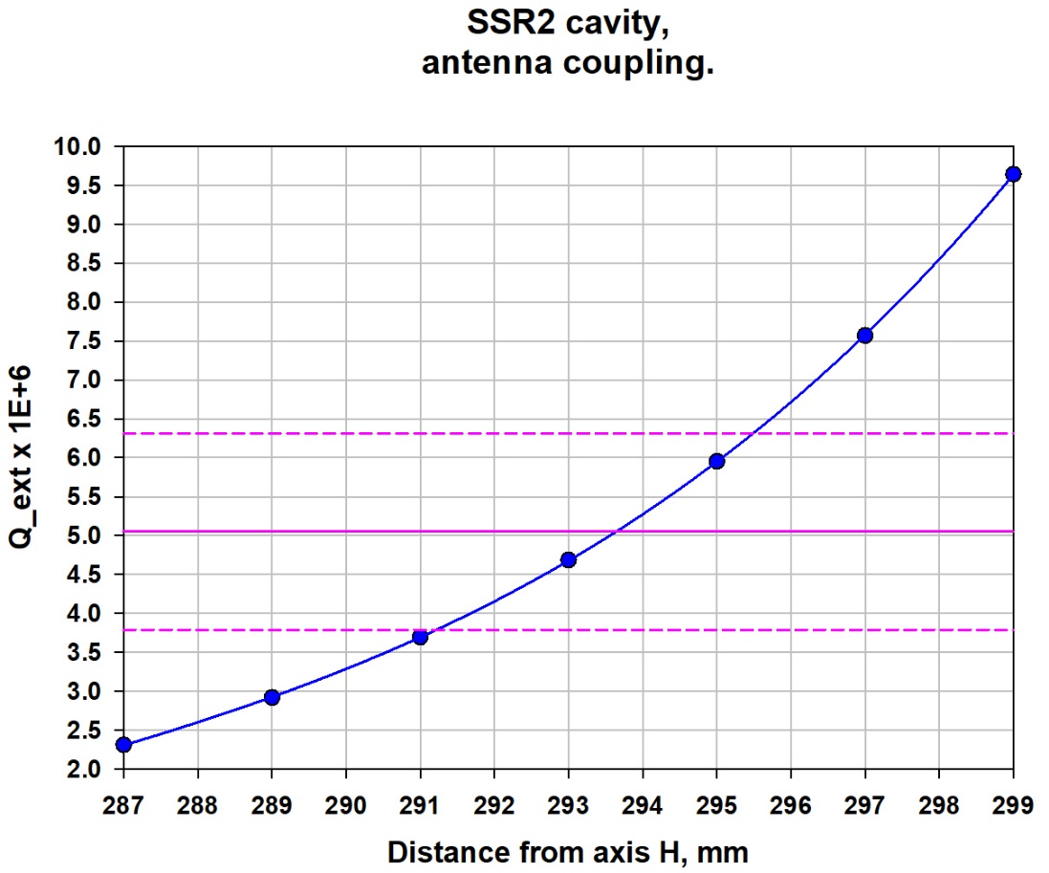
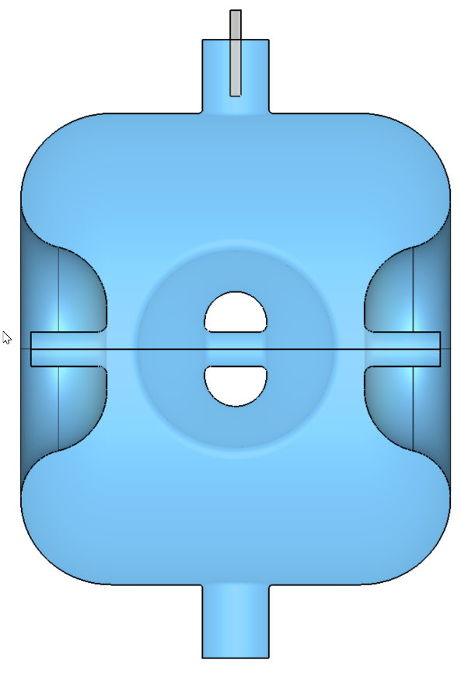
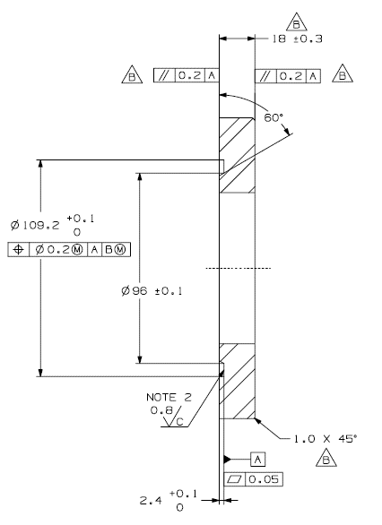
Power coupler mockup
Z20012000100_S2-ZA-002_S2-ZA-002_220_D002_x202200360_01.xslx
Dimension O: 346.31mm (Zanon)
Antenna length penetration measured: 53.35mm (PaD)
Seal groove on coupler flange: 3.2mm (PaD)
Seal groove on cavity flange:0.5mm
Seal thickness: 4.4mm
Real penetration:
H = 346.31 – 53.35 – 4.4 +0.5 +3.2
H = 292.26mm
346.31mm
Qext = 4.e6
SSR2
Sergey K. FDR
H
Flange 2K on the coupler
groove on the mockup: 3.2mm

Slide 22
SSRs CM design
SPM: M. Parise Presenter: M. Parise

Slide 23
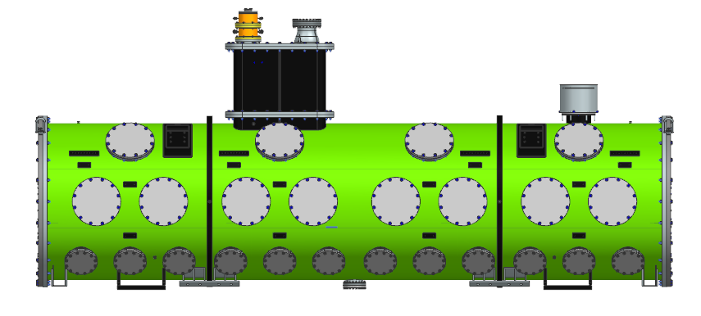
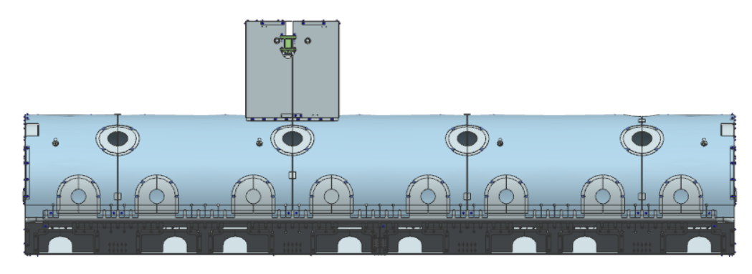
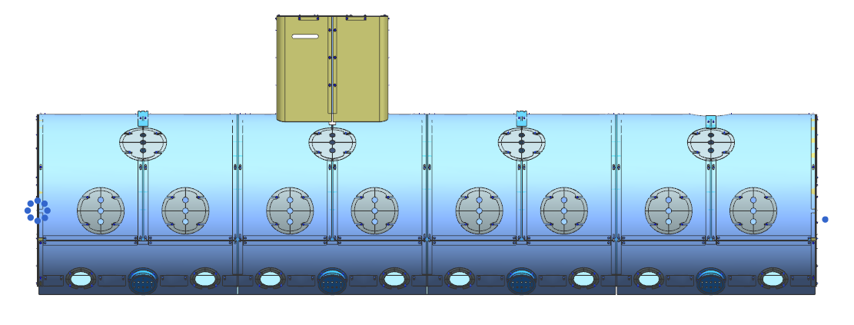
SSR1 Cryomodule Design
Vacuum Vessel and Strongback Tray: 3D model completed – Analyses completed – Drawings to be finalized
Global Magnetic Shield: 3D model completed – Analyses ongoing – Drawings to be finalized
Thermal shield: 3D model completed – Analyses ongoing – Drawings to be started
F10187714
F10191721
F10193985

Slide 24
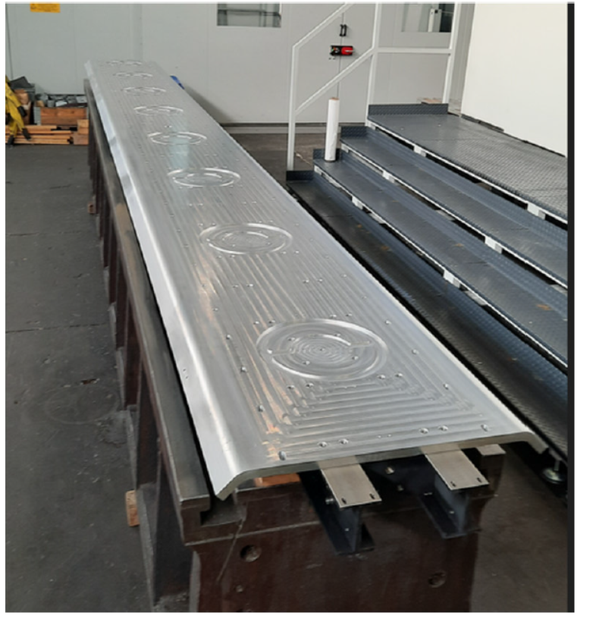
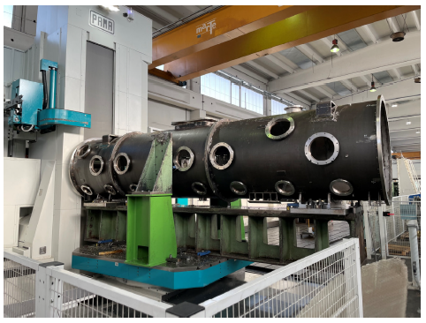
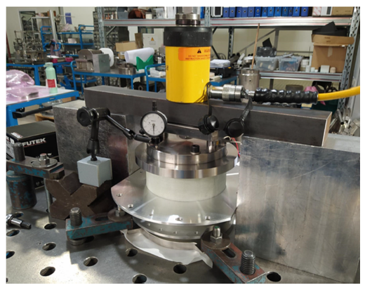
SSR2 Cryomodule Procurement
Vacuum Vessel final machined – Strongback final machined – 1st support post traction tested
Global magnetic shield manufacturing ongoing – 1st parts delivered and under QC
Thermal shield machining is ongoing – design changes were needed

Slide 25
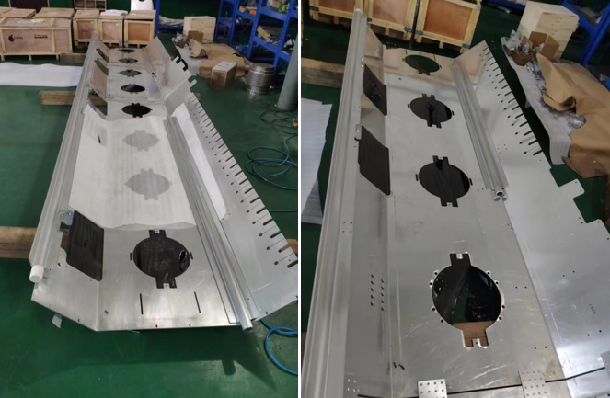
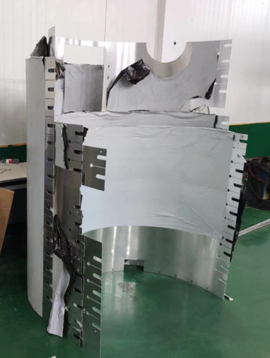
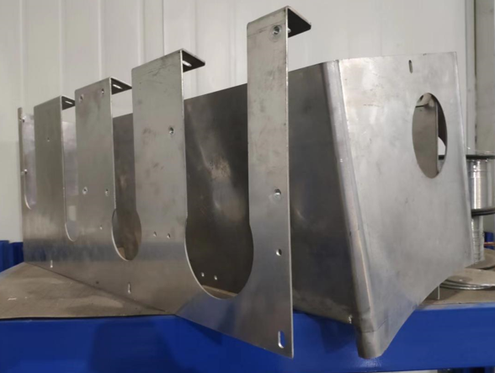
SSR2 Cryomodule Procurement
Vacuum Vessel final machined – Strongback final machined – 1st support post traction tested
Global magnetic shield manufacturing ongoing – 1st parts delivered and under QC
Thermal shield machining is ongoing – design changes were needed

Slide 26
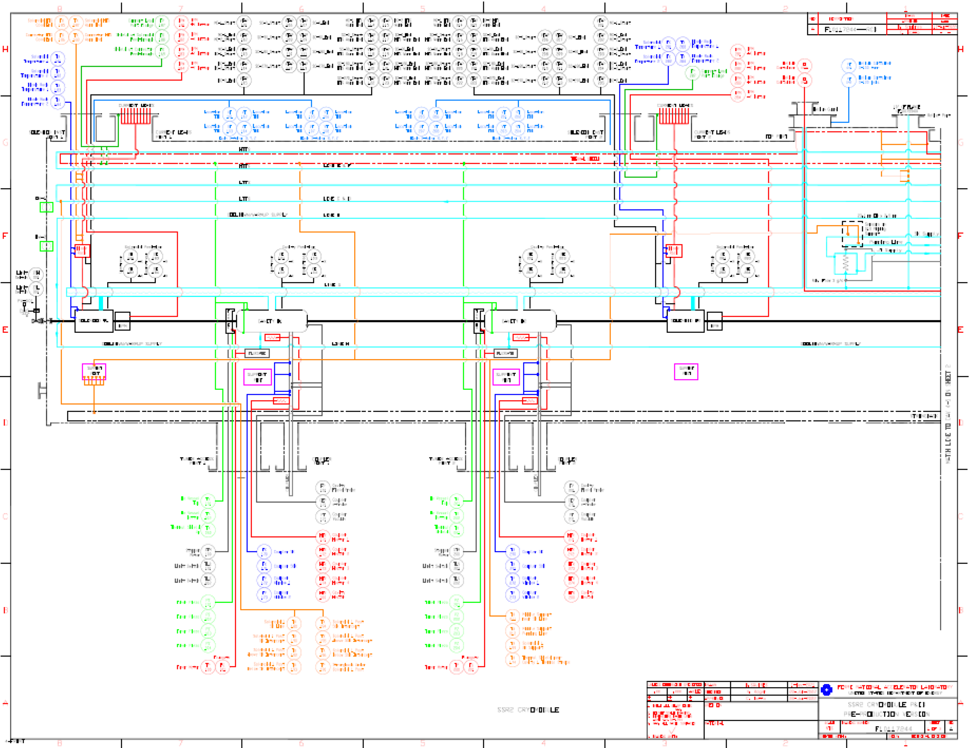
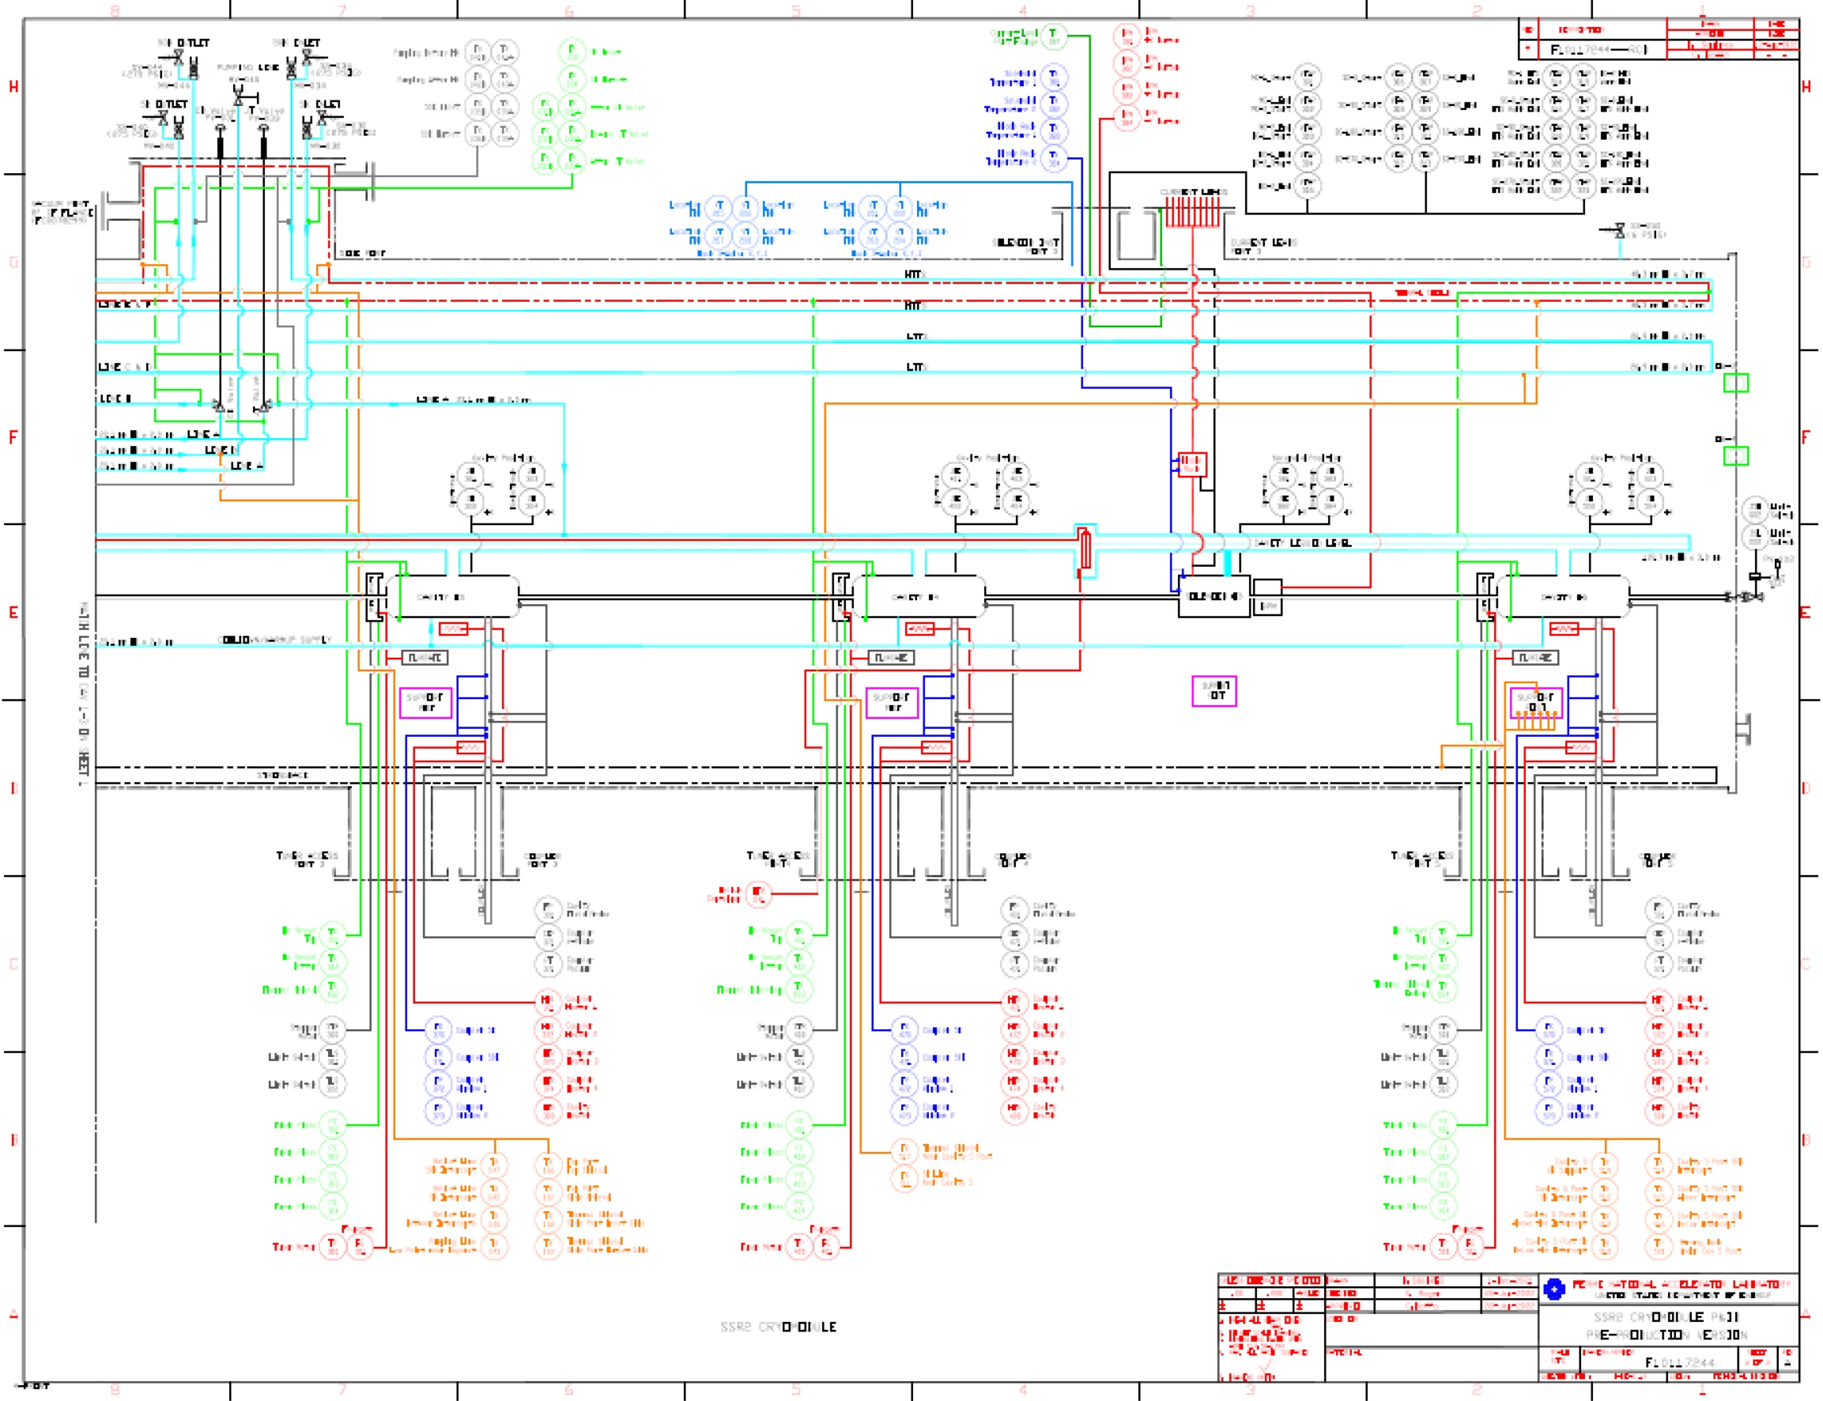
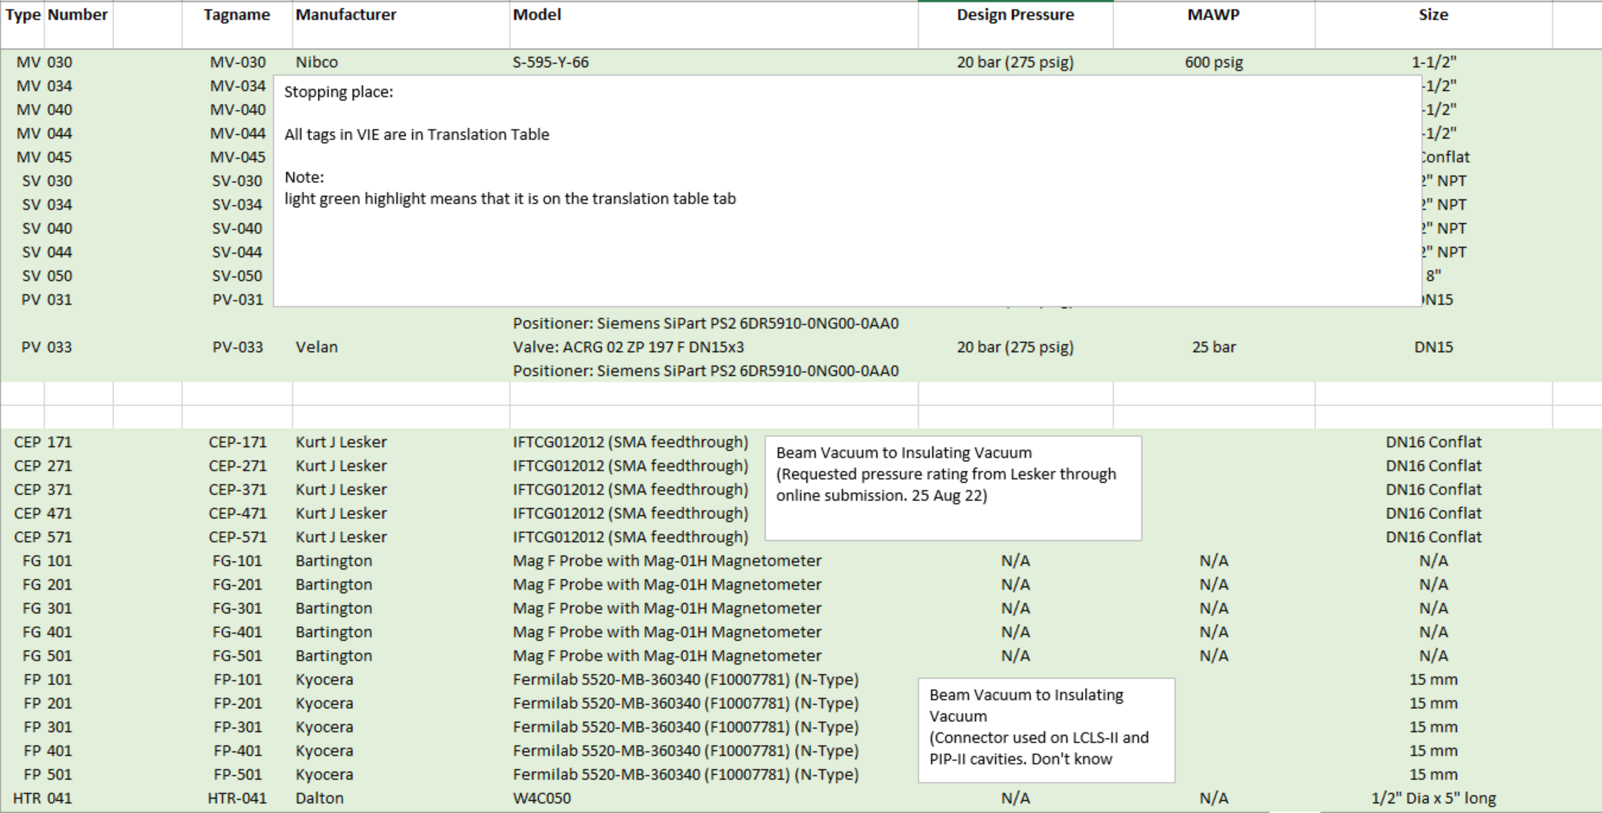
Instrumentation – ES&H Required Documents
Required for Cryo Review
P&ID
ppSSR2 (F10117244 Rev A) 99%
SSR1 Prod (F10137214 Rev -) Needs to be created
Valve and Instrumentation List
ppSSR2(F10117244 Rev A) 80%
SSR1 Prod (F10137214 Rev -) Out of Date

Slide 27
Vacuum vessel engineering notes
ppSSR2 cryomodule
Vacuum vessel engineering note EN05047 has been reviewed and pre-approved by Roger Rabehl.
Beamline vacuum vessel engineering note is also been reviewed and pre-approved by Roger Rabehl.
Waiting for fabrication documents to be uploaded. Then they can be released.
SSR1 Production cryomodule
Writing vacuum vessel engineering note EN09195 just started.

Slide 28
Near Term Milestones
Next SSR Status Report Meeting is set for January 11th 2023
FDR for SSR1 Production CM will be scheduled in February
Major near-term procurements:
Vacuum Vessel for SSR1 production CMs
Couplers and Tuners for SSR1 production CMs:
Req in the system March 2023

Slide 29
Action items from previous meetings
BARC: cavities tooling Technical discussion ongoing
BARC: Plan tuner Manufacturing Readiness Review Discussion in progress
Release TRS/ISD for the SSR2 cryomodule Released!!!

Slide 30
Action Items

