Slide 1
IJCLAB status/updates on SSR2 activities
Patricia Duchesne, Sandry Wallon, Nicolas Gandolfo, Longuevergne David
On behalf of PIP-II team at IJCLab

Slide 2
Status of proto couplers fabrication at PMB Cie
Status :
  Vacuum side
    2 vacuum parts shipped to Fermilab (flight scheduled for this week)
    2 other vacuum parts presented a leak problem that has been repaired: no leak detected
    3 External conductors were copper coated: problem of bubbling at the exit of the cone (checks in progress)
  Air side
    External conductor of the air side: test piece copper coated (thickness measurement in progress)
  Visit of PMB reported and planned the end of January for complete assembly and low level RF test.
External conductor of the vacuum side
External conductor (test piece) of the air side

Slide 3
Progresses on cavity prototypes
3 cavities being built @Zanon.
  First Prototype
    Processed @Zanon, tested in vertical cryostat @IJCLab the 25th of October 2022
    Re-processed @IJCLab: HPR, pumping, baking 120°C, from 5th to 15th of December 2022
    Preparation for the cold test from end of December 2022 to the 1^{rst} week of January 2023
    Test in vertical cryostat @IJCLab planned the 2nd week of January 2023
  Second prototype
    Bare cavity delivered @IJCLab in May 2022 for rotational BCP treatment
    Shipped back @Zanon for HPR, heat treatment and tank integration, delivered back @IJCLab the 1^{rst} of December
    Measurements with: dummy tuner (cavity stiffness & tuning sensitivity), power coupler mockup (Qext), Tuner 2 (tuning sensitivity, efficiency)
    Final BCP the 1rst week of January 2023; HPR, pumping, baking 120°C until the end of January 2023
  Third prototype
    To be delivered ready for vertical testing the beginning of January 2023
    If sufficient Helium storage, possibility to test it in vertical cryostat @IJClab with the 1^{rst} prototype
3 additional prototypes being built to be delivered @IJCLab ready for test in spring 2023.

Slide 4
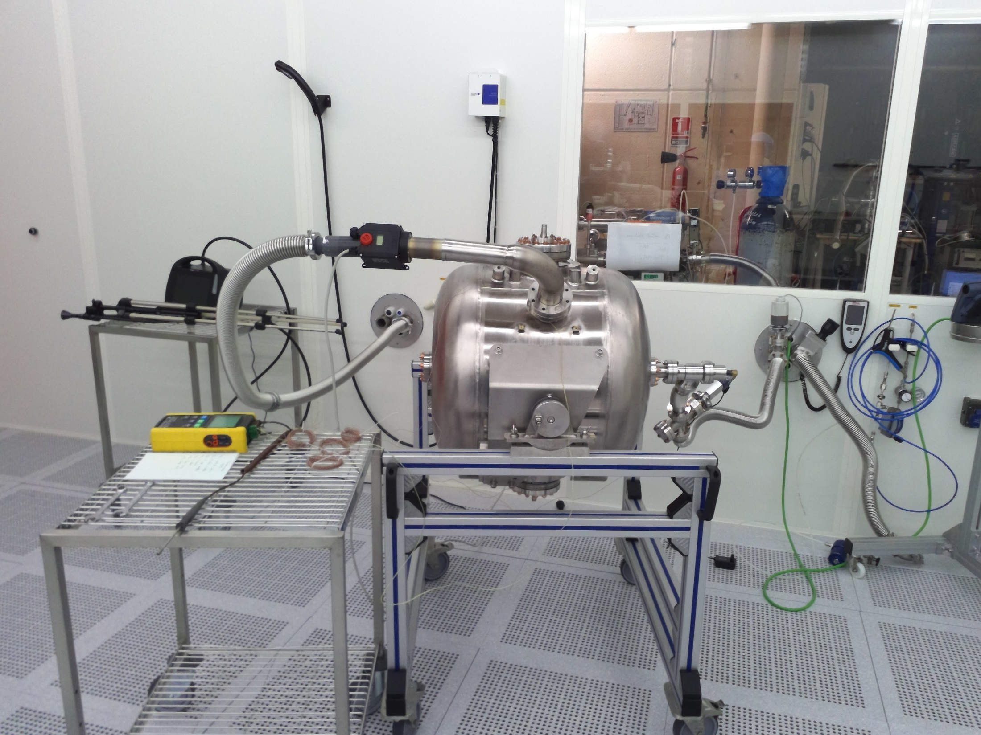
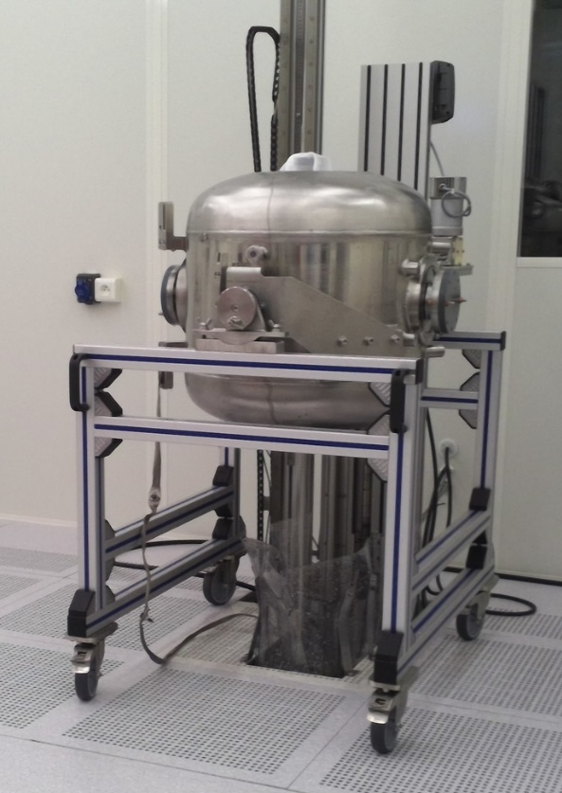
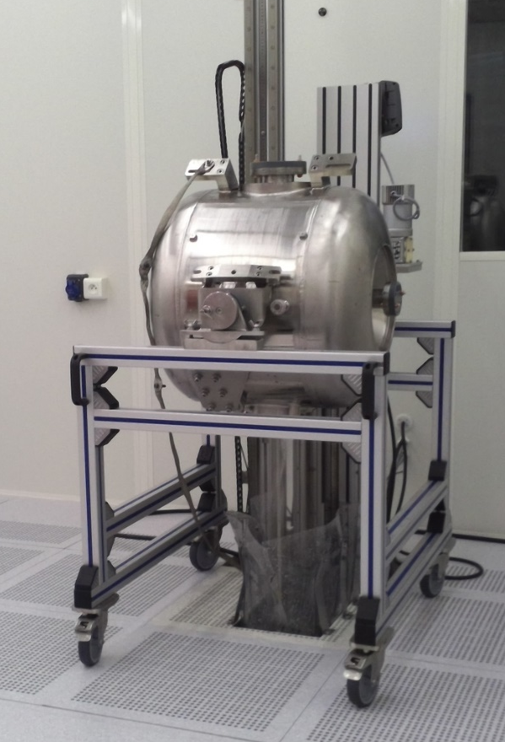
Progresses on cavity prototypes
Prototype 1
HPR
Baking at 120°C
Heat gun connected to the helium tank: hot air blow come from the clean room
The rod through the beam tubes
The rod through the side tubes

Slide 5
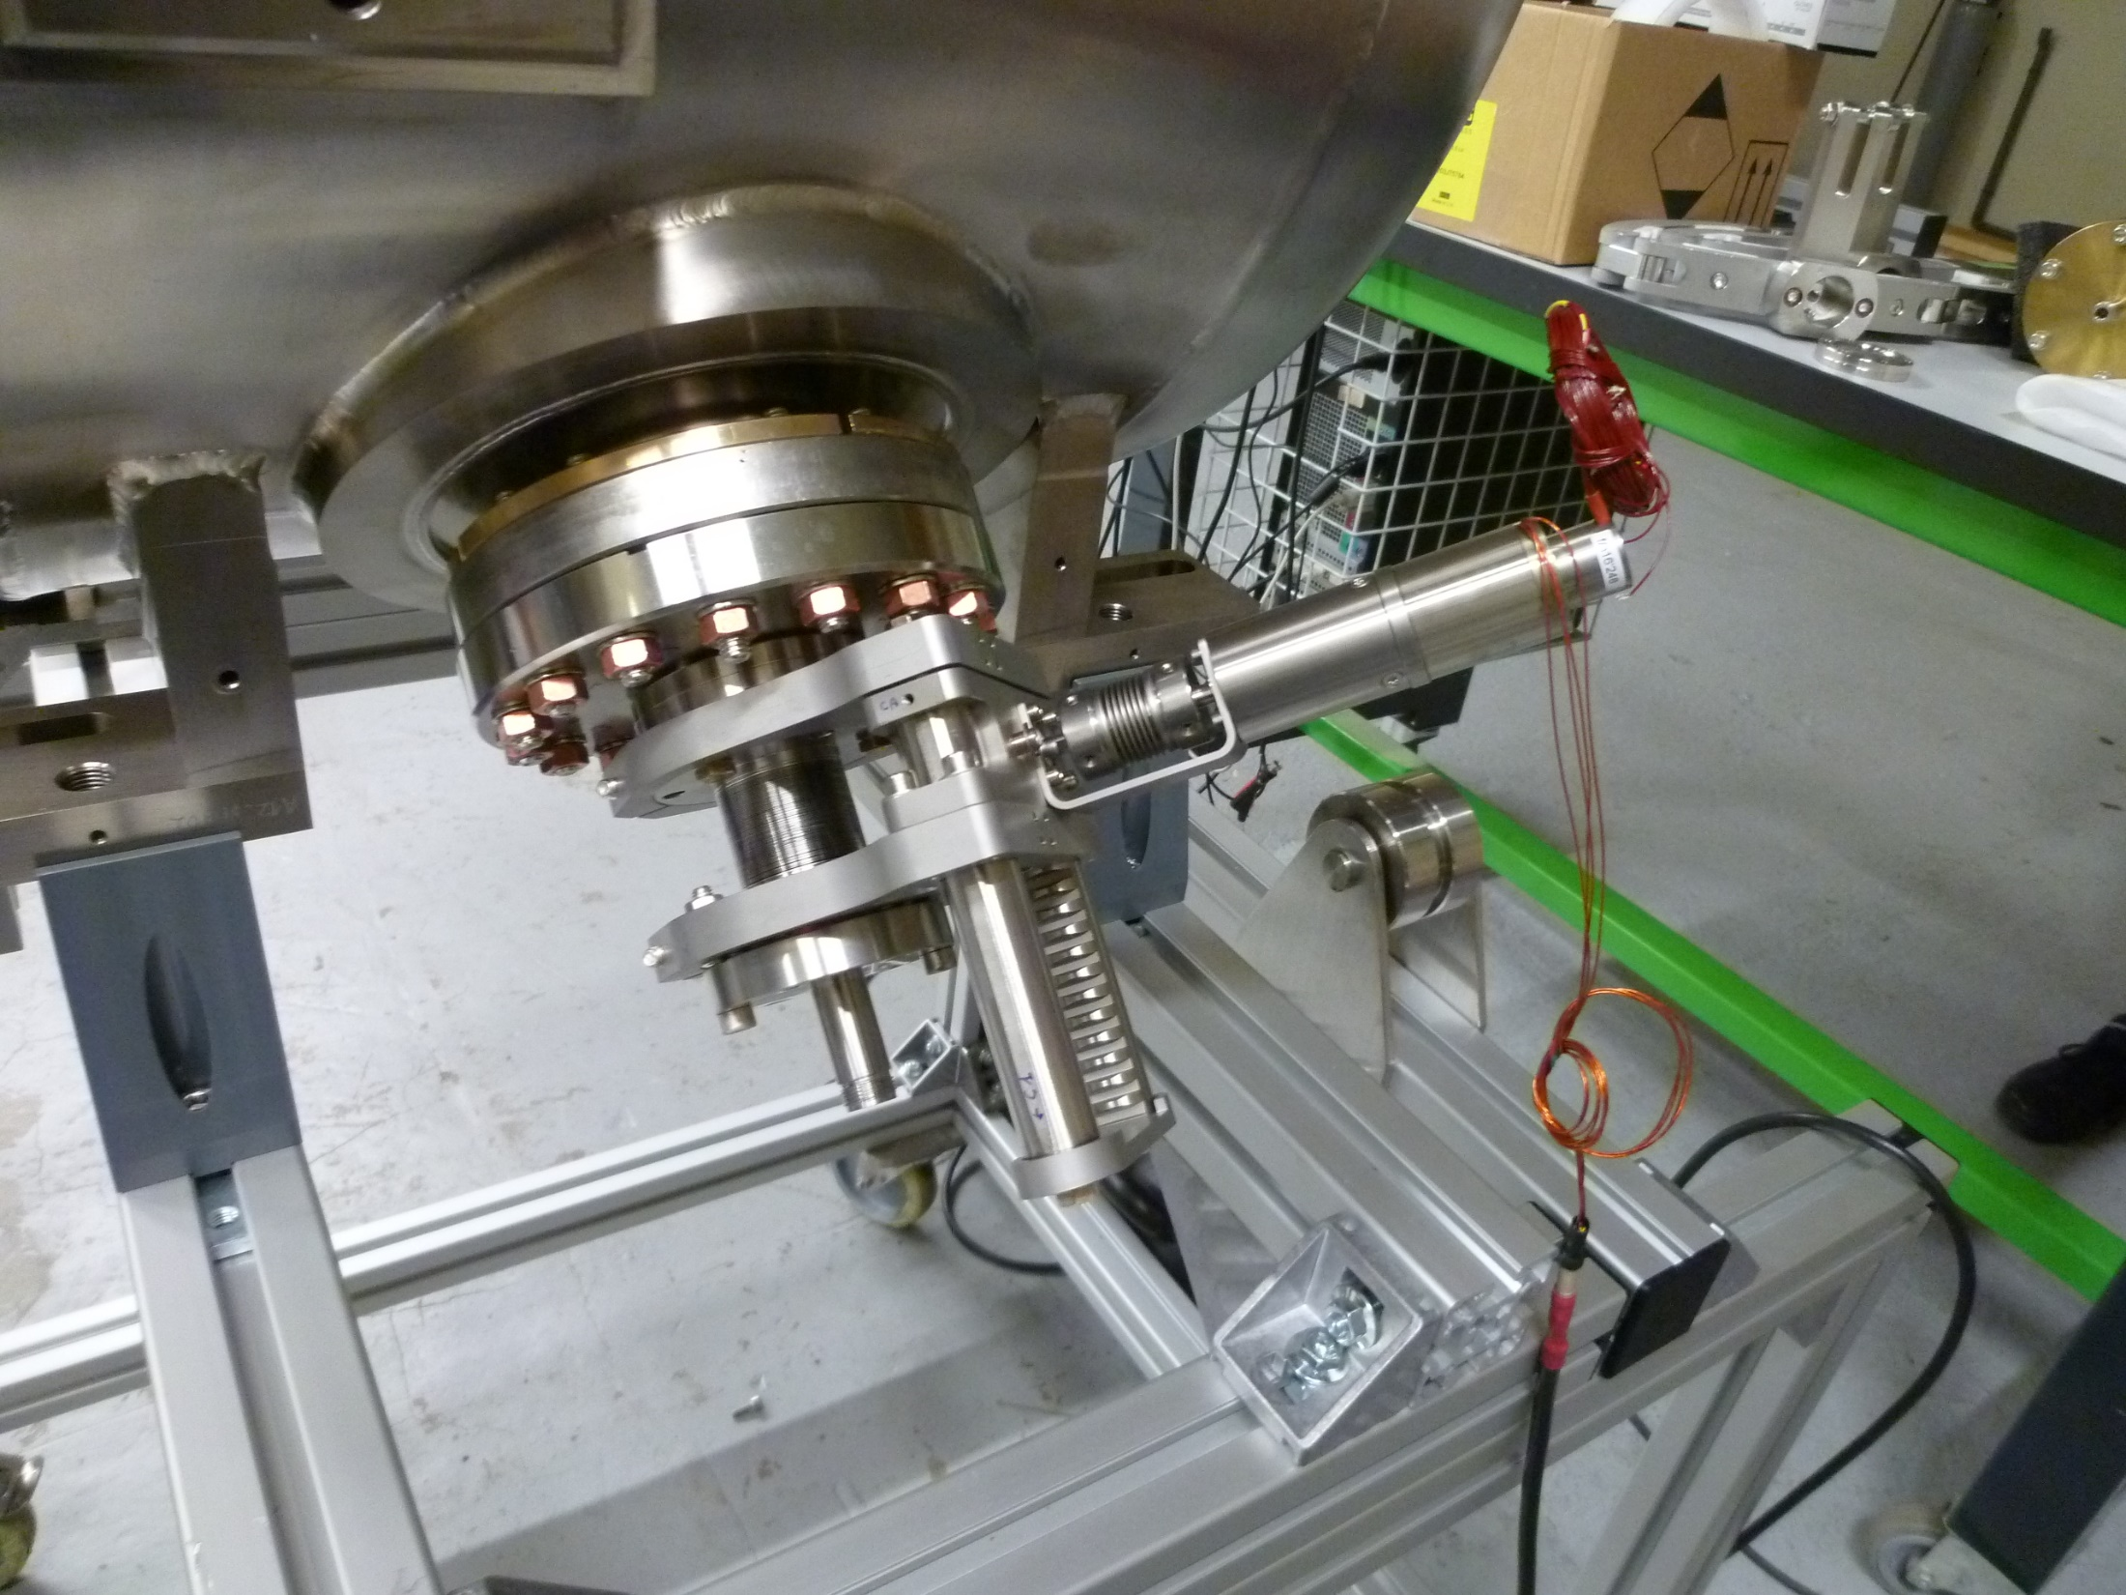
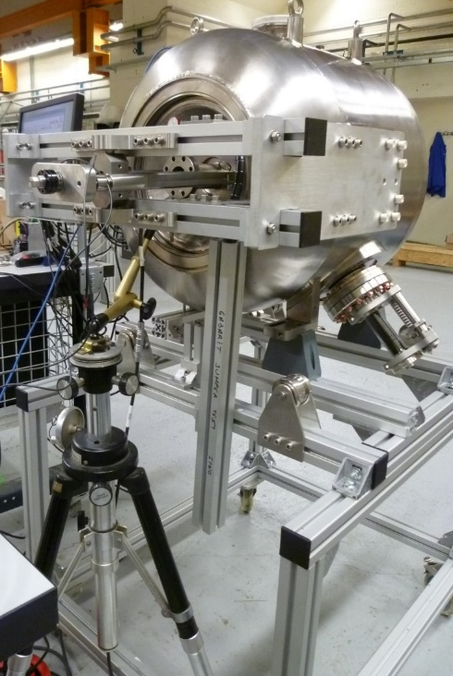
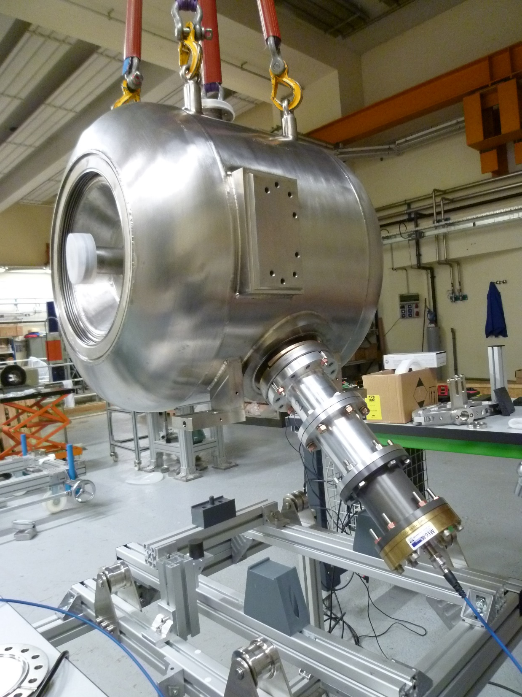
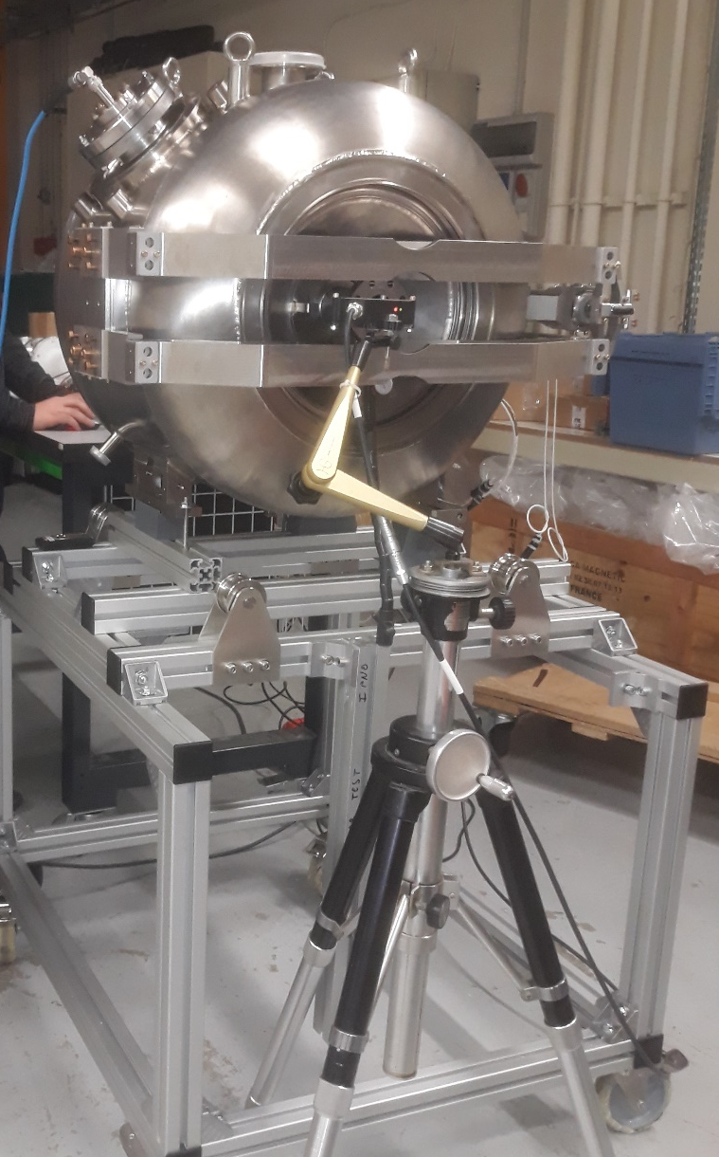
Progresses on cavity prototypes
Prototype 2
With dummy tuner
With tuner
With power coupler mockup
With moveable coupler
Adjust the antenna length during the cold test to obtain the adequat Qi
Cavity thickness @RT:
Measure ∼ 15.5kN/mm
FEM: 15kN/mm
Tuning sensitivity:
Measure ∼ 322 kHz/mm
FEM: 308 kHz/mm
Tuning sensitivity:
Measure ∼ 340 kHz/mm
(308 kHz/mm FEM)
Ucav/Uscrew = 0.6
Qext = 4.07e6 for 292.26mm of penetration
(4.2 e6 FEM)

