Slide 1
Brief update of Muon Collider Higgs Physics studies
1
Higgs & 4th Family Physics Studies 3/21/2012 https://indico.fnal.gov/conferenceDisplay.py?confId=5398
Higgs Observation by CMS, Atlas, LHC 7/4/2012
This update
G P Yeh 8/1/2012

Slide 2
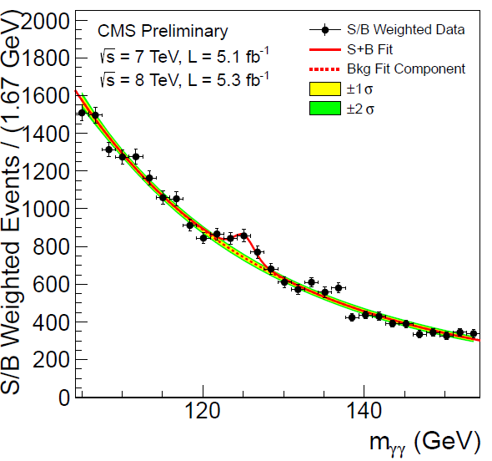
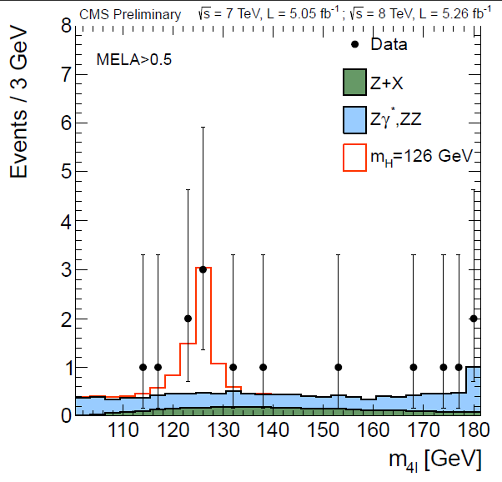
2

Slide 3
Christophe Grojean Physics @ SLHC Saclay Feb. 7, 2011
3

Slide 4
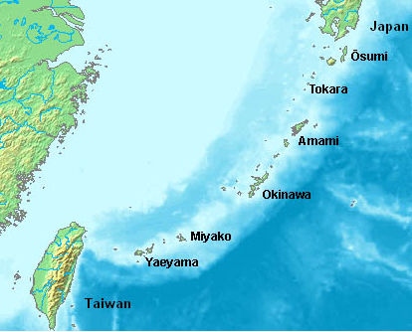
ILC
4
http://newsline.linearcollider.org/2012/02/02/a-visit-to-the-
two-candidate-japanese-ilc-sites/
Okinawa

Slide 5
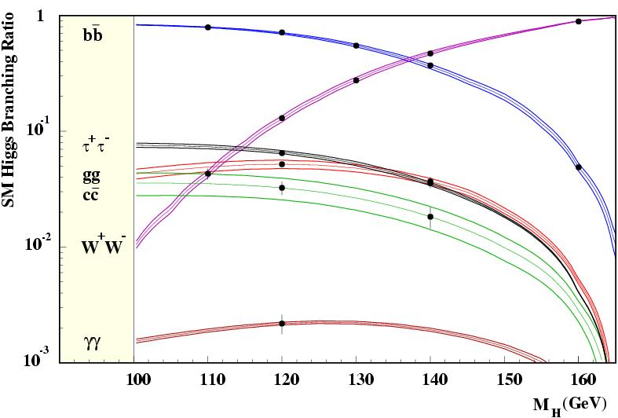
5

Slide 6
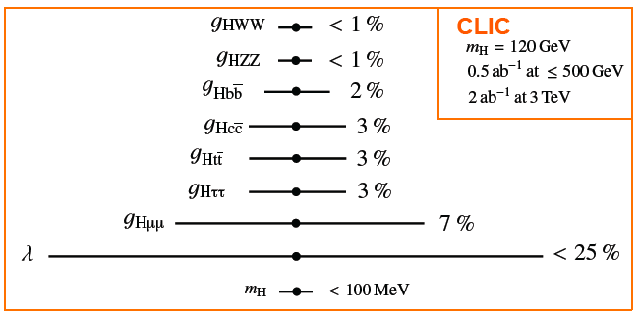
SM Higgs
6
Current understanding of SM-like Higgs coupling precision at CLIC
(including theoretical uncertainty)
(still some work to do, e.g. top coupling still derived from ILC)

Slide 7
7

Slide 8
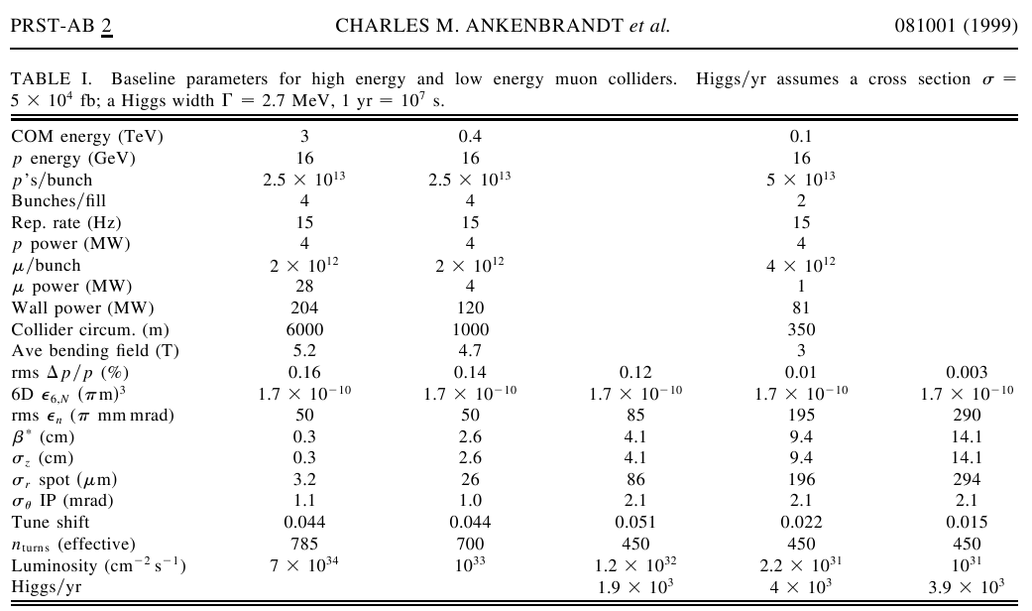
8

Slide 9
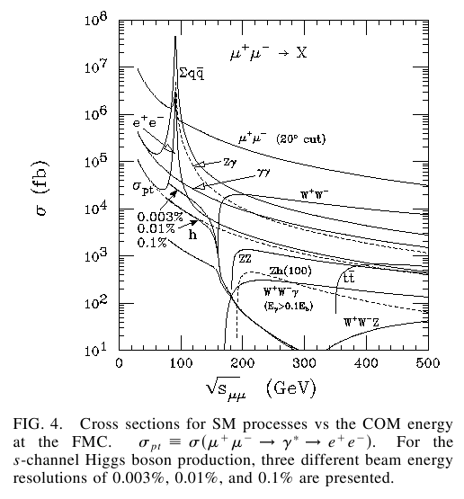
9

Slide 10
10

Slide 11
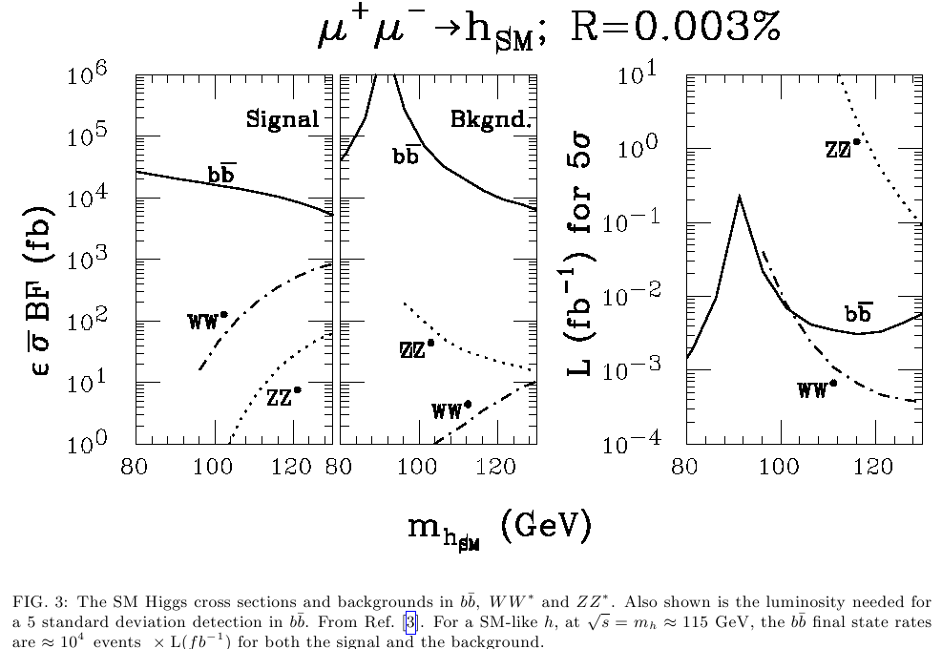
11

Slide 12
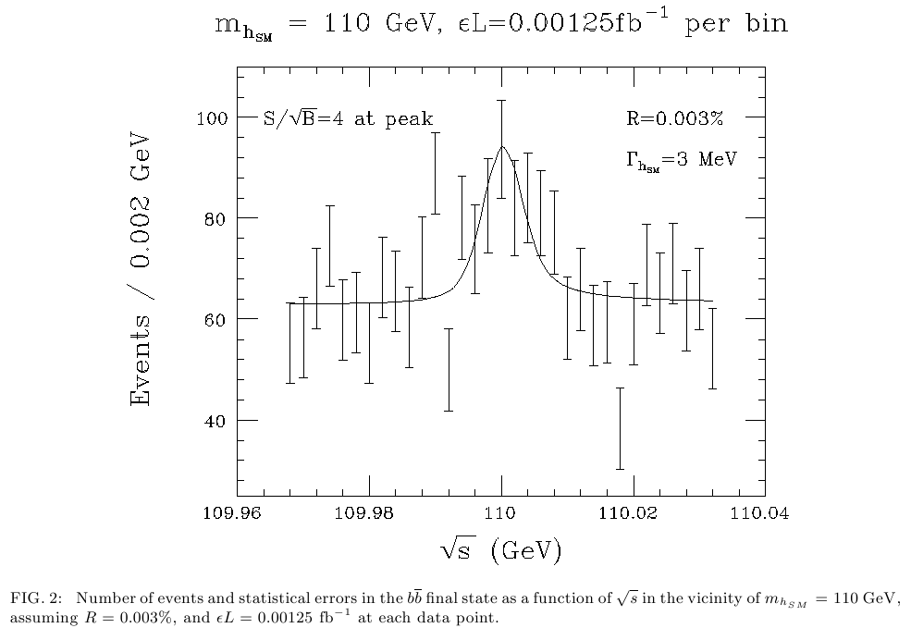
12
-1
L ~ 0.2 fb needed
>

Slide 13
13
Eichten 9/2011

Slide 14
14
Project X : Multi mA
Intensity Frontier

Slide 15
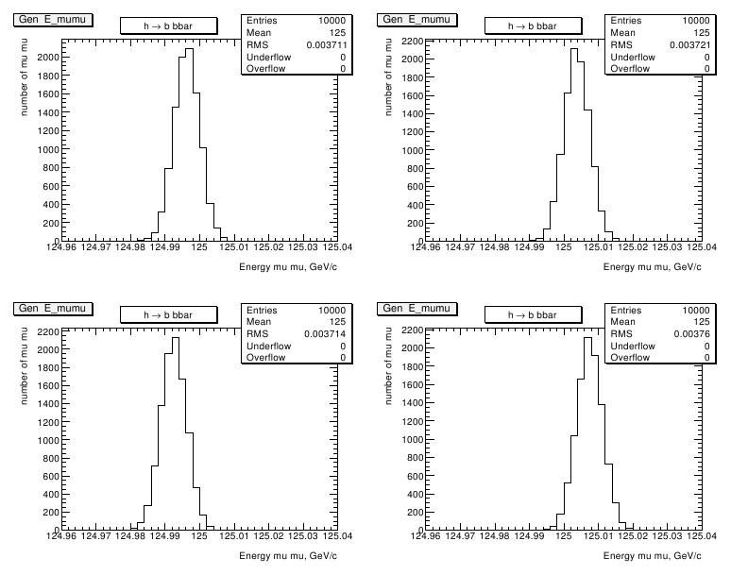
15

Slide 16
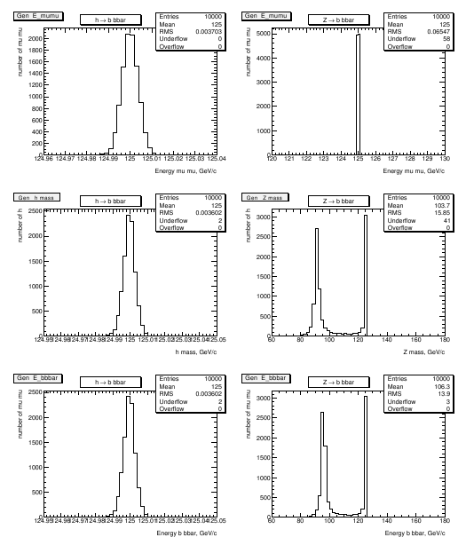
16

Slide 17
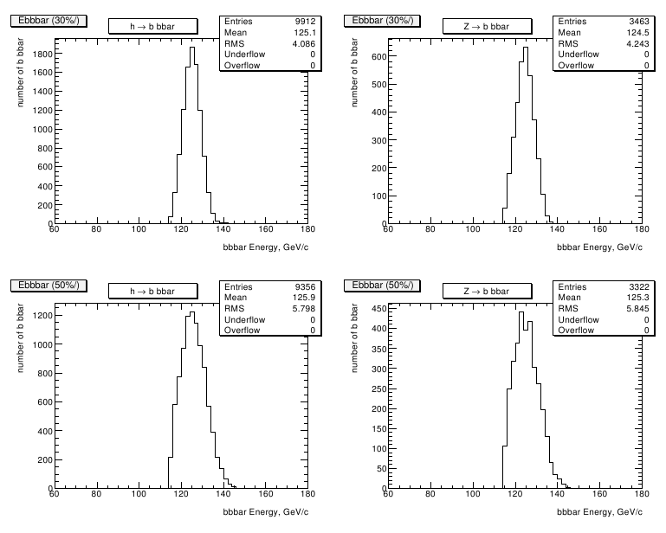
17

Slide 18
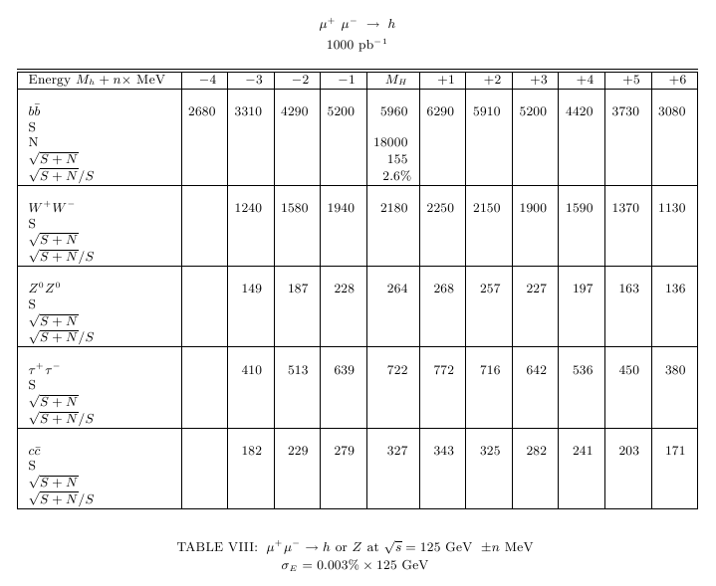
18

Slide 19
Summary
19
LHC has discovered Higgs
μ+ μ− Η ΖΗ ννΗ μμΗ ννΗΗ h A H H H ?
Muon Collider Higgs Factory μ+ μ− Η measure H mass & width to MeV level measure H coupling to b W to few %
0
0
0
+
-
31
L ~ 10 for Mh=125
~
>

Slide 20
Additional Info
20

Slide 21
21

Slide 22
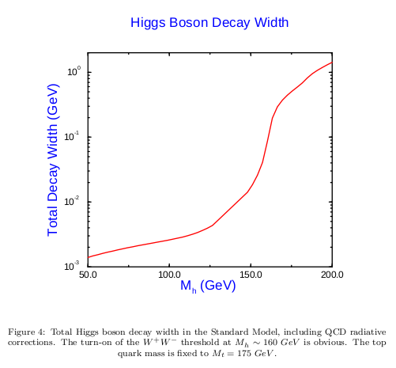
S. Dawson, arXiv:hep-ph/9703387
22
Pythia:
Γ(125) =
3.6 MeV
Γ(125) =
4 MeV

Slide 23
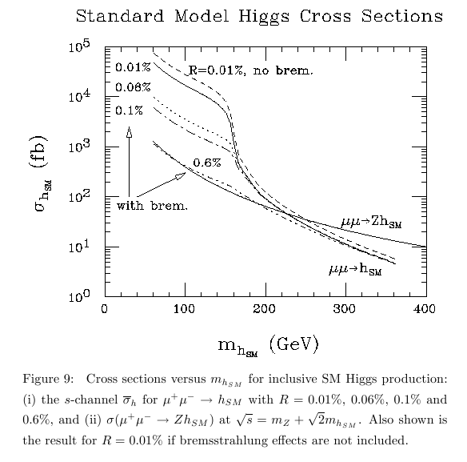
23

Slide 24
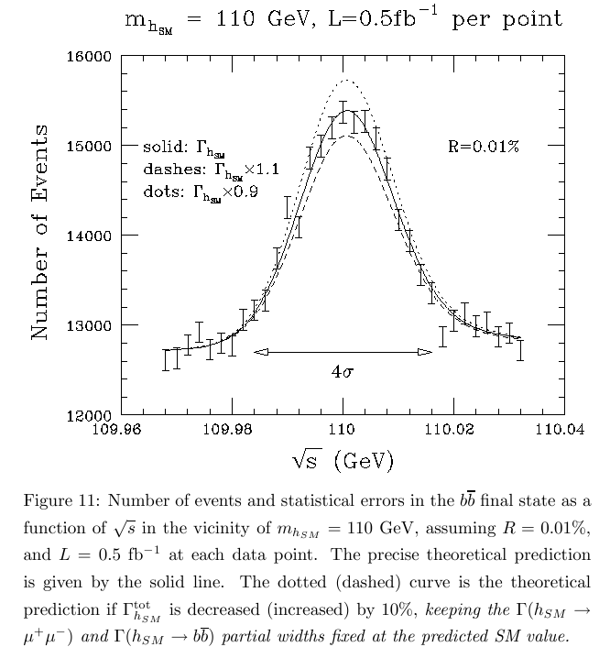
24

Slide 25
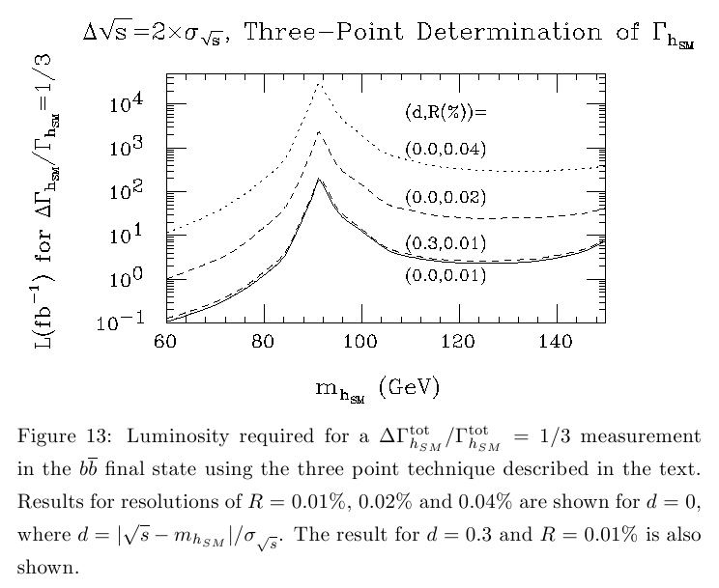
25
R = 0.01%
-1
L = 2 fb-1 needed
>

Slide 26
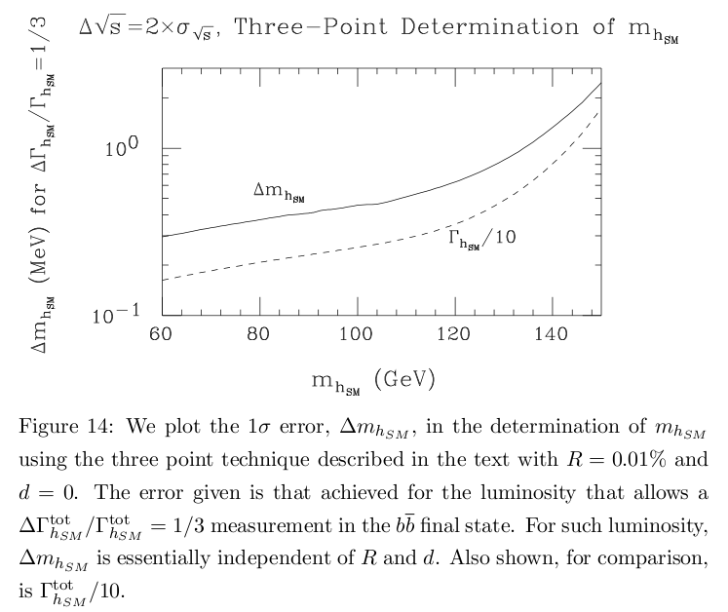
26

