Slide 1
72 Hour Summary
Spencer Schiefelbein
December 19, 2022

Slide 2
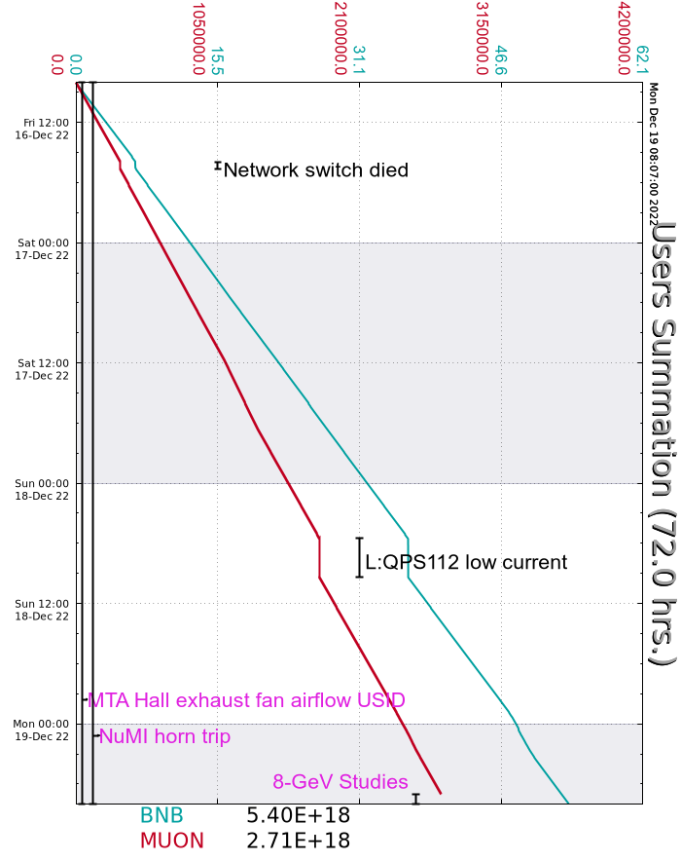
Summary
Friday
Swyd Meson Interlock Testing
F2,F3,MC7,MT6-1,MT6-2
Network Switch Failure – 45min
Spent Friday evening recovering
Saturday
Config Control Unlocked F-Manholes
Racked in Transfer Hall
Meson Primary Beam Permits and Run Conditions
Experts Established beam to Meson Dump
EE Support repaired F:MT4W supply
Sunday
QPS112 supply overheated – Linac personnel mounted fan
Domestic Water leaks repaired by Duty personnel
Chilled water in Linac Gallery
Hot Water in Transfer Gallery
Monday
MTest mode safety system testing in progress
Muon Studies ongoing
Current Conditions:
BNB: 8.27 E16 p/hr
Muon 8GeV studies

