Slide 1
Katherine Freese
Director, Weinberg Institute for Theoretical
Physics, Jeff & Gail Kodosky Chair,
Prof of Physics, University of Texas, Austin
Guest Professor, Stockholm University
Director Emerita, Nordita (Nordic Institute for Theoretical Physics, in Stockholm)
WHAT IS DARK MATTER?

Slide 2
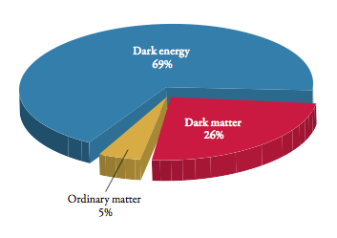
PIE CHART OF THE UNIVERSE
WHAT ARE THE PIECES OF THE PIE???

Slide 3
What is the Dark Matter? Candidates:
1980: Neutrinos? They exist. Too light, ½% of universe
NEXT: Cold Dark Matter w/ strong theoretical motivation:
WIMPs (SUSY or extra dimensions)
Axions (exist automatically in solution to strong CP problem)
--------------------------------------------------------------------------------
Now what? Sterile Neutrinos: no Standard Model interaction,
3.5 keV x-ray line?
Primordial black holes (did LITO discover them?)
Asymmetric Dark Matter
Light Dark Matter, Fuzzy Dark Matter
Self Interacting Dark Matter
Q-balls, WIMPZillas (Rocky and Dan), Planck scale DM
WIMPzillas, Planck-scale DM
Notes:
primordial black holes in the mass range 10−10 M⊙ to 10−8 M⊙ could still constitute the entirety of the dark matter.
LISA should be a formidable machine to detect the stochastic signal from the accumulated collection of such objects that have been gravitationally captured by SgrA∗

Slide 4
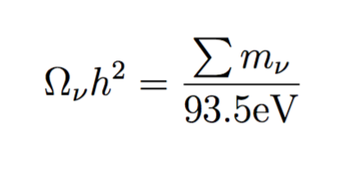
Historically, in the 1980s: Neutrinos as Dark Matter? No
Nearly relativistic, move large distances, destroy clumps of mass smaller than clusters
Too light,
50 eV neutrinos would “close” the Universe.
BUT
The sum of the neutrino masses adds to roughly 0.1 eV
Neutrinos contribute ½% of the mass of the Universe.

Slide 5
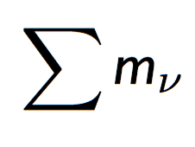
Cosmological data (CMB plus large scale structure) bound neutrino mass
Mν < 0.15 eV
at 95% C.L.
Vagnozzi, Gerbino, KF etal
arXIv:1701.0872
Planck Satellite: < 0.12 eV
Assumes standard Lambda CDM
If w>-1, stronger bounds
From oscillations: >0.06 eV
Giusarma, KF etal arXiv:1405:04320
Neutrino Properties in Particle Data Group’s Review of Particle Properties
Notes:
BAO are 6dFGS, WiggleZ, BOSS DR11 CMASS, BOSS DR11 LOWZ

Slide 6
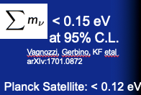
Neutrino Mass close to being measured (for the 3 active neutrinos)
From oscillation experiments:
> > 0.06 eV (Normal Hierarchy)
> 0.1 eV (Inverted Hierarchy)
Upper bounds from tritium beta-decay (KATRIN…),
neutrinoless double beta decay
From cosmology (CMB + Large Scale Structure +BAO)
THEORY: WHAT IS THE ORIGIN OF
NEUTRINO MASS? ONLY KNOWN PHYSICS
BEYOND THE
STANDARD MODEL

Slide 7
Two well motivated DM candidates, solve problems in particle physics
Axions and the strong CP problem in QCD (Weinberg and Wilczek)
WHERE ARE THE DAMN WIMPS?
The “WIMP” miracle. Particles interacting via the Weak Interactions in the early universe lead to the correct abundance of WIMPs today as dark matter
SUSY SUSY SUSY

Slide 8
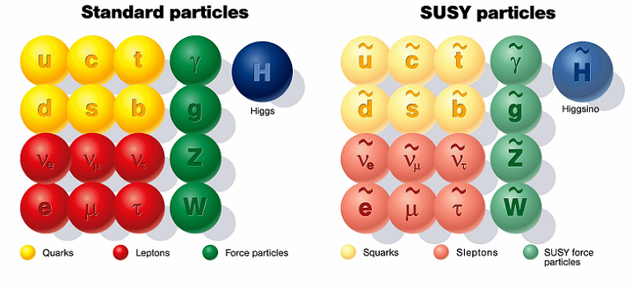
Second motivation for WIMPs: in particle theories, eg supersymmetry
Every particle we know has a partner
The lightest supersymmetric particle
may be the dark matter.
CARLOS
AND
MARCELA
Sebastian
Baum

Slide 9
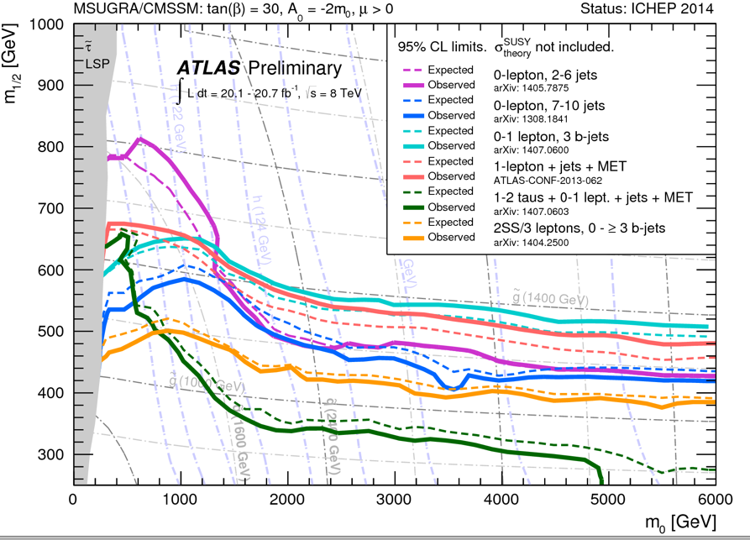
ATLAS bounds on CMSSM

Slide 10
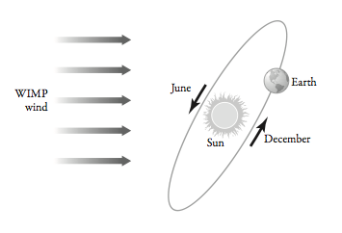
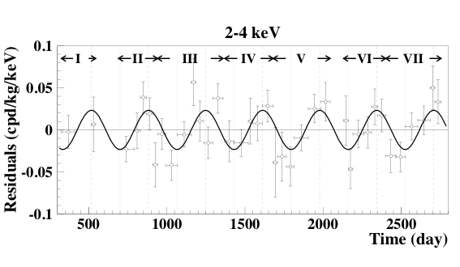
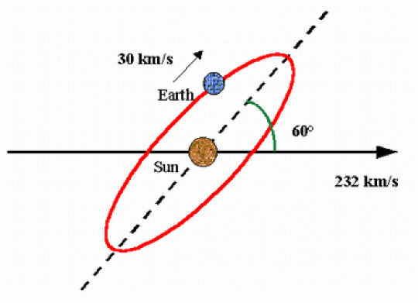
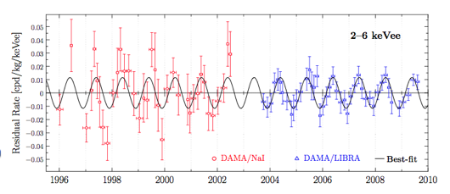
DAMA annual modulation Drukier, Freese, and Spergel (1986); Freese, Frieman, and Gould (1988)
NaI crystals in Gran Sasso Tunnel under the Apennine Mountains near Rome.
Data do show modulation at 12 sigma! Peak in June, minimum in December (as predicted). Are these WIMPs??

Slide 12
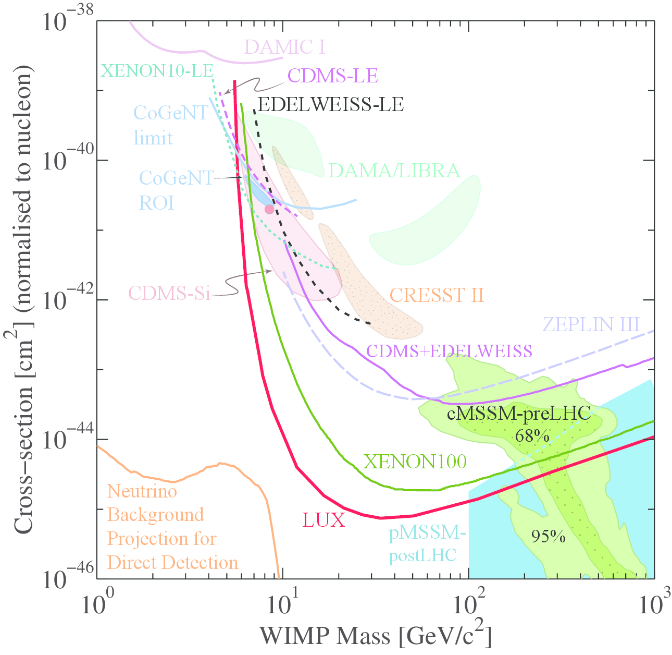
Bounds on Spin Independent WIMPs
PDG 2014
BUT:
--- it’s hard to
compare results from different detector materials
--- can we trust results near threshold?

Slide 13
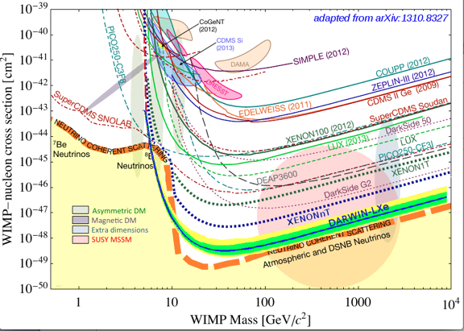
Future experiments

Slide 14
To test DAMA within next 5 years
The annual modulation in the data is still there after 13 years and still unexplained.
New DAMA data down to keV still see modulation (DAMA all by itself is not compatible with SI scattering)
Other groups are using NaI crystals:
COSINE-100 has 1.7 years of data release, will have an answer within 3-5 years
SABRE (Princeton) with Australia
ANAIS
COSINUS
Baum, Freese,Kelso 2018

Slide 15
COSINE-100 1.7 years of data
https://arxiv.org/pdf/1903.10098.pdf

Slide 17
Paleodetectors
WIMPs leave tracks in ancient
minerals from 10km below the
surface of the Earth.
Collecting tracks for 500 Myr.
Backgrounds: Ur-238 decay
and fission
Take advantage of nanotools: can
identify nanometer tracks in 3D
Baum, Drukier, Freese, Gorski,
Stengel arXiv:1806.05991
Pat Stengel Sebastian Baum
article in
New Scientist

Slide 18
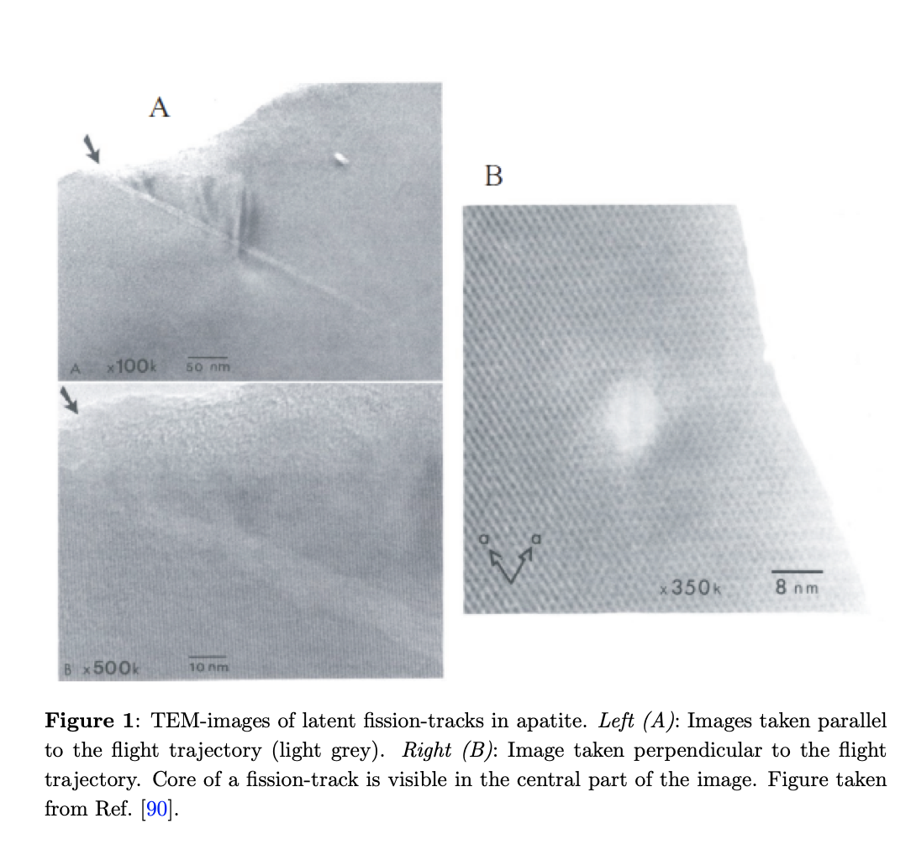
Mineral Detection of Neutrinos and Dark Matter. A Whitepaper
Recoiling nuclei lead to defects:
Fission tracks, vacancies in crystal lattice, etc
https://arxiv.org/pdf/2301.07118.pdf
Color Centers:
Vacancies in crystal lattice,
e pairs fill in, get excited and fluoresce,
the crystal changes color

Slide 19
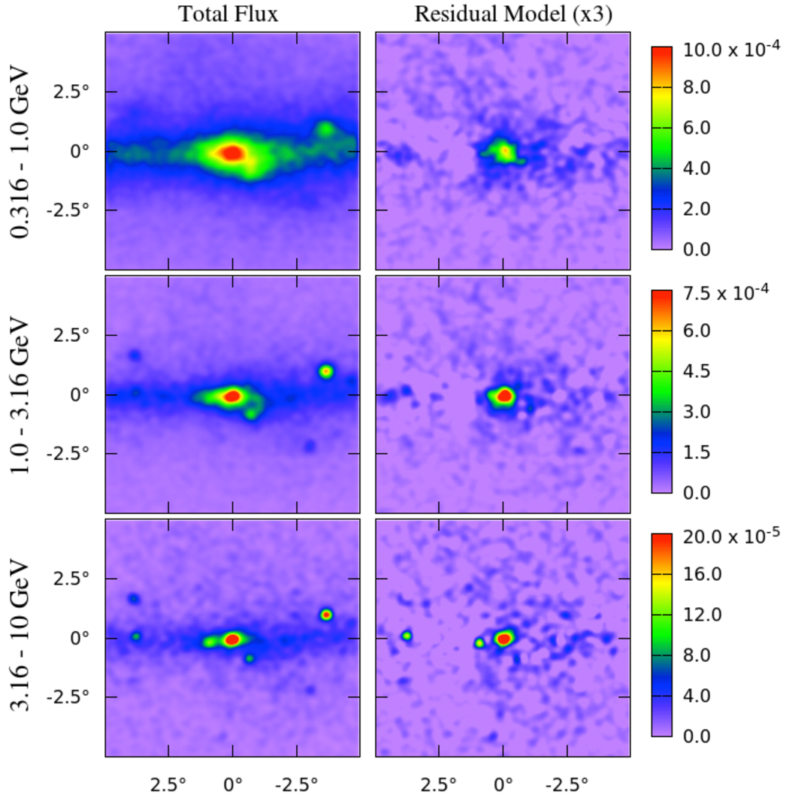
Indirect Detection: Fermi/LAT gamma-ray excess from the Galactic Center
Goodenough & Hooper (2009)
Daylan, Finkbeiner, Hooper, Linden, Portillo, Rodd, Slatyer (2014)
Towards galactic center:
Model and subtract astrophysical sources
Excess remains
Spectrum consistent with DM
BUT also consistent with astrophysical
point sources. PULSARS?

Slide 20
Fourth Way: Find Dark Stars (hydrogen stars powered by dark matter) in James Webb Space Telescope, sequel to Hubble Space Telescope
W Doug Spolyar, P. Gondolo

Slide 21
Dark Stars
The first stars to form in the history of the universe may be powered by Dark Matter annihilation rather than by Fusion. Dark stars are made almost entirely of hydrogen and helium, with dark matter constituting 0.1% of the mass of the star).
This new phase of stellar evolution may last millions to billions of years
Dark Stars can grow to be very large: up to ten million times the mass of the Sun. Supermassive DS are very bright, up to ten billion times as bright as the Sun. We have found candidates in James Webb Space Telescope
Once the Dark Matter runs out, the DS has a fusion phase before collapsing to a big black hole: is this the origin of supermassive black holes?

Slide 22
Has JWST found Supermassive Dark Stars?
JWST has found ~ 100 high redshift objects with z > 10. They assume these are “galaxy candidates”
Too many galaxies for Lambda CDM
Are some of them Dark Stars?
NIRSPEC on JWST has spectra for 9 of these; so far 5 are on the arxiv or published. One is a galaxy.
(W/out spectra, can’t be sure of redshift; some are low redshift)
Specifically, JADES has four. So far, these are the ones we have studied.
OUR RESULTS: Three of the five hi-z JWST objects w published spectra are consistent with Dark Stars.
(JWST Advanced Extragalactic Survey)

Slide 24
HELP! We don’t know what all the possible candidates are, and we don’t know how to look for them!
US Cosmic Visions: New Ideas in Dark Matter 2017: Community Report -

