Slide 1
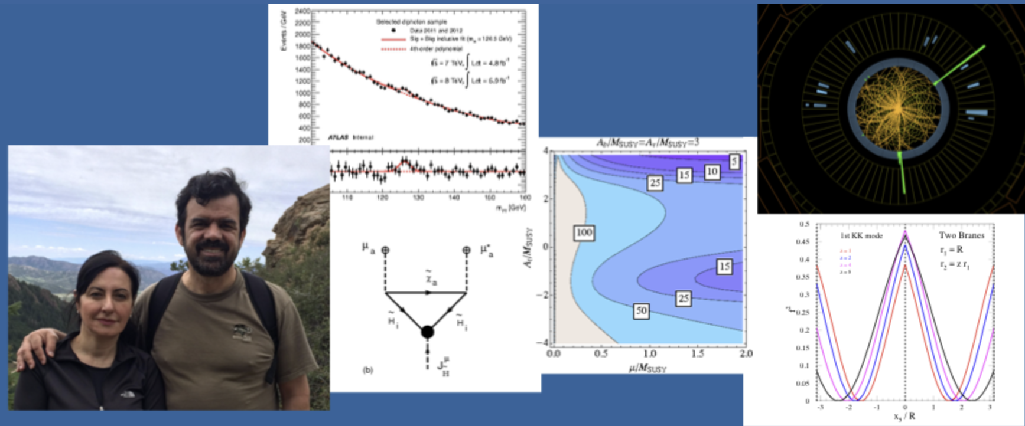

New Physics at Future Colliders
Zhen Liu
University of Minnesota
May.30th, 2022

Slide 2

Let’s begin with a story…
(One day, in 2014, I heard) SUSY is dead…
A rumor spread amongst youngsters that: Carlos walked around and mumbled, “SUSY is not there…”.
Many lessons learned:
  (A) the field counts on grandmasters opinions;
  (B) Young people are nervously watching;
  (C) Carlos and Marcela are responsible;
  (D) The physics endures, and SUSY Pheno is still intellectually nutritious & relevant;

Slide 3
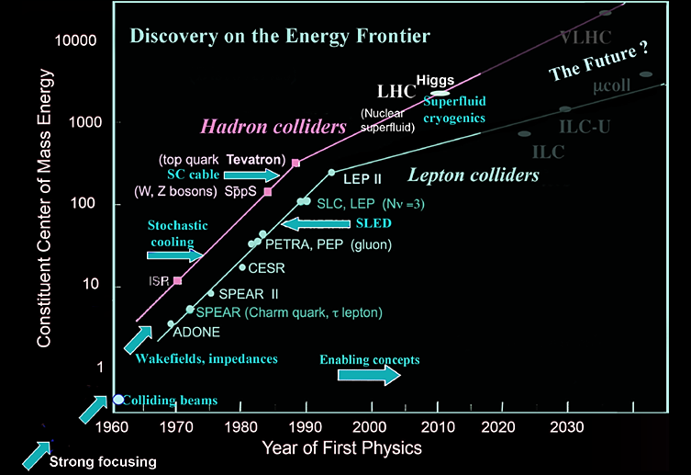
High Energy Rules
The forefront of tech & ambitions leads to discoveries.
The dream for high energy machines persists in our field
Snowmass Report: 1401.6114

Slide 4

High Energy Rules
The forefront of tech & ambitions leads to discoveries.
The dream for high energy machines persists in our field
People’s perspectives change over time, now:
there are excitement/call for future high energy muon collider from theory, accelerator and experimental community.
Interesting aspects of physics to be examined.
Snowmass Report: 1401.6114

Slide 5

We’ve been wondering why didn’t we approve MuC back then?
*From Daniel Elvira’s Monday standup “Unidos por el espanto (United in despair)”: it is Julian’s fault.
But who can blame such a handsome and successful Carena-Wagner? Hope he can sponsor a MuC fellowship in the future.
*I assume no responsibility for quoting Daniel here. Quoting does not mean I approve of the message.

Slide 6
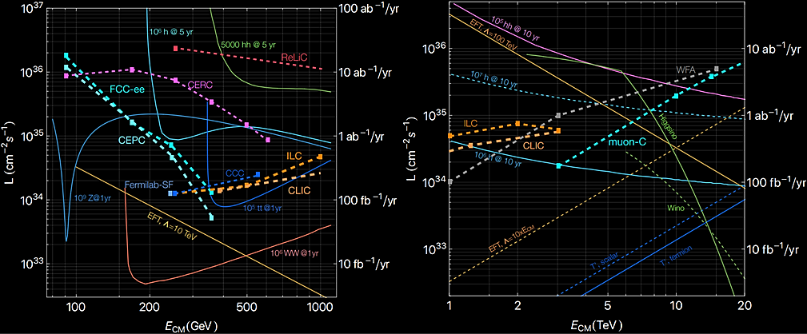
Distinctive Physics Programs
Many future collider options and excitement!
ZL, Wang, 2205.00031

Slide 7
All (good) measurements* are BSM
*either direct searches or stress-testing SM

Slide 8
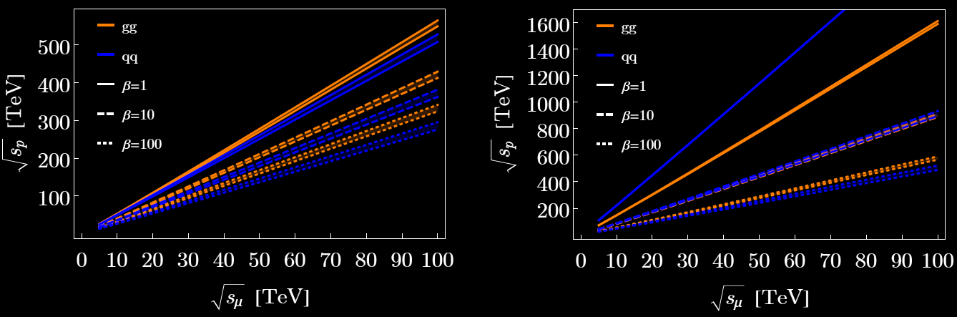
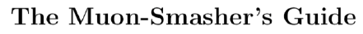

High Energies
$$β≡σ_{pp}/σ_{μμ}$$
10+ TeV MuC outperforms 100 TeV collider in almost every aspect
(except for dijet resonances; particles only color charged, no EW charges)
For electroweak states, already winning if MuC have 3+ TeV energy

Slide 9
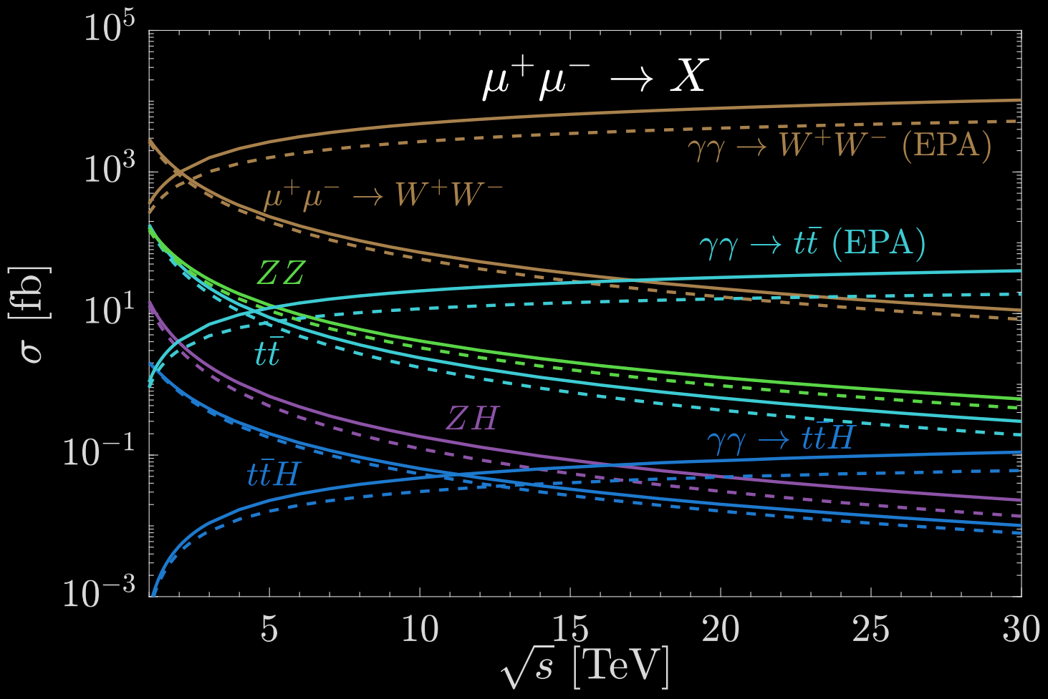
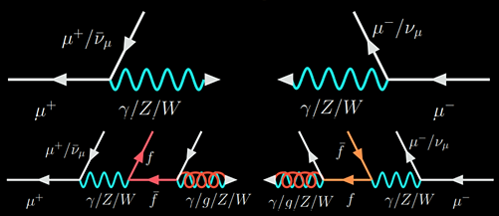
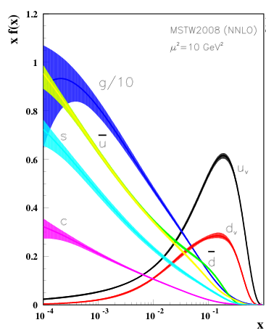
Muon “structure”
When colliding high energy leptons, we are colliding a bunch of electroweak states.
Quite different from proton
See in-depth discussion by T. Han, Y. Ma, K.-P. Xie, 2007.14300, 2103.09844; Ali et al, Muon Smasher’s guide 2103.14043

Slide 10
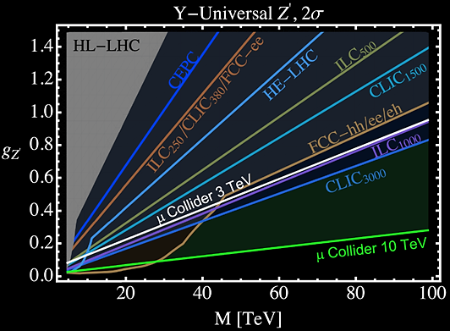
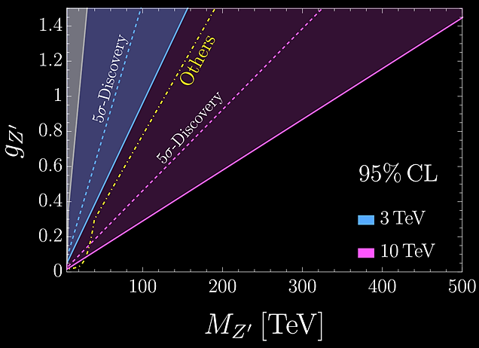
Benchmark Case: Zprime
The Muon Smasher's Guide 2103.14043
A Muon Collider Facility for Physics Discovery 2203.08033
Muon Collider Physics Summary 2203.07256
The physics case of a 3 TeV muon collider stage 2203.07261

Slide 11
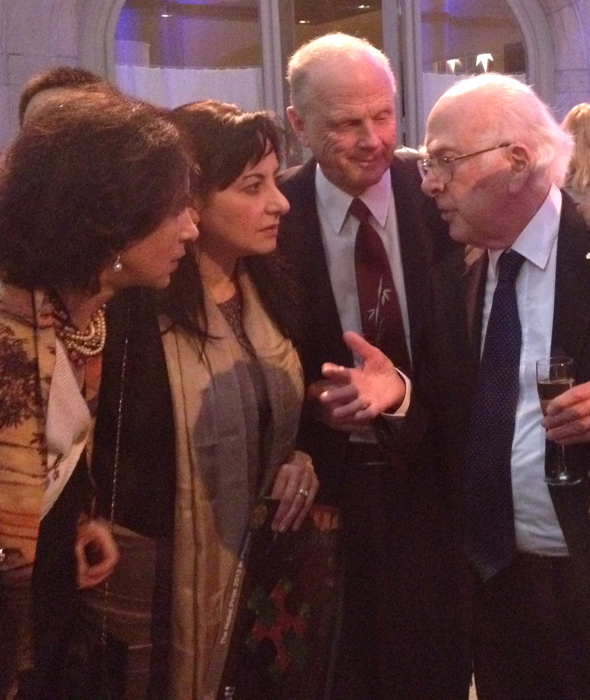
Call from the Higgs

Slide 12
















Higgs
Notes:
Update this number to be 38.

Slide 13
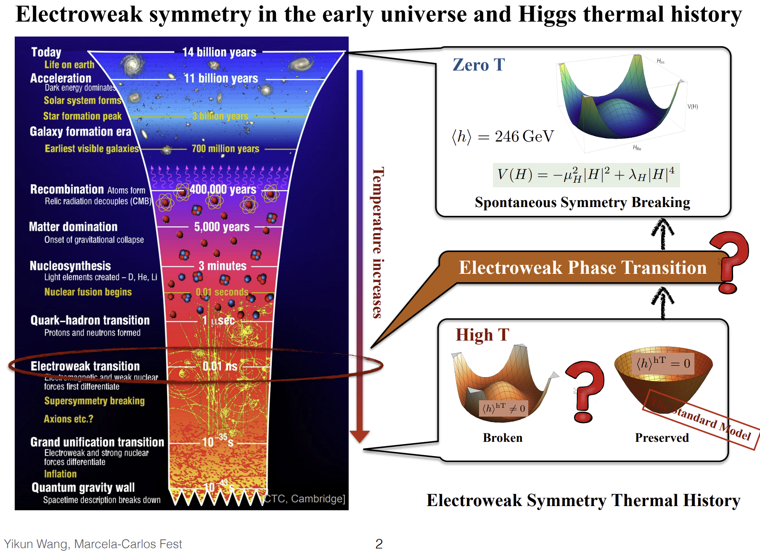

Intro from Y. Wang (Marcela’s first graduate student)

Slide 14
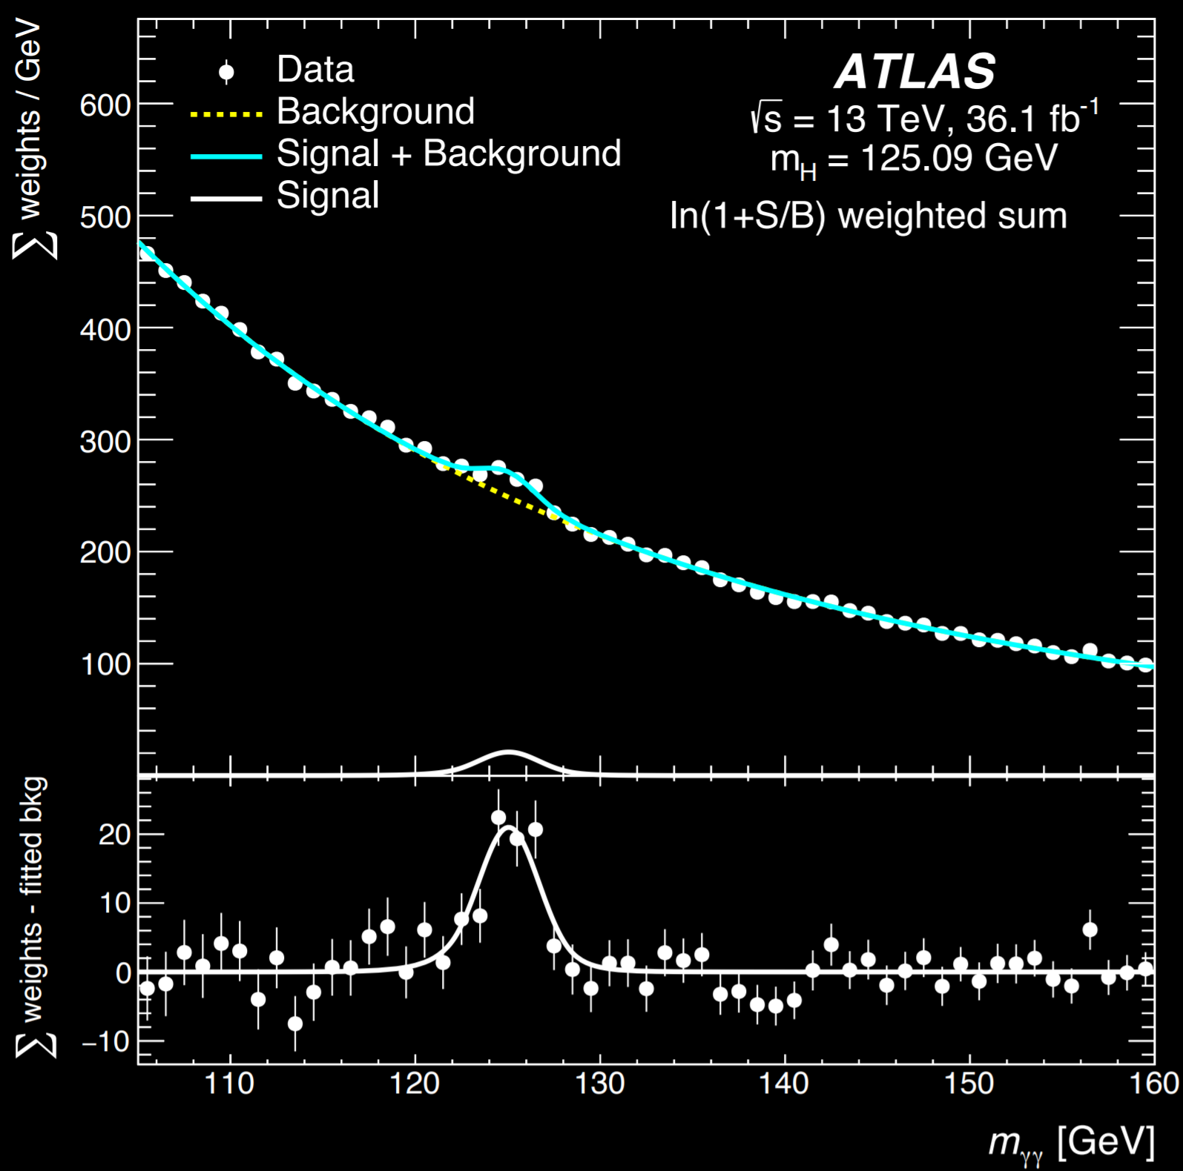
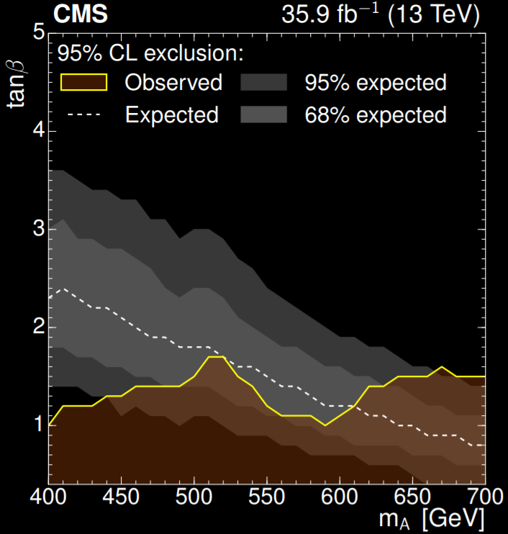
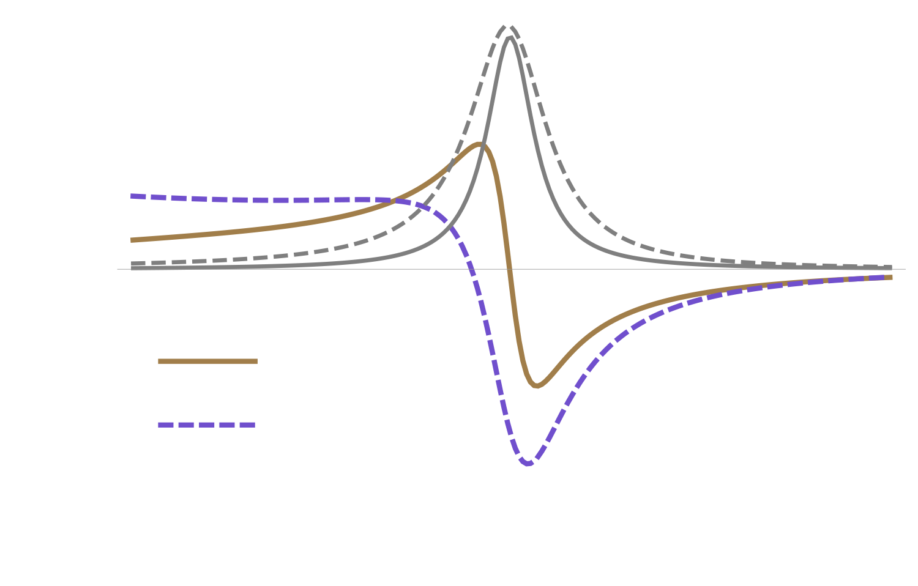
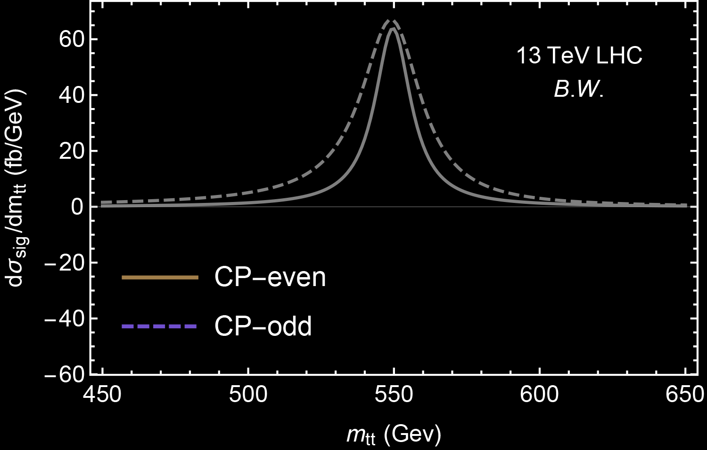
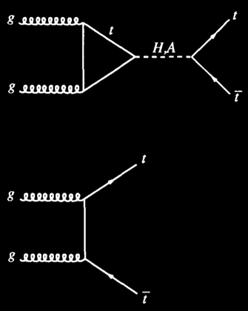
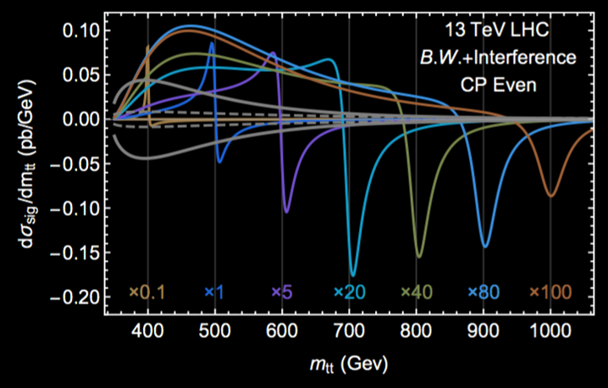

Beyond classical (recent $φ→t\overline{t}$ search)
M. Carena, ZL, arXiv:1608.07282
CMS 1908.01115
ATLAS (re-interpretation), PRL, 17’
D. Dicus, A. Stange, S. Willenbrock, hep-ph/9404359, Focusing on ttbar @LHC, M. Carena, ZL, arXiv:1608.07282
Other channels and effects, including ttH, tH (see in N. Craig, F. D’Eramo, P. Drapper, S. Thomas, H. Zhang arXiv:1504.04630 and J. Hajer, Y.-Y. Li, T. Liu J. Shiu arXiv:1504.07617, S. Gori, I.-W. Kim, N. Shah, K. Zurek arXiv:1602.02782 , N. Craig, J. Hajer, Y. Li, T. Liu, H. Zhang, arXiv:1605.08744, B. Hespel, F. Maltoni, E. Vryonidou arXiv:1606.04149, W.S. Hou, M. Kohda, T. Modak 1710.07260, 1906.09703), H+jet, charged Higgs searches,

Slide 15
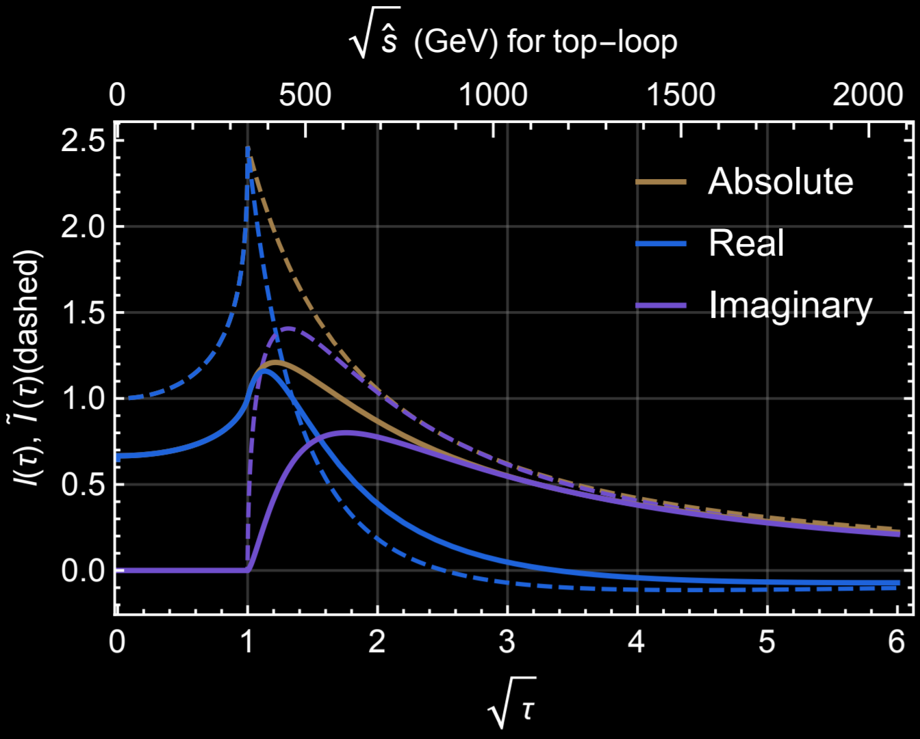
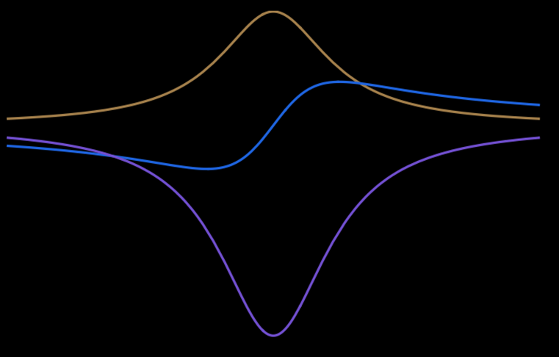
Unfamiliar look of heavy Scalars
Signal
Background
Triangle loop function
B.W.
Re. Int.
Im. Int.
Plus s- and u- channel
Plus s-channel $q\overline{q}→t\overline{t}$
Notes:
Optical theorem

Slide 16
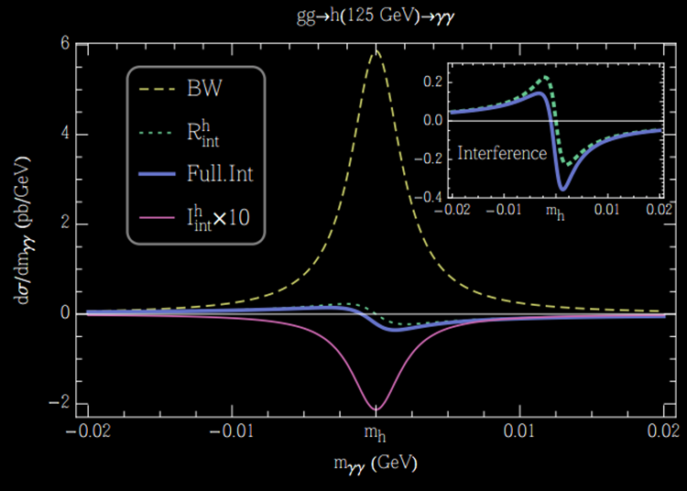
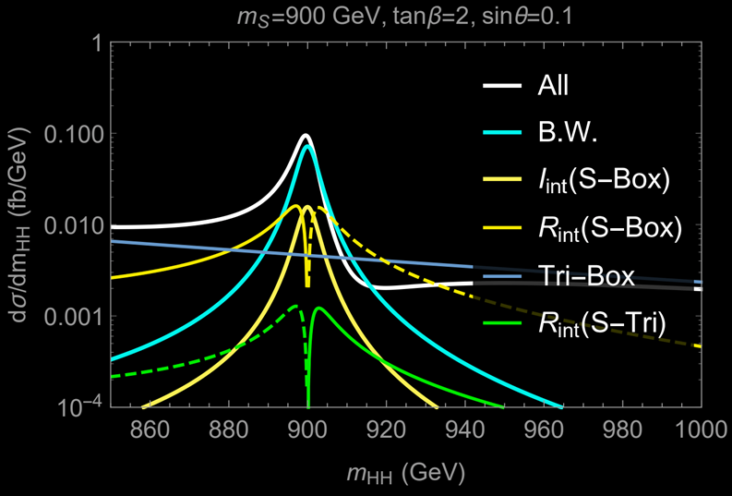
Interferences onsite
Not factorizable into signal and background calculation, Pole-behavior matters (not standard EFT friendly);
Gain new information about width and strong & weak phase;
Interesting test for Interference.
Carena, ZL, Riembau, 1801.00794
Campbell, Carena, Harnik, ZL, 1704.08259
Dixon, Siu, hep-ph/0302233
Cjeri, Coradeschi, de Florian, Fidanza, 1706.07331
Maltoni, Mandal, Zhao, 1812.08703
Chen, Heinrich, Jahn, Jones, Kerner, Schlenk, Yokoya 1911.09314
Hoche et al, in progress
Also (real-part interference): Dixon, Li, 1305.3854
HH whitepaper, 1910.00012
Kauer, Lind, Maierhoefer, Song, 1905.03296
Other channels: Jung, Sung, Yoon, 1510.03450, 1601.00006, (dijets) Martin, 1606.03026, Bhattipirolu, Martin, 2004.06181
Notes:
Helicity matching…

Slide 17
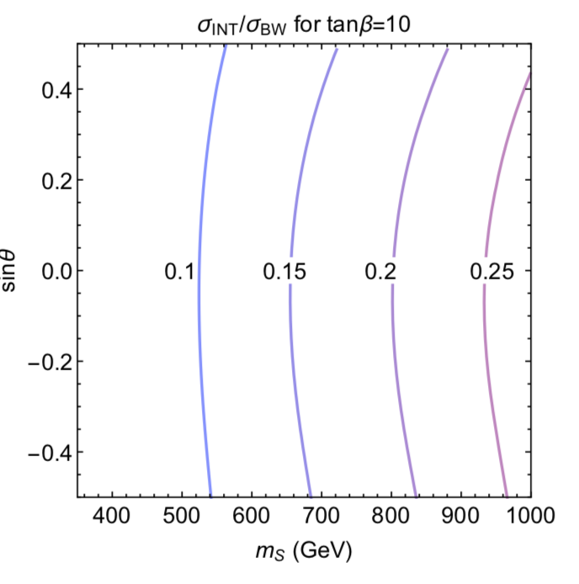
Size of the on-shell interference
The size of the on-shell interference effect w.r.t. the resonant signal.
For different parameters, it could be up to 40% below 1 TeV or increase even further for heavier singlet masses.

Slide 18
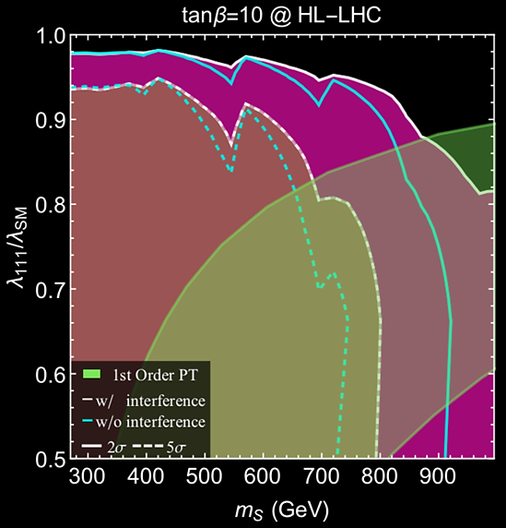
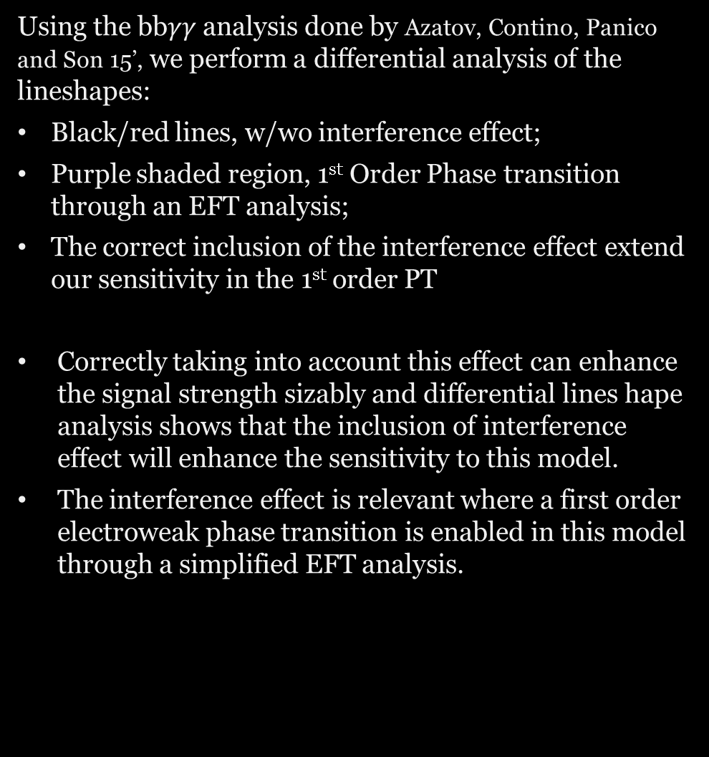
Interference Line shape
Using the bb$γγ$analysis done by Azatov, Contino, Panico and Son 15’, we perform a differential analysis of the lineshapes:
Black/red lines, w/wo interference effect;
Purple shaded region, 1st Order Phase transition through an EFT analysis;
The correct inclusion of the interference effect extend our sensitivity in the 1st order PT
Correctly taking into account this effect can enhance the signal strength sizably and differential lines hape analysis shows that the inclusion of interference effect will enhance the sensitivity to this model.
The interference effect is relevant where a first order electroweak phase transition is enabled in this model through a simplified EFT analysis.
M. Carena, ZL, M. Riembau, 1801.00794

Slide 19
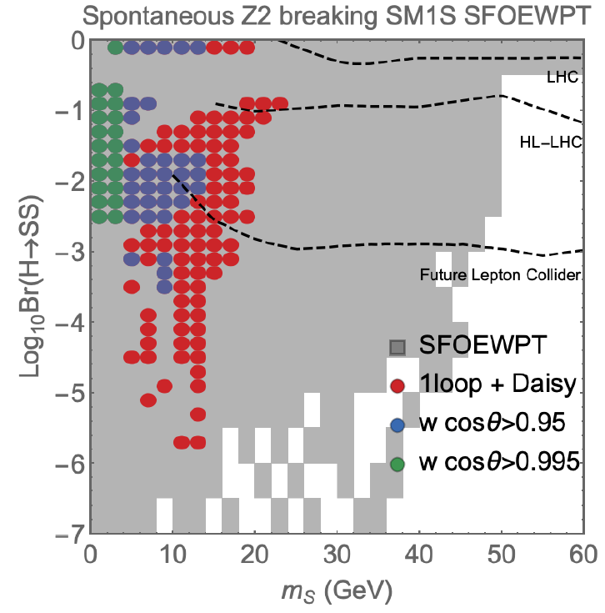
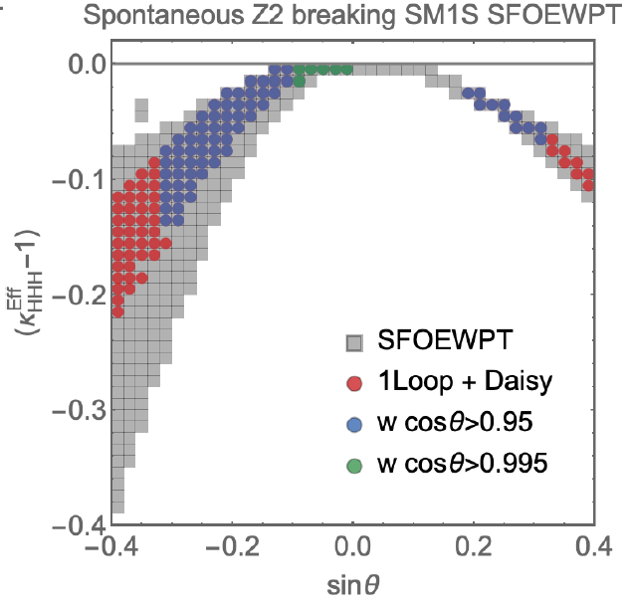
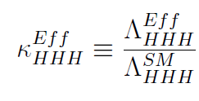
Predicts H→ss exotic decays and modified HH production
M. Carena, ZL, Y.K. Wang, 1911.10206

Slide 20
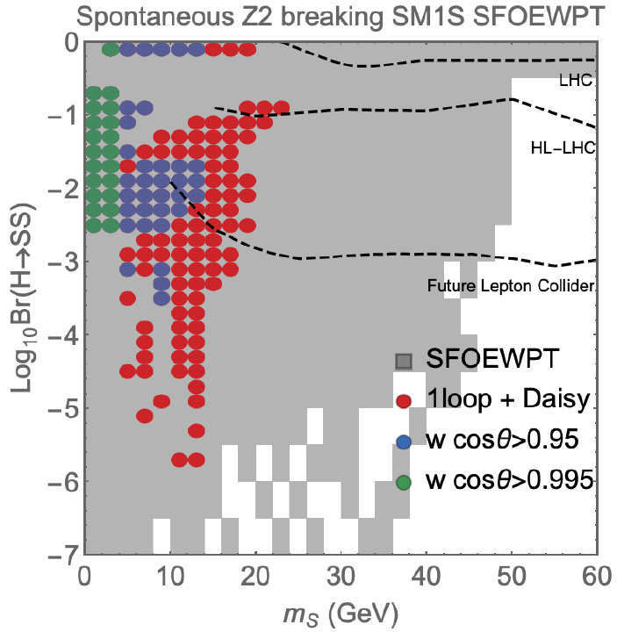
Higgs Exotic Decays
In the mass basis: $\frac{v_{c}}{T_{c}}=(\frac{v_{c}^{SM}}{T_{c}^{SM}})\frac{λ_{h}^{SM}}{\tilde{λ_{h}}}=(\frac{v_{c}^{SM}}{T_{c}^{SM}})[1+\sin^{2}θ \frac{m_{H}^{2}−m_{S}^{2}}{m_{S}^{2}}]$
A firm prediction of a light scalar in this model;
Higgs exotic decay into a pair of light scalars is a crucial probe;
Higgs exotic decays complements the Higgs precision program;
Higgs exotic decays requires further studies of merged jets for lighter singlet masses(Jung, ZL, Wang, Xie, 21’);
Also possible to have long-lived Higgs exotic decays in certain parameter space; (e.g., Craig et al, 18’; ZL, Liu, Wang, 18’)
Statistical limit

Slide 21
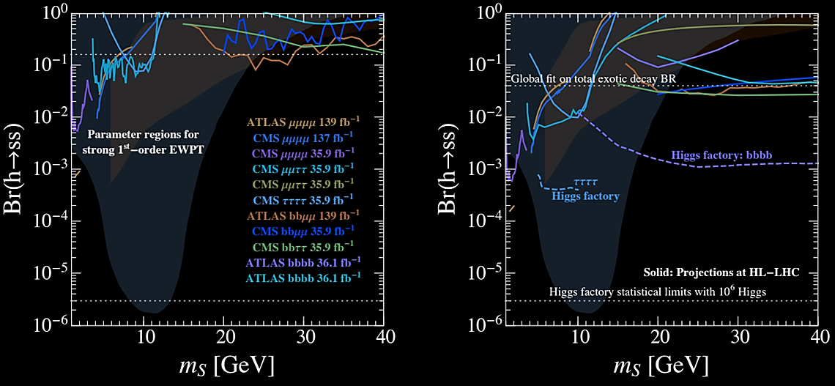
Higgs Exotic Decays to light Higgs pairs
Carena, Kozaczuk, ZL, Ou, Ramsey-Musolf, Shelton, Wang, Xie, 2203.08206

Slide 22
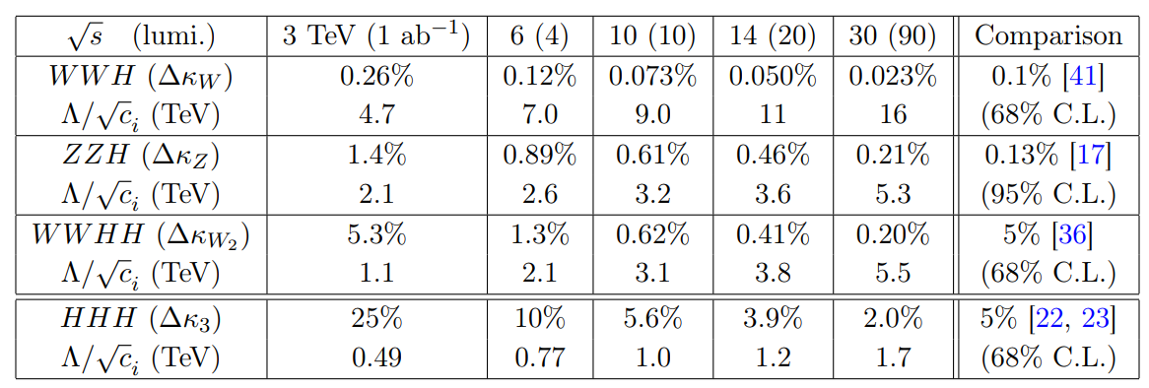
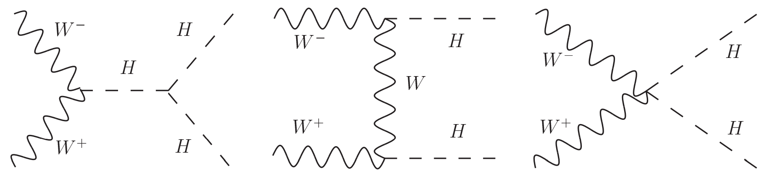
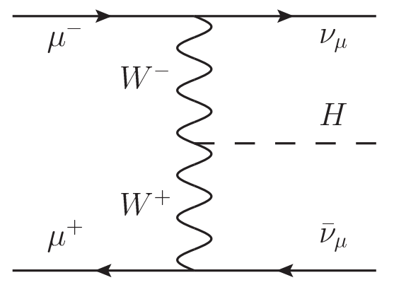
Multi-Higgs & Higgs Self-couplings
Allow %-level trilinear Higgs measurements, and a consistent measurement between gauge boson-Higgs coupling measurements.
T. Han, D. Liu, I. Low, X. Wang, 2008.12204

Slide 23
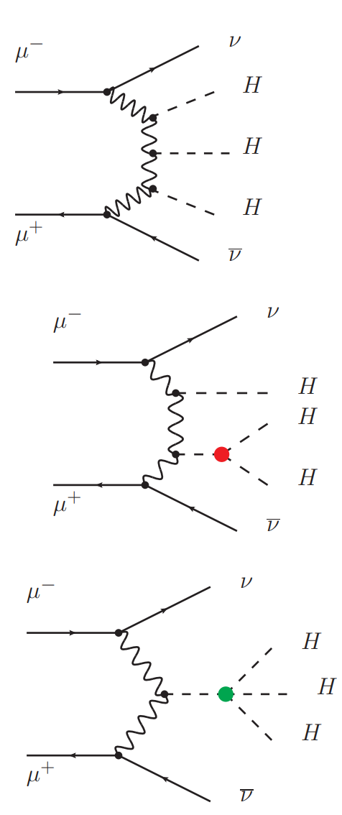
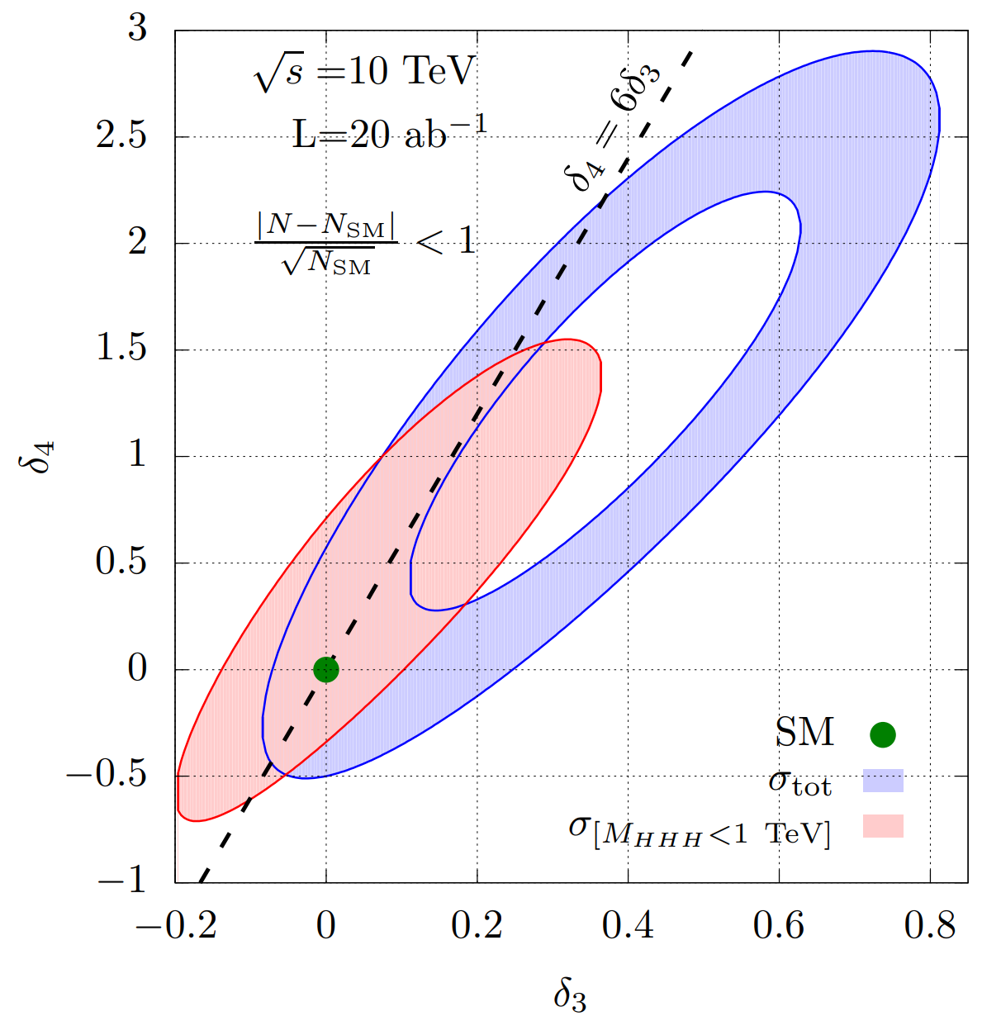
Multi-Higgs & Higgs Self-couplings
O(1) quartic determination possible.
Correlated measurements of trilinear and quartic couplings reveals deep information about EFT and EWPT.
Chiesa, Maltoni, Mantani, Mele, Piccinini, 2003.13628
e.g, Huang, Joglekar, Wagner, 1512.00068 , Falkowski, Gonzalez-Alonso, Grejio, Marzocca, M. Son, 1609.06312, Chang, Luty, 1902.05556,+Abu-Ajamieh, M. Chen, 2009.11293; DiHiggs review 1910.00012

Slide 24
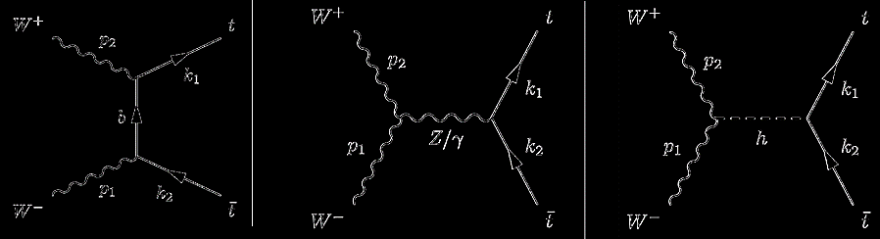
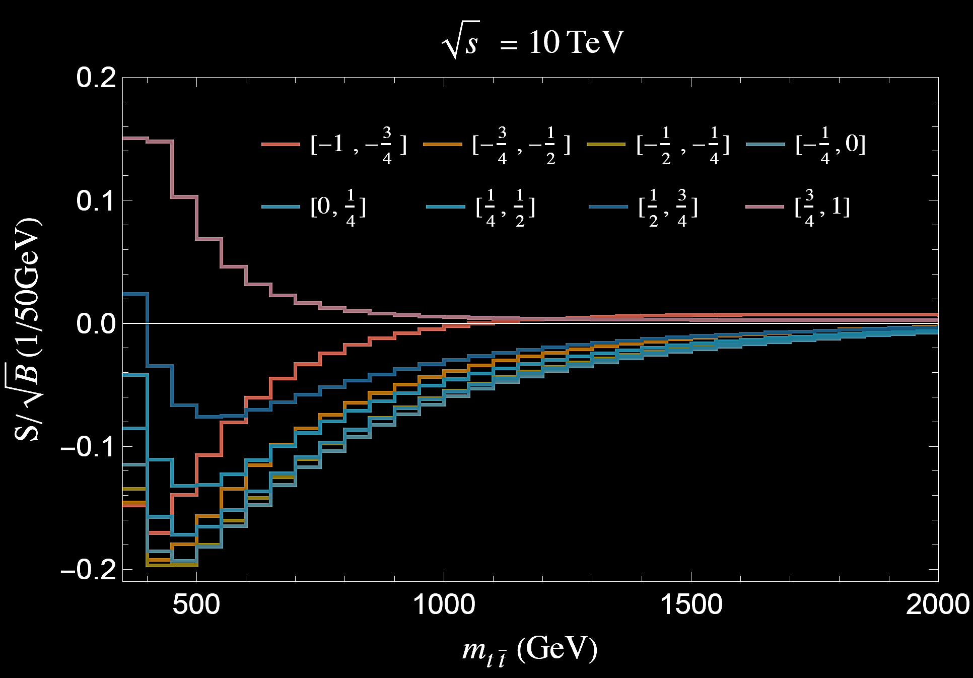
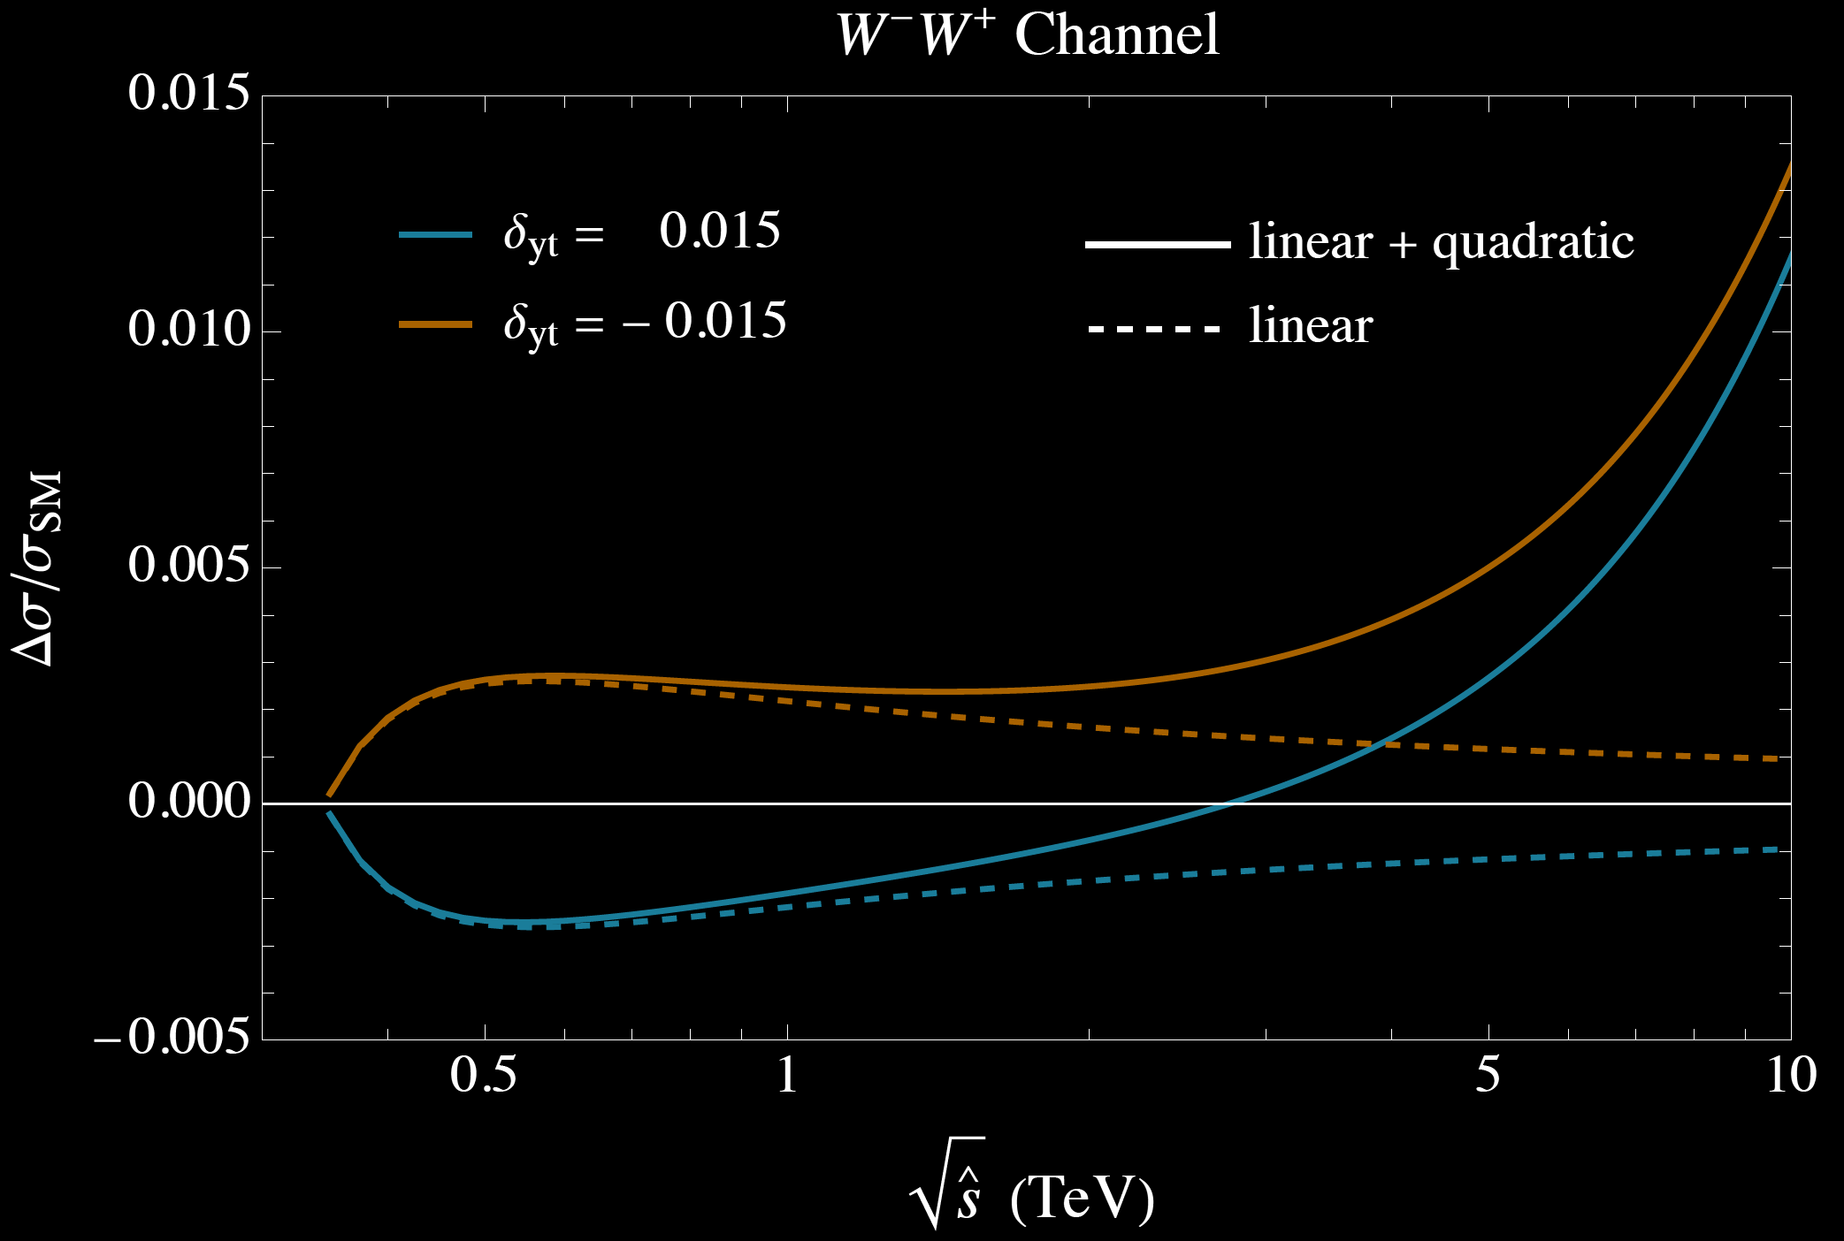
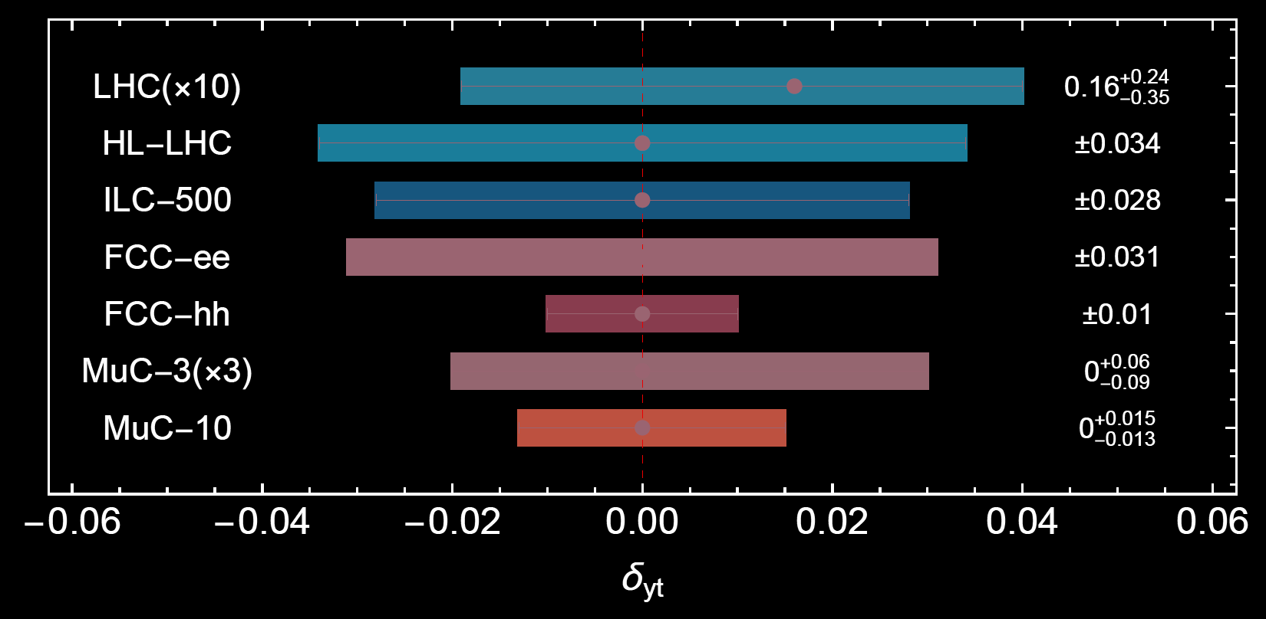
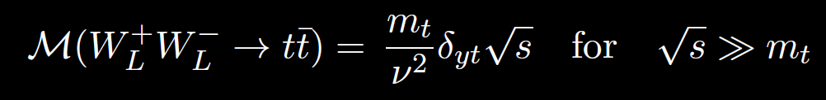

Top Yukawa from interference
$t\overline{t}$dominated by WW-fusion. The $W_{L}W_{L}$ contribution is large and sensitive to Higgs Yukawa deviations.
Higgs unitarize the $W_{L}W_{L}→ t\overline{t}$ to be $\log{\hat{s}}$.

Slide 25

Call from the Dark Matter

Slide 26
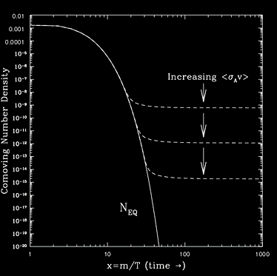
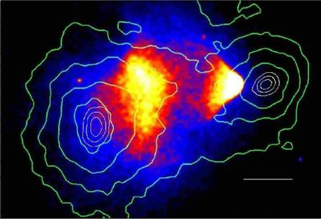


WIMP Dark Matter
Compelling, simple, predictive explanation for thermal, cold dark matter
$$Ωh^{2}≃0.1×(\frac{2×{10}^{−26}cm^{3}/sec}{<σ_{eff}v>_{freeze−out}})$$
$$<σ_{eff}v>_{χ\overline{χ}→VV}≃\frac{πα_{χ}^{2}}{m_{χ}^{2}}$$
There is a scale…

Slide 27
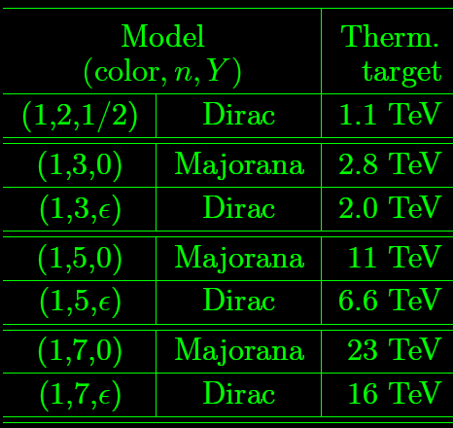
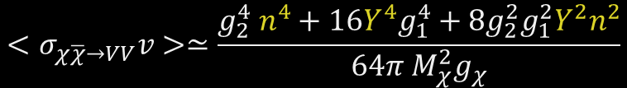
Our Approach: work on the “nightmare” scenario
Han, ZL, Wang, Wang, 2009.11287
Han, ZL, Wang, Wang, 2203.07351
Consider the following “Minimal Dark Matter”*:
“Nightmare”:
High thermal targets
  23 TeV for 7-plet Majarona
Minimal signatures
  Only missing energy
Additional considerations:
Doublet → “Higgsino”
Triplet → “Wino”
Use “epsilon” notation to indicate Dirac case
Even-plet requires non-zero Y (and additional splitting to suppress direct detection)
Perturbative Unitarity
Summonfeld and bound-state effect
$$<σ_{χ\overline{χ}→VV}v>≃\frac{g_{2}^{4} n^{4}+16Y^{4}g_{1}^{4}+8g_{2}^{2}g_{1}^{2}Y^{2}n^{2}}{64π M_{χ}^{2}g_{χ}}$$
Notes:
LHC is missing it!

Slide 28
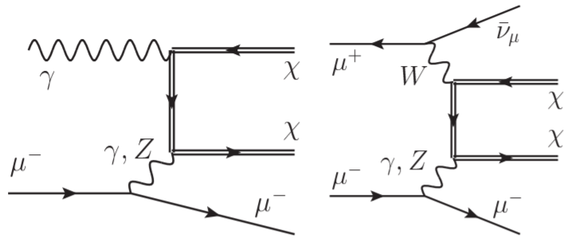
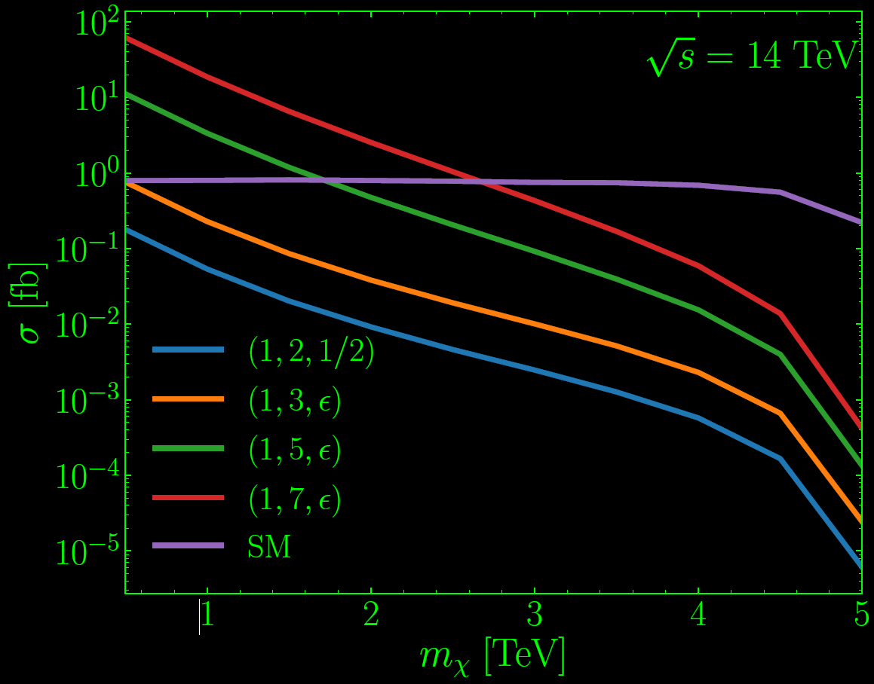
Unique Mono-Muon Channel
Han, ZL, Wang, Wang, 2009.11287
Han, ZL, Wang, Wang, 2203.07351
Apparent “Charge Violation” channel
(very different from the LHC)
Signature: Energetic mono muon
Muon pairs → muon + missing mass
One charge is missed due to the soft (non-reconstructable) decays of the charged states
Unique and powerful channel for low-rate channels.

Slide 29
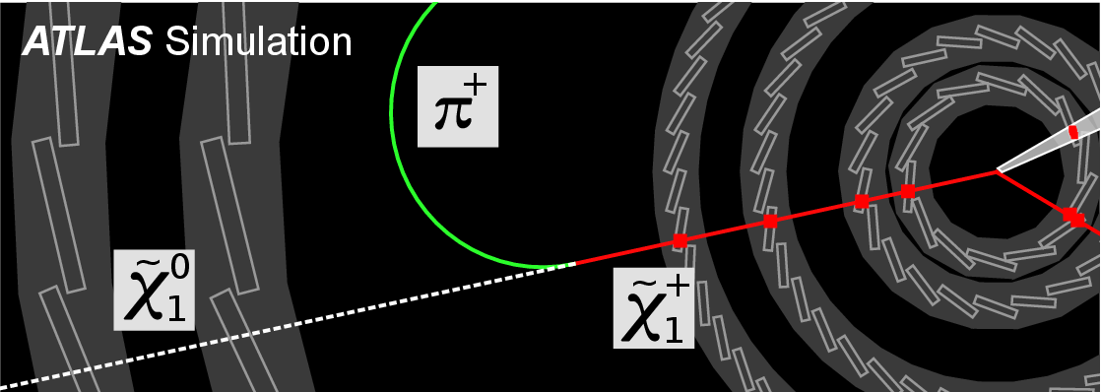
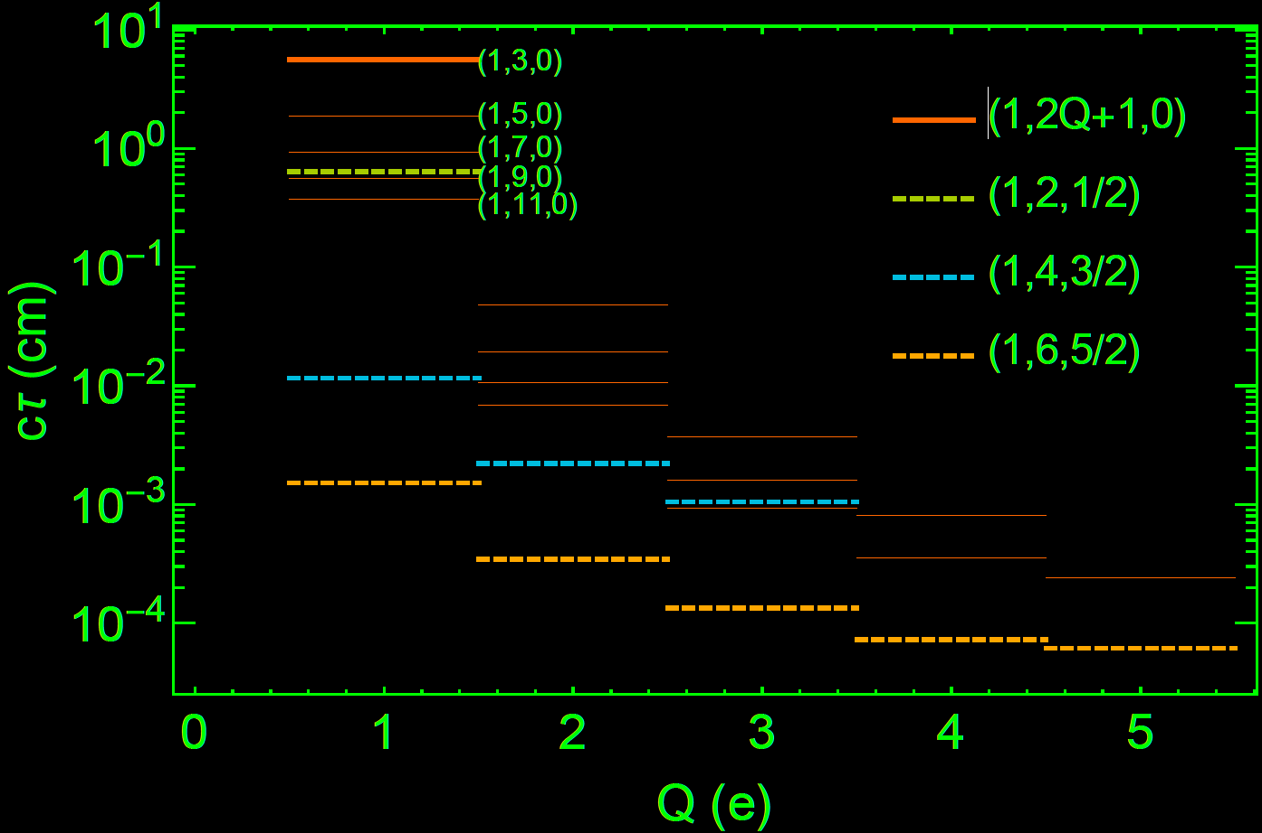
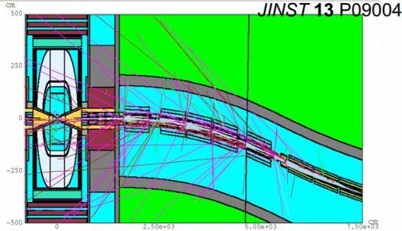
Disappearing Tracks: next to minimal signatures
Han, ZL, Wang, Wang, 2009.11287
Han, ZL, Wang, Wang, 2203.07351
Only useful for searches using charge 1 states
Still, all higher charged states will cascade back to charge 1 states promptly
Use all the production rates of charged states
Mono-photon+disappearing tracks
Beam Induced Background
See also discussion in
Bottaro, Buttazzo, Costa, Franceschini, Panci, 2107.09688
Capdevilla, Meloni, Simoniello, Zurita, 2102.11292

Slide 30
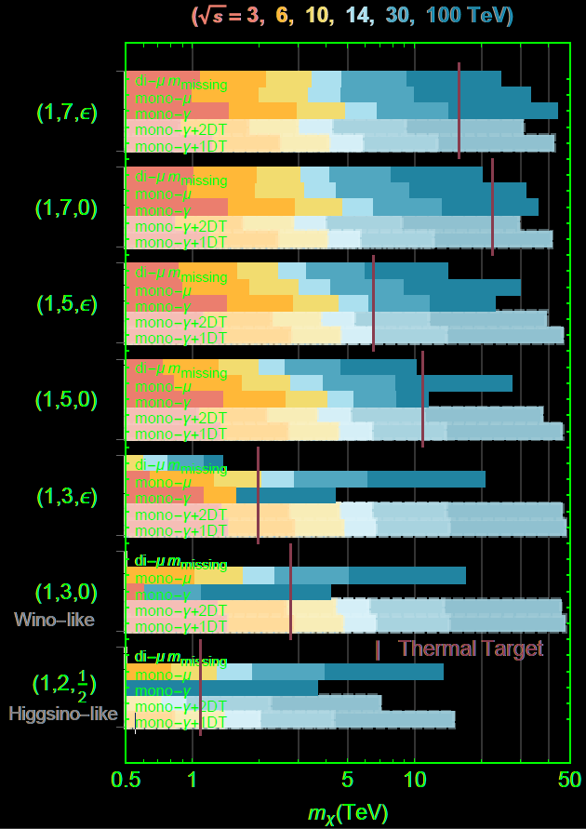


WIMP discovery Machine
Mono-photon powerful for high n-plets
Mono-muon uniquely powerful low multiplets (Wino and Higgsinos)
VBF dimuon large room to improve (we conservatively assumed |\eta mu|<2.5, losing lots of signals)
Disappearing track great potential (can push to the kinematic limit)!
We only combine the missing mass searches (mono-muon, mono-photon, VBF dimuon)
High Energy Muon Collider will cover all of them with different run energies.
Electroweak precision probes for these EW multiplets, mainly useful for the high n-plets.
Collider always provides definitive measures for new particles (even if we discover WIMP DM in e.g., DD).
High Energy Muon Collider will cover all of them with different run energies.

Slide 31

Call from Neutrinos

Slide 32

Neutrino is a puzzling sector
In SM, the neutrino is massless. At the same time, the experiments have confirmed its tiny mass <0.1 eV.
The new findings of the US flagship program will call for a new collider.
Find something→Why?
Find “SM” consistent→ Why?
People have high hope for US particle physics and Fermilab

Slide 33
The physics is rich
Direct Particle Probes:
  Production
    Meson decay, heavy lepton decay
    (On-shell/Off-shell) Gauge/Higgs boson decay
  Decay
    Short-lived
    Long-lived
Cosmo and astrophysical probe: BBN, CMB, etc
Indirect constraints: branching ratio of SM particles decays, oscillations, etc.

Slide 34



S-channel production ($e/ μ /τ$ flavored)
1/s suppressed;
Flat rate until near the threshold s/2
$O(fb)$ cross section;
Peiran Li, ZL, Kun-Feng Lyu, 2301.07117

Slide 35



Muon Flavor
Production dominated by t-channel

Slide 36

Projected sensitivity
Sensitivity to e and $τ$ flavor is moderate
Muon Collider features the strong direct probe of the $μ$ flavored HNL
10 TeV muon collider can probe the ${\left|U_{μ}\right|}^{2}$ to a few ${10}^{−7}$ for TeV scale HNLs.
The VBF background increases for high energy muon colliders and renders the 3 TeV muon collider competitive in sub TeV scale.
Peiran Li, ZL, Kun-Feng Lyu, 2301.07117

Slide 37

Projections w. others
Focusing on the muon-flavored case:
LHC and EWPD probe $O({10}^{−3})$
Muon Collider has unique roles in probing the parameter space (thanks to the t-channel enhancement).
In the inverse seesaw setup, ${\left|U_{ℓ}\right|}^{2}={\left(\frac{λv}{m_{N}}\right)}^{2}$, and hence a unitarity limit exist on the upper right corner, overlapping very little with the region of our interests.
Peiran Li, ZL, Kun-Feng Lyu, 2301.07117

Slide 38


BDT-based projections
T.H. Kwok, L. Li, T. Liu and A. Rock, arXiv:2301.05177
K. Mekała, J. Reuter and A.F. Zarnecki, arXiv:2301.02602

Slide 39

New studies for other regions
We have studied and demonstrated
The bottom left “type-I seesaw” represents the most pessimistic seesaw benchmarks. In general multi-generation seesaw, the motivated parameter regions spans over the space above that line, very much like the inverse seesaw spectra.
(Meson production) Displaced Vertices Regime.
(W, Z, H production) Displaced Vertices Regime.
From Snowmass EF BSM report

Slide 40
The Dream Machines
Physics Driver
Pheno Probes
Dark Matter
Baryogenesis
Naturalness
125 GeV Higgs factory
3-6 TeV High Energy
10-100 TeV Very High Energy
Notes:
Reasonable bet on naturalness. Even flavor precision with reasonable theories points to a lower scale.
If anomalies show up, one wants a machine to have few blind spots. Conclusive machine.
High quality NULL result!

Slide 41
Call from Carlos…

Slide 42



Often, Marcela’s schedule is so full that our research discussion starts >6 pm…
Carlos calls

Slide 43
Often, Marcela’s schedule is so full that our research discussion starts >6 pm… and often goes > 11pm
Carlos calls and calls and calls
Every such deep discussion evening, Carlos calls more frequently (from 40min to 30mins to every 10 mins…)

Slide 44


And the phone calls become more and more intense and brief
I had no idea beyond “Carlito” and “I am with Zhen,” typically in the first call...
But the air gets denser, I felt guilty that I am impacting their relationship…
After repeated training for many nights, I finally got it…

Slide 45


It was Carlos calls for food!
Family=dinner together
And…
Now imagine after one day of tired work and no food until 11:30pm…

Slide 46

This explains why I have zero papers with Carlos
I wish they are filled with joy (and family food).

Slide 47


Another story: Iris’s 1-year birthday

Slide 48



Thanks Marcela and Carlos and happy birthdays!
Many things I learned from Marcela: whenever I am frustrated, I think about Marcela; How can she handle >2 babies, run the groups, care for the family and achieve so much!
Thanks for making us a big family and physics so enjoyable!
❤ ❤ ❤

Slide 49

Lots of open questions
How would the width, mass, signal strength fit scale in various scenarios?
Change of Luminosity (expecting some non-linearities from the beam energy spread);
Lineshape scanning steps
Lineshape scanning range
Inclusion of more channels
The convolution of various effects are highly non-trivial. So new studies will help understand better:
125 MuC Higgs physics
Robustness of the width fit
Allowing future studies on systematics
We made attempt to address these in our recent study,
J. de Blas, Jiayin Gu, ZL, 2203.04324
We initially worked on Higgs width alone T. Han, ZL, 1210.7803

Slide 50


Scanning Range & Steps
New insights:
Optimal scanning range around +-10 MeV
Need at least 6 points to stabilize, 10 points scan should be sufficient

Slide 51

Now the Model-Independent MuC Width matters!
This MuC width is a parametrically new measurement; the correlations with other parameters are distinctive.
Complementary to other lepton collider Higgs factories
Sub-percent muon Yukawa
Good lumi scaling with couplings
Excellent improvement when combined with e+e- Higgs factories

Slide 52


Exotic Decay Overall Picture
Our study on CEPC/ILC/FCC-ee only used Z(->ll)H, there is 10x statistics to be used
125 GeV MuC: no tagging spectator Z issues and less combinatoric background.
with missing Energy (SUSY motivated, DM motivated channels)
3-4 orders of magnitude improvement for the constraints on such exotic branching fractions
$h→4f$ generic Higgs sector extensions, also Higgs portals
2-3 orders of magnitude improvement for the constraints on such exotic branching fractions
Original plot without MuC, ZL, Wang, Zhang, 1612.09284 , updated by ZL following future collider program updates; MuC very preliminary results compiled by ZL.

