Slide 1
9 O’Clock Meeting
Nathan Ruffatti
MCR Crew Chief
Wednesday, December 21th, 2022

Slide 2
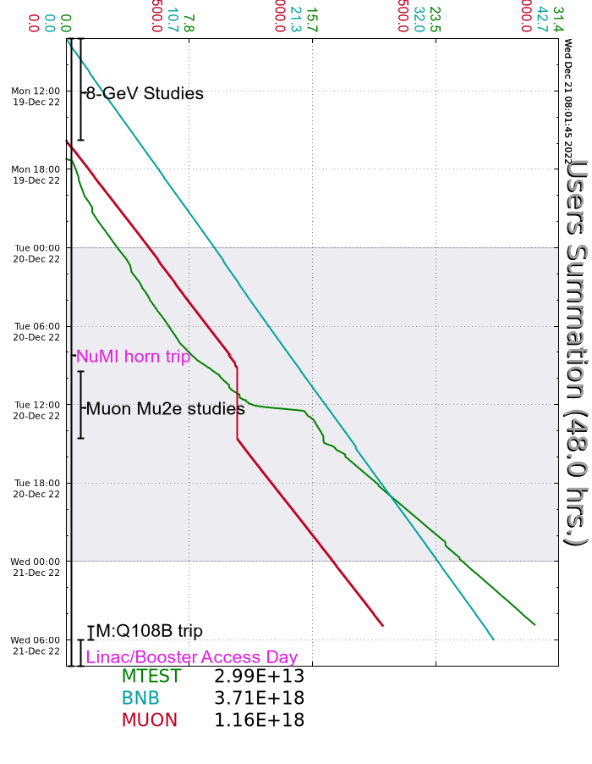
Since Monday…
Monday
Mu2e studies
MT4 target stuck out
Can’t run low energy pion mode
Beam established to MTest
MI10 upper VCB tripping off
Tuesday
Mu2e studies
Wednesday
M:Q108B trip, unable to reset.
EE support investigating
Beam off at 0600 for Linac/Booster Access Day

