Slide 1
Preacc/Linac Operation Dec 16 – Dec 23 2022
John Stanton
Friday 9 o'clock meeting
23 December 2021

Slide 2
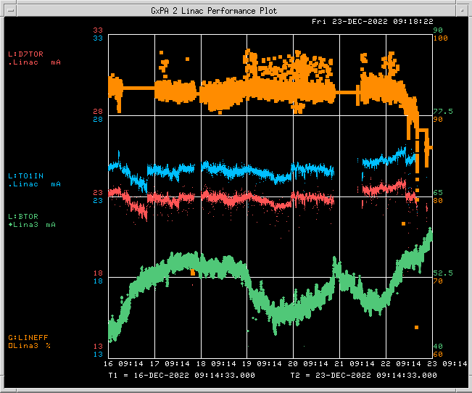
Operation (Dec 16 – Dec 23 2022)
BTOR: 57.5 mA
TO1IN: 25 mA
D7TOR: 22.3 mA
LINEFF: 88%

Slide 3
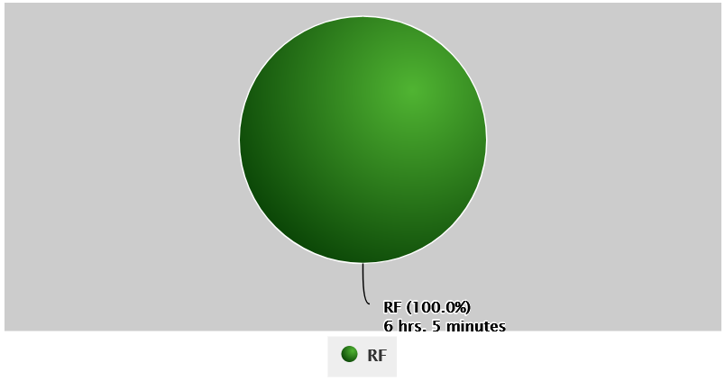
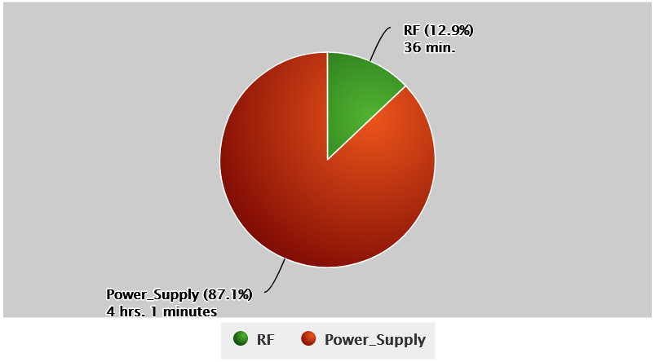
Downtime and Issues
Beam Inhibit Downtime PREACC: (6 hr 5 min)
LINAC: (~19 hr)
Issues:
QPS regulation issues (110, 112, 301). One requiring significant time to install a cooling fan on QPS112.
Multiple KRF2 CS Faults among other RF station trips, all reset with no significant issues.
Access on Wednesday (12/21) to investigate DTL Tank 5 vacuum issues.
RFQ driver forward/reverse power regulation issues due to extreme cold.

