Slide 1
MI/RR status
Meiqin Xiao
Friday 9am ops meeting
23 Dec 2022

Slide 2
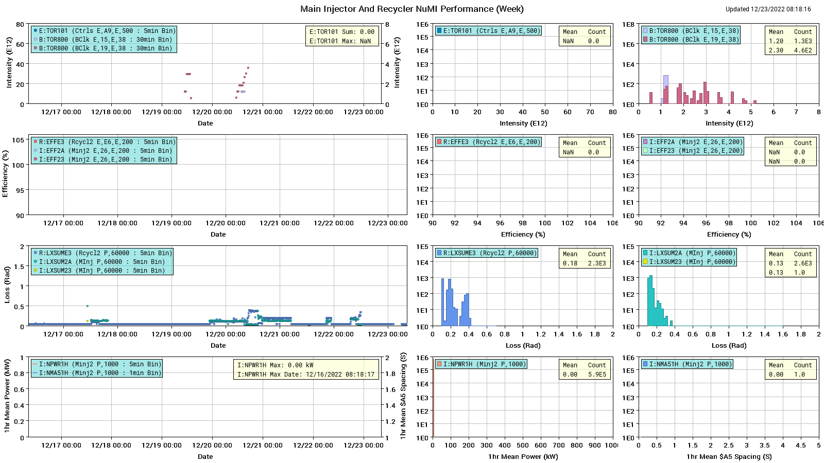
NuMI performance

Slide 3
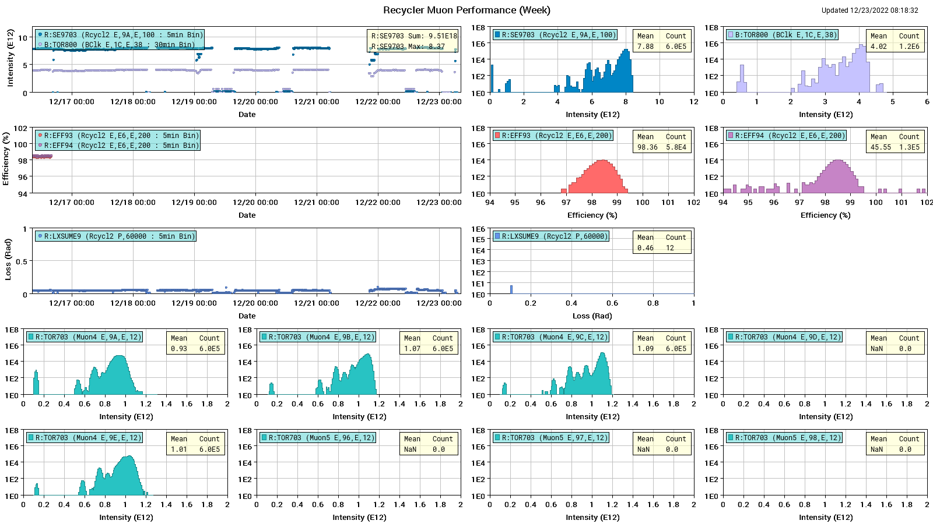
Muon Performance

Slide 4
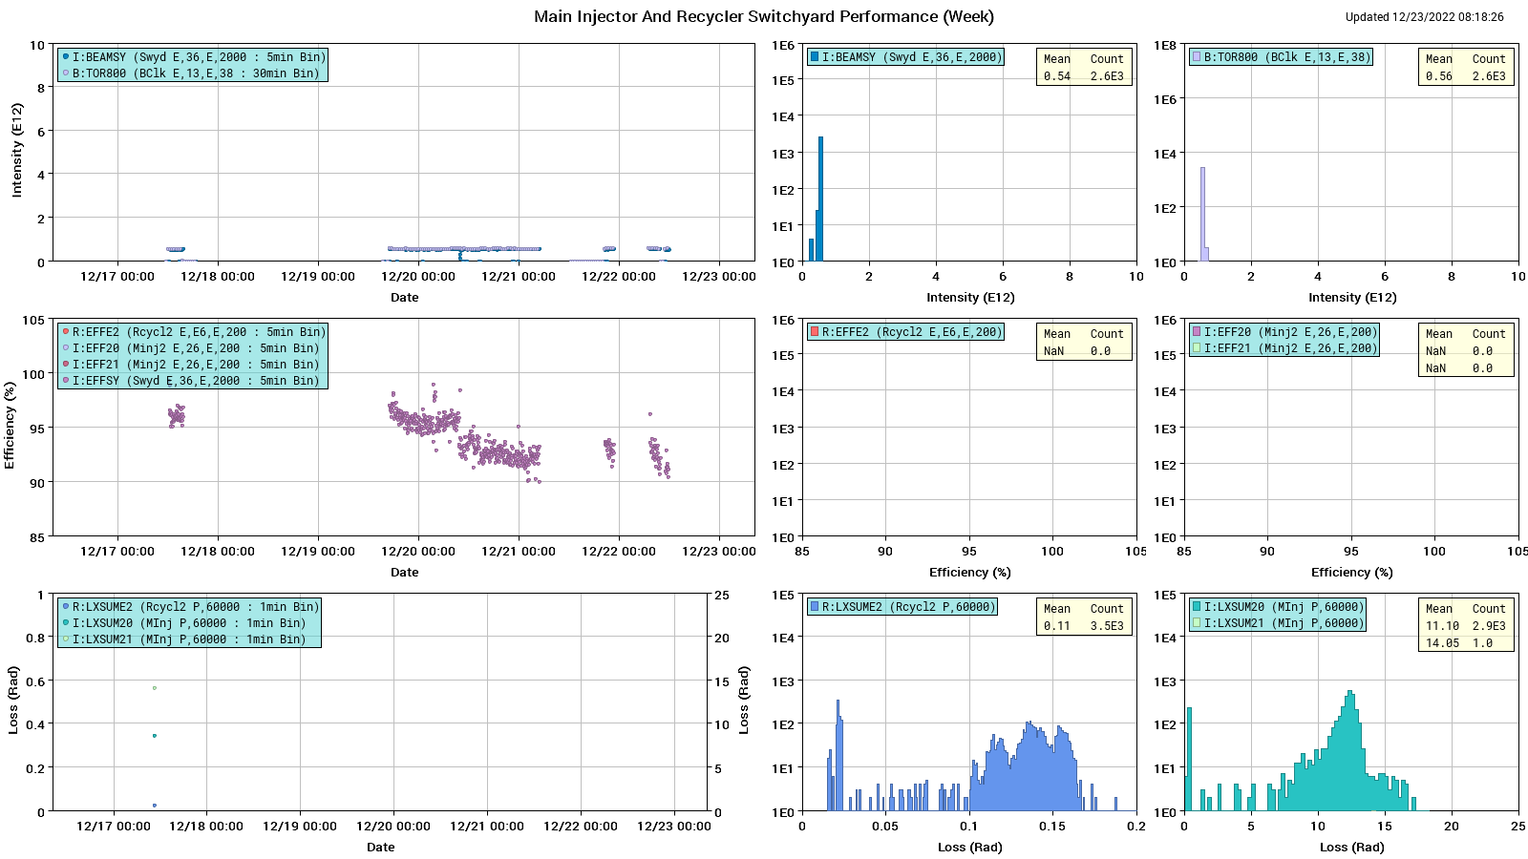
SY120 Performance

Slide 5
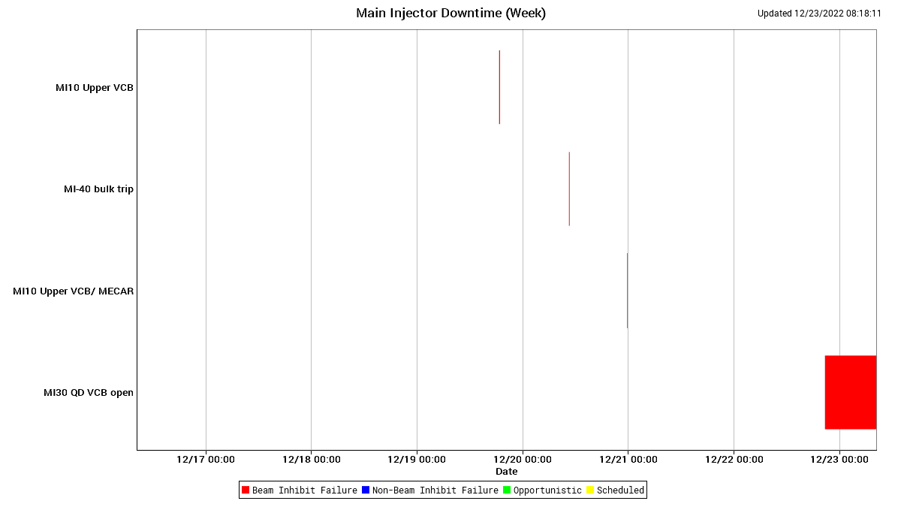
MI downtime

Slide 6
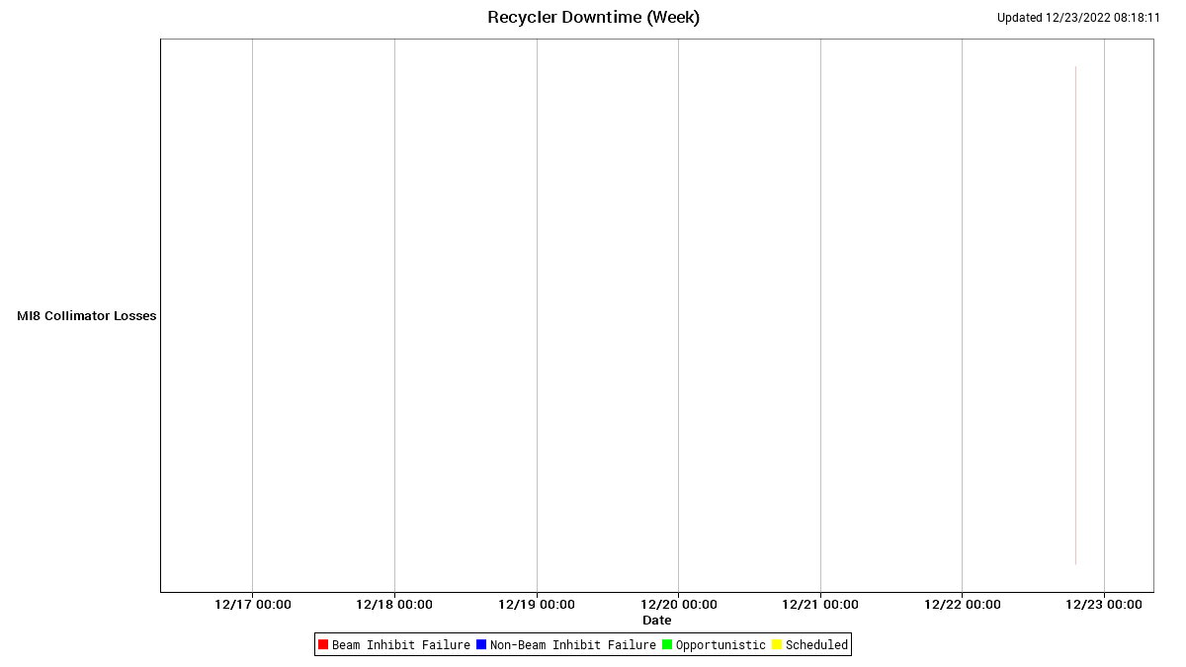
RR downtime

Slide 7
Weekly summary
Slow spill beam to test beam center started last Saturday. It’s running well since.
Beams to G-2 running well.
RR E1 studies
MI10 Upper VCB trips a couple of times. It seems get fixed last Wednesday
Mi-30 quad VCB opened and now will not close in. Every time they try to close it just gives a turn on fault.
R:KPS1D needed an oil refill
MIRF North and South anode trips, but reset OK

Slide 8
Today
Mi-30 quad VCB opened and now will not close in. Every time they try to close it just gives a turn on fault. The plan is request EE support look in the morning.

