Slide 1
9 O’Clock Meeting
Keymonty Bullock
MCR Crew Chief
Friday, December 23, 2022

Slide 2
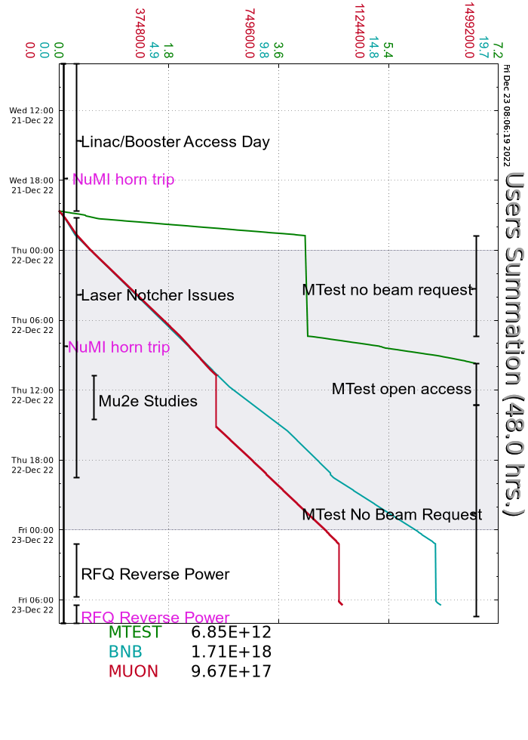
Since Wednesday…
Linac and Booster Access Day
Work performed on Drift Tube Linac tank 5 and BRF15
Linac Laser Notcher issues. Was brought back online after the pump diode was replaced.
RFQ regulation problems due to weather
E:V108 faulted. EE support is aware and will look into it.
MI30 Quad VCB won’t close. Experts will be looking into it this morning.
Walkthroughs on off-shifts
Beam to FAST when requested
No beam due temperature regulation issues.

