Slide 1
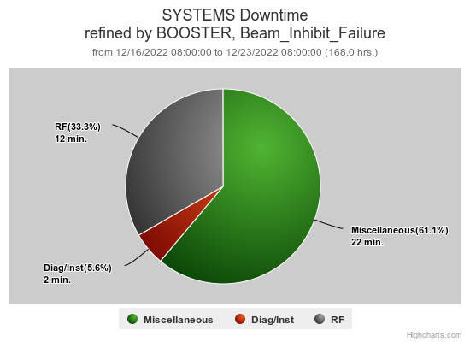
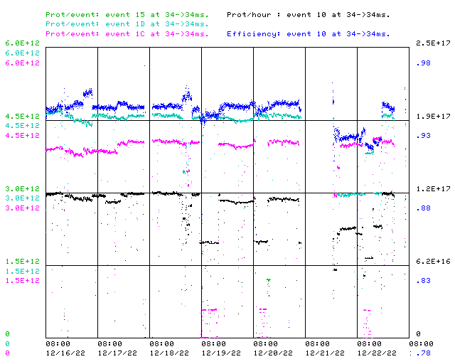
Booster Operations 12/16/22 – 12/23/22
F
F
Sa
Su
M
Tu
W
Th
F
Total Downtime: 36minutes
Minor RF Trips
Cogging FE power interruption
Minor loss trips
Wednesday evening, laser notcher died. Thanks Todd & Dave for coming in to try to recover.
Thanks to Controls folks for looking at Booster West Tower Camac link issues, also investigation into VBC0 turning off w BOOVAC boot
Efforts on Thursday to connect with Pritel, laser amplifier folks. Obtained replacement pump diode & splicer. Thanks Dave & Drew!
Cold overnight, heater in BLLRF room tripped panel breaker, taking down Cogging FE
Thanks to Ops for diligence & tuning on the off shifts
This week:
Booster running well.
Beam to Muon as requested, $1C’s $ 4.0E12/pulse for >1E12POT
Beam to BNB $1D’s 3.0E12 - 4.5E12 per pulse@ 5Hz
Beam to SY as requested
Access on Wednesday to replace BRF15 cavity. Good to have done, but have sparking under the PA, will need to follow up. A very long day! Thanks RF Folks, Mechanical Folks, & Surveyors. Also thanks ES&H.

