Slide 1
9 O’Clock Meeting
Cassidy Mayorga
MCR Crew Chief
Wednesday, December 28, 2022

Slide 2
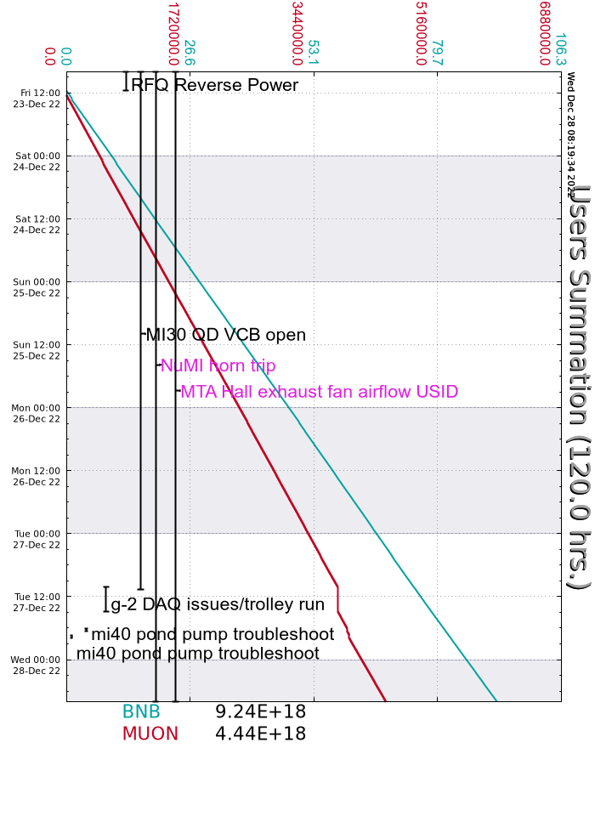
Since Friday…
MS6 Pump 2 tripped, repaired Tuesday
RFQ temp, resolved
Saturday
Possible power glitch, systems recovered
BRF2, R:K1COOL, RRRF1, MIRF17, I:Q847
Cold temps over the weekend
Sunday
LCW leak found on E:QD118
Source B sparking
Monday
MIRF12 cavity leak
Tuesday
MI30 QD VCB repaired, MI ramped and working
g-2 trolley run
Wednesday
Breaker for rack at MI60 has a bad fan

