Slide 1
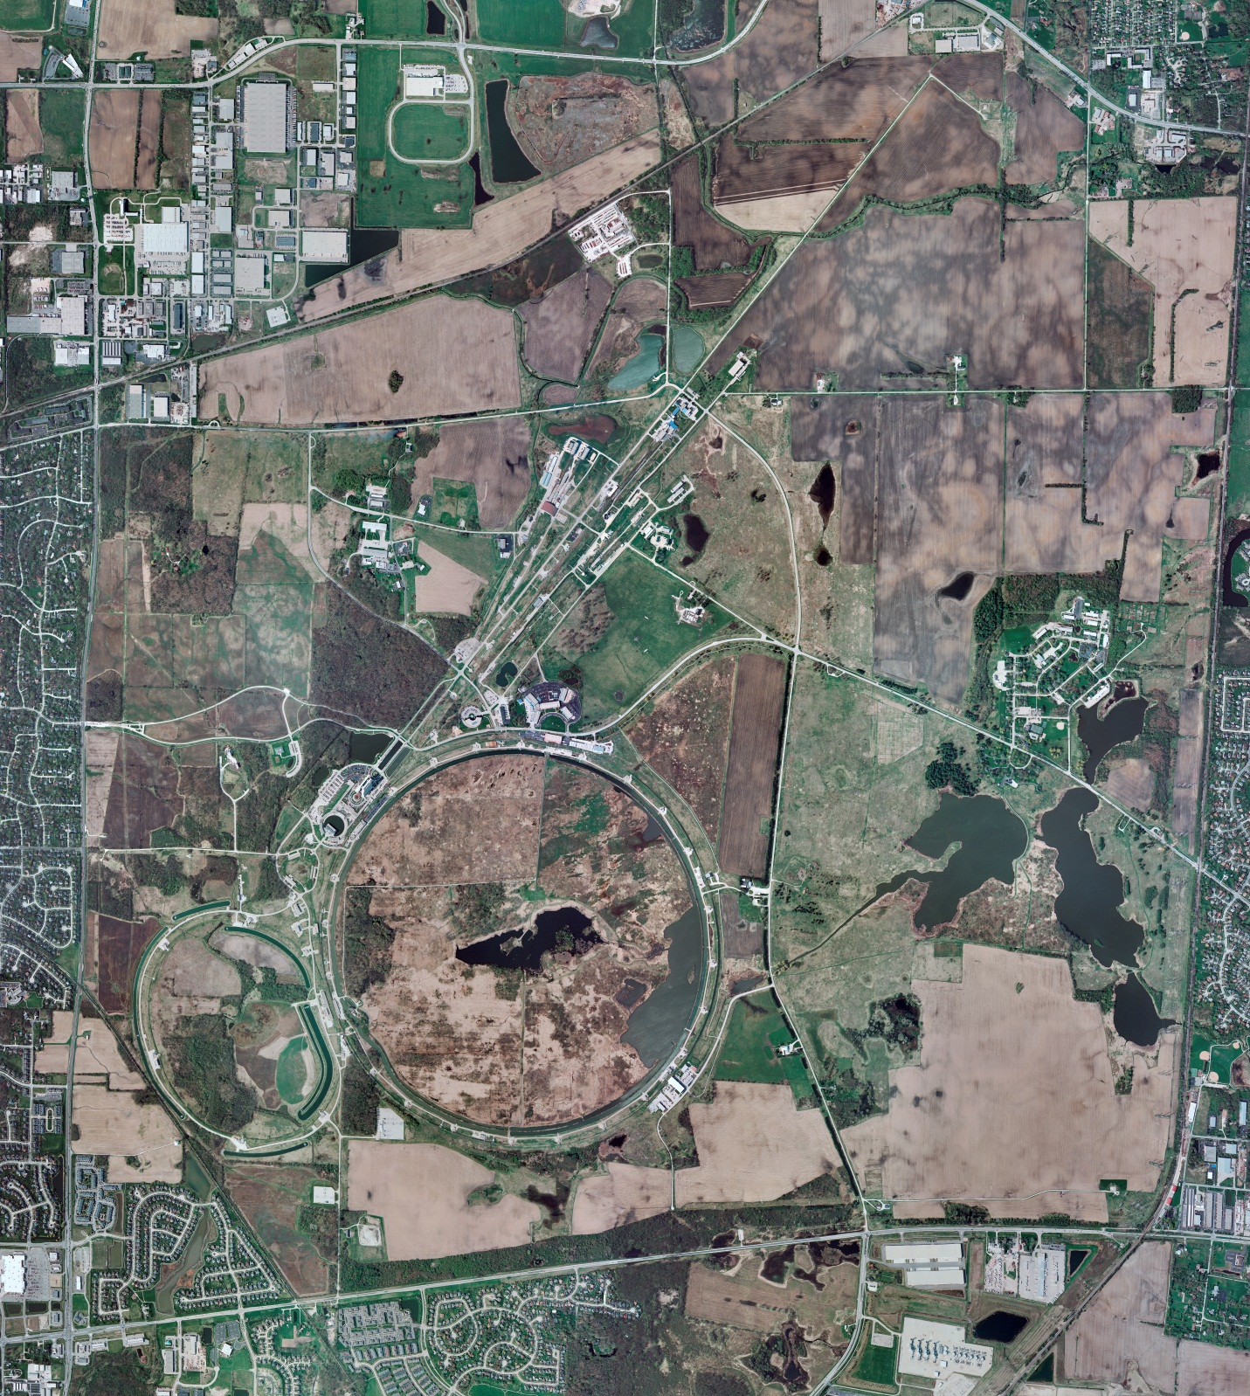
Helium Cryogenics
Status 12/30/2022 J.Makara
CMTF: SCP and comprs shut down
CMTS: HECM23 installation in progress
PIP2IT: SSR1 at RT and HB650 installation prep continuing
MCTF: cryo system warmed up to RT, shut down, and isolated
MDB/HTS: at RT
MDB/STC: at RT
MDB Magnet: at RT
NML/FAST: Cryo system cold and running fine
CC1: cold at 2 K
CC2: cold at 4 K by choice, ready for 2 K
CM: cold at 2 K
IB1: cryo system cold and operating fine with test stands at 4 K or 2 K
Muon Campus: A0 comprs (3) online with MC-1 g-2 cryogenic system cold at 5 K and running fine, though lost 200 liters Lhe due to cold weather-related valve stem seal leak which was readily fixed once found
Misc:. LN2, LHe, and Ghe subcontracts under service extensions, of concern.
Survived cold weather issues and delayed LN2 deliveries during holiday weekend

