Slide 1
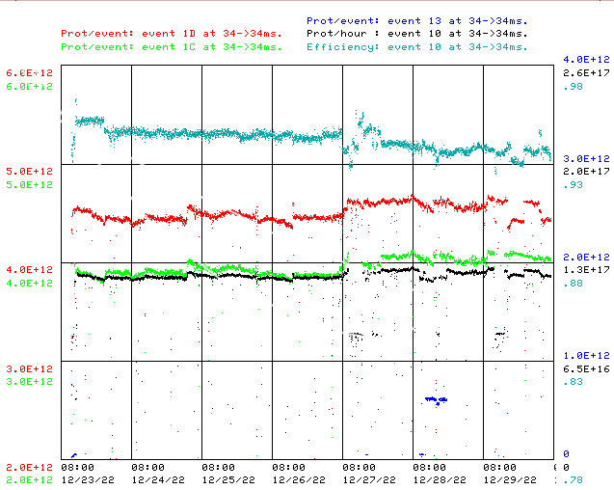
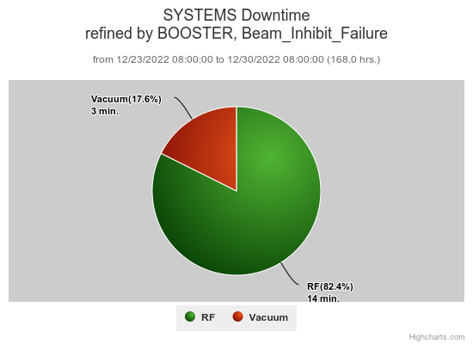
Booster Operations 12/23/22 – 12/30/22
F
F
Sa
Su
M
Tu
W
Th
F
Total Downtime: ~17 minutes
Minor RF Trips
Vacuum pump trip resets
This week:
Booster running well.
Beam to Muon as requested, $1C’s $ 4.0E12/pulse at ~1E12POT
Beam to BNB $1D’s 4.4E12 - 4.6E12 per pulse@ 5Hz
Beam to SY as requested.
General tuning. Thanks to Ops for machine tuning over week.
Looking for opportunistic access for BRF15 tunnel repair, currently running with 1 spare RF station.
Cold weather last weekend did not have direct impact on Booster operations.

