Slide 1
Muon Campus Status
D. Vander Meulen
AD Friday 09:00 Meeting
Dec 30, 2022

Slide 2
This Week ...
Running well to G-2.
No studies.

Slide 3
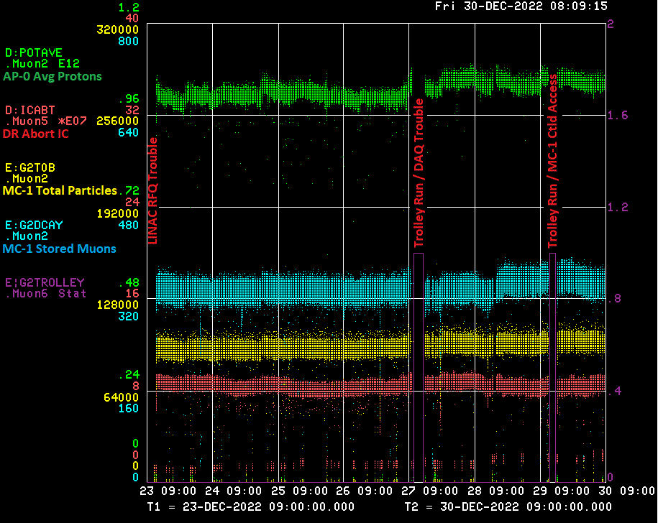

Slide 4
Down Time ...
Muon Campus: (none)
G-2: (8hrs 59min)
Trolley Run / DAQ Problem: 4hrs 40min
MC-1 Controlled Access (“WPC”): 1hr 2min
Trolley Run: 3hrs 17min

Slide 5
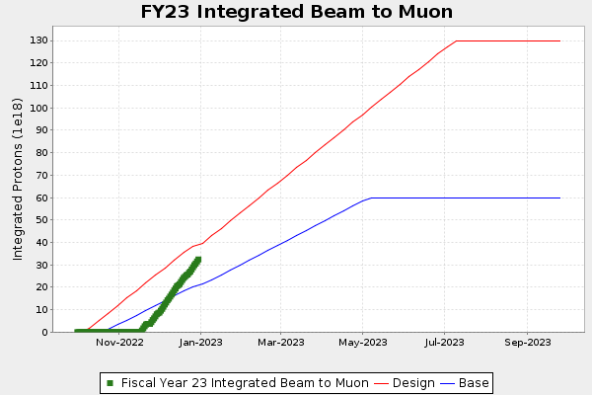
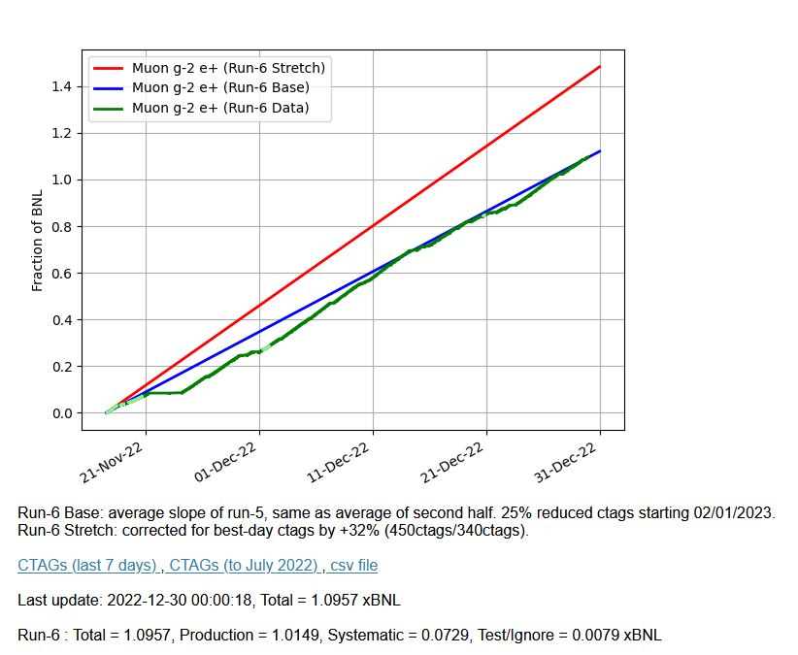
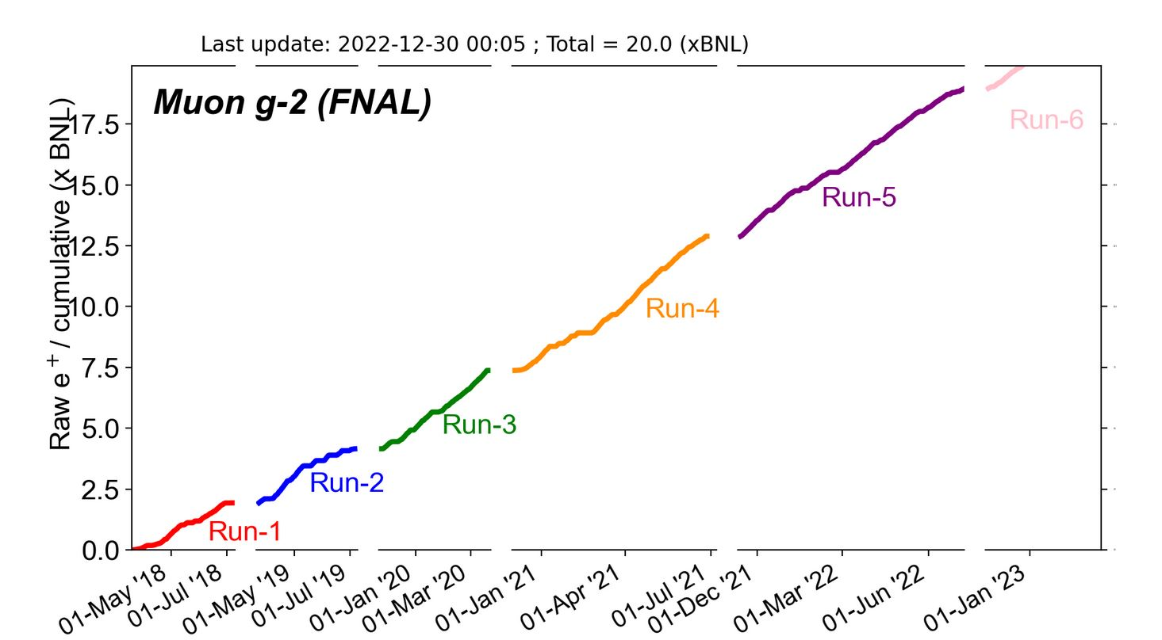
G-2 Performance – Integrated for Run 6
Run 6 # POT
G-2 Experiment POT Run Goal: ~4.2E20 POT
Run 6 period is Nov 2022 – July 2023
Run 6: Goal of ~x6 BNL
Total Run: Goal of x21 BNL
Run 6 Integrated: 1.0957 BNL
Total Integrated = 20.0 x BNL

Slide 6
Today / Weekend …
Tune up as needed today.
Run to G-2.

Slide 7
Next Week ...
More 8 GeV studies next week (planning).
Repairs to Delivery Ring RF system?
Running to G-2.

