Slide 1
48 Hour Summary
Patrick Dowdle
December 30, 2022

Slide 2
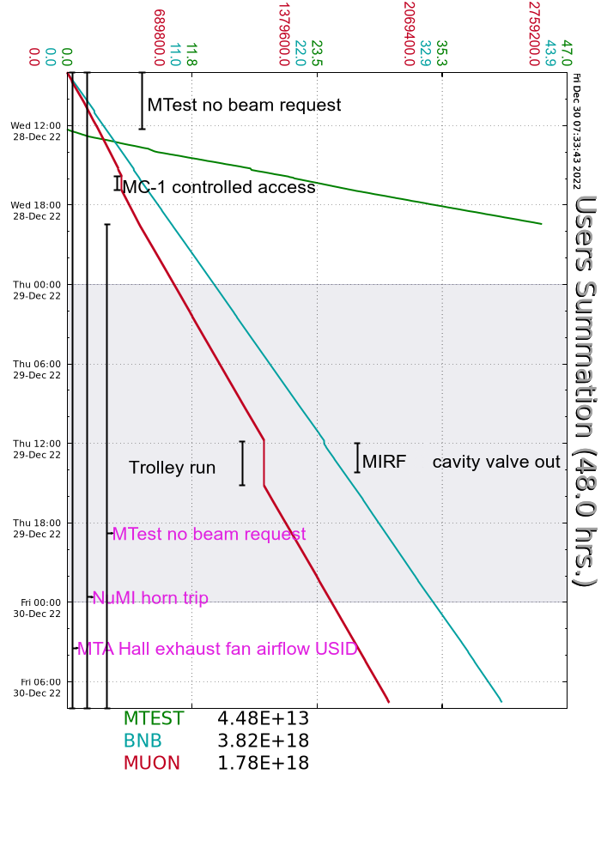
Summary
In general:
Supporting machine studies, tuning
Running beam to BNB/g-2/MTest (on Wed)
Thursday:
Computer room AC unit motor replaced without incident
Accessed MI to valve out MIRF12 from the cavity system
MS2 tower return temp high, tried to get one of the towers, the MCC breaker at MS2 failed
Friday:
Ran slightly lower intensity to BNB while trying to tune out MI8 collimator losses
B:MP02I tripped 3x in ~5 mins, “PS no fire” and “Regulation outside limit”
BNB horn trip on PS not ready/repetition rate fault
Currently 8.33E16 p/hr to BNB, 1.04E12 POT to g-2

