Slide 1
MI/RR status
Meiqin Xiao
Friday 9am ops meeting
30 Dec 2022

Slide 2
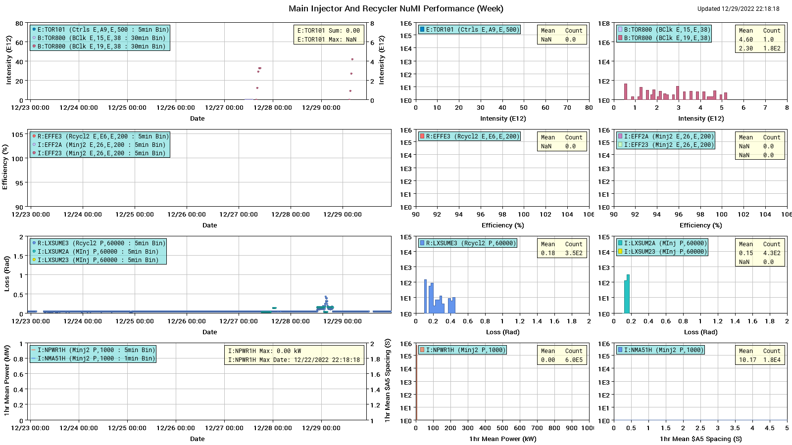
NuMI performance

Slide 3
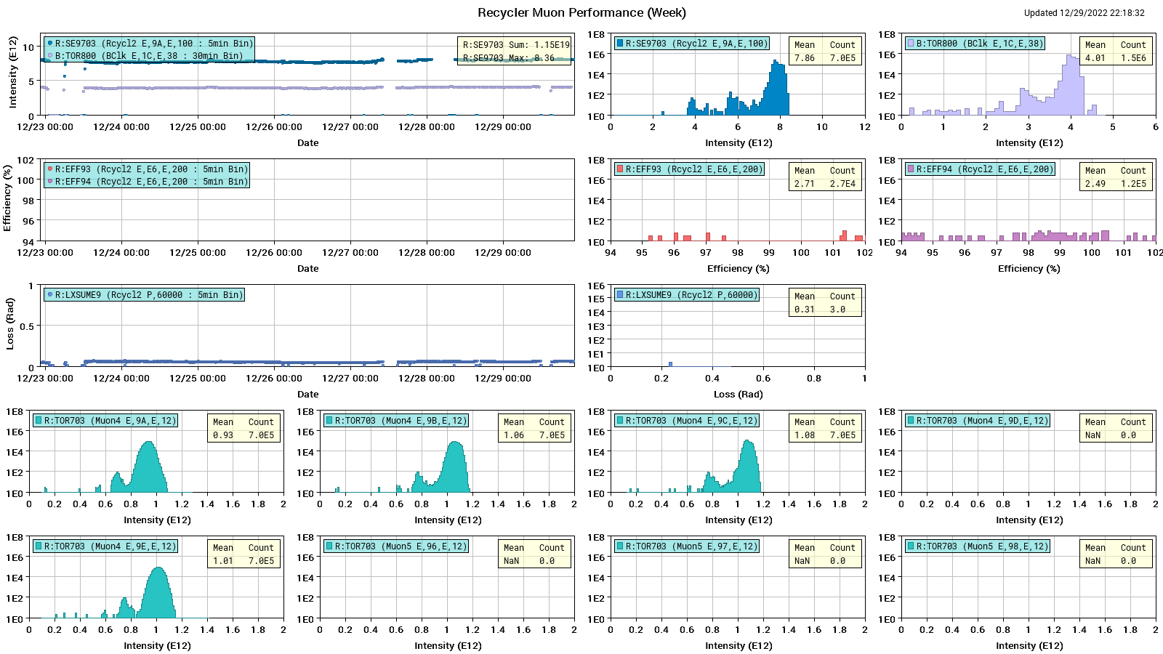
Muon Performance

Slide 4
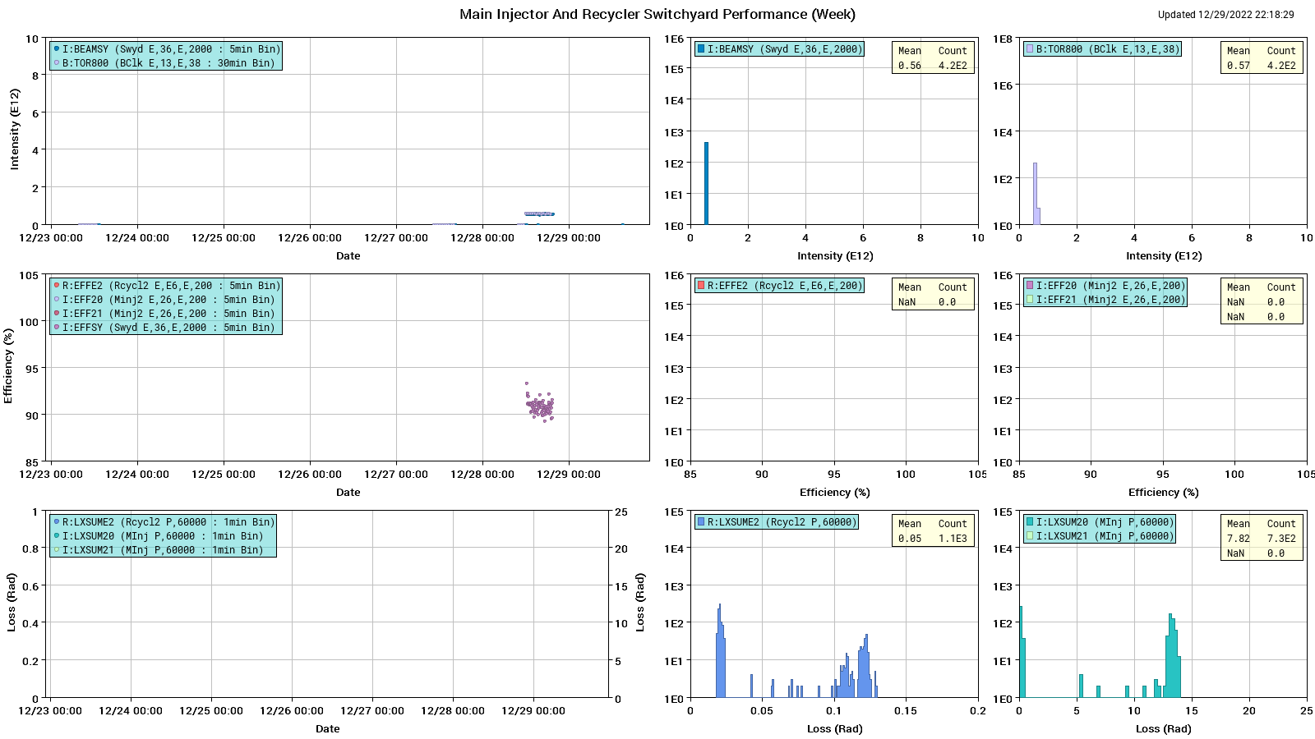
SY120 Performance

Slide 5
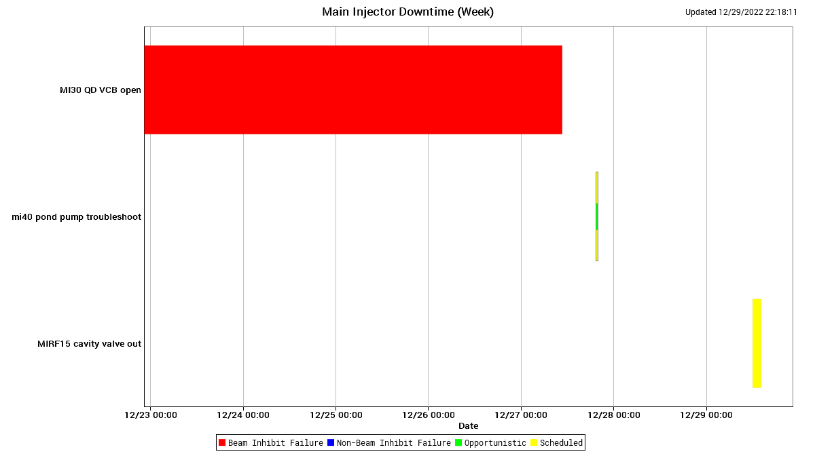
MI downtime

Slide 6
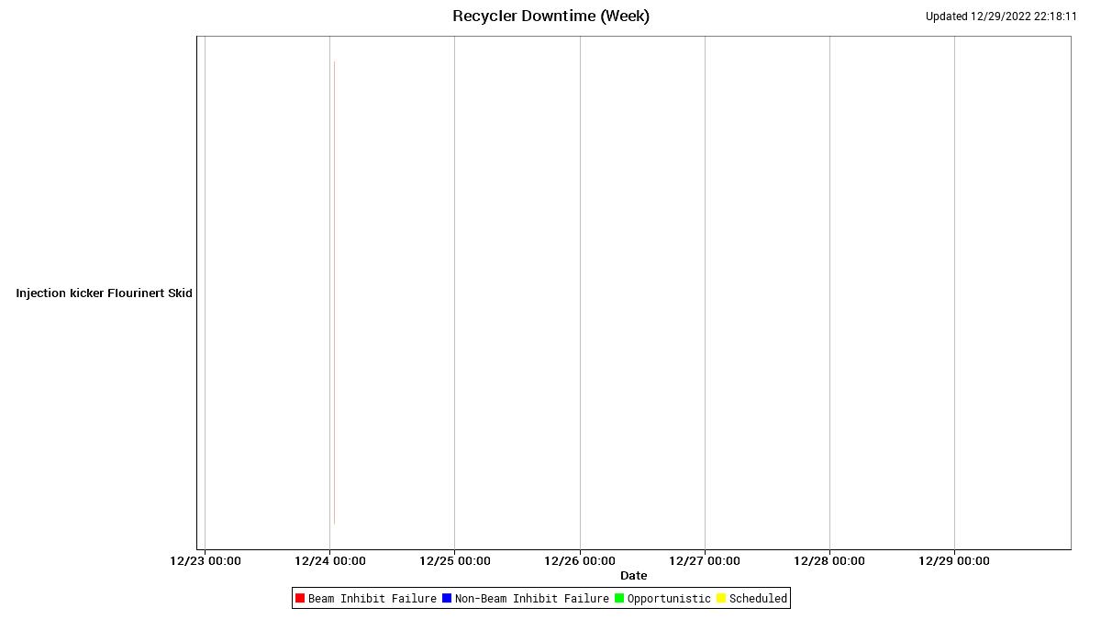
RR downtime

Slide 7
Weekly summary
Beams to G-2 running well.
Mi-30 quad VCB issue since last Friday. It got fixed this Tuesday.
The MI40 pond pump S04 was not running properly Tuesday. ISD repair it on Wed.
MI RF Cavity LCW has a leak , and leaking rate was increased since Thursday morning. Puddle is growing on the tunnel video image.
This is about a 500gal tank and at this rate the system will not last until Tuesday without someone coming in to fill the tank. It was decided to have MI access to valve out MIRF12 Thursday afternoon.

Slide 8
Today

