Slide 1
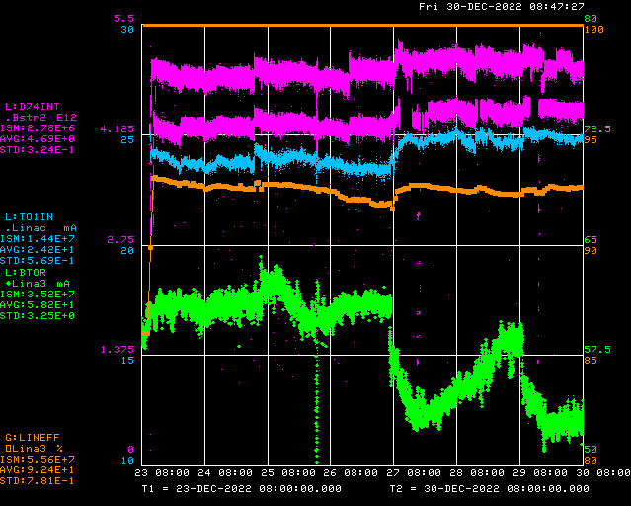
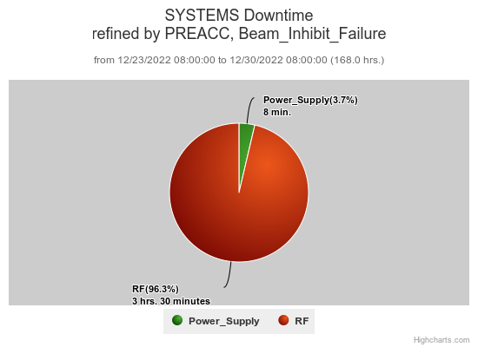
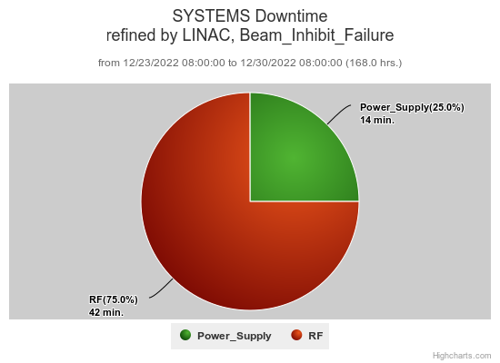
Preacc/Linac Weekly Performance
No Preacc
Downtime
Weekend Recovered RFQ
Source B sparking
Reset source heater PS
HT4001 regulation issues
Tuesday Restored source cooling
Wednesday Reset LRF1 LLRF VXI
Linac roof leak at S. Hi-bay
Thursday LEBT pressure tuning
QPS112 regulation issues
ML phase tuning demo(!)
All week:
DTL tank 5 vacuum
LRF4 over gradient
KRF2 CS faults

Slide 2
Current Conditions/Plans
Source B – 54 mA
Linac input – 25 mA
Linac output – 23 mA, 4.7E12 /pulse
Opportunistic DT request
4 hrs. for DTL tank 5 ion pump checkout

