Slide 1
TSD
12/30

Slide 2
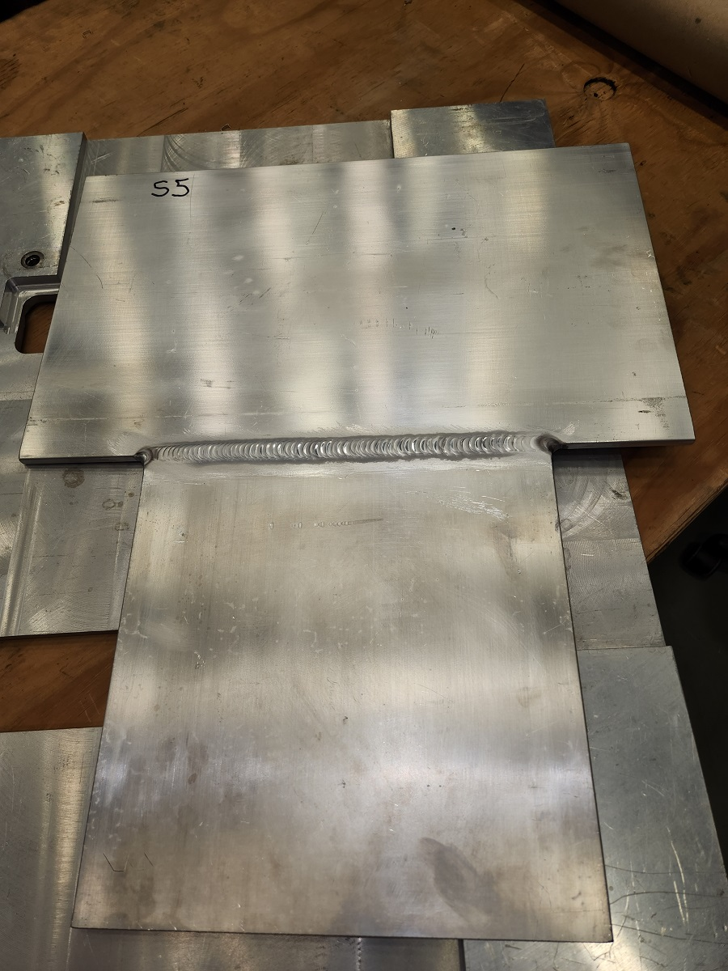
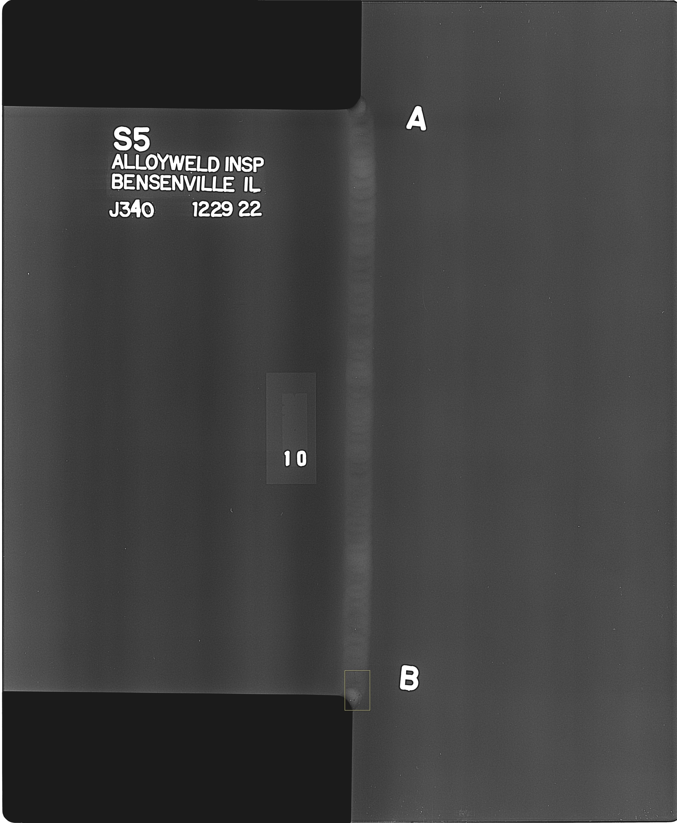
Sample inspections and welding
Welding of stripline and radiography of samples. Still waiting on parts and analyzing test results.

Slide 3
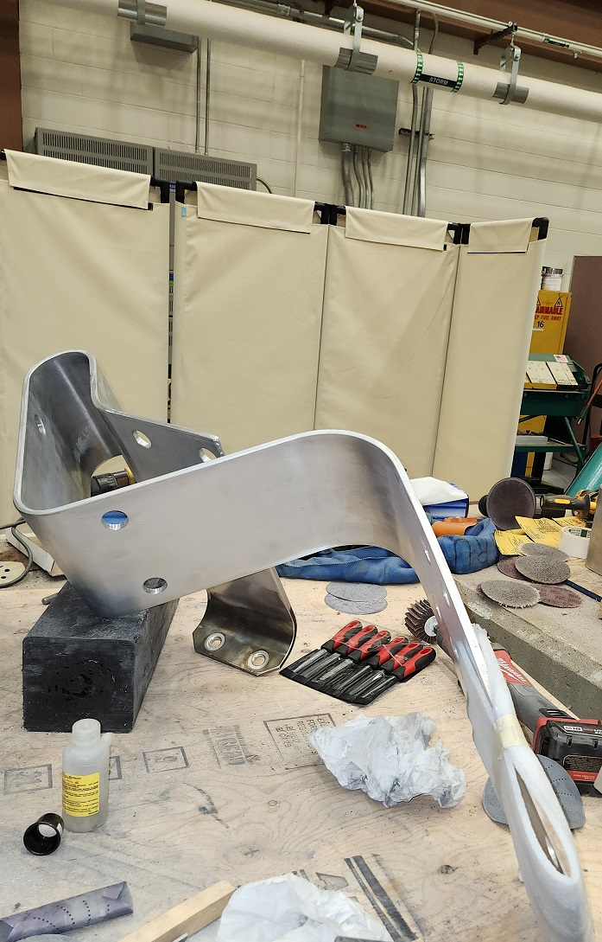
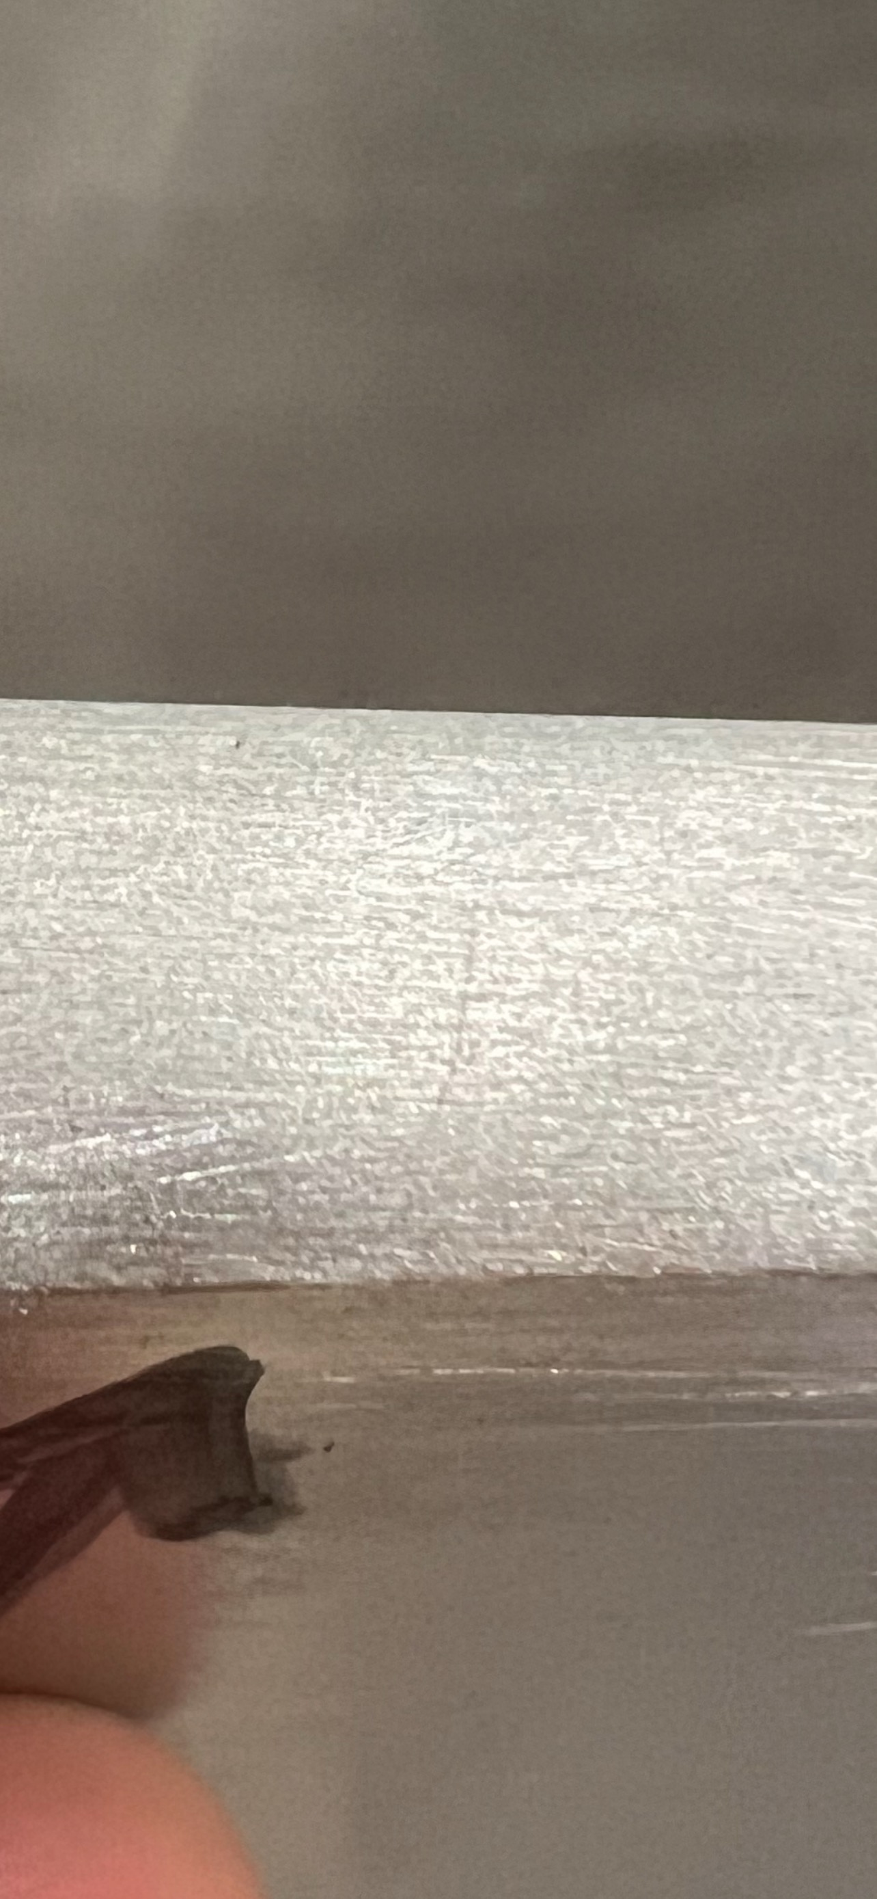
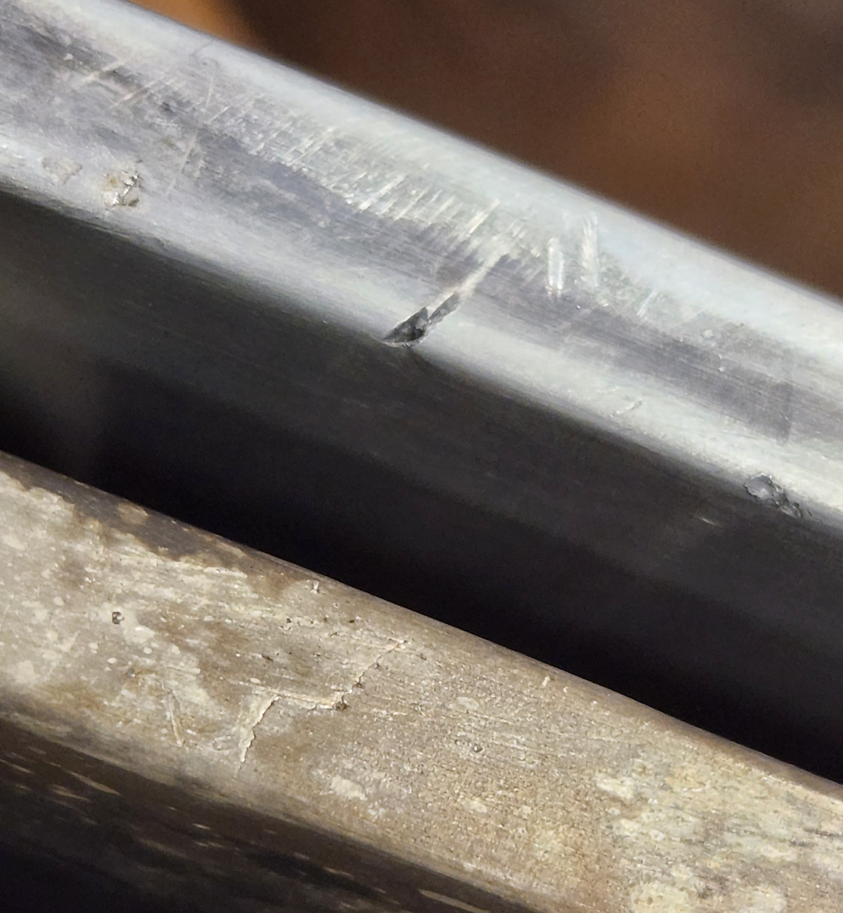
Horn 02-03
Horn 02-03 work continues. Rounding of the edges and removal of the flaws found during radiography.

Slide 4
Moving forward
Weld tests of stripline and radiography of samples and then pulse testing of the Horn 02-03. Horn 01-06 is finished testing for now.
Move of the coffin looking at 1/7 at 0600 unless weather problems arise.
Still looking like first week of February for all the work being complete.

