Slide 1
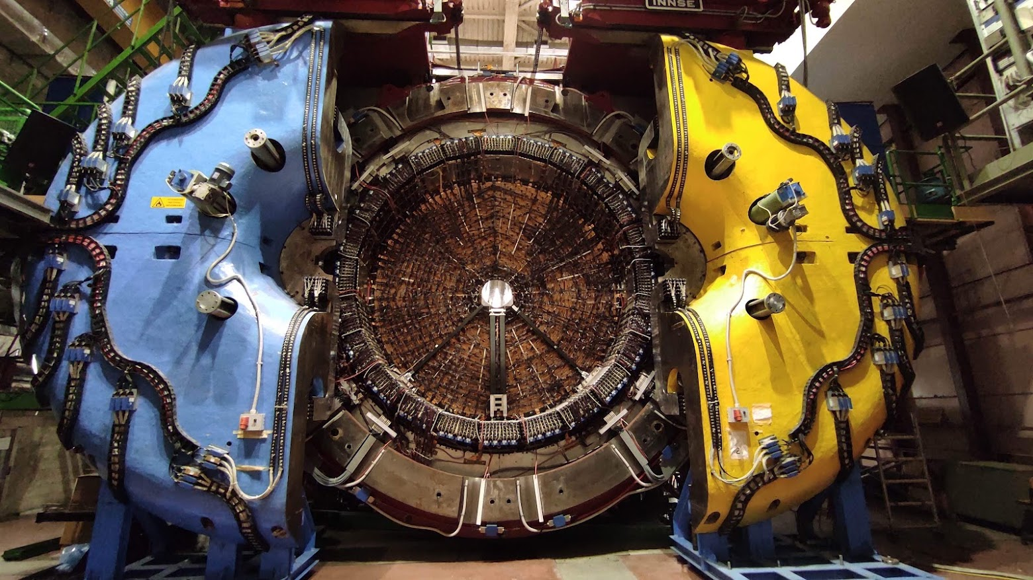
SAND – ECAL Working Group
Antonio Di Domenico
Dipartimento di Fisica, Sapienza Università di Roma
and INFN-Roma, Italy
Danilo Domenici
INFN-LNF, Frascati, Italy
9 January 2023

Slide 2
ECAL operations in progress
Long beam inserted in the KLOE DC
Alignment and positioning

Slide 3
ECAL operations in progress
Successful test of the rail system

