Slide 1
120 Hour Summary
Kevin McDonough
January 4, 2023

Slide 2
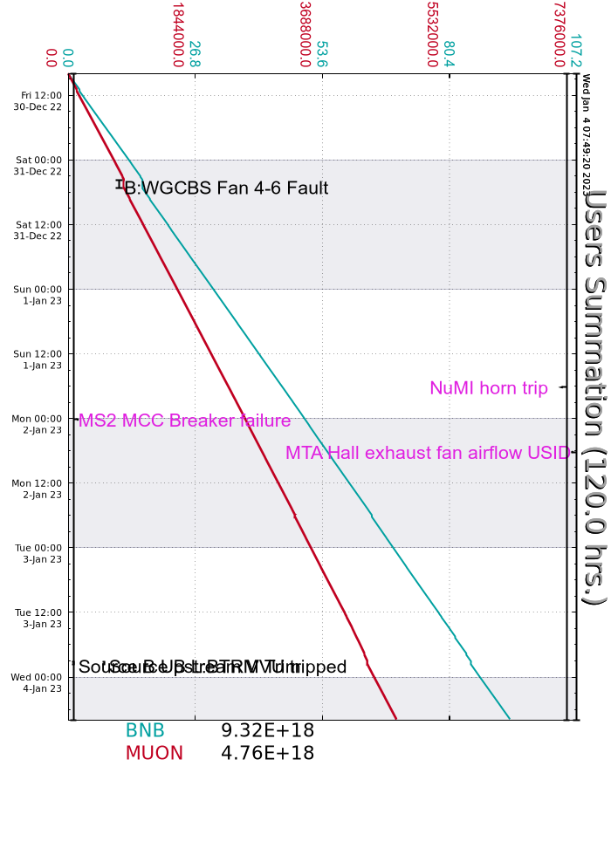
Summary
FRIDAY
Started the day with an MS2 power outage to put in a spare breaker
Beam to g-2 and BNB when it was available.
SATURDAY and SUNDAY
Put a box fan on the RFQ turbo to help with the rising pump temperature
Output of the source wandered a bit over shift
MONDAY
BRF07 Bias Supply failed, BRF20 used in its place.
TUESDAY
BRF07 likely blew its 480V breaker outside
Leak found on MI60 Magnet LCW pump #2, pump was turned off
MS2 breaker work finished up
EE support investigating F:MT2WD2 which wouldn't reset.
MI10 3-way valve stopped regulating - experts replaced the temp controller.
WEDNESDAY
Instance of BV610 and BV110 closing, pulling Muon permit
Vacuum in area has been struggling to recover
Source A boiler PID loop adjusted for high temp

