Slide 1
TSD
1/6

Slide 2
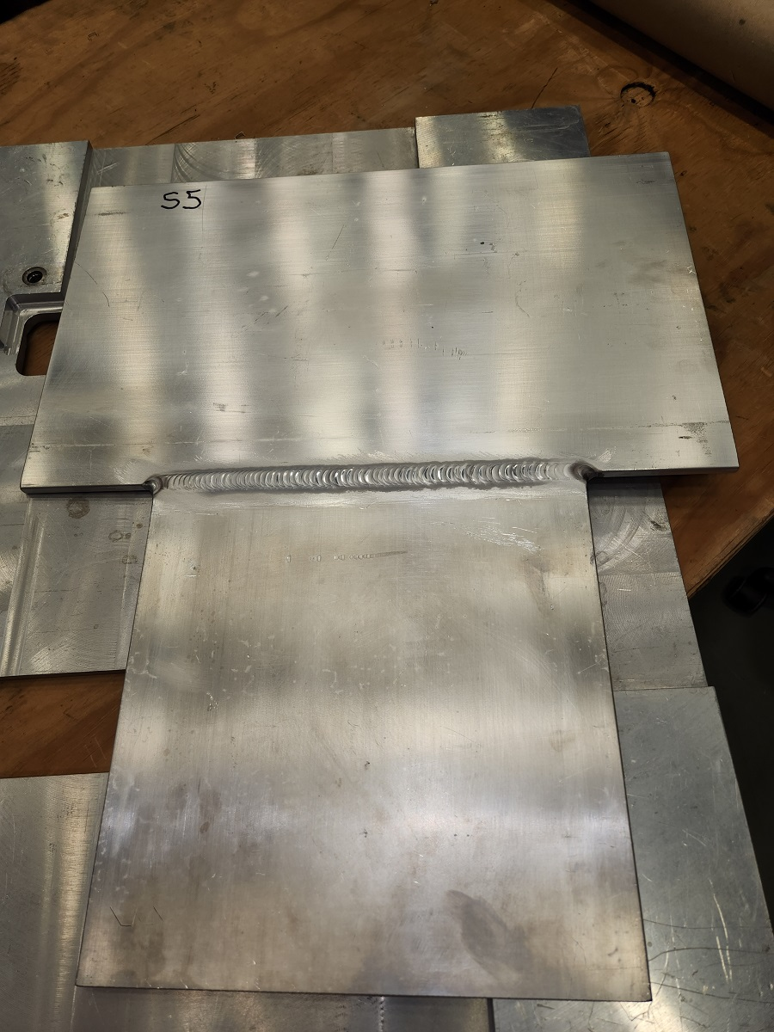
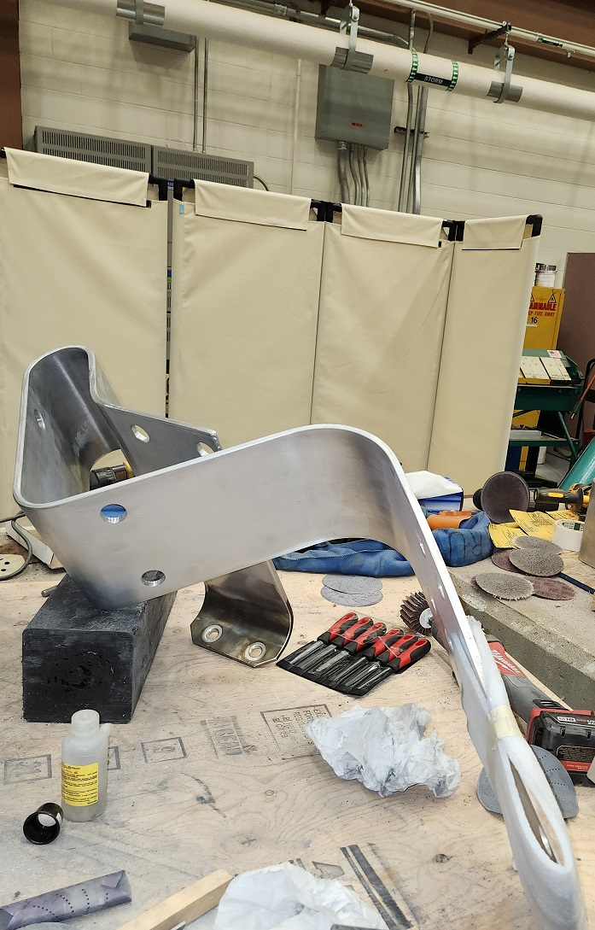
Sample inspections and welding
Welding of stripline and radiography of samples. Still waiting on parts and analyzing test results. Horn 2 stripline work continues. Reassemble next week.

Slide 3
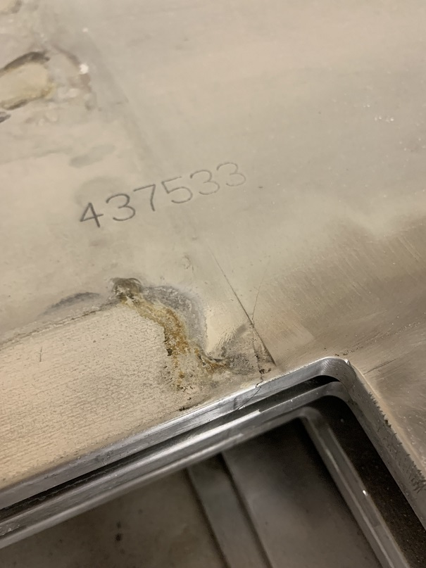
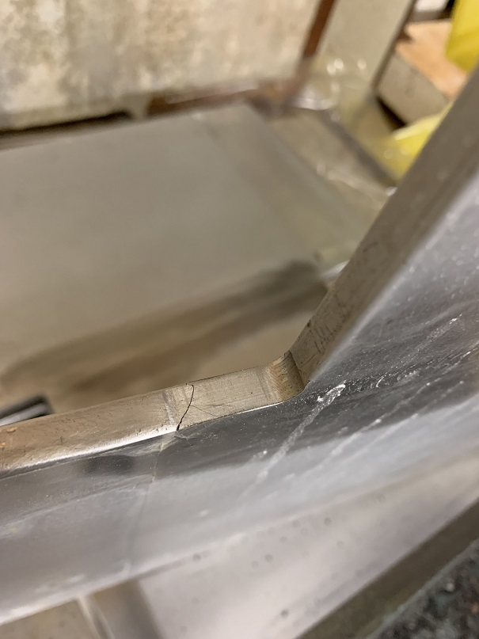
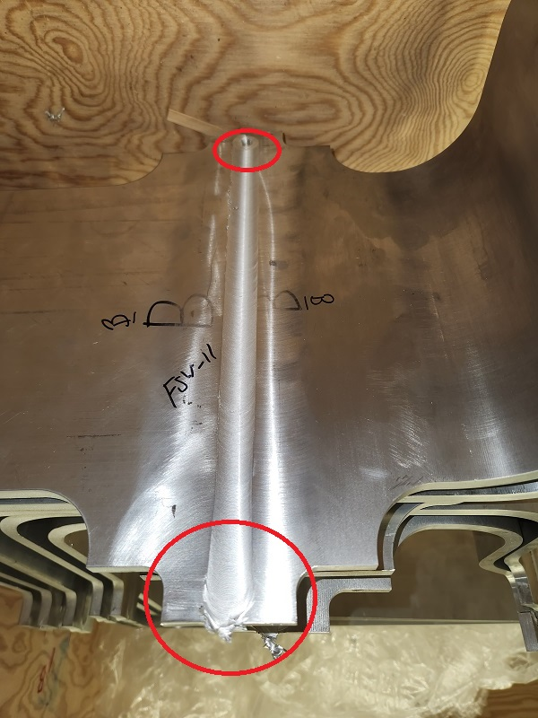
Stripline stub
Stripline stub work continues. More flaws found during inspections.

Slide 4
Moving forward
Weld tests of stripline and radiography of samples and then pulse testing of the Horn 02-03.
Move of the coffin looking at 1/7 at 0600 unless weather problems arise.
Still looking like first week of February for all the work being complete.

