Slide 1
Main Injector Status
Phil Adamson
6th January 2023
1974

Slide 2
Status
Beam to Muon
Beam to SY120 as requested
Plan READS (fast loss monitor readout) study today

Slide 3
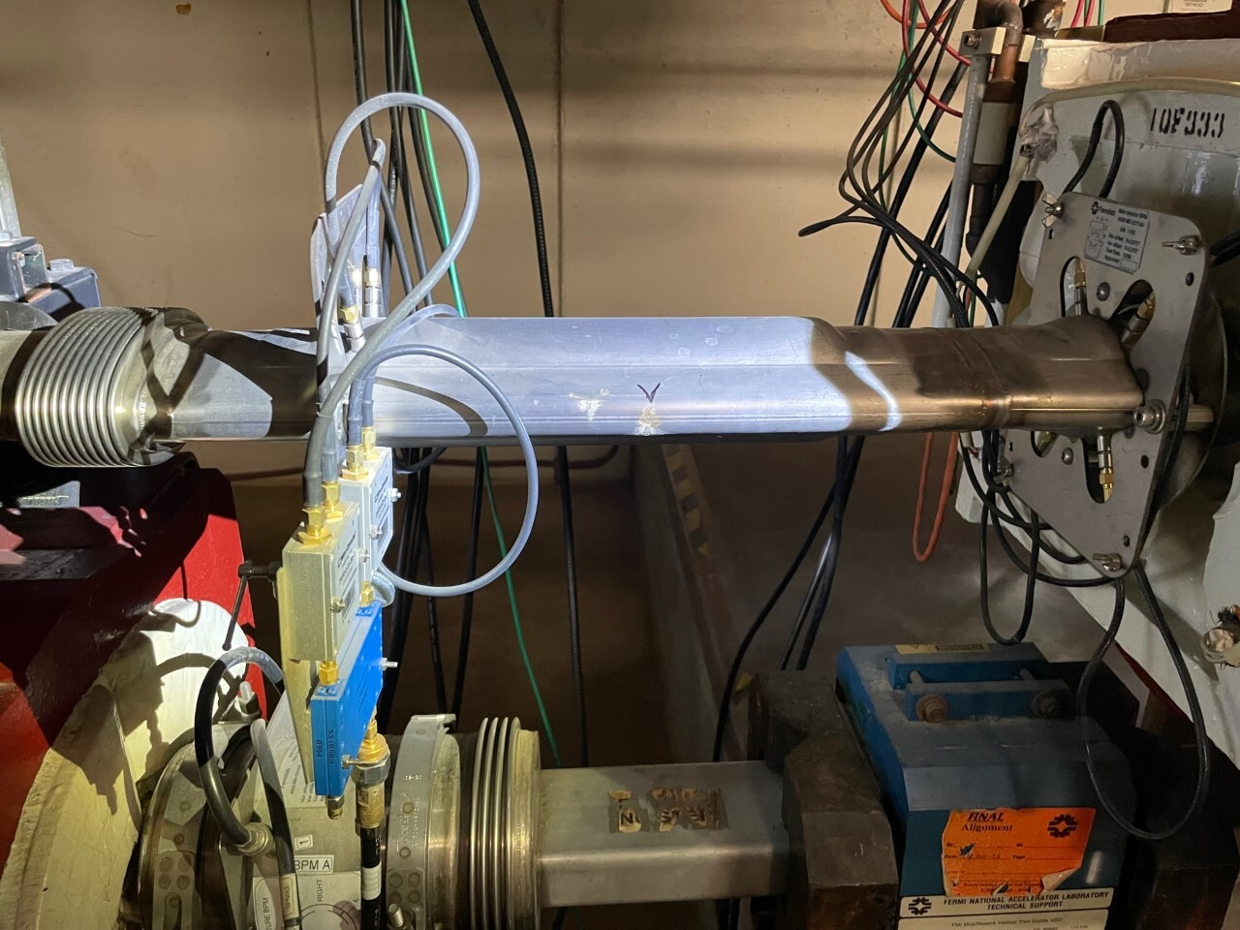
Status
Access yesterday
Triggered by worsening vacuum problems at MI-40
Leak found at seam in BPM at 403 used by e-cloud measurement equipment
Leak patched. Department will discuss the future of this device

Slide 4
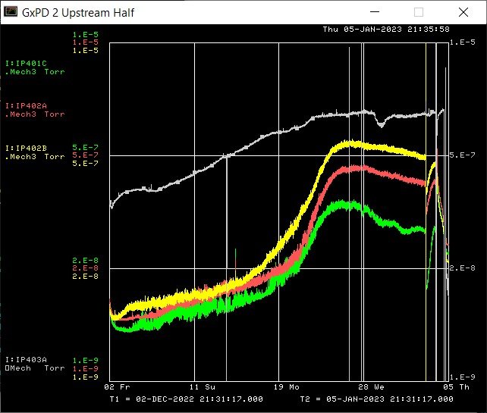
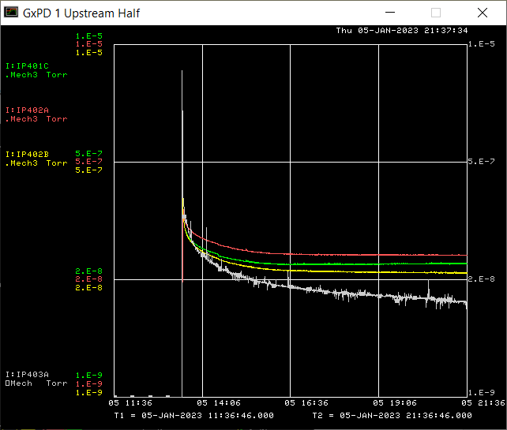
MI40 Vacuum
Last month on left. Last night on right

Slide 5
Other work yesterday
Leak on MIRF12 cavity repaired
Leaking orange hose found at 608 Lambertson. Replaced.
MIRF15 – failed counter replaced on modulator
I:IP837 ion pump failed. Did not access, because this pump is in the collimator region and requires significant ALARA/work planning to touch.

