Slide 1
48 Hour Summary
Kevin McDonough
January 6, 2023

Slide 2
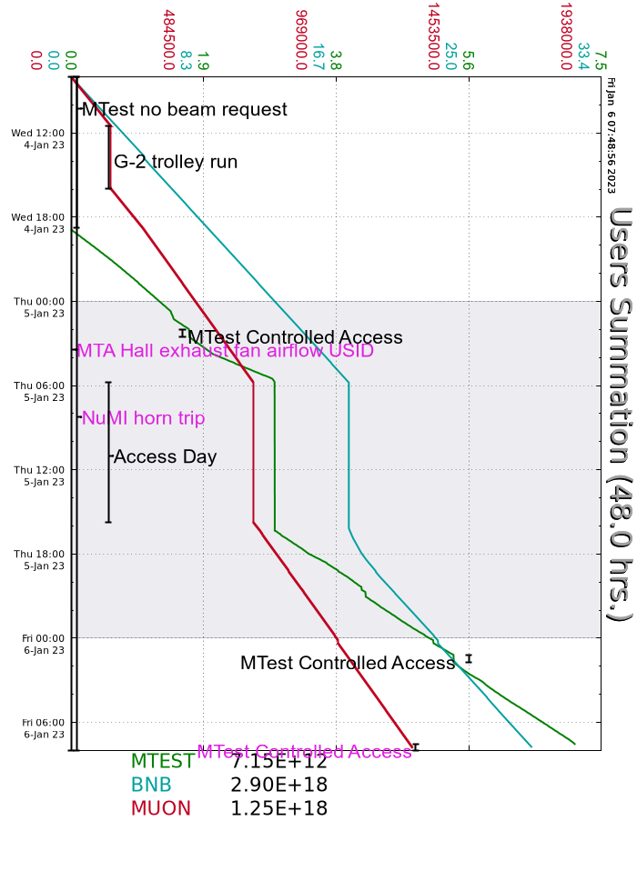
Summary
Wednesday
Access to MT3 to look at target. This were done to get it into a good position to run.
MI40 vacuum burst this afternoon. Things are getting better. Access tomorrow to leak check.
Beam to BNB,g-2 and M-Test during shift
Thursday
Prepared Booster and MI20-62 for Controlled Access
Source A LEBT crosses were installed today
MI, BNB, Linac and Booster Booster access for most of day shift.
MI 608 water leak oh a Lambertson hose was repaired. Vacuum leak at MI 40 was found and repaired today.
BNB still on access to repair pump electronics.
BRF15 repaired successfully today.
Friday
WAPS trip on BRF09 Mod Deck FaultScreen Supply circuit breaker needed to be reset
Booster tuning for MI8 collimator losses
Current Conditions:
Beam to g-2, BNB, MTest

