Slide 1
Muon Campus Operation Report
Dean Still
Friday 09:00 Operation Meeting
Week of January 2, 2023

Slide 2
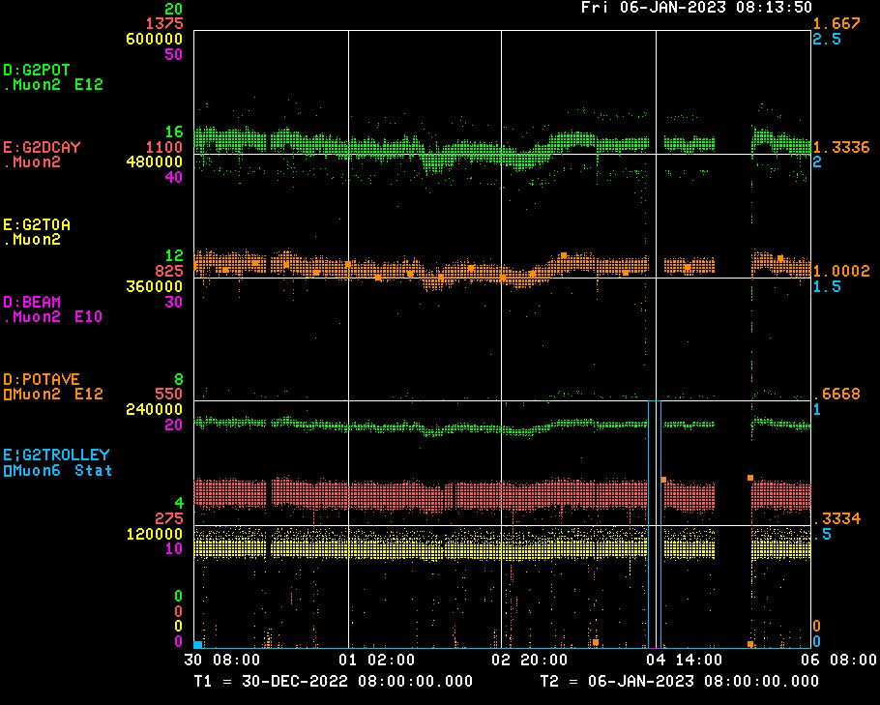
Performance for the Past Week
Protons On Target
Avg Protons on Target
Particles to Entrance of G-2 Ring
Decay Positrons in G-2 Ring
G-2 Trolley Run
g-2 trolley run
Shutdown – MI vacuum repairs
<-------Weekend ------→
<------------Week Days -------------------→

Slide 3
Activities for the Past Week
G-2 Status:
Delivered beam to g-2 .
Work completed:
Target blower maintenance
RF water cooling skid at AP50 has been off since Oct 2022.
MSD is looking into the req’s needed to diagnose and repair the skid. NO current estimate.
IMPACT: Delivery Ring has NO RF needed for 8Gev Studies. Starting to impact ability to commission the new DR BPM system which could delay resonant extraction studies.
8Gev Studies:
None

Slide 4
Machine Downtime for the Week
Muon: (Total 0.03 hours)
- Vacuum vales closed ( 0.03 hr)
Upstream Machine: (Total 12.6 hours)
Preacc- ( 0.0 hr )
LINAC ( 0.4 hr )
MI ( 0.0 hr )
Booster ( 2.2 hr )
RR ( 0.0 hr)
Shutdown – Repair day (10.0 hr)
-
G-2 Experiment: (Total 4.45 hours)
Trolley run ( 4.45 hr )
Request access (0 hr)
Total Downtime: (17.1 hours)
Downtime % : 10.2 %
Uptime % : 90.0 %
AD Downtime : 7.5%
Experiment Downtime: 2.7 %
Reporting Period from 0800 Friday Dec 30 to 0800 Friday Jan 6 -- 168 hours per week potential operation

Slide 5
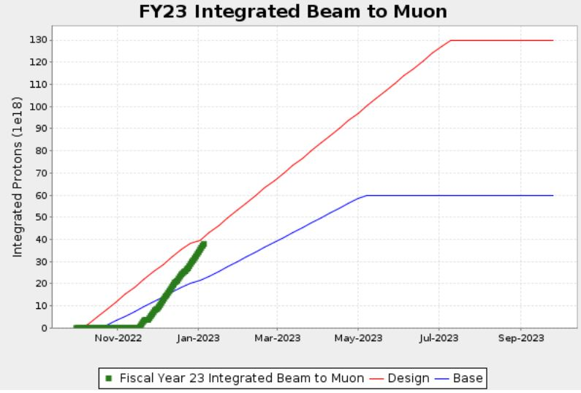
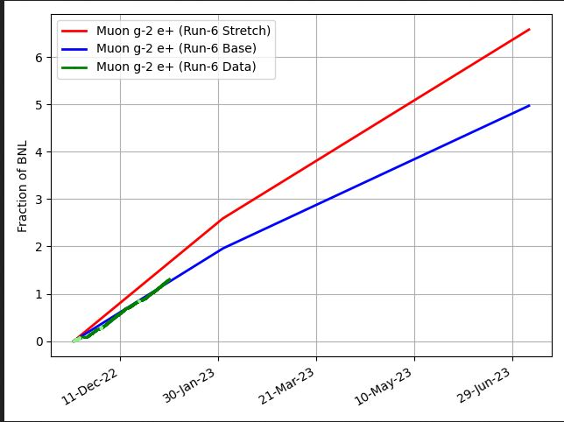
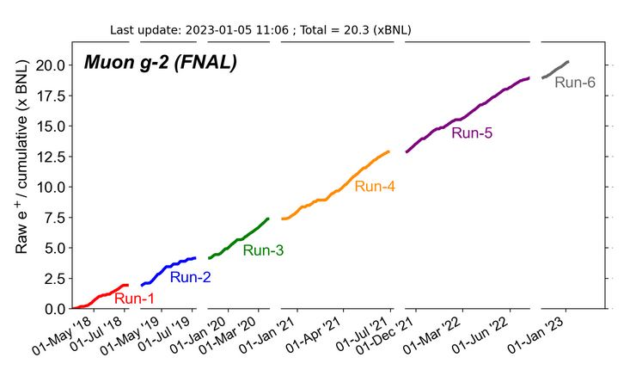
G-2 Performance – Integrated for Run 6
G-2 Experiment POT Run Goal
~4.2E20 POT
Run 6 period is Nov 2022 – June 2023
Run 6: Goal of ~x6 BNL
Total Run: goal of x21 BNL
Run 6 # POT
Run 6 Integrated ~ x 1.3 BNL
0.22 for the week
Total Integrated ~ x 20.3 BNL
Start of
Summer
Shutdown
2023
Plots as of 1/6/2023

Slide 6
Plan for Next Week
g-2 operation:
g-2 is planning a scheduled cryo purification for Jan 9-13 (5 days) -- No g-2 beam
Muon Campus Plans for Jan 9-13 :
3 days of vacuum working in the Delivery Ring tunnel.
Replace up to 7 ion pumps in 20 sector. (Vrbos)
Leak Check 10 sector for vacuum leak. (Vrbos)
2 days of 8Gev Studies.
Q106 polarity reversal study (Morgan)
BPM 8Gev beam studies. Time in 10 & 60 house BPM's. (Patel +)
M4 Profile monitor intensity calibration (Werkema, Drendel +) or Injection Tune measurement.
Low Momentum Yield Study (Morgan)
Monday 1/9:
0400 – beam to g-2 off.
0400-0700 -- g-2 will start a trolley
0800 or after g-2 trolley run -- Switch OFF DR and M4 beamline.
Make DR supervised access (need RCT).
Make M4 controlled access.
1030 -- Keys available for supervised access in DR and controlled access into M4
G-2 line
Mu2e M4
line

