Slide 1
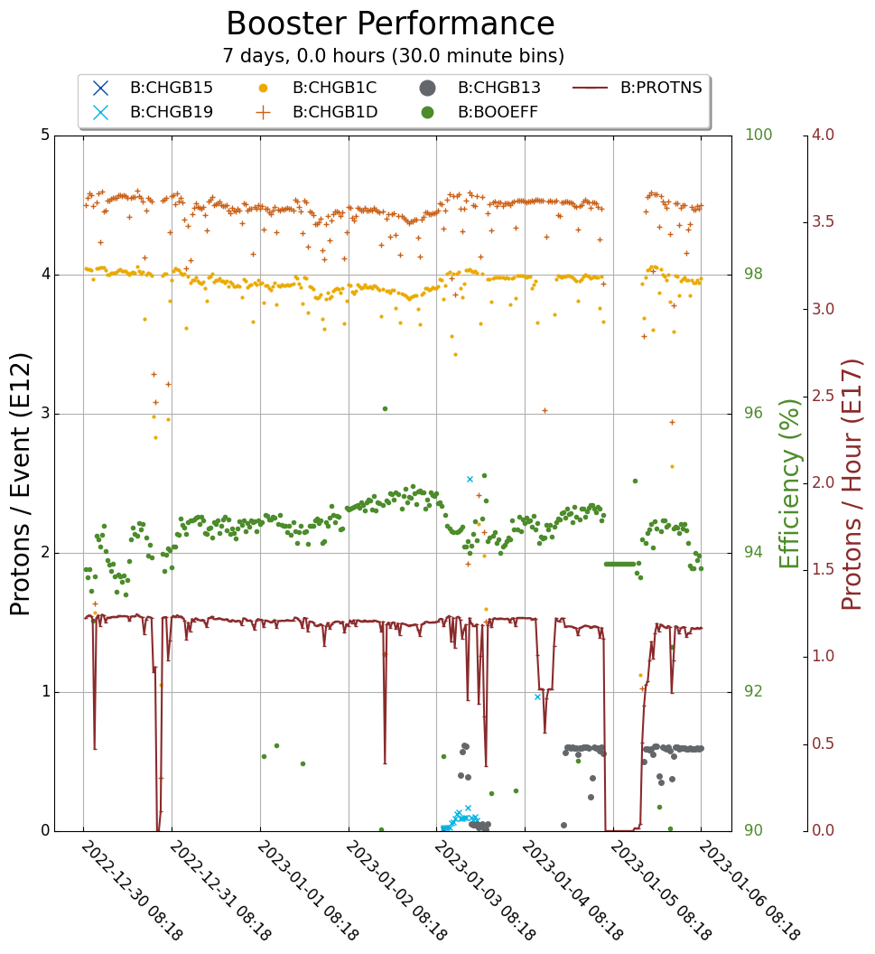
Booster Operations
Downtime: 2h,24m
WGCBS fan troubleshooting
RF trips
$1D: 4.6e12 ( 4.7e12 )
$1C: 4.0e12
94-95% efficiency
Thursday access:
BRF15 repaired
WGCBS fan replaced
Controls working on BPM archiving function.

