Slide 1
IOTA Proton Injector Update
Dean (Chip) Edstrom
11/18/2022

Slide 2
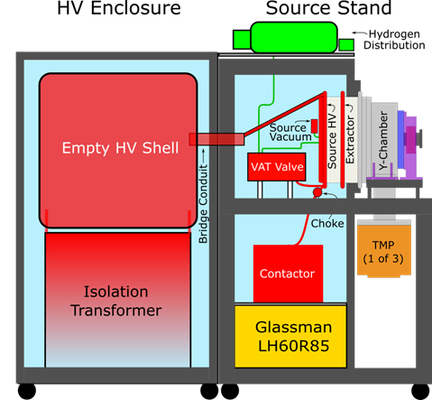
IPI Summary – Source Commissioning
HV ORC Conclusion
HV Enclosure items remaining:
✓ Redo CU Ground bar configuration
✓ HV Enclosure Door latches installed
🕑 HV Enclosure Door interlock wiring and interface needs to be completed.
🕑 10 kV (Extractor) Supply Output & remote-on kludge touch-up (Jeff Simmons)
🕑 Extractor Modulator / Spark Protection boxes (Jeff Simmons)
✓ 50 kV Bridge Supports in hand… will cut bridge to length upon installation
❌ 120 VAC distribution only set up for only 20A??? Meeting with Kermit early next week…
Next steps
Button-up / Evaluation by Dave Mertz / Final 50kV Test
Source Characterization ORC Preparation
Rad Safety Status (Dan)

Slide 3
IPI Summary – Bigger picture
Beamline Installation
MEBT Layout (Steve Wesseln, Sasha R.)
Cable Acquisition in progress
All non-stock cable reqs in
No initial cable pull contract estimate
BPM pre-amp enclosures being fabricated (Brian Fellenz)
RF
600A Windowed & Kirk Key’d Disconnect
Rescheduled to ship on 12/12, but schedule continues to slip…
Modulator controls to follow (EE Support)
HLRF
Ding continued evaluation of the buncher SSA
LLRF
Met with Euclid… Upgrade quote requested.

