Slide 1
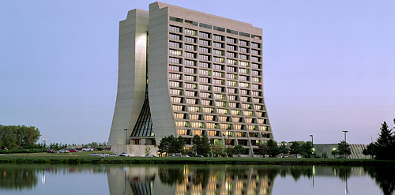
Investigation of Varying Nuclear Decay Rates
Sarah Derylo
St. Charles East High School, Fermilab

Slide 2
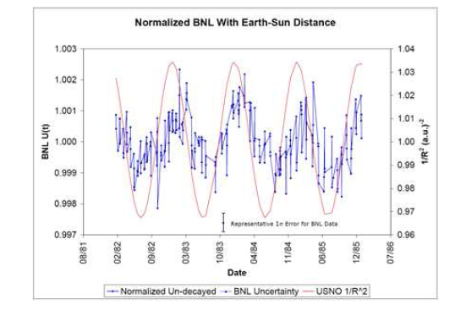
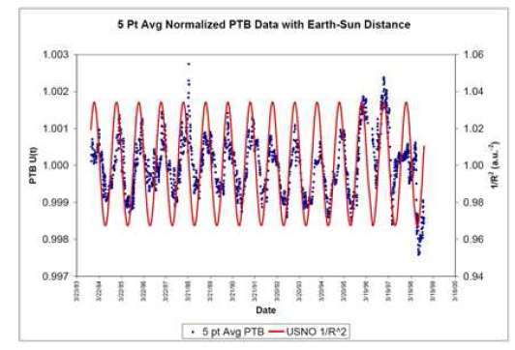
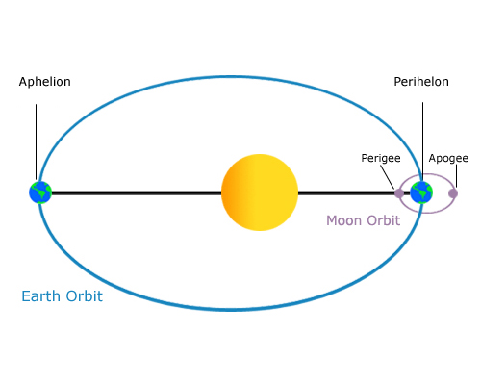
Other’s Efforts
Fewer neutrinos
More decays
More neutrinos
Fewer decays
Jenkins, et al. “Evidence for Correlations Between Nuclear Decay Rates and Earth-Sun Distance” 8/25/08 arXiv:0808.3283v1 [astro-ph]

Slide 3
Neu-Rad
Neu-Rad is an experiment set up to investigate observed variation in isotope decay rates correlated with the earth-sun distance and solar flares.
The isotope decay rates are recorded using a Ge detector

Slide 4
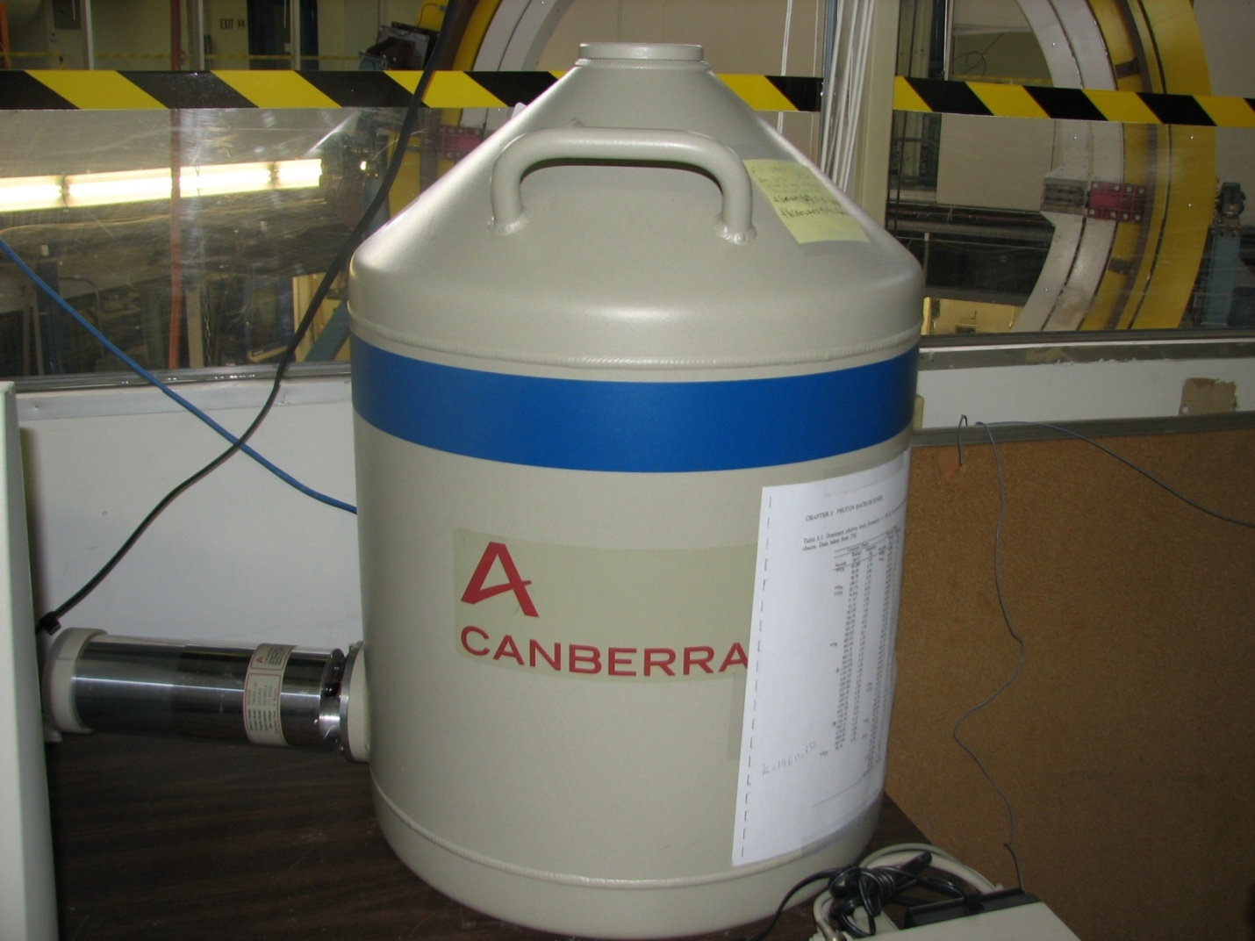
The Detector
Liquid nitrogen
Ge detector

Slide 5
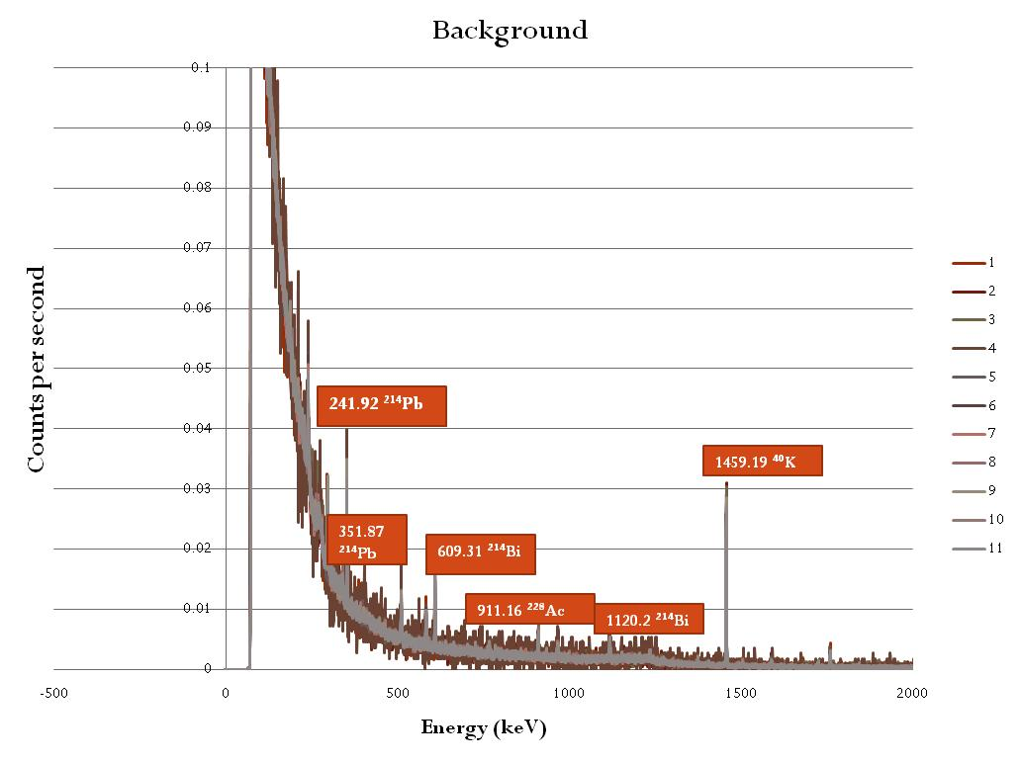

Slide 6
Peak Trendlines

Slide 11
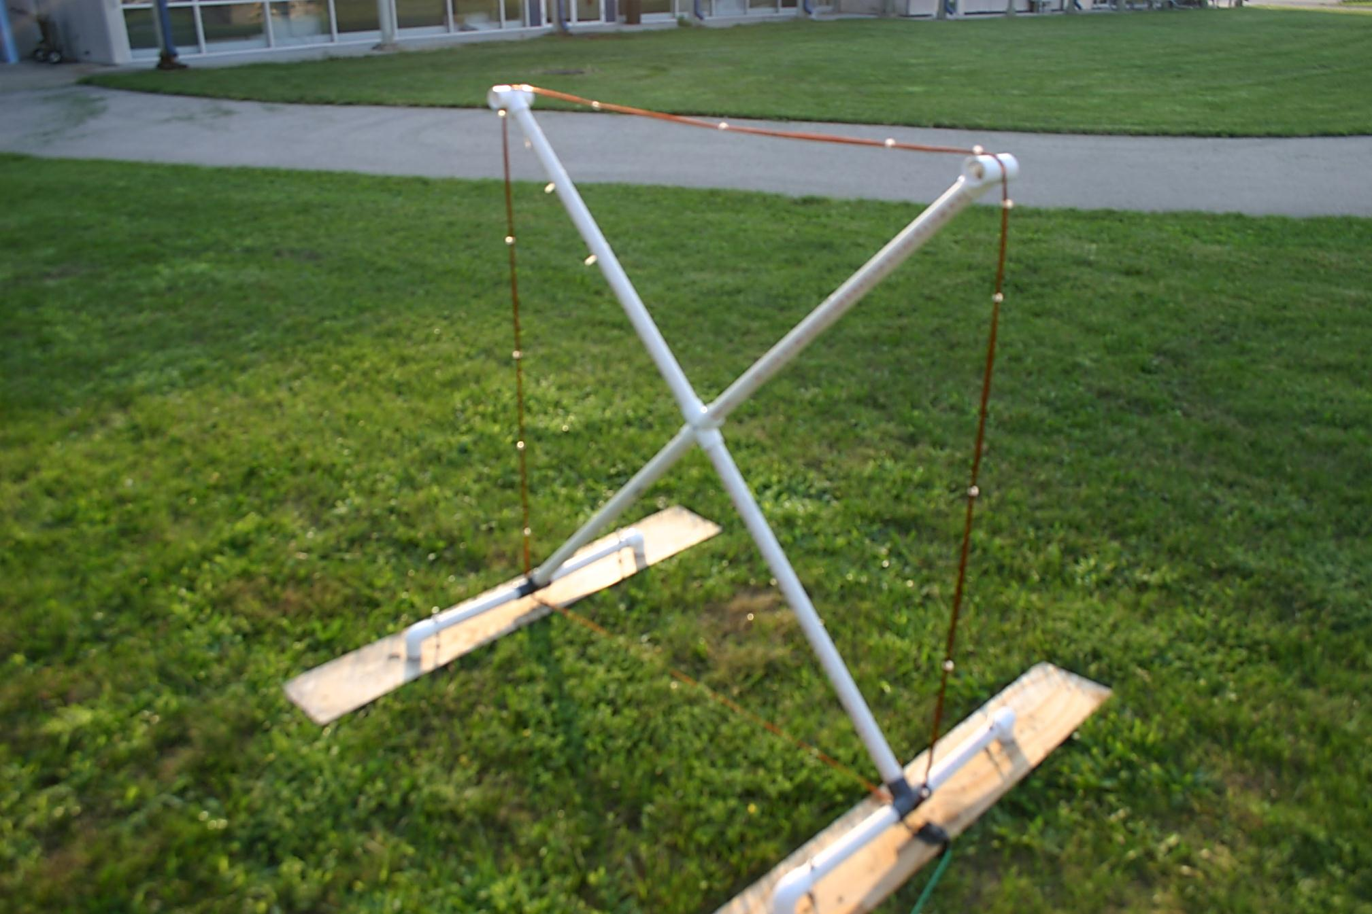
SID Antenna

Slide 12
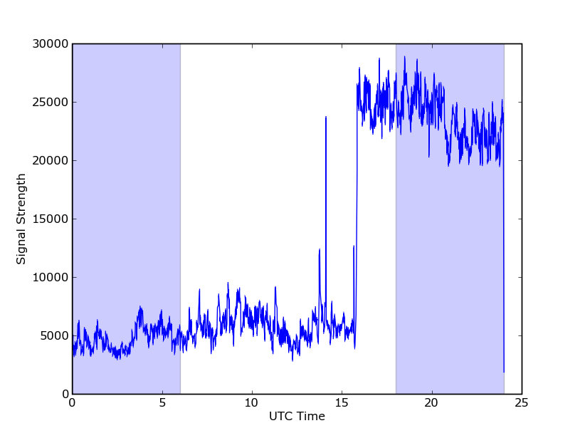
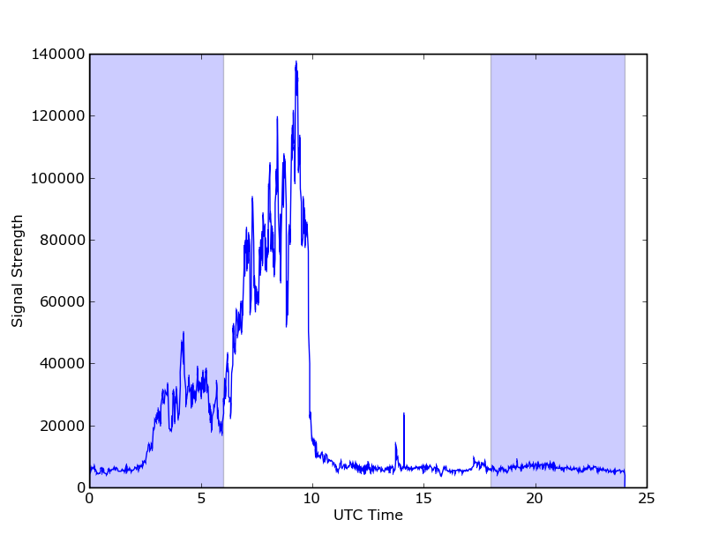
Difference in Stations
NLK Station – High Noise
NML Station – Low Noise

Slide 13
Flares reported by SWPC
Flares spotted by SID Antenna

Slide 14
What’s Next
Get the SID antenna constant
  Find a station with a low-noise signal
  Send data back to Stanford
Once Ge detector has a low enough error, add source
Possibly set up a detector in a neutrino source

