Slide 1
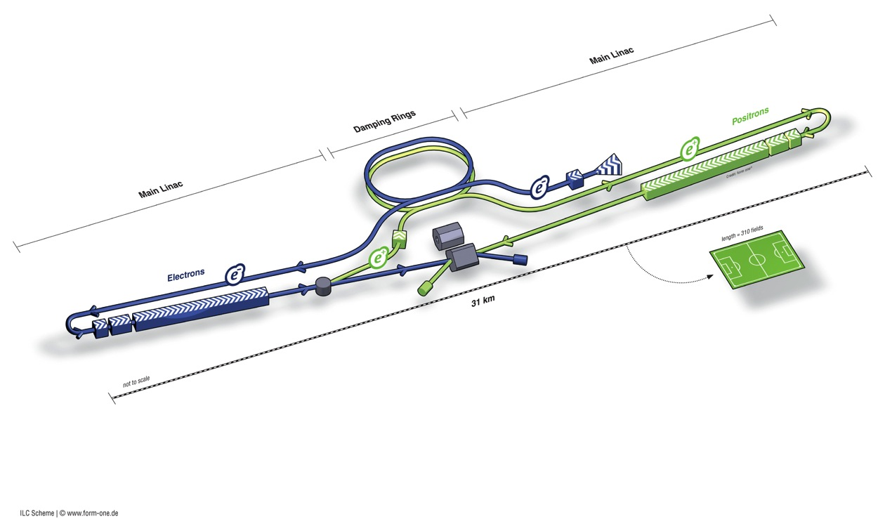

ILC as a
Higgs Factory
Nick Walker (DESY)
for the Global Design Effort
Accelerators for a Higgs Factory:
Linear vs. Circular (HF2012)
Fermilab, 14.11.12
Higgs & Co
…you gotta have Mass!
Powered by
250
GeV

Slide 2
Known (☺) Physics
~125 GeV ‘that new boson’
  125+91=216 GeV cm → 250 GeV
173 GeV Top quark
  2x173=346 GeV cm → 350-400 GeV
Higgs self coupling (t-coupling) ???
  ≥ 500 CM (up to 650 ??)
TeV and beyond….?
Staging / Upgrading

Slide 3
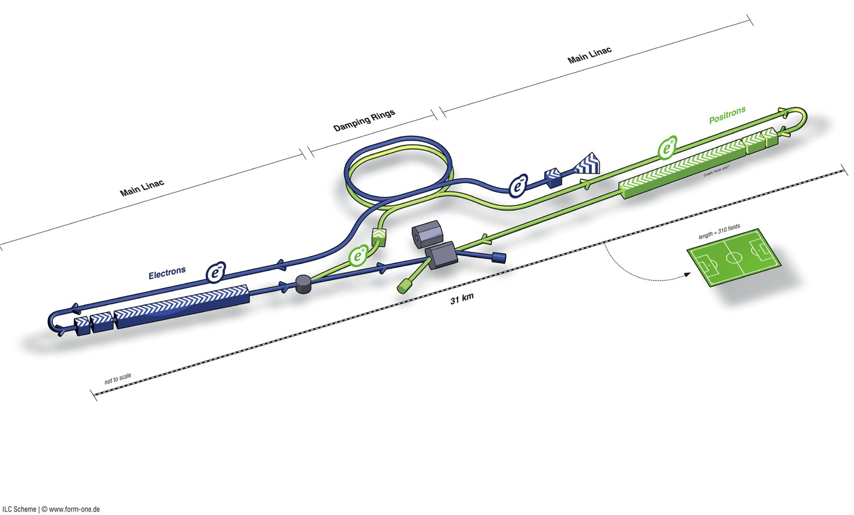
ILC in a Nutshell
Polarised electron source
Damping Rings
Ring to Main Linac (RTML)
(inc. bunch compressors)
e+ Main Linac
Beam Delivery System (BDS) & physics detectors
Polarised positron
source
Beam dump
e- Main Linac
not too scale

Slide 4
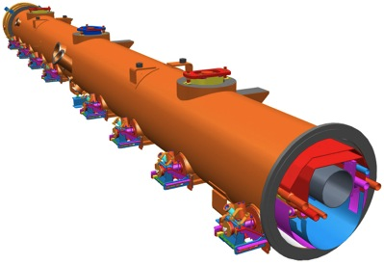
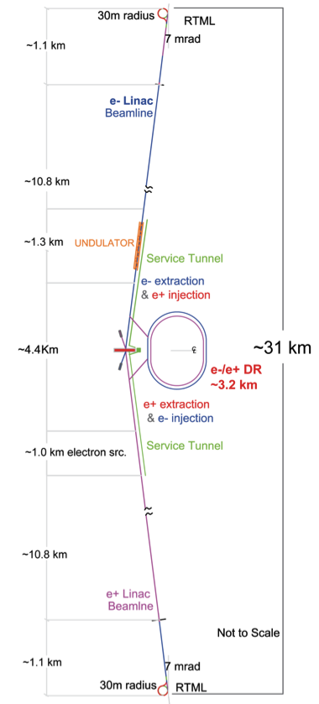
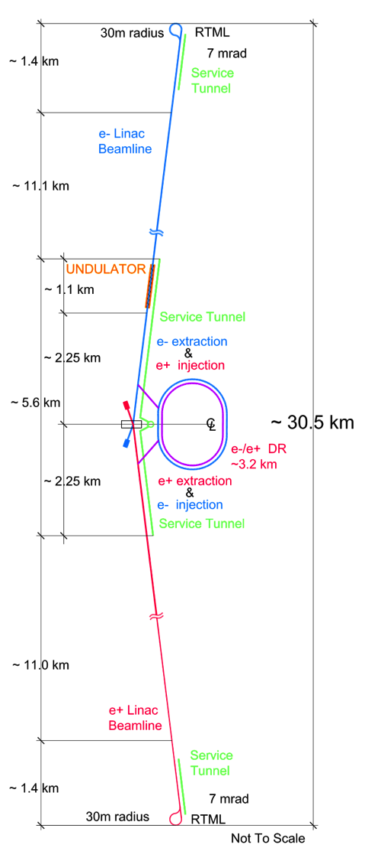
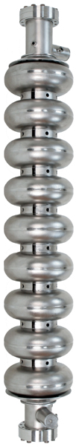
The ILC
200-500 GeV E_{cm} e⁺e⁻ collider
L ~2×10³⁴ cm⁻²s⁻¹
  upgrade: ~1 TeV
SCRF Technology
  1.3GHz SCRF with 31.5 MV/m
  17,000 cavities
  1,700 cryomodules
  2×11 km linacs
Developed as a truly global collaboration
  Global Design Effort – GDE
  ~130 institutes
  http://www.linearcollider.org

Slide 5
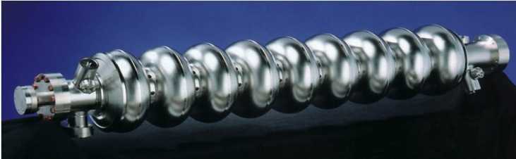
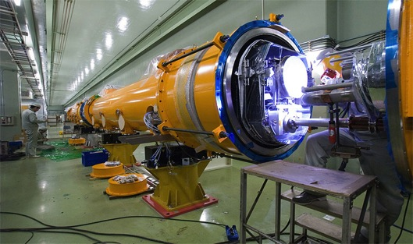
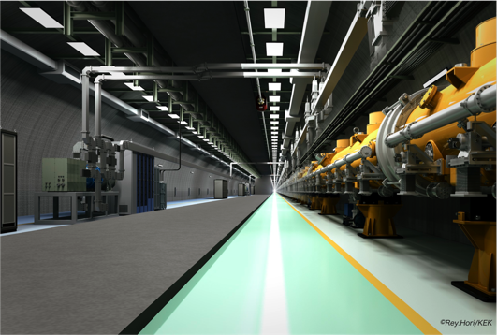
SCRF Linac Technology
1.3 GHz Nb 9-cellCavities | 16,024
Cryomodules | 1,855
SC quadrupole pkg | 673
10 MW MB Klystrons & modulators | 436 / 471 *
* site dependent
Approximately 20 years of R&D worldwide
→ Mature technology, overall design and cost

Slide 6

Global SCRF Technology
TRIUMF, Canada
◉
IHEP, China
◉
STFC
◉
FNAL, ANL
◉
Cornell
◉
◉
◉
KEK, Japan
SLAC
JLAB
LAL
Saclay
◉
DESY
◉
◉
◉
INFN Milan
◉
BARC, RRCAT India
GDE

Slide 7
Luminosity Scaling Law
RF→beam power efficiency
Beamstrahlung
(physics)
Vertical emittance

Slide 8
The Luminosity Issue
High current (n_{b} N)
High efficiency
(P_{RF} →P_{beam})
High Beam Power
Small IP vertical
beam size
Small emittance ε_{y}
strong focusing
(small β*_{y} , σ*_{y} ~ nm)

Slide 9
ILC Published Parameters
Centre-of-mass independent:
Luminosity Upgrade
Collision rate | Hz | 5
Number of bunches |  | 1312 | 2625
Bunch population | ×10¹⁰ | 2
Bunch separation | ns | 554 | 366
Pulse current | mA | 5.8 | 8.8
Beam pulse length | μs | 730 | 960
RMS bunch length | mm | 0.3
Horizontal emittance | μm | 10
Vertical emittance | nm | 35
Electron polarisation | % | 80
Positron polarisation | % | 30
http://ilc-edmsdirect.desy.de/ilc-edmsdirect/item.jsp?edmsid=D00000000925325

Slide 10
ILC Published Parameters
Centre-of-mass dependent:
Centre-of-mass energy | GeV | 200 | 230 | 250 | 350 | 500
Electron RMS energy spread | % | 0.21 | 0.19 | 0.19 | 0.16 | 0.12
Positron RMS energy spread | % | 0.19 | 0.16 | 0.15 | 0.10 | 0.07
IP horizontal beta function | mm | 16 | 16 | 12 | 15 | 11
IP vertical beta function | mm | 0.48 | 0.48 | 0.48 | 0.48 | 0.48
IP RMS horizontal beam size | nm | 904 | 843 | 700 | 662 | 474
IP RMS veritcal beam size | nm | 9.3 | 8.6 | 8.3 | 7.0 | 5.9
Vertical disruption parameter |  | 20.4 | 20.4 | 23.5 | 21.1 | 24.6
Enhancement factor |  | 1.83 | 1.83 | 1.91 | 1.84 | 1.95
Geometric luminosity | ×10³⁴ cm⁻²s⁻¹ | 0.25 | 0.29 | 0.36 | 0.45 | 0.75
Luminosity | ×10³⁴ cm⁻²s⁻¹ | 0.50 | 0.59 | 0.75 | 0.93 | 1.8
% luminosity in top 1% ΔE/E |  | 92% | 90% | 84% | 79% | 63%
Average energy loss |  | 1% | 1% | 1% | 2% | 4%
Pairs / BX | ×10³ | 41 | 50 | 70 | 89 | 139
Total pair energy / BX | TeV | 24 | 34 | 51 | 108 | 344
http://ilc-edmsdirect.desy.de/ilc-edmsdirect/item.jsp?edmsid=D00000000925325
Notes:
General observations:
Factor of 2 in L from enhancement – relatively large disruption parameter -> tight tolerances on collisions to IP (feedback)

Slide 11
ILC Published Parameters
Centre-of-mass dependent:
Centre-of-mass energy | GeV | 200 | 230 | 250 | 350 | 500
Electron RMS energy spread | % | 0.21 | 0.19 | 0.19 | 0.16 | 0.12
Positron RMS energy spread | % | 0.19 | 0.16 | 0.15 | 0.10 | 0.07
IP horizontal beta function | mm | 16 | 16 | 12 | 15 | 11
IP vertical beta function | mm | 0.48 | 0.48 | 0.48 | 0.48 | 0.48
IP RMS horizontal beam size | nm | 904 | 843 | 700 | 662 | 474
IP RMS veritcal beam size | nm | 9.3 | 8.6 | 8.3 | 7.0 | 5.9
Vertical disruption parameter |  | 20.4 | 20.4 | 23.5 | 21.1 | 24.6
Enhancement factor |  | 1.83 | 1.83 | 1.91 | 1.84 | 1.95
Geometric luminosity | ×10³⁴ cm⁻²s⁻¹ | 0.25 | 0.29 | 0.36 | 0.45 | 0.75
Luminosity Upgrade | ×10³⁴ cm⁻²s⁻¹ | 1.00 | 1.18 | 1.50 | 1.86 | 3.6
% luminosity in top 1% ΔE/E |  | 92% | 90% | 84% | 79% | 63%
Average energy loss |  | 1% | 1% | 1% | 2% | 4%
Pairs / BX | ×10³ | 41 | 50 | 70 | 89 | 139
Total pair energy / BX | TeV | 24 | 34 | 51 | 108 | 344
http://ilc-edmsdirect.desy.de/ilc-edmsdirect/item.jsp?edmsid=D00000000925325

Slide 12
ILC Published Parameters
Centre-of-mass dependent:
Centre-of-mass energy | GeV | 200 | 230 | 250 | 350 | 500
Electron RMS energy spread | % | 0.21 | 0.19 | 0.19 | 0.16 | 0.12
Positron RMS energy spread | % | 0.19 | 0.16 | 0.15 | 0.10 | 0.07
IP horizontal beta function | mm | 16 | 16 | 12 | 15 | 11
IP vertical beta function | mm | 0.48 | 0.48 | 0.48 | 0.48 | 0.48
IP RMS horizontal beam size | nm | 904 | 843 | 700 | 662 | 474
IP RMS veritcal beam size | nm | 9.3 | 8.6 | 8.3 | 7.0 | 5.9
Vertical disruption parameter |  | 20.4 | 20.4 | 23.5 | 21.1 | 24.6
Enhancement factor |  | 1.83 | 1.83 | 1.91 | 1.84 | 1.95
Geometric luminosity | ×10³⁴ cm⁻²s⁻¹ | 0.25 | 0.29 | 0.36 | 0.45 | 0.75
Luminosity | ×10³⁴ cm⁻²s⁻¹ | 0.50 | 0.59 | 0.75 | 0.93 | 1.8
% luminosity in top 1% ΔE/E |  | 92% | 90% | 84% | 79% | 63%
Average energy loss |  | 1% | 1% | 1% | 2% | 4%
Pairs / BX | ×10³ | 41 | 50 | 70 | 89 | 139
Total pair energy / BX | TeV | 24 | 34 | 51 | 108 | 344
http://ilc-edmsdirect.desy.de/ilc-edmsdirect/item.jsp?edmsid=D00000000925325

Slide 13
Higgs Factory
Centre-of-mass dependent:
Centre-of-mass energy | GeV | 200 | 230 | 250 | 350 | 500
Electron RMS energy spread | % | 0.21 | 0.19 | 0.19 | 0.16 | 0.12
Positron RMS energy spread | % | 0.19 | 0.16 | 0.15 | 0.10 | 0.07
IP horizontal beta function | mm | 16 | 16 | 12 | 15 | 11
IP vertical beta function | mm | 0.48 | 0.48 | 0.48 | 0.48 | 0.48
IP RMS horizontal beam size | nm | 904 | 843 | 700 | 662 | 474
IP RMS veritcal beam size | nm | 9.3 | 8.6 | 8.3 | 7.0 | 5.9
Vertical disruption parameter |  | 20.4 | 20.4 | 23.5 | 21.1 | 24.6
Enhancement factor |  | 1.83 | 1.83 | 1.91 | 1.84 | 1.95
Geometric luminosity | ×10³⁴ cm⁻²s⁻¹ | 0.25 | 0.29 | 0.36 | 0.45 | 0.75
Luminosity | ×10³⁴ cm⁻²s⁻¹ | 0.50 | 0.59 | 0.75 | 0.93 | 1.8
% luminosity in top 1% ΔE/E |  | 92% | 90% | 84% | 79% | 63%
Average energy loss |  | 1% | 1% | 1% | 2% | 4%
Pairs / BX | ×10³ | 41 | 50 | 70 | 89 | 139
Total pair energy / BX | TeV | 24 | 34 | 51 | 108 | 344
http://ilc-edmsdirect.desy.de/ilc-edmsdirect/item.jsp?edmsid=D00000000925325

Slide 14
Positron Production
Polarised positron
source
e- Main Linac
not too scale

Slide 15
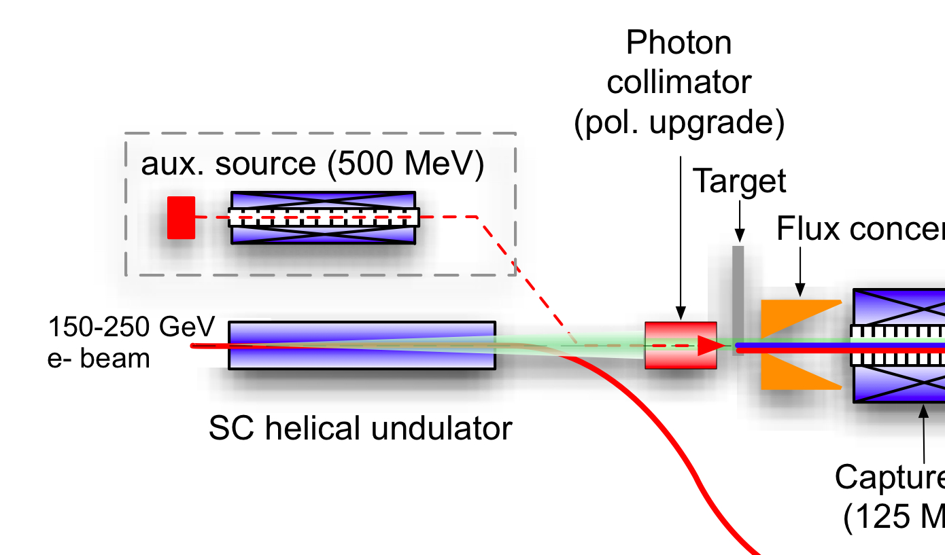
ILC Polarised-Positron Production
e- linac
Uses primary electron beam to generate ~30 MeV photons in a SC helical undulator
Photons converted into e+e- pairs in “thin” titanium target
Positron production yield dependent on e- beam energy (and therefore E_{cm})
e- to IP

Slide 16
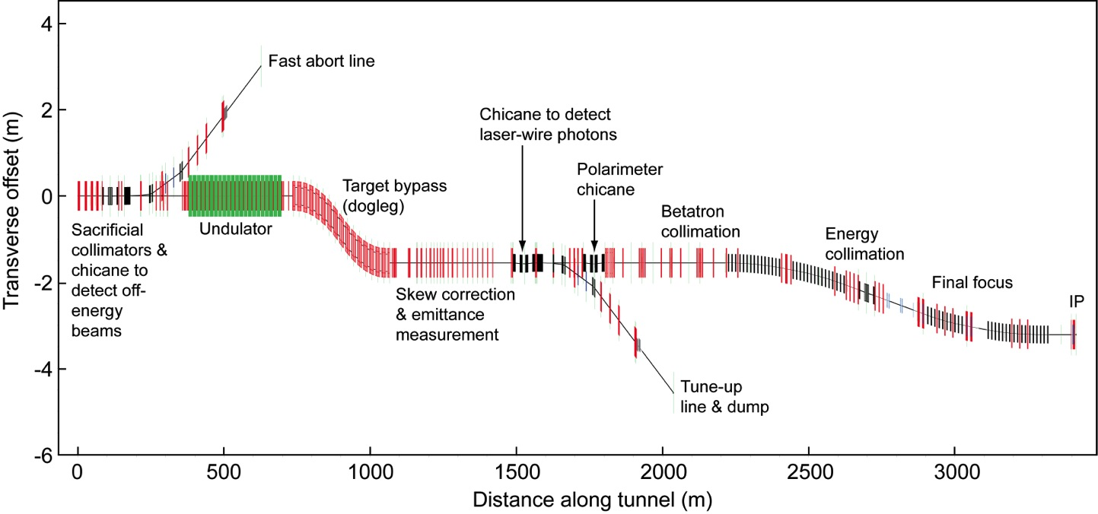
Beam Delivery System
e+ source
e- BDS
electron Beam Delivery System

Slide 17
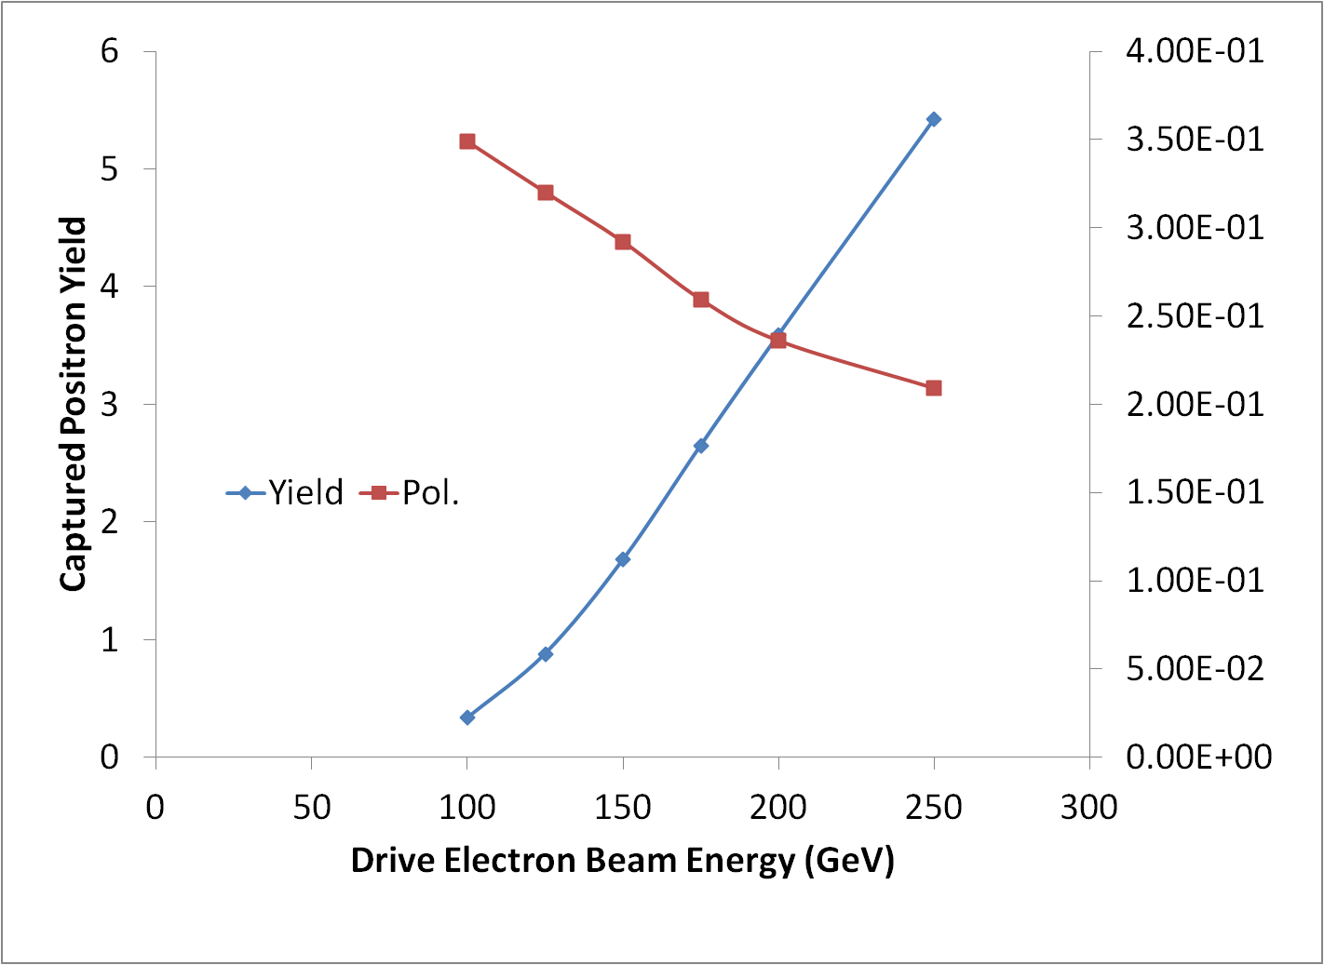
Positron Yield
147m helical undulator
(TDR baseline)
E_{beam} = 125 GeV
design point
yield margin
Wei Gai (ANL) et al

Slide 18
Positron Yield for a LHF
Recover yield by going to
~250 m of undulator
E_{beam} = 125 GeV
yield margin
Wei Gai (ANL) et al
Notes:
Power density on target (WG says OK but should check).

Slide 19
10-Hz Mode
For TDR, we are required to have solutions down to Z-pole (~45 GeV beam)
ILC TDR assumes 10-Hz mode where
  e- linac is pulsed at 10 Hz
  first pulse @ 150 GeV to make positrons
  second pulse @ E_{cm}/2 to make luminosity
Issues
  DR damping time halved (extra cost and MW)
  Beam dynamics in Main Linac (looks OK)
  Additional beam lines and pulsed magnet systems
  Additional AC power for elec linac 10-Hz mode
    But for 500 GeV design, additional power already available
    Not insignificant cost increase for a dedicated LHF

Slide 20
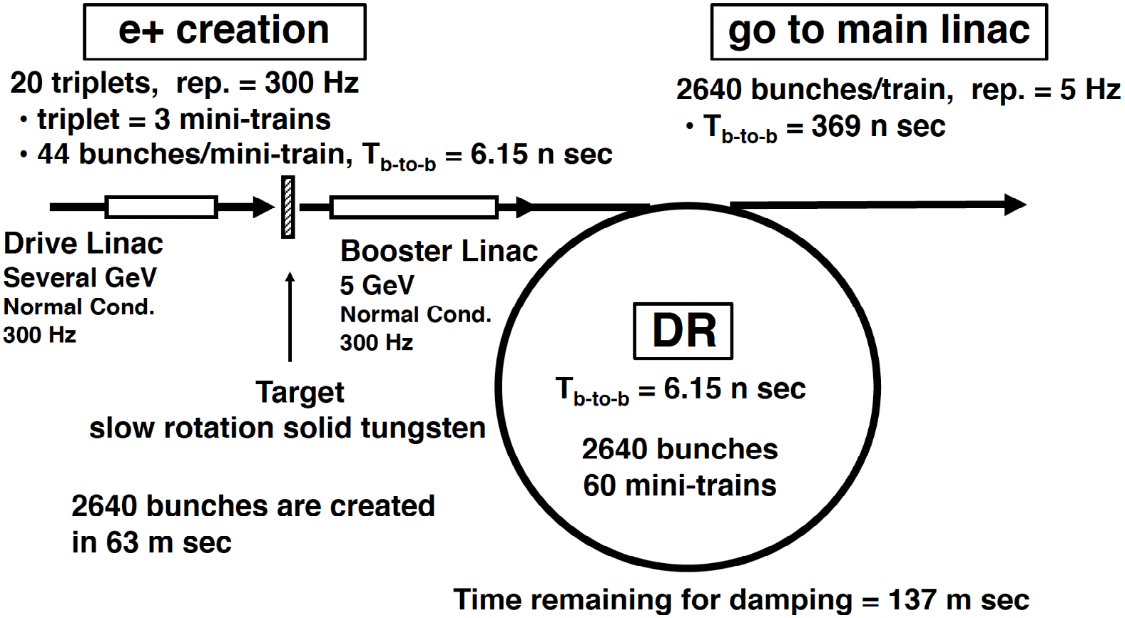
Conventional Source
T. Omori et al, Nucl. Instrum. Meth. A 672 (2012) 52-56

Slide 21
Higgs & Co
…you gotta have Mass!
Powered by
250
GeV

Slide 22
TDR 500 GeV Baseline
15.4 km
(site length ~31 km)
1.1 km
10.8 km
1.3 km
2.2 km
Main Linac
BDS
e+ src
IP
bunch comp.
Main Linac
<G_{cavity}> = 31.5 MV/m
G_{eff} ≈ 22.7 MV/m
(fill fact. = 0.72)
central region
Cost: 100%
P_{AC}: 161 MW

Slide 23
250 GeV Only
8.6 km
(site length ~16 km)
Half the linac
Shorter BDS ½
RTML LRL ½
10Hz mode e- linac
1.1 km
5.1 km
1.3 km
1.1 km
Main Linac
BDS
e+ src
IP
bunch comp.
central region

Slide 24
250 GeV staged (scenario 1)
15.4 km
1.1 km
5.1 km
1.3 km
2.2 km
Main Linac
BDS
e+ src
IP
bunch comp.
central region
Half the linac
Full-length BDS tunnel & vacuum (TeV)
½ BDS magnets (instrumentation, CF etc)
½ RTML LTL
Extended tunnel/CFS already 500 GeV stage
10Hz mode e- linac

Slide 25
250 GeV staged (scenario 2)
15.4 km
1.1 km
5.1 km
1.3 km
2.2 km
Main Linac
BDS
e+ src
IP
bunch comp.
125 GeV transport
central region
Half the linac
Full-length BDS tunnel & vacuum (TeV)
½ BDS magnets (instrumentation, CF etc)
1 RTML LTL
5km 125 GeV transport line
Extended tunnel/CFS already 500 GeV stage
10Hz mode e- linac
quasi-adiabatic energy upgrade?

Slide 26
250 GeV CM (as first stage)
Relative to TDR 500 GeV baseline (1312 bunches)
Two stage compressor (5-15 GeV)
Half linacs solution
G = 31.5 MV/m

Slide 27
250 GeV CM (as first stage)
Relative to TDR 500 GeV baseline (1312 bunches)
Two stage compressor (5-15 GeV)
POSITRON linac straightforward
~50% ML linac cost (cryomodules, klystrons, cryo etc.)
~50% ML AC power
Half linacs solution
G = 31.5 MV/m

Slide 28
250 GeV CM (as first stage)
Relative to TDR 500 GeV baseline (1312 bunches)
Two stage compressor (5-15 GeV)
POSITRON linac straightforward
~50% ML linac cost (cryomodules, klystrons, cryo etc.)
~50% ML AC power
Half linacs solution
G = 31.5 MV/m
ELECTRON linac needs 10Hz mode for e+ production
ΔE = 135 GeV instead of 110 GeV (+25 GeV)
~57% ML linac cost (cryomodules, klystrons etc)
10Hz needs (1/2 linac × 10Hz/5Hz):
100% ML AC power (1/2 linac × 10Hz/5Hz)
80% cryo cost (50% static + 100% dynamic)

Slide 29
250 GeV CM (as first stage)
Relative to TDR 500 GeV baseline (1312 bunches)
Two stage compressor (5-15 GeV)
POSITRON linac straightforward
~50% ML linac cost (cryomodules, klystrons, cryo etc.)
~50% ML AC power
Half linacs solution
G = 31.5 MV/m
ELECTRON linac needs 10Hz mode for e+ production
ΔE = 135 GeV instead of 110 GeV (+25 GeV)
~57% ML linac cost (cryomodules, klystrons etc)
10Hz needs (1/2 linac × 10Hz/5Hz):
100% ML AC power (1/2 linac × 10Hz/5Hz)
80% cryo cost (50% static + 100% dynamic)
Total Main Linac infrastructure
Linac components: 50%
Cryogenics: 65%
RF AC power 75%

Slide 30
Summary
Warning!
Approximate Scaling Only!
Highly likely to change

Slide 31
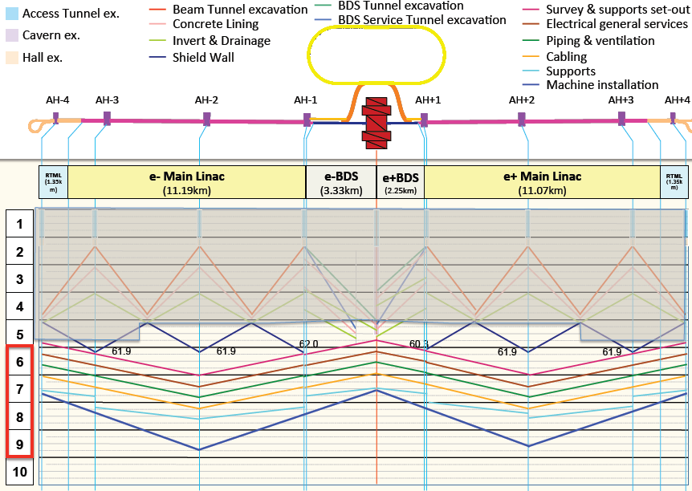
Schedule for 500 GeV Machine

Slide 32
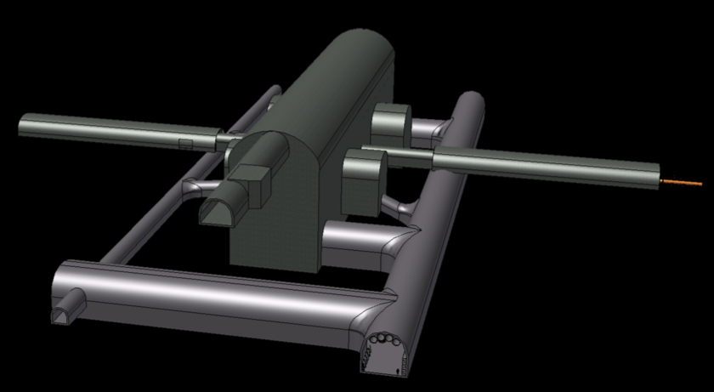
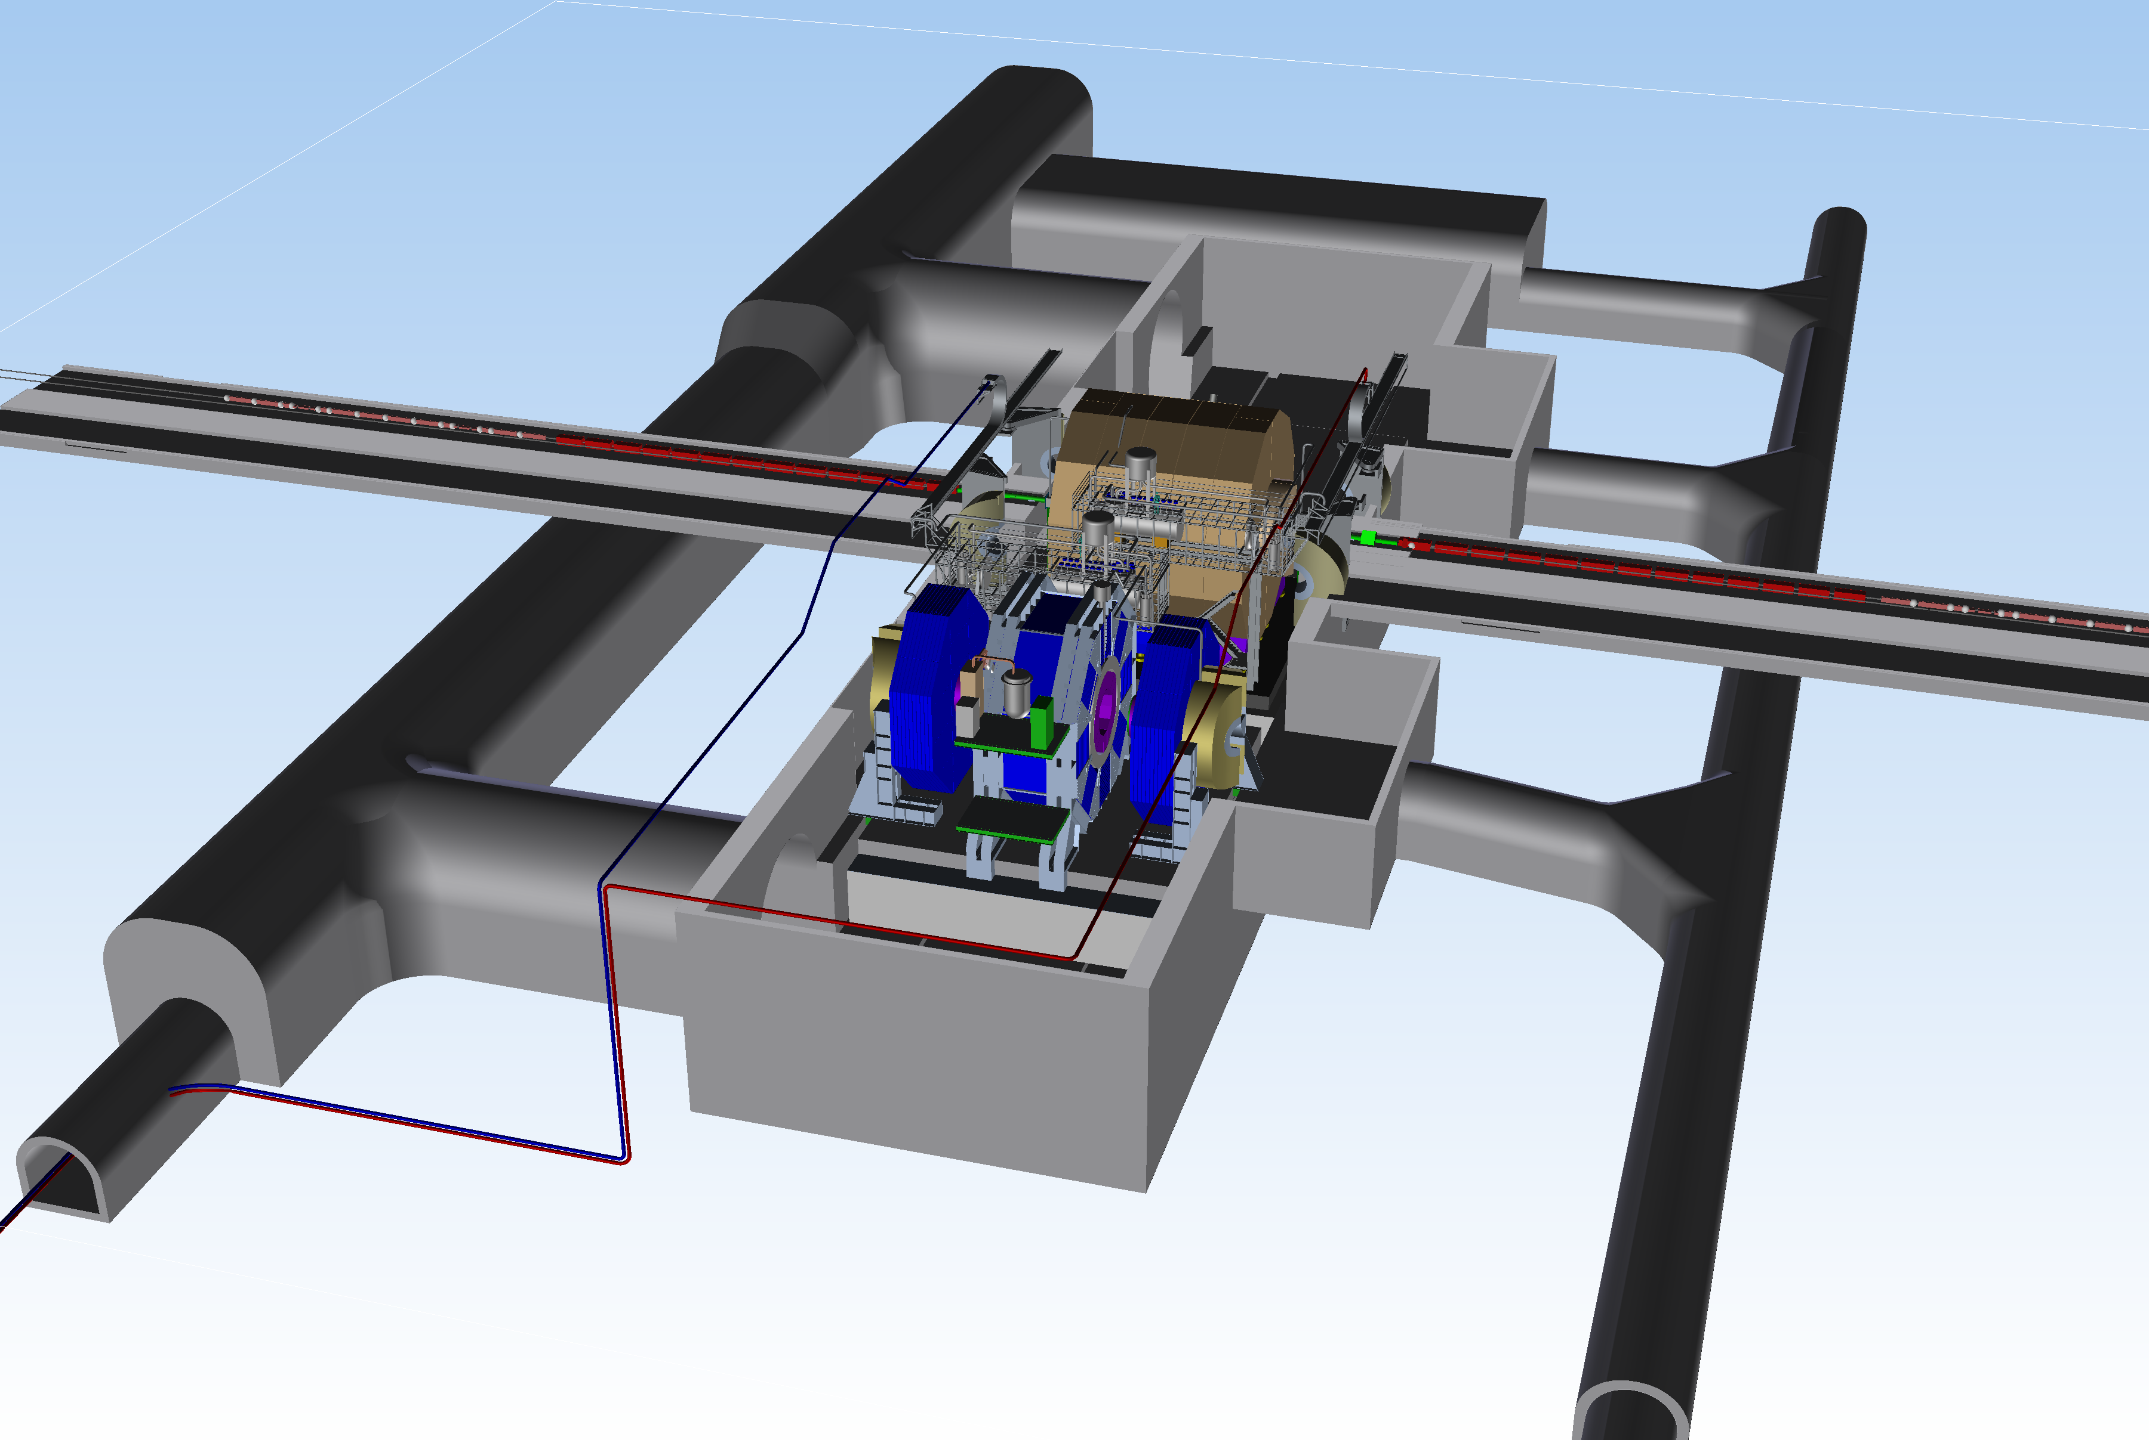
MDI (Detector Hall)
2 Detectors in push-pull configuration
Detector construction:
9 years (can be shorter?)
Notes:
Should add mountain 3D graphic

Slide 33
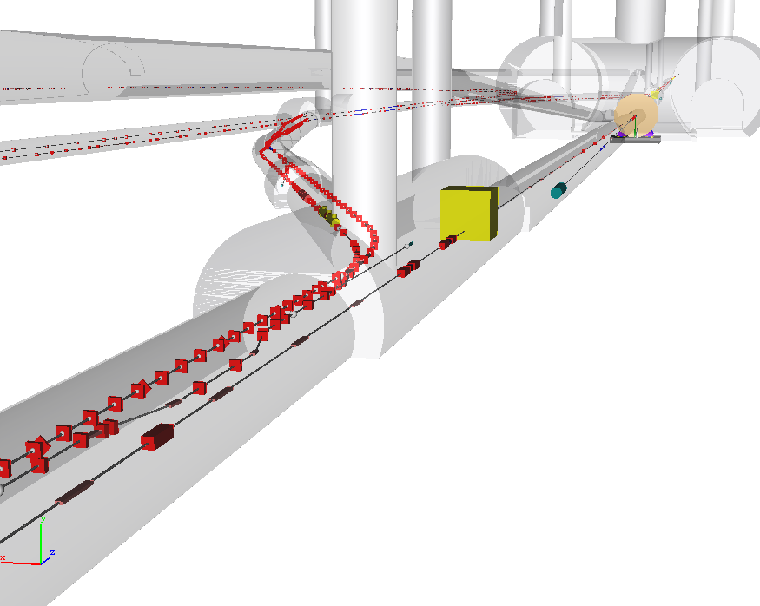
Central Region
Damping Rings
detector
RTML return line
e+ main beam dump
e- BDS muon shield
e+ source
e- BDS
Central region, detector hall (and detector) are
schedule drivers
Possible reduction for 250 GeV machine is 12-18 months (out of 10 years)

Slide 34
Summary
ILC (500 GeV) machine already “contains” a light Higgs factory
  Luminosity: 7.5×10³³ cm⁻² s⁻¹
  (Possible to upgrade by factor 2)
Standalone machine for LHF
  reduced cost to ~65% of 500 GeV machine
    P_{AC} ~ 100 MW
  reduces schedule by 12-18 months
  (perhaps a little more)
Only really makes sense as part of a first-stage machine
  scope of complete project still ~500 GeV
  TeV upgrade remains optional

