Slide 1
Summary – Higgs Factory: Accelerators
Weiren Chou
Fermilab, U.S.A.
Presentation to the ICFA Higgs Factory Workshop
November 14-16, 2012, Fermilab

Slide 2
Many thanks
  to all speakers for well-prepared excellent talks
  to tall participants for stimulating discussions
  to the Local Committee (Elliott McCrory, Cynthia Sazama, Suzanne Weber and Tanja Waltrip) for wonderful administrative support
  to the Organizing Committee members (Alain Blondel, Alex Chao, Jie Gao, Daniel Schulte, Kaoru Yokoya) for helping prepare this summary

Slide 3
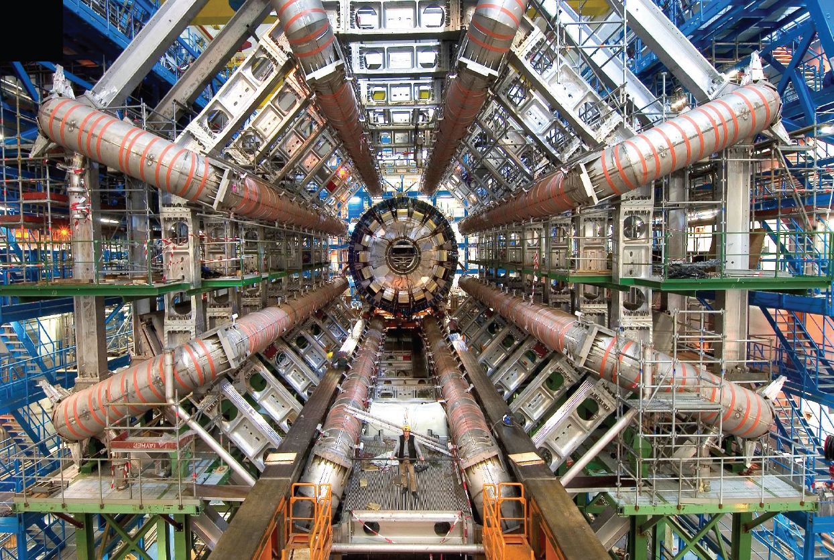
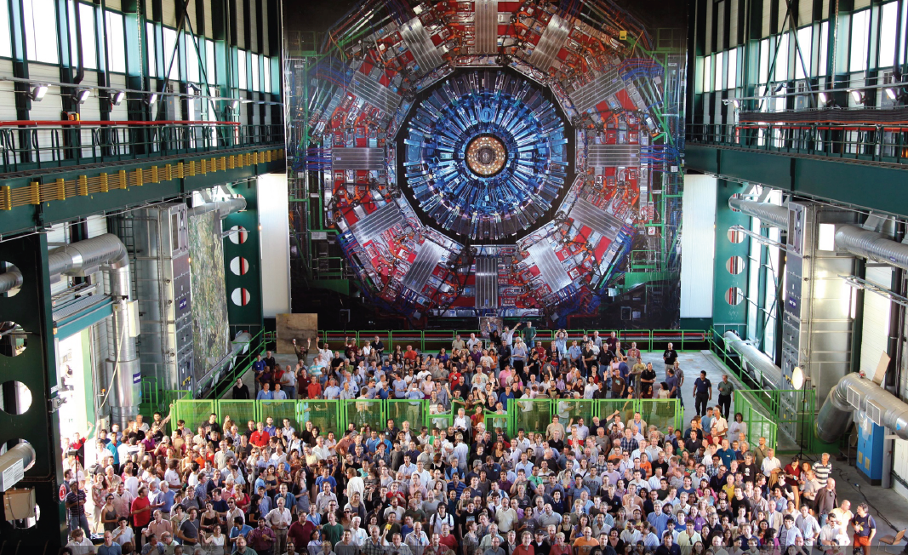
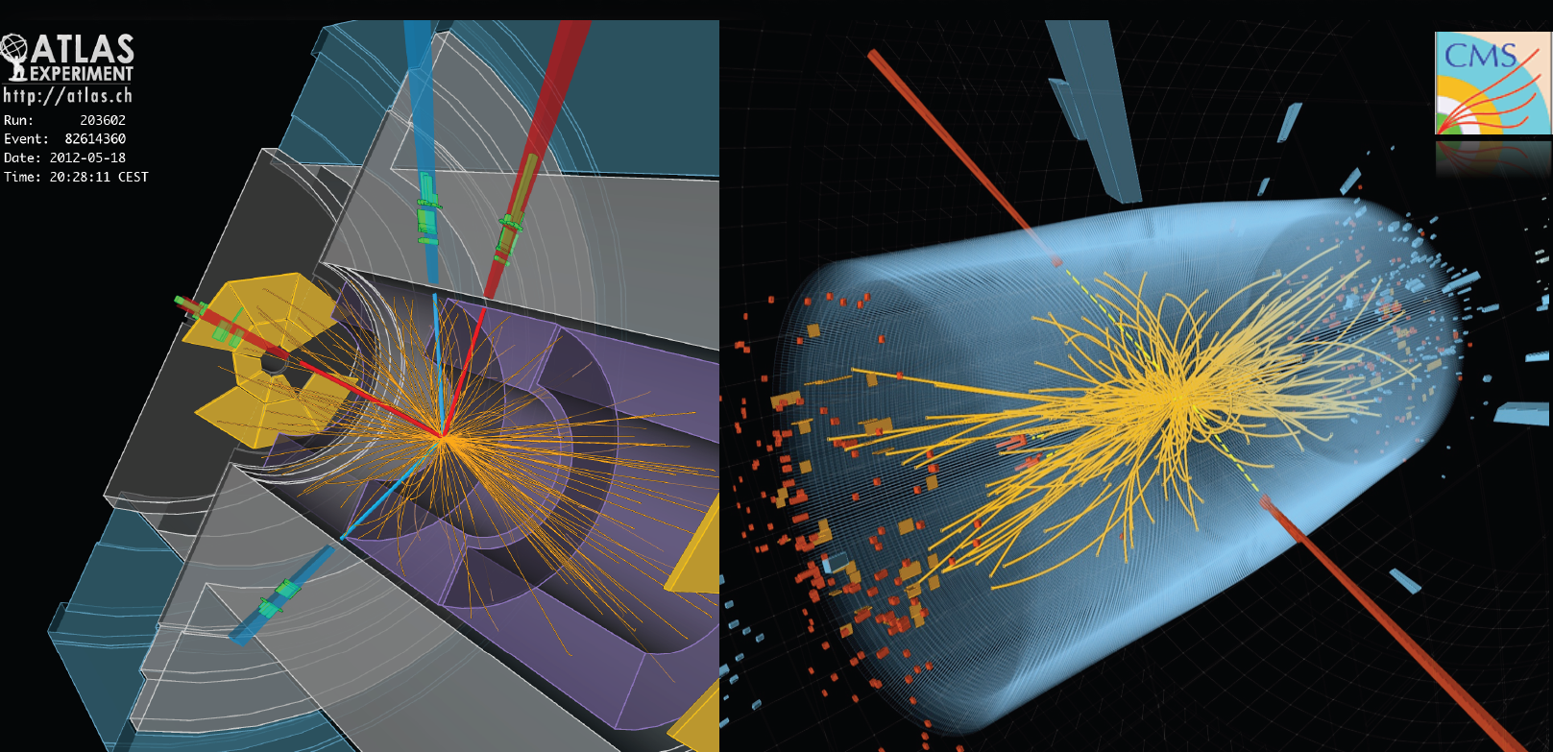

Slide 4

One in 16 of the passengers passing through Geneva airport are in some way associated with CERN.

Slide 5

HIGGS Factories

Slide 6



Slide 7
A Circle?
At Snowmass 2001, all options for after-the-LHC were on the table:
  Linear e+e-
  Circular e+e-
  VLHC
  Muon collider
  High intensity proton source (aka Proton Driver)
In the following years, ICFA played a leading role in making the choice:
  The next one would be an e+e- collider
  It would be a linear e+e- collider
  It would be a cold linear e+e- collider
And the world HEP community followed faithfully
However, the debate seemed to come back again after July 4, 2012:
  The discovery of a Higgs boson may justify a dedicated Higgs Factory
  The low Higgs mass (126 GeV) makes a circular Higgs Factory possible
  Even a warm Higgs factory is not bad

Slide 8
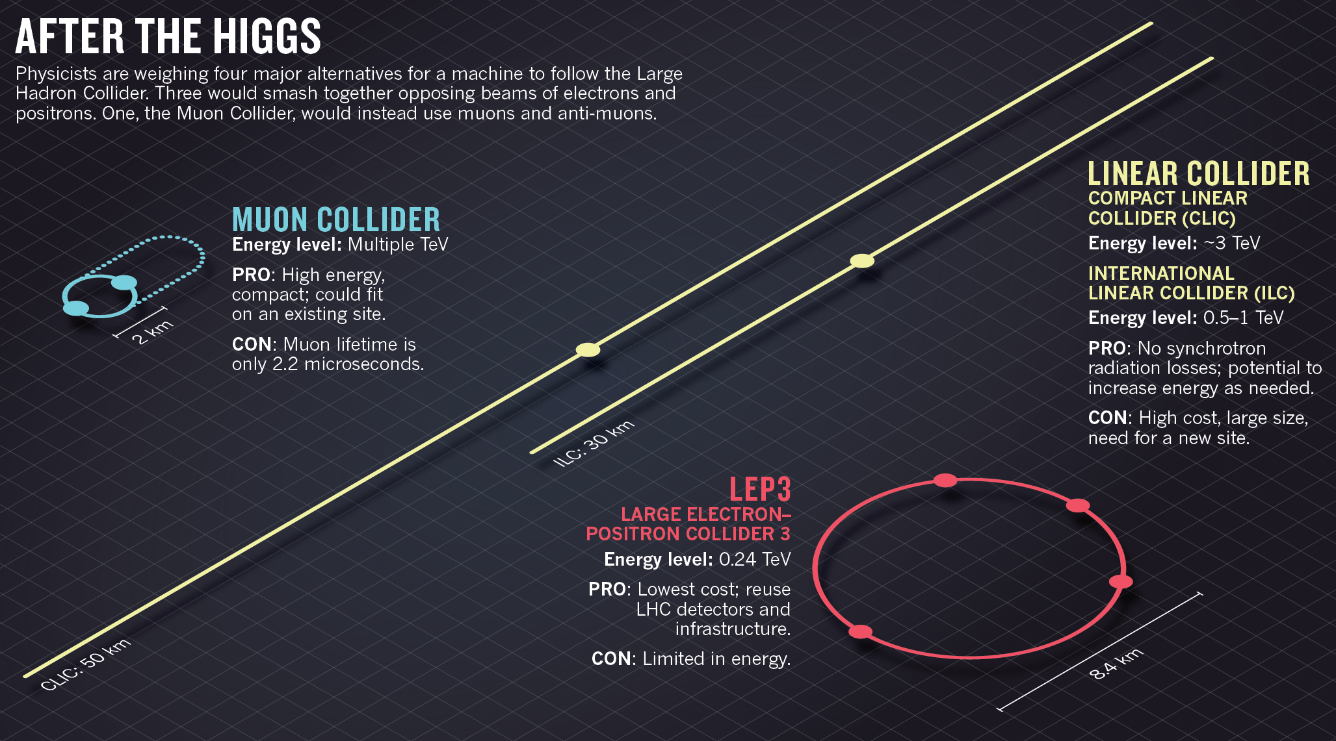

Slide 9
A Zoo of Candidates for a Higgs Factory
Linear e+e- collider:
  ILC
  CLIC
  X-band klystron based
Circular e+e- collider:
  LEP3
  TLEP
  SuperTRISTAN
  Fermilab site-filler
  China Higgs Factory (CHF)
  SLAC/LBNL big ring
Muon collider
  Low luminosity
  High luminosity
γγ collider:
  ILC-based
  CLIC-based
  Recirculating linac-based (SAPPHiRE)
  SLC-type
The purpose of this workshop is not to make a choice or recommendation among these candidates (pre-mature).
Rather, it is to make a credible technical comparison between these candidates:
  Physics reach
  Performance (energy, luminosity)
  Upgrade potential
  Technology maturity and readiness
  Technical challenges requiring further R&D
There will be a comparison table.
The cost is not included in the comparison because it would have no credit for such an exercise at this point.

Slide 10
Comparison Table

Slide 11
Comparison Table – Linear Higgs Factories

Slide 12
Comparison Table – Circular Higgs Factories

Slide 13
Comparison Table – Muon Collider as a Higgs Factory

Slide 14
Comparison Table – Photon Collider as a Higgs Factory

Slide 15
Comparison Table – Linear Higgs Factories (other parameters)

Slide 16
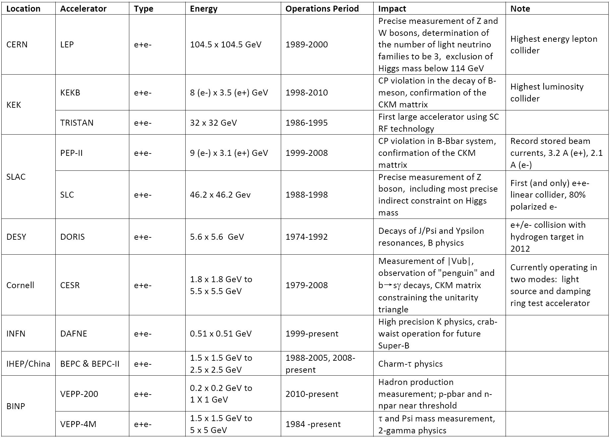
e⁺e⁻ Collider in the Last 20 Years (1991 – 2011)

Slide 17
Linear e⁺e⁻ Collider as a Higgs Factory
Advantages:
  Extensive design and prototyping work have been done
  Big investment have been made. Key technologies are in hand.
  There exist well-organized international collaborations led respectively by the ILC GDE and CLIC Collaboration (to be combined under the Linear Collider Director appointed by ICFA)
  Important step towards high energy e+e- collisions
  Polarized beams (e- 80%, e+ 30%)
  A front runner (in terms of readiness)
Challenges:
  High cost
Specific issues:
  ILC
    FFS
    Positron source
    Industrialization of SRF
    For Higgs factory: Need 10 Hz for e+ production, or use unpolarized e+ beam as a backup scheme
  CLIC
    Accelerating structure
    Industrialization of major components
    From CDR to TDR

Slide 18
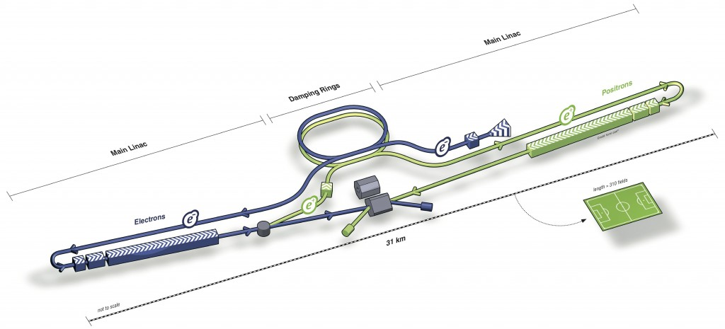
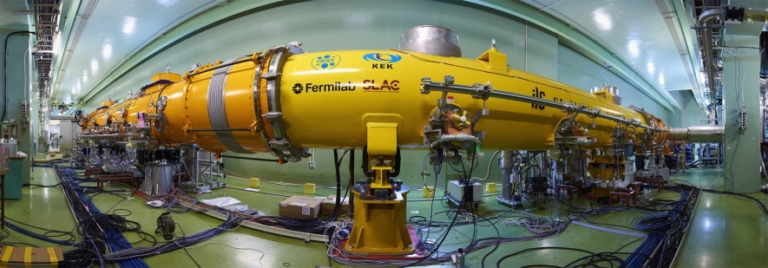
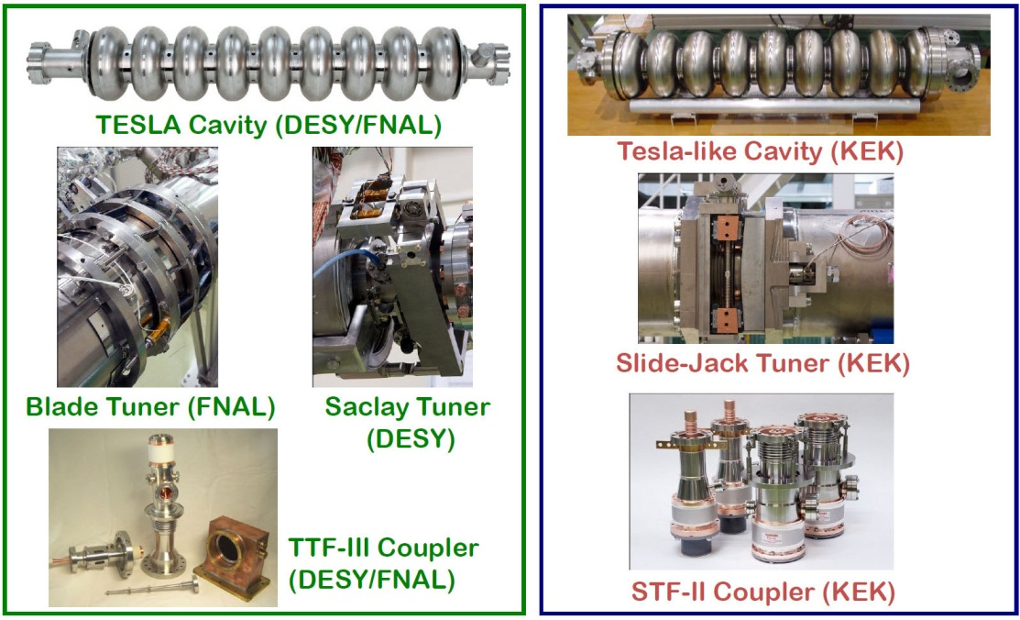
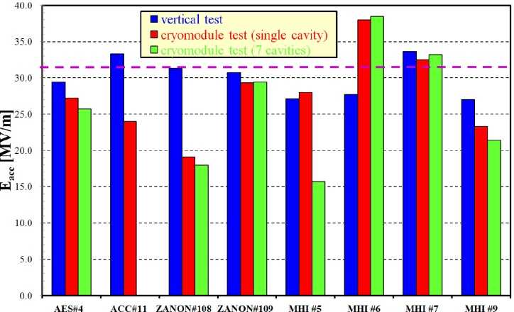
ILC as a Higgs Factory

Slide 19
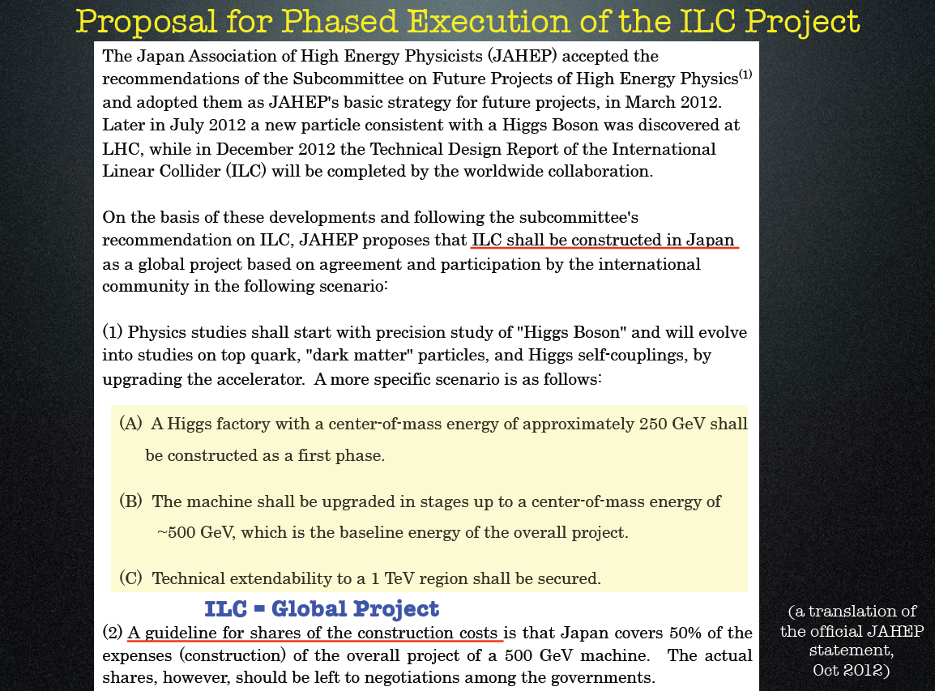
JAHEP Statement (October 2012)

Slide 20
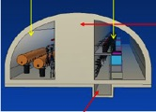




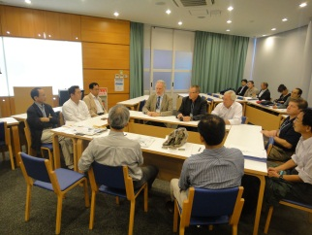

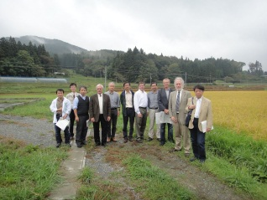
Two Candidate Sites in
Japanese mountainous locations
5 m
SEFURI
- GDE-CFS group visited two candidates sites,
Oct. 14 and 15, 2011

Slide 21

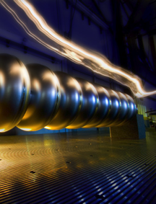
TDR Technical Volumes
2007
2011
2013*
TDR Part I:
R&D
~250 pages
Deliverable 2
ILC Technical Progress Report
(“interim report”)
AD&I
TDR Part II:
Baseline
Reference
Report
~300 pages
Deliverables 1,3 and 4
Technical Design Report
Reference Design Report
* end of 2012 – formal publication early 2013

Slide 22
TDR 500 GeV Baseline
15.4 km
(site length ~31 km)
1.1 km
10.8 km
1.3 km
2.2 km
Main Linac
BDS
e+ src
IP
bunch comp.
Main Linac
<G_{cavity}> = 31.5 MV/m
G_{eff} ≈ 22.7 MV/m
(fill fact. = 0.72)
central region
Cost: 100%
P_{AC}: 161 MW

Slide 23
250 GeV staged (scenario 1)
15.4 km
1.1 km
5.1 km
1.3 km
2.2 km
Main Linac
BDS
e+ src
IP
bunch comp.
central region
Half the linac
Full-length BDS tunnel & vacuum (TeV)
½ BDS magnets (instrumentation, CF etc)
½ RTML LTL
Extended tunnel/CFS already 500 GeV stage
10Hz mode e- linac

Slide 24
250 GeV staged (scenario 2)
15.4 km
1.1 km
5.1 km
1.3 km
2.2 km
Main Linac
BDS
e+ src
IP
bunch comp.
125 GeV transport
central region
Half the linac
Full-length BDS tunnel & vacuum (TeV)
½ BDS magnets (instrumentation, CF etc)
1 RTML LTL
5km 125 GeV transport line
Extended tunnel/CFS already 500 GeV stage
10Hz mode e- linac
quasi-adiabatic energy upgrade?

Slide 25
Summary (N. Walker)
ILC as a Higgs Factory
ILC (500 GeV) machine already “contains” a light Higgs factory
  Luminosity: 7.5×10³³ cm⁻² s⁻¹
  (Possible to upgrade by factor 2)
Standalone machine for LHF
  reduced cost by ~35% (P_{AC} ~ 100 MW)
  reduces schedule by 12-18 months
  (perhaps a little more)
Only really makes sense as part of a first-stage machine
  scope of complete project still ~500 GeV
  TeV upgrade remains optional

Slide 26
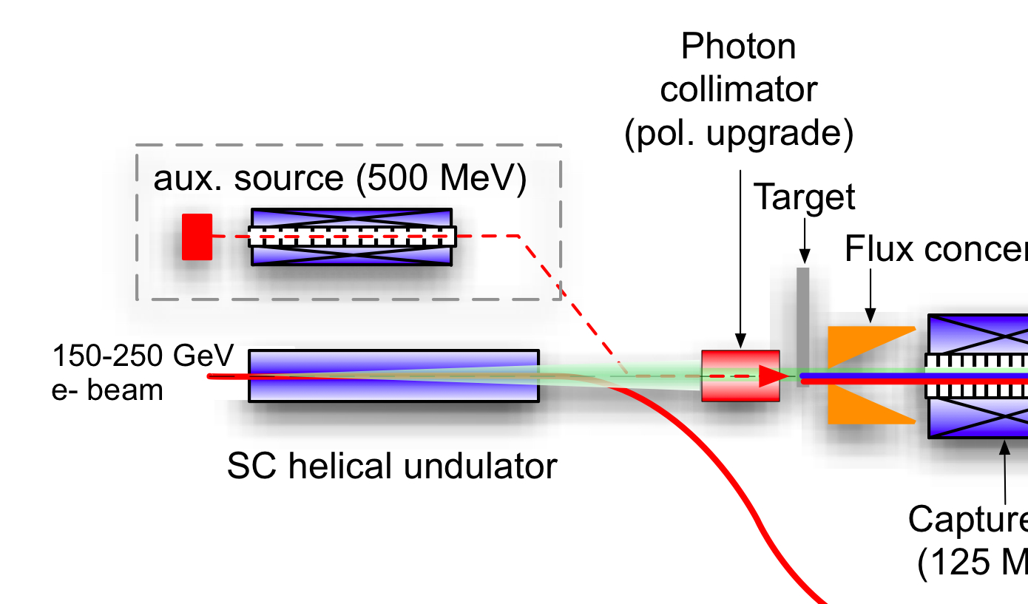
ILC Polarised-Positron Production
e- linac
Uses primary electron beam to generate ~30 MeV photons in a SC helical undulator
Photons converted into e+e- pairs in “thin” titanium target
Positron production yield dependent on e- beam energy (and therefore E_{cm})
e- to IP

Slide 27
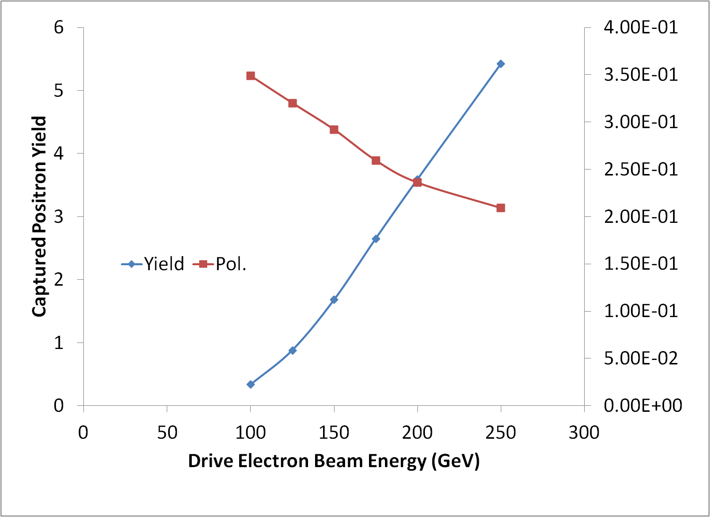
Positron Yield
147m helical undulator
(TDR baseline)
E_{beam} = 125 GeV
design point
yield margin
Wei Gai (ANL) et al

Slide 28
Positron Yield for a LHF
Recover yield by going to
~250 m of undulator
E_{beam} = 125 GeV
yield margin
Wei Gai (ANL) et al
Notes:
Power density on target (WG says OK but should check).

Slide 29
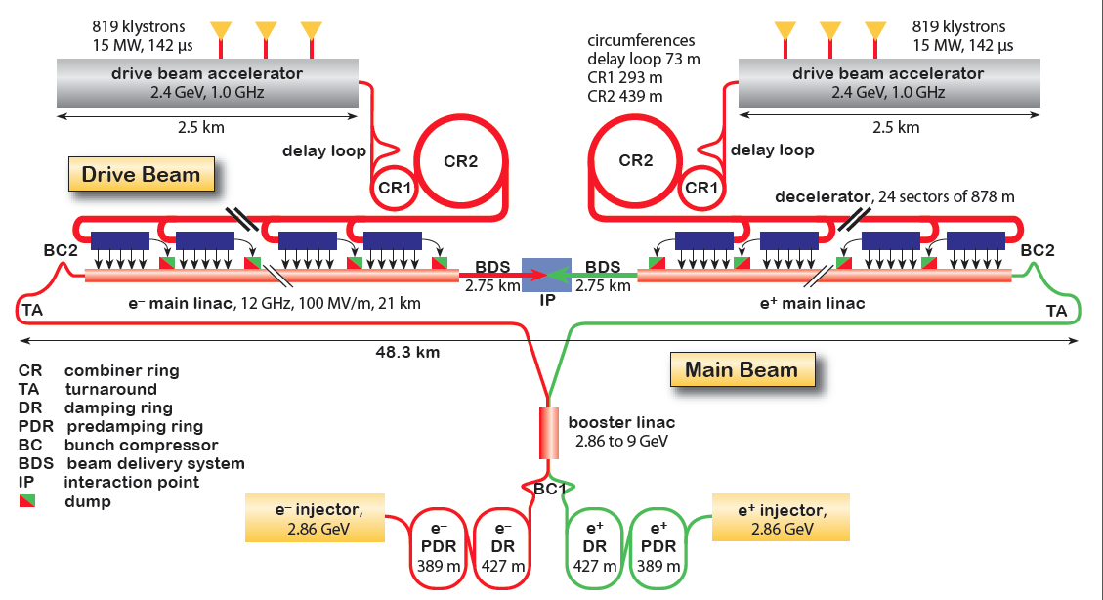
CLIC Layout at 3 TeV
Goal: Lepton energy frontier
Drive Beam Generation Complex
Main Beam Generation Complex

Slide 30
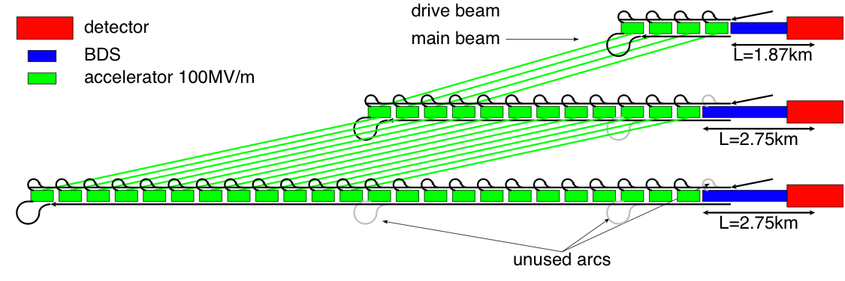
Staging Scenario B
4 sectors equal 500GeV
12 sectors equal 1.5TeV
24 sectors equal 3TeV
Energy choices made with Physics Group
Need to be reviewed when more
LHC results become available
They are only an example

Slide 31
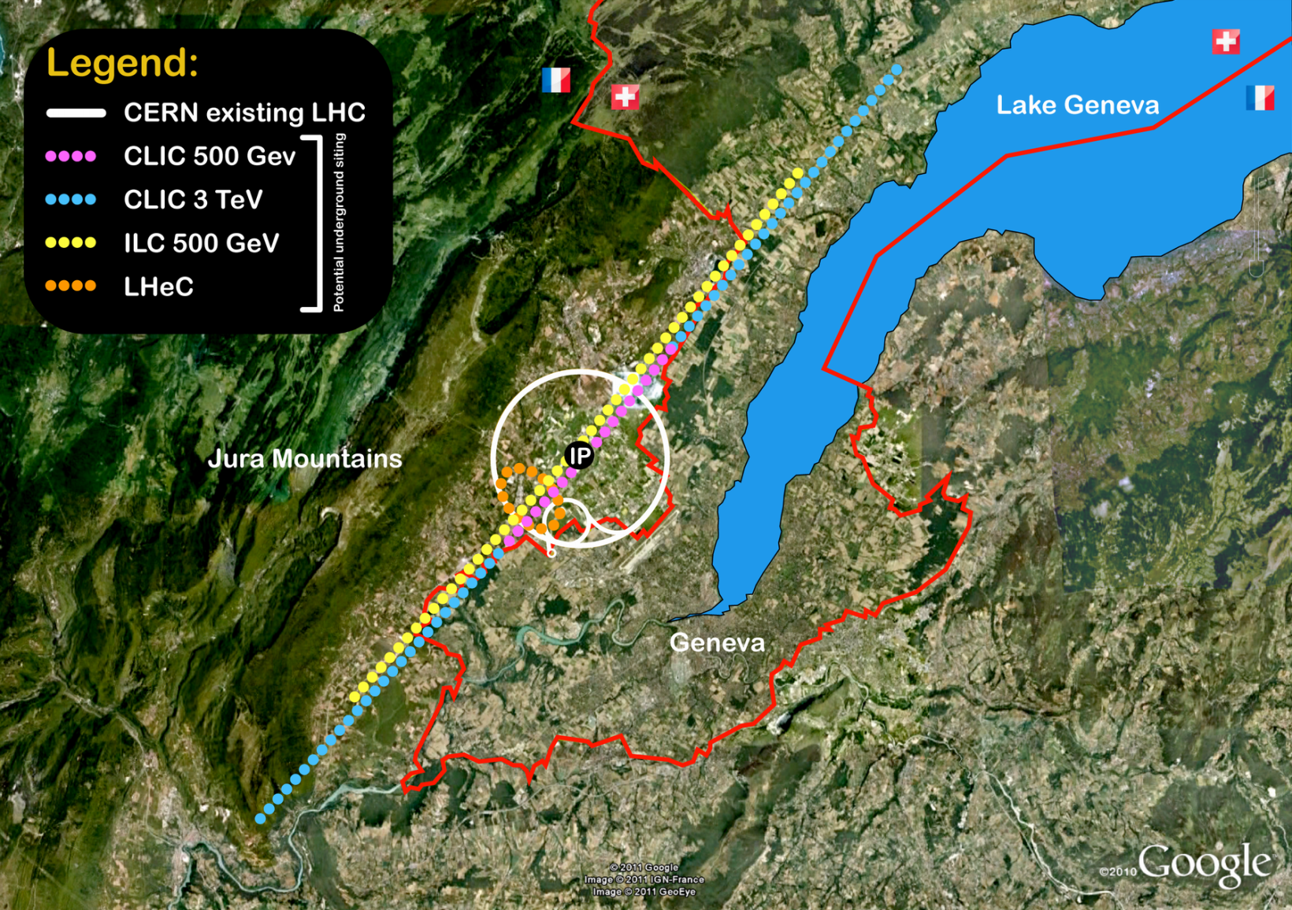
Layout
14 km, ~100 m deep
31 km, ~100 m deep

Slide 32
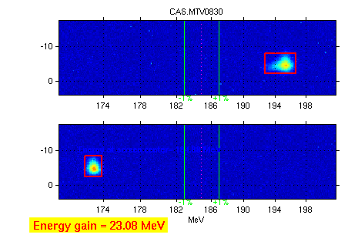
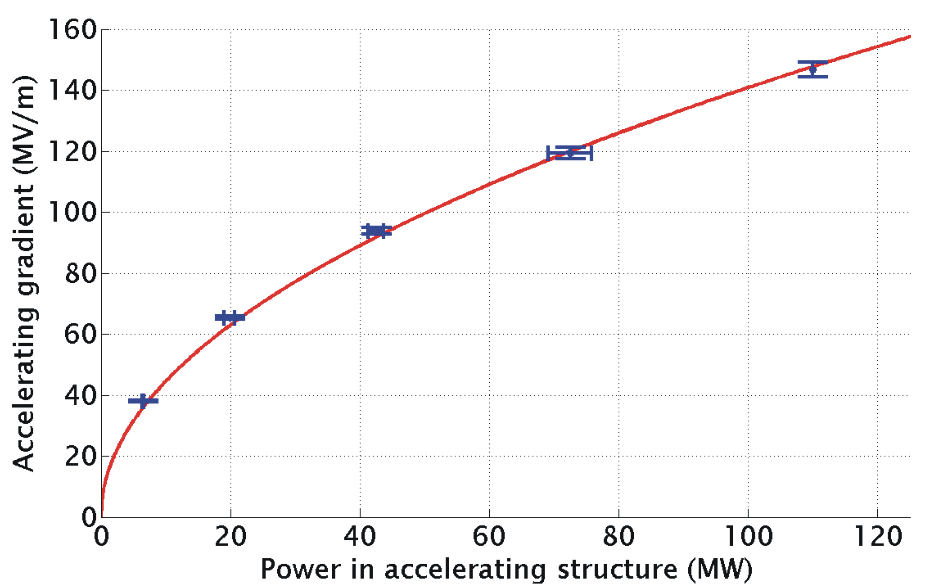
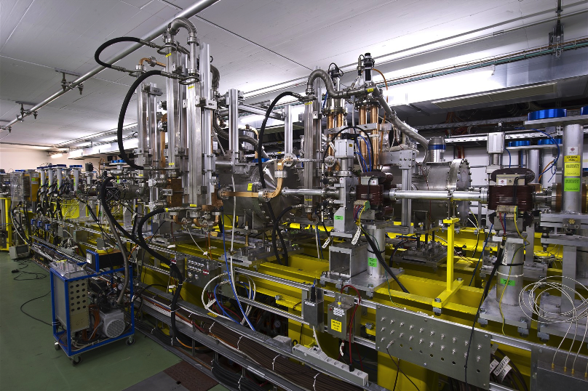
TBTS: Two Beam Acceleration
Measured accelerating gradient
Maximum gradient 145 MV/m
Consistency between
produced power
drive beam current
test beam acceleration

Slide 33
The CLIC CDR documents
Vol 1: The CLIC accelerator and site facilities (H.Schmickler)
- CLIC concept with exploration over multi-TeV energy range up to 3 TeV
- Feasibility study of CLIC parameters optimized at 3 TeV (most demanding)
- Consider also 500 GeV, and intermediate energy range
- Complete, presented in SPC in March 2011, in print: https://edms.cern.ch/document/1234244/
Vol 2: Physics and detectors at CLIC (L.Linssen)
- Physics at a multi-TeV CLIC machine can be measured with high precision, despite challenging background conditions
- External review procedure in October 2011
- Completed and printed, presented in SPC in December 2011 http://arxiv.org/pdf/1202.5940v1
Vol 3: “CLIC study summary” (S.Stapnes)
- Summary and available for the European Strategy process, including possible implementation stages for a CLIC machine as well as costing and cost-drives
- Proposing objectives and work plan of post CDR phase (2012-16)
- Completed and printed, submitted for the European Strategy Open Meeting
in September http://arxiv.org/pdf/1209.2543v1
In addition a shorter overview document was submitted as input to the European Strategy update, available at:
http://arxiv.org/pdf/1208.1402v1

Slide 34
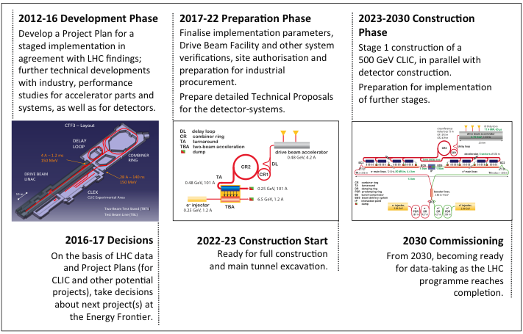
Timeline

Slide 35
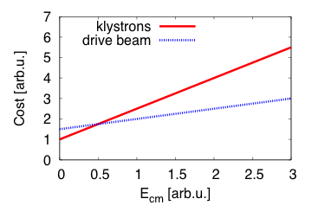
Note on Klystron-based First Stage
Klystrons-based design have been
Developed in the past: NLC and JLC-X
NLC RF unit
Chr. Adolphsen et al.
They aimed at
75MW power, 1.6μs pulse length and 55% efficiency
-> reasonable limit of feasibility
Would need about 30,000 klystrons for CLIC at 3TeV
-> much more expensive than drive beam
But could be interesting at low energies
-> is being explored for first stage

Slide 36
Circular e⁺e⁻ Collider as a Higgs Factory
“Happy families are all alike; every unhappy family is unhappy in its own way.”
- Leo Tolstoy, Anna Karenina, Chapter 1, first line
Circular e+e- colliders are all alike.
The only difference is their size:
  16 km (Fermilab site-filler)
  27 km (LEP3)
  40 km (SuperTRISTAN-40)
  50 km (CHF-1)
  70 km (CHF-2)
  80 km (TLEP, SuperTRISTAN-80)
  233 km (VLLC)

Slide 37
Circular e⁺e⁻ Collider as a Higgs Factory
Advantages:
  At 240 GeV, potentially a higher luminosity to cost ratio than a linear one
  Based on mature technology and rich experience
  Some designs can use existing tunnel and site
  More than one IP
  Tunnel of a large ring can be reused as a pp collider in the future
Challenges:
  Beamstrahlung limiting beam life time requires lattice with large momentum acceptance
  RF and vacuum problem from synchrotron radiation
  A lattice with low emittance
  Efficiency of converting wall power to synchrotron radiation power
  Limited energy reach
  No comprehensive study; design study report needed.

Slide 38
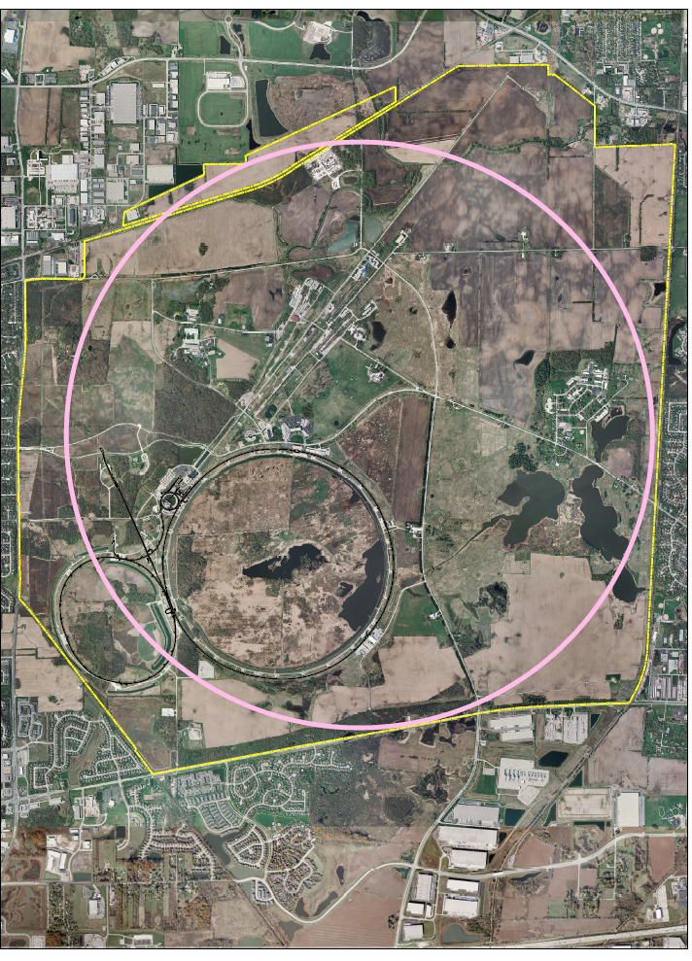
Fermilab Site-Filler
Higgs factory
Beam Energy = 120 GeV
SR power, both beams=100MW
Initial luminosity=5x10³³ cm⁻² s⁻¹
βx*, βy* = (20, 0.2) cm
Beam-beam tune shifts =(0.067, 0.095)
Beam current = 5 mA
Z Factory
Beam Energy = 46 GeV
SR power, both beams= 60 MW
Initial luminosity=3x10³⁴ cm⁻² s⁻¹
Beam-beam tune shifts= (0.032, 0,045)
Beam current = 134 mA
Fermilab Site Filler rings
Circumference = 16 km

Slide 39
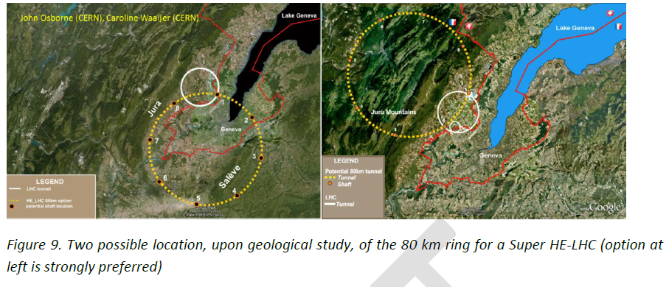
LEP3 & TLEP
Beyond HE-LHC : new tunnels in Geneve area
47 km – 80 km
1) 42 TeV c.o.m. with 8.3 T (present LHC dipoles)
2) 80 TeV c.o.m. with 16 T (high field based on Nb3Sn)
3) 100 TeV c.o.m with 20 T (very high field based on HTS)

Slide 40
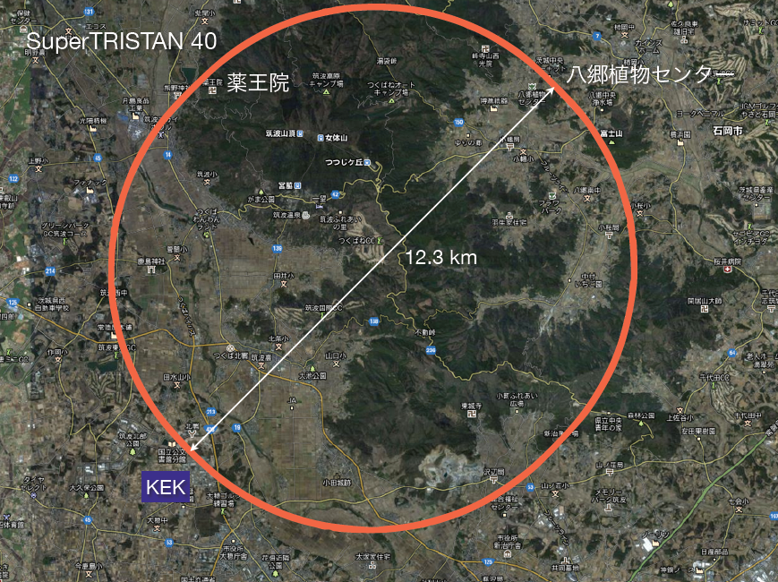
SuperTRISTAN
~ 2 B CHF
(only the tunnel)
13 Feb. 2012 K. Oide (KEK)

Slide 41
What is a (CHF + SppC)
China Higgs Factory (CHF)
Circular Higgs factory (phase I) + super pp collider (phase II) in the same tunnel
pp collider
e⁻e⁺ Higgs Factory

Slide 42
Conclusion (Q. Qin)
China Higgs Factory (CHF)
A CHF + SppC was proposed in IHEP for high precise probe of Higgs, and new discovery of physics as well.
Main parameters and basic lattices are studied and further iterations are required.
Budget and time schedule are not yet estimated.

Slide 43
LEP3/TLEP R&D items (F. Zimmermann)
choice of RF frequency: 1.3 GHz (ILC)
  or 700 MHz (ESS)? & RF coupler
SR handling and radiation shielding
  (LEP experience)
beam-beam interaction for large Q_{s}
and significant hourglass effect
IR design with large momentum
acceptance
integration in LHC tunnel (LEP3)
Pretzel scheme for TERA-Z operation

Slide 44
Benchmark of Beam-Beam Code
3D PIC Simulation (BBI)
Measurement
94.3 GeV
Parameters provided by Frank Zimmermann
Helmut Burkhardt
R. Assmann and K. Cornelis, Proceeding of EPAC 2000, Vienna, Austria
http://hbu.web.cern.ch/hbu/BeamDyn/LEP.html
ε_{y}=0.19 nm, without beam-beam perturbation
11/15/2012
Yunhai Cai, HF2012 Workshop
44

Slide 45
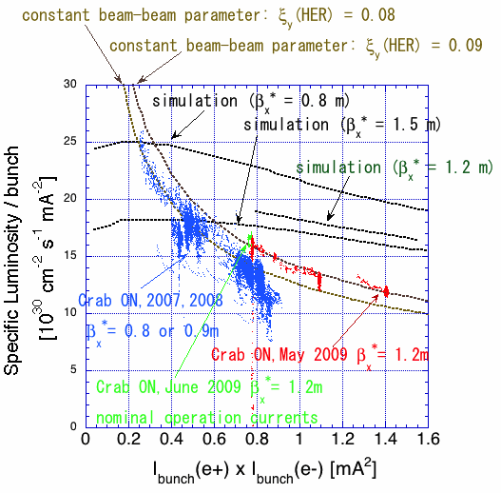
Specific luminosity of KEKB w/ crab cavities
KEKB was operation well above the
beam-beam limit

Slide 46
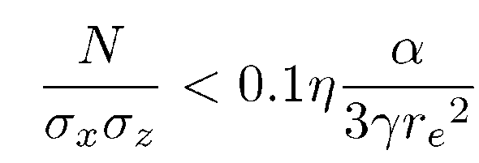
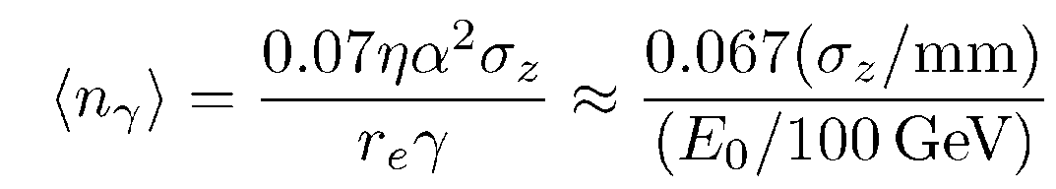
Beamstrahlung (V. Telnov)
Eq. * imposes the following restriction on the beam parameters:
(**)
This formula is the basis for the following discussions.
In collision of Gaussian beams the average number of beamstrahlung photons , their average energy and
, that gives
Hence, the beam lifetime is determined by photons with
energy 8.5/0.13 = 65 times greater than .
With account of (**)
=2.12

Slide 47
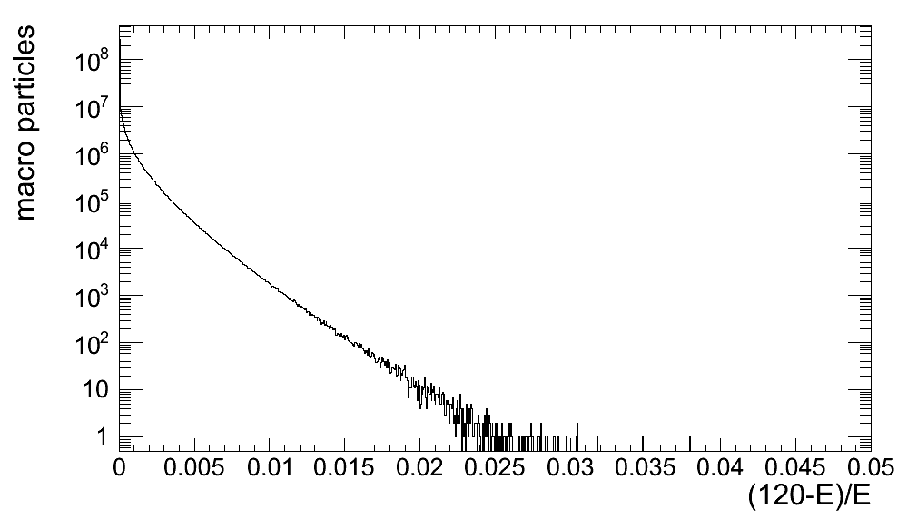
BS lifetime (M. Zanetti)
Simulate and track O(10⁸) macroparticles and check the energy spread spectrum
Lifetime computed from the fraction of particles beyond a given momentum acceptance (η)
Exponential dependence on η
TLEP-H
Lifetime>4h η=3%

Slide 48
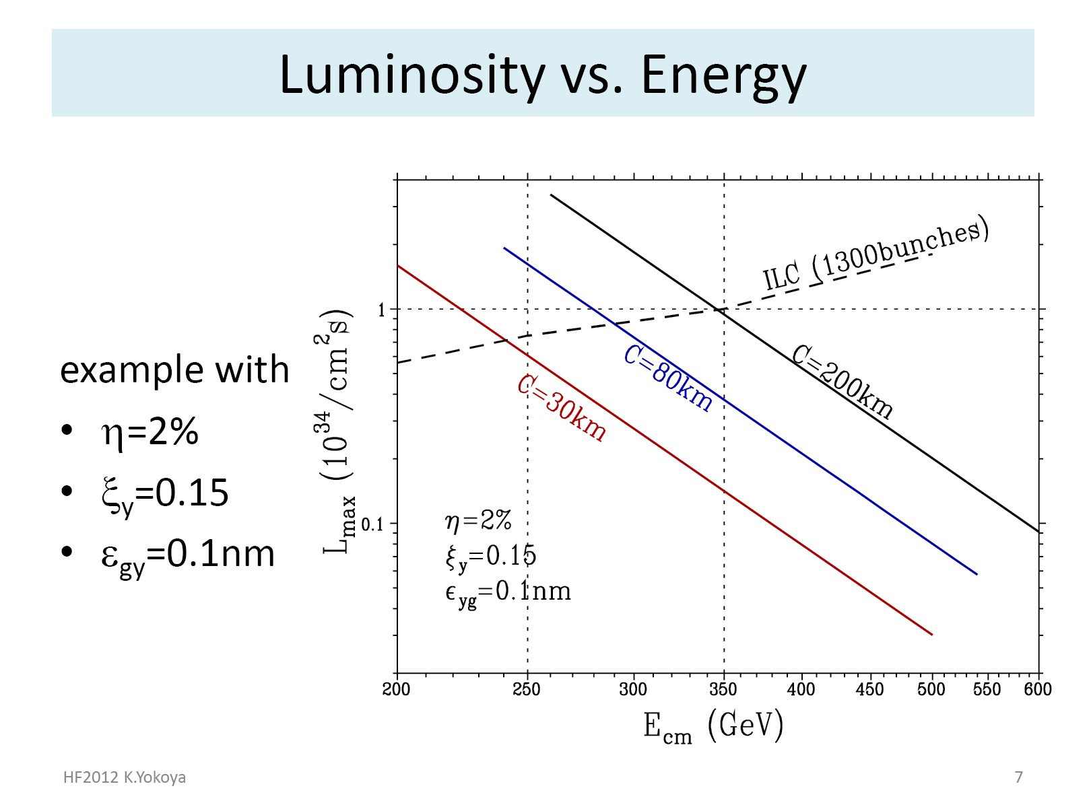

Slide 49
Momentum Bandwidth (SLAC/LBNL Ring)
Horizontal
Vertical
Four families of sextupole used in the optimization,
achieving ±2% momentum bandwidth.
11/16/2012
Yunhai Cai, HF2012 Workshop
49

Slide 50
Final Focus System
at IP:
β_{x}=50 mm
β_{y}=1 mm
L*=4 m
11/15/2012
Yunhai Cai, HF2012 Workshop
50
Notes:
Minimize number of quadrupoles.
Imaging system with a secondary focusing point.

Slide 51
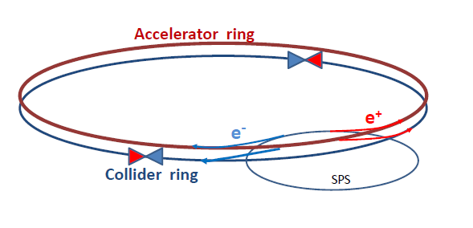
How can one increase over LEP 2 (average) luminosity by a factor 500
without exploding the power bill?
Answer is in the B-factory design: a very low vertical emittance ring with
higher intrinsic luminosity
electrons and positrons have a much higher chance of interacting
➔ much shorter lifetime (few minutes)
➔ feed beam consituously with a ancillary accelerator

Slide 52

Top-up Injection: Schematic Cycle
beam current in collider (15 min. beam lifetime)
100%
99%
almost constant current
energy of accelerator ring
120 GeV
injection into collider
injection into
accelerator
20 GeV
10 s

Slide 53
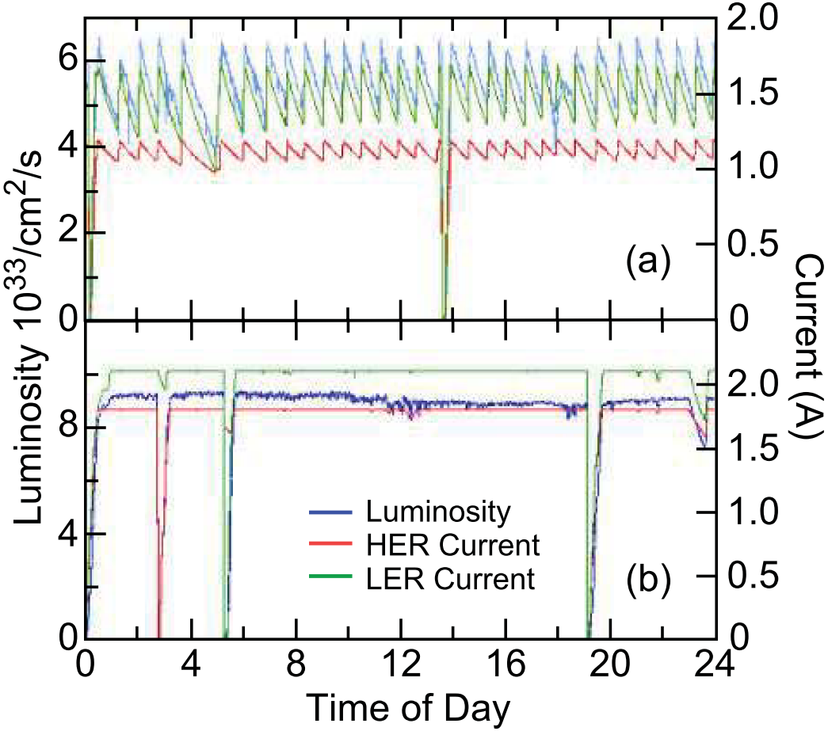
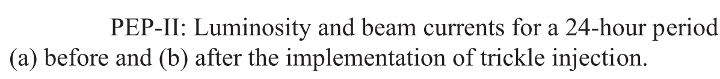
PEP-II/BaBar Top-Up Injection (Accelerator)
Improved peak and average luminosity.
Before Top-Up Injection
After Top-Up Injection

Slide 54
Conclusions (J. Seeman)
Top-up Injection: Schematic Cycle
Top-up injection will work for a Circular Higgs Factory.
A full energy injector is needed.
A synchrotron injector will work the best but is more than is needed. (60 Hz)
A rapidly ramped storage ring is likely adequate. (4 sec)
A slowly ramped storage ring injector doesn’t make the luminosity constant enough.
The detectors will need to mask out the buckets with damping injected bunches during data taking.

Slide 55
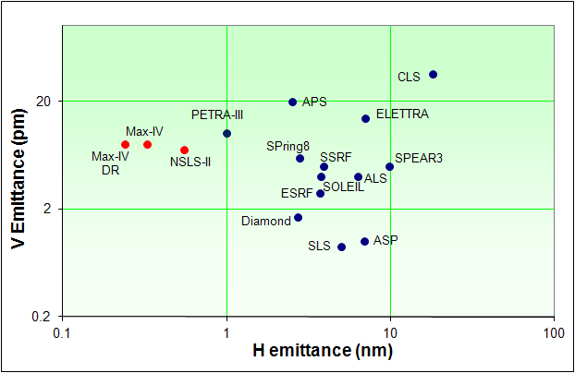
Emittance in 3rd generation light sources
operating
under construction
This is the geometric emittance
SLS wertical normalised emittance is ~5 nm
Transverse coherence requires small emittance
Diffraction limit at 0.1 nm requires 8 pm
Notes:
55

Slide 56
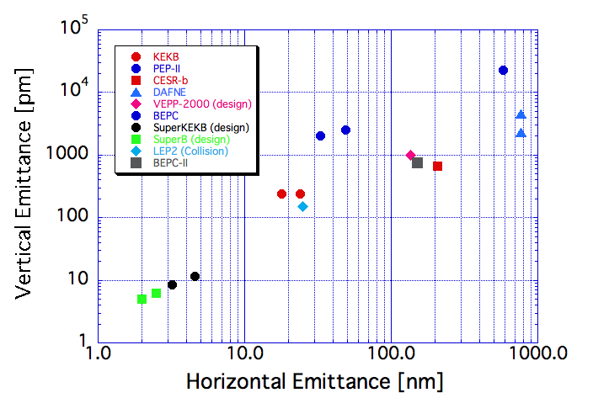
Comparison of emittances of colliders
Future colliders
LEP3
Existing colliders
TLEP-H
From Beam Dynamics Newsletter No. 31
Courtesy of F. Zimmermann, H. Burkhardt and Q. Qin

Slide 57
Difference between SR ring and high energy colliders (Y. Funakoshi)
IR
  Detector solenoid and its compensation
  Low beta insertion
  Local chromaticity correction
Size of rings
  In larger rings, orbit drift tends to be large.
    Accuracy of optics measurement with orbit drifts
Beam-beam interaction
  Restriction on choice of working point

Slide 58
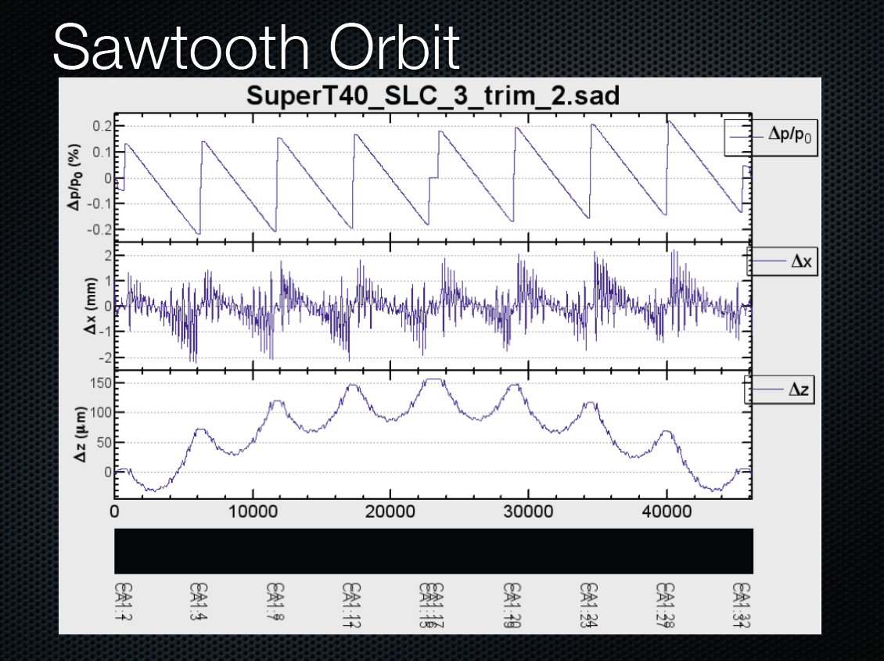

Slide 59
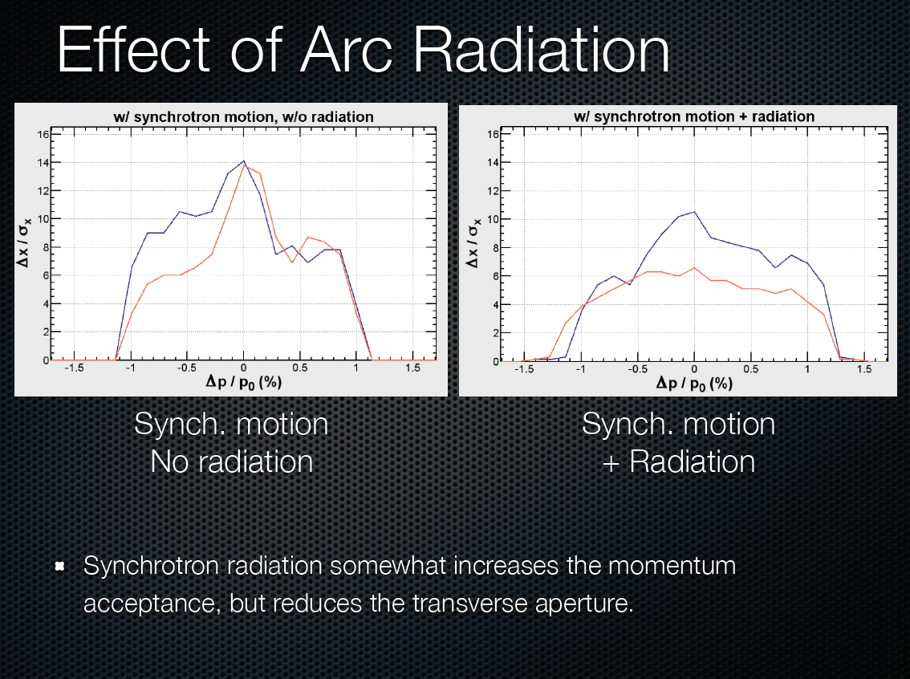

Slide 60
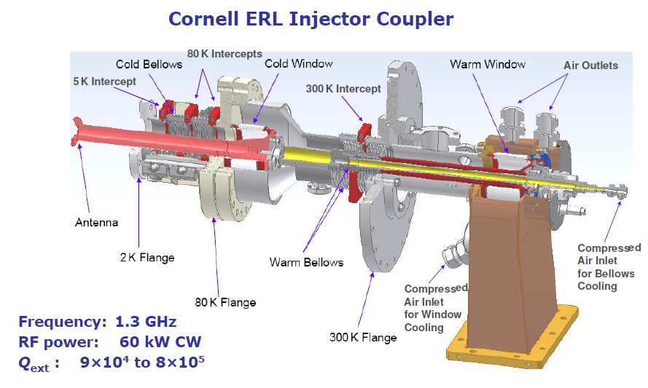
1.3 GHz power couplers
TTF-III couplers tested to 5 kW in CW
  8kW with improved cooling (BESSY)
Some higher power adaptations for ERL injectors
  e.g. Cornell 60 kW CW
2 couplers per 2-cell cavity in ERL injector cryomodule
Gradient: 5-15MV/m
Beam current: 100 mA
V. Vescherevitch, ERL’09
Developing a power coupler for 1.3 GHz high gradient and 200 kW CW looks challenging…
Notes:
Main issue with these couplers for high CW power is the cooling of the cold window which is in vacuum.

Slide 61
Tentative conclusions (A. Butterworth)
We cannot use ILC technology “off the shelf”
  power coupler limitations
  loss factors and HOM damping
Backing off in frequency to 700 MHz seems preferable
  ongoing R&D at BNL, CERN, ESS for 704 MHz cavities and components
  fundamental power couplers look feasible at > 200 kW CW
  compatible with HOM damping scheme for eRHIC
  high-power klystrons available
Cryogenic power will probably fit into the envelope of the existing LHC cryoplants (for LEP3)
Open questions
  power coupler design
  HOM damping (especially for TLEP)
  low level RF & feedback requirements
An RF system for a circular Higgs factory such as LEP3 or TLEP is not without its challenges but appears to be very feasible, especially as there are strong synergies with other ongoing development projects.

Slide 62
Synchrotron Radiation Comparison (N. Kurita)
 | PEPII | SPEAR3 | LEP3 | TLEP-Z | TLEP-H | TLEP-t
E (GeV) | 9 | 3 | 120 | 45.5 | 120 | 175
I (A) | 3 | 0.5 | 0.0072 | 1.18 | 0.0243 | 0.0054
rho (m) | 165 | 7.86 | 2625 | 9000 | 9000 | 9000
Linear Power (W/cm) | 101.8 | 92.3 | 30.5 | 8.8 | 8.8 | 8.8
LEP3 has 2 beams so SR = 61 W/cm
Thermal stresses from the SR striking the vacuum chamber should be manageable (lower than PEP-II and SPEAR3)
Critical photon energy = 1.4 - 2 MeV
  Radiological risk, activation (see Zimmerman’s talk)
  Use discrete masks to minimize the radiation shielding and materials activated.

Slide 63
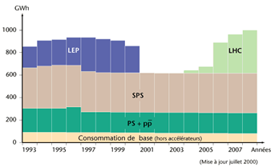
Power Consumption and Electricity bill
CERN in 2008: ~1000 GWh /year
Fermilab: 2010 average 58 MW (D. Wolff)
Fermilab current electricity bill:
  $440k per MW-year
  $20M a year
If increased to 200 MW:
  $80M a year
  i.e., 20% of the lab budget

Slide 64
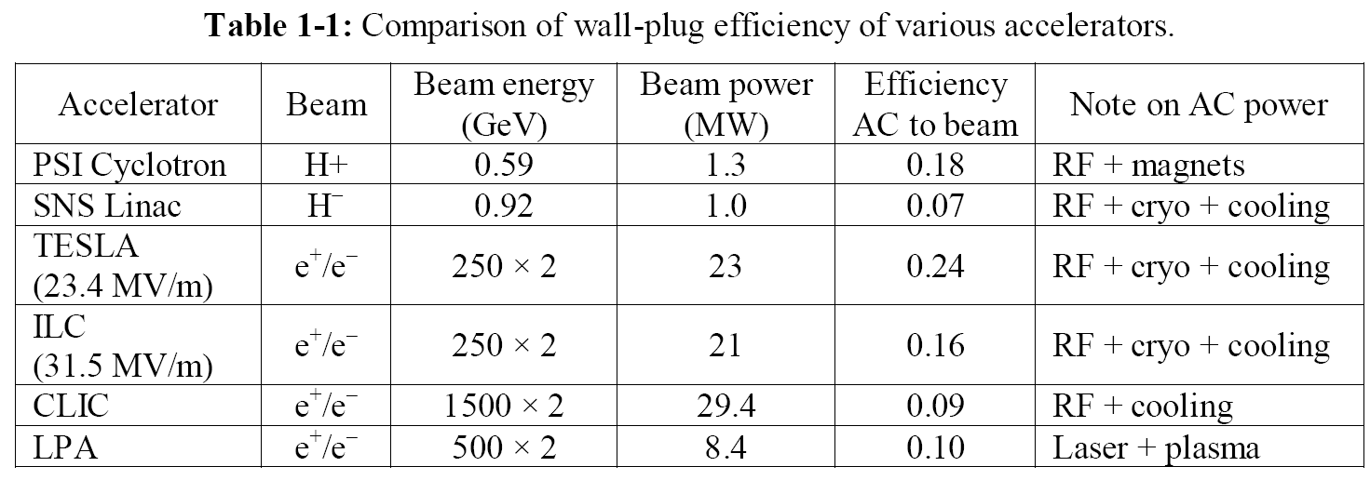
Efficiency to Convert Wall Power to Beam Power

Slide 65
Muon Collider as a Higgs Factory
Advantages:
  Large cross section σ (μ+μ- → h) = 41 pb in s-channel resonance will compensate low luminosity (to compare to e+e- → ZH at 0.2 pb)
  Small size footprint
  No synchrotron radiation problem
  No beamstrahlung problem
  Unique way for direct measurement of the Higgs line shape and total decay width Γ
  Exquisite energy calibration
  A path to very high energy lepton-lepton collisions
Challenges:
  Muon 4D and 6D cooling needs to be demonstrated
  Need small c.o.m energy spread (0.003%)
  RF in a strong magnetic field
  Background from constant muon decay
  Significant R&D required towards end-to-end design and firming up luminosity figures
  Cost unknown (not much cheaper than a TeV muon collider)

Slide 66
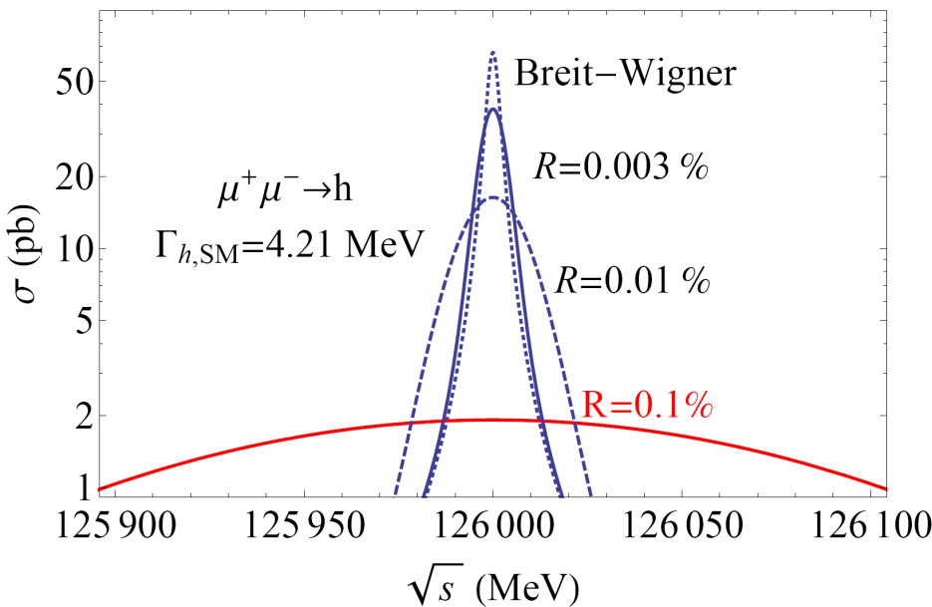
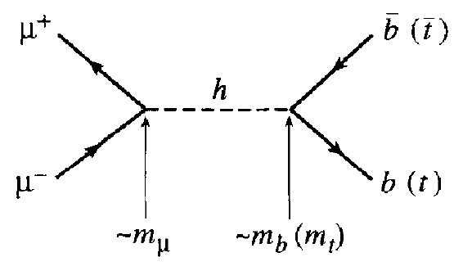
Muon Collider as a Higgs Factory
s-channel production of Higgs boson (Han and Liu)
s-channel Higgs production cross section in a muon collider is 40,000 times larger than in an e⁺e⁻ collider
Muon collider can measure the decay width Γ directly without any theoretical assumption (a unique advantage) – if the muon beam energy resolution is sufficiently high
But the required energy resolution is very demanding

Slide 67
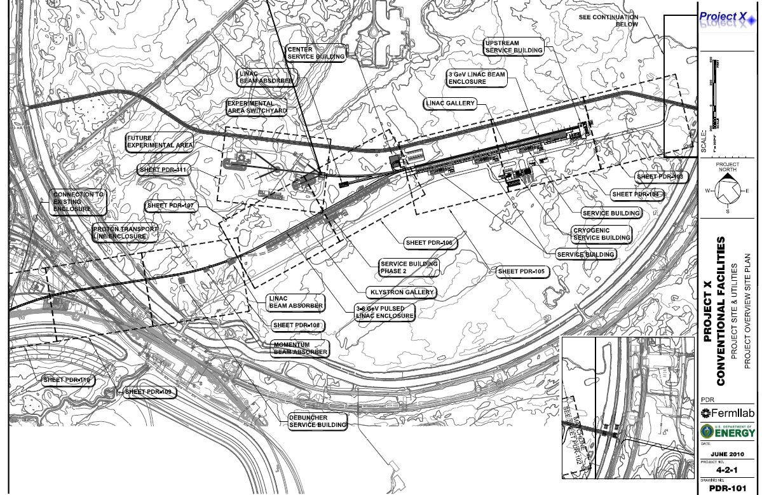
Scale of facility
Collider Ring
Proton Ring
Target +π→μ
Capture
RLA
Cooling line
Linac

Slide 68
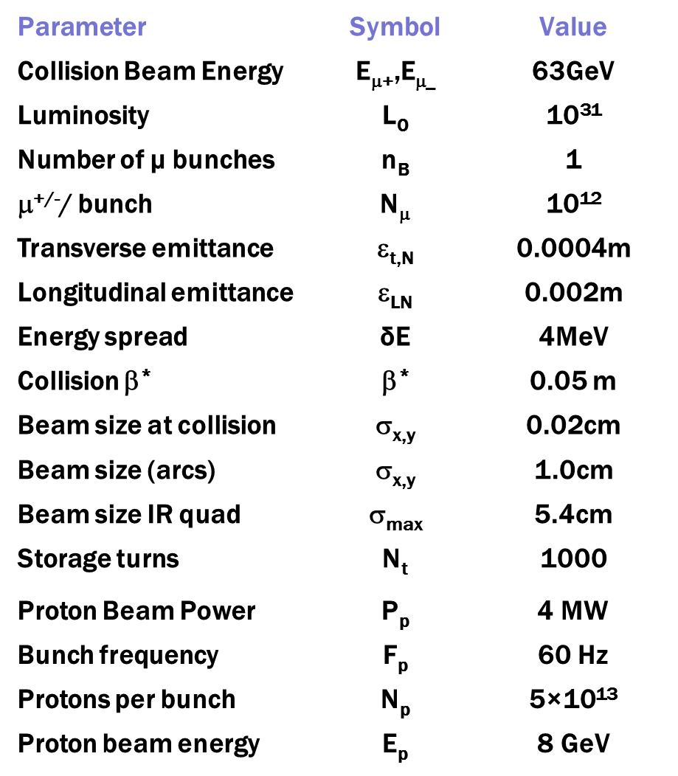
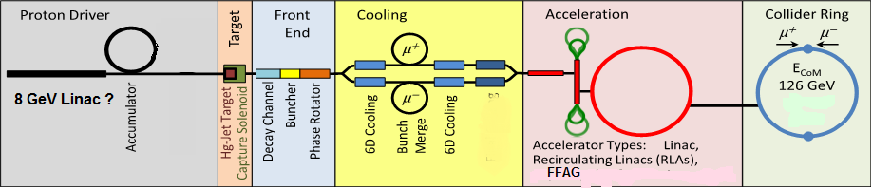
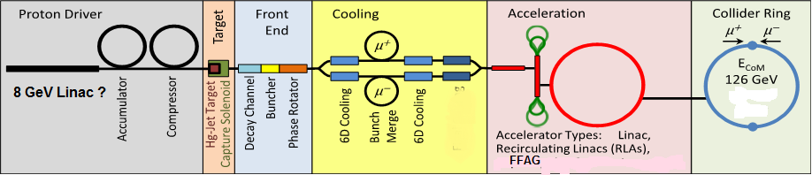
126 GeV μ⁺-μ⁻ Collider
8 GeV, 4MW Proton Source
  15 Hz, 4 bunches 5×10¹³/bunch
π→μ collection, bunching, cooling
    ε_{⊥,N} =400 π mm-mrad, ε_{‖,N}= 2 π mm
    10¹² μ/ bunch
Accelerate, Collider ring
  δE = 4 MeV, C=300m
  Detector
  monitor polarization precession
  for energy measurement
    δE_{error} → 0.1 MeV

Slide 69
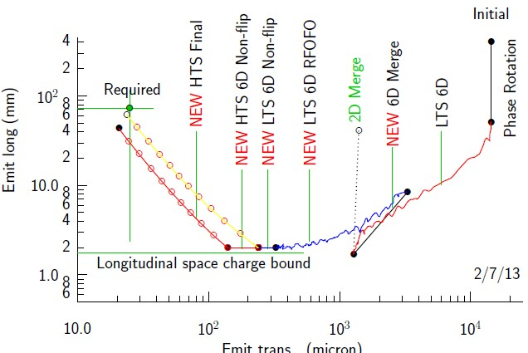
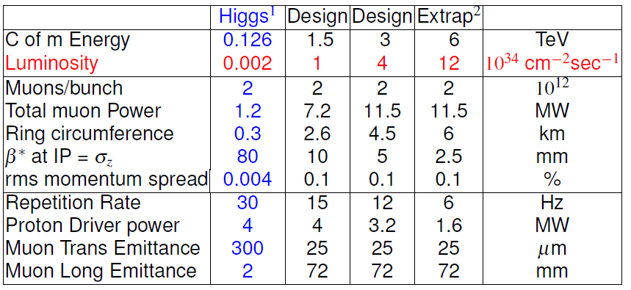
Upgrade path (E and L)
More cooling
  ε_{t,N}→ 0.0002, β*→1cm
Bunch recombination
  60Hz → 15 ?
  L →10³²
More cooling
  low emittance
  ε_{t,N}→ 0.00003, β*→0.3cm
  L→10³³
More Protons
  4MW → 8 → ?
  15Hz
  L→10³⁴
more Acceleration
  →4 TeV or more …
  L→10³⁵

Slide 70





Polarization & Energy measurement
Raja and Tollestrup (1998) Phys. Rev. D 58 013005
Electron energy (from decay) depends on polarization
  polarization is ~25% → 10%
  Measure ω from fluctuations in electron decay energies
    10⁶ decays/m
  <E_{μ}> depends on Frequency
  Frequencies can be measured very precisely
  E, δE to 0.1 MeV or better (?)
  need only > ~5% polarization ?
$$ω=2πγ\frac{g−2}{2}=\sim 0.7∗2π$$

Slide 71


Polarization
Because the absolute value of the polarization is not relevant, and only frequencies are involved, the systematic errors are very small (~5-100 keV) on both the beam energy and energy spread.
  A. Blondel

Slide 72
γγ Collider as a Higgs Factory
Advantages:
  Allow access to CP property of the Higgs
  Lower beam energy (80 GeV per e- beam to generate 63 GeV γ beam)
  High polarization in the colliding γ beams
  No need for e+ beam
  160 GeV e- linac has a lower cost w.r.t. a 240 GeV linear e+e- collider
  Can be added on a linear e+e- collider
Challenges:
  Physics not as comprehensive as a 240 GeV e+e- collider would be.
  Background problem
  IR design
  No comprehensive study.; design study report needed.
Specific issues:
  ILC-based
    Optical cavity
  CLIC-based
    Laser can piggy-back on the Livermore LIFE fusion project. (But the project schedule is unknown.)
  Recirculating linac-based:
    Polarized low emittance e- gun

Slide 73


Two Original Papers on γγ Collider

Slide 74





γγ Collider as a Higgs Factory
γγ → h cross section
CLIC-based

Slide 75
Issues for γ γ colliders
IR related
  Beam crossing angle
  Optics in the IR region
  extraction line(e) and beam dump (γ)
Lasers
(T. Takahashi)

Slide 76
ILC-based γγ Collider
1 ps
370 ns
980 μs (2640 pulses in a train)
200 ms (5 Hz)
Laser Requirements
Pulse width | Pulse energy | Pulse spacing | No. pulses in a train | Laser power in a train | Laser average power | Rep rate | Wavelength | Spot size | Crossing angle
1 ps | 10 J /Q | 370 ns | 2640 | 25 MW /Q | 150 kW /Q | 5 Hz | 1 μm | 120 nm x 2.3 nm | 25 mrad
Need an optical cavity with Q ~ 300

Slide 77


Pulse Stacking Cavity for ILC
total length ~100m
power enhancement ~100
L =nλ
ｄL<< λ/enhancement
mode locked pulsed laser
100MHz 0.1J/pulse
K. Moeing

Slide 78

Urakawa
The mirror of two mirror cavity had the surface damage around 2 to 6mJ/pulse.
Notes:
1mJ 15GW/cm^2

Slide 79
CLIC-based γγ Collider
1 ps
0.5 ns
177 ns (354 pulses in a train)
20 ms (50 Hz)
Laser Requirements
Pulse width | Pulse energy | Pulse spacing | No. pulses in a train | Laser power in a train | Laser average power | Rep rate | Wavelength | Spot size | Crossing angle
1 ps | 5 J | 0.5 ns | 354 (5 x 354 = 1770 J per train) | 10 GW | 88.5 kW | 50 Hz | 1 μm | 120 nm x 2.3 nm | 25 mrad
Livermore LIFE fusion project laser beam: 130 kW average power, 8100 J /pulse, 16 Hz
(LIFE would have 384 such beams)

Slide 80


Slide 81

LIFE Laser for a CLIC-based γγ Collider (A. Bayramain)

Slide 82

SAPPHiRE: a Small γγ Higgs Factory
scale ~ European XFEL,
about 10-20k Higgs per year
SAPPHiRE: Small Accelerator for Photon-Photon Higgs production using Recirculating Electrons

Slide 83
SLC-ILC-Style (SILC) Higgs Factor (T. Raubenheimer)
Some challenges with 2-pass design!
45 GeV, 1.5 km
or 85 GeV, 3 km
250 m
1 km radius
Final focii ~ 300 meters in length
Laser beam from fiber laser or FEL
Upgrade with plasma afterburners (what cms energy is possible?)

Slide 84
What’s Next?
The Organizing Committee will write a workshop report:
  Higgs physics: What the LHC can do? What a Higgs factory can do for given energy and luminosity (e+e-, μ+μ-, γγ)?
  Performance, technology maturity and readiness, upgrade potential, and technical challenges requiring further R&D for each type of Higgs factory
  Comparison tables
  An Executive Summary
Target readers:
  Joint ICFA – Lab Directors meeting (February 21-22, 2013 at TRIUMF)
  US Snowmass 2013 conference (July 29 – August 6, 2013 at Univ. of Minnesota)
  European Strategy Updates meeting (January 21-22, 2013)
  HEP roadmap study in Asia (Japan and China)
  World HEP and accelerator communities (report to be published in the ICFA Beam Dynamics Newsletter no. 60, April 2013)
Target date for completing the report:
  January 15, 2013
The organizing committee recommends these studies should continue. It also believes this workshop provides a good platform for the international community to get together for discussions of a future Higgs factory and should also continue. The next workshop will be about one year from now. The place and dates are yet to be decided. Stay tuned!

Slide 85
Questions?

