Slide 1
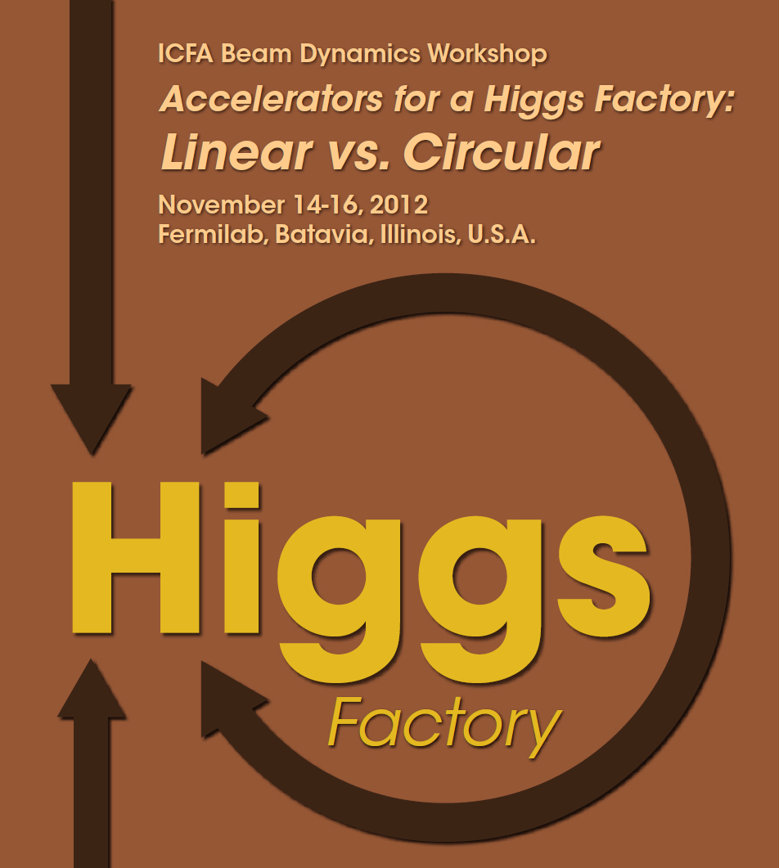
Higgs Factory Workshop
Fermilab, 14-16 2012
Experimental summary
Alain Blondel

Slide 2
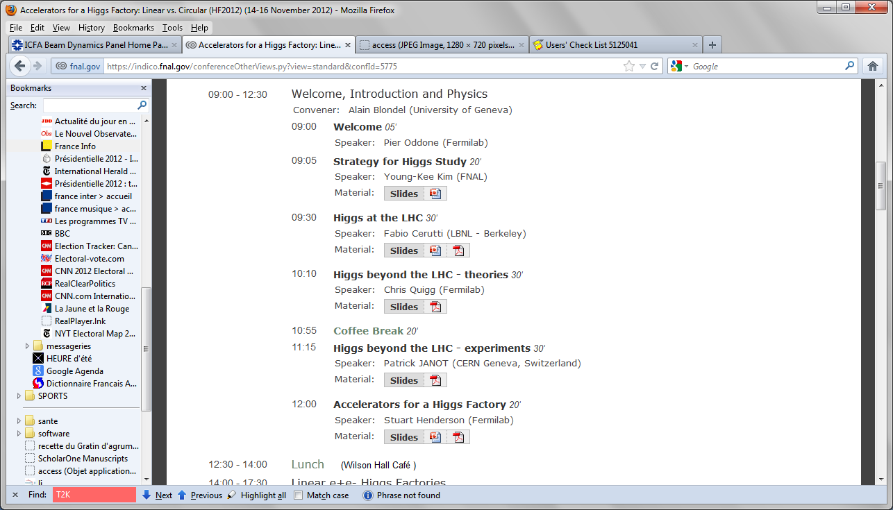
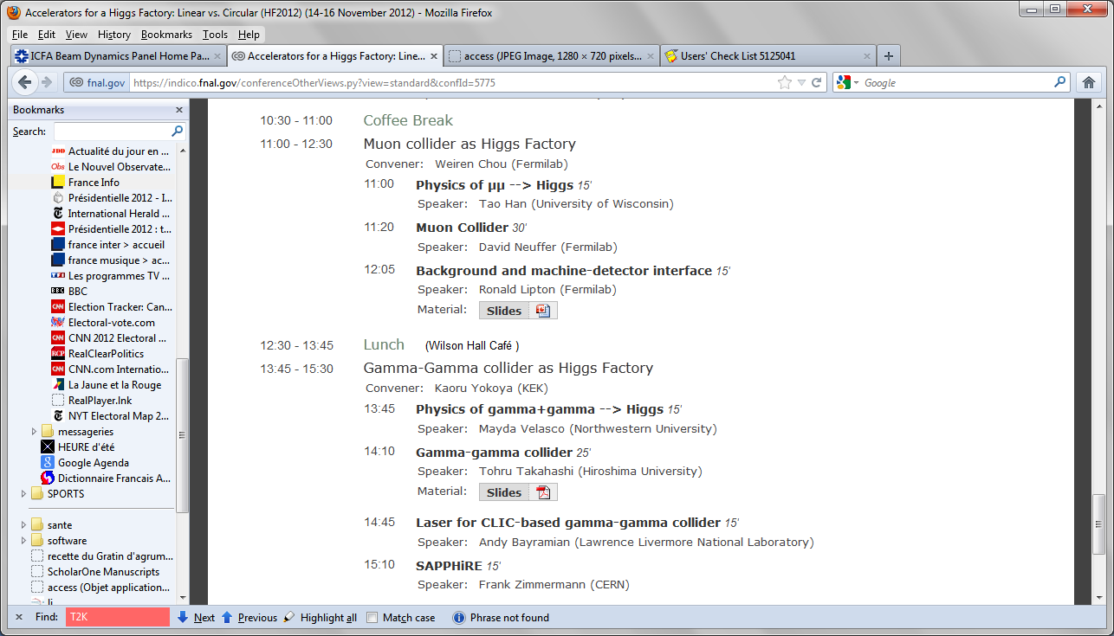
Physics session
Warnings:
1. Physics was not the primary
goal of the workshop.
2. report claimed precisions
based on claimed performances
as ‘potential’
without critical evaluation of
the possible difficulties of
reaching claimed performances

Slide 3
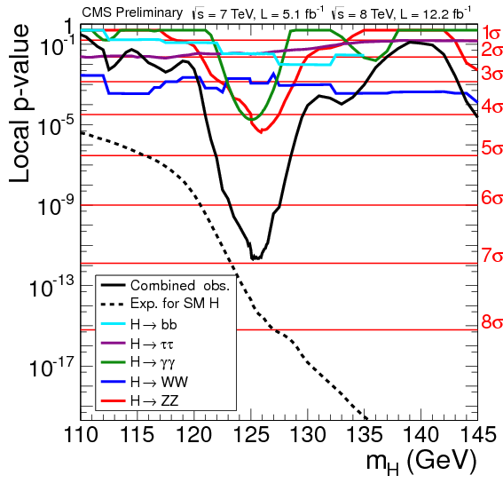
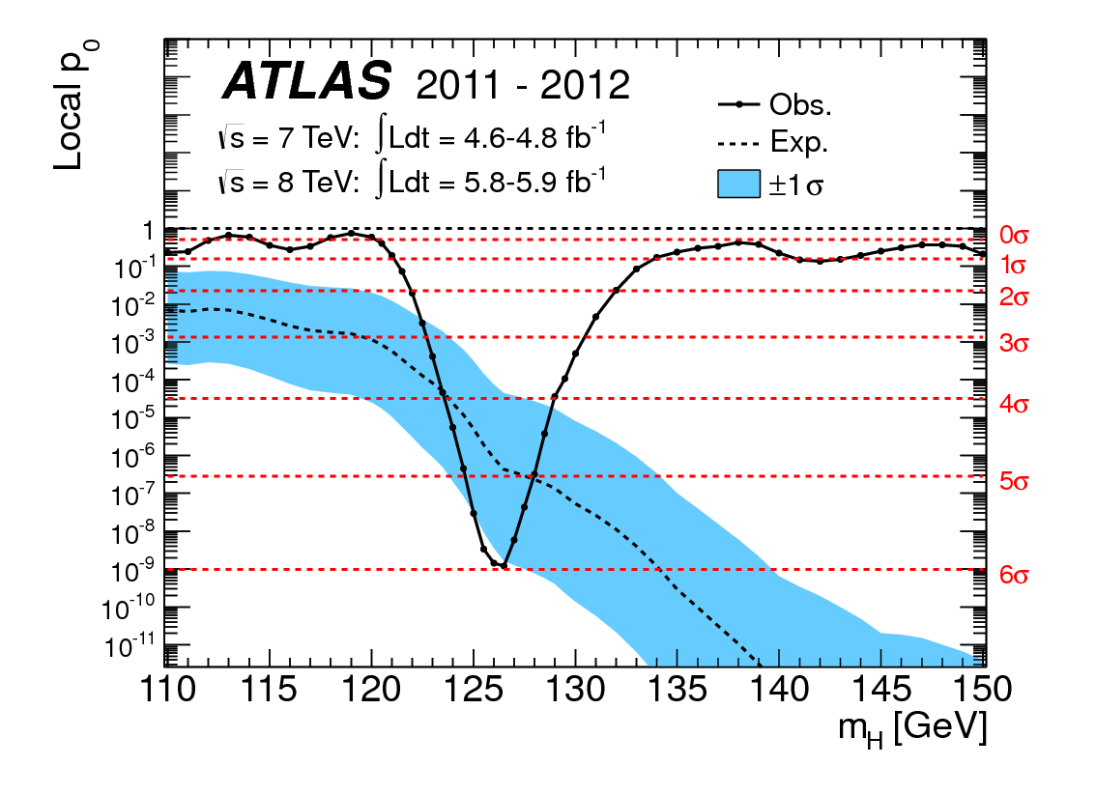
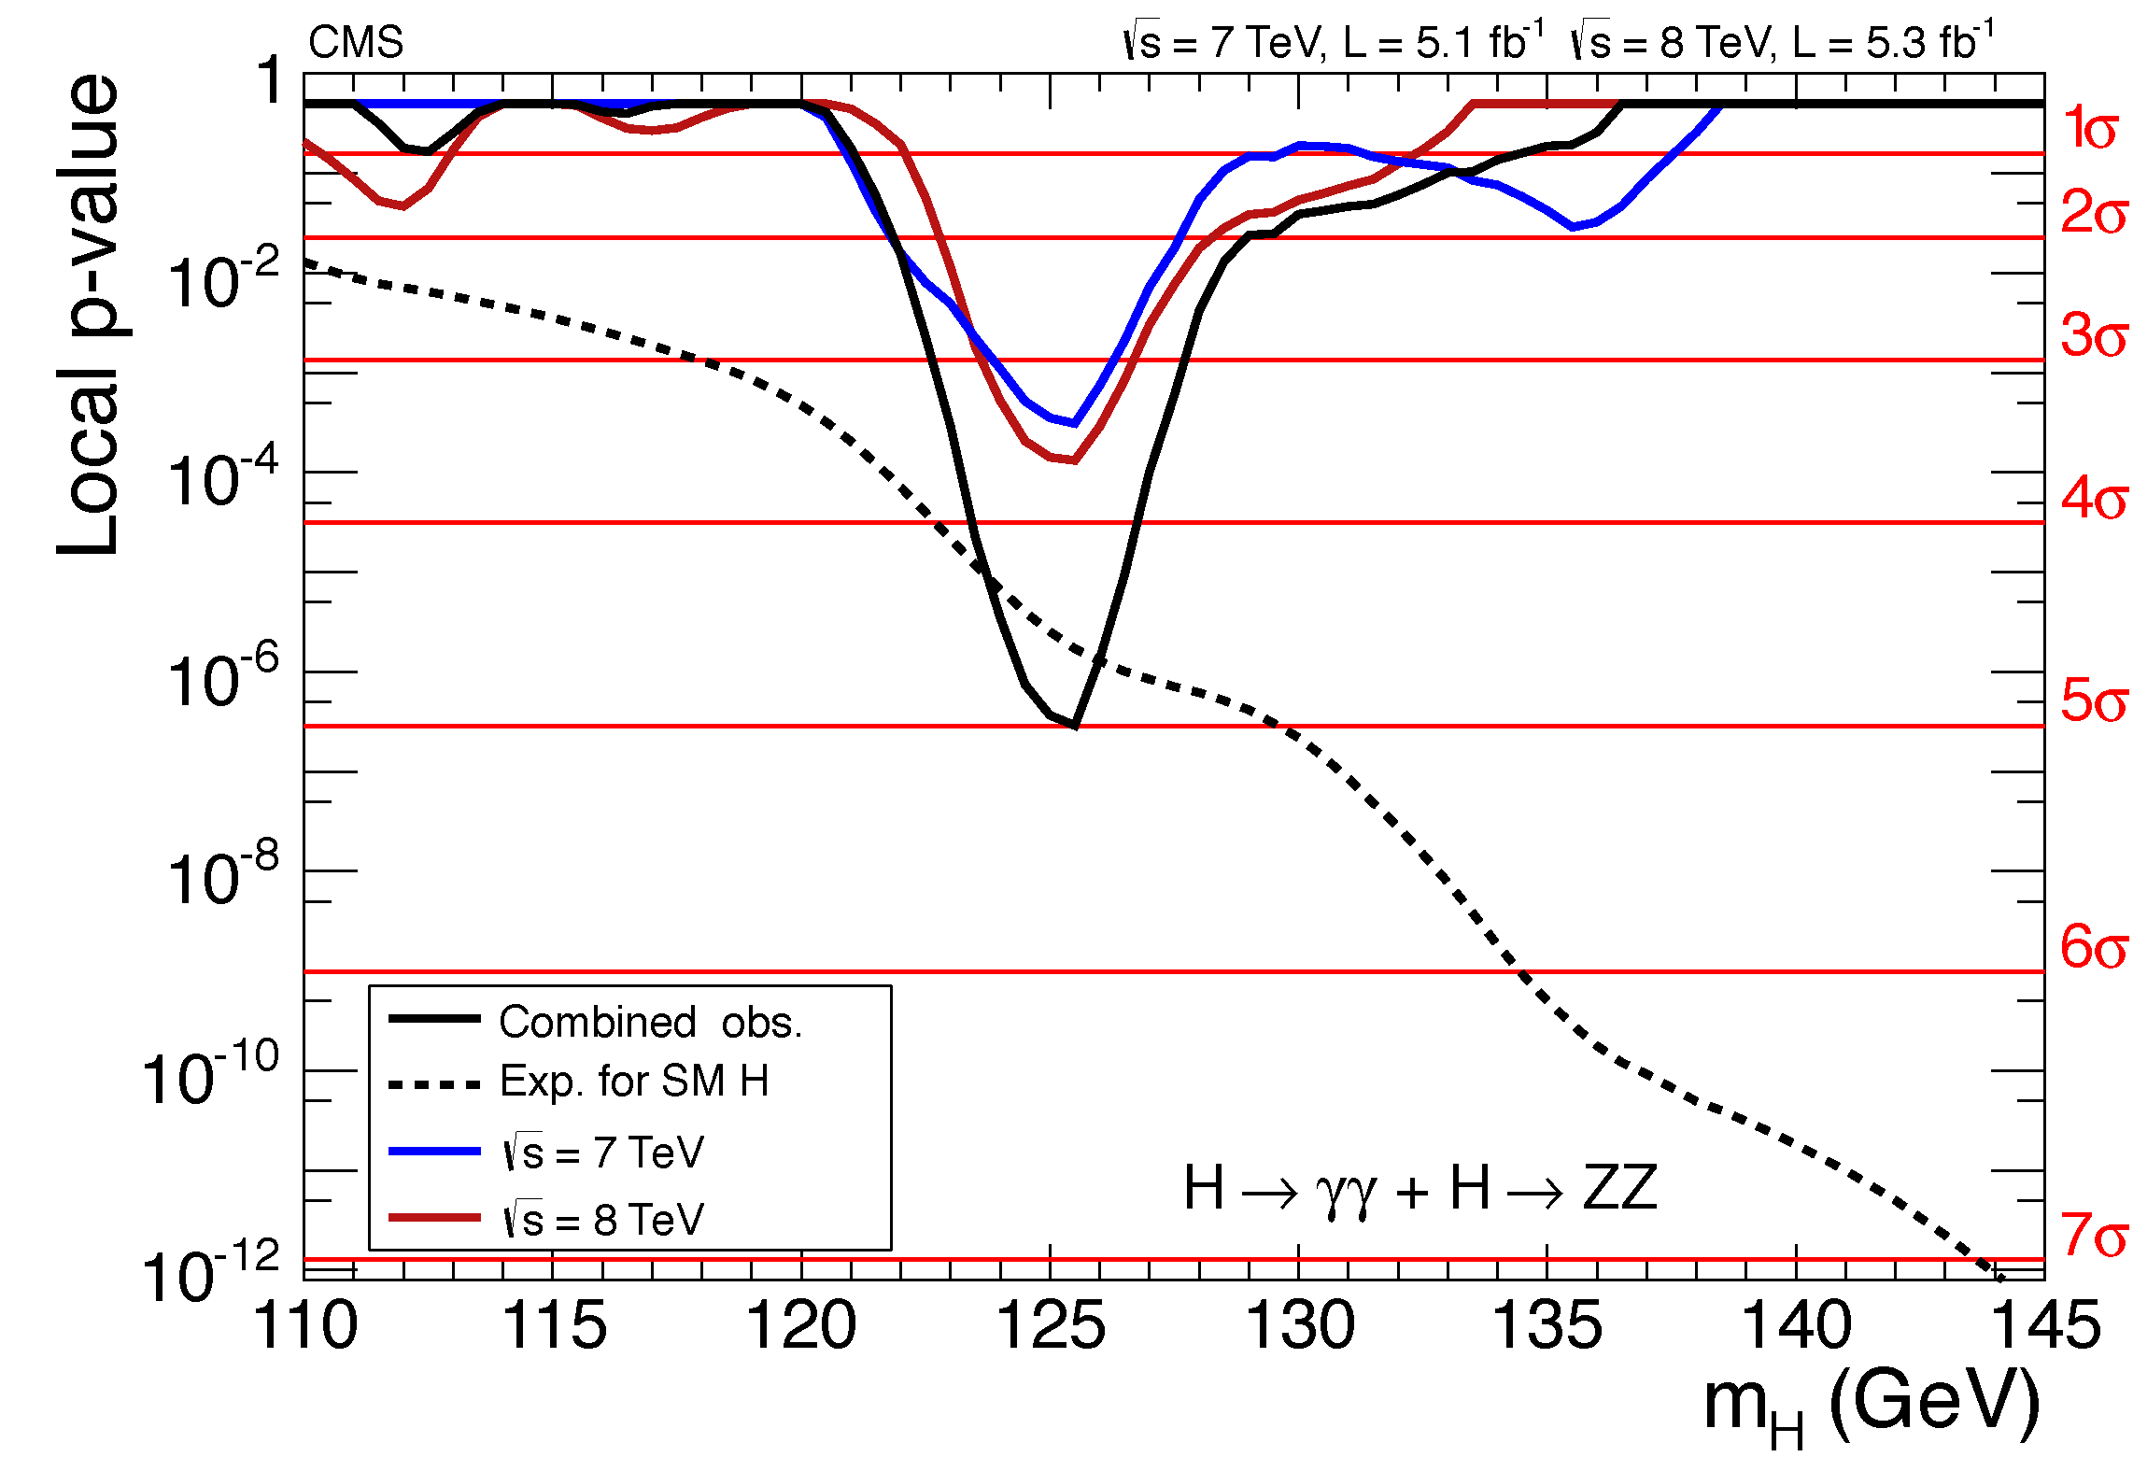
The Higgs Boson Discovery
  4th July 2012
Discovered Higgs-like Boson: Clear mass peak in γγ and ZZ*→4l
Is this the SM one ? From searches to measurements
CMS
HCP
CMS
  observed: 6.9; expected: 7.8
3

Slide 4
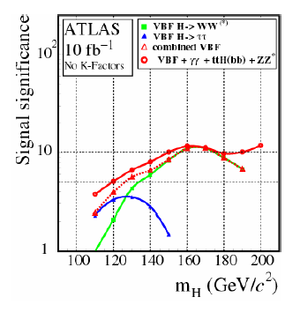
LHC has done better than projected:
here is a plot from ATLAS in 2005,
expected 3-4σ with 10fb-1 at 14TeV

Slide 5
The questions (Young-Kee-Kim):
Is this the Standard Model Higgs?
A Higgs beyond the SM?
Measure the properties of this new particle with high precision
your Banker’s question:
What precision is needed to see something interesting?

Slide 6
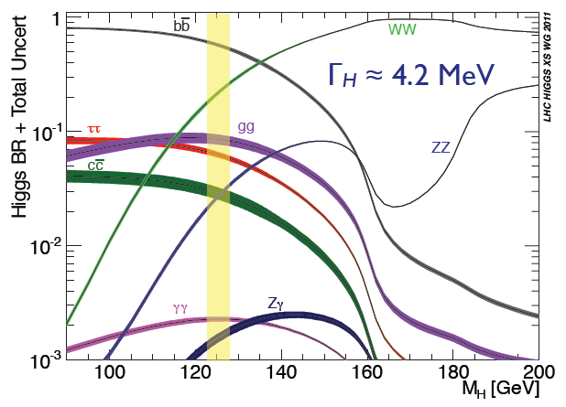
Once the Higgs boson mass is known, the Standard Model is entirely defined.
-- with the notable exception of neutrino masses, nature & mixings
***the only new physics there is***
but we expect these to be almost completely decoupled from Higgs observables. (true?)
Does H(125.9)
Fully accounts for EWSB (W, Z couplings)?
Couples to fermions?
Accounts for fermion masses?
Fermion couplings ∝ masses?
Are there others?
Quantum numbers?
SM branching fractions to gauge bosons?
Decays to new particles?
All production modes as expected?
Implications of MH ≈ 126 GeV?
Any sign of new strong dynamics?
your Banker’s question:
What precision is needed to see something interesting?

Slide 7

The theorists (Chris Quigg) answer:

Slide 8
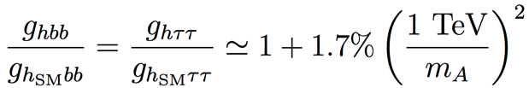
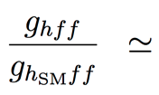
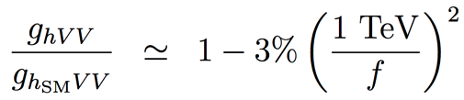
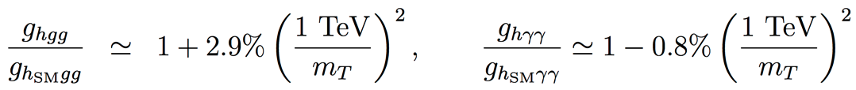
Some guidance from other theorists
New physics affects the Higgs couplings
  SUSY , for tanβ = 5
  Composite Higgs
  Top partners
  Other models may give up to 5% deviations with respect to the Standard Model
  Sensitivity to “TeV” new physics needs per-cent to sub-per-cent accuracy on couplings for 5 sigma discovery.
  LHC discovery/(or not) at 13 TeV will be crucial to understand the strategy for future collider projects
R.S. Gupta, H. Rzehak, J.D. Wells, “How well do we need to measure Higgs boson couplings?”, arXiv:1206.3560 (2012)
H. Baer et al., “Physics at the International Linear Collider”, in preparation, http://lcsim.org/papers/DBDPhysics.pdf

Slide 9
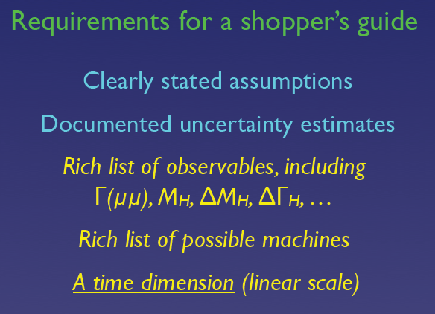
But good wisdom:
--Important measurements at any moment depend on what is already known
C. Quigg

Slide 10
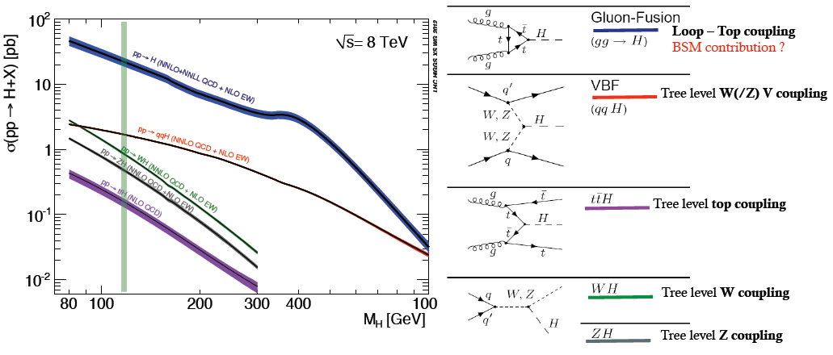
The LHC is a Higgs Factory !
1M Higgs already produced – more than most other Higgs factory projects.
15 Higgs bosons / minute – and more to come (gain factor 3 going to 13 TeV)
Difficulties: several production mechanisms to disentangle and
significant systematics in the production cross-sections σ_{prod} .
Challenge will be to reduce systematics by measuring related processes.
σ_{i→f} ^{observed} ∝ σ_{prod} (g_{Hi} )²(g_{Hf})² extract couplings to anything you can see or produce from
Γ_{H} if i=f as in WZ with H→ ZZ → absoulte normalization

Slide 11
Conclusions
Approved LHC 300 fb⁻¹ at 14 TeV:
Higgs mass at 100 MeV
Disentangle Spin 0 vs Spin 2 and main CP component in ZZ*
Coupling rel. precision/Exper.
  Z, W, b, τ 10-15%
  t, μ 3-2 σ observation
  γγ and gg 5-11%
HL-LHC 3000 fb⁻¹ at 14 TeV:
Higgs mass at 50 MeV
More precise studies of Higgs CP sector
Couplings rel. precision/Exper.
  Z, W, b, τ, t, μ 2-10%
  γγ and gg 2-5%
  H→HH >3 σ observation (2 Exper.)
Assuming sizeable reduction of theory errors
LHC experiments entered the Higgs properties measurement era: this is just the beginning !
LHC Upgrade crucial step towards precision tests of the nature of the newly-discovered boson

Slide 12
HL-LHC’s evaluation today:
LHC will measure couplings between 2-10% for Z,W, gluon, γ, b, tau, and muon
and the Higgs self-coupling to about 30%
-- Total width (and invisible width by difference with expected one)
-- CP properties
will be investigated
-- detailed line shape will not be measured
Caveat :
1. HL-LHC not approved yet
2. systematic errors will go down (how much?)
3. theory errors will reduce (how much?)
History has shown that smart people working hard usually do better
than expected (ref. W mass at Tevatron etc…)

Slide 13
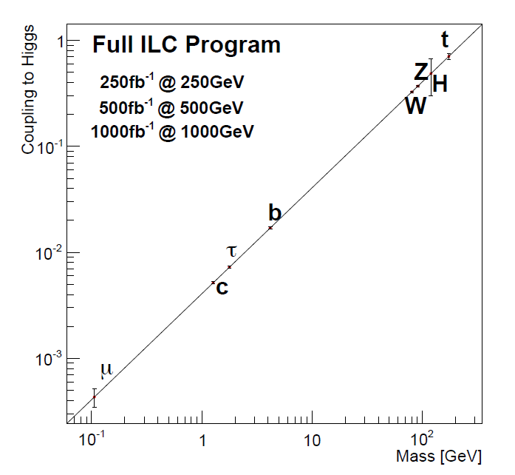
t
Full HL-LHC
H
Z
W
b
τ
μ

Slide 14
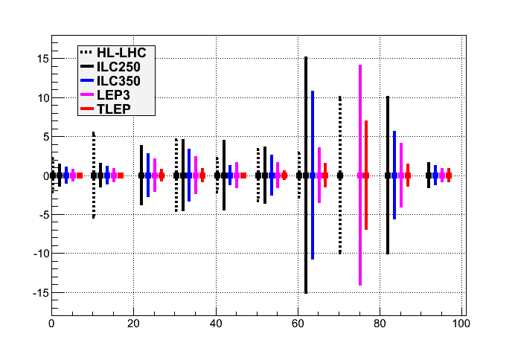
HL-LHC
?
?
?
κ_{i}
gHZ gHb gHc gHg gHW gHτ gHγ gHμ Γ_{H} Γ_{H,inv}

Slide 15
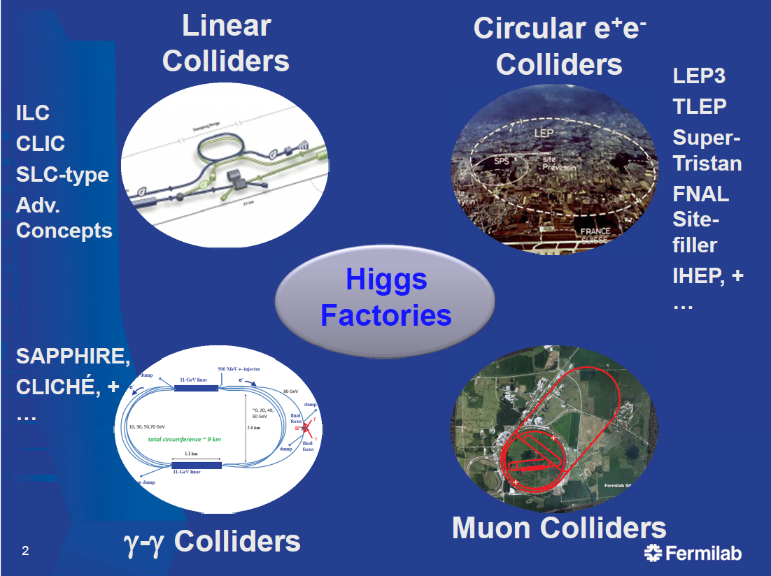
S. Henderson

Slide 16
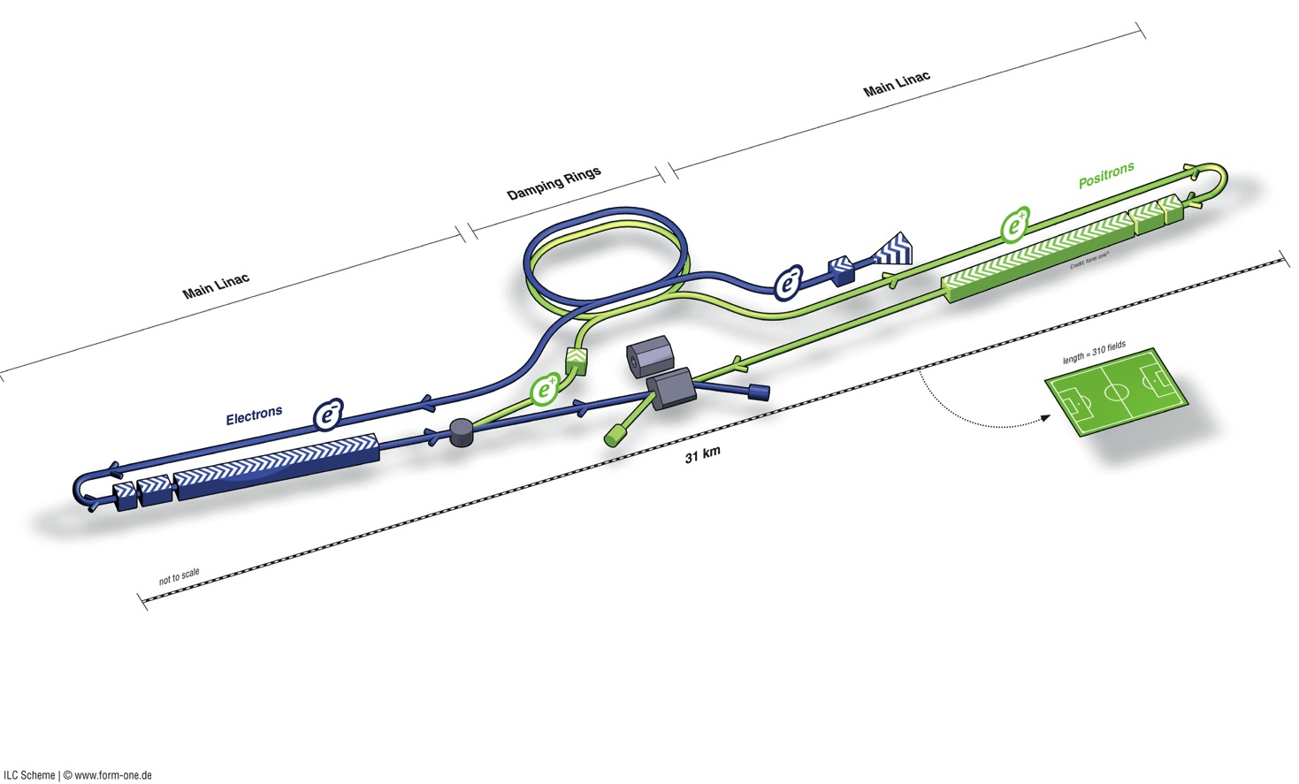
ILC in a Nutshell
Polarised electron source
Damping Rings
Ring to Main Linac (RTML)
(inc. bunch compressors)
e+ Main Linac
Beam Delivery System (BDS) & physics detectors
Polarised positron
source
Beam dump
e- Main Linac
not too scale

Slide 17
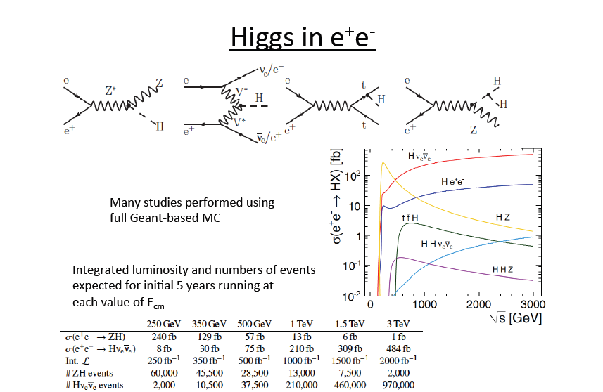
Wyatt, Cracow

Slide 18
LEP3
and TLEP
Circular e+e- colliders to study THE BOSON X(126)
as you can see a very young concept
(although there were many predecessors)

Slide 19
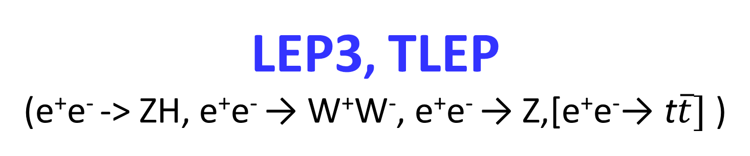
LEP3, TLEP
(e⁺e⁻ -> ZH, e⁺e⁻ → W⁺W⁻, e⁺e⁻ → Z,[e⁺e⁻→ t$\overline{t}]$ )
key parameters
 | LEP3 | TLEP
circumference | 26.7 km | 80 km
max beam energy | 120 GeV | 175 GeV
max no. of IPs | 4 | 4
luminosity at 350 GeV c.m. | - | 0.7x10³⁴ cm⁻²s⁻¹
luminosity at 240 GeV c.m. | 10³⁴ cm⁻²s⁻¹ | 5x10³⁴ cm⁻²s⁻¹
luminosity at 160 GeV c.m. | 5x10³⁴ cm⁻²s⁻¹ | 2.5x10³⁵ cm⁻²s⁻¹
luminosity at 90 GeV c.m. | 2x10³⁵ cm⁻²s⁻¹ | 10³⁶ cm⁻²s⁻¹
at the Z pole repeating LEP physics programme in a few minutes…

Slide 20
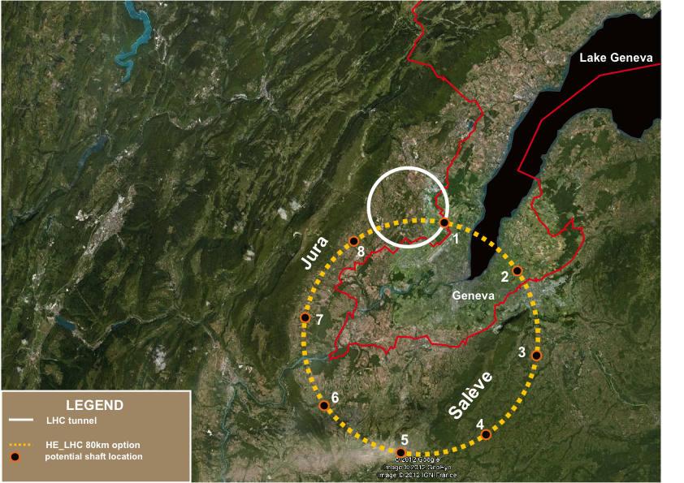
prefeasibility assessment for an 80km project at CERN
John Osborne and Caroline Waiijer ESPP contr. 165

Slide 21
The main point of the workshop was to understand whether
the performance of circular machines could be as high as advertised,
because they offer a potentially better luminosity/cost ratio
than the linear ones and the possibility to have several Ips.
There is lots of experience with e+e- storage ring colliders.
The high energy ones considered here involve very small β*
-- leading to strong beamstrahlung that requires large momentum
acceptance 4% for LEP3, 3% for TLEP that requires
1) extra RF
2) special design of the optics which has not been demonstrated
and very large synchrotron radiation
-- what is the wall to beam power transmission efficiency?
-- detail beam pipe design is challenging.
There was no obvious show stopper found but a rather long to-do list!
In the following I assume that the performance could be achieved

Slide 22
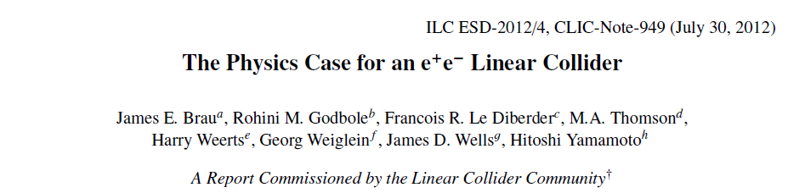
Latest reference:
The Higgs at a Linear e+e- Collider has been studied for many years
Community is large and well organized
At a given Ecm and Luminosity, the physics has marginally
to do with the fact that the collider is linear
--specifics: -+- e- polarization is easy at the source, (not critical for Higgs)
-- EM backgrounds from beam disruption
-- one IP
see later for precision on Higgs boson couplings and self couplings

Slide 23
Higgs production mechanism
Assuming that the Higgs is light, in an e⁺e– machine it is produced by the “higgstrahlung” process close to threshold
Production xsection has a maximum at near threshold ~200 fb
10³⁴/cm²/s ➔ 20’000 HZ events per year.
e⁻
H
Z – tagging
by missing mass
Z*
e⁺
Z
For a Higgs of 125GeV, a centre of mass energy of 240GeV is sufficient
➔ kinematical constraint near threshold for high precision in mass, width, selection purity

Slide 24
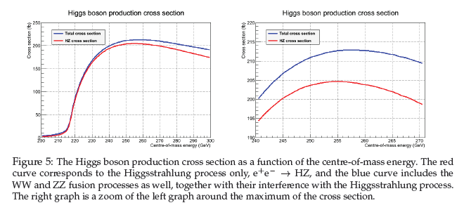
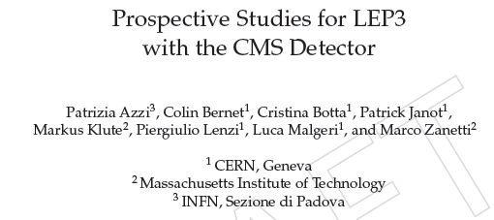
best for tagged ZH physics:
Ecm= m_{H}+111±10
W. Lohmann et al LCWS/ILC2007
take 240 GeV.

Slide 25
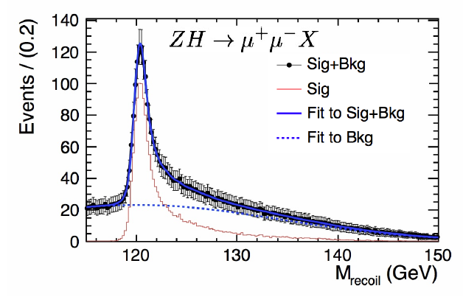
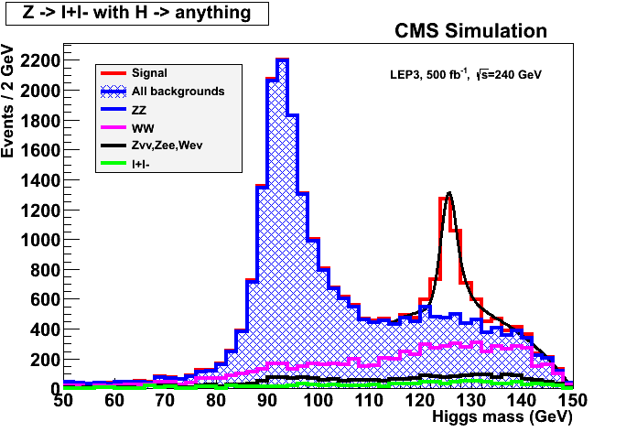
ILC
Z – tagging
by missing mass
total rate ∝ g_{HZZ}²
ZZZ final state ∝ g_{HZZ}⁴/ Γ_{H}
➔ measure total width Γ_{H}
empty recoil = invisible width
‘funny recoil’ = exotic Higgs decay
easy control below theshold
e⁻
H
Z*
e⁺
Z

Slide 26
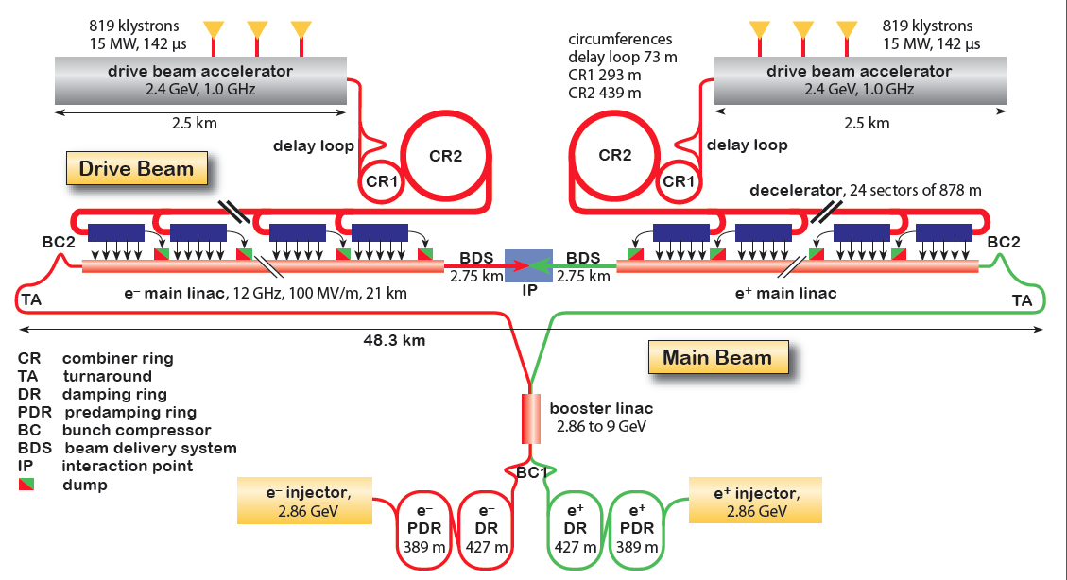
CLIC Layout at 3 TeV
Goal: Lepton energy frontier
Drive Beam Generation Complex
Drive beam time structure - initial
Drive beam time structure - final
240 ns
240 ns
5.8 μs
140 μs train length - 24 × 24 sub-pulses
4.2 A - 2.4 GeV – 60 cm between bunches
Main Beam Generation Complex
24 pulses – 101 A – 2.5 cm between bunches

Slide 27
Higgs Physics with high-energy e⁺e⁻ colliders
  1. Similar precisions to the 250/350 GeV Higgs factory for W,Z,b,g,tau,charm, gamma and total and invisible width
  2. ttH coupling possible with similar precision as HL-LHC (8%)
  3. Higgs self coupling also very difficult… precision 20-30% similar to
  HL-LHC
  I have to conclude that on the basis of the study of H(126) alone is concerned, the high energy e+e- collider is not compelling
  (NB. CLIC can work at 250 GeV onwards
  – can it be brought down to Z pole?)

Slide 28
gHZ gHb gHc gHg gHW gHτ gHγ gHμ Γ_{H} Γ_{H,inv}

Slide 29

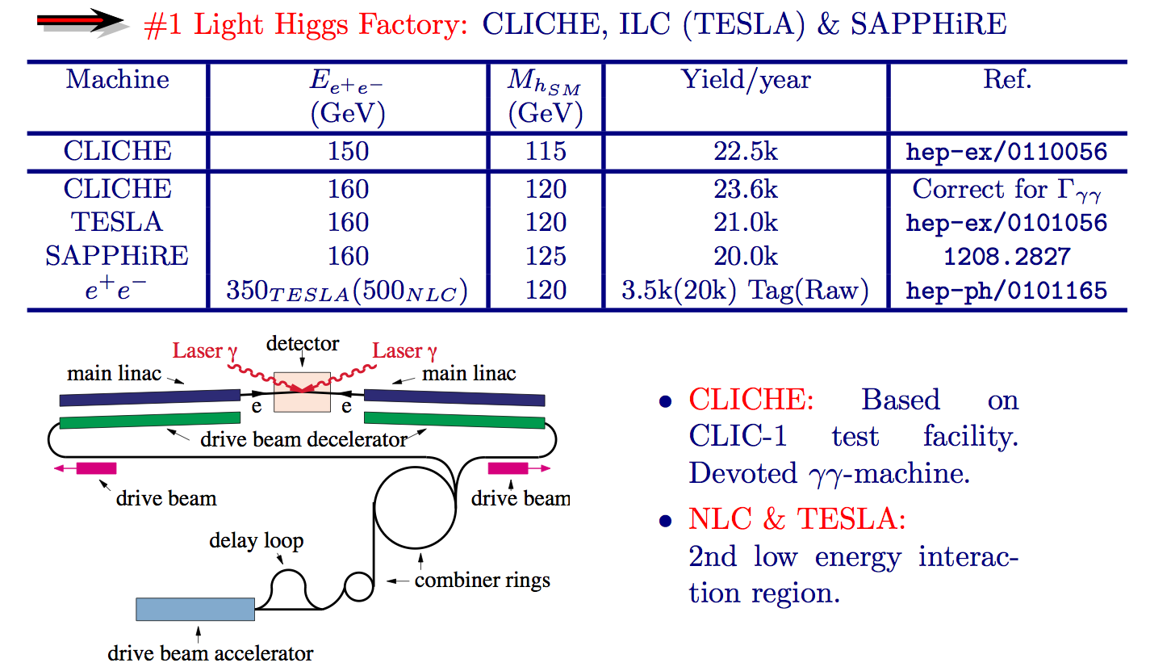
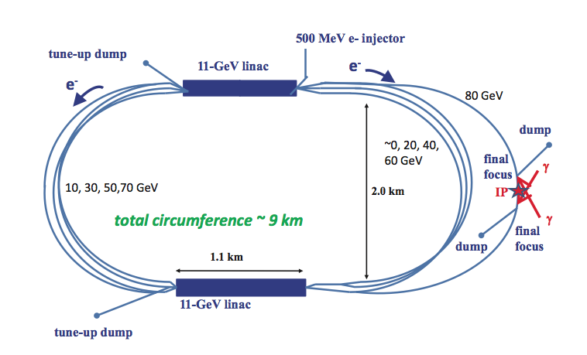

Slide 30
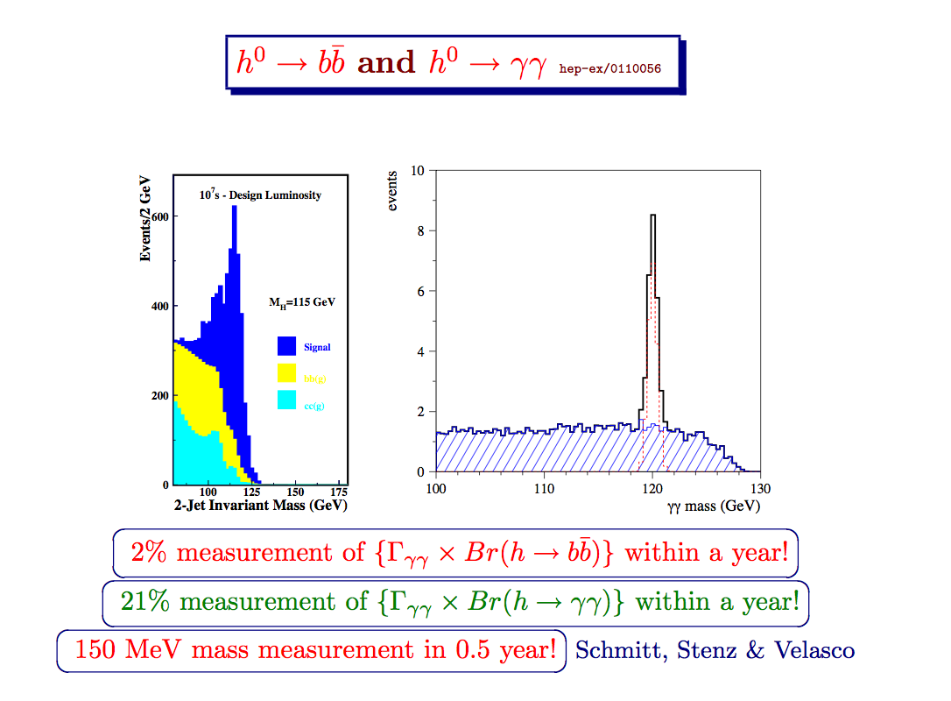

Slide 31
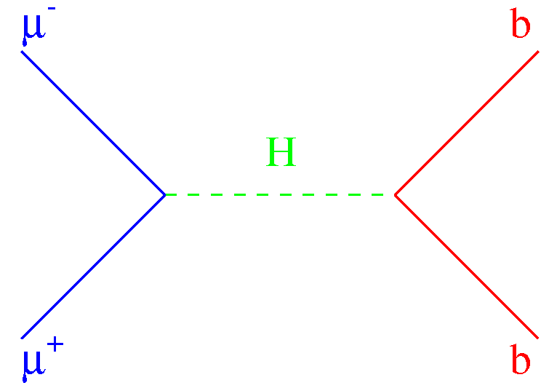
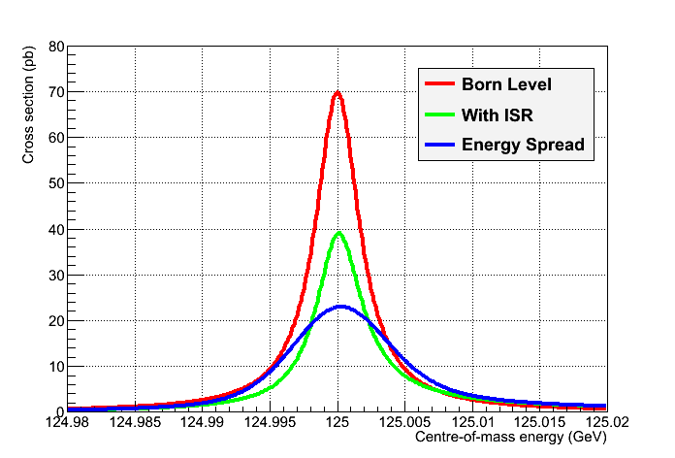
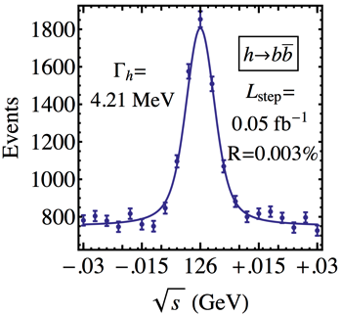
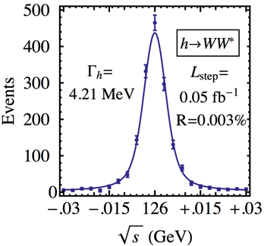
μ⁺μ⁻ Collider vs e⁺e⁻ Collider ?
A μ⁺μ⁻ collider can do things that an e⁺e⁻ collider cannot do
  Direct coupling to H expected to be larger by a factor m_{μ}/m_{e}
    ,jh [σ_{peak} = 70 pb at tree level]
  Beam energy spread δE/E may be reduced to 3×10⁻⁵
    6D Cooling, no beamstrahlung, ~no bremsstrahlung
    For δE/E = 0.003% (δE ~ 3.6 MeV, Γ_{H} ~ 4 MeV)
      Corresponding luminosity ~ 10³¹ cm⁻²s⁻¹
        Expect 2300 Higgs events in 100 pb⁻¹/ year
  Polarization, beam energy and energy spectrum
    Can be measured with an exquisite precision
      From the electrons of the muon decays
  Then measure the lineshape of the Higgs at √s ~ m_{H}
    Five-point scan, 50 + 100 + 200 + 100 + 50 pb⁻¹
      Precision from H→bb and WW :
[16,17]
, W, …
σ (pb)
_{, W, …}
√s
σ(m_{H}), TLEP
m_{H} | σ_{Peak} | Γ_{H}
0.1 MeV | 0.6 pb | 0.2 MeV
10⁻⁶ | 2.5% | 5%

Slide 32
Conclusions
-- The newly discover H(126) candidate is a fascinating particle of a new nature (elementary scalar!) that deserves detailed measurements
-- there is much more to understand about Higgs physics measurments
and their potential to test physics beyond the SM. This should be discussed in a dedicated and detailed Higgs Physics workshop.
-- The LHC will already be an impressive Higgs factory. This must be taken into account in any future machine discussion!
-- Still, a measurement of the Higgs invisible width, search for exotic decays, and improvement of the fermions, W, Z couplings wrt LHC by factors 2-5 can be achieved at the well-studied linear collider.

Slide 33
Extension possibilities
1. LEP3 (C=27km) is limited to the ZH threshold and luminosity 10³⁴
TLEP (C=80km) can reach 350 km. The luminosity of 5 10³⁴
can be reached at ZH, 0.7 10³⁴ at top threshold.
all can accept up to 4 collision points.
Much progress has been brought about by the experience of LEP2
B factories and Synchrotron light sources.
400-500 GeV is the end limit to circular machines.
2. linear machines can be upgraded to energies up to ~3 TeV
3. a 80km circular e+e- collider could be upgraded to O(100 TeV) pp collider
4. A muon collider remains the most promising option for the very high
energy exploration with point-like particles.

Slide 34
Conclusions(2)
In combination with HL-LHC the physics coverage of e+e- machines
is quite complete.
A γγ collider is a good add-on to linear collider
--one should discuss carefully what can be done at γγ collider
that cannot be done between LHC and e+e- collider
--the claim of uniqueness is 2% resolution on Γγγ ; very interesting
A study dedicated to the understanding of the feasibility of the machine
and of the specificity of the measurements would be worthwhile
A muon collider could do everyting an e+e- could do if same luminosity
can be reached.
--If an energy resolution of 0.003% can be achieved (4D and 6D cooling!)
s-channel Higgs production allows superb measurements of the
H(126) line shape and ‘fine structure’ exploration
-- A muon collider is completely unique to study the H/A system of
a Higgs doublet model
-- it remains the best way to reach >3 TeV energy collisions between
point like particles.

Slide 35
Conclusions(3)
-- The main point of the workshop was to understand whether the performance of circular machines could be as high as advertised, because they offer a potentially better luminosity/cost ratio than the linear ones and the possibility to have several IPs.
The answer is ‘maybe’ but there is a some work to do to establish this. This calls for a conceptual design study of circular e+e- HF.
-- if the luminosities advertised can be reached, the resolutions
on several Higgs couplings can be improved from a few % to below percent precisions, opening the possibility of discovery of TeV scale new physics.
-- The possibility to revisit the Z pole and the W threshold is
very exciting: this can be done at both circular and linear machines with some differences regarding energy calibration or polarization.
-- the time structure is very different between linear (pulsed) and circular (CW) which has impact on the detector design. (The ILC detectors would not work on the rings)

Slide 36
Higgs boson production at LHC
8 TeV
M_{H}(125 GeV) | σ(fb) | δ(th)_{TOT} | δ(th)_{QCD-Scale} | δ(th)_{PDF+αs} | δσ/δM(.5GeV)
ggH | 19.5 x 10³ | 15% | 8% | 7% | 0.8%
VBF | 1.58 x 10³ | 3% | 0.2% | 3% | 0.4%
WH | 697 | 4% | 0.5% | 4% | 1.3%
ZH | 394 | 5% | 1.5% | 4% | 1.3%
ttH | 130 | 14% | 7% | 8% | 1.9%
Theory systematics more relevant for ggH and ttH - Mass dependency very weak

Slide 37
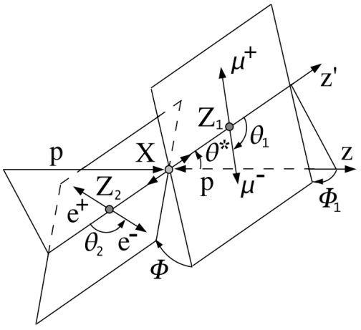
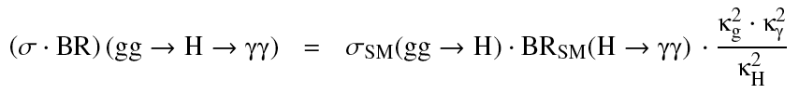
--Important measurements at any moment depend on what is already known
What are the expected precisions from HL-LHC?
-- mass (125.9±0.4 GeV/c²) (my average)
-- spin parity (0+ preferred at 2.45σ -- CMS) →
Couplings :
-- H-Z and H-W (κ_{V} to ~20%)
-- H-t,b,c (κ_{f} to ~20%)
-- H-τ, μ
-- H-invisible (dark matter candidates)
-- H-exotic
-- H-gluon, H-γ (20-30%)
-- H self coupling
-- CP violation
-- detailed line shape (more than one peak etc…)
green = today
black = HL-LHC
red = no claim to
be possible
κ_{i} = g_{i}^{meas}/ g_{i}SM

Slide 38
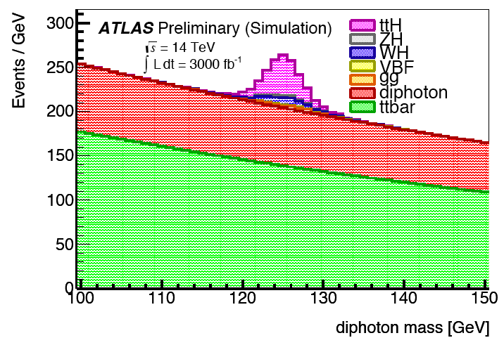
Couplings at HL-LHC: ATLAS
MC Samples at 14 TeV from Fast-Sim.
  Truth with smearing: best estimate of physics objects dependency on pile-up
  Validated with full-sim. up to μ~70
Analyses included in ATLAS study:
  H→ γγ 0-jet and VBF
  H → ττ VBF lep-lep and lep-had
  H → ZZ → 4l
  H→ WW → lνlν 0-jet and VBF
  WH/ZH → γγ
  ttH → γγ (ttH → μμ) Direct top Y coupling
  H → μμ Second generation fermion coupling
  HH→ bb γγ Higgs Self-Couplings
ttH → γγ
Very Robust channel
Good S/B
Statistically limited

