Slide 1
Muon Collider Higgs Factory Physics and Detector Studies
R. Lipton, Fermilab
A Muon Collider is uniquely capable of producing Higgs bosons in the s channel with beam energy resolution comparable to it’s width
(m_{μ}/m_{e})² = ~40,000
Γ(H)~4.2 MeV
ΔE(beam) ~ few MeV
Beam energy resolution could be comparable to the Higgs width
  Direct measurement of width
  Precise mass measurement
e⁺e⁻ machines can measure the width indirectly
This talk will concentrate on the physics environment and beam background issues
Context - Muon collider Higgs factory as a step on a path to a multi-TeV energy frontier lepton collider.

Slide 2
Rates
Cross section
At scan point
Overall rates
Luminosity estimates are in the
10³¹-10³² range
If we fold a 4.2 MeV Breit-
Wigner with a 2.5 MeV
Gaussian beam we get a on-peak
cross section of ~46 pb
This gives us between 3,000 (5 MeV, 10³¹) and 46,000 (2.5 MeV, 10³²) Higgs/year
The physics we can do depends strongly on machine parameters

Slide 3
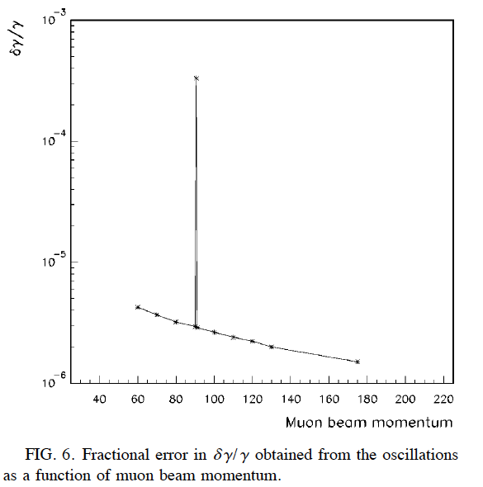
Machine Environment
Raja, Tollestrup
PHYSICAL REVIEW D 58 013005
Narrow beam energy spread
  Precision scan
  Kinematic constraints
∼300 meter circumference
  ΔT_{bunch} ~ 500 ns
1000 turns (~0.8 ms)/store
Polarization, (g-2)/2 provide precise beam energy measurement
2x10⁻⁶

Slide 4
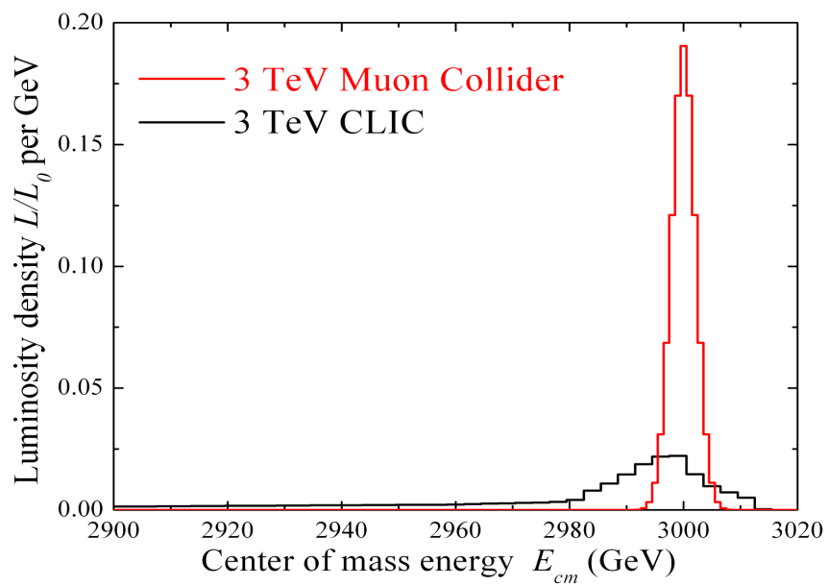
Physics Environment
Physics environment compared to ILC:
lower beamstrahlung
  more precise beam constraints – e⁺e⁻/μ⁺μ⁻ difference for higher energy machines
Intense muon beam decay backgrounds
  Challenging detector
lower polarization ~10-20%
central 10 degrees obscured by tungsten absorber designed to limit detector backgrounds
Higgs/SM Cross Section ~ 0.12
Beamstrahlung in
any e+e- collider
δE/E ∝ γ²

Slide 5
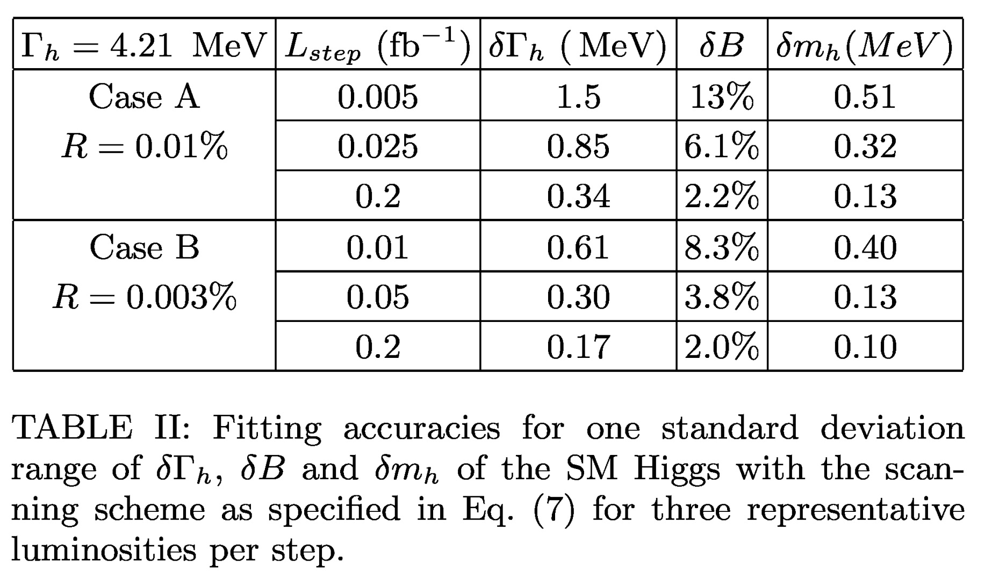
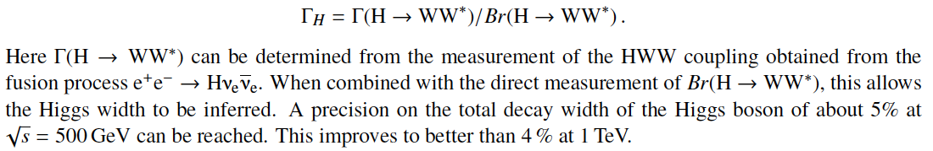
Width Fitting Results (Han and Liu)
Int. Lum fb⁻¹
.1
.5
4
.2
1
4
ILC ~ 5 MeV
ILC ~ 50 MeV
ILC Expectations (Archive 1210.0202)

Slide 6
Further Work
The Han and Liu results provide an nice framework for future studies – the essential elements are there but we need to access the reach with realistic detector and background simulation
What is the b-tag efficiency with background?
What are the dominant backgrounds to WW*?
  Han and Liu assume unit efficiency and no γ/Z* background
  What calorimetery is needed for the WW*->4-jet mode?
How does adding background affect the studies?

Slide 7
For Experimenters - It’s All About the Background
Experiments at the Muon Collider will endure very harsh background environments. The first order of business in evaluating physics capabilities is to understand and simulate the machine backgrounds.
Muon beam decays: For 62.5-GeV muon beam of 2x10¹², 5x10⁶ dec/m per bunch crossing
Beam halo: Beam loss at limiting apertures; severe, can be taken care of by an appropriate collimation system far upstream of IP.
No detailed simulation yet. Decays/meter ~ 23 x 3 TeV muon collider, but showers are also much softer, shielding easier…
For now we use the 1.5 TeV simulation as a baseline

Slide 8
Detector Simulation
Initial work based on ILCROOT – moving to LCSIM
Both full and fast simulation available
  Mars backgrounds incorporated into full simulation
  A variety of detector options can be explored
MARS particles handed off to LCSIM at detector boundries
Background only studies
  Full event simulation
    Use timing to cut off tracing of “late” particles
    Study parameterization of backgrounds
    Build background library
  Background characteristics
    Time and energy distributions

Slide 9
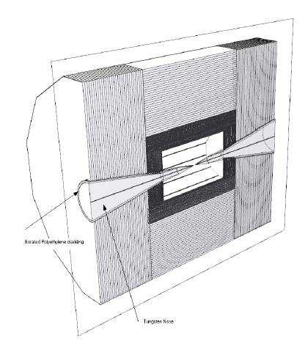
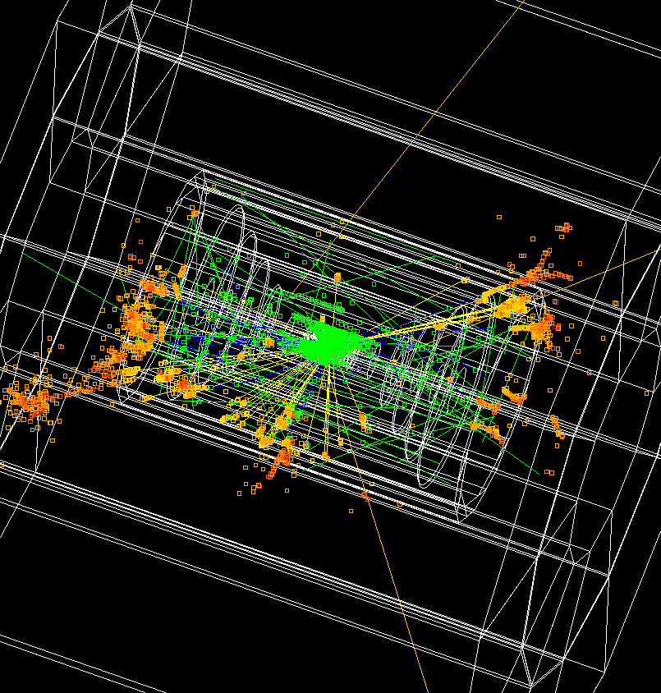
Detector Models based on ILC concepts (SiD, ILD, 4Th)
LCSIM Detector Model
Full Simulation

Slide 10
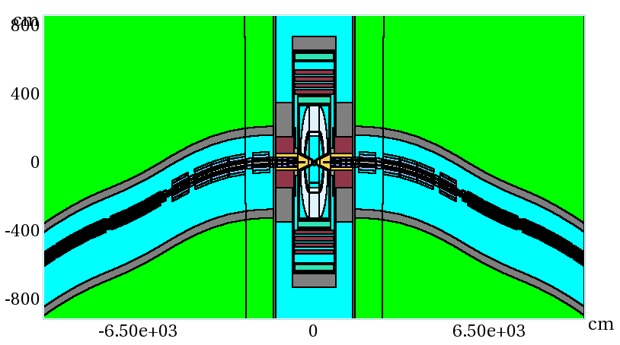
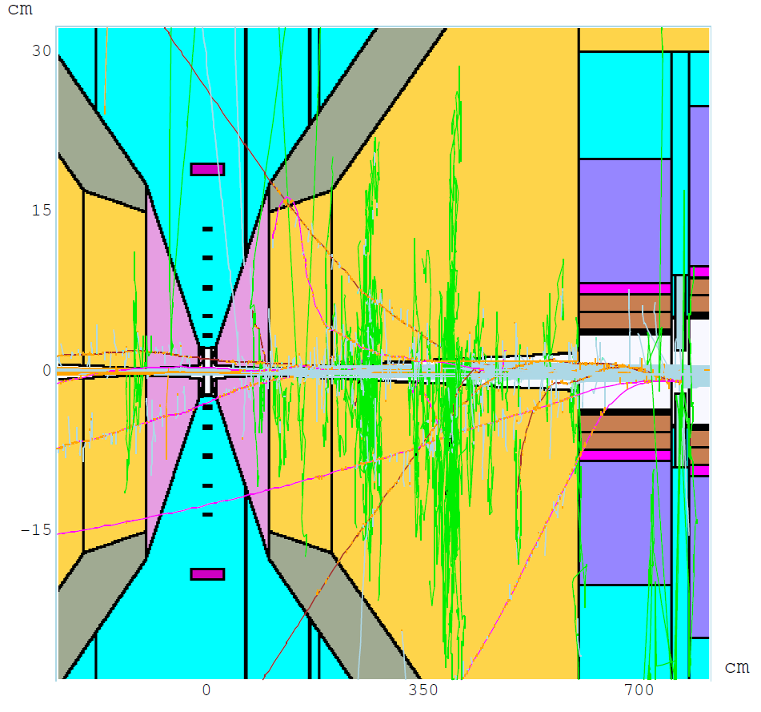
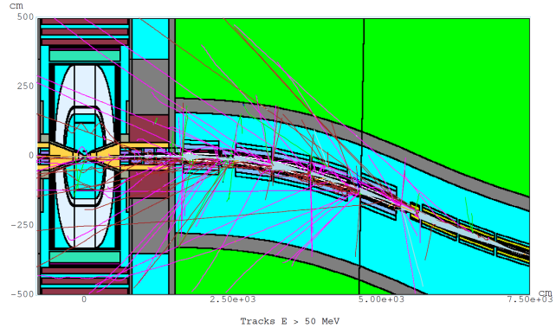
MARS 1.5 TeV
Machine Detector Interface Model
Θ = 10º 6 < z < 600 cm x:z = 1:17
Q1
W
BCH₂

Slide 11
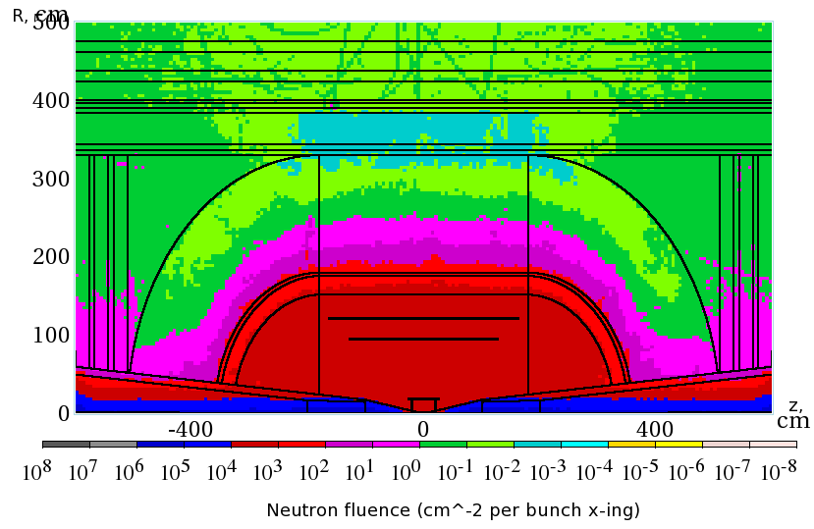
Overall Background – 1.5 TeV
Non-ionizing background ~ 0.1 x LHC
But crossing interval 10μs/25 ns 400 x

Slide 12
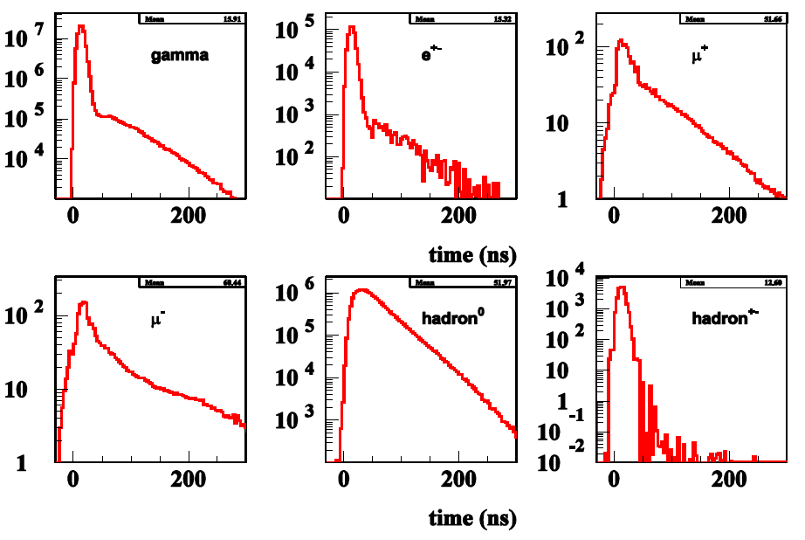
Much of the Background is Soft
And Out of Time
(Striganov)

Slide 13
Attacking the Background
It is clear that timing and energy discrimination will be crucial in limiting the background in a Muon Collider
We have concentrated on understanding the time resolution required and how it may affect the detector mass and resolution for physics objects
The R&D is synergistic with CLIC, which requires ns level resolutions, LHC which is looking at fast timing for background reduction, and intensity frontier experiments, which may require 100’s of ps resolutions
Studies have proceeded with several tools – ILCROOT, LCSIM and GEANT

Slide 14
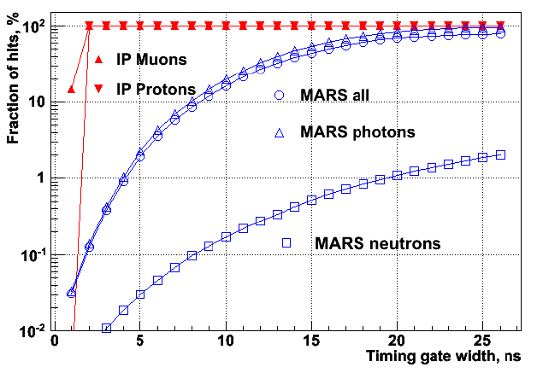
Track Timing Information
Tracking can benefit from precise timing, low occupancy in a pixelated silicon detector.
(Terentiev)

Slide 15
Background Inside a silicon detector:
Detector thickness
Angled tracks
dE/dX
MIP
Path in detector
Background Path length in silicon detector vs de/dx

Slide 16
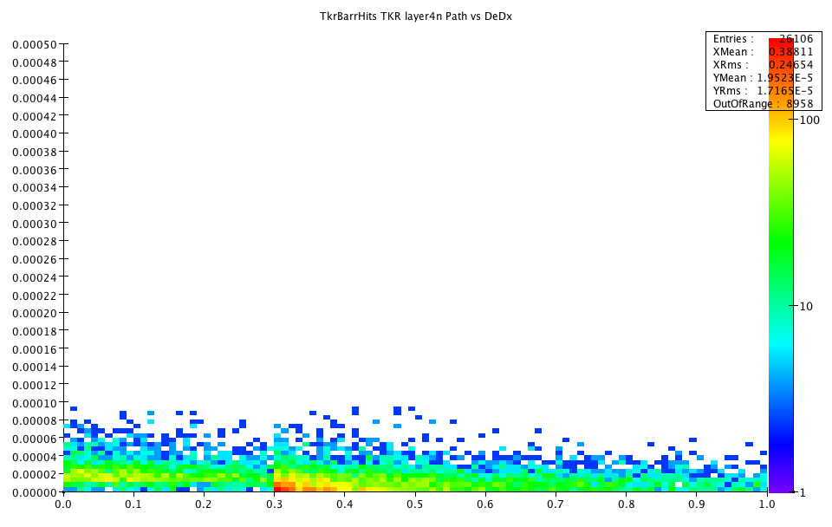
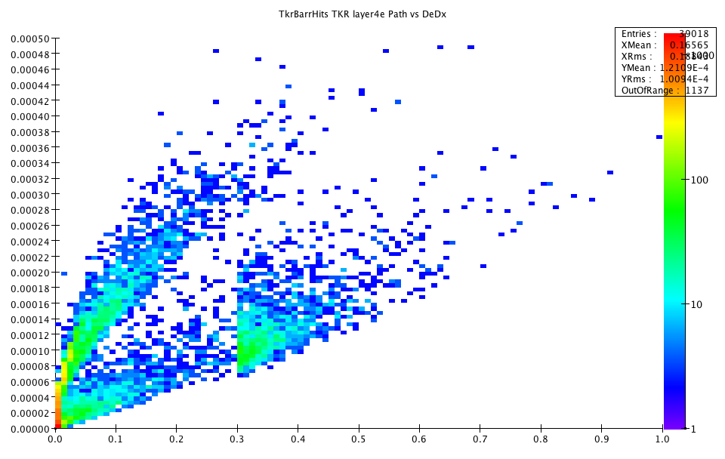
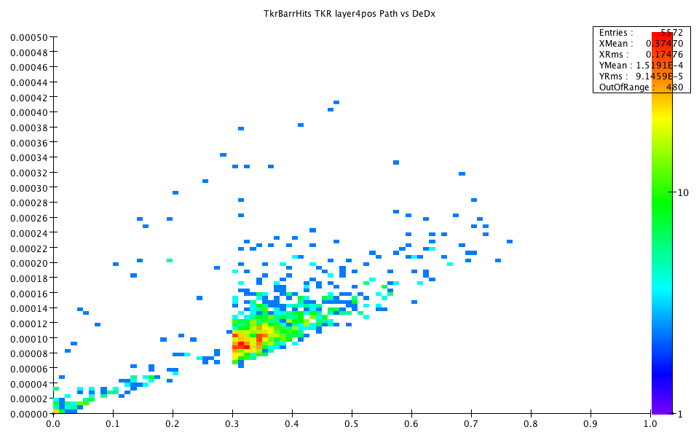
Time of energy deposit with respect to TOF from IP
Neutrons
electrons
positrons
Compton
High energy
conversions
soft
conversions

Slide 17
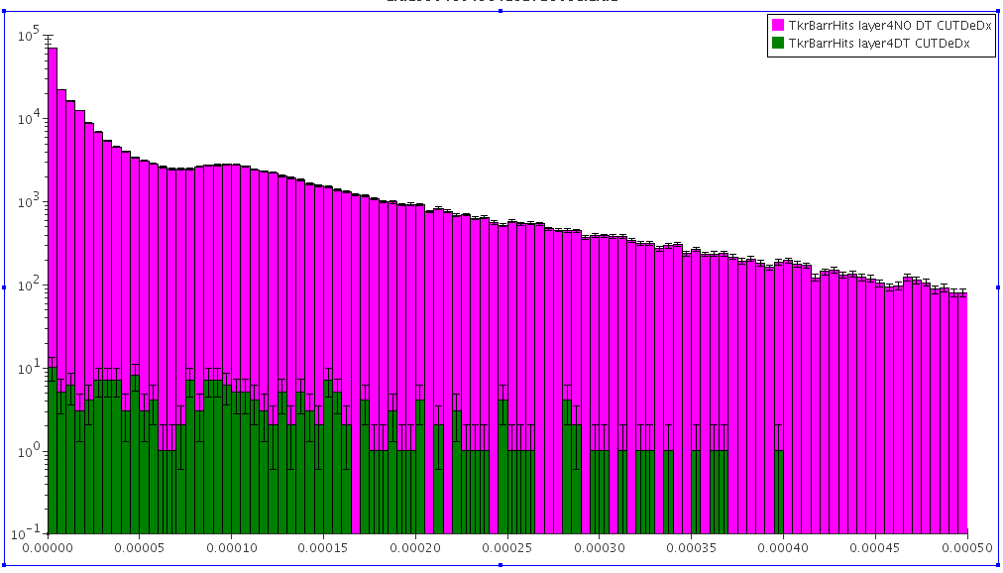
Effects of Cuts on Tracker Background
Tracker Layer 4
Background, no time cut
Timing is the most
important
  Reduce backgrounds by 3 orders of magnitude
De/dx also is also important
  We need pulse height information anyway since our timing accuracy will depend on signal/noise and time walk corrections
Background, 1ns time cut
de/dx
Radius | DT Cut | DT & rphi & dedx
20 | 0.0012 | 0.0009
46.2 | 0.0008 | 0.0006
71.7 | 0.0011 | 0.0007
97.3 | 0.0006 | 0.0004
122.9 | 0.0009 | 0.0006
Background Hit rejection

Slide 18
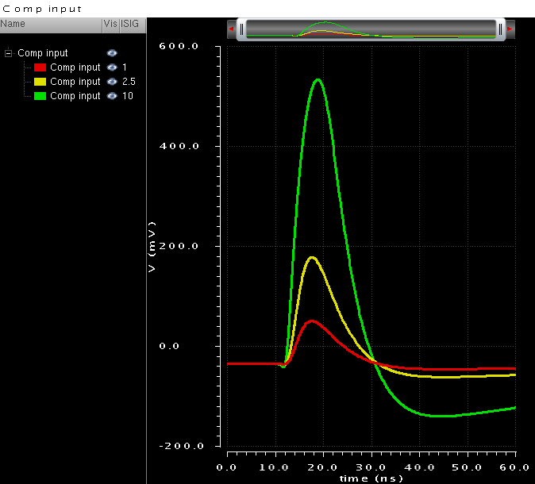
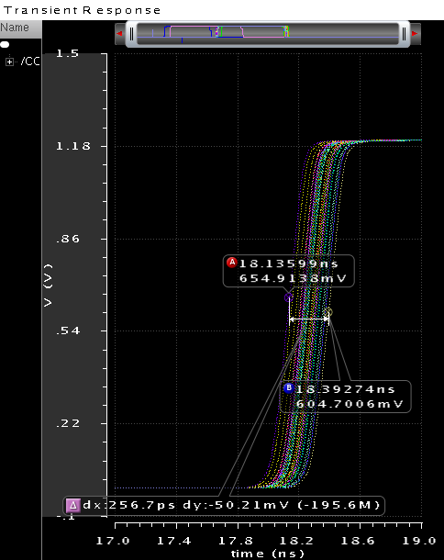
Timing In a Tracker
There is already an example of a fast timing IC design at CERN for CMS upgrades
Intent is to use fast timing to reject “loopers”
65 nm process
  Pixel ~ 1mm x 100 μ x 200 μ thick
  Peaking time: 6 ns
  220 e- ENC for 260 fF input capacitance
  Consumption for nominal bias: 65 uA
Jitter for 0.6fC V_{th} and 2.5fC signal; ~50 ps rms
Jitter for 1 fC signal; ~100 ps rms.
Time resolution defined by time walk (~3 ns) → without correction the resolution will be ~500 ps RMS
Time walk for signals 1 to 10 fC (0.6 fC threshold); <3 ns

Slide 19
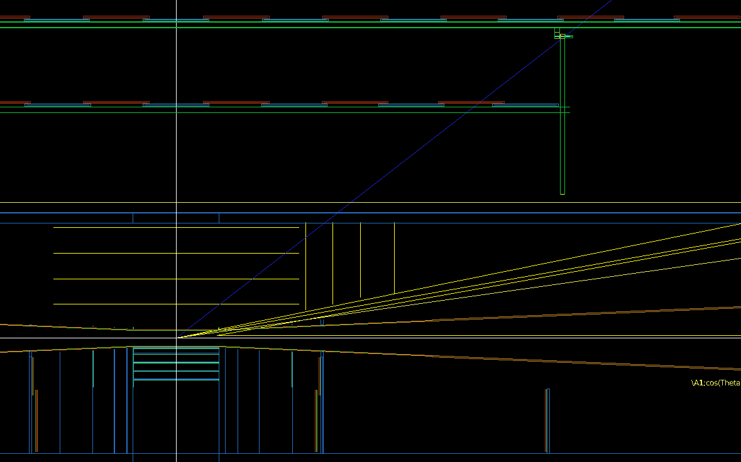
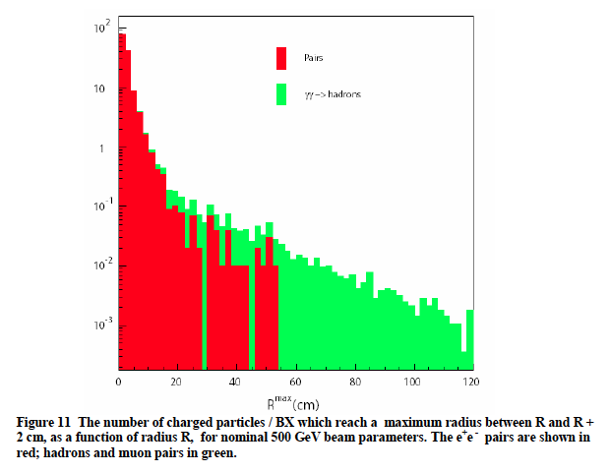
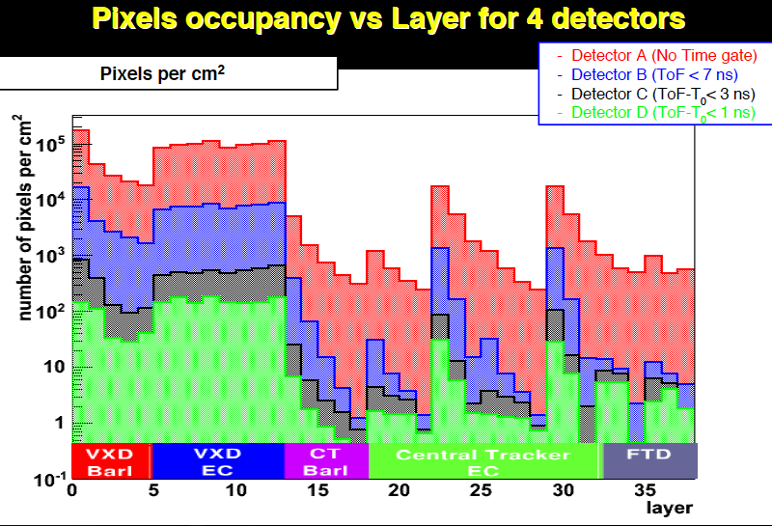
Vertex Detector
ILC inner radius ~1.5 cm set by beamstrahlung
MuC Inner radius ~5 cm set by EM background from cone
Preserve IP resolution
by scaling by
r_{outer}/r_{inner}
MuC vertex
ILC vertex
ILC Charged particle
Density vs radius
(Mazzacane)

Slide 20
Tracking Strategy
Tracker segmentation very similar to CMS Phase 2 tracker (1mm x 100 μ x 200 μ)
Lots of space for time stamping circuitry
  Read out all hits within a ~10ns window
  Time stamp each hit to ~0.5 ns
  Pulse height to allow offline energy cuts and time walk corrections
Offline include time stamp in fit to allow for low momentum tracks, protons and kaons …
Need to demonstrate that this works in full simulation with MARS backgrounds.

Slide 21
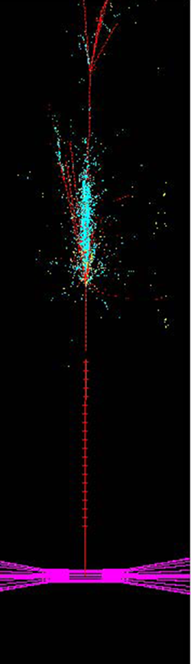
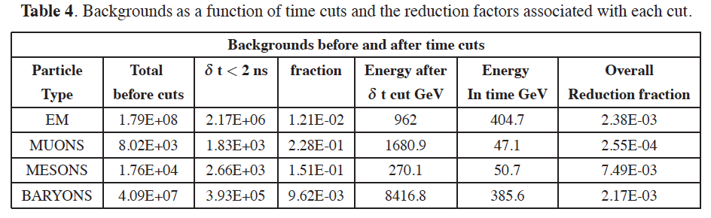
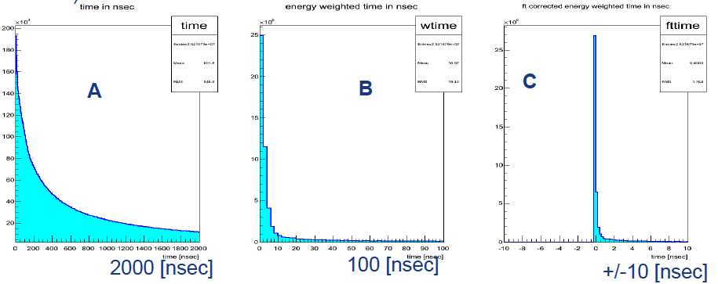
Calorimetry – two approaches
Software compensation
Based on nuclear int. vertices
Pixelated digital calorimeter with 2ns gate
[R Raja 2012 JINST 7 P04010]
Hadron shower time development
Dual readout calorimetry with fast timing

Slide 22
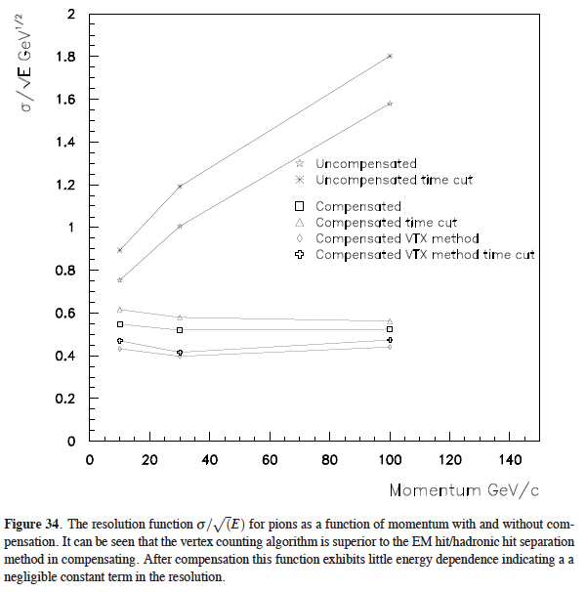
Resolution of a pixelated calorimeter with vertex counting compensation

Slide 23
Plans
Fast simulation studies of Higgs width measurements
  Develop optimized sets of algorithms to measure Higgs mass and width with realistic jet and tracker resolutions.
Develop MARS background model suitable to 125 GeV
Full simulation with background included
  Verify that high purity tracking can be achieved
  Understand jet energy resolutions with timing cuts.
  Redo the fast simulation studies with fully simulated backgrounds
Longer term focus is on a high energy machine – that is the natural path for a MUC Higgs Factory
Much of the development will apply to both

Slide 24
Conclusion
An S-channel Muon Collider Higgs Factory provides unique capabilities
Several years of R&D will be necessary to be in a position to build such a machine
  Could be part of a staged program toward a very high energy lepton collider
  Only a Muon Collider can deliver >3 TeV lepton CM energy with reasonable power consumption
There are plausibility arguments that detector backgrounds can be handled.
  Understand tradeoffs in detector mass and resolution
  Need much more detailed simulations

